Slide 1
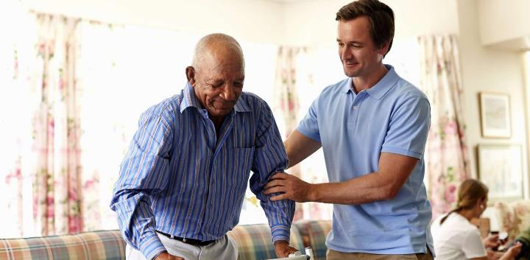
INZIKI YODABA:
UTHANDO KUMBE UBUGOVU?
Isifundo sesibili kuMabasa ilanga letshumi lantathu ku2024

Slide 2
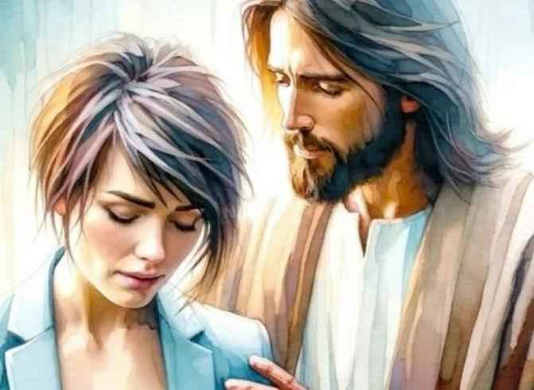
“Ungesabi, ngokuba ngilawe; ungapheli amandla, ngokuba mina nginguNkulunkulu wakho; ngiyakuqinisa, yebo, ngiyakusiza, ngiyakusekela ngesandla sami sokunene sokulunga” (Isaya 41:10, NKJV).

Slide 3
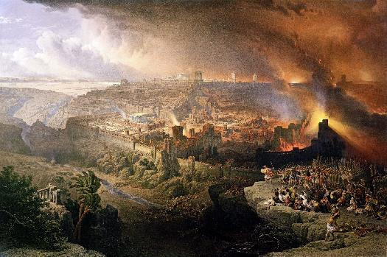
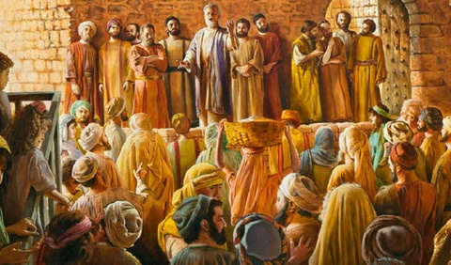
Unyaka wama-70 waphawula ukuphela kuka-Israyeli njengesizwe. Loba kwakuyiRoma bhidliza iJerusalema leThempeli, amanye amandla ahlanganyela kuleyo mpi.
Ngakolunye uhlangothi, uSathane wabangela u-Israyeli ukuba ele uMsindisi, wase thatha ilungelo lakhe lokubhubhisa isizwe.
Ngakolunye uhlangothi, uNkulunkulu waxwayisa ngokuphindaphindiweyo ngempumela yokumlahla; ukubambelela ukuqala kwesigwebo; futhi walungiselela abantu, iBandla, ukuba bathathe isibani seqiniso futhi bakhanyisele umhlaba ngomlayezo wothando lukaNkulunkulu.
Izifundo ekubhujisweni kweJerusalema:
Ukwaliwa kothando lukaNkulunkulu.
UNkulunkulu unakekela abantu bakhe.
Izifundo kumaKristu okuqala:
Ukwethembeka ekuphitshekeleni.
Siza abaswelayo.
Uthando, uphawu lwethu lobuthina.

Slide 4
IZIFUNDO EKUBHUJISWENI KWEJERUSALEMA

Slide 5
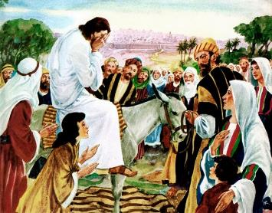
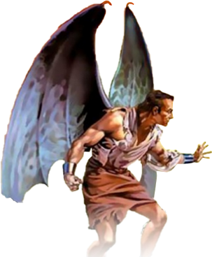
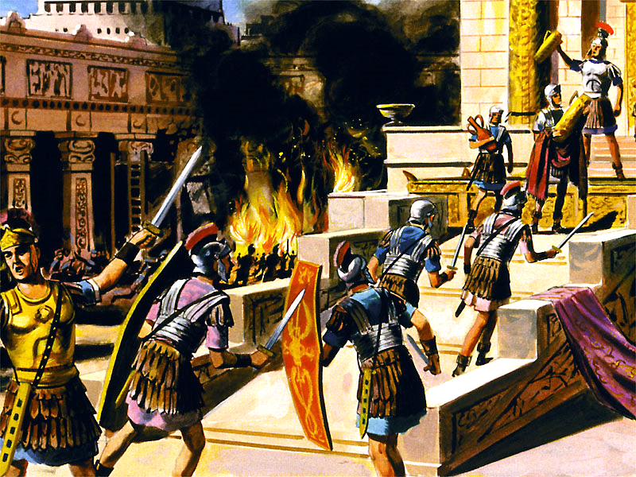
UKWALIWA KOTHANDO LUKANKULUNKULU
“Jerusalema, Jerusalema, wena obulala abaprofethi, okhanda ngamatshe abathunywe kuwe, kukangaki ngithanda ukubuthela ndawonye abantwana bakho njengesikhukhukazi sibuthela amatshiyane aso ngaphansi kwamaphiko aso, kodwa alivumanga. ( Mathewu 23:37 )
UJesu wakhala lapho esondela eJerusalema ( Luka 19:41-44 ). Wayesazi ukuthi babezabhekana lemiphumela ebafaneleyo yokwala kwabo ngenkani ubizo lukaNkulunkulu lothando ( Math. 23:37 ).
Wakhala ngoba lesi senzakalo esibuhlungu sasingavikeleka. Ngoba uNkulunkulu usithanda kakhulu kangangokuthi akafuni kufe muntu, kodwa ukuba wonke umuntu athole ukuphila okuphakade ( Joh. 5:39-40; Hez. 18:31-32 ).
Imbali isitshela ukuthi amaJuda ahlubuka ngonyaka ka-66 ngokumelene lokuhlukunyezwa kwamaRoma. Amaqembu ahlukahlukeneyo amaJuda alwa wodwa, kuyilapho amaRoma evimbezela umuzi. Ngomnyaka wama-70 konke kwaphela. UThithu wabhubhisa iJerusalema leThempeli. Kwafa amaJuda ayisigidi
Kodwa imbili ayisitsheli ukuthi uSathane wabangela kanjani ukuba amaJuda ahlubuke, lamaRoma ukuba aziphindiselele. Ukubhujiswa kweJerusalema kwakungumsebenzi kasathanei oqondileyo. Ngokuphambuka emthonjeni wokuphila, uIsrayeli wayesesitheni lesitha esifuna ukubhubhisa lokubulala kuphela.

Slide 6
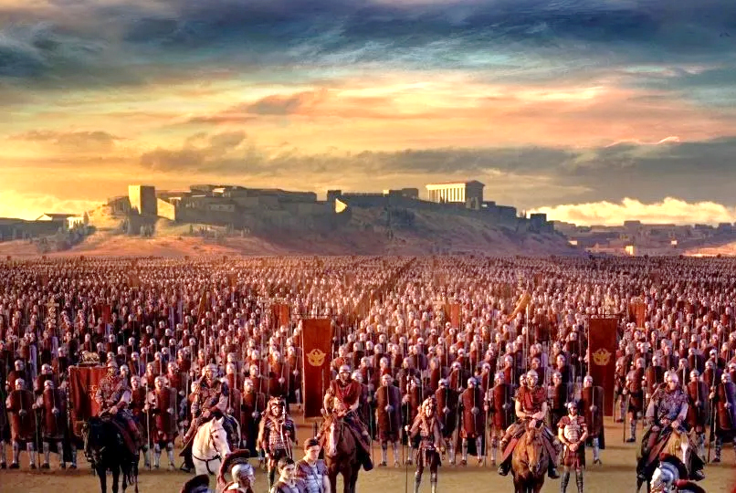
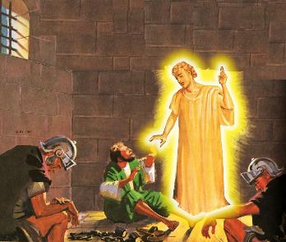
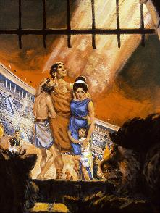
UNKULUNKULU UNAKEKELA ABANTU BAKHE
Ngakho ungesabi, ngokuba mina ngilawe; ungapheli amandla, ngokuba mina nginguNkulunkulu wakho. ngiyakuqinisa, ngikusize; ngiyakusekela ngesandla sami sokunene sokulunga” (Isaya 41:10).“
Ngothando lwakhe, uNkulunkulu wanika wonke umuntu owayefuna ukusinda ekubhujisweni ithuba. Wanikeza isibonakaliso: IJerusalema lizungezwe ngamabutho (Luka 21:20).
UGaius Cestius Gallus wasigcwalisa leso sibonakaliso ngonyaka ka-66. Ukuvinjezelwa kwasuswa, futhi umholi wamaZealot u-Eleazar ben Simon wajaha amaRoma futhi wawanqoba.
Wonke umuntu owayekholelwa emazwini kaJesu wasizakala ngaleso sikhathi lapho iJerusalema lalitshiywe lingalidwanga ukuba libaleke.
Ezinyangeni ezimbalwa kamuva, uNero wathumela uVespasian ukuba ayoqeda lokho kuvukela. Kusukela ngonyaka ka-67 kuya ku-70, ukuvinjezelwa kwaba unomphela.
UNkulunkulu uyenelisa futhi ufuna ukuvikela abantwana bakhe, ngitsho lasezikhathini ezinzima kakhulu ( IHu. 46:1; Isaya 41:10 ). Ngalokho, abaningi baye balahlekelwa ukuphila kwabo ngenxa yokwethembeka kwabo kuNkulunkulu ( Heb. 11:35-38 ).
Kungani abanye bevikelwe futhi abanye, ngokusobala, belahliwe nguNkulunkulu?

Slide 7
“Ukuphatha okuyimfihlakalo okuvumela abalungileyo ukuba bahlukuluzwe esandleni somubi kube yimbangela yokudideka okukhulu kwabanengi ababuthakathaka ekukholweni. Abanye sebekulungele ngitsho lokulahla ithemba labo kuNkulunkulu ngoba uhlupheka kubantu abaphansi ukuze baphumelele, kuyilapho abangcono kakhulu labamsulwa behlutshwa futhi bahlutshwa amandla abo ohluku. Kubuzwa ukuthi Lowo olwehlula okulungileyo lesihe, futhi olamandla angelamkhawulo, angakubekezelela kanjani ukungabi lokwehlula okulungileyo lokucindezelwa okunjalo? Lo ngumbuzo esingenzi lutho ngawo. UNkulunkulu usinikeze ubufakazi obaneleyo bothando Lwakhe, futhi akufanellanga singabaze ubuhle Bakhe ngoba asikwazi ukuqonda ukusebenza kokuphatha Kwakhe.”
EGW (The Great Controversy, pg. 47)

Slide 8
IZIFUNDO EZIVELA KUMAKRESTU AKUQALA

Slide 9
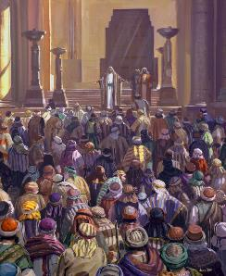
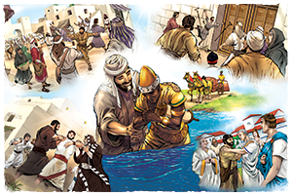
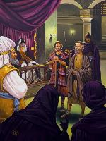
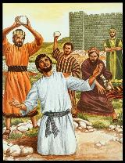
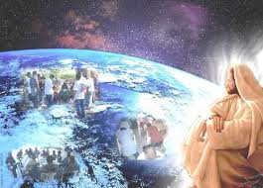
UKWETHEMBEKA EKUHLUTSHWENI
“Kodwa uSawuli waqala ukubhidliza ibandla. Ehamba indlu ngendlu, ehudula abesilisa labesifazane, wabafaka etilongweni.” ( IzEnzo 8:3 )
Iziqalo zazilethemba ngempela: abaphendukileyo babalelwa ezinkulungwaneni
( IzEnzo 2:41; 4:4 ); amakholwa atshumayela ngamandla (IZenzo 4:31; 5:42).
Kodwa isitha sasingahlaliseki. Uusonga kwakuqala ( IzEnzo 4:17-18 ); bese kuba lezijeziso ( IzEnzo 5:40 ); ekugcineni, yikufa ( IzEnzo 7:59 ).
Because of the persecution raised by Saul, the disciples were scattered (Acts 8:1). But, far from the light going out, thanks to the faithfulness of the believers, it shone with much more brilliance throughout the entire known world (Acts 8:4; 11:19-21; Rom. 15:19; Col. 1:23).
UJesu wayenike iBandla lakhe umsebenzi lamandla okuwuqhubekisela phambili (IZenzo 1:8). Awekho amandla, ngokomzimba loba ngokomoya, angavimba ukuqhubeka kwevangeli (Math. 16:18). “Aluba uNkulunkulu engakithi, akekho ongamelana lathi!” ( Roma 8:31 )

Slide 10
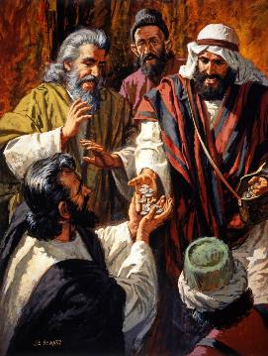
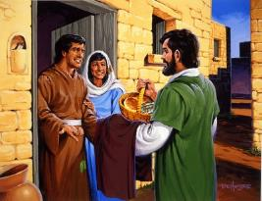
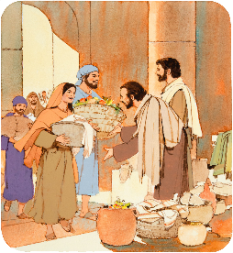
SIZA ABASWELAYO
“Bathengisa impahla yabo lezinto zabo, babela bonke ngokwesidingo salowo lalowo” ( IzEnzo 2:45 )
IVangeli laba lawuphi umphumela kumaKristu okuqala ( IzEnzo 2:42-47 )?
t
Babekholwa emfundisweni kaJesu
Labo ababelesiphiwo basilisa abagulayo.
Babelezinto zonke ezifanayo
Babelana ngalokho ababelakho labaswele
Babelemihlangano ebandla
Babelemihlangano emakhaya, lapho babegubha khona iSidlo SeNkosi Sakusihlwa
Baphila ngenjabulo lobubelu benhliziyo
Badumisa uNkulunkulu
Njengabameli bakaKristu, balingisa uJesu. Ngokunakekela izidingo zalabo ababazungezile, bathola umusa wedolobha lonke.
Ngakho-ke, iBandla kufanele libonakale ngothando lwamaKrestu komunye lomunye, lokukhathalela umphakathi wabo.

Slide 11
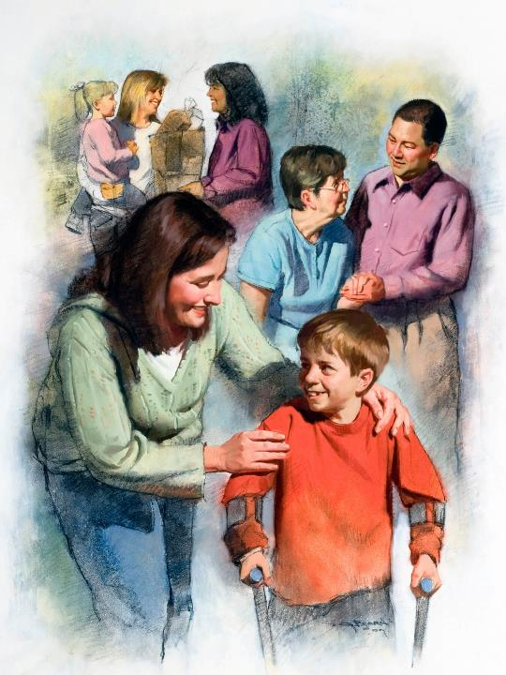
UTHANDO,LUPHAWU LWETHU LOKUBA YITHINA
“Ngalokho bonke bayakukwazi ukuthi lingabafundi bami, aluba lithandana” (Johane 13:35)
Iqembu ngalinye elihilelekileyo engxabanweni yamazulu linezici zalo: USathane uyazonda futhi uyabhubhisa; UNkulunkulu uyathanda futhi uyabuyisela.
Abalandeli beqembu elithile loba elinye benza ngokwala maphethini. Uma silandela uNkulunkulu, sizokubonisa ngothando oluboniswa abanye (1Joh. 4: 20-21).
AmaKristu ekhulu lesi-2 lelesi-3 asebenzisa uthando lokuzidela. Phakathi lezifo eziwubhadane ezimbili ezinkulu (ngeminyaka engu-160 no-265), bazinikela ekunakekeleni abathintekile, ngaphandle kokucabangela ukuphepha kwabo siqu.
Bazinikela ngenxa yothando, futhi bazuzisa izigidi zabantu. Kodwa abazange bazinake bona, kodwa kulowo ababezimisele ukunikela ukuphila kwabo ngenxa yakhe, uMsindisi wabo: uJesu.

Slide 12
“Kulilungelo layo yonke imiphefumulo ukuba yindlela ephilayo uNkulunkulu angadlulisela ngawo emhlabeni ingcebo yomusa Wakhe, ingcebo kaKristu engaphenyekiyo. Ayikho into uKristu ayifisa kakhulu njengamanxusa azomela umhlaba uMoya wakhe lesimo sakhe. Ayikho into edingwa umhlaba njengokubonakaliswa kothando loMsindisi ngobuntu. Izulu lonke lilindele umzila okungathelwa ngayo amafutha angcwele ukuze kube intokozo lesibusiso ezinhliziyweni zabantu.”.”
EGW (God's Amazing Grace - Unsearchable Riches, June 28)

