Slide 1
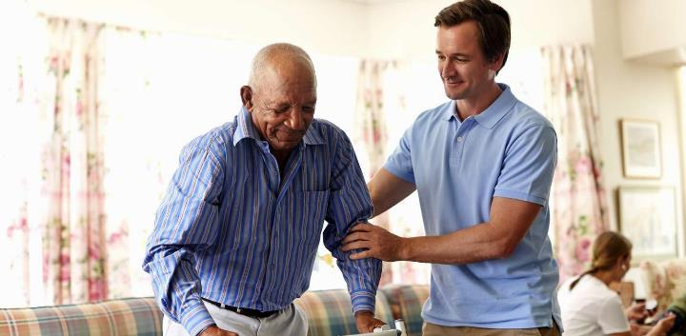
NKHANI YAYIKULU:
CHIKONDI KAPENA UNDEKHA?
Phunziro 2, April 13, 2024

Slide 2
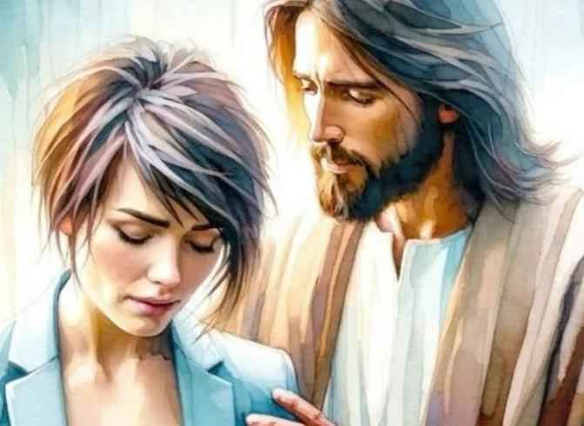
“Tsono usaope, pakuti Ine ndili nawe; usataye mtima chifukwa Ine ndine Mulungu wako. Ndidzakupatsa mphamvu ndipo ndidzakuthandiza, ndidzakutchinjiriza ndi dzanja langa lamanja logonjetsa” (Yesaya 41:10, CCL)

Slide 3
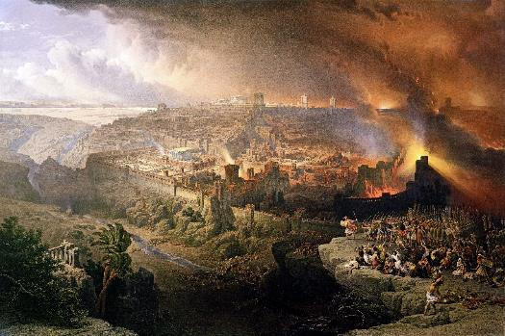
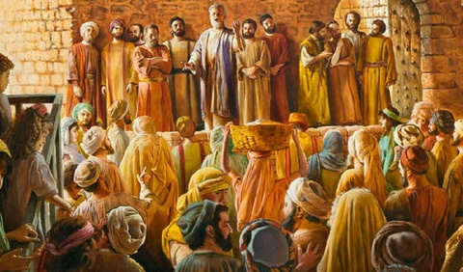
Chaka cha 70 chinali kutha kwa mtundu wa Israyeli. Ngakhale kuti anali Aroma amene anawononga Yerusalemu ndi Kachisi, maulamuliro enanso anatenga nawo mbali pankhondo imeneyo.
Mbali ina, Satana anasonkhezera Aisrayeli kumukana Mesiya, kenako iye ananena kuti ali ndi ufulu wowononga mtunduwo..
Kumbali ina, Mulungu anachenjeza mobwerezabwereza za zotsatirapo za kumukana; anachedwetsa kupereka chiweruzo; nakonzekeretsa anthu, Mpingo, kuti anyamule nyali ya choonadi ndi kuunikira dziko lapansi ndi uthenga wa chikondi cha Mulungu.
Maphunziro pa kuwonongedwa kwa Yerusalemu:
Kukanidwa kwa chikondi cha Mulungu.
Mulungu amasamalira anthu ake.
Maphunziro kuchokera kwa Akhristu oyambirira :
Kukhulupirika pofunafuna.
Kuthandiza osowa.
Chikondi, chizindikiro chathu cha kudziwika.

Slide 4
ZOMWE TINGAPHUNZIRE PA KUWONONGEDWA KWA YERUSALEMU

Slide 5
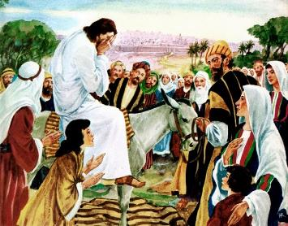
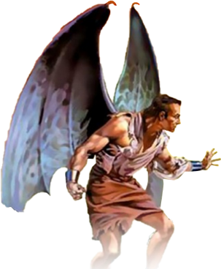
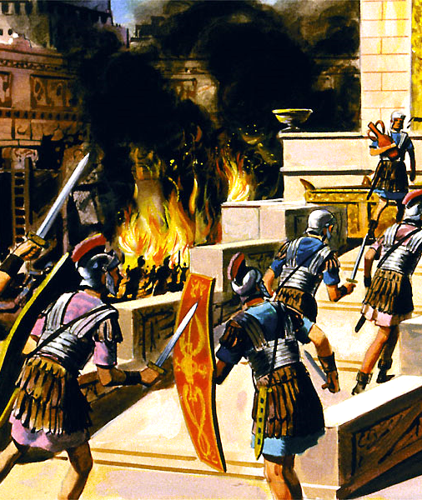
KUKANIDWA KWA CHIKONDI CHA MULUNGU
“Haa! Yerusalemu, Yerusalemu, iwe amene umapha aneneri ndi kugenda miyala amene atumidwa kwa iwe, kawirikawiri ndimafuna kusonkhanitsa ana ako, monga nkhuku imasonkhanitsira ana ake pansi pa mapiko ake, koma iwe sunafune!” (Mateyu 23:37 CCL)
Yesu analira pamene anali kuyandikira Yerusalemu ( Luka 19:41-44 ). Anadziwa kuti anthu ake adzavutika ndi zotsatira za kukana maitanidwe achikondi a Mulungu poumitsa khosi ( Mateyu 23:37 ).
Iye analira chifukwa tsokali likanapeweka. Chifukwa chakuti Mulungu amatikonda kwambiri ndipo safuna kuti wina aliyense afe, koma kuti aliyense akhale ndi moyo wosatha ( Yohane 5:39-40; Ezekieli. 18:31-32).
Mbiri imatiuza kuti Ayuda anapanduka mu chaka cha 66 potsutsana ndi nkhanza za Aroma. Magulu osiyanasiyana achiyuda anali kumenyana okhaokha, pamene Aroma anazinga mzindawo. M’chaka cha 70 zonse zinatha. Tito anawononga Yerusalemu ndi Kachisi. Ayuda zana limodzi anawonongeka.
Koma mbiri simatiuza mmene Satana anasonkhezera Ayuda kuti apanduke, komanso kubwezera kwa Aroma. Kuwonongedwa kwa Yerusalemu inali ntchito yachindunji ya mdierekezi. Pakupatuka pa magwero a moyo, Israyeli anali mmanja mwa mdani amene amangofuna chiwonongeko ndi imfa.

Slide 6
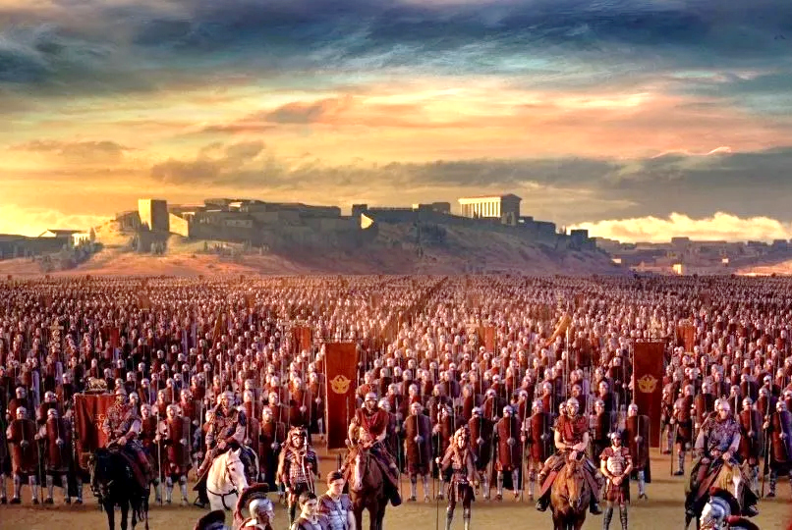
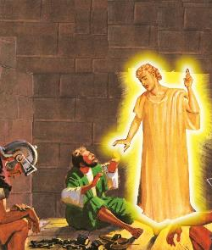
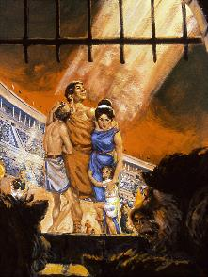
MULUNGU AMASAMALIRA ANTHU AKE
“Tsono usaope, pakuti Ine ndili nawe; usataye mtima chifukwa Ine ndine Mulungu wako. Ndidzakupatsa mphamvu ndipo ndidzakuthandiza, ndidzakutchinjiriza ndi dzanja langa lamanja logonjetsa” (Yesaya 41:10)
Mwachikondi chake, Mulungu anapereka mwayi kwa aliyense amene anafuna kupulumuka ku chiwonongeko. Iye anapereka chizindikiro: Yerusalemu wazunguliridwa ndi ankhondo (Luka 21:20).
Gaius Cestius Gallus anakwaniritsa chizindikiro chimenecho m’chaka cha 66. Kuzingako kunachotsedwa, ndipo mtsogoleri wa Azeloti Eleazar ben Simon anathamangitsa Aroma ndi kuwagonjetsa.
Aliyense amene anakhulupirira mawu a Yesu anapezerapo mwayi othawa pa nthawi imene Yerusalemu analibe chitetezo.
Patapita miyezi ingapo, Nero anatumiza Vespasian kuti akathetse kupandukako. Kuchokera m’chaka cha 67 kufikira 70, kuzingidwako kunali kokhadzikika.
Mulungu angathe ndipo amafuna kuteteza ana ake, ngakhale pa nthawi zovuta kwambiri ( Masalimo 46:1; Yesaya 41:10 ). Komanso, ambiri ataya miyoyo yawo chifukwa cha kukhulupirika kwawo kwa Mulungu ( Ahebri 11:35-38).
Chifukwa chiyani ena amatetezedwa ndipo ena, muwonekera, Mulungu anawasiya?

Slide 7
“Chinsinsi cha chisamaliro chimene chimalola olungama kuzunzidwa ndi oipa chakhala chochitika chododometsa chachikulu kwa ambiri amene ali ofooka mu chikhulupiriro. Ena ali okonzeka kutaya chikhulupiriro chawo pa Mulungu chifukwa Iye amafuna kuti otayikitsitsa achite bwino, pamene abwino kwambiri ndi oyera amasautsidwa ndi kuzunzika ndi mphamvu za ankhanza. Funso nkumati, Kodi ndizotheka bwanji kuti, amene ali wolungama ndi wachifundo, amenenso ali ndi mphamvu zopanda malire, angalolere kupanda chilungamo ndi kuponderezana koteroko? Ili ndi funso lomwe tilibe yankho lake. Mulungu watipatsa umboni wokwanira wa chikondi chake, ndipo sitiyenera kukayikira ubwino wake chifukwa sitingathe kumvetsa ntchito za ulamuliro wake.”
EGW (The Great Controversy, pg. 47)

Slide 8
MAPHUNZIRO KUCHOKERA KWA AKHRISTU OYAMBIRIRA

Slide 9
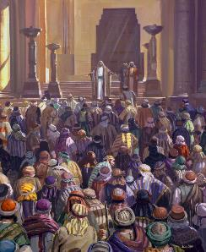
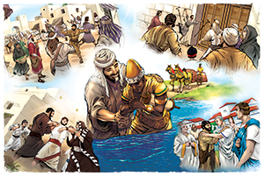
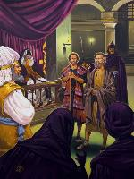
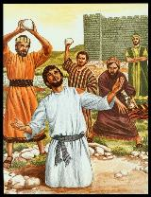
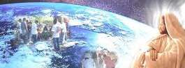
KUKHULUPIRIKA POFUNAFUNA
“Koma Saulo anayamba kuwononga mpingo. Amapita nyumba ndi nyumba, ndipo amagwira amuna ndi amayi ndi kukawatsekera ku ndende.” (Machitidwe 8:3 CCL)
Poyambirira zinalidi za chiyembekezo: otembenuka anali mazanamazana (Machitidwe 2:41; 4:4); okhulupirira analalikira mwa mphamvu (Machitidwe 4:31; 5:42).
Koma mdani anasowa mtendere. Anayamba ndi kuopseza ( Machitidwe 4:17-18 ); kenazo mazunzo ( Machitidwe 5:40 ); Pomaliza, imfa (Machitidwe 7:59).
Chifukwa cha mazunzo amene Saulo anayambitsa, ophunzira anabalalika (Machitidwe 8:1). Koma, mmalo moti kuwala kuzimitsidwe, chifukwa cha chikhulupiriro chawo, kuwala koonjezereka kunaonetseredwa kudziko lonse lodziwika pa nthawi imeneyi ( Machitidwe 8:4; 11:19-21; Aroma 15:19; Akolose 1; 23).
Yesu anapatsa mpingo wake ntchito ndi mphamvu zopitira patsogolo (Machitidwe 1:8). Palibe mphamvu, yakuthupi kapena kuuzimu, yomwe ingalepheretse uthenga wabwino kupita patsogolo (Mateyu 16:18). “Nanga tsono tidzanena chiyani pa izi? Ngati Mulungu ali mbali yathu, adzatitsutsa ife ndani?!” (Aroma 8:31)

Slide 10
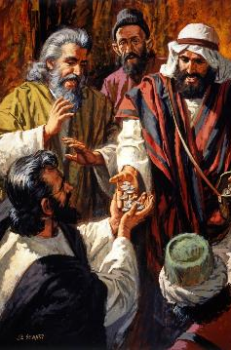
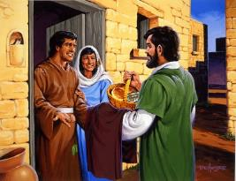
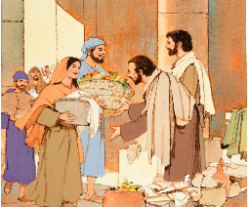
KUTHANDIZA OSOWA
“Ankagulitsa minda yawo ndi katundu wawo, ndi kugawira kwa aliyense molingana ndi zosowa zake.” (Machitidwe 2:45 CCL)
Kodi uthenga wabwino unakhudza bwanji Akhristu oyambirira? (Machitidwe 2:42-47)
Iwo anakhulupirira chiphunzitso cha Yesu
Iwo amene anali ndi mphatso anachiritsa odwala.
Anali ndi zinthu zonse mofanana
Iwo ankagawana zomwe anali nazo ndi osowa.
Iwo ankakhala ndi misonkhano pabwalo
Ankakhala ndi misonkhano m’nyumba pokondwerera mgonero wa ambuye
Amakhala mwa chimwemwe ndi mitima yofatsa
Iwo amatamanda Mulungu
Monga akazembe a Khristu, anatsanzira machitidwe a Yesu. Posamalira zosowa za iwo owazungulira, anapeza chiyanjo mizinda yonse.
Monga mmene zinali nthawi imeneyo, Mpingo uyenera kukhala wodziwika ndi chikondi cha akhristu kwa wina ndi mzake, komanso podera nkhawa za mdera lawo.

Slide 11
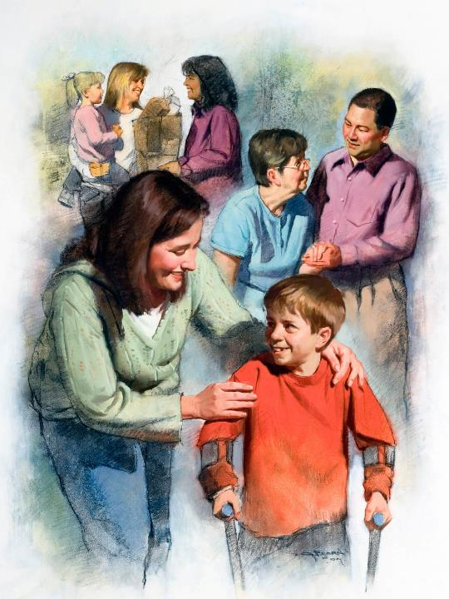
CHIKONDI, CHIZINDIKIRO CHATHU CHA KUDZIWIKA
“Mukamakondana aliyense adzadziwa kuti ndinu ophunzira anga” (Yohane 13:35)
Mbali zonse zomwe zikukhudzidwa ndi mkangano wa waukulu ili ndi makhalidwe ake: Satana amadana nafe ndi kuwononga; Mulungu amakonda ndi kubwezeretsa.
Otsatira mbali ina iliyonse amachita molingana ndi khalidwe la mbaliyo. Ngati titsatira Mulungu, tidzaonetsera chikondi kwa anthu ena (1 Yohane 4:20-21).
Akhristu a m’zaka za pakati pa 200 ndi 300 anasonyeza chikondi chawo ndi mtima onse. Mkati mwa miliri iŵiri ikuluikulu (m’zaka za pakati pa 160 ndi 265), anadzipereka kusamalira okhudzidwa, popanda kulingalira za chitetezo chawo.
Anadzipereka okha chifukwa cha chikondi, ndipo anathandiza anthu mazanamazana. Koma sanaike maganizo awo pa iwo eni, koma pa amene anali okozeka kupereka moyo wawo chifukwa cha Iye, Mpulumutsi wawo: Yesu.

Slide 12
“Ndi mwai wa moyo uliwonse kukhala chida chimene Mulungu angagwiritse ntchito kuuza dziko lapansi za chuma cha chisomo chake, chuma chosasanthulika cha Khristu. Palibe chomwe Khristu amafuna monga nthumwi zoyimirira Mzimu Wake ndi khalidwe lake kudziko lapansi. Palibe chimene dziko lapansi likusowa kwambiri monga chikondi cha Mpulumutsi kuwonetseredwa kudzera mwa anthu. Kumwamba konse kukuyembekezera zida zoti azitsanulire mafuta opatulika kuti zikhale chisangalatso ndi madalitso ku mitima ya anthu.”
EGW (God's Amazing Grace - Unsearchable Riches, June 28)

