Slide 1
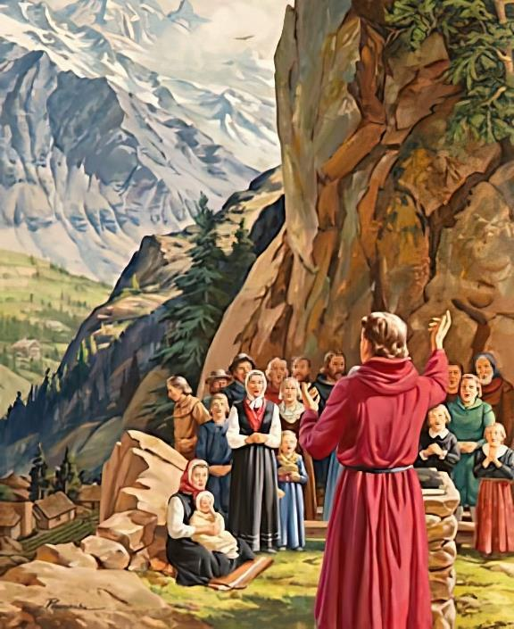
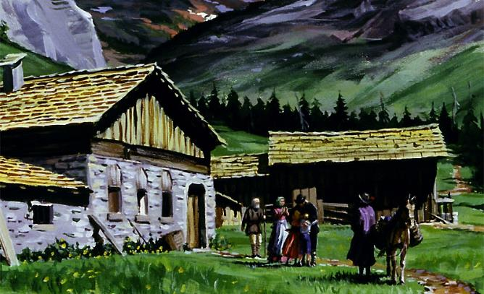
KUMIRIRA IDI
Chidzidzo 4 cha Kubvumbi 27, 2024

Slide 2
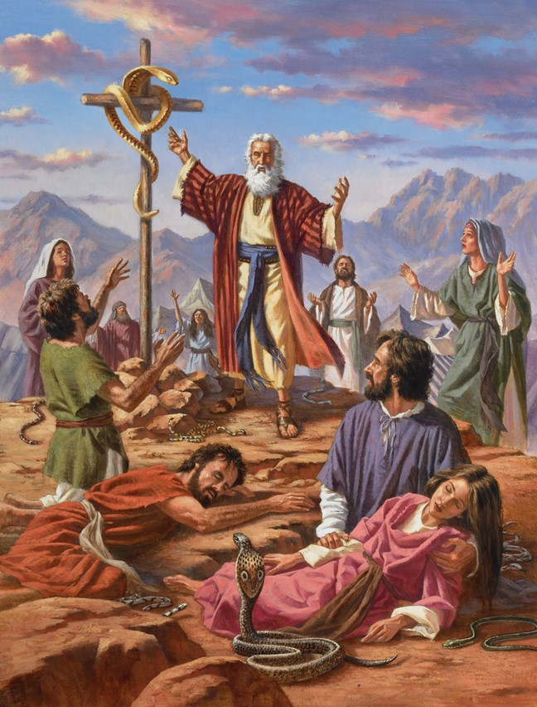
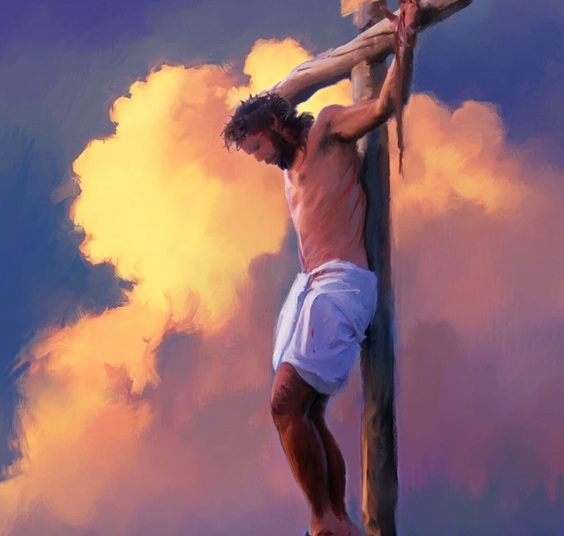
“Mosesi seɀaakasimudza nyoka murenje, saiɀoɀo Mŋanakomana womunhu unofanira kusimudzwa ʋo,kuti aninani unotenda kwaari, aʋe noʋupenyu bgusiŋgaperi” (Johani 3:14, 15)

Slide 3
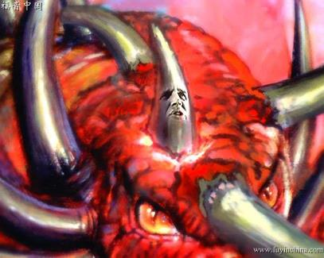
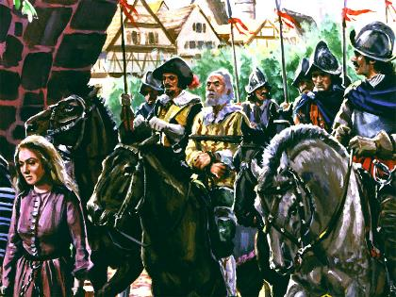
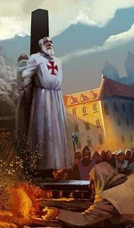
Dhanieri naZvakazarurwa vanozivisa nguva apo Satani aizoshandisa simba rezvematongerwe enyika nerechitendero kutambudza uye kuparadza vaya vakamira vakasimba muidi.
Simba iri “rinowisira pasi ɀokwaɗi” (Dan. 8:12). Panguva iyoyo “Ʋamŋe ʋaʋo ʋakacenjera ʋacaparadzwa, kuti ʋaidzwe, ʋanatswe, ʋaceneswe, kuȿikira kuŋguʋa yokupedzisira; nokuti ŋguʋa yokupedzisira icigere kuȿika.” (Dan. 11:35)
Munguva iyi - Nguva yeRima - idi rakapokanwa. Asi kwakanga kune vanhu vakauya vachidzivirira chokwadi, uye vakanga vachidisa kupa upenyu hwavo nokuda kwaro.
Idi riri kupokanwa:
Nguva dzekutambudzwa.
Kutendeka pakutambudzwa.
Kudzivirirwa kwechokwadi:
Kugoverana Bhaibheri: Mawaridhenzi.
Nyeredzi yevandudzo: John Wycliffe.
Kusimbiswa nokutenda: John Hasi nevamwe.

Slide 4
IDI RIRI KUPOKANWA

Slide 5
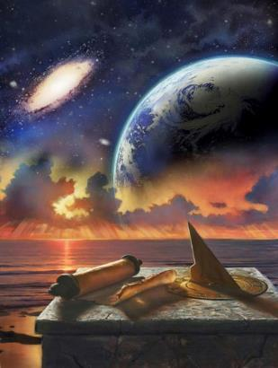
NGUVA DZEKUTAMBUDZWA
“Ucataura mashoko okumhura Wokumsoro‐soro, ucaparadza ʋatȿene, ʋuye ucatȿaka mano okushandura ŋguʋa nemirairo; iʋo ʋacaiswa mumaʋoko ake kuȿikira ŋguʋa imŋe nedzimŋe ŋguʋa, nehafu yeŋguʋa” (Danieri 7:25)
Nguva yekutambudzwa inoziviswa nenzira nhatu dzakasiyana
“ŋguʋa imŋe nedzimŋe ŋguʋa, nehafu yeŋguʋa” (Dan. 7:25; 12:7; Zva. 12:14)
Mazuva 1,260 (Zva. 11:3; 12:6)
Mwedzi 42 (Zva. 11:2; 13:5)
Mazwi “ŋguʋa imŋe ” rinofanana nerokuti “gore,” ukuwo izwi “nedzimŋe ŋguʋa” akashandiswa naDhanieri sezvariri rinoreva kuti “nguva mbiri”.
Zvese munguva dzekare uye nhasi,kureba kwemwedzi kuri kwese kwese, mazuva makumi matatu:
Mwedzi42
Mazuva30
Mazuva1.260
Gore 1
Makore 2
gore½
Makore3 ½
Matauriro ese anoratidza nguva imwe chete: mazuva 1,260.
Mwedzi
12
24
Mwedzi
6
Mwedzi
42
Pasi pemutemo we“zuʋa rimŋe nerimŋe rifananidze gore” (Ez. 4:6; Num. 14:34), iyi nhambo yechitambudzo inotora makore 1 260 enhoroondo.
Mwedzi42
Mazuva30
Mazuva1.260

Slide 6
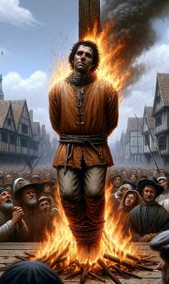
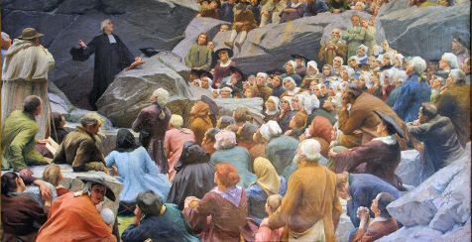
NGUVA DZEKUTAMBUDZWA
“Ucataura mashoko okumhura Wokumsoro‐soro, ucaparadza ʋatȿene, ʋuye ucatȿaka mano okushandura ŋguʋa nemirairo; iʋo ʋacaiswa mumaʋoko ake kuȿikira ŋguʋa imŋe nedzimŋe ŋguʋa, nehafu yeŋguʋa” (Daniel 7:25)
Inguva ipi yenhorondo iyo chitambudzo chamakore 1 260 chakaziviswa naDhanieri naZvakazarurwa chinofukidza?
Gore ra 538
Gore ra 1798
Chechi yeRoma yakawana simba rezvematongerwo enyika apo marudzi matatu aigamuchira chiArian akakundwa: Heruli, Vandals ne Ostrogoths
Mutungamiriri wehondo yeFrance Berthier, pasi pemirairo yaNapoleon, anotapa Pope, zvichigumisa hukuru hweChechi yeRoma
Apo umambo gumi hwezvamatongerwe enyika hwakamuka kubva muRoma (ndudzi dzakavhozhokera umambo), humwe umambo hwaizooneka ndokupidigura hutatu hwoumambo hune gumi(Dn. 7:23-25).
Sezvakaporofitwa, Mwari akagadzirira nzvimbo yekubatsira sangano rakatendeka: renje, kureva nzvimbo dzinogarwa vashoma (Zva. 12:6, 14).
Munguva dzakaoma nechitambudzo, vatendi vakatendeka vakamira vakasimba mukudzivirira zvokwadi, vachipotera murudo nokutarisira kwaMwari(Mapis. 46:1-3).
Zvinosuruvarisa, vakawanda vaifanira kubhadhara kuvimbika kwavo neropa ravo.

Slide 7
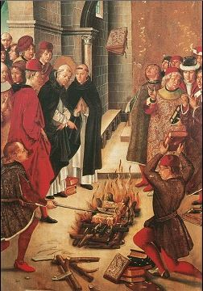
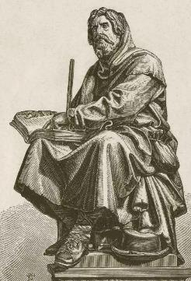
KUTENDEKA PAKUTAMBUDZWA
“Ʋaɗikanwa, ndakati ndicishiŋgaira ɀikuru kukunyorerai pamsoro pokuponeswa kweɗu tose, ndakaʋona kuti ndinofanira kukunyorerai, ndicikurairai kuti murwire kwaɀo kutenda kwakaɗeya kupiwa ʋatȿene kamŋe” (Judasi 1:3)
Payakangowana simba rezvamatongerwe enyika, Chechi yeRoma yakatanga kushandisa simba rayo kurayira kuti munhu ari wose aite maererano nemirayiro yayo yechitendero, mizhinji yayo yakanga yatsveyamiswa.
Kuwedzera kune izvi kwaiva kuwedzera uori pakati pevatungamiriri vechitendero. Kuti adzivise vanhu vazhinji kupandukira simba rake, akatora kwavari chinhu chinokosha zvikurusa: Shoko raMwari.
Asi haana kukwanisa kuriparadza zvachose. Vakatendeka vakamuka avo, vachitungamirirwa nedzidziso dzeBhaibheri uye vachitevera zano raJudhasi, vakarwa zvakasimba kuti vadzivirire kutenda kwavo(Judasi 1:3).
Vasimbiswa nesimba reShoko, vakaparadzira dzidziso dzaro vasingatyi. Vasimbiswa nezvipikirwa zvakadai saZvakazarurwa 2:10 , vakaramba vakatendeka kusvikira parufu, vachiziva kuti vaizogamuchira korona youpenyu.

Slide 8
KUDZIVIRIRWA KWECHOKWADI

Slide 9
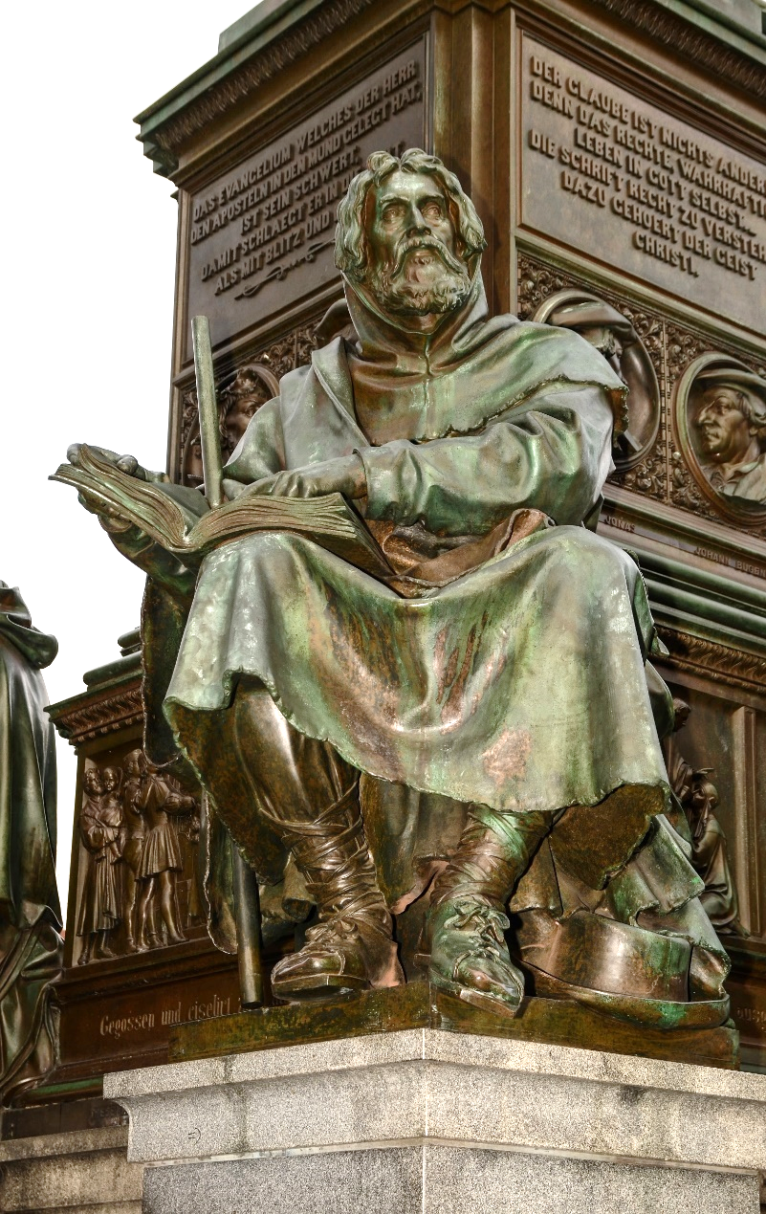
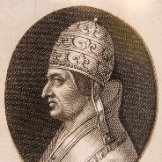
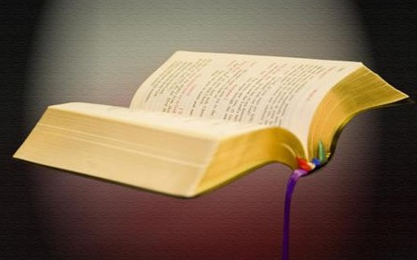
KUGOVERANA BHAIBHERI: MAWARIDHENZI
“Ɀino Petro naʋaapostora ʋakapindura, ʋakati: ‘Tinofanira kuterera Mŋari kupfuʋura ʋanhu’ ” (Mabasa 5:29)
Peter Waldo (1140-1218), muzvinabhizimisi akapfuma wokuFrance akasiya pfuma yake kuti aparidze Kristu, akatanga sangano re“Varombo veLyon,” rinozivikanwa se“vaWaldenses.” Pope Alexander III akabvuma mhiko yake yehurombo.
Nguva pfupi yapfuura, Francis weAssisi (1181-1226), uyo akaitawo mhiko yehurombo, yakagamuchirwa naPapa Innocent III, akatanga sangano reFrancisca.
Panguva iyoyo, Pope Lucius III akanga ashora vateveri vaPeter Waldo savapanduki. Zvisinei, vaFrancisca vakava mbiru yeChechi yeRoma ukuwo vaWaldenses vakatambudzwa kusvika vatsakatika. Ngenyi?
Nokuda kwekutendeka kwake. Vekutanga vaive vakatendeka kuna Pope, nepo vekupedzisira vaive vakatendeka kudzidziso dzeBhaibheri.

Slide 10
KUGOVERANA BHAIBHERI: MAWARIDHENZI
Chii chaizivikanwa nevaWaldenses?
Vakanga vari vokutanga kuita kuti Bhaibheri riwanike mumutauro wavo (kusvikira panguva iyoyo, raingowanika muchiLatin, chiGiriki kana kuti chiHebhuru).
Sezvo rakanga riri bhuku rinorambidzwa, vakarikopa mumapako, vachihwanda kubva kuvatendi vekereke ye Roman Catholic vakavakomba.
Nguva dzose vaitakura zvikamu zveBhaibheri izvo, panguva yakafanira, vaigoverana navamwe, zvichivapa tariro nekurudziro munaShe.
Vakachengeta chokwadi cheBhaibheri chavaiziva kwemazana emakore. Vaizivikanwa nekuvimbika kwavo uye kuzvipira.
Misha yose yakashandurwa kumaodzanyemba kweFrance uye kuchamhembe kweItari, Piedmont.
Mizhinji yemisha iyi yakaparadzwa nePapa, uye vagari vayo vakaurayiwa.

Slide 11
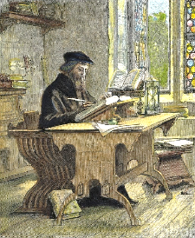
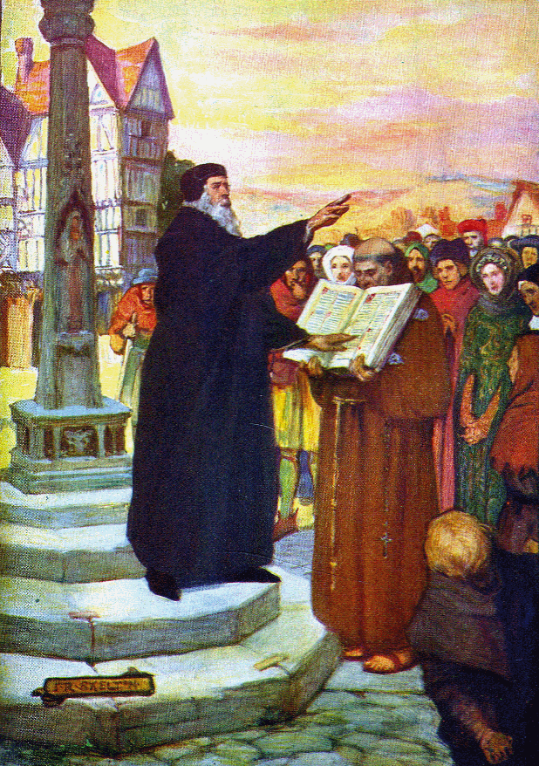
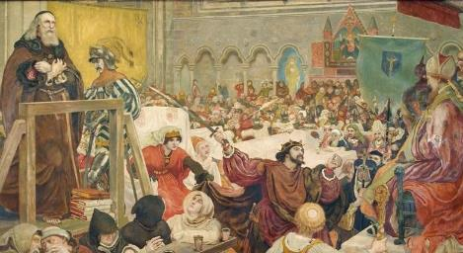
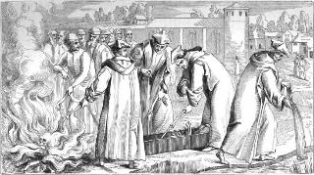
NYEREDZI YEVANDUDZO: JOHN WYCLIFFE
“Asi gwara raʋakarurama rakaita seciedza camambakwedza,
Cinoramba ciciwedzera kubginya kuȿikira pamasikati makuru” (Zvirevo 4:18)
John Wycliffe (1324-1384) akapa nguva yakawanda youpenyu hwake kuti ashandure Bhaibheri muChirungu. Chii chakaita kuti aite izvi? Zvikonzero zviviri: Kristu akanga amushandura kuburikidza neShoko; uye aida kugoverana rudo rwaKristu navamwe.
Uyo anodzidza Bhaibheri nemoyo wose, uye anozarura mwoyo wake kusimba reMweya Mutsvene, anoshandurwa(VaHeb. 4:12).
Chokwadi, izvi zvakaita kuti apesane neChechi yepamutemo. Nemhaka yohukama hwake nevakuru vakuru muEngland, John akanzvenga rufu pamaoko eChechi.
Muna 1428 zvisaririra zvomuvandudzi zvakapiswa, uye madota ake akakandirwa murwizi. Madota ake akapararira akava mucherechedzo wenhaka yake.
Chiedza chiduku chechokwadi chakabatidzwa naJohn Wycliffe chakasvika kuBohemia, uko John Hus akatora nhaka yake. Neiyi nzira, zvokwadi yakapinda munzira yayo kutozosvikira pamavambo evandudzo. Zuva rakanga rotanga kupenya.

Slide 12
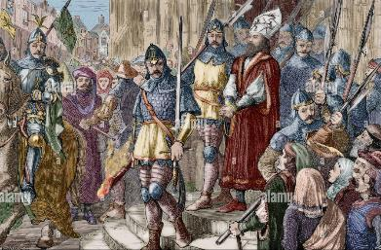
KUSIMBISWA NOKUTENDA: JOHN HASI NEVAMWE
“UnoMŋanakomana, unoʋupenyu; usinoMŋanakomana waMŋari, haanoʋupenyu” (1 Johani 5:12)
Pashure paJohn Wycliffe, vamwe vashanduki vakamuka:
John Huss (1370-1415)
Jerome (1360-1416)
Tyndale (1494-1536)
Hugh Latimer (1490-1555)
Chii chakavapa ushingi hwokuita vandudzo dzavo ndokutarisana nezvinetso norufu?
Vaitenda muzvipikirwa zvaKristu
Simba raKristu rakanga rakakwana kuti vakunde miedzo
Vakawana mufaro mukubatanidzwa mukutambura kwaKristu
Kuvimbika kwake kwaiva uchapupu hune simba kunyika
Vakatarisa mberi kwenguva yazvino, kunguva yemberi ine mbiri
Vaiziva kuti rufu muvengi akakundwa
Vakabatirira pazvipikirwa zveShoko raMwari
John Hus akaiswa mujeri uye pakupedzisira akapisirwa padanda. Ari mujeri akanyora kuti: “Mwari akandinzwira ngoni sei, uye akanditsigira nenzira inoshamisa sei.” Sezvo zvipikirwa zvaMwari zvakatsigira vanhu vake munguva yakapfuura, zvinotitsigira nhasi.

Slide 13
“Vose avo muzuva rakaipa iroro vaizoshumira Mwari vasingatyi maererano nezvinorairwa nehana, vachada ushingi, kusimba, neruzivo rwaMwari neshoko Rake; nokuti avo vari vechokwadi kuna Mwari vachatambudzwa, vavariro dzavo dzichashorwa, kuedza kwavo kukuru kududzirwa zvisizvo, uye mazita avo acharaswa seakaipa. Satani achashanda nesimba rake rose rinonyengera kupesvedzera mwoyo nokudzikatidza kunzwisisa. […] Kusimba nekuchena kwekutenda kwevanhu vaMwari, uye nekusimba kwekutsunga kwavo kumuteerera, Satani achaedza zvakasimba kumutsa hasha dzeavo, kunyange vachizviti vakarurama, vanotsika mutemo waMwari. Zvinoda kuvimba kwakasimba, chinangwa chehugamba, kubatisisa kutenda kwakambopihwa kuvatsvene.” -Non Official Translation by Gift Mawoyo
EGW (The Acts of the Apostles, pg. 431.1)

