Slide 1
GAL JOUSE HUNG KUONDOHNA GAL
Simmun 1: April 6, 2024

Slide 2
“Chuphat in vanmun ah gal ahung um tai. Michael leh avantilte’n Dragon leh ama vantilte chu asatta uvin ahi. Chuin Dragon chun gal chu aleltan, hiti chun ama le avantilte chu van a kuon in nodoh ahita uve” (Thuphuon 12:7, 8)

Slide 3
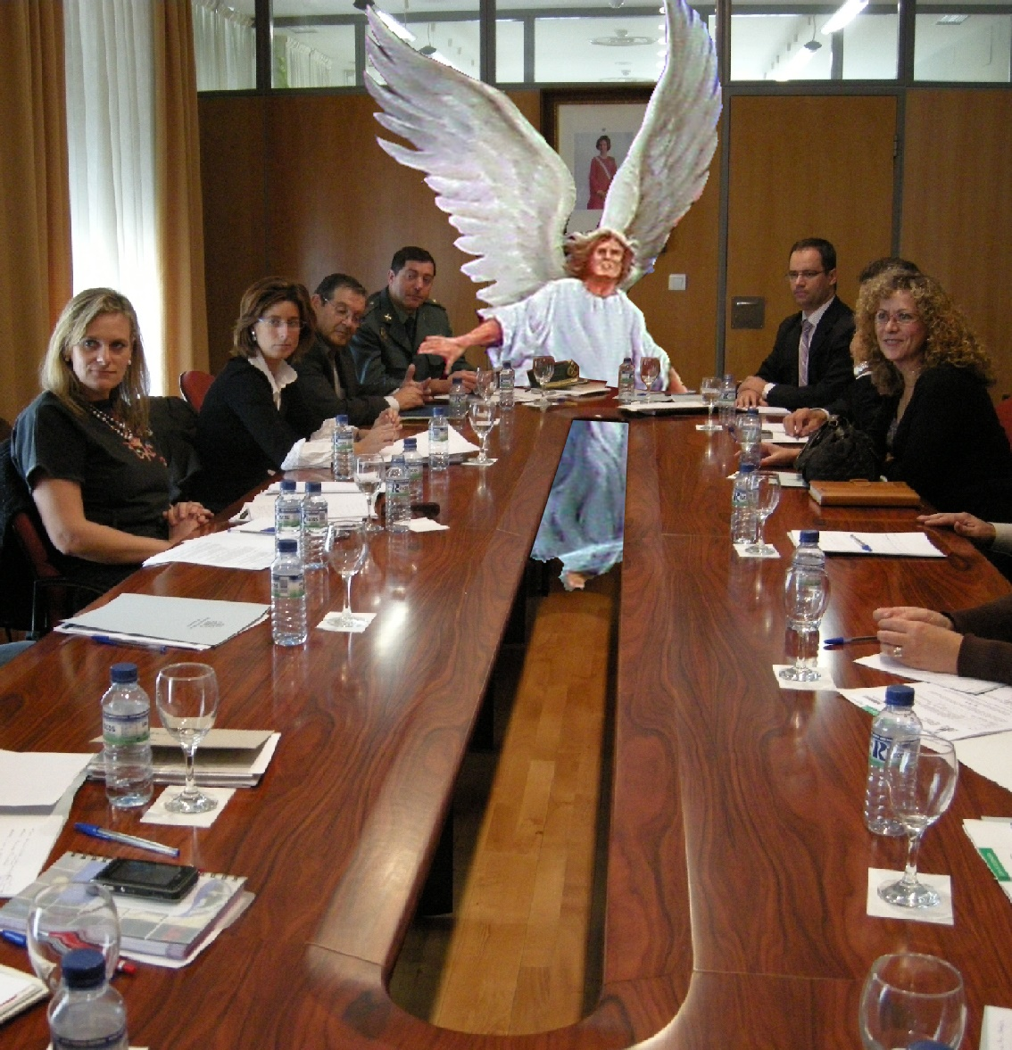
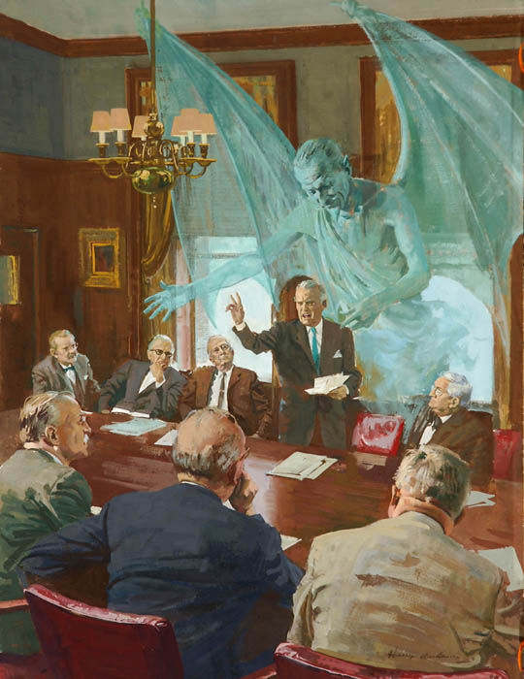
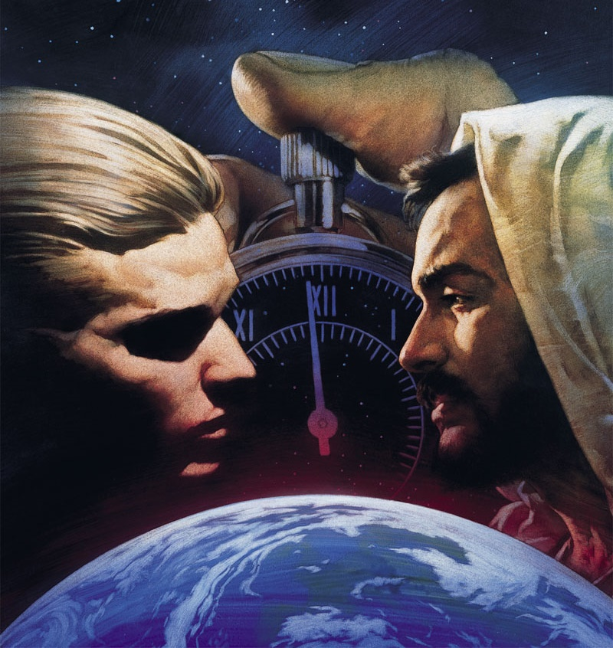
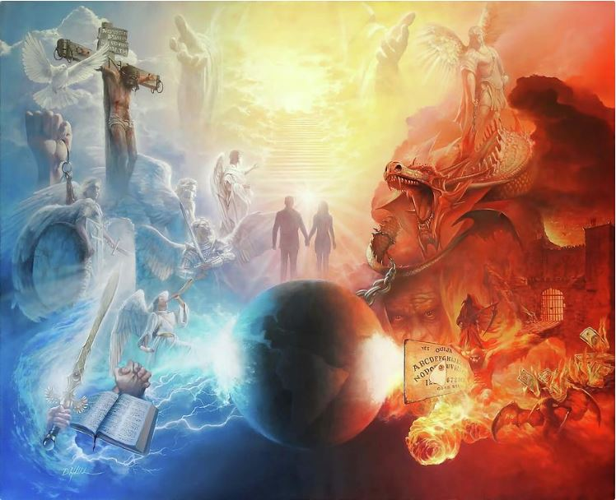
Vanmun jouse losuoh kidouna a chun eiho jong langnei a, panla chieh ihi uve. Ihetdohlouvu jong himai thei, hithei dia itahsanlouvu jong himai thei, ahin hiche kidouna chu um mong ahi.
Akidou langkai teni chu lhagaova kidou ahin, mit a muthei ahi poi (Eph. 6:12). Hijengjong leh kidouna ga hetthei tah in aum e. Gamna, siet ngaina hinkho, thina…
Pathien Amatah vaihomna, avantilte leh vanmun dang tampi a athilsiem jouse kitahna susethei khop in gal akibolkhum tan ahi. Hiche gal hin tuni nang le kei kitahna jong lhuhsah tei ding aguot ahi.
Kidou kipatna
Vanmun a kiphinna
Leisiet a kiphinna
Ngailut lethuhna
Tu nikho kidouna

Slide 4
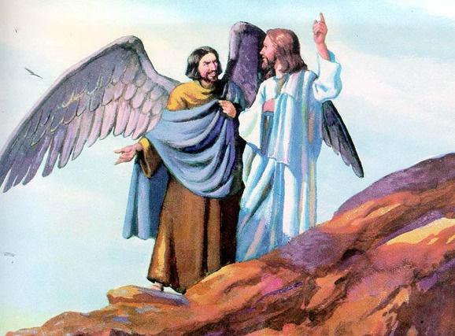
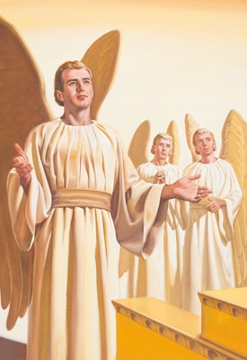
KIDOU KIPATNA
“Nakisiemdoh nikho a pat nangma hi nalamlhahna jouse a nuolna bei nahi, hiti a chu nasung a thiemmona akimudoh kahse’n” (Ezekiel 28:15)
Eden huon sung a Evi’n Pathien tahsanlelna aneitheina ding a atiildohgo aum chun mihiem um masang a Pathien douna kiphinna umsa ahitah dan atahlah e (Gen. 3:1).
Jesu’n Pathien leh asiemsate kikah a kitahsanlelna muchi hin thelut a chu “melma” ti’n akou e, Diabol chu ahi ati (Mt. 13:39).
Ei le ei thudoh kidoh masat ding chu: Pathien in Diabol kiti sietna mipa hi asiem hin tem?
Bible in Diabol chu Lucifer ti a kiminvo vantil khat anahi ati (Is. 14:12). Hiche vantil hi chamkim le melhoi tah a kisiem anahi (Ez. 28:12). Vantil dinmun sang pen, vengbittu cherub hina, chan dopsang in anaum e (Ez. 28:13-14).
Lucifer chu chamkim ah ahileh iti Diabol hung suohthei hin tem? Pathien toh akikah kidouna iti hung umdohthei a hin tem? Pathien in athilsiem jouse apieh bang in, ama jong deilhentheina ape’n ahi, ahin ajieh umlouvin Lucifer chun Pathien douna kiphinna, Pathien laltouna chu ding, akilhenjo tan ahi (Ez. 28:15; Is. 14:13-14).

Slide 5
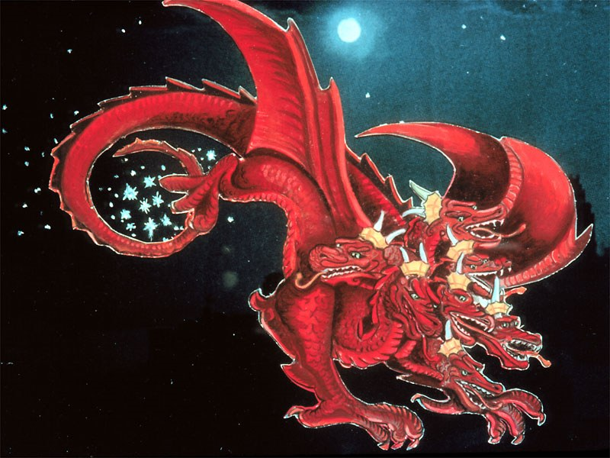
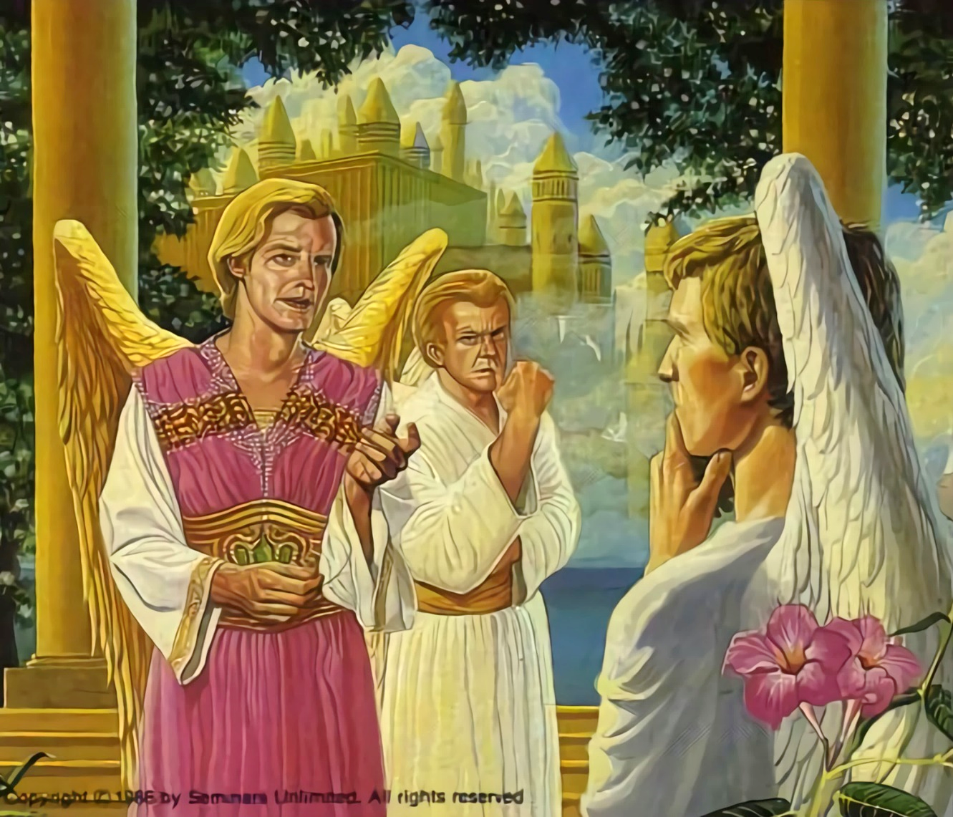
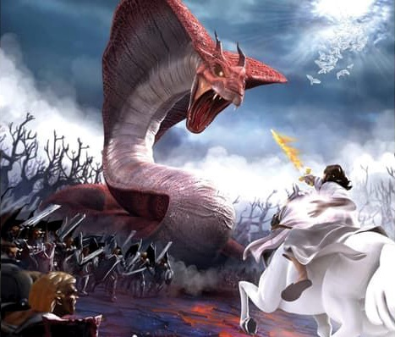
VANMUN A KIPHINNA
“Chuleh amei chun van a ahsiho hopthum a hopkhat aluoilha’n, lei ah aseplha’n ahi…” (Thuphuon 12:4a)
Vanmun laltouna avetlel jieh chun vantilho lungsung ah Pathien vaihom thudih ginchatlelna muchi phalou ahin tulut tan ahi. Jalen ngen hilouvu ham? Ibol a dan khaotah, dihlou tah le hetthiem hah tah jui dia kipehlut ngai khel hintem? ati.
Lucifer chu mihehse jing Satan ahung suoh tai (Rev. 12:10; Job 1:6, 9-10). Pathien ngailut kamcheng in alungput dihlou khelsah dia akounaho khat jong asaanpeh tapoi.
Kiphinna chu lhangphuong tah a kidouna ahungsuoh tan, vantil cheng in ama ama kaina ding kilhen dia thulhuhna akisiem chieh diu angai tan ahi. Hopthum a hopkhat chun Satan ajuita uvin, adangse vang Pathien ang ah kitah tah in adingdet tauvin ahi (Rev. 12:4a).
Hiche kidouna chu tuni’n jong achejom jing nalai in ahi. Satan natoh akichol naipoi. Mitin Pathien douna a kiphin din ano jing e. Kaina ding lang ni bou aum e. Pathien Dan nung leh nungsunho tin akikhen e. Thulhuhna chu nang bou in nakibol ding ahi (Deut. 30:11, 16, 19; Josh. 24:15).

Slide 6
“Loupi tah Pathien chun thilsiem jouse lhemchavai a pang Lucifer hi vanmun a kuon ahin nomang thei ngal ahi; ahin hichu ama natoh dan ahipoi. Kiphinna hin pandoh Lucifer jong, Achapa tah leh avantilho jouse toh kibang a, Pathien tha le hatna mudohthei din dinmun kibang in adinsah in ahi. Hiche kidouna hi vantil jouse’n langkaina akilhen diu, thilsiem jouse muthei a kitahlah diu ahi. […] Pathien in kiphin lamkaipa chung a gotna natoh tong ngal ta hen lang hileh langkaina kikhel vantilho hina dihtah mudohlouva um ding ahi; hijeh chun Pathien in boldan chuom in abol tan, vanmun a um jouse’n Ama thutan dihje leh umdol kichieh tah a amu diuvin abol tai.”
EGW (The Story of Redemption, pg. 17)

Slide 7
LESIET A KIPHINNA
“Hichun aman jong, “Koi ham nangma nasagohkeo nahi ti a naseipeh a chu? Ne hih beh in ti a kathupieh thingga chu naneh khattou hitam?’ ” (Siemtilbu 3:11)
Pathien in vantilho chu chonsiet umlouhielna, chamkimna gam, ah anasiem e. Hitobang tah chun mihiemte jong chamkim sel gam, chonsiet kijahkhahlouna mun ah anasiem e (Gen.1:31).
Vantilte abolpieh bang in, mihiemte jong se le pha lhenkahtheina chihna toh eisiemtha un ahi. Hijeh chun Adam le Evi jong adeijoh lhon kilhentheina tha anei lhon in, Pathien chun thupieh jui bailam tah “amavang se le pha hetna thingga khu nanehlou hiel ding ahi” chu ape lhon tan ahi” (Gen. 2:17).
Hilai tailou thildang him him ah Pathien thusei tahsanlelna muchi tuluttheina lampi Satan in aneipon ahi. Duha thutah pum in alungtup amuolso tai. Adam le Evi’n Pathien thusei agingchalel lhon in, thupieh apalkeh lhon in, hinna tuinah a kuon akiheimang lhon tai (Gen.3:6, 9-13, 19). Adam in chonsiet kot ahong tan, mitin thina achansah tai (Rom. 5:12).
Hiche nikho a apat ichenna u vannuoi nat, veisiet le thina toh akikhen tapon ahi. Adam chonsiet jeh a genthei ihi u hin tem?
Eimaho chonsiet man pe ihibou ui: “ajieh chu mi jouse chonse ahitan, Pathien loupina changlel ahita uve” (Rom. 3:23).

Slide 8
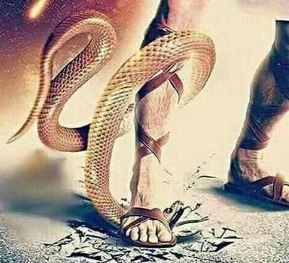
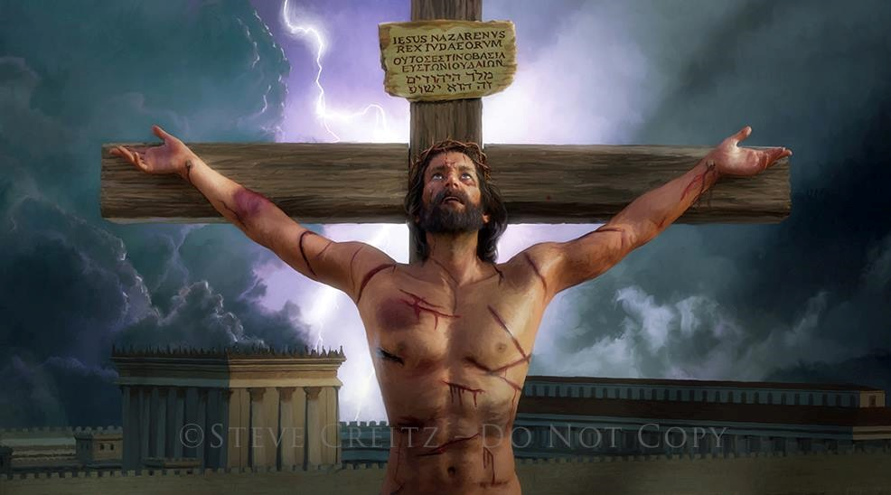
NGAILUT LETHUHNA
“Hiche a hi ngailut um ah ahi; eihon Pathien chu ingailut u ahipoi, amajoh in eina ngailut u ahibouve. Chuleh aman achapa chu eiho chonsiet thiensona a ahinsol ahi” (1Jn. 4:10)
Thununlou ga ipi ahi aseipeh masang in, Pathien in Adam le Evi heng ah amani lhatdamna tohguon aum aseipeh masa e (Gen.3:15).
Mihiemte’n adeitah un Siempa toh kikhen ding anakilhen uve. Ahin, kipaje helou chate donlouva koi tahsang in, Pathien in ahina dihtah chu angailutna akhonbei in avetsah tan ahi (John 3:16).
Chonse din thina chu tuonsot kikheltheilou achan ding ahitan ahi. Jesu’n chonsiet man dia ahinkho atodoh jieng chun angailutna ichan ahi avetsah tai (Rom. 5:8).
Pathien ngailut chantheina ding eiho ah ima aum poi. Ahin, Calvary a athisan valha cheng chun “Nang kangailu’i” ati Pathien awcheng eijahsah ui.”

Slide 9
NGAILUT DONBUTNA
“Hiche a hi ngailut um ah ahi; eihon Pathien chu ingailut u ahipoi, amajoh in eina ngailut u ahibouve. Chuleh aman achapa chu eiho chonsiet thiensona a ahinsol ahi” (1Jn. 4:10)
Jesu’n angailut iti ei vetsah um?
Thilsiem um jouse Jesu siem ahi (Jn. 1:3)
Ama jong thilsiem khat ahung hi (Jn 1:14)
Eiho bang in hahsat, thuoh genthei, kiel leh nat athuoh e (Is. 53:3; Mark 11:12)
Eiho bang in patep in aum e (Heb. 4:15)
Chondihtah ahivang in eiho chonsiet ga thuoh din akiphal e (1 Pet. 3:18; John 10:17-18)
Athi le athodoh jal chun ama a tuonsot hinna neithei din lhamuonna eipe uve (Rom. 6:3-4)
Abol jouse ngailut jal ahin ahi (1Jn. 4:10)

Slide 10
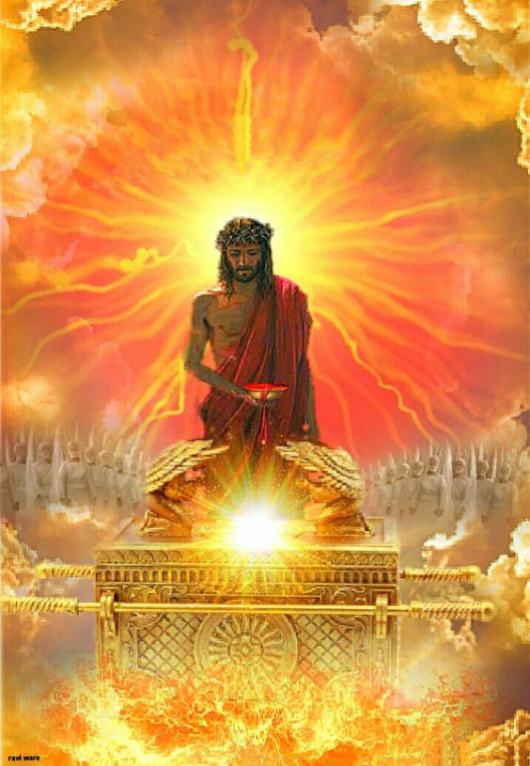
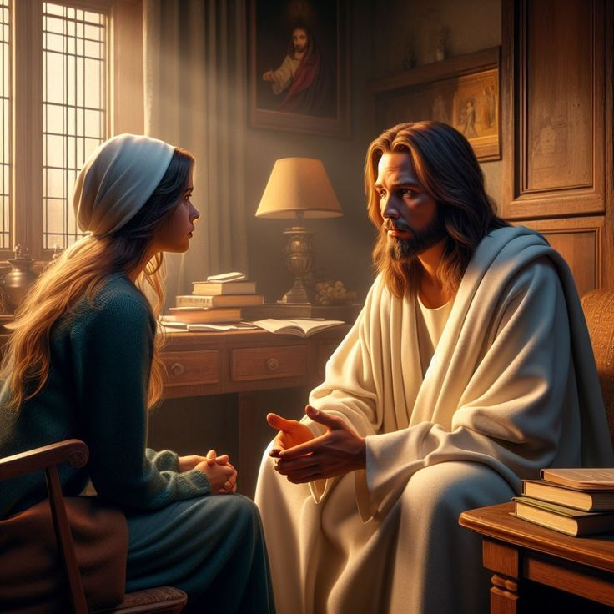
TU NIKHO KIDOUNA
“Hijeh chun ama vang a Pathien kom nailutteho chu taopeh ding a ama hing jing jeng ahijeh a chu amaho chu huhhing chamkimsuoh thei ahi” (Hebrews 7:25)
Tu hin, Jesu Van Houbuh ah eiho din palai na eitohpeh ui (Heb. 9:24; 7:25).
Cross a athisan kiso jal chun, Pa ang ah eiho thalheng in apang thei in- vanmun jouse a um thilsiemho muthei in jong- dihtah, chamkim tah, Van a mun neitheilom tah hidin eidinpi uve.
Hijeh chun Jesu vang a Pathien ang lungngam tah a nailut din ei tiem ui (Heb. 4:15-16).
Jesu’n ingaichatna chan uva ama a kingai din eidei ui (Jn. 14:13-14). Kichat umthei nalai ding ham, aman lungolmolouna eipe ta u chu; lungsung ki-oimona umthei nalai ding ham, aman ngaidam eichansah ta u chu; lhahsamna ah thahat eipe ta u chu.
Jesu deilhen chungnung chu eiho toh tuonsot a chenkhom ding chu ahi (Jn. 17: 24). Nang deilhen chungnung jong hinam?

Slide 11
“Lhepna’n nahin nokhum a, buoina, lungdonna, chuleh muthim in nalhagao ahin u’mkimvel abah tieng, vah namuna mun chu nungvil kit in. Christa ngailutna a chun kichol in lang, avenbitna a chun kisel in. Chonsiet in lungsung lodim aguot jing lai hin, lungsung a chang ki-oimona’n ilhagao le hetna chung gih tah a akoi a, tahsanlelna’n meilom bang a eihin tuom tieng, Christa lungsietna chu chonsiet suniem le muthim tolmang ding a bulhingset ahi geldoh in. Huhhingpu toh kihoumat hi chamna mun a lutpet chu ahi."
EGW (The Ministry of Healing, pg. 193)

