Slide 1
THE CRUCIBLES THAT COME
Lesson 2 for July 9, 2022

Slide 2
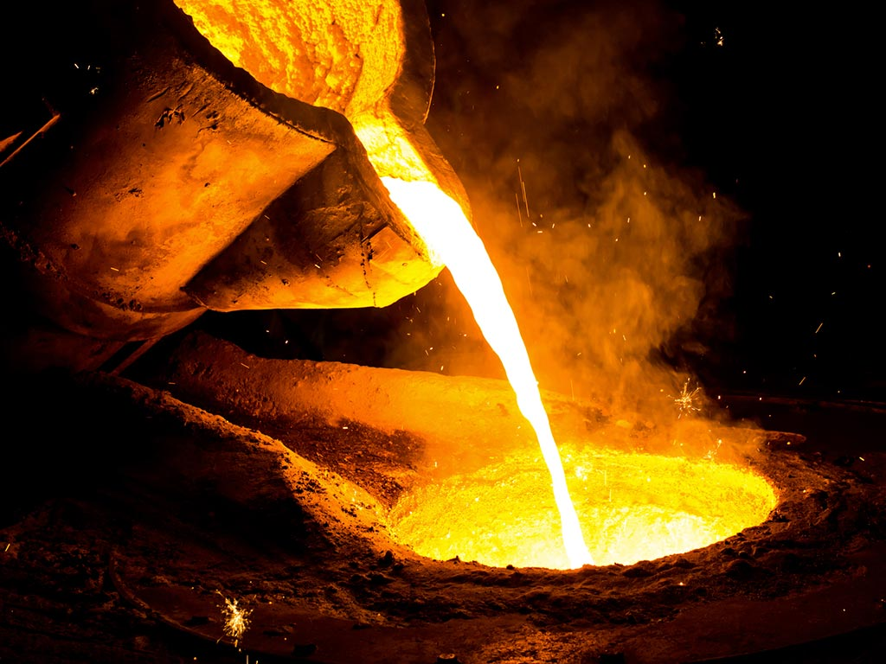
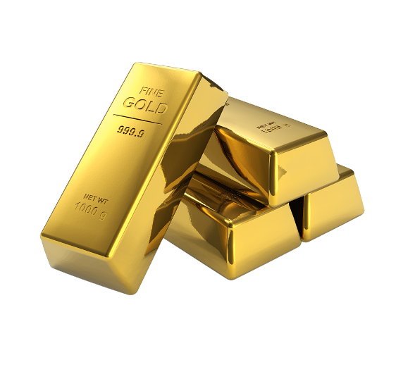
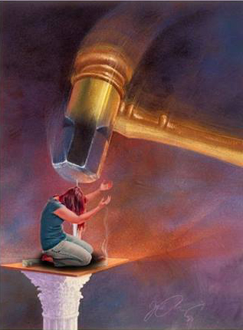
A crucible is a vessel used for smelting a substance that requires a high degree of heat (e.g. gold).
It also refers to a severe test, or to a place or situation that may cause a change in a person or their character.
Not all crucibles are the same or have the same source. Let’s study which types of crucibles believers face.
Crucibles of Christians. 1 Peter 4:12-19
Crucibles of Satan. 1 Peter 5:8-11
Crucibles of sin. Romans 1:18-32
Crucibles for salvation. Jeremiah 9:7-16
Crucibles for protection. 2 Corinthians 12:7-10

Slide 3
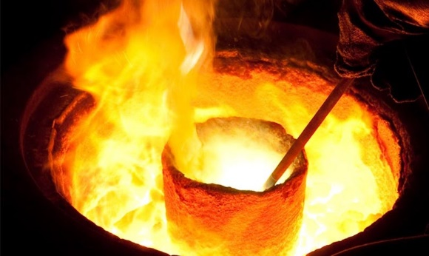
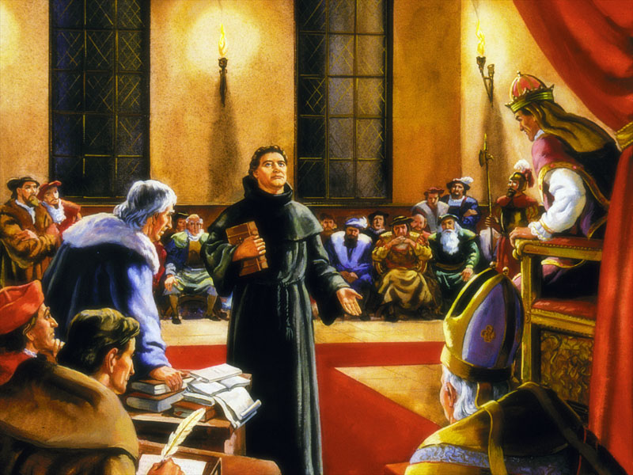
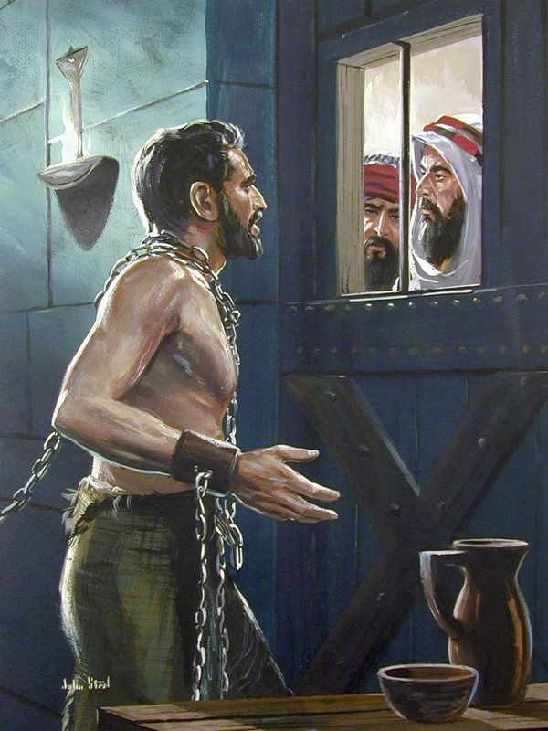
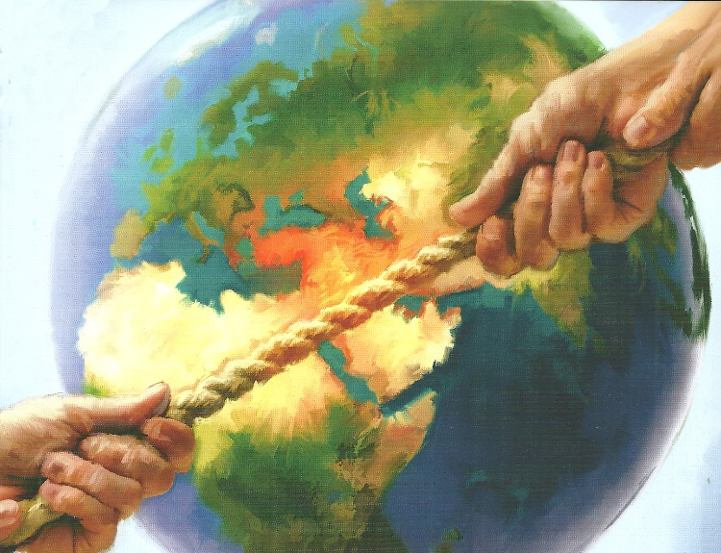
CRUCIBLES OF CHRISTIANS
“Beloved, do not think it strange concerning the fiery trial which is to try you, as though some strange thing happened to you.” (1 Peter 4:12)
Following Christ comes with difficulties. Remaining faithful when sin attacks, defending the truth above falseness, testifying that Jesus is the Savior of the world… When we do these things, enemies may try to harm us to silence our testimony.
This experience of suffering for our faith could be considered a “smelting process,” the process of the crucible.
We live in the midst of a dispute between good and evil, between God and Satan. Therefore, we shouldn’t be surprised if we face trouble when we openly stand on God’s side.

Slide 4
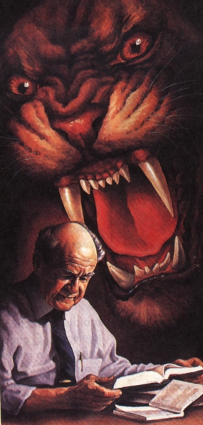
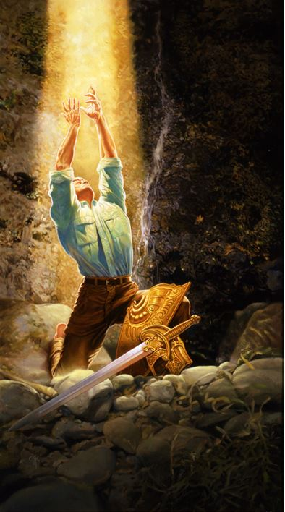
CRUCIBLES OF SATAN
“Be sober, be vigilant; because your adversary the devil walks about like a roaring lion, seeking whom he may devour.” (1 Peter 5:8)
Satan is an active and real enemy. He wants to cause damage. His work is palpable all around us (death, suffering, immorality, falsehood…).
He’s especially interested in making us sin or destroying us if we don’t. He tries to do so by any means.
What can we do about it? Exercising self-control, being alert, withstanding the temptations, standing firm in our faith (1P. 5:8-9 NIV).
God has promised to restore us, and to make us strong, firm, and steadfast in this battle (1P. 5:10 NIV). Remember that Satan has already been defeated (Lk. 10:18; Ro. 16:20; Rev. 12:11). Our victory is assured as long as we cling to Jesus.

Slide 5
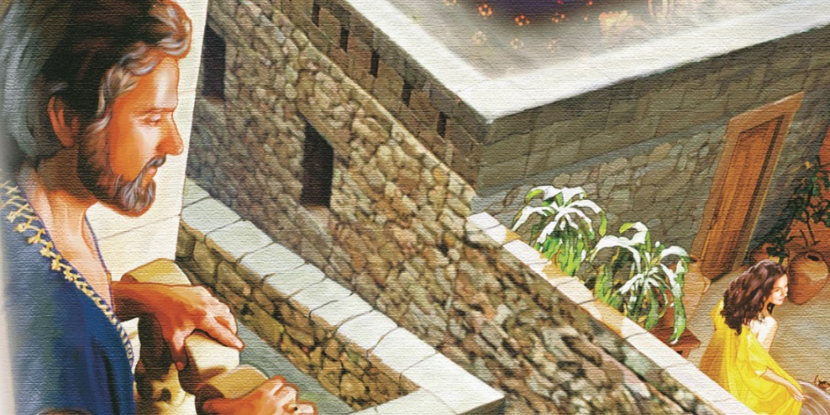
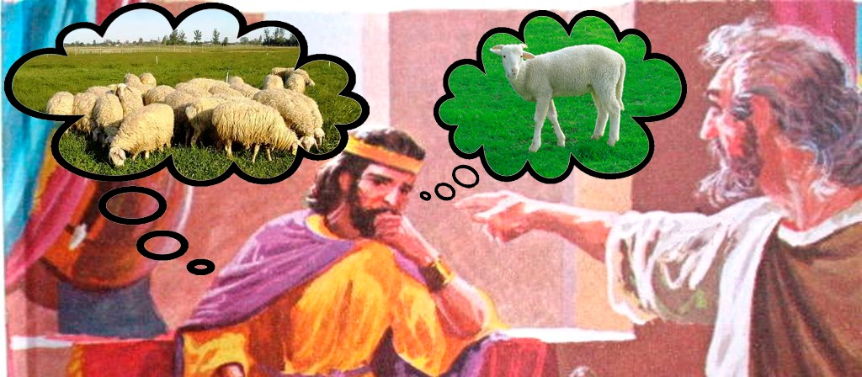
CRUCIBLES OF SIN
“For the wrath of God is revealed from heaven against all ungodliness and unrighteousness of men, who suppress the truth in unrighteousness,” (Romans 1:18)
Sin always has side effects (Gal. 6:7). God might remove the consequences of our sins, but He usually doesn’t, so we can understand how harmful and offensive our sins are.
We shouldn’t expect to sin and then be unharmed, or to think that “God will understand my current situation and deliver me from my sin’s consequences.” Transgressing the moral and health laws brings suffering, a self-imposed crucible.
Romans 1:21-32 explains the process of sin.
We stop thinking about God (v. 21)
We trust our own wisdom (v. 22)
We worship earthly things (v. 23)
God let us follow our own way (v. 28)
Sin appears (v. 29-32)

Slide 6
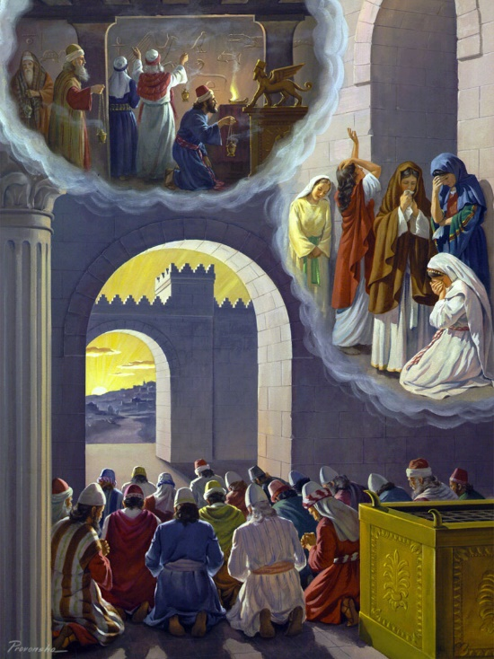
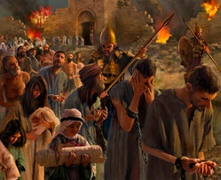
CRUCIBLES FOR SALVATION
“Therefore thus says the Lord of hosts: ‘Behold, I will refine them and try them; for how shall I deal with the daughter of My people?’” (Jeremiah 9:7)
Beyond the consequences of our sin, God is worried about the sin itself, especially the sins that we refuse to confess.
When we don’t confess our sin, God allows us to go through the crucible, so we acknowledge our sin and feel the need for salvation.
The crucible begins when God makes us focus our attention on our sin (sometimes in painful ways)
We feel deep pain because we are aware of our sin
The process becomes harsher as we must decide to quit the sin that we are embracing

Slide 7
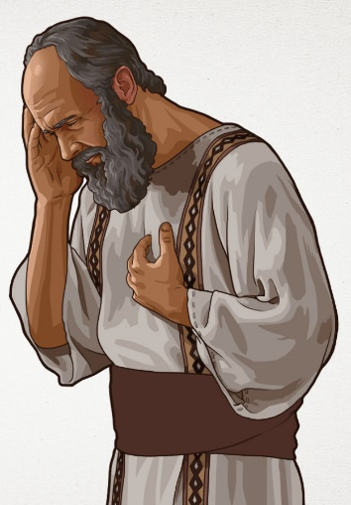
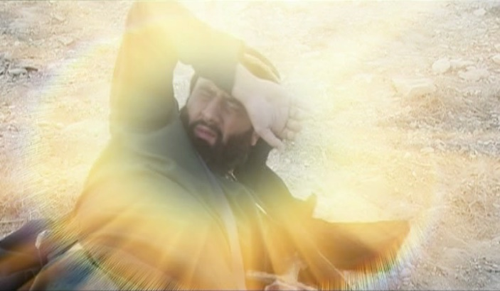
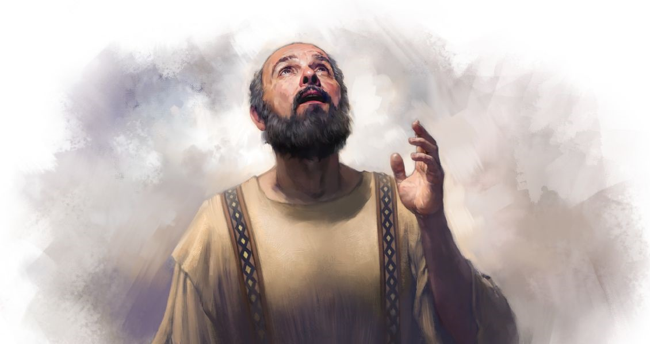
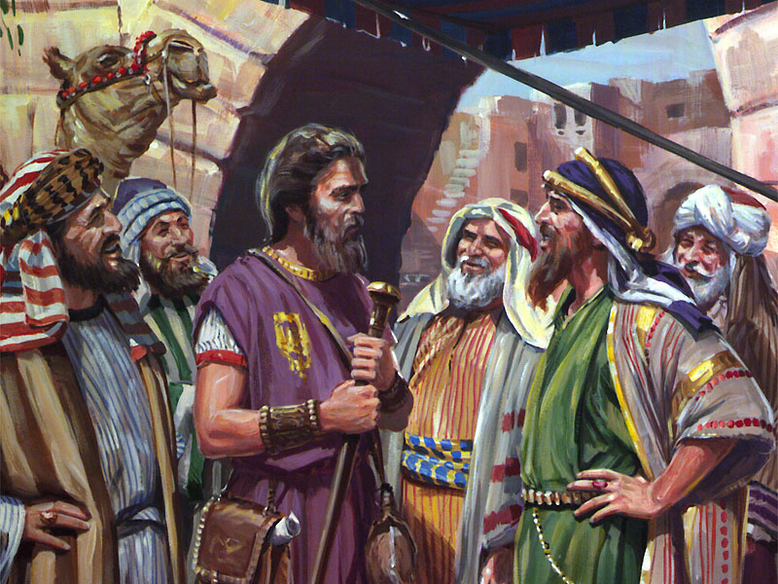
CRUCIBLES FOR PROTECTION
“And lest I should be exalted above measure by the abundance of the revelations, a thorn in the flesh was given to me, a messenger of Satan to buffet me, lest I be exalted above measure.” (2 Corinthians 12:7)
Sometimes God allows Satan to make us go through certain crucibles, so we are strengthened, thus becoming ready to withstand future temptations.
Paul understood that the “thorn” he was suffering had prevented him from exalting himself, and from giving in to pride and self-confidence.
He concluded that “when I am weak, then I am strong.” (2Co. 12:10)
In summary, not all the crucibles or trials we suffer are produced the same way or with the same intention. Let’s ask the Holy Spirit to help us understand each case, and to act accordingly.

Slide 8
“Those who hold fast their faith unto the end will come forth from the furnace of trial as fine gold seven times purified... When in trouble, remember that faith tried in the furnace of affliction is more precious than gold tried with fire.”
E. G. W. (Christ Triumphant, July 11)

