Slide 1
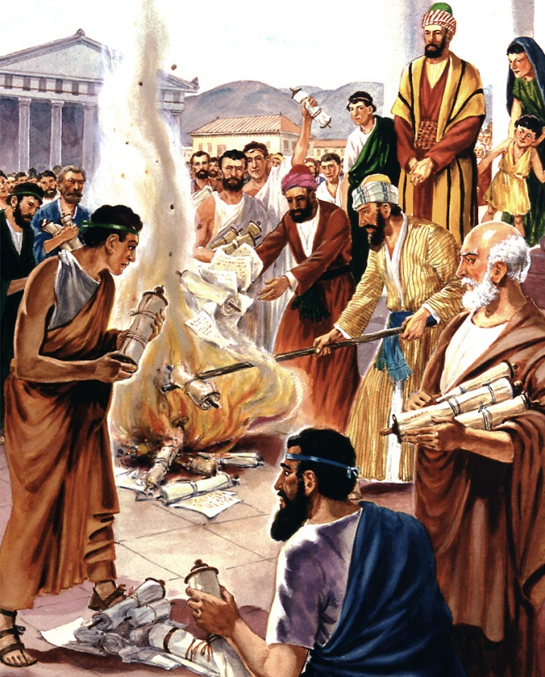
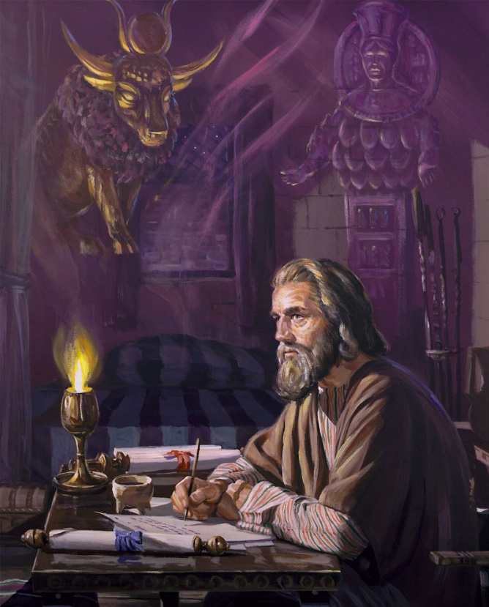
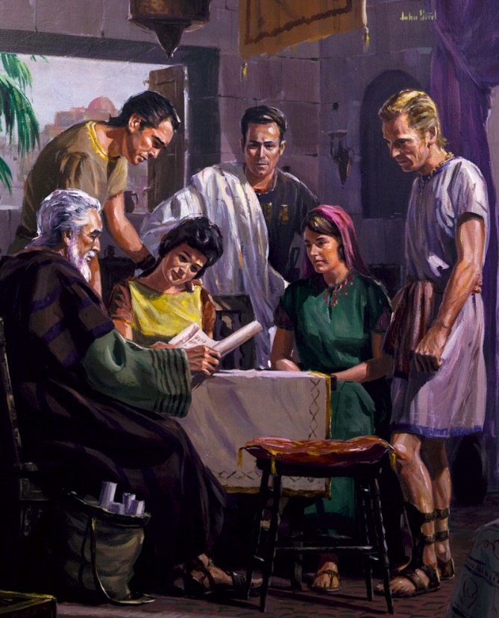
PAUL AND THE EPHESIANS
Lesson 1 for July 1, 2023

Slide 2
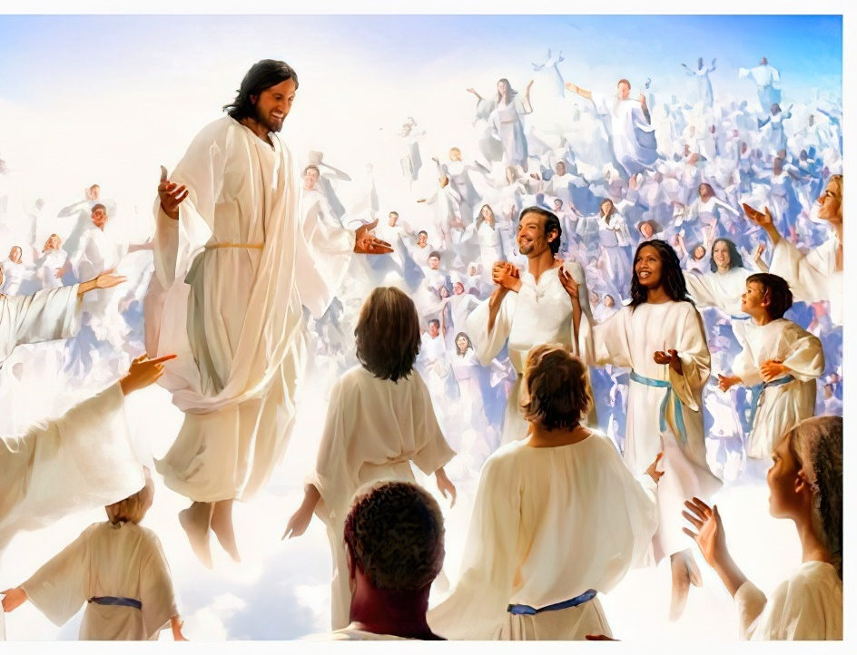
“Making known to us the mystery of his will, according to his purpose, which he set forth in Christ as a plan for the fullness of time, to unite all things in him, things in heaven and things on earth”
(Ephesians 1:9, 10)

Slide 3
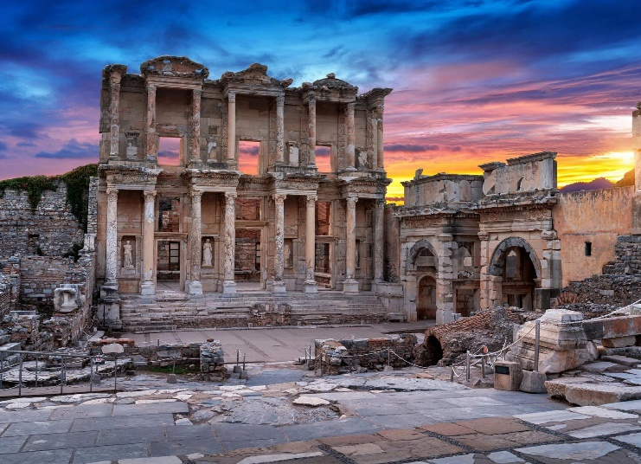
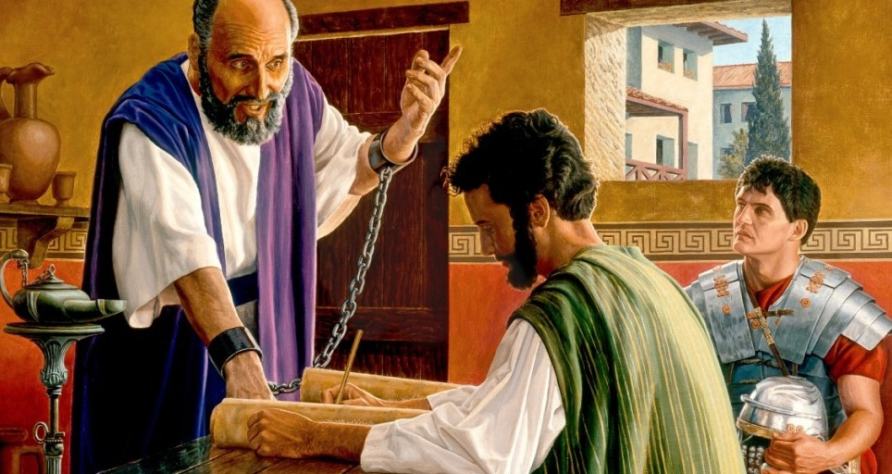
Ephesus was one of the cities where Paul stayed for a long time to preach. The Ephesians were extremely interested in the Gospel. They even took drastic steps to abandon their old lifestyle.
Paul said goodbye to the Ephesians sadly and warned them about a future apostasy among them. Some time after that, he felt the need to teach them and encourage them with a letter: the epistle to the Ephesians.
The author:
Paul preaches in Ephesus
Reactions to the message
The addressees
The theme:
Exalted style and metaphors
The main subject: Christ

Slide 4
THE AUTHOR

Slide 5
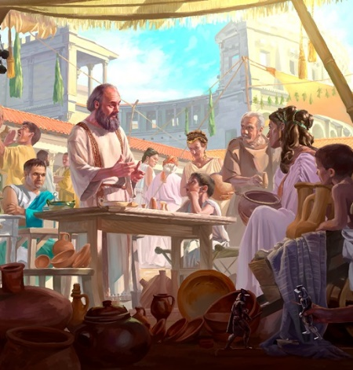
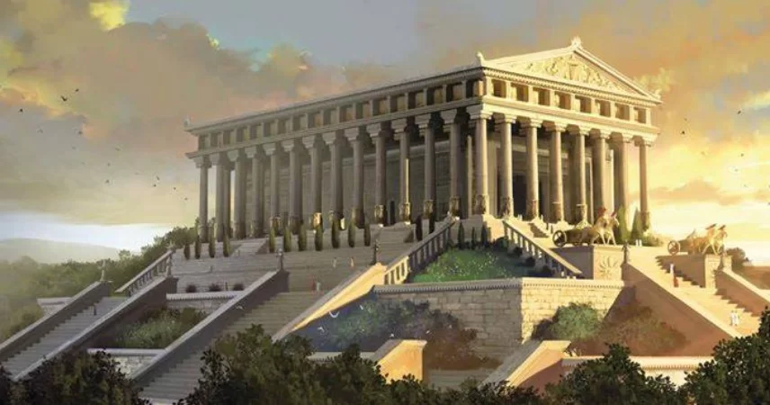
PAUL PREACHES IN EPHESUS
“And he came to Ephesus […] entered the synagogue and reasoned with the Jews.” (Acts 18:19)
In Paul’s times, Ephesus was a prosperous city and the capital of Asia (the Roman province). The temple of Artemis (Diana for the Romans) was one of the seven wonders of the ancient world.
Paul preached in Ephesus for a brief time by the end of his second missionary journey. He consolidated his work there during his third journey.
52 AD
52-53 AD
53-56 AD
57 AD
62 AD
Paul preached in Ephesus (Acts 18:19-22)
Aquila, Priscilla, and Apollos preached (Acts 18:24-26)
Paul preached for 3 years (Acts 19:1, 10, 22; 20:31)
Paul said goodbye to the elders of Ephesus in Miletus (Acts 20:17)
Paul wrote the epistle to the Ephesians in Rome (Acts 28:30; Eph. 3:1)

Slide 6
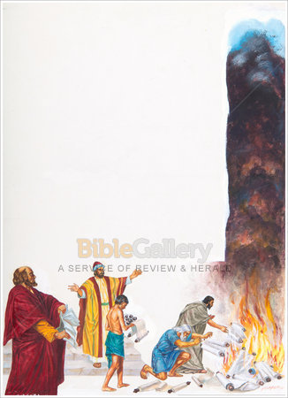
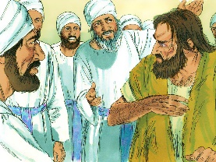
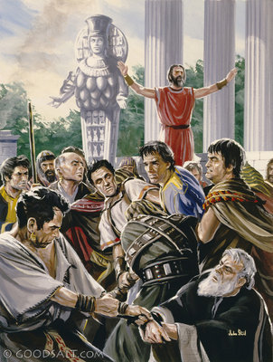
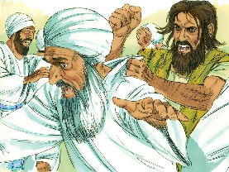
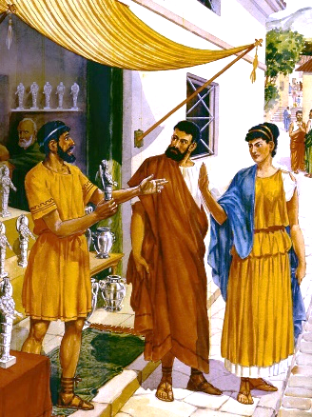
REACTIONS TO THE MESSAGE
“Also, many of those who had practiced magic brought their books together and burned them in the sight of all. And they counted up the value of them, and it totaled fifty thousand pieces of silver.” (Acts 19:19)
The Christians in Ephesus voluntarily burned books of magic with a total value of four million US dollars (Acts 19:19). Why did they do it (Acts 19:11-18)?
They understood that Jesus is more powerful than Satan. They had to destroy any connection to Satan’s powers in order to serve Jesus.
Not everyone reacted this way. Demetrius made silver shrines of Diana, so his income was threatened. He thought that his business would go bankrupt if everyone accepted Christ (Acts 19:23-28).
Paul had to leave Ephesus because of the turmoil that Demetrius provoked (Acts 19:29-41).

Slide 7
“These treatises on divination contained rules and forms of communication with evil spirits. They were the regulations of the worship of Satan—directions for soliciting his help and obtaining information from him. By retaining these books the disciples would have exposed themselves to temptation; by selling them they would have placed temptation in the way of others. They had renounced the kingdom of darkness, and to destroy its power they did not hesitate at any sacrifice. Thus truth triumphed over men's prejudices and their love of money.”
E. G. W. (The Acts of the Apostles, cp. 27, p. 288)

Slide 8
THE ADDRESSEES

Slide 9
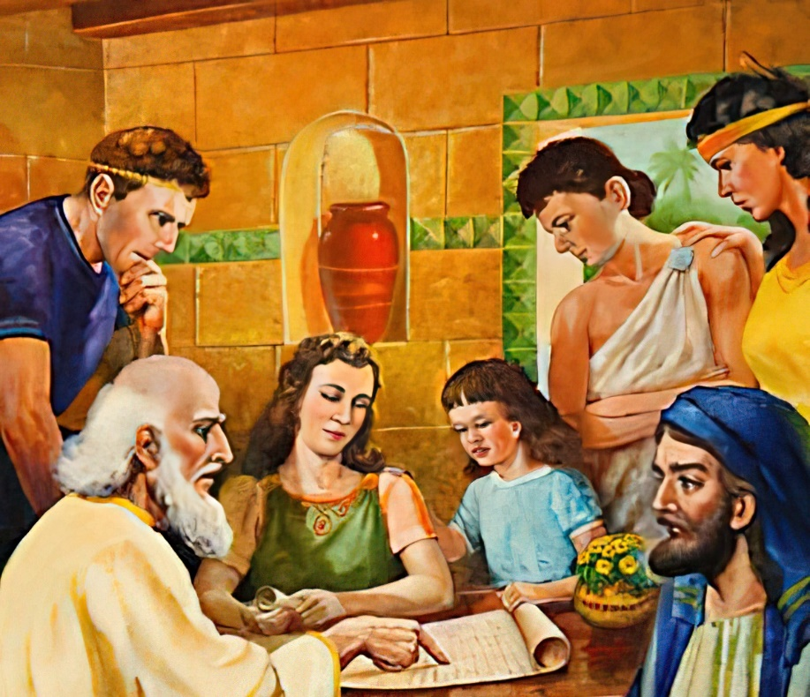
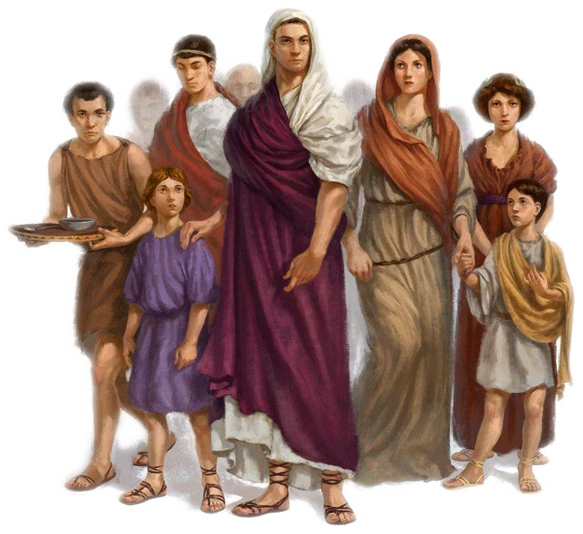
“Paul, an apostle of Jesus Christ by the will of God, to the saints who are in Ephesus, and faithful in Christ Jesus:” (Ephesians 1:1)
Paul wrote a letter (epistle). It was not a letter to a specific person, but to the church. It had to be read in public by Tychicus who carried it (Eph. 6:21-22).
In that time, the church gathered in homes where several families came together to worship (See Phlm. 1).
The assembled groups likely included members of the host household, slaves, clients (free persons who depended on the householder for support), and even customers.
Paul included special messages for some of those groups in his letter.

Slide 10
THE THEME

Slide 11
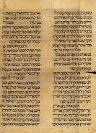
OUTLINE OF THE LETTER
Doctrinal section:
Blessing (1:3-14). “Blessed be the God and Father of our Lord Jesus Christ, who has blessed us with every spiritual blessing in the heavenly places in Christ” (1:3)
Prayer for the church (1:15-23). “[I] do not cease to give thanks for you, making mention of you in my prayers” (1:16)
Unity among Jews and Gentiles (2:1-22). “For He Himself is our peace, who has made both one, and has broken down the middle wall of separation” (2:14)
Revelation of the mystery of Christ (3:1-21). “to know the love of Christ which passes knowledge; that you may be filled with all the fullness of God” (3:19)
Practical section:
Unity through the gifts (4:1-16). “for the equipping of the saints for the work of ministry, for the edifying of the body of Christ” (4:12)
Changing our lifestyle (4:17-5:21). “that you put off, concerning your former conduct, the old man which grows corrupt according to the deceitful lusts” (4:22)
Practicing Christianity at home (5:22-6:9). “Nevertheless let each one of you in particular so love his own wife as himself, and let the wife see that she respects her husband” (5:33)
The armor of the Christian (6:10-20). “Put on the whole armor of God, that you may be able to stand against the wiles of the devil” (6:11)

Slide 12
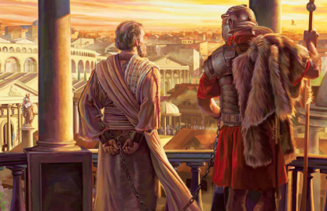
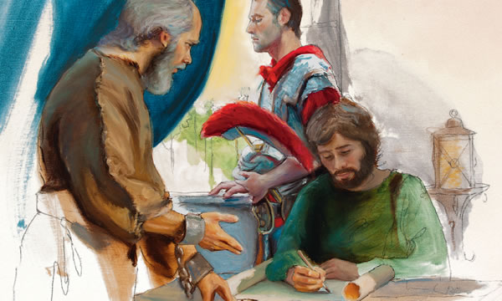
EXALTED STYLE AND METAPHORS
“Therefore I ask that you do not lose heart at my tribulations for you, which is your glory.” (Ephesians 3:13)
Some years after saying goodbye to the elders of Ephesus, Paul was imprisoned in a rented house in Rome (Acts 20:17, 36-38; 28:30).
The Church as a body
The Church as a building/temple
The Church as a wife
The Church as an army
He thought that situation could discourage the Ephesians (3:13). Therefore, he wrote a letter in an exalted literary style, beautifully written, and with well-thought repetitions that would imbue his listeners/readers with spiritual truths.
He also included four metaphors to better explain the purpose of the Church:

Slide 13
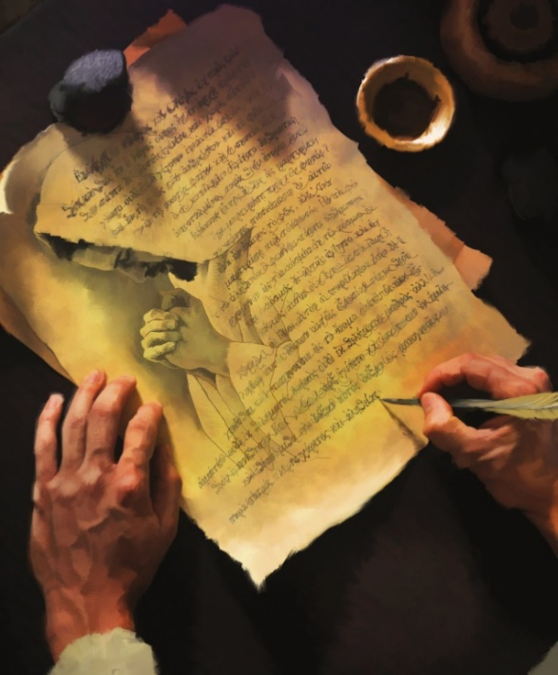
THE MAIN SUBJECT: CHRIST
“even when we were dead in trespasses, made us alive together with Christ (by grace you have been saved),” (Ephesians 2:5)
The main subject of the letter is noticeably clear. Paul mentioned Jesus 49 times in diverse ways (Jesus, Christ, Jesus Christ).
He saves us (2:5)
He makes us similar to Him to do good (2:10)
He unites Jews and Gentiles (2:11-14)
He makes sure we can reach the Father (3:10-12)
He lives in our hearts (3:17)
He gives us spiritual gifts (4:7-8)
He helps us to grow (4:15)
He is our love example (5:2)
He is the Lord we serve (6:5-6)
Paul wanted to revive the spiritual commitment of the Ephesians. He reminded them that they were part of the Church which is the core of God’s plan to unite everything in Christ.

Slide 14
“These messages [Paul’s letters], written with a power not of man but of God, contain lessons which should be studied by all and which may with profit be often repeated. In them practical godliness is outlined, principles are laid down that should be followed in every church, and the way that leads to life eternal is made plain.”
E. G. W. (The Acts of the Apostles, cp. 45, p. 470)

