Slide 1
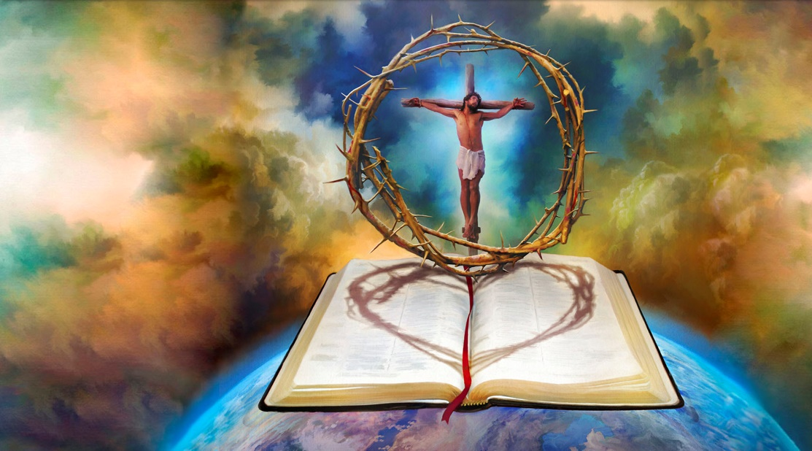
Lesson 2 for July 8, 2023
GOD’S GRAND, CHRIST-CENTERED PLAN

Slide 2
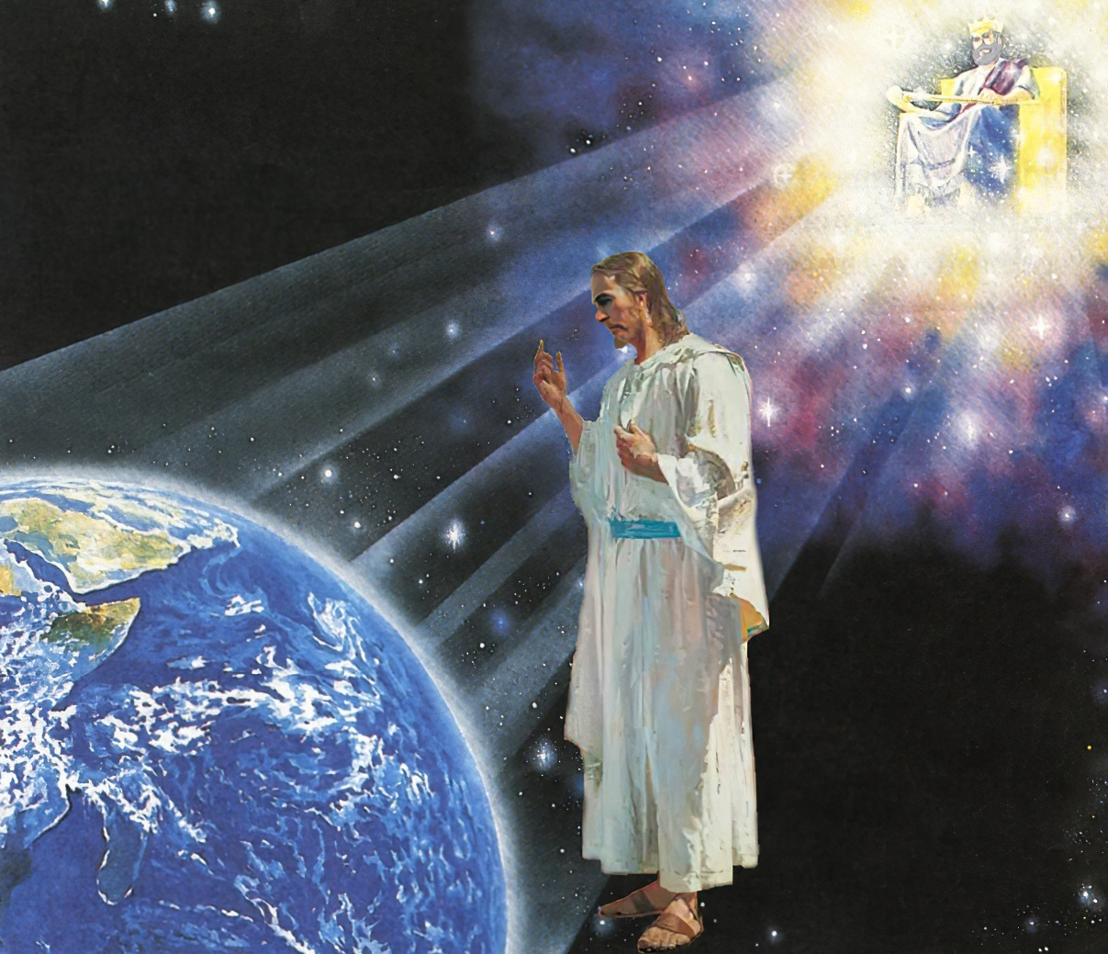
“Blessed be the God and Father of our Lord Jesus Christ, who has blessed us in Christ with every spiritual blessing in the heavenly places”
(Ephesians 1:3, ESV)

Slide 3
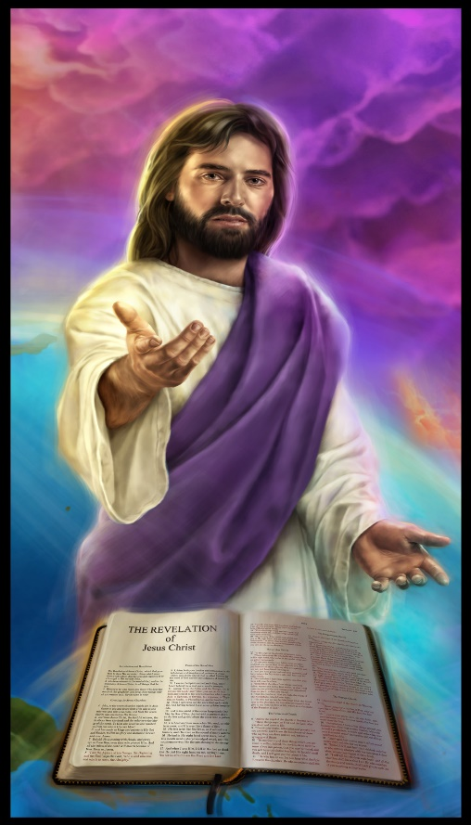
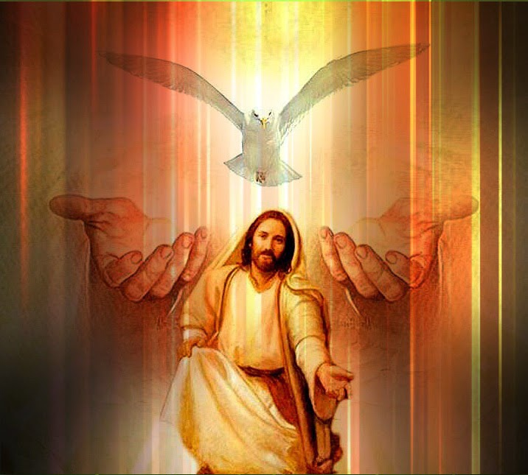
Paul began his letter by writing about Christ (Ephesians 1:3-14).
In Christ, God chose us and accepted us. In Christ, we’ve been forgiven and redeemed. In Christ, we receive salvation from God. In Christ, humankind can find unity and harmony. In Christ, we live full of happiness and praise.
Thanks go Christ we receive the seal of God and a foretaste of eternal salvation. Thanks go Christ we can receive the presence and the gifts of the Holy Spirit.
The gifts God gives us in Christ:
“Accepted in the Beloved” Ephesians 1:3-6
“Redemption through His blood” Ephesians 1:7-8
“Gather together in one all things in Christ” Ephesians 1:9-10
Our response to His gifts:
“The praise of His glory” Ephesians 1:11-12
A foretaste of future gifts:
“The guarantee of our inheritance” Ephesians 1:13-14

Slide 4
THE GIFTS GOD GIVES US IN CHRIST

Slide 5
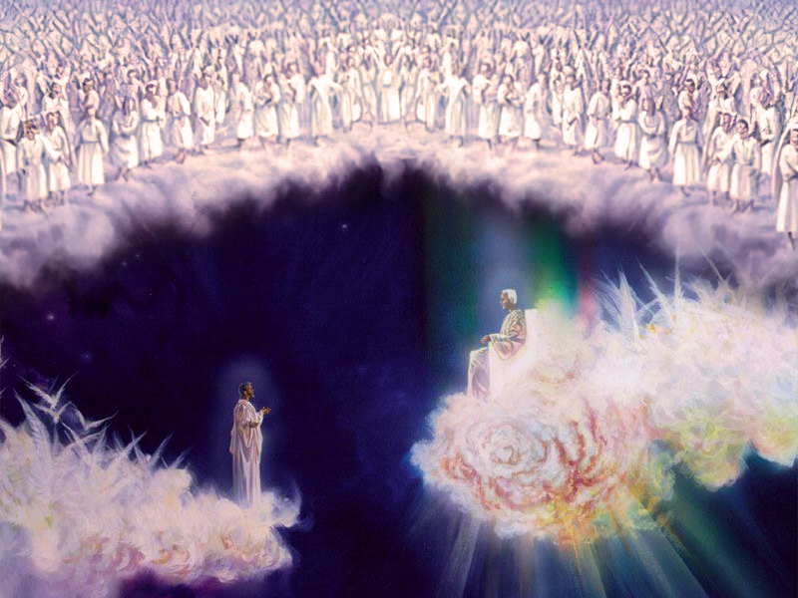
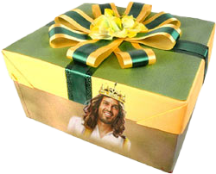
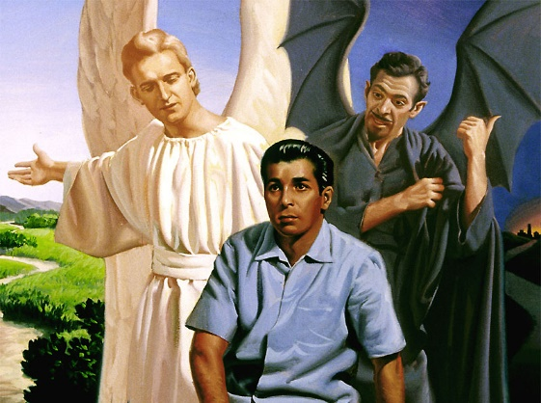
“ACCEPTED IN THE BELOVED”
Ephesians 1:3-6
God has given us spiritual blessings “in the heavenly places in Christ” (1:3). This is a reference to the place where Christ is seated at the right hand of God (1:20), and the spiritual realm where angels move (both good and evil ones).
For God we are already seated next to Him and Jesus in the heavenly places (2:6), we are a testimony for the angels (3:10), and we must arm ourselves against the attack of the fallen angels that live in that spiritual realm (6:12).
What are the blessings and gifts that God gives us?
We are holy and without blame (1:4)
We are adopted as His children (1:5)
We are made accepted in the Beloved (1:6)

Slide 6
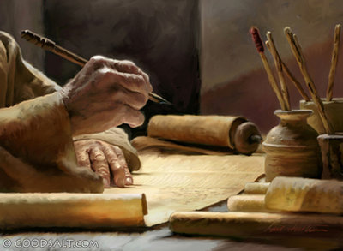
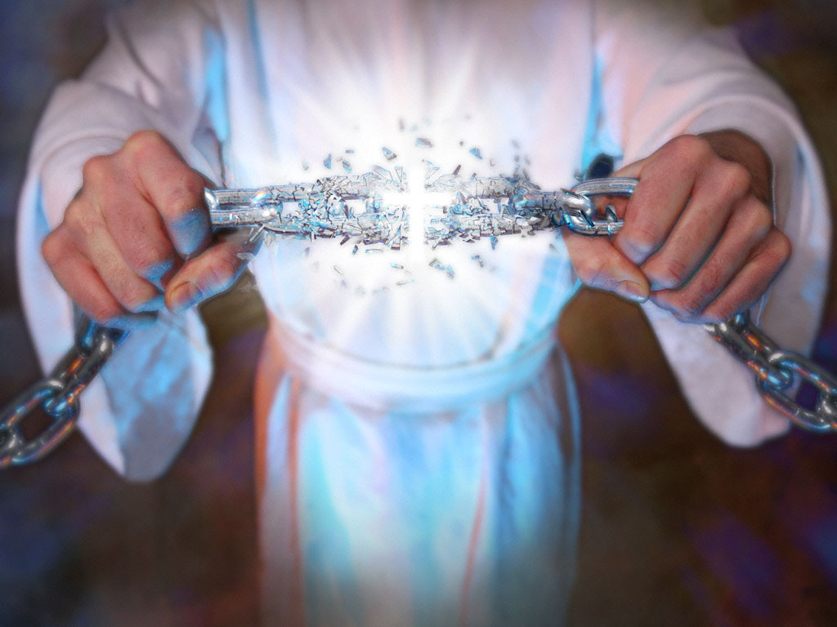
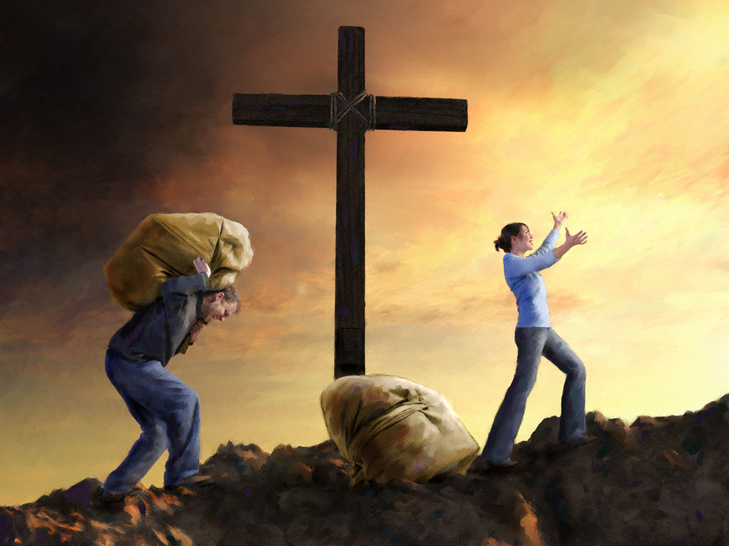
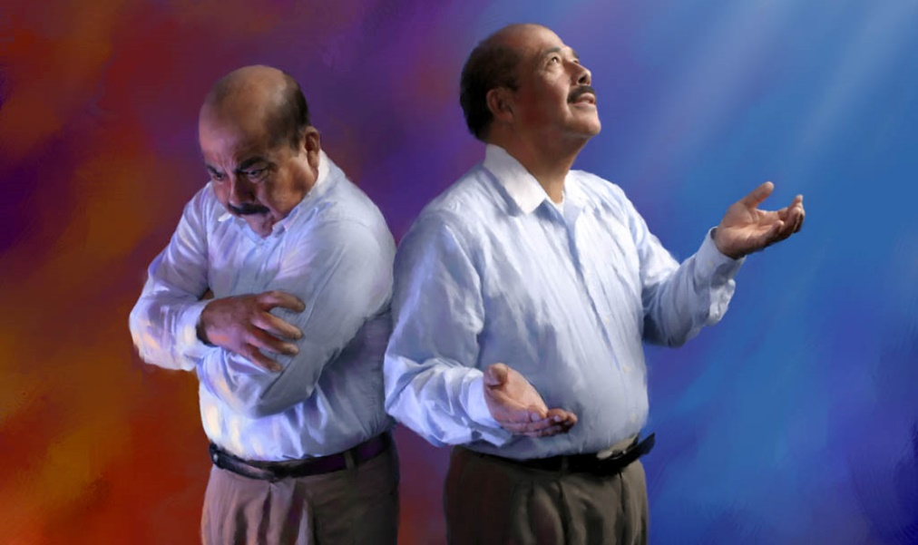
“REDEMPTION THROUGH HIS BLOOD”
Ephesians 1:7-8
Paul was writing to people who had been “children of wrath,” slaves of sin, like us (2:1-3).
But they had been redeemed and liberated from the slavery of sin (1:7) [redemption allowed a slave to be free from their master (in this case, the master was sin)].
We also receive forgiveness for our sins with a huge price: the blood of Jesus (1P. 1:18-19).
We are no longer worthless objects used by a tyrant master, but free and priceless beings: sons and daughters of God.

Slide 7
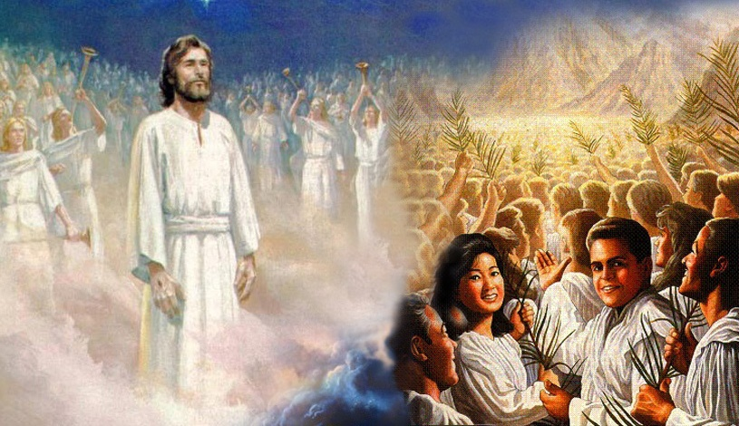
“GATHER TOGETHER IN ONE ALL THINGS IN CHRIST”
Ephesians 1:9-10
God, “making known to us the mystery of his will, according to his purpose, which he set forth in Christ as a plan for the fullness of time, to unite all things in him, things in heaven and things on earth.” (Ephesians 1:9-10 ESV).
Paul explains this plan in detail in the rest of his letter:
Unity in Christ is based on His death, resurrection, ascension, and exaltation (1:15-2:10)
The plan began by unifying humanity [Jews and Gentiles] in one church (2:11-3:13)
The church must remain united, avoiding behaviors that might split it (4:1-6:9)
The church will fight for peace as an army united in the name of Christ (6:10-20)

Slide 8
OUR RESPONSE TO HIS GIFTS

Slide 9
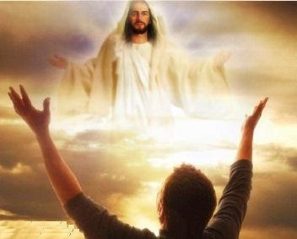
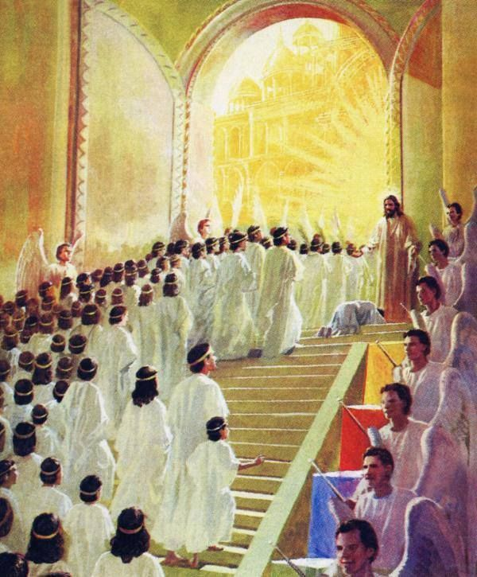
“THE PRAISE OF HIS GLORY”
Ephesians 1:11-12
In order to strengthen our faith and our identity as Christians, Paul reminded us that God has given us blessings. He has made us sons and daughters of God, and He has a special plan that will fulfill through us: uniting everything in Christ.
We must be aware that God has put His trust in us. We should respond to that by living a life “to the praise of his glory.”
Besides, “In Him also we have obtained an inheritance” (1:11). We receive an inheritance from God, but we also become an inheritance to God (Ex. 19:5; Dt. 9:29; 32:9).

Slide 10
A FORETASTE OF FUTURE GIFTS

Slide 11
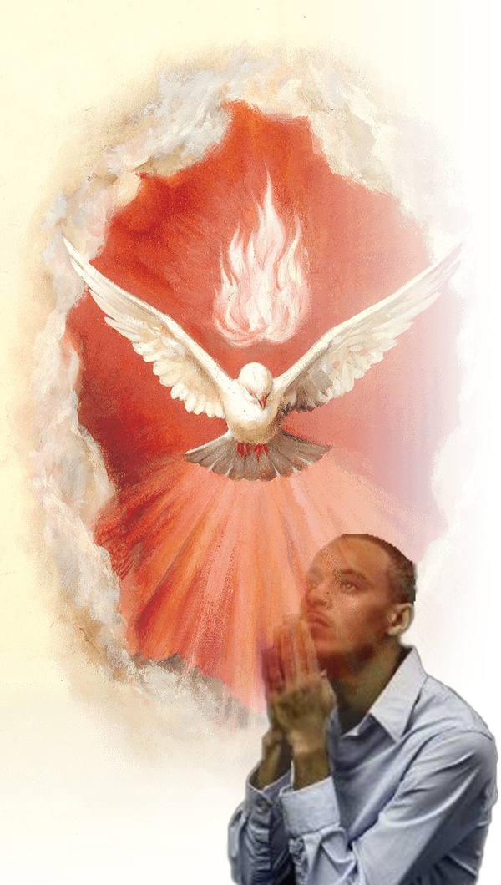
“THE GUARANTEE OF OUR INHERITANCE”
Ephesians 1:13-14
God wants us to be sure that we’ll receive an inheritance with Jesus. He wants us to enjoy things that “eye has not seen, nor ear heard” (1Co. 2:9). Therefore, He has given us the Holy Spirit (Jn. 14:26). Paul explained it by using two metaphors:
The seal. When we accept Jesus as our Savior, we receive the Holy Spirit and are marked as God’s property.
The guarantee. Having the Holy Spirit is the guarantee of being part of God’s people and receiving the promised inheritance.
The guarantee is usually the first payment made to assure that the rest of the payments will be paid. Now we are enjoying part of the inheritance, but the best is yet to come.

Slide 12
“The mercies of God surround you every moment; and it would be profitable for you to consider how and whence your blessings come every day. Let the precious blessings of God awaken gratitude in you. You cannot number the blessings of God, the constant loving-kindness expressed to you, for they are as numerous as the refreshing drops of rain. Clouds of mercy are hanging over you, and ready to drop upon you. If you will appreciate the valuable gift of salvation, you will be sensible of daily refreshment, of the protection and love of Jesus; you will be guided in the way of peace.”
E. G. W. (Sons and Daughters of God, November 29)

