Slide 1
Lesson 3 for July 15, 2023
THE POWER OF THE EXALTED JESUS

Slide 2
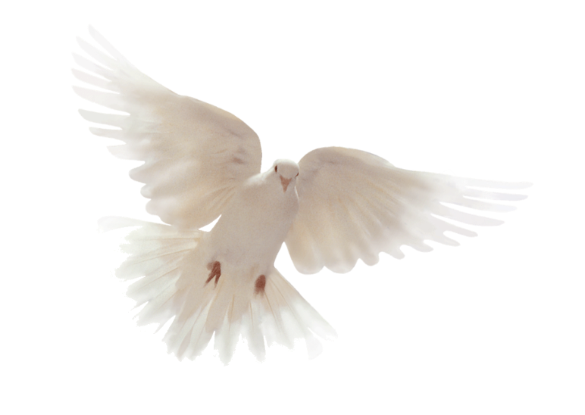
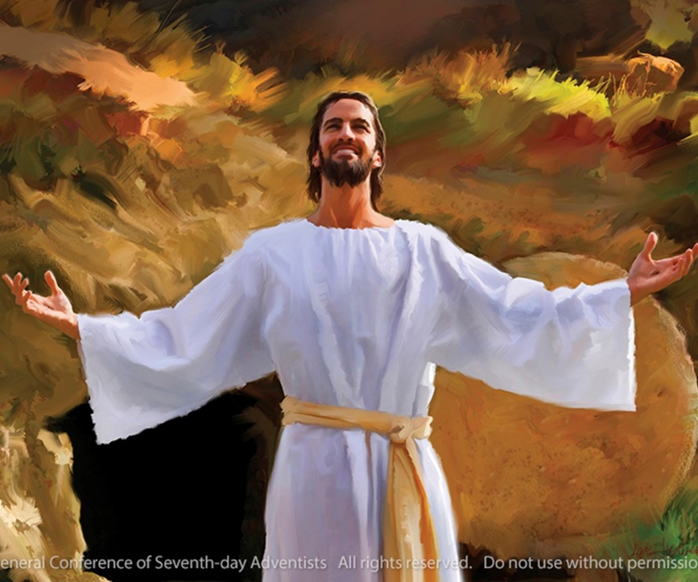
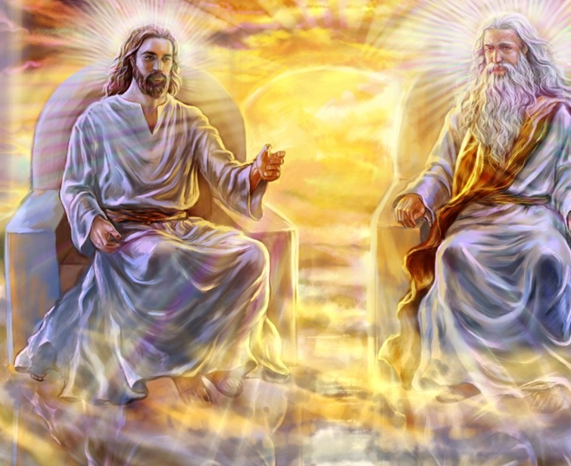
“Through the Holy Spirit, believers may know ‘what is the exceeding greatness of His power toward us who believe, according to the working of His mighty power which He worked in Christ when He raised Him from the dead and seated Him at His right hand in the heavenly places’” (Ephesians 1:19, 20)

Slide 3
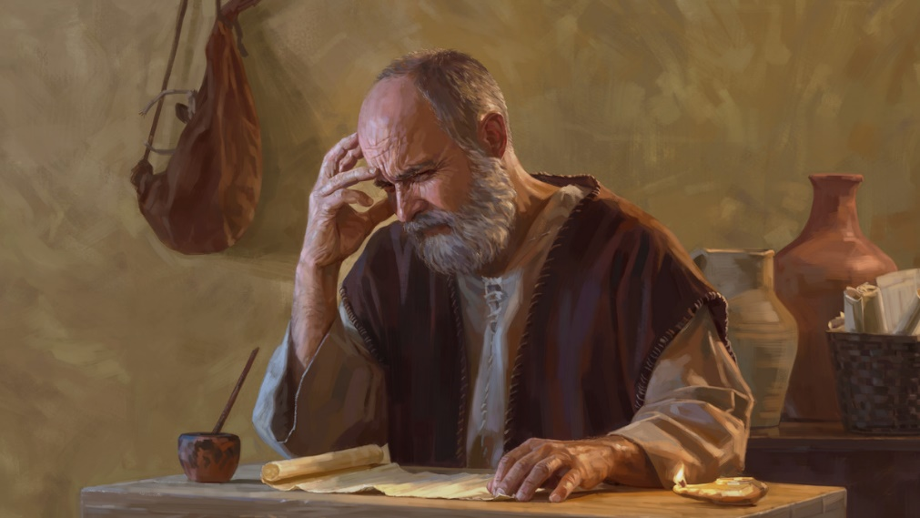
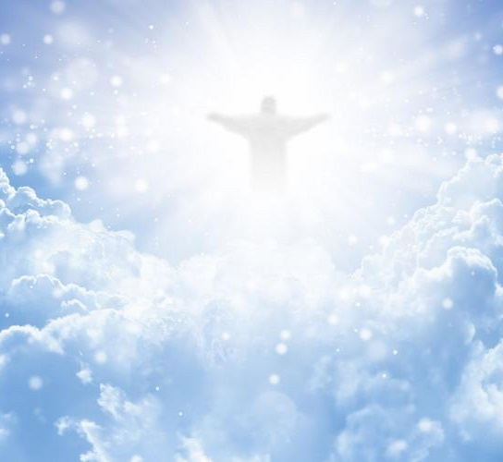
In Paul’s prayer [Ephesians 1:15-23], he asked the Father to give the Ephesians the experience of knowing God through His revelation, the hope that emanates from God’s calling and promises, and the faith through which they might experience the infinite power of the Lord Jesus Christ.
He finished his prayer by assuring them that Christ has subdued everything.
A prayer of thanksgiving and intercession. Ephesians 1:15-16
What did Paul request the believers to do?
Seeing as God does. Ephesians 1:17-19
Participating in the power of resurrection. Ephesians 1:20
Understanding the supremacy of Jesus. Ephesians 1:21
Epilogue:
Jesus, the head of the Church. Ephesians 1:22-23

Slide 4
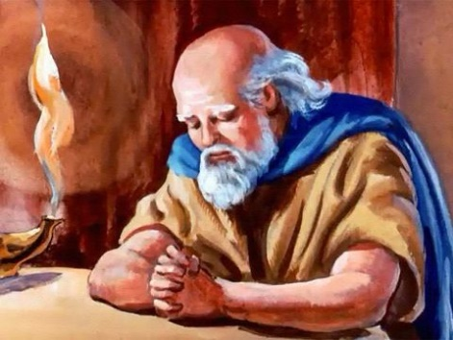
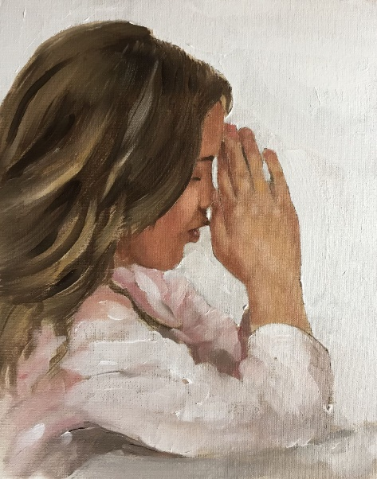
A PRAYER OF THANKSGIVING AND INTERCESSION
Ephesians 1:15-16
Paul had heard that the Ephesians were growing in love and faith (1:15). The joy of hearing that news moved him to pray, giving thanks to God (1:16). He also interceded in their favor, an intercession that would continue later in the letter (3:14-21).
Our hearts are always open to the influence of the Holy Spirit
We seek reasons to give thanks to God
We put our problems in His hands
We seek God’s counsel in the difficulties of this life
We are always willing to be led by God
The apostle encouraged us to follow his example: “Pray without ceasing” (1Ts. 5:17).
What does that mean?

Slide 5
WHAT DID PAUL REQUEST THE BELIEVERS TO DO?

Slide 6
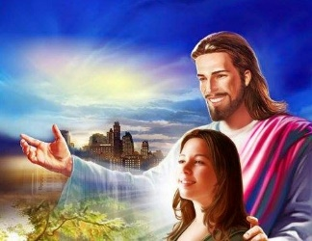
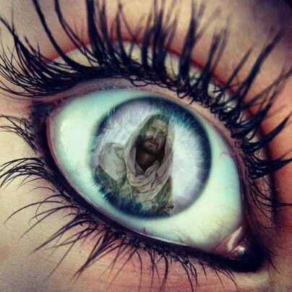
SEEING AS GOD DOES
Ephesians 1:17-19
God will give us wisdom if we ask for it. He will also reveal the things we cannot understand by ourselves (1:17). He will remove the veil from our spiritual eyes and will enlighten us with His knowledge (1:18a). We will see as God does.
What did Paul want us to understand (1:18-19)?
The hope to which we are called
That we are the glory of God’s inheritance (His treasure)
The incomparable greatness of His power in our favor
Paul asked God to make us capable of “knowing Him better” (1:17 NIV).

Slide 7
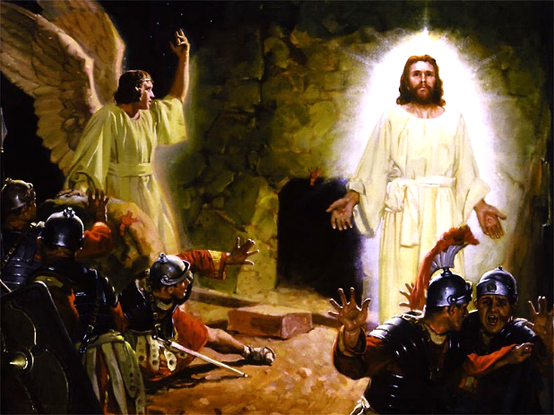
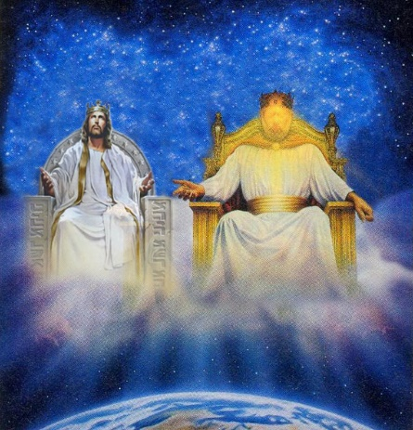
PARTICIPATING IN THE POWER OF RESURRECTION
Ephesians 1:20
Paul used two examples to explain the great power of God that He uses in our favor: the resurrection of Jesus and His exaltation at the right hand of the Father (1:20).
The power of His resurrection:
It assures our own resurrection (1Co. 15:20-22)
It enables us to come to Him to receive our blessings (Heb. 7:25)
It assures the presence of the Holy Spirit (Jn. 16:7)
The power of His exaltation:
It gives us gifts (Eph. 4:8-11)
It assures that Jesus has power over everyone (Philp. 2:9-10)
Jesus was resurrected and exalted, but He isn’t still on His throne. He controls all the power in heavens and earth (Mt. 28:18).

Slide 8
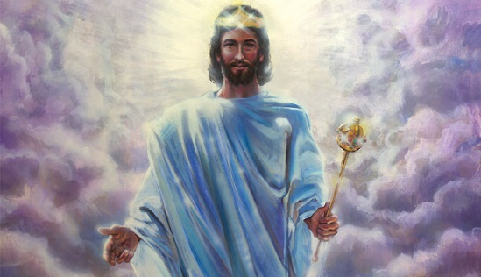
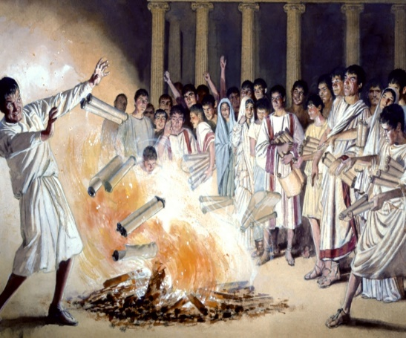
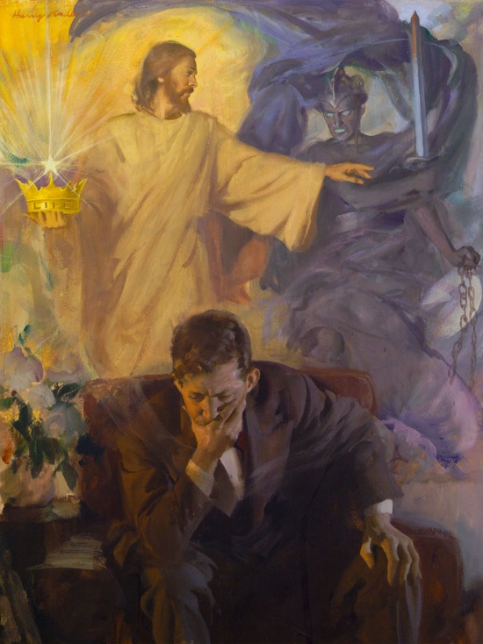
UNDERSTANDING THE SUPREMACY OF JESUS
Ephesians 1:21
Jesus is sovereign “far above all rule and authority, power and dominion, and every name that is invoked, not only in the present age but also in the one to come” (1:21 NIV).
The reference to invoking a name had a special meaning for the Ephesians.
The sons of Sceva tried to expel demons by invoking Jesus’ name, although they didn’t believe in Him (Acts 19:11-16). Invoking the name of deities or infernal powers was common at that time. It was a practice documented in the books of witchcraft that the Ephesians destroyed (Acts 19:19).
That’s why Paul emphasized that Jesus’ name is above any demonic power. Only He can liberate us from Satan.

Slide 9
EPILOGUE

Slide 10
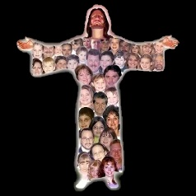
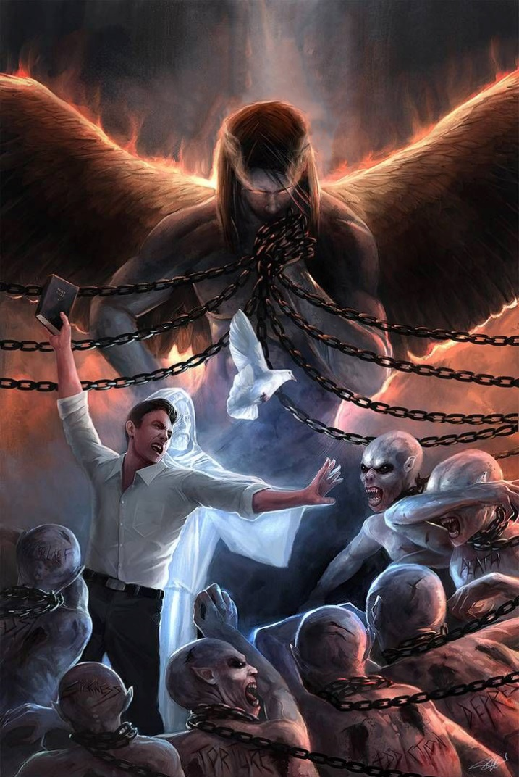
JESUS, THE HEAD OF THE CHURCH
Ephesians 1:22-23
God made Jesus sit at His right hand and put all His enemies as “a footstool for His feet” (Ps. 110:1).
All our enemies are subdued to Him: Rulers, authorities, the powers of this dark world, and the spiritual forces of evil in the heavenly realms (Eph. 6:12 NIV).
Besides, Jesus is the head of the Church. He guides it to a safe place. “And the gates of Hades shall not prevail against it” (Mt. 16:18).
However, we don’t see everything subdued to Jesus yet (Heb. 2:8), hence Paul’s prayer that our eyes are enlightened so we can see the realities that we currently cannot see.

Slide 11
“All earthly powers are under the control of the Infinite One. To the mightiest ruler, to the most cruel oppressor, He says, ‘Hitherto shalt thou come, but no further.’ Job 38:11. God's power is constantly exercised to counteract the agencies of evil; He is ever at work among men, not for their destruction, but for their correction and preservation.”
E. G. W. (Patriarchs and Prophets, cp. 68, p. 694)

