Slide 1
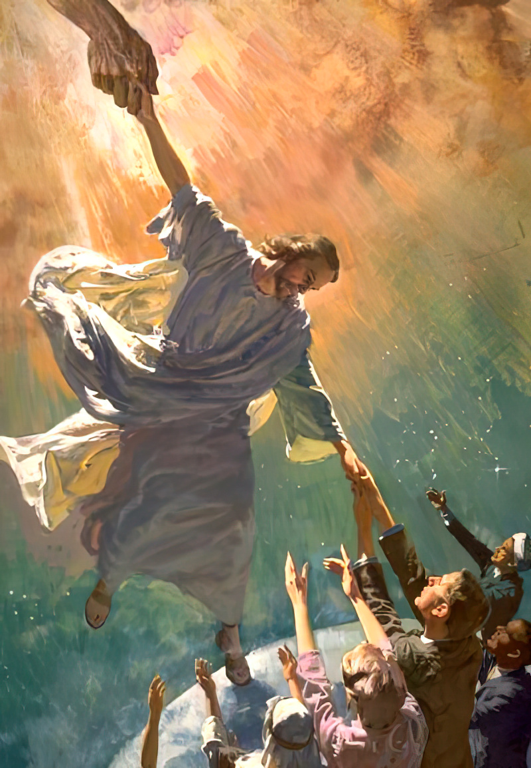
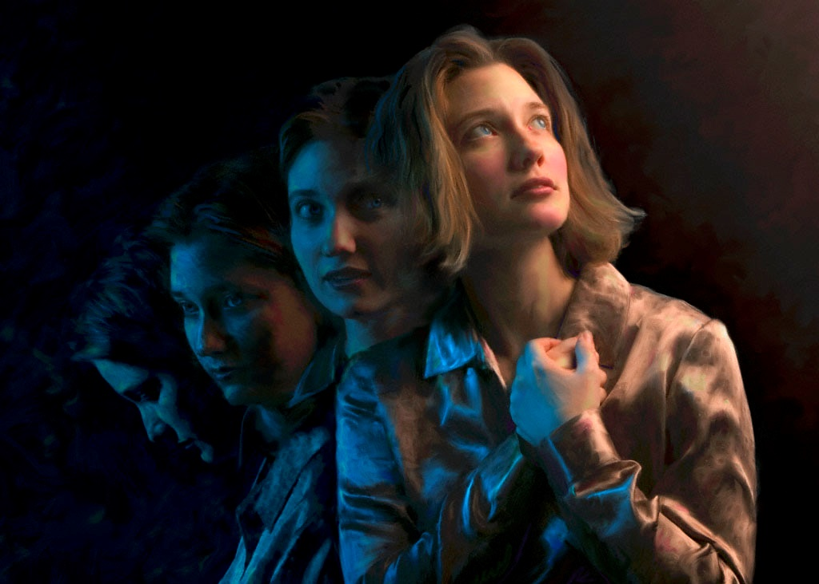
HOW GOD RESCUES US
Lesson 4 for July 22, 2023

Slide 2
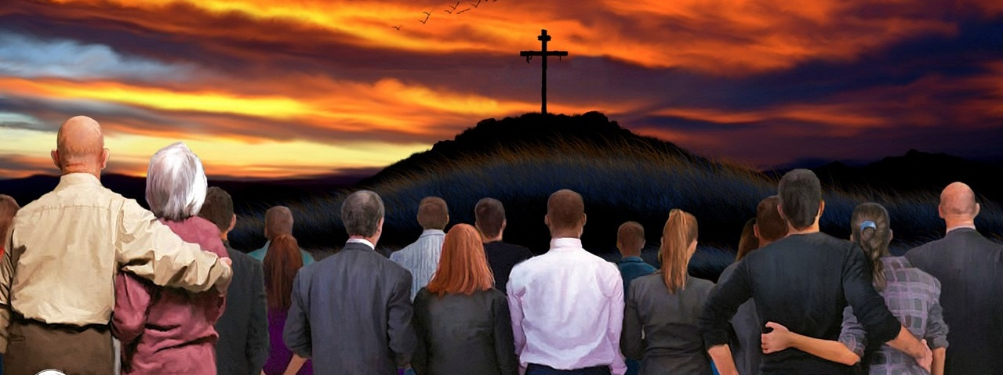
“But God, being rich in mercy, because of the great love with which he loved us, even when we were dead in our trespasses, made us alive together with Christ” (Ephesians 2:4, 5)

Slide 3
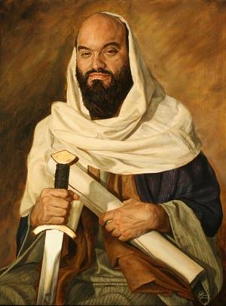
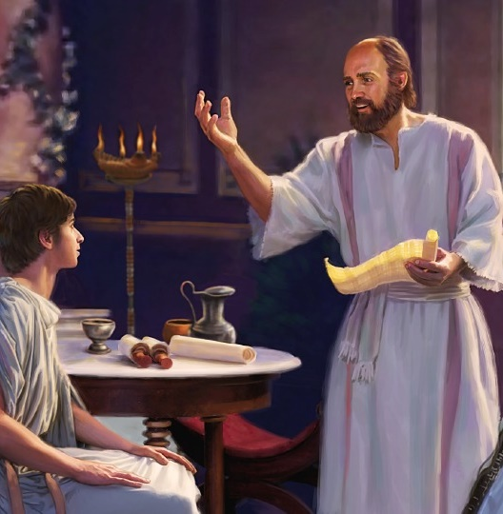
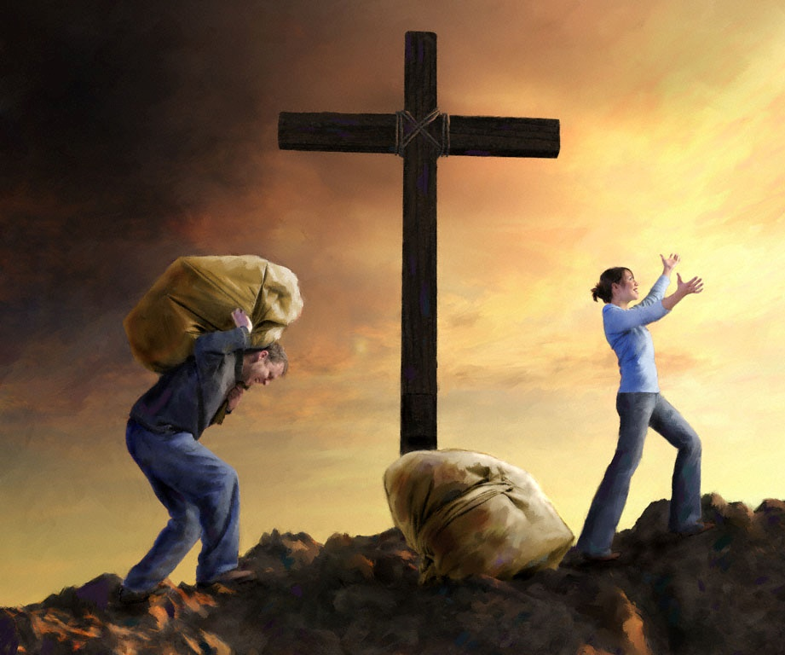
In Ephesians 2:1-10, Paul offers us a glimpse into two moments of our lives: yesterday and today. He also explains what God has done for us by His grace.
When reading this passage, we should ask these three questions: What does it mean to be dead in sin? What does it mean to be raised with Christ to new life in Him? What does it mean to be saved by grace through faith?
Living under Satan’s banner:
Dead in our sins. Ephesians 2:1-2
Following the desires of the flesh. Ephesians 2:3
Living under God’s banner:
Exalted with Christ. Ephesians 2:4-6
Enjoying eternal riches. Ephesians 2:7
What God offers us:
Saved by grace. Ephesians 2:8-10

Slide 4
LIVING UNDER SATAN’S BANNER

Slide 5
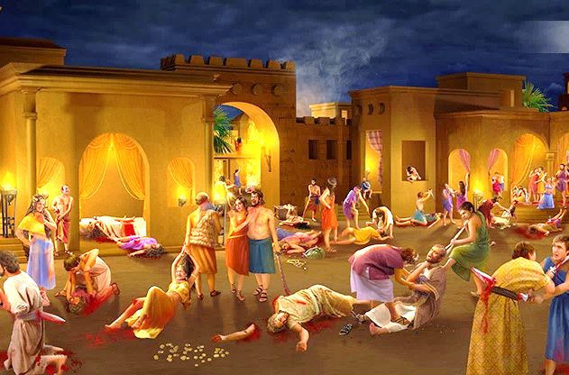
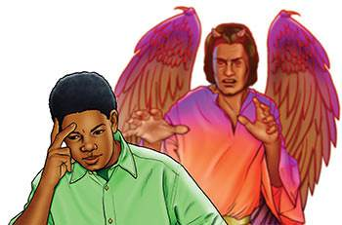
DEAD IN OUR SINS
Ephesians 2:1-2
We were dead in sin
God gave us life with Christ
We are saved by grace
Paul presents our lives in a clear sequence:
What does it mean that we were dead in sin?
Sin was our way of life
We followed the customs of the world
We were dominated by the prince of this world
We were children of disobedience
This means that we lived under the dominion of two external forces before we met Christ:
The environment that surrounded us
The prince of the power of the air (Satan)

Slide 6
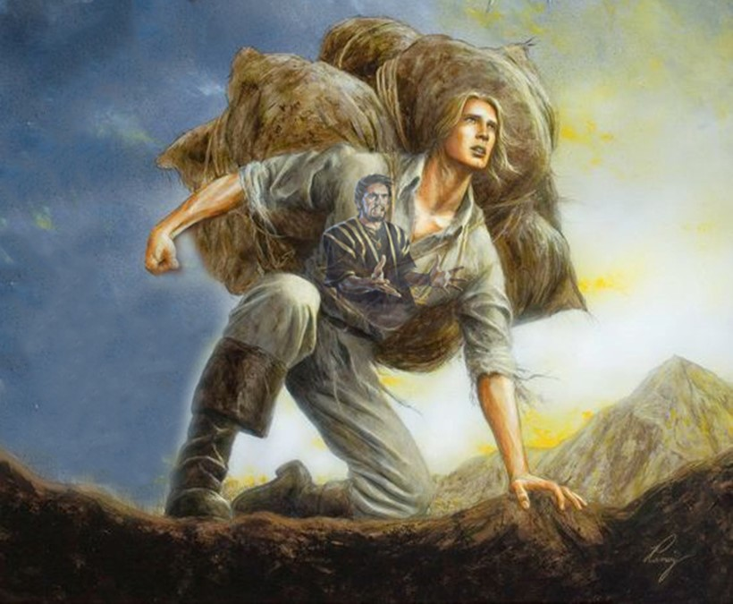
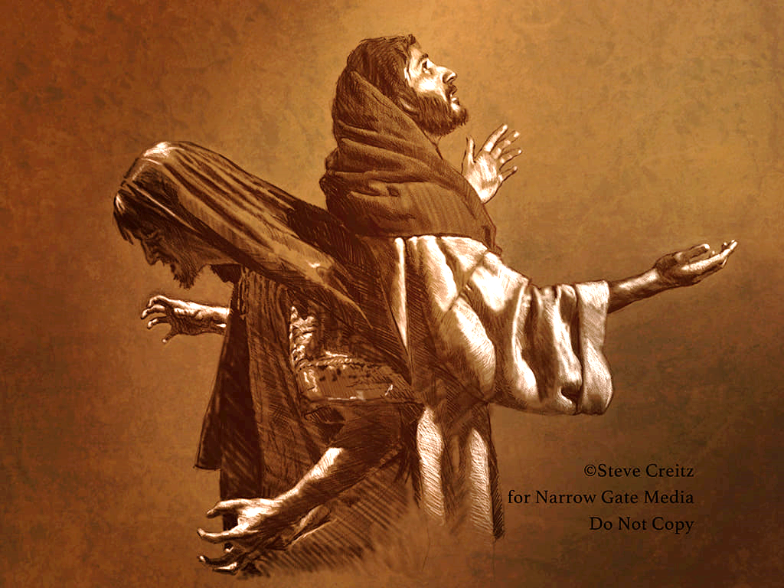
FOLLOWING THE DESIRES OF THE FLESH
Ephesians 2:3
Paul had mentioned two external forces that dominated us. Then he clarified the reason they did: we actually wanted to submit to them.
We wanted to do what we pleased, to follow the thoughts of our hearts (James 1:14-15). Our nature was that of "children of wrath," like all those who do not yet know God.
In other words, we continuously committed sin because we were sin (our nature was sinful); we constantly thought about sin and lived for sin.
But even though we still tend to sin we are no longer dominated by it thanks to God’s grace. We are no longer children of wrath.

Slide 7
LIVING UNDER GOD’S BANNER

Slide 8
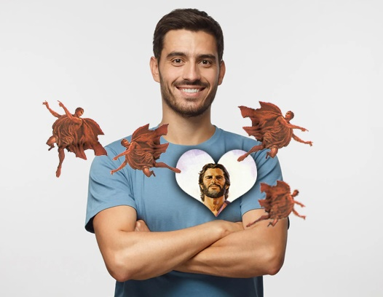
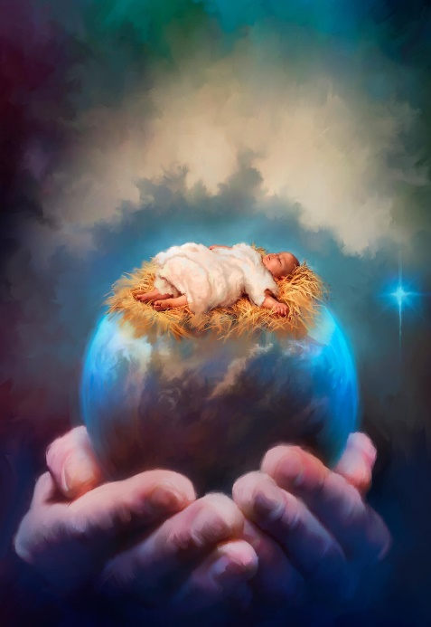
EXALTED WITH CHRIST
Ephesians 2:4-6
For us, it was impossible to change our way of life and our tendencies. That's why Paul began this new section by saying, "But God...". What did God do for us?
He gave us life with Christ (He removed our sins)
He raised us with Christ (He gave us a new life)
He seated us in the heavenly places with Christ (He gave us power over the evil one)
We have turned from a demon-dominated existence to a life of spiritual abundance and power in Christ.
What did we do to deserve all this?
Nothing. God did it out of “mercy, because of His great love with which He loved us.” All the merits and glory belong to Him.

Slide 9
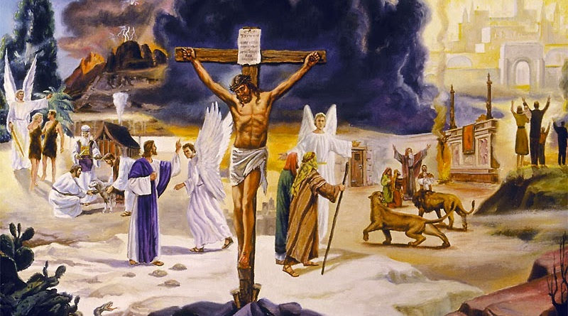
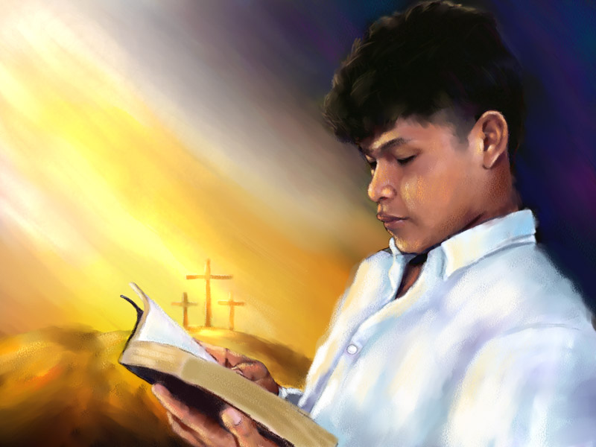
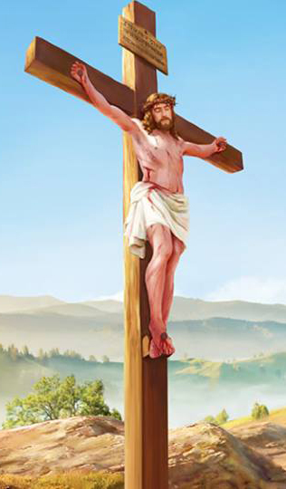
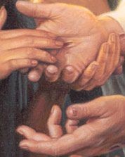
ENJOYING ETERNAL RICHES
Ephesians 2:7
God's plan unfolded in the past with the vicarious death of Christ, His resurrection, and His exaltation.
It unfolds in the present in our lives, with the same power that worked in Christ.
It will continue to unfold “in the coming ages,” because God's grace never ends.
This grace was made evident in the past, we experience it today, and it will be our theme (as well as the theme of the angels and the worlds that never fell) for all eternity.
The way we experience divine grace today is a testimony that shows the incomparable love of God to the Universe.

Slide 10
WHAT GOD OFFERS US

Slide 11
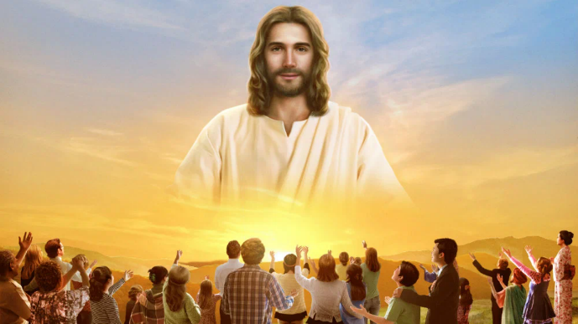
SAVED BY GRACE
Ephesians 2:8-10
At the end of this section, Paul wanted his readers to understand what salvation is and what is God’s and our part in it:
We are saved by grace
Faith is the means
But faith is not ours; it is a gift from God
Our work cannot save us
Therefore, no one can boast about their salvation
After saving us, God recreates us for good works
God had already prepared beforehand every good work we do
It is clear: Salvation comes from God; we just have to accept it.

Slide 12
“In the matchless gift of His Son, God has encircled the whole world with an atmosphere of grace as real as the air which circulates around the globe. All who choose to breathe this life-giving atmosphere will live and grow up to the stature of men and women in Christ Jesus.”
“O Precious, loving, long-suffering, long-forbearing Jesus, how my soul adores Thee! That a poor, unworthy, sin-polluted soul can stand before the Holy God, complete in the righteousness of our Substitute and Surety! Wonder, O Heavens, and be astonished, O earth, that fallen man is the object of His infinite love and delight.”
E. G. W. (Steps to Christ, ch. 8, p. 68)
E. G. W. (The Upward Look, December 29)

