Slide 1
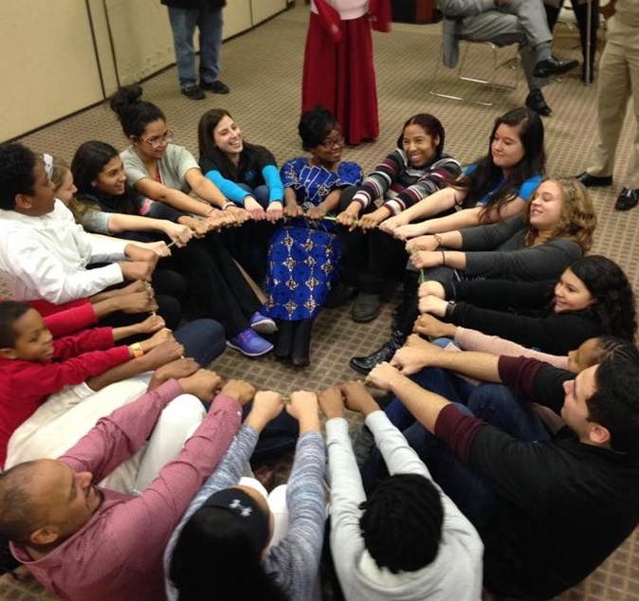
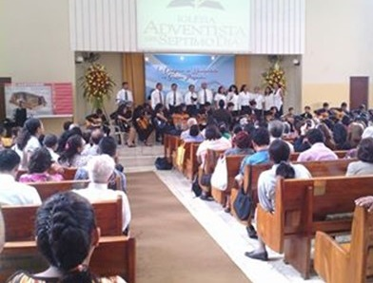
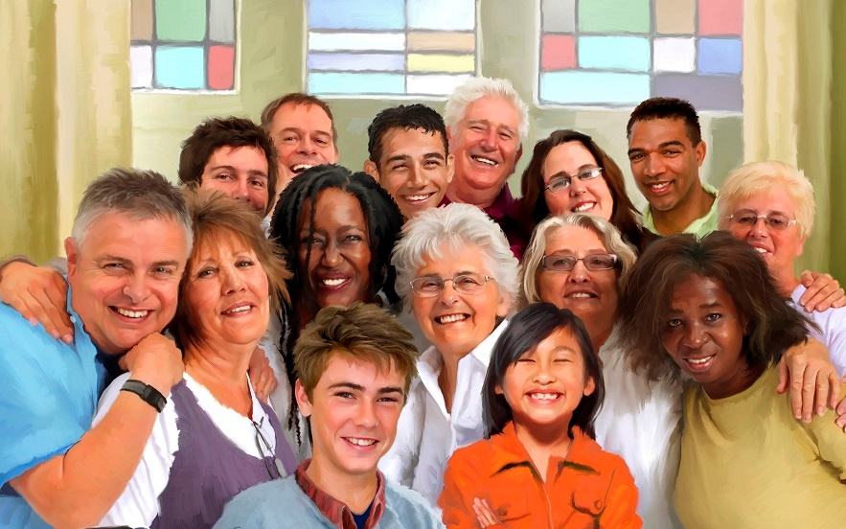
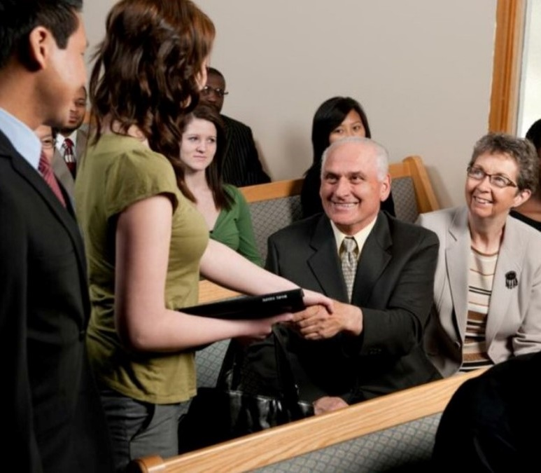
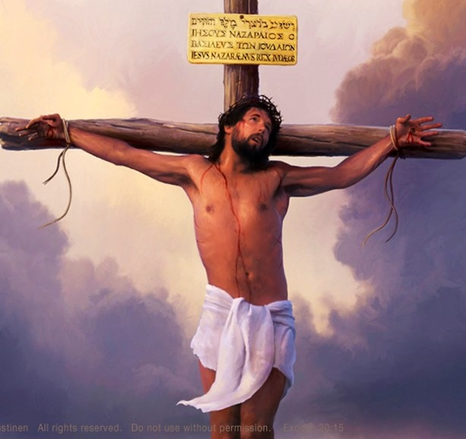
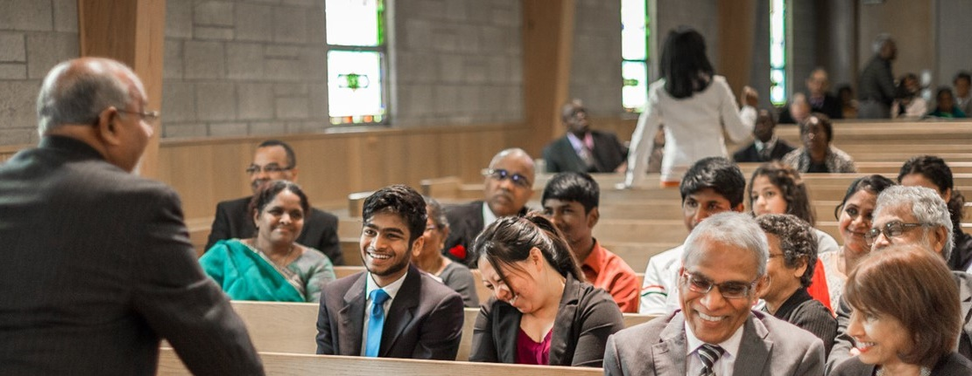
HORIZONTAL ATONEMENT: THE CROSS AND THE CHURCH
Lesson 5 for July 29, 2023

Slide 2
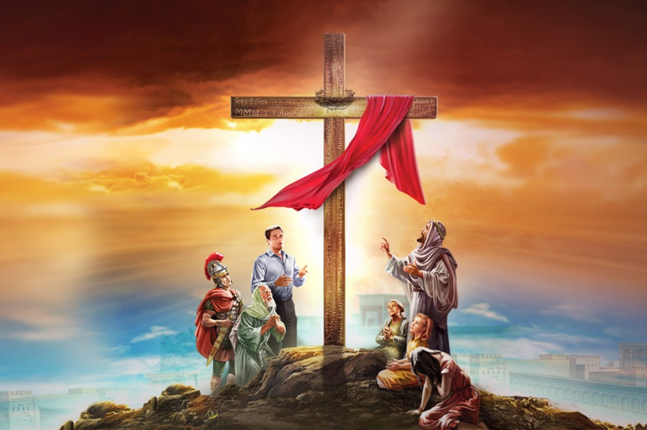
“But now in Christ Jesus you who once were far off have been brought near by the blood of Christ. For he himself is our peace, who has made us both one”
(Ephesians 2:13, 14)

Slide 3
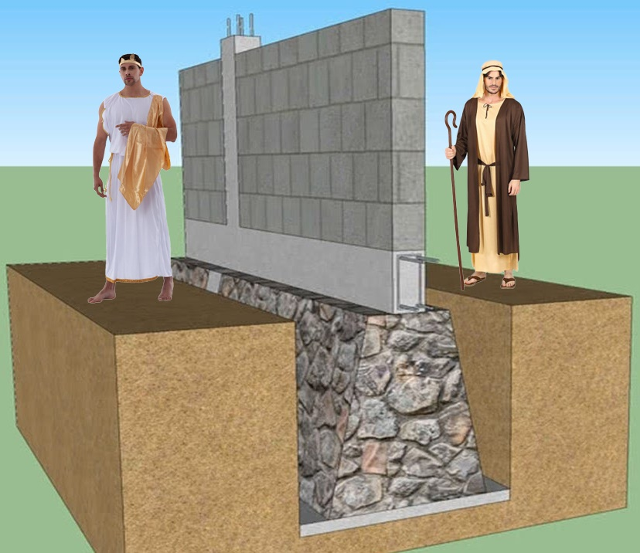
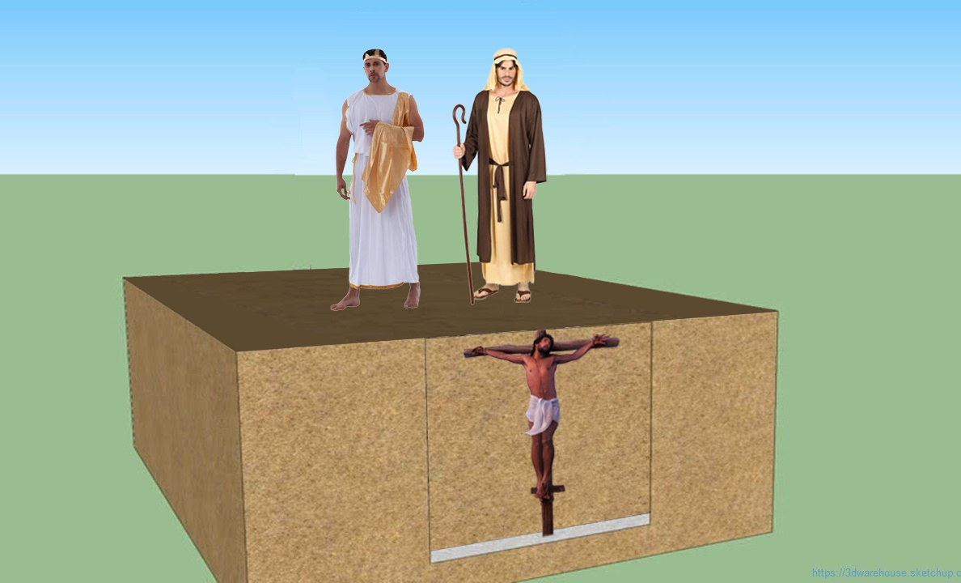
Ephesians 2:11-22 takes us on a journey that begins with two opposing peoples and ends with a building/temple constructed by them in peace, with Christ as its foundation and mortar.
In the course of this journey, Jesus manages to reconcile both peoples, tears down the walls that divided them, and enables them to live in peace.
What similarities do you find between these two peoples and the believers who currently form the "temple of God"?
The division. Ephesians 2:11-12
The reconciliation. Ephesians 2:13-14
The broken wall. Ephesians 2:15-16
The message of peace. Ephesians 2:17-18
The temple of the Lord. Ephesians 2:19-22

Slide 4
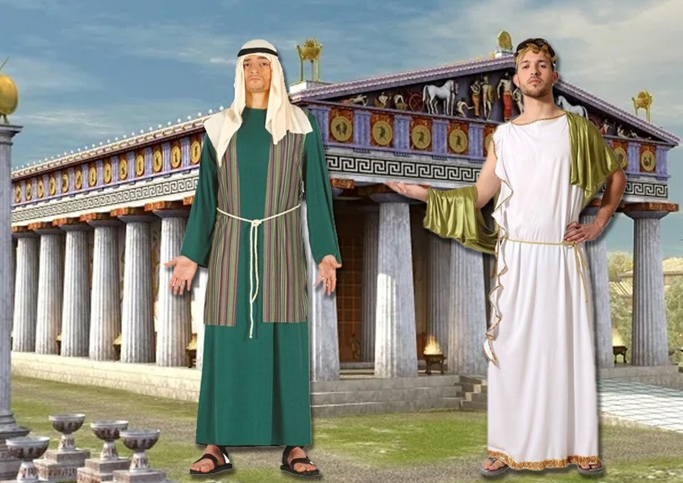
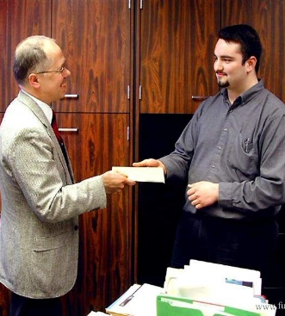
THE DIVISION
“Therefore, remember that at one time you Gentiles in the flesh, called 'the uncircumcision' by what is called the circumcision, which is made in the flesh by hands—remember that you were at that time separated from Christ, alienated from the commonwealth of Israel and strangers to the covenants of promise, having no hope and without God in the world” (Ephesians 2:11-12)
The Jews despised the Gentiles because they were uncircumcised. And the Gentiles despised the Jews because of their circumcision!
But the difference between the two peoples was deeper than an external sign. Before knowing Jesus, the Gentiles were unaware of the true path of salvation.
They were not part of the chosen people of God
They had no part in the covenant made with Israel
They had no hope
They had no God
How can we help those who are currently in the same condition?

Slide 5
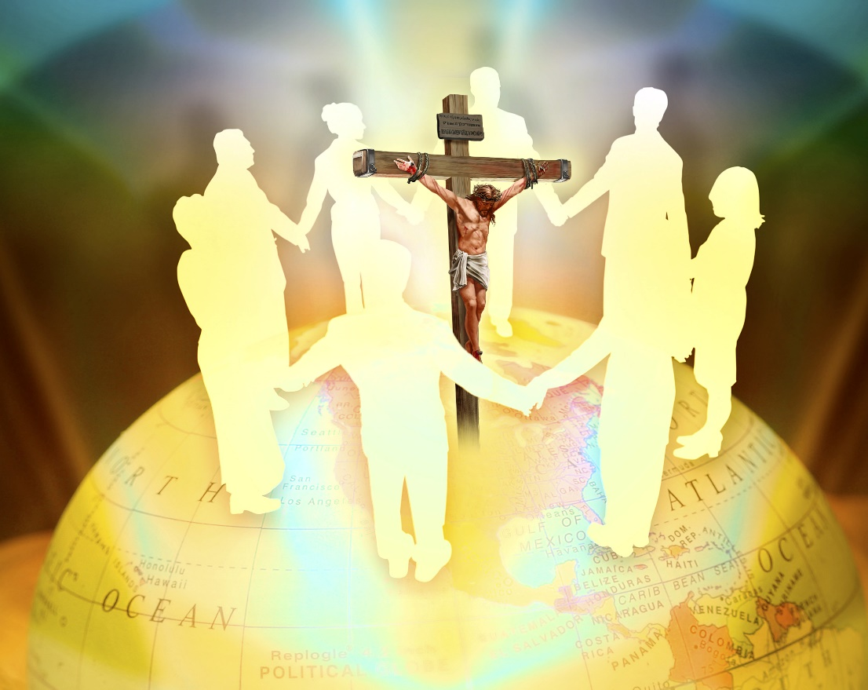
RECONCILIATION
“But now in Christ Jesus, you who once were far off have been brought near by the blood of Christ. For he himself is our peace, who has made us both one and has broken down in his flesh the dividing wall of hostility” (Ephesians 2:13-14)
By accepting Jesus, both Jews and Gentiles found a point of unity and brotherhood.
Those who were far off (Gentiles) are now near
They are redeemed, just like the Jews
Jews and Gentiles leave their hostilities at the foot of the cross
The cross eliminates enmity, bringing forth peace
Jesus reconciles them, creating one people
They are now brothers and sisters; a united family
Reconciliation is experienced when church members set aside their differences and recognize the other members of the church as beloved brothers and sisters. Jesus is the only one who can bring about the miracle of reconciliation.

Slide 6
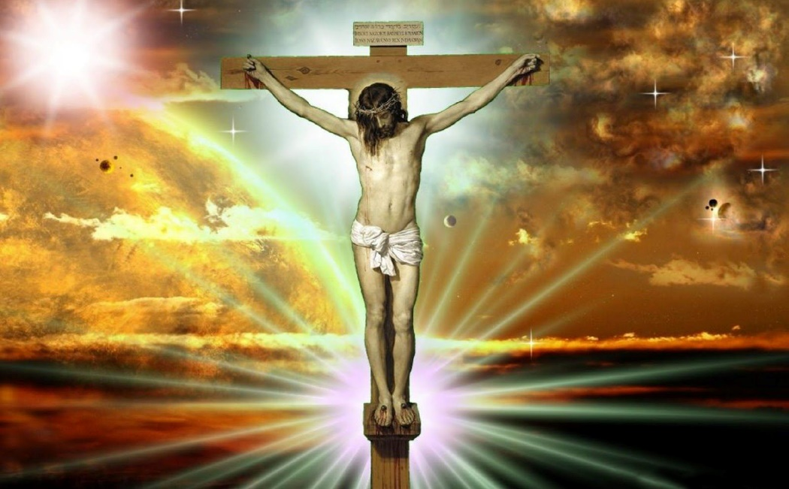
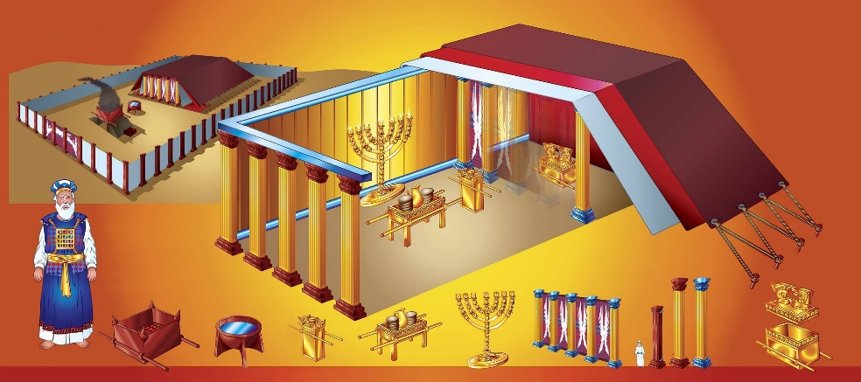
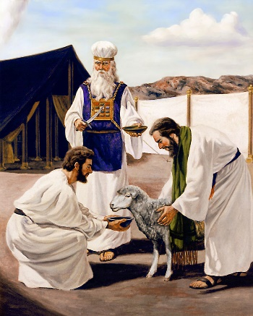
THE BROKEN WALL
“by abolishing the law of commandments expressed in ordinances, that he might create in himself one new man in place of the two, so making peace, and might reconcile us both to God in one body through the cross, thereby killing the hostility” (Ephesians 2:15-16)
If that were the case, why did Paul encourage the church to continue keeping them? Furthermore, who would argue against not killing or stealing?
Paul mentioned these commandments:
The 5th (6:2-3)
The 7th (5:3)
The 8th (4:28)
The 9th (4:25)
The 10th (5:5)
To achieve the unity of Jews and Gentiles, Jesus broke down "the dividing wall of hostility" and "set aside in His flesh the law with its commands and regulations" (2:15 NIV). Did He abolish the Ten Commandments?
The law that generated conflicts between Jews and Gentiles was the ceremonial law that the Jews had made a means of salvation, and to which they had added their own precepts (Acts 15:5; Colossians 2:20-22; Galatians 2:11-14).

Slide 7
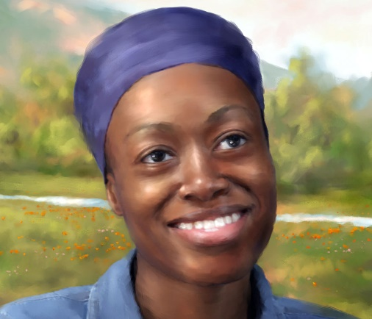
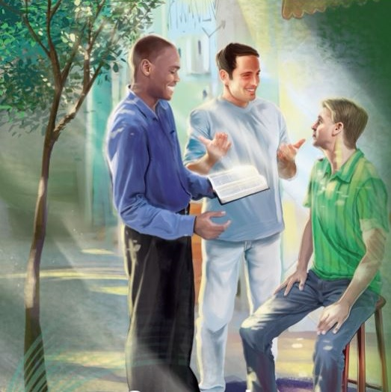
THE MESSAGE OF PEACE
“And he came and preached peace to you who were far off and peace to those who were near. For through him we both have access in one Spirit to the Father” (Ephesians 2:17-18)
Paul sees in the Ephesians the fulfillment of Isaiah 52:7 and 57:19. Christ had proclaimed (through the apostles) the gospel of peace to both Gentiles (who were far off) and Jews (who were near).
Jesus gave us His peace (John 14:27). He Himself is our peace (Ephesians 2:14). And wherever the gospel is preached, peace is proclaimed (Acts 10:36).
We should seek peace and strive to live in peace with everyone (Heb. 12:14; 1 Thes. 5:13; Romans 12:18).
What brings us that peace? It is the knowledge that we are forgiven, redeemed, and reconciled with God (Romans 5:1).

Slide 8
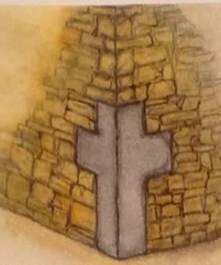
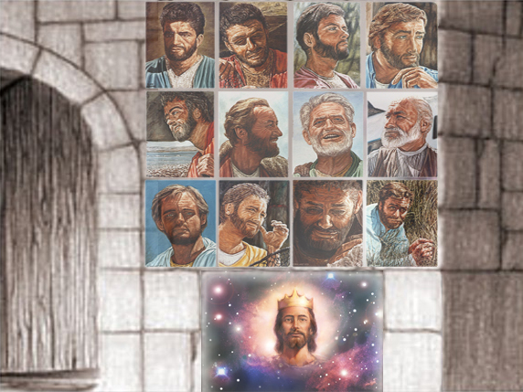
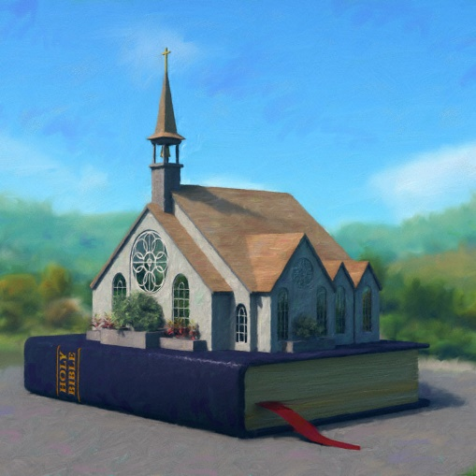
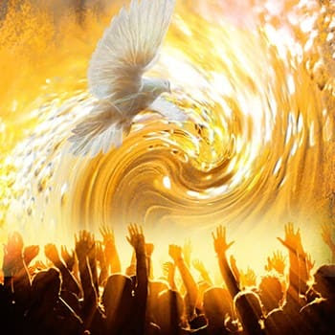
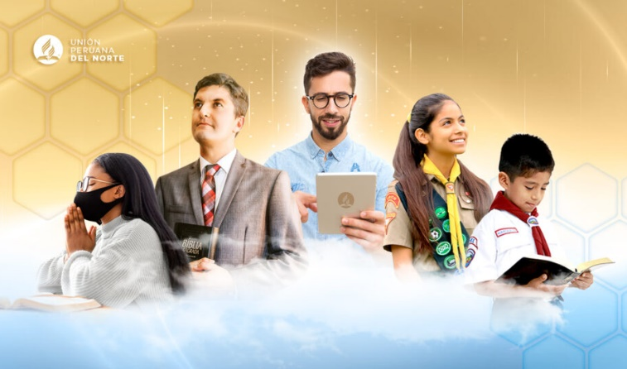
THE TEMPLE OF THE LORD
“So then you are no longer strangers and aliens, but you are fellow citizens with the saints and members of the household of God, built on the foundation of the apostles and prophets, Christ Jesus himself being the cornerstone, in whom the whole structure, being joined together, grows into a holy temple in the Lord. In him you also are being built together into a dwelling place for God by the Spirit” (Ephesians 2:19-22)
At the cross, Jesus demolished all separation among believers. Now they can work together as a compact "building." A spiritual building that constitutes a holy temple.
Jesus Christ is the cornerstone upon which the temple stands; the Bible (the teaching of the apostles and prophets) is its foundation; the Holy Spirit coordinates each part and causes the building to grow.
With this analogy, Paul concludes his exposition about the two peoples. Where there were once walls, there is now harmony. We all work together, growing "in the Spirit."

Slide 9
“We have not six patterns to follow, nor five; we have only one, and that is Christ Jesus. If the Italian brethren, the French brethren, and the German brethren try to be like Him, they will plant their feet upon the same foundation of truth; the same spirit that dwells in one will dwell in the other—Christ in them, the hope of glory. I warn you, brethren and sisters, not to build up a wall of partition between different nationalities. On the contrary, seek to break it down wherever it exists. We should endeavor to bring all into the harmony that there is in Jesus, laboring for the one object, the salvation of our fellow men”
E. G. W. (Testimonies for the Church, Vol. 9, Ch. 18, p. 181)

