Slide 1
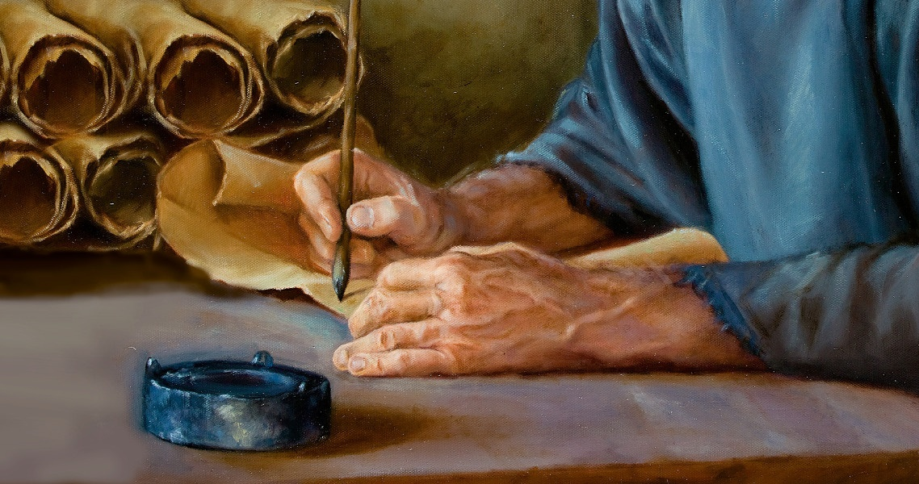
THE MYSTERY OF THE GOSPEL
Lesson 6 for August 5, 2023

Slide 2
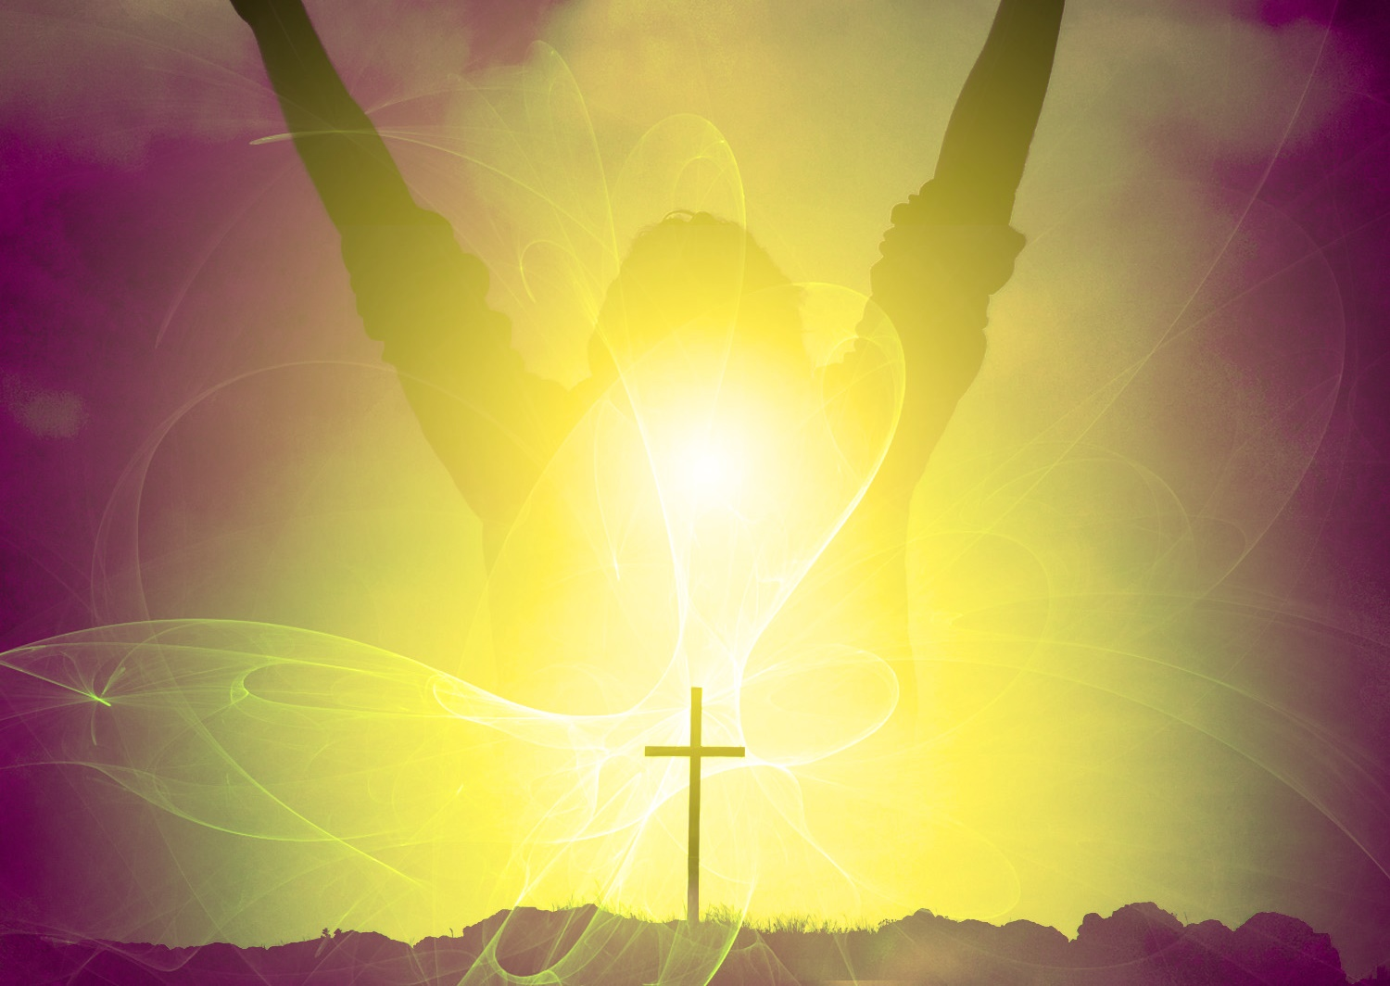
“Now to him who is able to do immeasurably more than all we ask or imagine, according to his power that is at work within us, to him be glory in the church and in Christ Jesus throughout all generations, for ever and ever! Amen”
(Ephesians 3:20, 21, NIV)

Slide 3
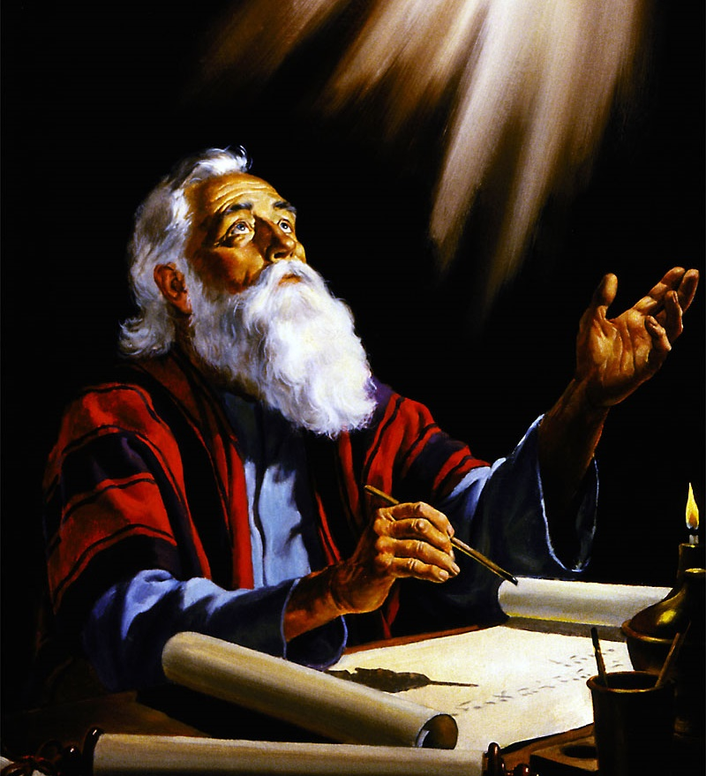
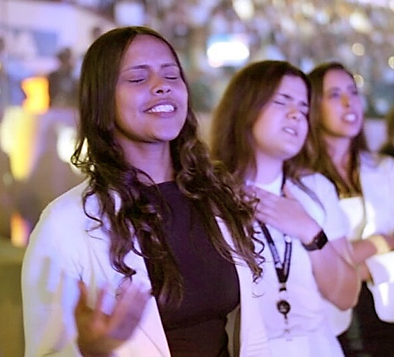
Paul received extraordinary revelations (2 Corinthians 12:1-4) and he wanted to share them with the church in Ephesus.
He hoped that with this knowledge, the church would represent God's character to "the principalities and powers in the heavenly places."
Chapter 3 of Ephesians concludes with a prayer in which the apostle invites the church to give glory to the Father "in Christ Jesus.”-
The receiver of the revelation. Ephesians 3:1, 13.
The revelation:
The mystery of Christ: Ephesians 3:2-6
God revealed through His Church: Ephesians 3:7-12
Consequences of the revelation:
A family that knows God: Ephesians 3:14-19
Glory to God in Christ! Ephesians 3:20-21

Slide 4
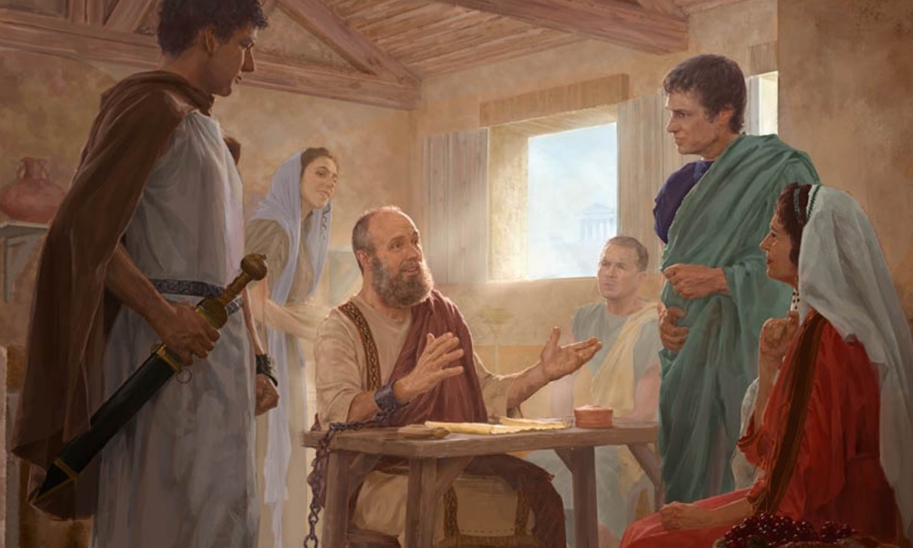
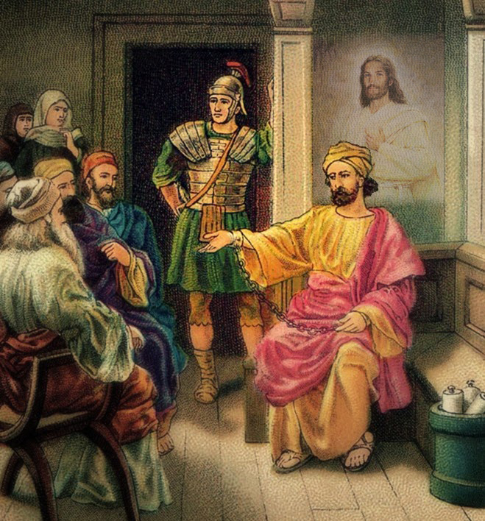
THE RECEIVER OF THE REVELATION
Ephesians 3:1, 13
When Paul wrote to the Ephesians (62 AD), he was in chains (Ephesians 6:20). He expected to be judged before Nero. Therefore, he was considered a criminal suspect. This situation was causing discouragement among the Ephesians (3:13).
But Paul's conscience was clear. From other letters he wrote at the same time as Ephesians, we know that he was confident in being released soon (Philippians 2:24; Philemon 22). Furthermore, he never considered himself a prisoner of Rome. He was a "prisoner of Christ" (3:1). Imprisoned for believing and preaching Christ.
And even in his confinement, he continued to gather groups of people to proclaim the gospel to them (Ephesians 6:18-20).

Slide 5
THE REVELATION

Slide 6
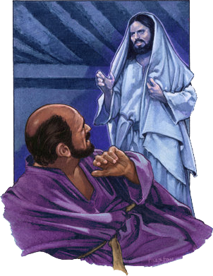
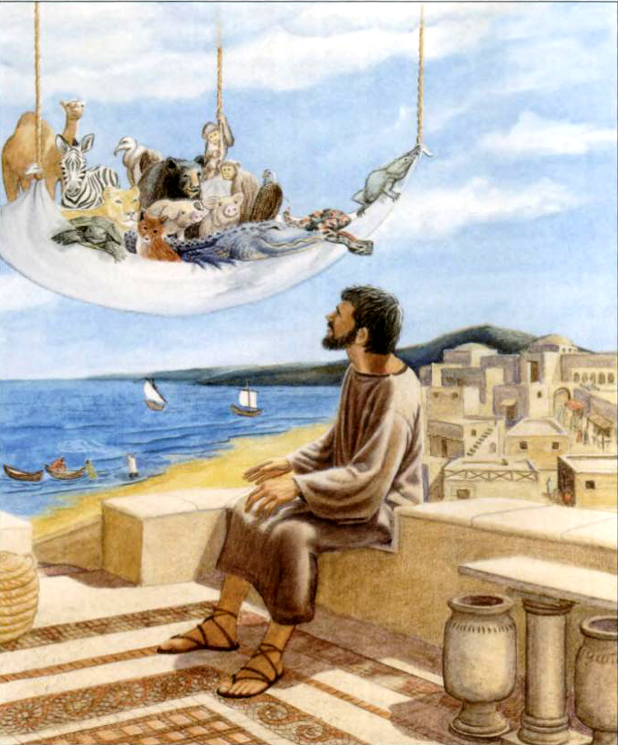
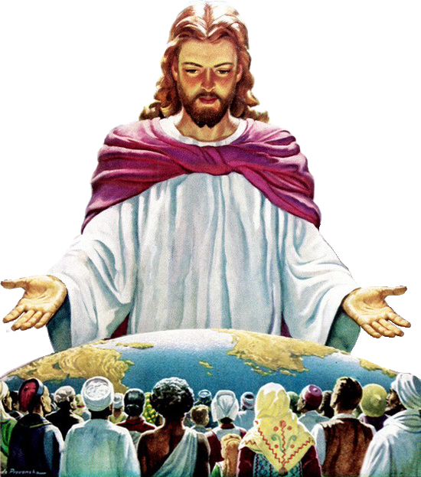
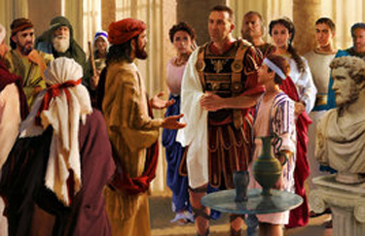
THE MYSTERY OF CHRIST
Ephesians 3:2-6
Jesus himself commissioned Paul as an apostle to the Gentiles (3:2; see Acts 9:15; 1 Timothy 2:7), and he wants to share with them the mystery that He revealed to him (3:3-4).
This mystery had not been fully revealed before but has now been disclosed through the apostles and prophets who have received the gift of the Holy Spirit (3:5).
And what is this mystery? "This mystery is that through the gospel the Gentiles are heirs together with Israel, members together of one body, and sharers together in the promise in Christ Jesus." (3:6, NIV).
Until the death of Jesus, God primarily revealed Himself to the people of Israel. Now the revelation encompasses everyone, without distinction of ethnicities.

Slide 7
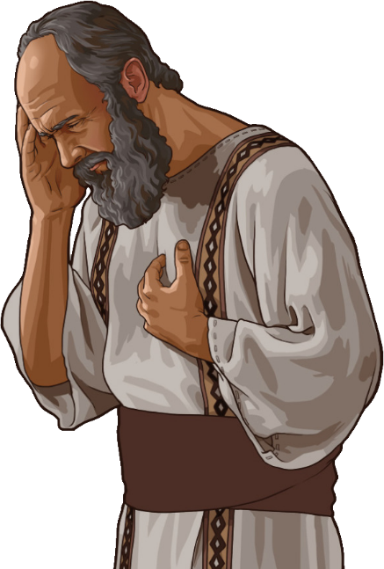
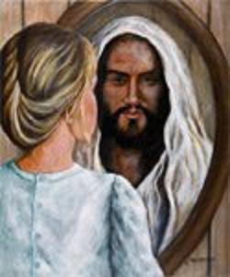
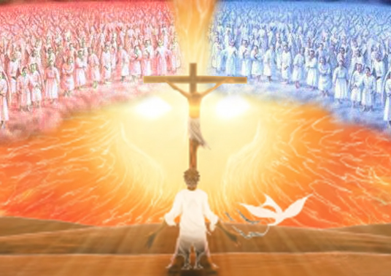
GOD REVEALED THROUGH HIS CHURCH
Ephesians 3:7-12
Although Paul had received special revelations, he did not consider himself special. He had a sense of unworthiness (3:8); he saw himself as a sinner (1Tim. 1:15).
The faithful angels
They understand the wisdom of God in His dealings with the powers of evil
The malevolent angels
They understand that their false accusations about the character of God have been exposed, and that they are defeated and condemned
The closer we are to Jesus, the more unworthy we see ourselves, more aware of our sinful nature. But at the same time, we are being transformed into His image (2Cor. 3:18).
The change that occurs in our lives is a testimony that allows us to make known the wisdom of God even to the heavenly powers (3:10). In what sense does this happen?

Slide 8
CONSEQUENCES OF THE REVELATION

Slide 9
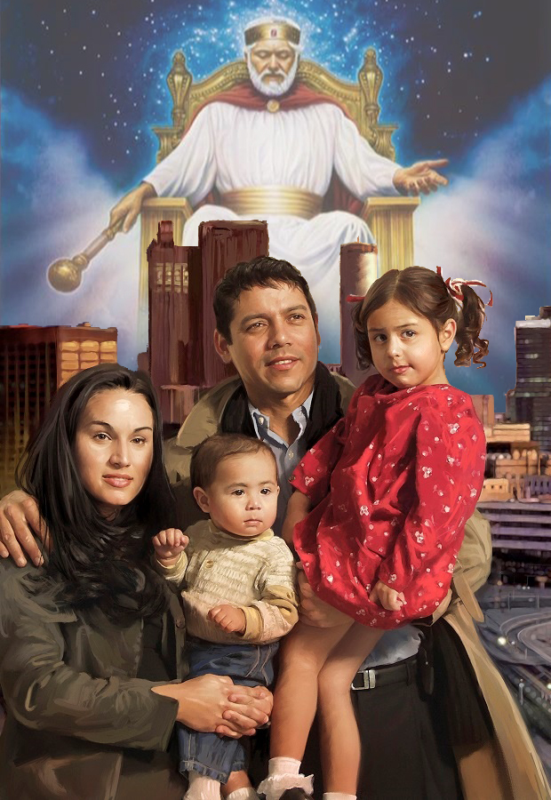
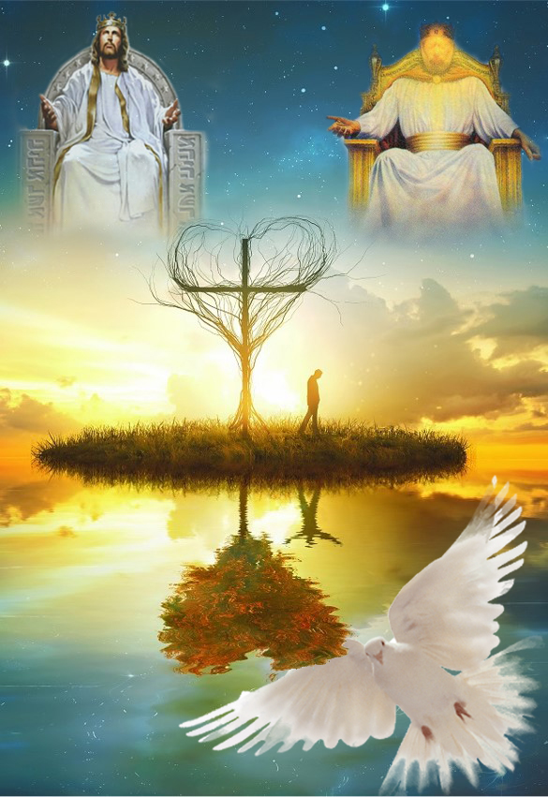
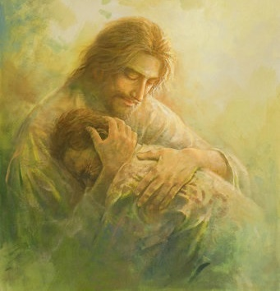
A FAMILY THAT KNOWS GOD
Ephesians 3:14-19
Paul kneels to pray to the Father. He begins with a beautiful statement (in Greek): every family (patria) takes its name from the Father (patēr). In other words, all families (no matter how imperfect they may be) belong to the Father (3:15).
Then he asks God to give us spiritual strength through His Spirit (3:16) and for Christ to dwell in us so that, through the combined action of the Trinity, we may be "rooted and grounded in love" (3:17).
He then asks the impossible, that we may know (in four dimensions) what "surpasses knowledge": the love of Christ (3:18-19).

Slide 10
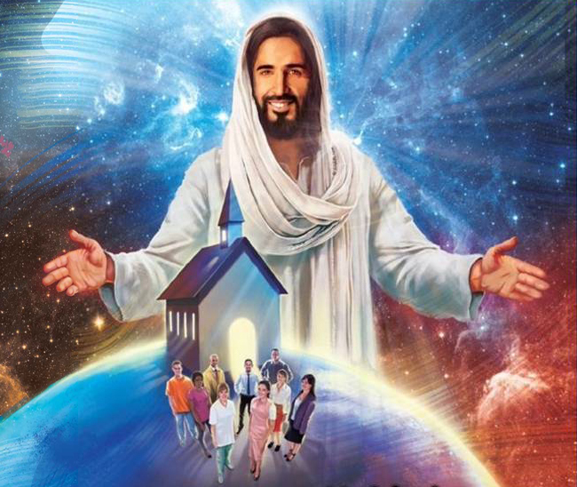
GLORY TO GOD IN CHRIST!
Ephesians 3:20-21
As Paul meditates on the love of Christ, he bursts into a doxology of praise and glory, praying that Christ may be glorified in His Church.
This doxology teaches us that:
God is able to do far more than what we ask
God can do for us what we don't even understand
His power works in us
As a Church, we must always give glory to Jesus
Which of these teachings are especially significant to you?

Slide 11
“It is Christ dwelling in the soul that gives us spiritual power, and makes us channels of light. The more light we have, the more we can impart to others around us. The more closely we live to Jesus, the clearer views shall we have of His loveliness. As we behold Him in His purity, we discern more clearly our own faults of character. We yearn after Him, and for that fullness that is in Him, and that shines out in the perfection of His heavenly character; and by beholding we become changed into His image.”
E. G. W. (Lift Him Up, September 9)

