Slide 1
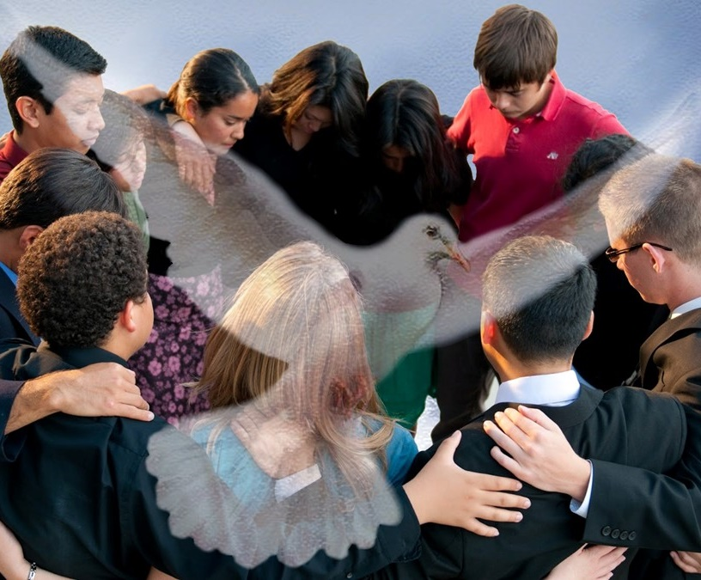
THE UNIFIED BODY OF CHRIST
Lesson 7 for August 12, 2023

Slide 2
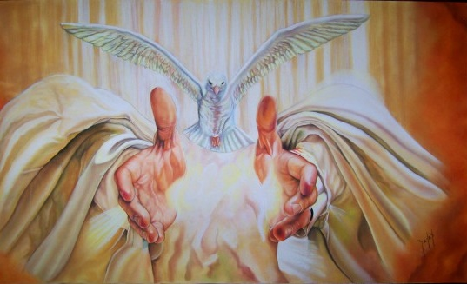
“And he gave the apostles, the prophets, the evangelists, the shepherds and teachers, to equip the saints for the work of ministry, for building up the body of Christ”
(Ephesians 4:11, 12, ESV)

Slide 3
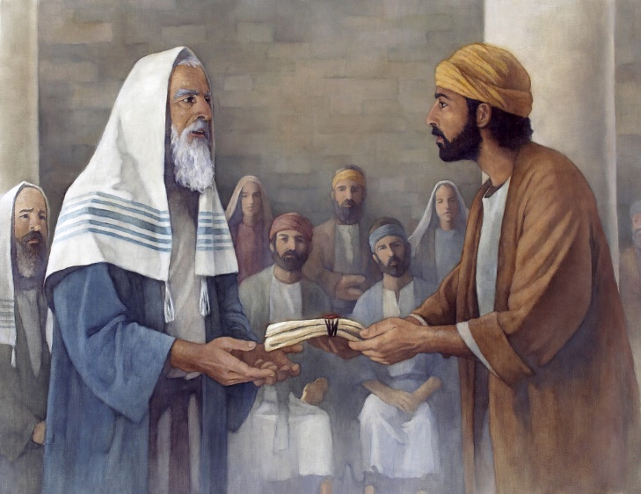
Once the doctrinal (or theoretical) part is completed, Paul moves on to the practical part of his letter: how to apply what has been learned so far in the life of the believer and the church.
Since Christ has broken down the wall of separation, making us all brothers and sisters without ethnic or cultural distinction, Ephesians 4:1-16 shows us how to make unity a reality in the Church.
Seeking unity:
The unity of the Spirit. Ephesians 4:1-3
How to achieve unity:
The seven "ones." Ephesians 4:4-6
The giver of gifts. Ephesians 4:7-10
The purpose of the gifts. Ephesians 4:11-13
The result of unity:
Growth in Christ. Ephesians 4:14-16

Slide 4
SEEKING UNITY

Slide 5
THE UNITY OF THE SPIRIT
Ephesians 4:1-3
To achieve "the unity of the Spirit" (4:3), Paul urges the Ephesians to "live a life worthy of the calling you have received." (4:1 NIV). What is this calling?
With humility. A virtue that allows us to appreciate and serve others (Philippians 2:3)
With gentleness. Treating one another with courtesy, consideration, and kindness (Galatians 6:1)
With patience. Being able to endure provocation or trials (4:2)
With peace. A bond (union) that is achieved when each member of the church develops the three preceding virtues (4:3)

Slide 6
HOW TO ACHIEVE UNITY

Slide 7
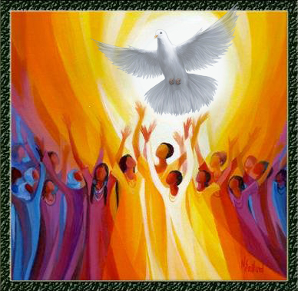
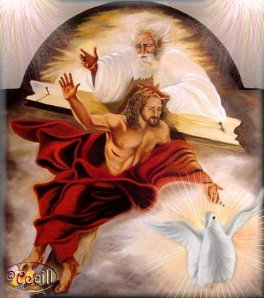
THE SEVEN "ONES" Ephesians 4:4-6
Unity based on what is already ONE
The Holy Spirit (4:4)
One body
One Spirit
The Son (4:5)
One Lord
One hope
One faith
One baptism
The Father (4:6)
One God
We must strive to achieve unity (4:3), based on these seven "ones" that emanate from the one God (4:6). For example, we are united when we have one faith, and not various doctrines; we worship one Lord and not several.
God is "in all." That does not mean that everything is God (pantheism), but rather that God dwells in everyone through His Spirit (John 14:17; 1 Corinthians 3:16).

Slide 8
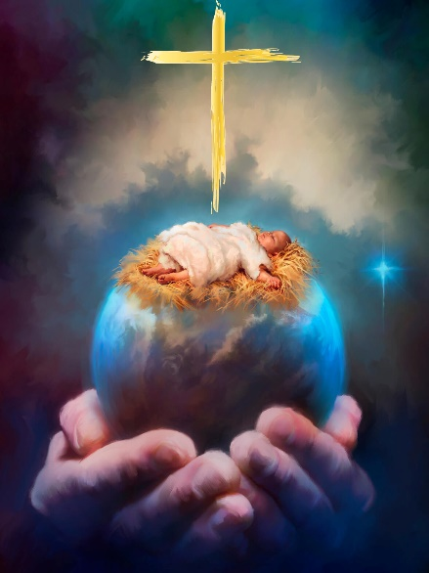
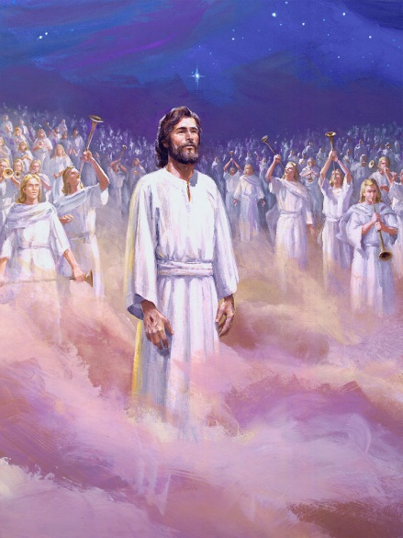
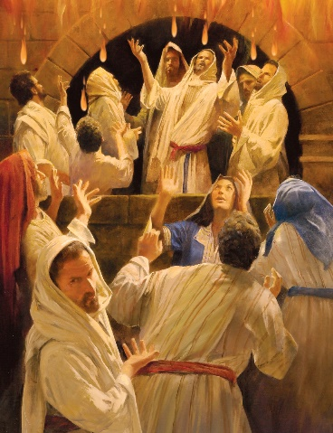
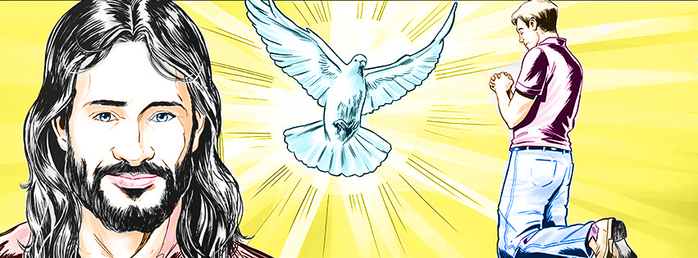
THE GIVER OF GIFTS Ephesians 4:7-10
Using a loose interpretation of Psalm 68:18, Paul presents Jesus descending to earth to fight the battle against sin (4:9 NIV).
Once victory is achieved, like a triumphant general, He ascends to Heaven to be exalted (4:10).
After being exalted, Jesus gave gifts to men (4:7-8). These gifts began to be poured out at Pentecost (Acts 2:33).
Although the Holy Spirit administers the gifts according to His will (1 Corinthians 12:11), these gifts are given to us "by grace, according to the measure of Christ's gift" (4:7). This implies that Jesus is actually the giver of gifts.

Slide 9
THE PURPOSE OF THE GIFTS
Ephesians 4:11-13
Apostles
Prophets
Evangelists
Pastors and teachers
Paul does not mention the gifts given by Jesus here, but rather four groups of people who receive those gifts (4:11): (1) apostles; (2) prophets; (3) evangelists; and (4) pastor-teachers. What do they all have in common?
They are the leaders of the church, the ministers who are to build up "the body of Christ" (4:12). They are responsible for achieving and maintaining unity (4:13).
In the 21st-century church, the role of "apostles" is performed by pastors who administer at a higher level than the local church (Union, Conference, Division…); the "evangelists" are pastors dedicated exclusively to preaching; the "pastor-teachers" are those who shepherd local churches. And what about the prophets?
Ellen G. White
God has not left us without this gift, which currently manifests itself in the work of Ellen G. White.

Slide 10
THE RESULT OF UNITY

Slide 11
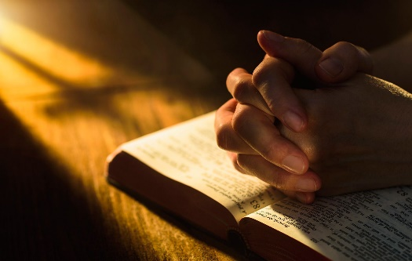
GROWTH IN CHRIST
Ephesians 4:14-16
What dangers can disrupt unity (4:14 NIV)?
Lack of growth ("infants")
Acceptance of false teachings ("tossed back and forth by the waves")
Spiritual wolves ("craftiness of people in their deceitful scheming")
To avoid these dangers, we must hold fast to the truth in love and strive to grow in Christ (4:15).
Although the individuals mentioned by Paul are responsible for maintaining unity, each and every member of the church has a part to play in achieving that unity (4:16).

Slide 12
“A union of believers with Christ will as a natural result lead to a union with one another, which bond of union is the most enduring upon earth. We are one in Christ, as Christ is one with the Father.”
E. G. W. (Testimonies for the Church, volume 5, Ch. 4, p. 45)
“Unity in diversity is God's plan. Among the followers of Christ there is to be the blending of diverse elements, one adapted to the other, and each to do its special work for God. Every individual has his place in the filling up of one great plan bearing the stamp of Christ's image.”
E. G. W. (Our High Calling, June 12)

