Slide 1
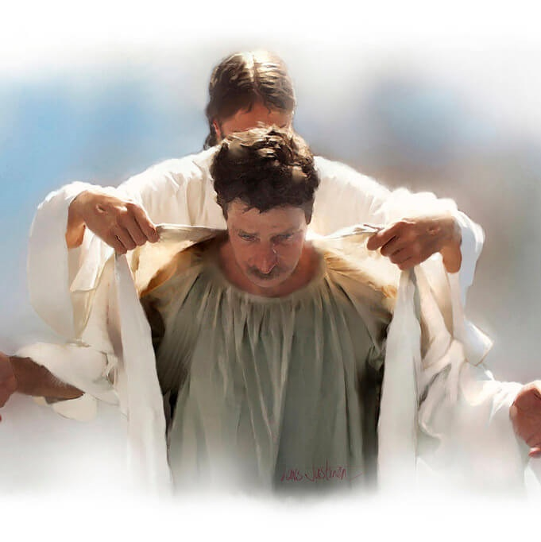
CHRIST-SHAPED LIVES AND SPIRIT-INSPIRED SPEECH
Lesson 8 for August 19, 2023

Slide 2
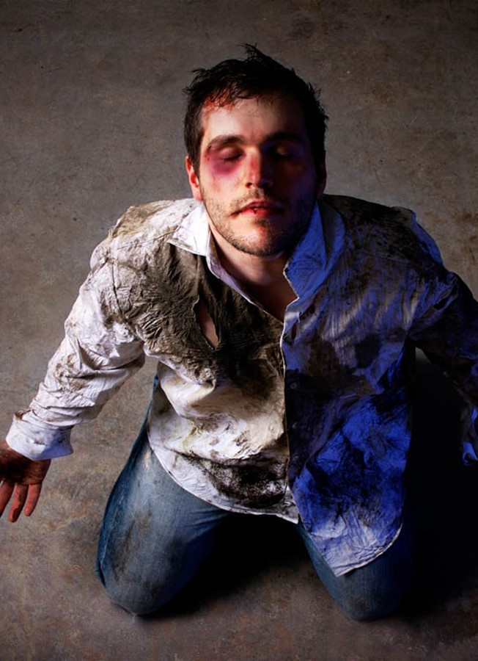
“You were taught, with regard to your former way of life, to put off your old self, which is being corrupted by its deceitful desires; to be made new in the attitude of your minds; and to put on the new self, created to be like God in true righteousness and holiness”
(Ephesians 4:22-24, NIV)

Slide 3
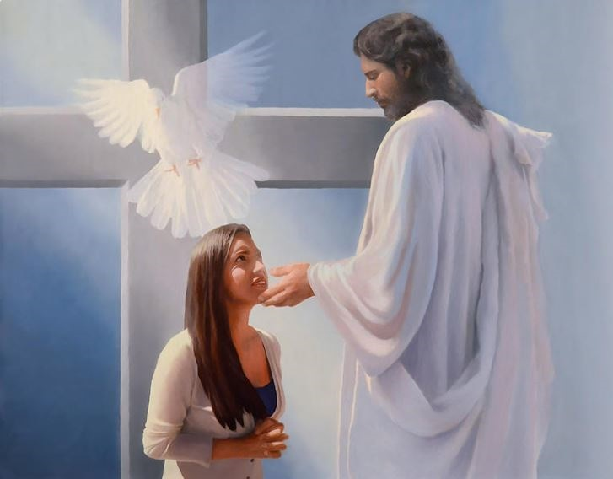
The Holy Spirit is continuously calling people to abandon a meaningless life dominated by sin.
When a person responds to the call, a transformation begins, a new life in Christ.
How should someone who has been renewed by the Spirit live? Paul explained it to us in Ephesians 4:17-32.
Life without Christ:
From sin to sin. Ephesians 4:17-19
Life in Christ:
A new garment. Ephesians 4:20-24
The transformation:
A new way of living. Ephesians 4:25-29
The work of the Holy Spirit. Ephesians 4:30
What to leave behind and what to do. Ephesians 4:31-32

Slide 4
LIFE WITHOUT CHRIST

Slide 5
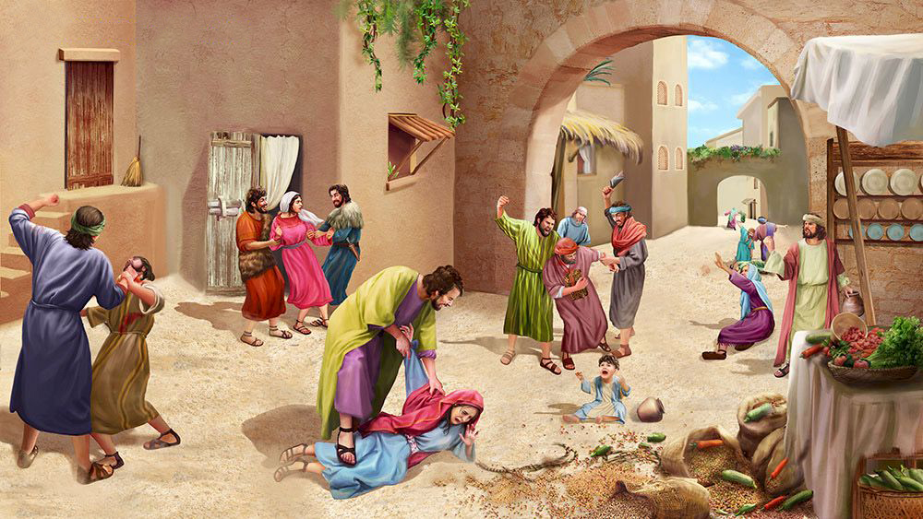
FROM SIN TO SIN Ephesians 4:17-19
How do pagans live (4:17-19 NIV), and by extension, all those who do not know or accept God?
Futile thinking
Darkened in their understanding
Hardened in heart
Ignorant and separated from the life of God
Having lost all sensitivity
Given themselves over to sensuality
Indulging in every kind of impurity
When people do not follow God, they and society fall into a downward spiral of sin. What similarities do you see between Paul's description and the society around you?

Slide 6
LIFE IN CHRIST

Slide 7
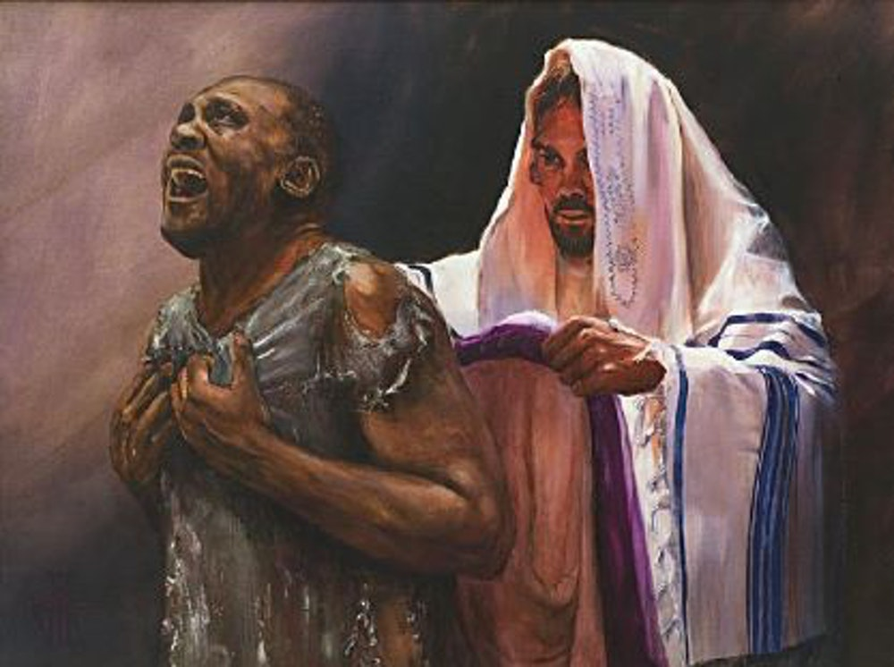
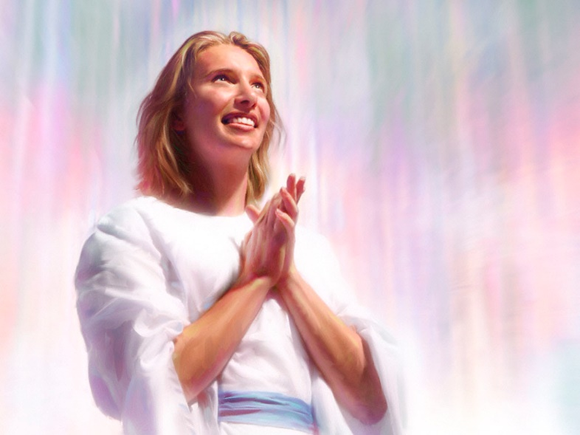
A NEW GARMENT
Ephesians 4:20-24
After showing life without Christ, Paul reminded us that we have a different experience. Christ has taught us, we have learned from Him, and His truth has transformed us (4:20-21).
This implies a change of life. It's like a person who takes off their dirty clothes, cleanses themselves, and puts on new clothes (4:22-24):
Put off the old self
We stop living under the dominion of the sinful life we had before accepting Christ
Renew your mind
The teachings of Jesus and His example shape our minds, and we remain loyal to Him as our Lord
With God's help, we live a life of righteousness and holiness
Put on the new self

Slide 8
THE TRANSFORMATION

Slide 9
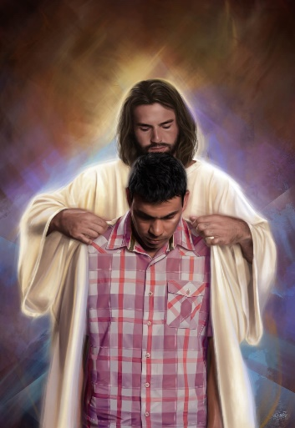
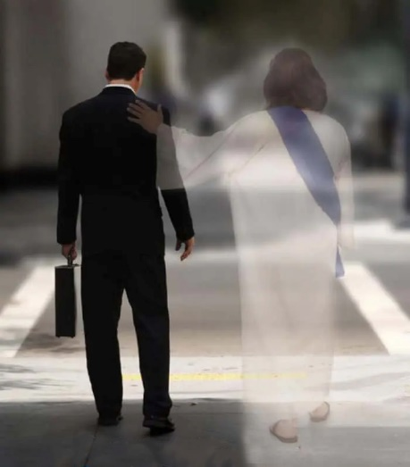
A NEW WAY OF LIVING
Ephesians 4:25-29
Paul provided a series of instructions on how those who have put on Christ should live, using a curious pattern:
[A] what to leave behind
[C] the reason for change
[B] what to do
v. 25
Put away falsehood
Speak truthfully
v. 26-27 ^{(*)}
Do not sin in your anger
Be angry (at injustice)
v. 28
Steal no longer
Do honest work
We are members of one another
If you stay angry you give the devil a foothold
So that it may benefit those who listen
Share with those in need
v. 29
Avoid unwholesome talk
Speak words to build others up
(*) In verses 26-27, Paul changes the order of [A] "Be angry" and [B] "but do not sin."

Slide 10
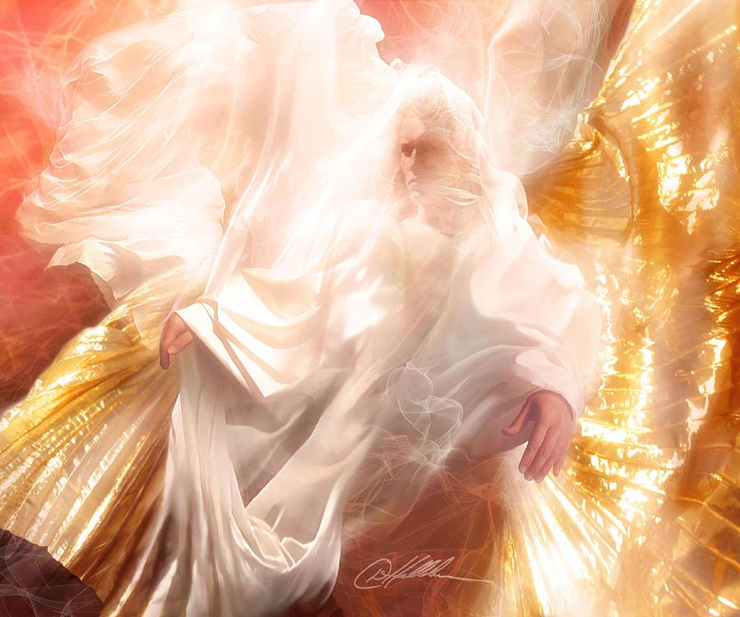
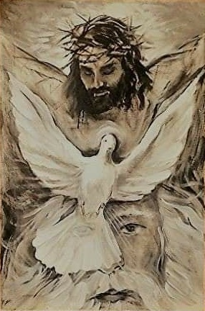
THE WORK OF THE HOLY SPIRIT
“Do not grieve the Holy Spirit of God, with whom you were sealed for the day of redemption.” (Ephesians 4:30)
Interrupting his exposition on the wrong behaviors of believers, Paul gives a particularly important reason to abandon them: They grieve the Holy Spirit with whom we have been sealed.
We were sealed with the Holy Spirit at our conversion (Ephesians 1:13), and He remains with us until "the day of redemption" (4:30). He does not abandon us when we do wrong things... but He is grieved.
This attitude of the Holy Spirit shows us that He is not merely a force emanating from God, but a Person. A divine Person with feelings, like the Father and the Son, but distinct from them.

Slide 11
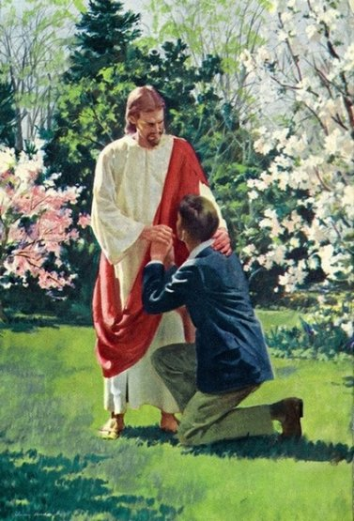
WHAT TO LEAVE BEHIND AND WHAT TO DO Ephesians 4:31-32
Using the same previous pattern, we have six attitudes to abandon, three attitudes to replace them, and a reason for making the change (4:31-32 NIV).
What to leave behind?
Bitterness
Rage
What to do?
Be kind
Be compassionate
Why?
Because God has forgiven us in Christ
Anger
Brawling
Slander
Malice
Forgive
Our conversations and actions among the family of Christ—and beyond it, as well—are to be motivated by kindness, tenderheartedness, and forgiveness based on the highest standard of all, the forgiveness that God has extended to us in Christ.

Slide 12
OUR PLEDGE
I wish for my influence within the Seventh-day Adventist Church family and beyond to be positive, uplifting, faith-building, and morale-boosting.
Recalling Christ’s calls for unity and love, I will expend more energy affirming those doing and saying things I believe to be good than in pointing out the failings of those I believe to be wrong.
When I do disagree with someone, I will make my respect for my fellow believer clear. I will assume his or her integrity and commitment to Christ. I will offer my differing opinion gently, not stridently.
I will live joyfully, looking for every opportunity to build up and affirm my fellow church members, as I await the return of Christ.

Slide 13
“Through the power of Christ, men and women have broken the chains of sinful habit. They have renounced selfishness. The profane have become reverent, the drunken sober, the profligate pure. Souls that have borne the likeness of Satan have become transformed into the image of God. This change is in itself the miracle of miracles. A change wrought by the Word, it is one of the deepest mysteries of the Word. We cannot understand it; we can only believe.”
E. G. W. (The Acts of the Apostles, Ch. 45, p. 476)

