Slide 1
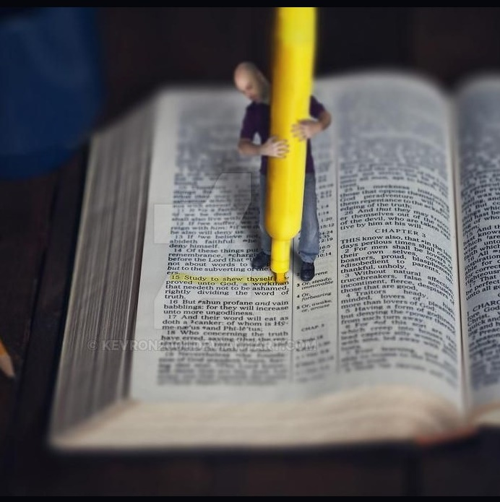
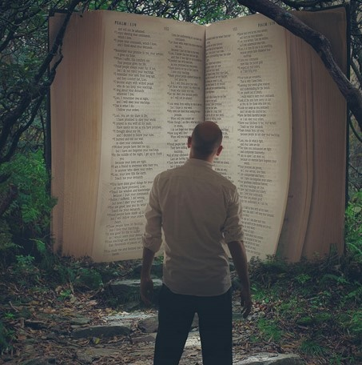
LIVING WISELY
Lesson 9 for August 26, 2023

Slide 2
“Look carefully then how you walk, not as unwise but as wise, making the best use of the time, because the days are evil. Therefore do not be foolish, but understand what the will of the Lord is” (Ephesians 5:15-17, ESV)

Slide 3
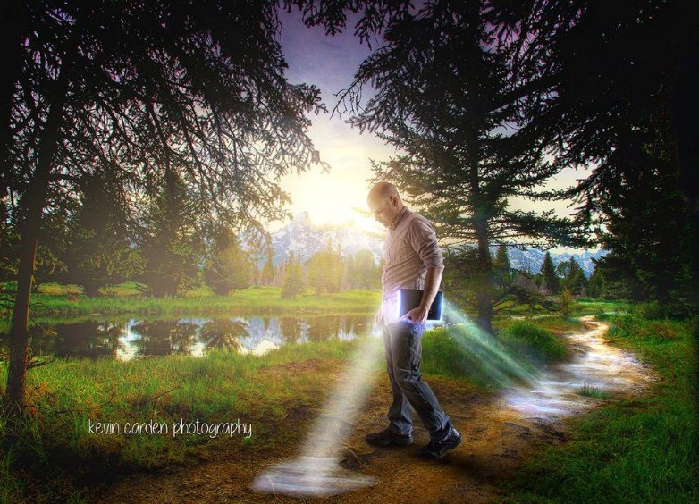
How to imitate God? By walking in love, walking as children of light, walking as wise, making the most of your time.
Ephesians 5:1-20 also tells us what to avoid: immorality, greed, corrupt speech, foolishness, and drunkenness.
What is the result of a life that imitates God and avoids wrongdoing? We are enlightened by Christ; we are the light of the world; we sing, praise, and give thanks to God through Jesus Christ.
Imitating God:
Walking in love. Ephesians 5:1-5
Walking as children of light. Ephesians 5:6-10
Walking in the light:
The light exposes everything. Ephesians 5:11-14
Enlightened by Christ. Ephesians 5:15-17
Praising in the Spirit:
Psalms, hymns, and spiritual songs. Ephesians 5:18-20

Slide 4
IMITATING GOD

Slide 5
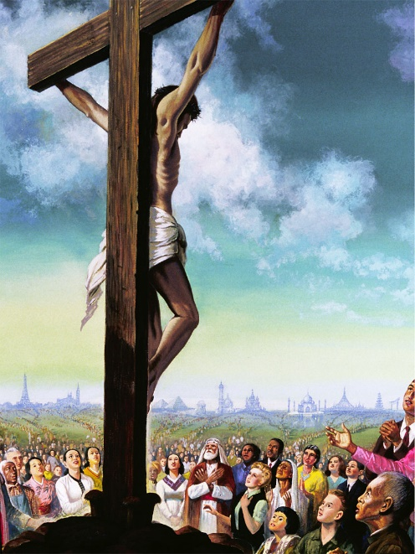
WALKING IN LOVE
Ephesians 5:1-5
Paul uses the verb "to walk" as a synonym for behavior or way of living. Our motivation to live a life of love is the sacrifice of Jesus (5:1-2):
He loved us and gave Himself for us (Galatians 2:20)
It was a substitutionary sacrifice, bearing our sins (Isaiah 53:6)
It was a fragrant offering, pleasing to God (Ex. 29:18; 2 Cor. 2:15; Phil. 4:18)
What should we avoid while walking in love, and why?
What is fitting and what is not fitting?
Things not even to be named (v. 3):
Fornication
Uncleanness
They will not inherit the kingdom of God (v. 5):
Fornicators
Unclean persons
Greed
Greedy (idolaters)
Things not fitting (v. 4a):
Things fitting (v. 4b):
Thanksgiving
Filthiness
Foolish talking
Coarse jesting

Slide 6
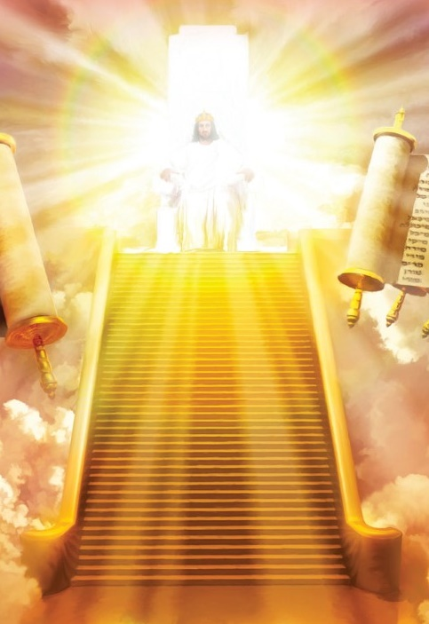
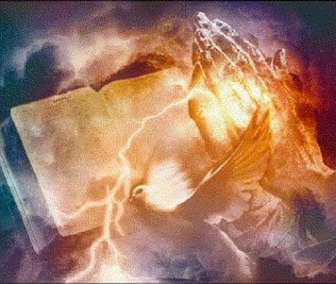
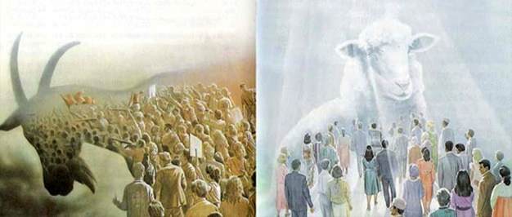
WALKING AS CHILDREN OF LIGHT
Ephesians 5:6-10
Paul tells us why "neither fornication, nor uncleanness, nor greed" are fitting, and why we should not support those who engage in such things: they are under God's wrath because of their disobedience (v. 6-7).
God's wrath is not like ours – a violent, irrational outburst – but a just response to evil (James 1:20; 2 Chronicles 24:18; Romans 1:18).
We no longer participate in the "works of darkness," that is, the behavior of those who reject or do not know God (2 Cor. 6:14). Now, we are "light" (Mt. 5:14), and our fruit in the Spirit is "all goodness, righteousness, and truth," which is pleasing to God (5:8-10).

Slide 7
WALKING IN THE LIGHT

Slide 8
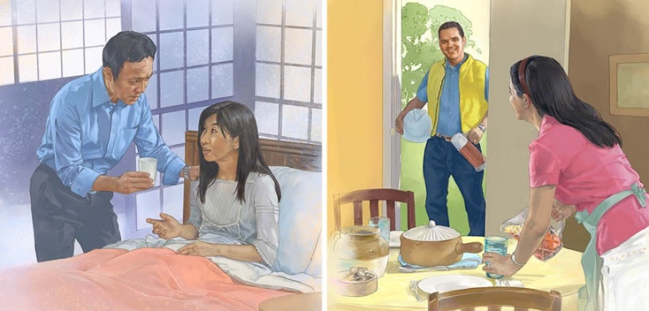
THE LIGHT REVEALS EVERYTHING
Ephesians 5:11-14
Paul continually uses a dichotomy: living a lifestyle that honors God versus living an immoral lifestyle that opposes God.
Those of us who have chosen to live a life that honors God reprove the works of darkness by showing the right alternative through our way of living. We are light, and "the light reveals everything" (5:11-13).
Paul considers the Christian who participates in "the unfruitful works of darkness" as "asleep." Therefore, using the lyrics of a hymn, he calls them to awaken and rise "from the dead" (5:14). By doing so, they will also reflect the light of Christ in a world of darkness (Philippians 2:15).

Slide 9
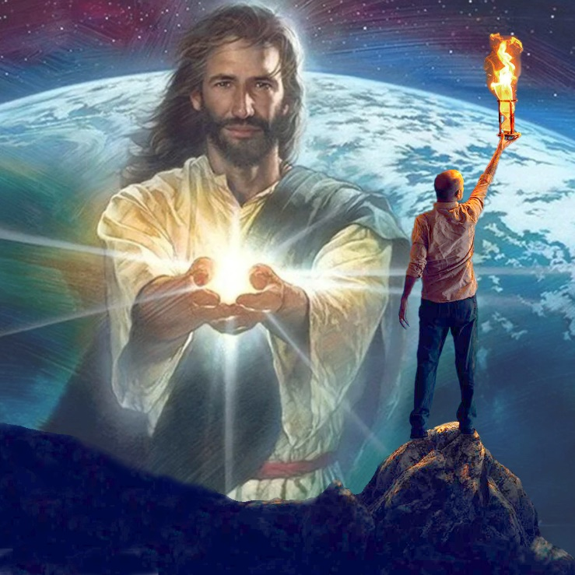
ENLIGHTENED BY CHRIST
Ephesians 5:15-17
To those who are awake (no longer sleeping), Paul says, "Christ will shine on you" (5:14). What happens when Christ enlightens us?
He explains it by using a "sandwich" structure (v. 15 and 17) with an exhortation in the middle (v. 16):
v. 15
Do not walk as fools
Walk as wise
v. 17
Do not be unwise
Understand what the Lord's will is
Notice that to be wise, we must understand God's will (Proverbs 9:10).

Slide 10
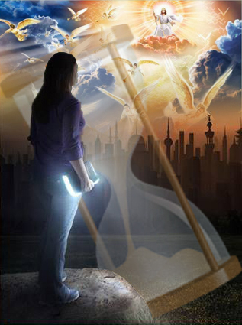
ENLIGHTENED BY CHRIST
Ephesians 5:15-17
The exhortation that Paul includes in the middle tells us how we should live if we walk wisely in these "evil days" (5:16).
exagorazō [redeem, make the most of]. It was used for bargains offered in the market.
kairos [time, moment]. It indicates the opportune moment to do something.
In this case, the original Greek helps us better understand the meaning of the exhortation:
While waiting for the coming of Christ, believers live in tough times. We must pay close attention to how we use the time that remains, like bargain hunters during a sale. We must promptly seize what God offers us in Christ (Isaiah 55:1; Revelation 22:17).

Slide 11
PRAISING IN THE SPIRIT

Slide 12
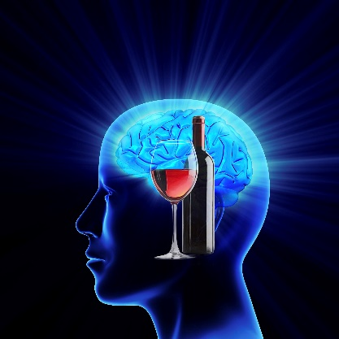
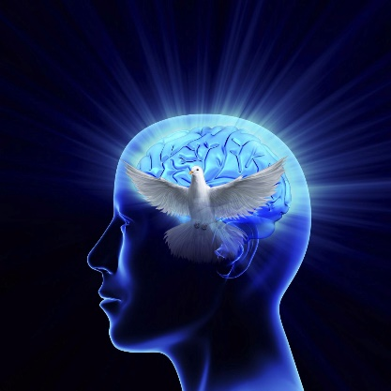
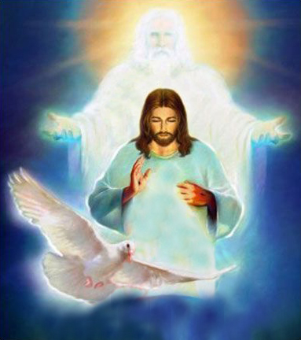
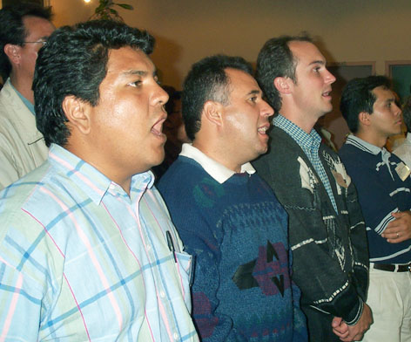
PSALMS, HYMNS, AND SPIRITUAL SONGS
Ephesians 5:18-20
Again, Paul presents two opposite thoughts: filling our minds with alcohol or filling them with the Holy Spirit (5:18).
As the Bible indicates, alcohol clouds our minds (Proverbs 20:1; 23:29-35). Under the influence of drunkenness, we are easily led to fornication, impurity, and bad language.
But when our minds are filled with the Holy Spirit, we share psalms, hymns, and spiritual songs with our brothers and sisters; we sing and praise God (5:19).
Filled with the Spirit, we give thanks to the Father in the name of the Son (5:20). Blessed Trinity!

Slide 13
“Wherever there is union with Christ there is love […] When we are united to Christ, we have the mind of Christ. Purity and love shine forth in the character, meekness and truth control the life. The very expression of the countenance is changed […] If we are connected with the Light, we shall be channels of light, and in our words and works we shall reflect light to the world. Those who are truly Christians are bound with the chain of love which links earth to heaven, which binds finite man to the infinite God. The light that shines in the face of Jesus Christ shines in the hearts of His followers, to the glory of God.”
E. G. W. (Selected Messages, book 1, Ch. 51, p. 337)

