Slide 1
HUSBANDS AND WIVES: TOGETHER AT THE CROSS
Lesson 10 for September 2, 2023

Slide 2
“Husbands, love your wives, just as Christ also loved the church and gave Himself for her, that He might sanctify and cleanse her with the washing of water by the word, that He might present her to Himself a glorious church, not having spot or wrinkle or any such thing, but that she should be holy and without blemish” (Ephesians 5:25-27)

Slide 3
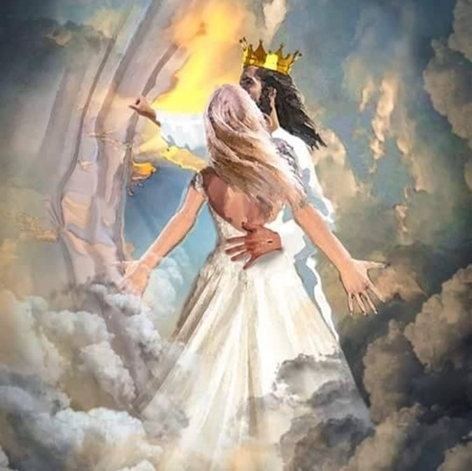
Deliberately, Paul intertwines advice for marriage in Ephesians 5:21-33 with similes of the "conjugal" relationship between Christ and His Church.
The advice Paul gives to the Church can be summarized as follows: "Submit to one another ... to become one flesh with Christ."
His advice for a successful marriage: "Husbands, love your wives as yourselves; and wives, respect your husbands."
ADVICE
For wives (Ephesians 5:21-24)
For husbands (Ephesians 5:28-30)
CHRIST AND HIS CHURCH
Husband and wife (Ephesians 5:25-27)
One flesh (Ephesians 5:31-33)

Slide 4
ADVICE FOR WIVES
Ephesians 5:21-24
Unity is essential for the Church (Eph. 2:13-14). Paul introduces a general advice to achieve this unity: mutual submission (5:21). He then applies this advice to a specific case: marriage.
The woman submits to her husband, not as to a boss, but as to Christ, her Savior and Protector.
The Bible offers no basis for the concept that the wife is inferior to her husband and, therefore, must submit to him as a superior.
The wife should act with humility and respect toward her husband, not with arrogance and superiority. She should assume an attitude of loving and supportive loyalty, subject to him "as ... to Christ" (5:24).

Slide 5
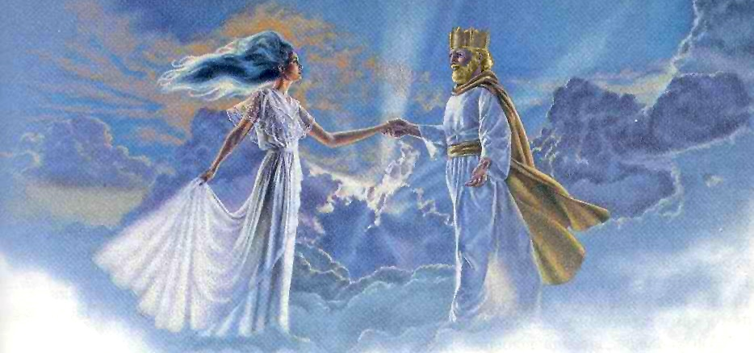
CHRIST AND HIS CHURCH: HUSBAND AND WIFE
Ephesians 5:25-27
In Paul's analogy, Christ is the Husband (bridegroom) and the Church is His wife (bride).
What does Christ do for His wife?
Loves the church as a wife
Jesus loves us!
Gives Himself as the bride's price
The bridegroom had to give goods or money to the bride's father to take her as his wife, showing how much he valued her (Gen. 29:18; 34:11)
Bathes the bride
Christ takes on the role of the bridesmaids, preparing the bride Himself
Speaks the word of promise
Through the promise, Christ commits to caring for and loving the Church
Prepares and adorns the bride
Adorned by Christ, the Church appears "holy and without blemish"
Presents the bride
Assuming the role of the father, Jesus presents the Church to Himself and marries her

Slide 6
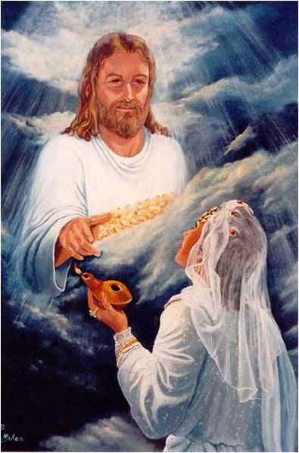
CHRIST AND HIS CHURCH: HUSBAND AND WIFE
Ephesians 5:25-27
Paul presents the wedding of Jesus and His Church in its chronological development:
Engagement (v. 25)
Jesus paid the bride's price by dying on the cross. In this way, He officially engaged Himself to the Church.
Preparation for the wedding ceremony (v. 26)
Currently, He prepares the Church by sanctifying and purifying each member, cleansing every stain of sin, and smoothing every wrinkle of character.
The wedding ceremony itself (v. 27)
Finally, Jesus will come to take His wife, "a glorious church," to live happily ever after.
Am I preparing for the wedding? Do I let Jesus prepare me every day for that beautiful ceremony? Do I long for the moment when I can see my Husband face to face?

Slide 7
ADVICE FOR HUSBANDS
Ephesians 5:28-30
Much harm and sorrow have been caused by a misinterpretation of the words spoken to Eve: "Your desire will be for your husband, and he will rule over you" (Gen. 3:16 NIV).
Aware of this, Paul wants husbands to understand how they should act towards their wives. Firstly, to love them "as Christ loved the church," willing to give their lives for them (5:25, 29).
If they are ever tempted to treat them harshly, they must remember that she is a part of themselves, and by mistreating her, they show that they do not love either her or themselves (5:28). Those who exercise improper dominion and harm their wives mistreat their own bodies, their own flesh, and their own bones (5:30).

Slide 8
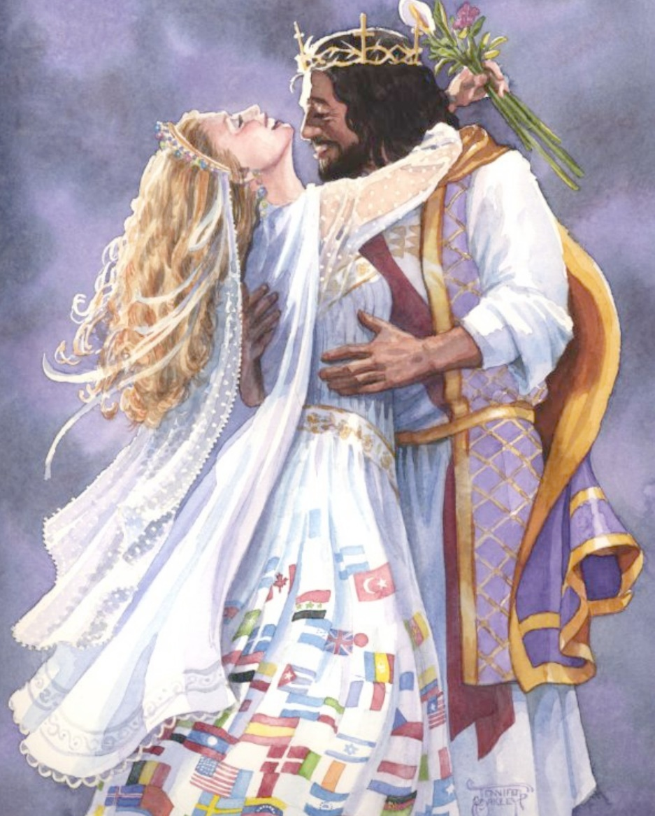
CHRIST AND HIS CHURCH: ONE FLESH
Ephesians 5:31-33
Paul concludes his advice to spouses with a reference to Genesis 2:24 (5:31). What does the expression "one flesh" mean?
The sexual unity in marriage reflects their emotional and spiritual unity. They are no longer two. They no longer act separately. They have left their past to create a future together, united. They are ONE.
This is a mystery, a divine gift, which Paul spiritually applies to Christ and His Church (5:32). The Church cannot exist separately from Christ but depends on its union with Jesus.
Being one, "the husband loves his wife (and vice versa); the wife respects her husband (and vice versa); as Christ loves and respects each one of us (and vice versa)" (paraphrased Eph. 5:33).

Slide 9
“Marriage, a union for life, is a symbol of the union between Christ and His church. The spirit that Christ manifests toward His church is the spirit that the husband and wife are to manifest toward each other. If they love God supremely, they will love each other in the Lord, ever treating each other courteously, drawing in even cords. In their mutual self-denial and self-sacrifice they will be a blessing to each other.”
E. G. W. (The Adventist Home, Ch. 14, p. 82)

