Slide 1
PRACTICING SUPREME LOYALTY TO CHRIST
Lesson 11 for September 9, 2023

Slide 2
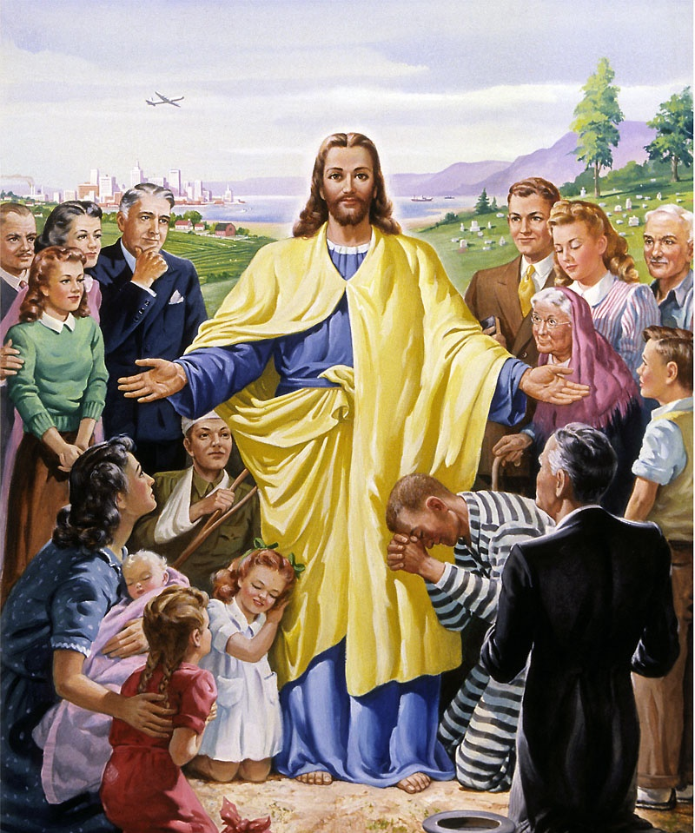
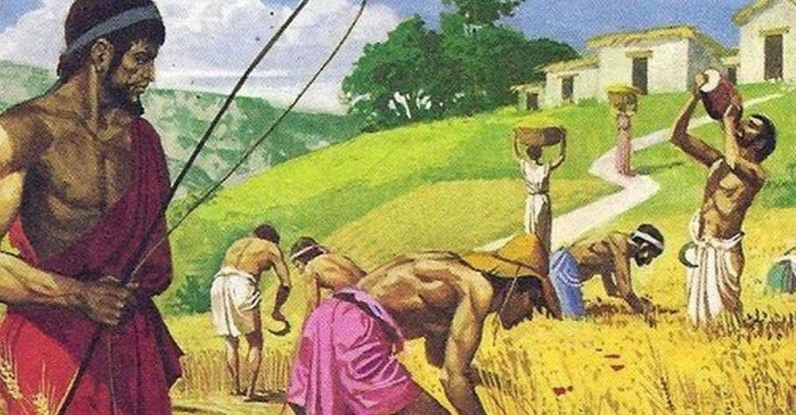
“And masters, treat your slaves in the same way. Do not threaten them, since you know that he who is both their Master and yours is in heaven, and there is no favoritism with him” (Ephesians 6:9, NIV)

Slide 3
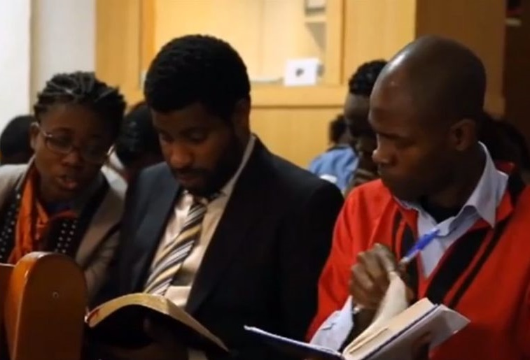
Paul concludes his advice on maintaining unity in the church by addressing relationships among members who, in their personal lives, have authority over other members or are subordinate to them (Ephesians 6:1-9).
Specifically, he addresses two types of relationships: between parents and children, and between masters and slaves [in modern times, this would be applicable to the hierarchical relationship between bosses and subordinates].
Unity across generations:
Advice for children. Ephesians 6:1-3
Advice for parents. Ephesians 6:4
Unity across hierarchies:
Advice for slaves. Ephesians 6:5-8
Advice for masters. Ephesians 6:9

Slide 4
UNITY ACROSS GENERATIONS

Slide 5
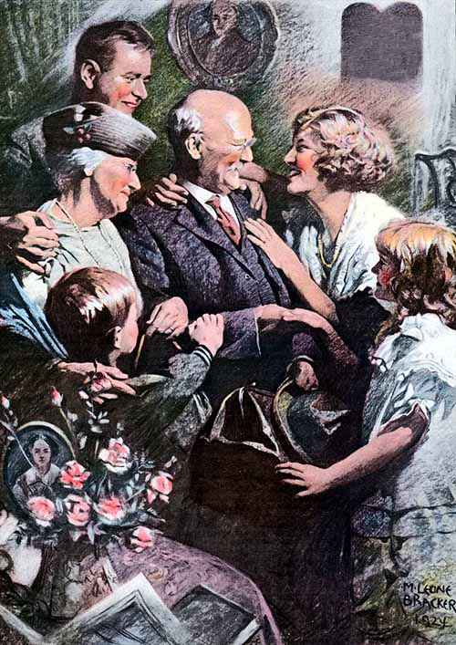
ADVICE FOR CHILDREN
Ephesians 6:1-3
The word "children" (ta tekna) includes both sons and daughters, regardless of age. This implies that the advice applies to all those whose parents (or at least one of them) are still alive.
Honour thy fathers
However, when thinking about relationships among church members, Paul likely had teenagers and young people in mind who are already active church members and are also still subordinate to their parents or dependent on them.
Although in Christ we are all equal, a teenager or young person cannot treat their parents disrespectfully but must obey them, as the fifth commandment states. This obedience is only limited by obedience to Christ and the rest of the Law.

Slide 6
ADVICE FOR PARENTS
Ephesians 6:4
The obligatory obedience of children places parents in a position where they can potentially abuse their power.
Therefore, parents must exercise restraint in their authority. They should not overwhelm their children with severity that leads them to anger.
All discipline, admonition, and instruction should be "in Christ." The purpose of parental authority is to lead the children to the feet of the Savior.
Ellen G. White defines this relationship as follows: “Be pleasant in the home. Restrain every word that would arouse unholy temper […] No license is given in God’s Word for parental severity or oppression or for filial disobedience.” (Child Guidance, p. 259)

Slide 7
“Children are admonished by the apostle to obey their parents in the Lord, to be helpful and submissive […] How precious is the thought that the youth who strive against sin, who believe, and wait and watch for Christ's appearing, who submit to parental authority, and who love the Lord Jesus, will be among those who love His appearing and who meet Him in peace.”
E. G. W. (In Heavenly Places, July 28)

Slide 8
UNITY ACROSS HIERARCHIES

Slide 9
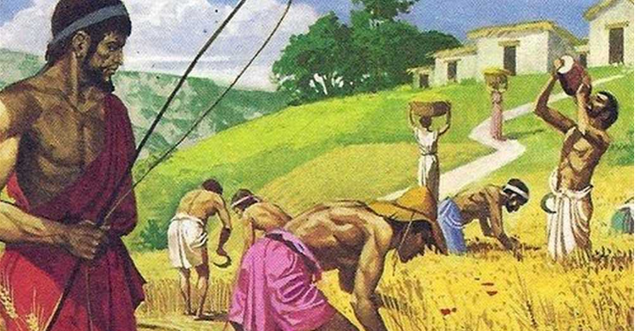
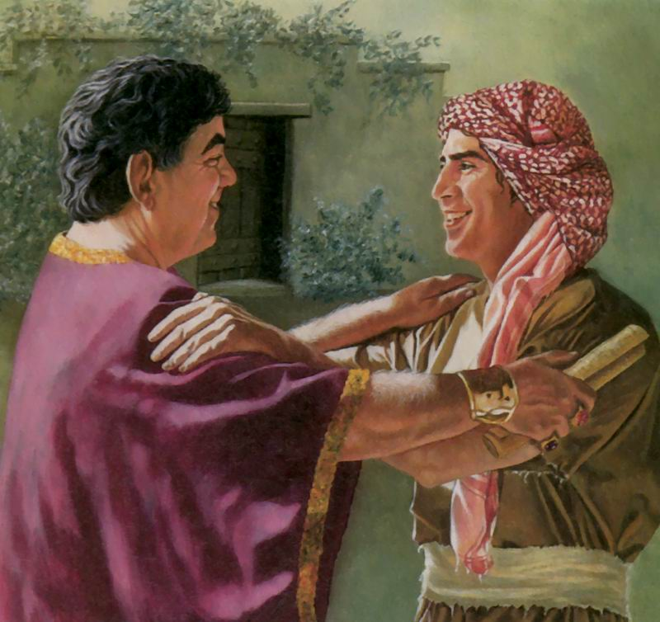
ADVICE FOR SLAVES
Ephesians 6:5-8
Slaves in the church? Unfortunately, that was a reality in the first-century churches.
This situation contrasted with the apostle's words: "There is neither [...] slave nor free [...] for you are all one in Christ Jesus" (Galatians 3:28).
Why didn't Paul ask Christian masters to free their slaves, or slaves to escape from their masters or rebel against them?
Philemon 15-16
The church was not called to change the social reality at that moment but to lay the foundation that would eventually end that unjust situation.
However, silence was not an option. The master/slave relationship needed to be redefined "in Christ."

Slide 10
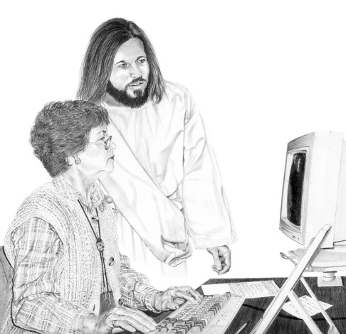
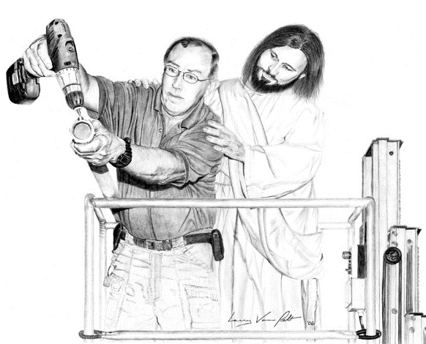
ADVICE FOR SLAVES
Ephesians 6:5-8
What advice did Paul give to slaves or subordinates?
Obey your masters with respect and sincerity, as to Christ (v. 5)
Don't work only when being watched. Work as if you were serving Jesus (v. 6)
Serve willingly, as if you were serving God rather than men (v. 7)
Know that you will receive a reward not from men but from the Lord (v. 8)
We serve earthly, temporal masters or bosses. But our true service is to Jesus. Therefore, our reward will come from Christ at His Coming.
If you work under someone's authority, how can you apply these pieces of advice?

Slide 11
ADVICE FOR MASTERS
Ephesians 6:9
Surprising! Masters must do "the same things" as their (Christian) slaves do to them and not threaten them.
Why does Paul give this advice to masters?
Every master has a heavenly Master above. We are all "fellow slaves" of Christ
Masters must treat their slaves with dignity, as there is no difference between them and their slaves before God
The only way masters and slaves (bosses and subordinates) can come together and worship in the church is if both act courteously in their relationships, treating each other as Jesus, their Master, treats them.

Slide 12
“Christ calls us His servants, if we do what He commands us. There is to every man assigned his particular sphere, place, and work, and God asks no more and no less from the lowliest, as well as the greatest, than that they fulfill their calling. We are not our own property. We have become servants of Christ by grace.”
E. G. W. (This Day With God, June 6)

