Slide 1
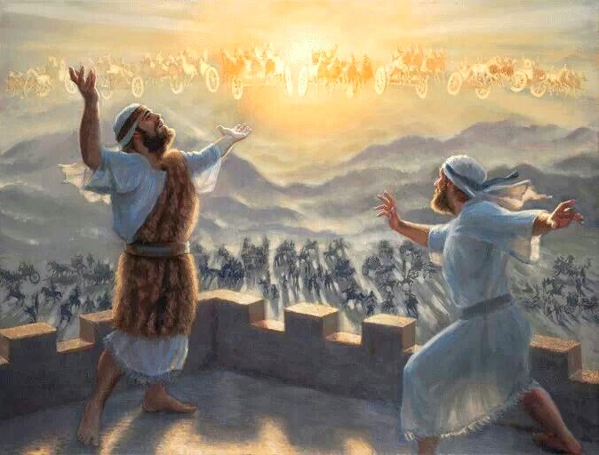
THE CALL TO STAND
Lesson 12 for September 16, 2023

Slide 2
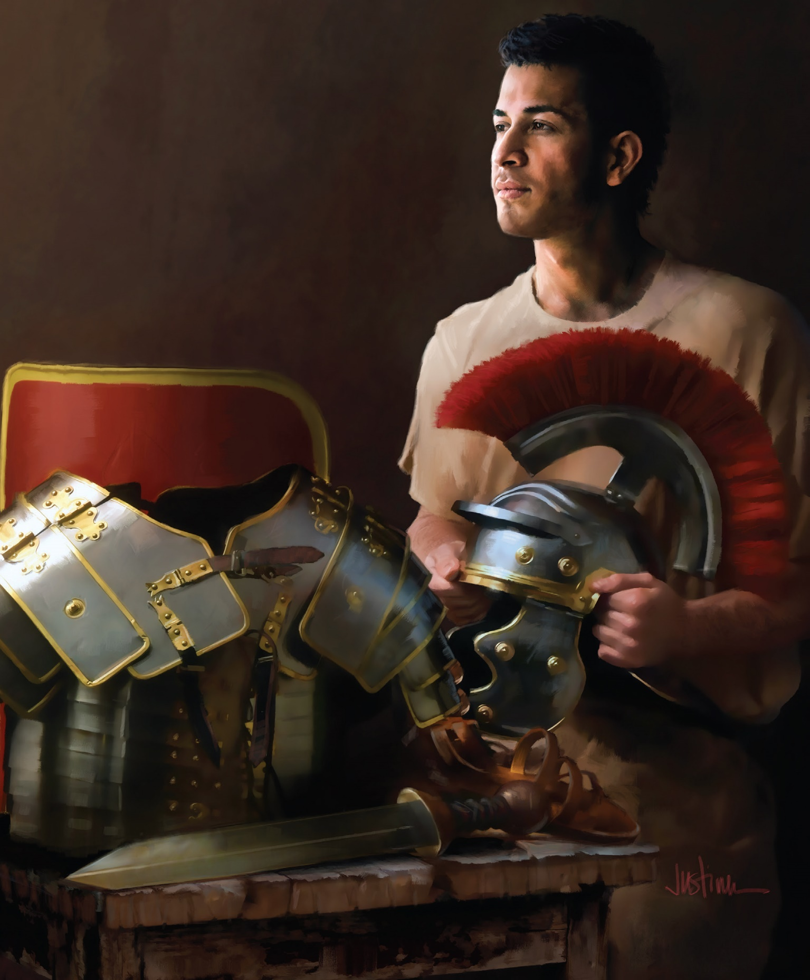
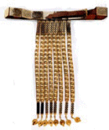
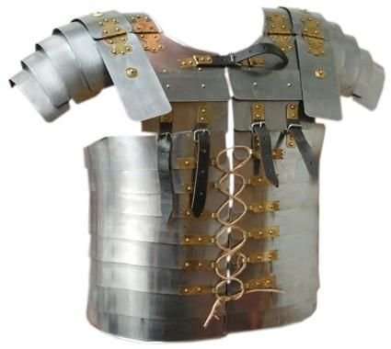
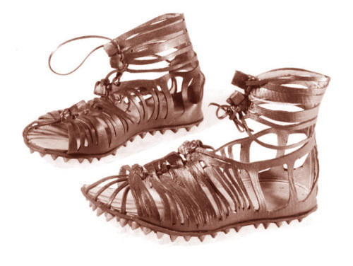
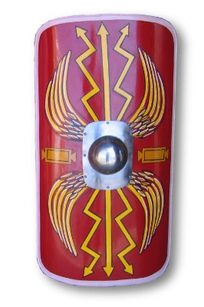
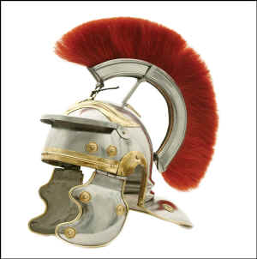
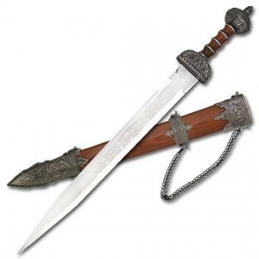
“Finally, be strong in the Lord and in the strength of his might. Put on the whole armor of God, that you may be able to stand against the schemes of the devil” (Ephesians 6:10, 11, ESV)

Slide 3
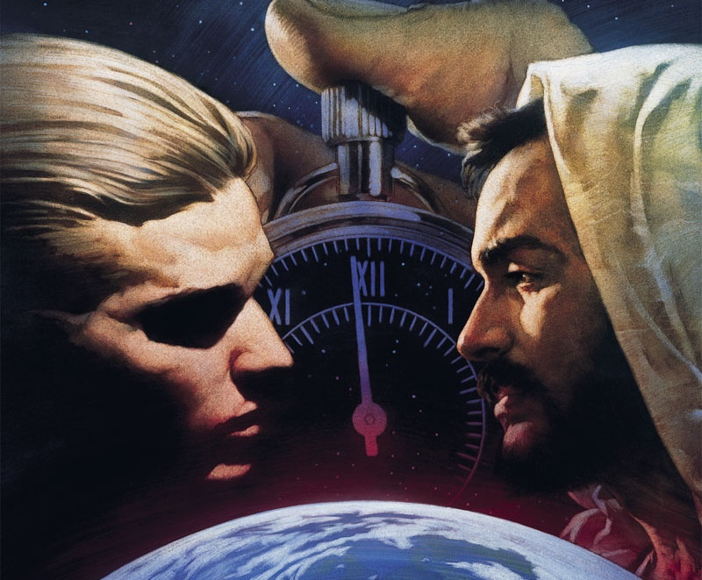
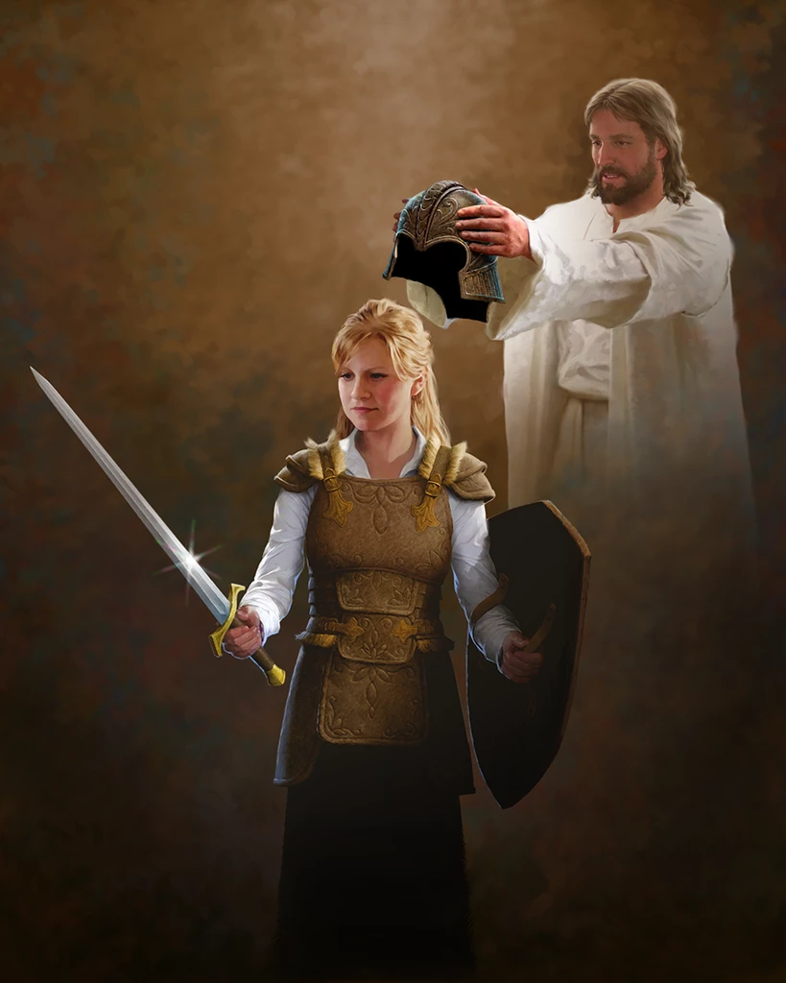
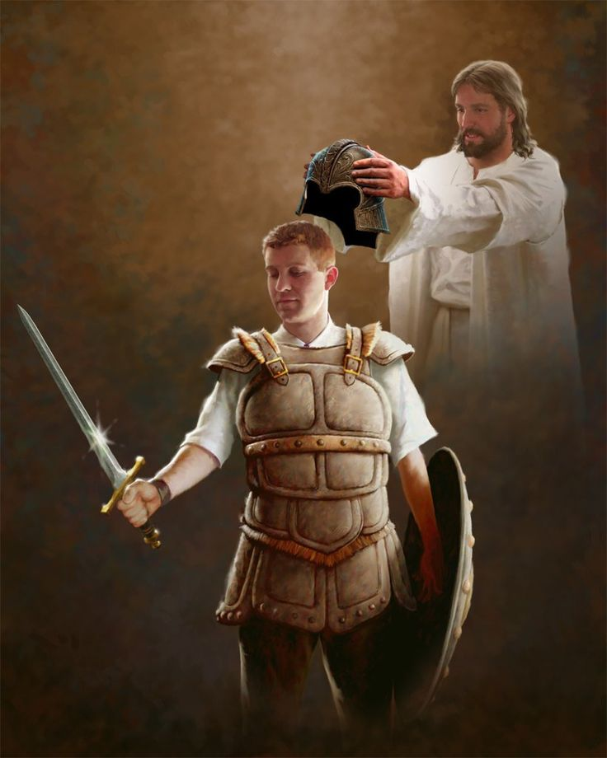
We are immersed in a cosmic war between two kingdoms. Therefore, when we join the Kingdom of Jesus, we become a part of its defense and promotion.
Upon entering battle, we cannot rely on our own strength, weapons, or abilities. Our source of power is in Jesus Christ. We fight dressed in the armor of God, in a war that Jesus has already won.
Preparation for battle (Ephesians 6:10)
Call to battle
Forces for victory
The battle (Ephesians 6:11, 13)
The cosmic conflict
Standing firm
The enemy (Ephesians 6:12)
Principalities and powers

Slide 4
PREPARATION FOR BATTLE
“Finally, my brethren, be strong in the Lord and in the power of His might” (Ephesians 6:10)

Slide 5
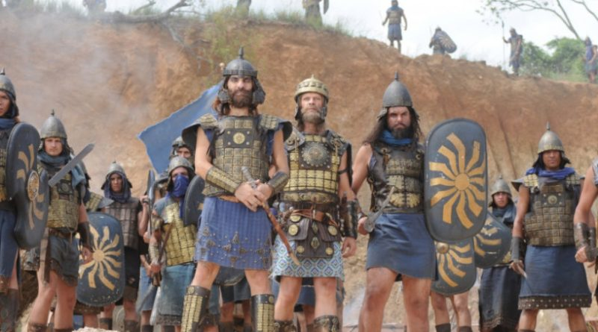
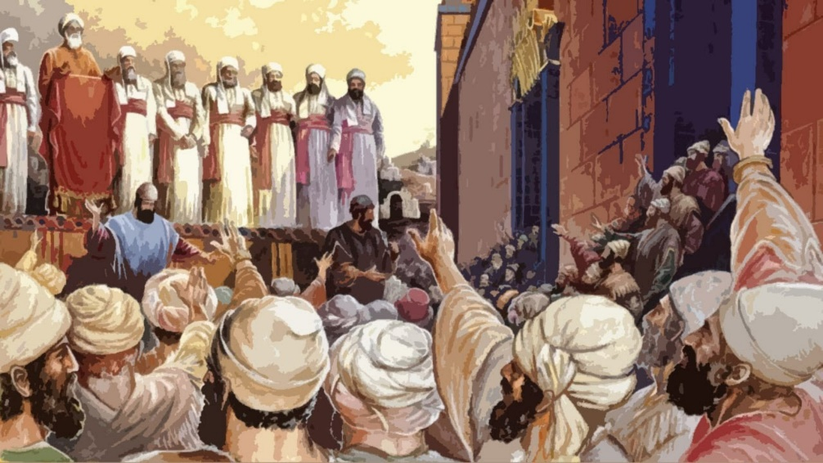
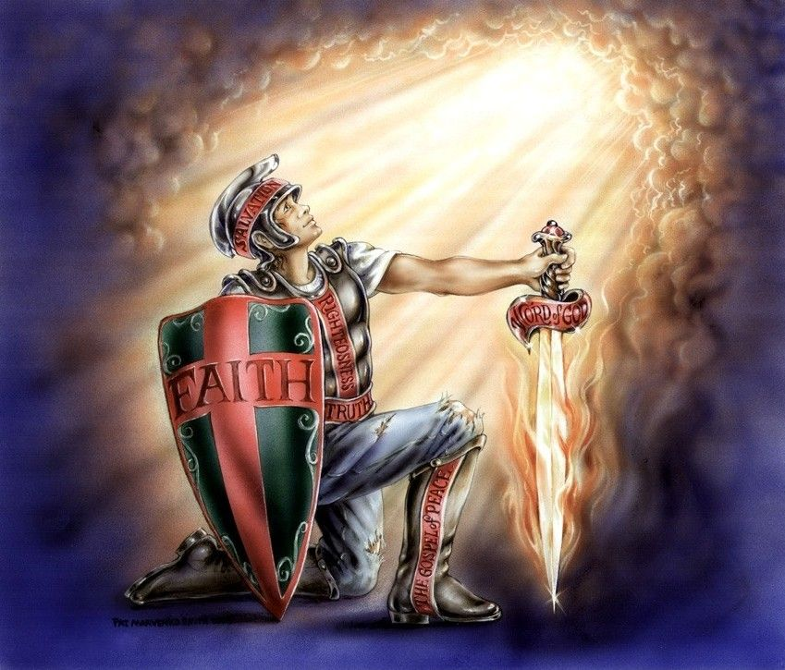
CALL TO BATTLE
When an ancient army prepared to go to the battlefield, the general would stand at the front and rally his men to embolden them for the impending battle (1 Samuel 4:9).
But when God's people faced an army, the rallying cry included a different aspect. The soldiers' courage was not based on their own strength but on the fact that God fought for them (Deuteronomy 20:2-4; 2 Chronicles 32:6-8).
Aware of the spiritual battle we are immersed in, Paul encourages us to strengthen ourselves "in the Lord and in the power of His might" (Ephesians 6:10).
We can only overcome enemies much more powerful than us by relying on Christ and putting on His armor.

Slide 6
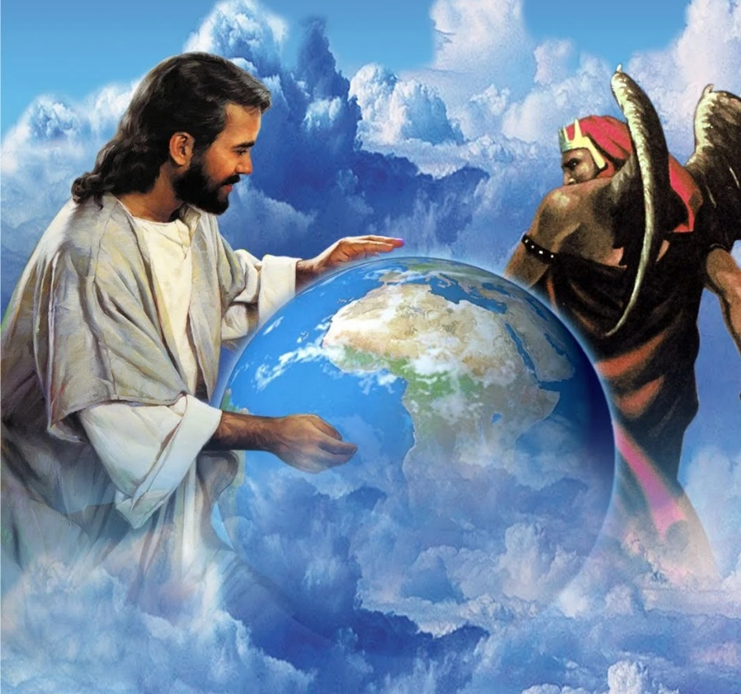
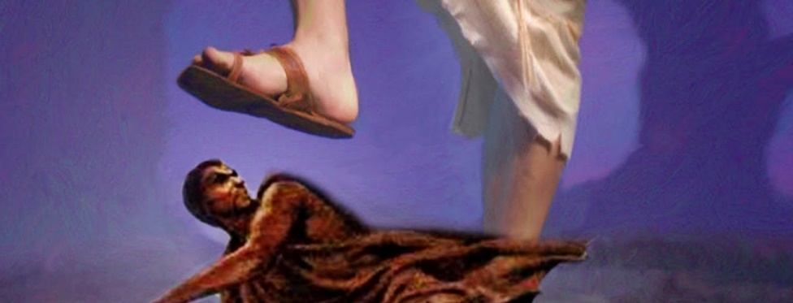
FORCES FOR VICTORY
The conflict surrounding us is not a war against us as simple soldiers on one side or the other but a war between God and Satan.
While Satan focuses on attacking the church, each member is supported and strengthened by the three persons of the Trinity:
Jesus
He provides us with the power of His might (6:10)
The Father
He provides us with His armor (6:11)
The Holy Spirit
He provides us with the weapon to attack (6:17) and the battle plan (6:18)
Considering that Jesus has already overcome (John 16:33), who do you think will be the victor in our battles against the prince of evil?

Slide 7
THE BATTLE
“Put on the whole armour of God, that ye may be able to stand against the wiles of the devil. […] Wherefore take unto you the whole armour of God, that ye may be able to withstand in the evil day, and having done all, to stand” (Ephesians 6:11, 13)

Slide 8
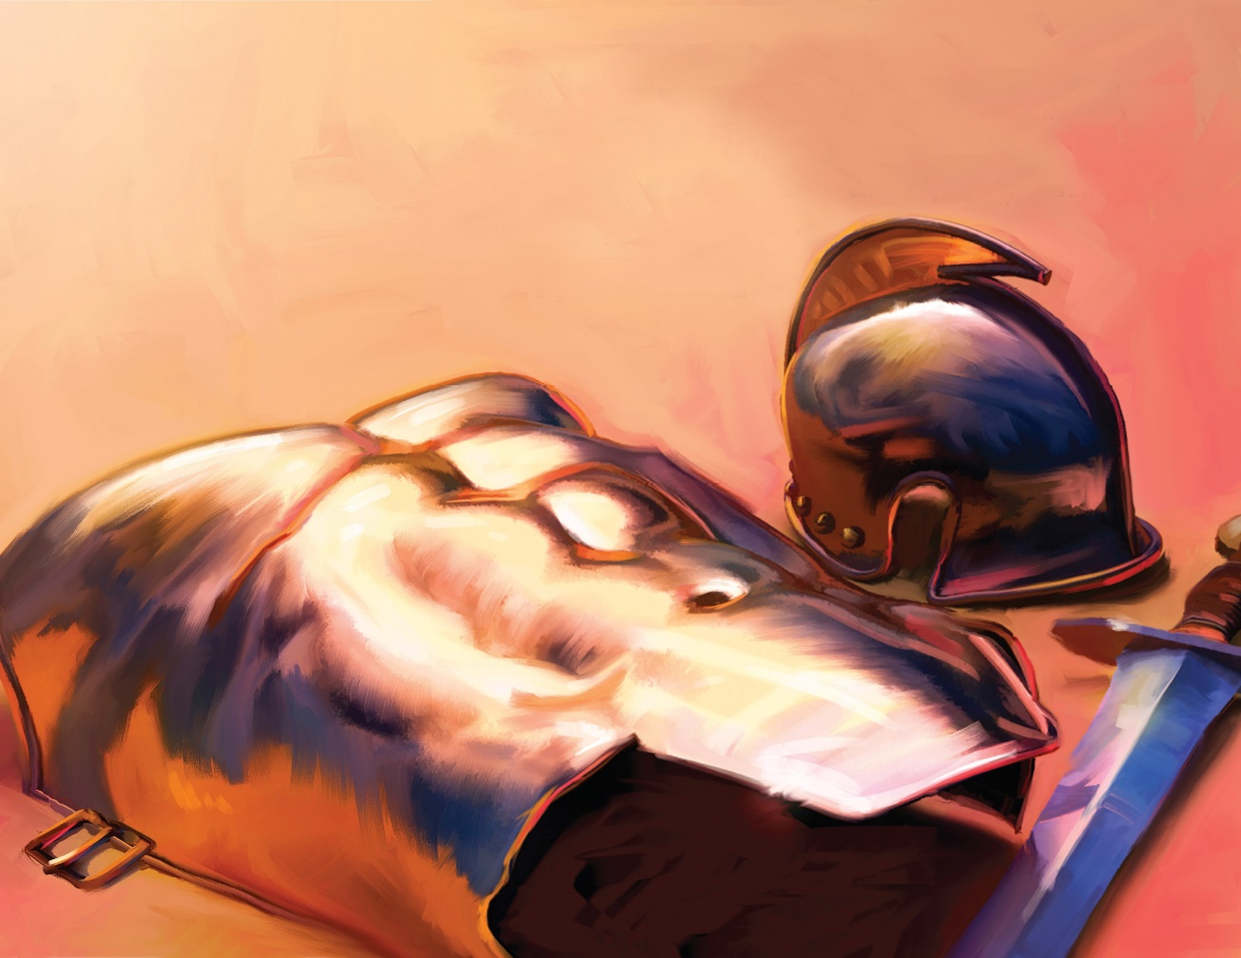
THE COSMIC CONFLICT
Using clear military language, Paul urges us to put on "the armor of light" (Ro. 13:12), "with the breastplate of righteousness and love, and as a helmet, the hope of salvation" (1 Th. 5:8). But he doesn't speak of a physical confrontation (2 Cor. 10:3-4).
How do we participate in this cosmic conflict "in heavenly places" (Eph. 6:12)?
Out of love, God gives us life and enlists us in His army (Eph. 2:4-6)
He uses us as ambassadors to the enemy powers (Eph. 3:10)
He strengthens us with power (Eph. 3:16)
He provides gifts to equip us (Eph. 4:7, 12)
He clothes us in righteous-ness and holiness (Eph. 4:24)
He gives us His armor to withstand the battle (Eph. 6:13)

Slide 9
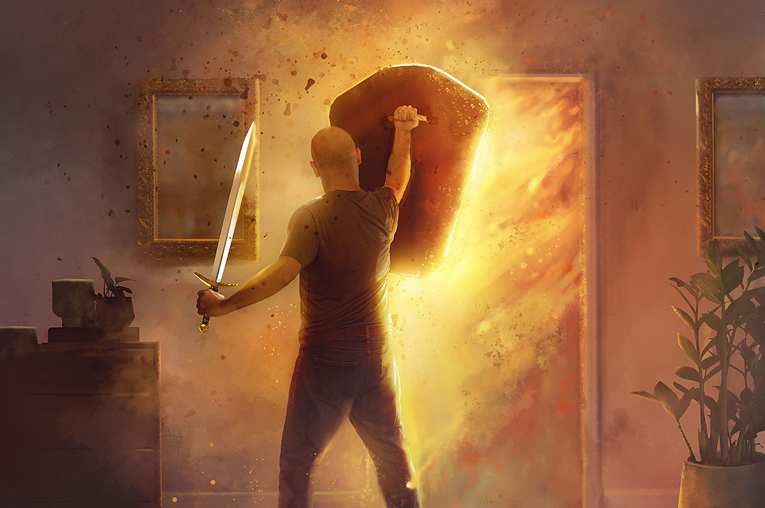
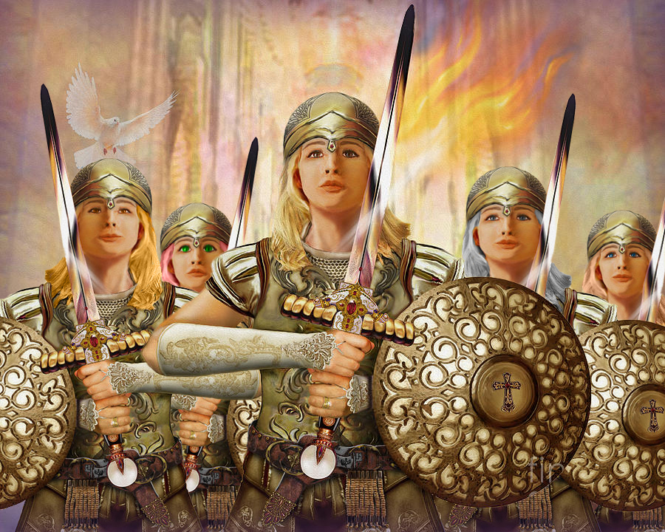
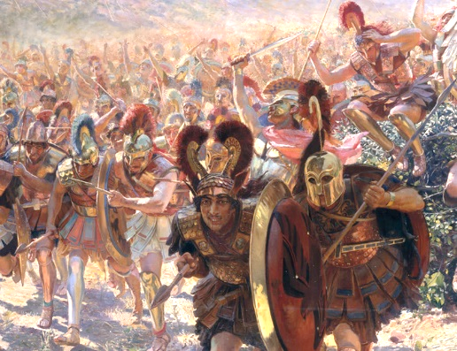
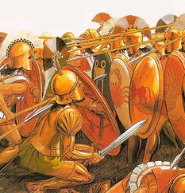
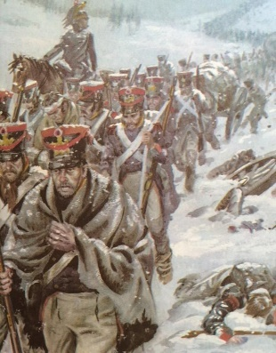
STANDING FIRM
Battles in ancient times unfolded in three phases:
Advancing toward the enemy
Standing firm and defending the position in hand-to-hand combat
Advancing and forcing the enemy to retreat
The decisive point that marked victory was the second phase. If they could stand firm in their position, they could force their enemy to retreat. Therefore, Paul invites us to "stand firm against the schemes of the devil," to "resist in the evil day," and, having pushed back the enemy, to continue standing firm (Ephesians 6:10, 13).
Unity also plays a significant role in achieving victory. We are called to present a united front against the enemy's power (Philippians 1:27).

Slide 10
THE ENEMY
“For we do not wrestle against flesh and blood, but against principalities, against powers, against the rulers of the darkness of this age, against spiritual hosts of wickedness in the heavenly places” (Ephesians 6:12)

Slide 11
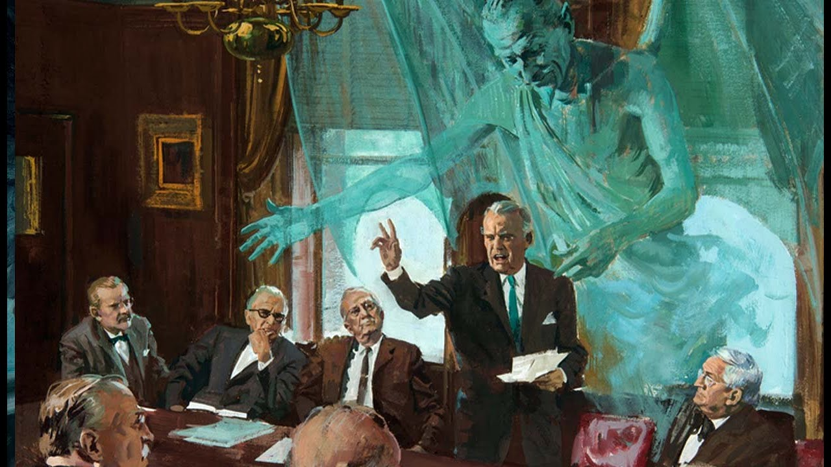
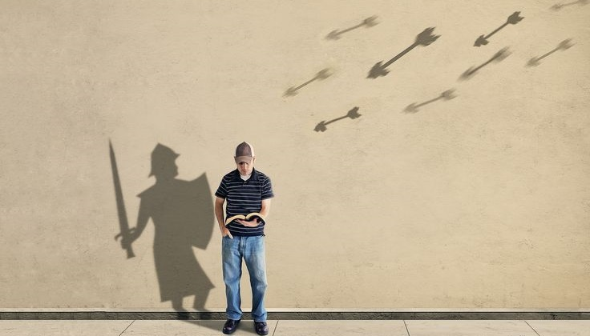
RULERS AND AUTHORITIES
Often, we make the mistake of misidentifying the enemy. We think the enemy is the boss threatening to fire us if we don't work on Sabbath, or the sibling who spoke hurtful words.
The true enemy is hidden behind, imperceptible to us. The "powers that dominate this world of darkness" are "evil spiritual forces" (6:12 NIV). Our enemy is Satan and his angels. Let's not underestimate them; they are stronger than us.
Therefore, God urges us to put on His armor, fight with His strength, and achieve victory. With this equipment, we cannot fail. Victory is assured (Romans 16:20; 1 Corinthians 15:24).

Slide 12
“All who would be soldiers of the cross of Christ, must gird on the armor and prepare for conflict. They should not be intimidated by threats or terrified by dangers. They must be cautious in peril, yet firm and brave in facing the foe and doing battle for God […] His final reward will be to share with Christ the throne of immortal glory.”
E. G. W. (Conflict and Courage, May 2)

