Slide 1
WAGING PEACE
Lesson 13 for September 23, 2023

Slide 2
“In all circumstances take up the shield of faith, with which you can extinguish all the flaming darts of the evil one; and take the helmet of salvation, and the sword of the Spirit, which is the word of God” (Ephesians 6:16, 17, ESV)

Slide 3
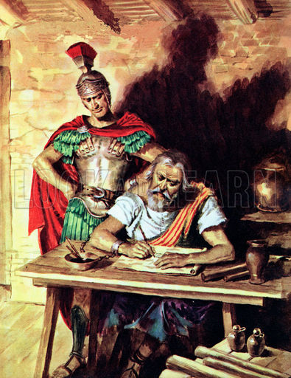
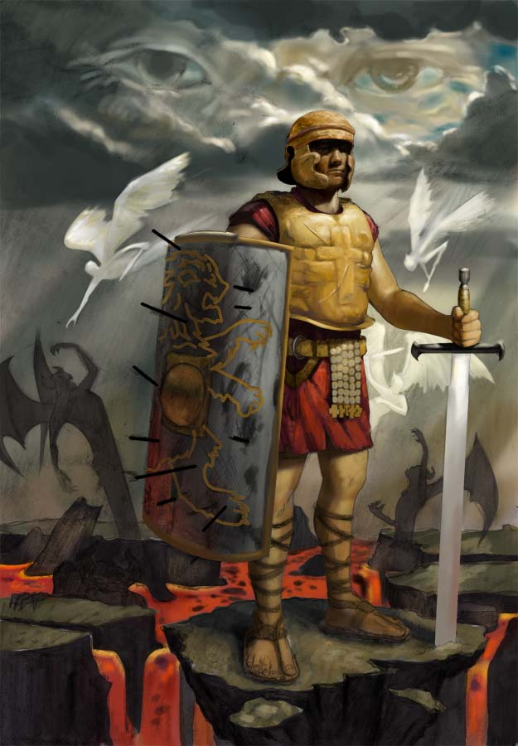
This is how Paul (the "ambassador in chains") explains our part in the conflict between Christ and Satan:
To "take our stand against the devil’s schemes" and to fight "against the spiritual forces of evil," God has provided His servants with spiritual armor so they "may be able to stand their ground" (Ephesians 6:11-13, NIV).
Well-equipped with this armor, believers present a united front against the enemy; we are led by our Captain—Jesus Christ; we cooperate in every battle, and we await the final victory when "His enemies [the enemies of Christ] shall be made His footstool" (Hebrews 10:13).
The soldiers of God’s army
The soldier’s equipment:
Truth and righteousness. Ephesians 6:14
The gospel of peace. Ephesians 6:15
Faith, salvation, and the Word. Ephesians 6:16-17
The unifying ingredient:
Prayer. Ephesians 6:18-20

Slide 4
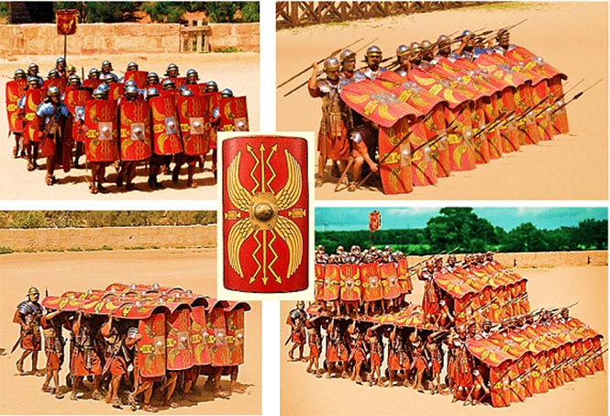
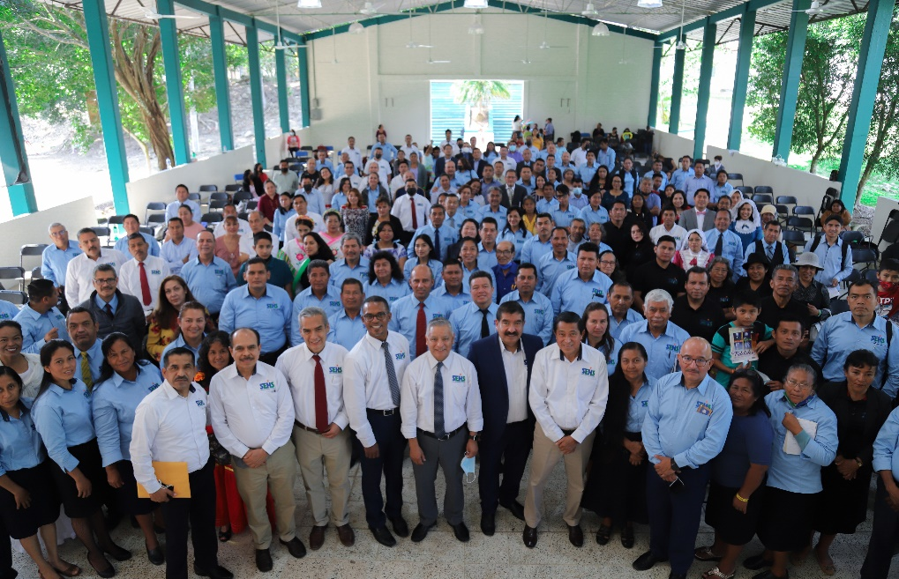
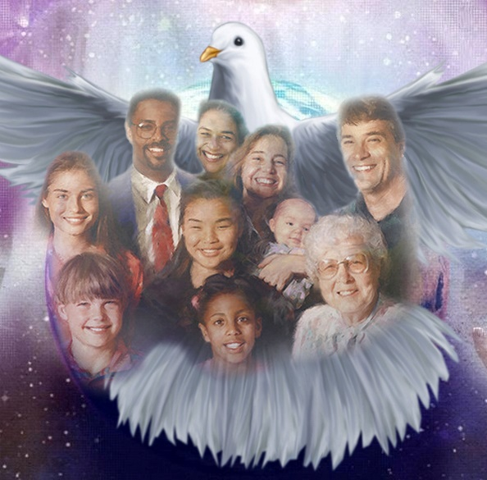
THE SOLDIERS OF GOD'S ARMY
“The night is far spent, the day is at hand. Therefore let us cast off the works of darkness, and let us put on the armor of light.” (Romans 13:12)
By describing the armor of God, Paul does not intend to depict a solitary warrior. On the contrary, he uses second-person plural verbs (Ephesians 6:10-13): "be strong"; "put on"; "you may be able"; "take." He envisions an entire army of warriors standing in battle against evil.
The bride of Christ—the Church—is composed of different members fulfilling their specific roles within the body, different bricks forming the building/temple, and soldiers equipped to fight side by side until the glorious day when the Church can unite with her Bridegroom in eternal union.
United by the Holy Spirit, we form "an exceedingly great army" (Ezekiel 37:10). Victory will not be achieved through heroic feats by isolated soldiers acting on their own, independent of the rest of the soldiers.
Victory comes when we act in cooperation with one another, occupying our positions and carrying out the mission God has prepared for each of us.

Slide 5
“An army in battle would become confused and weakened unless all worked in concert. If the soldiers should act out their own impulsive ideas, without reference to each other’s positions and work, they would be a collection of independent atoms; they could not do the work of an organized body. So the soldiers of Christ must act in harmony. They alone must not be cherished. If they do this, the Lord’s people in the place of being in perfect harmony, of one mind, one purpose, and consecrated to one grand object, will find efforts fruitless, their time and capabilities wasted. Union is strength. A few converted souls acting in harmony, acting for one grand purpose, under one head, will achieve victories at every encounter.”
E. G. W. (Spalding and Magan Collection, p. 121)

Slide 6
THE SOLDIER'S EQUIPMENT
“The weapons we fight with are not the weapons of the world. On the contrary, they have divine power to demolish strongholds”
(2 Corinthians 10:4 NIV)

Slide 7
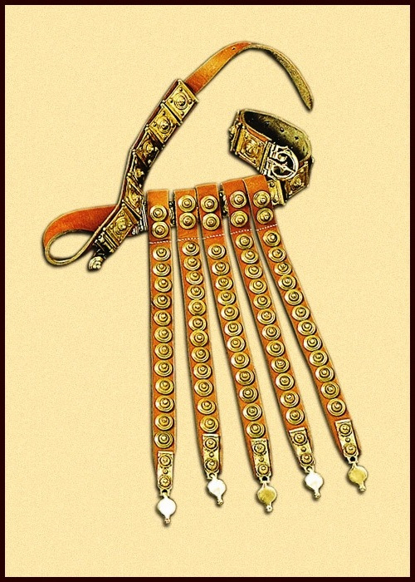
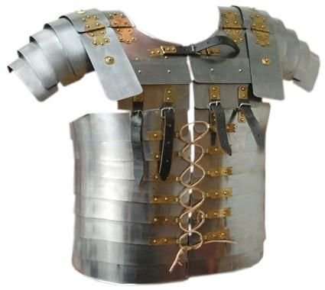
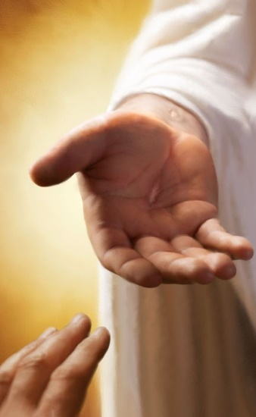
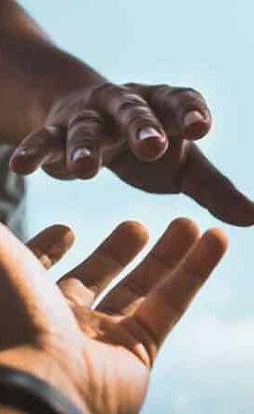
TRUTH AND RIGHTEOUSNESS
“Stand therefore, having girded your waist with truth, having put on the breastplate of righteousness” (Ephesians 6:14)
Before entering battle, we must be properly dressed. The loose garments worn in ancient times were comfortable but could hinder physical effort. Imagine what would happen if your tunic got caught when drawing your sword. Therefore, the belt cinched the clothing to the body, preventing it from obstructing movement.
Christ and His Word are truth. "I am the truth" (John 14:6) said Jesus. If we are grounded in truth, no doubt will hinder our progress.
Once girded, we need to put on the "bulletproof vest." The breastplate, made of interlocking metal plates, protected the soldier from a mortal wound to the heart, lungs, or abdomen. God provides us with His righteousness to protect us from wounds that could cause spiritual death.
Righteousness, like truth, is intimately tied to holiness and goodness (Eph. 4:24; 5:9). The protective righteousness we receive from God becomes an integral part of our conduct, and we treat others justly and kindly.

Slide 8
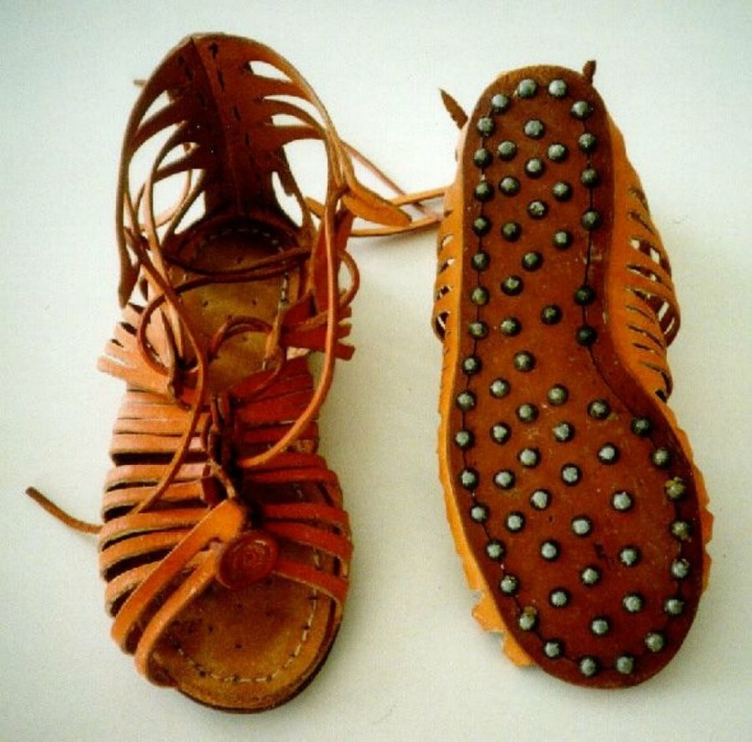
THE GOSPEL OF PEACE
“and having shod your feet with the preparation of the gospel of peace” (Ephesians 6:15)
In the midst of military language, Paul introduces the concept of peace because we are not called to physical combat.
It is true that we live in a war. A war in which we all start on the wrong side. By nature, we are enemies of God. But He enters the conflict to rescue us, to snatch us from the clutches of the evil one and give us peace (John 16:33).
Therefore, our feet must always be ready to share the gospel we have received, bringing peace to people's hearts. We should not "kill" or "defeat" our opponents. We should encourage them to switch sides and embrace the "gospel of peace."
According to the letter to the Ephesians, peace arises from Jesus, and it is our responsibility to maintain and share it:
Ephesians 2:14
Ephesians 2:15
Ephesians 2:17
Ephesians 4:3
Ephesians 6:15
Jesus, our peace, has broken down the walls that separate us
Jesus has proclaimed the good news of peace
We must keep unity in the bond of peace
We must have the readiness to proclaim the gospel of peace (NIV)
Jesus has purchased this peace with His own blood

Slide 9
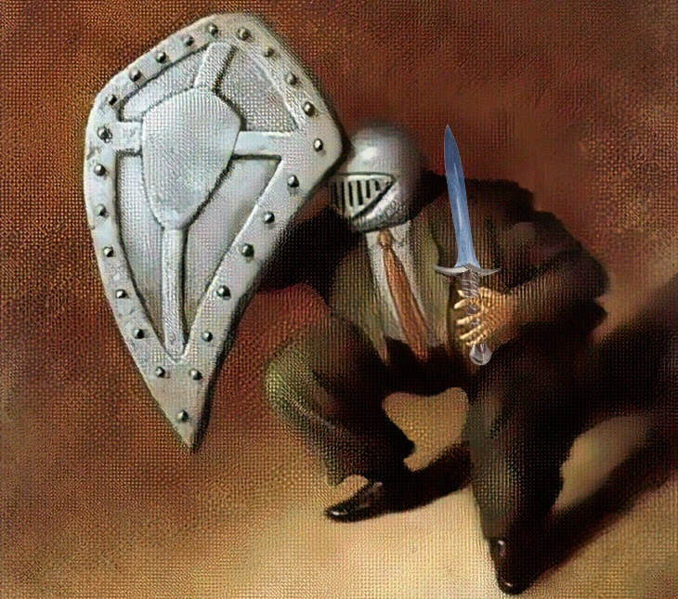
FAITH, SALVATION, AND THE WORD
“Above all, taking the shield of faith with which you will be able to quench all the fiery darts of the wicked one. And take the helmet of salvation, and the sword of the Spirit, which is the word of God” (Ephesians 6:16-17)
Made of wood covered with leather and adorned with metal, the shield could completely protect a crouching soldier and prevent arrows or sword strikes from harming him.
God is our shield (Psalm 3:3; 18:2). By faith, we face the conflict with complete trust in His protection. It is faith that will extinguish the darts of trials that the wicked one seeks to use against us.
The Roman metal helmet had various pieces that protected the soldier's neck and cheeks, ensuring complete head protection.
Our thoughts must be focused on the salvation that God has secured for us and the hope that this salvation will soon materialize in an eternal life without sin (1 Thessalonians 5:8).
With a length of half a meter and a straight, double-edged blade, the Roman sword allowed the soldier to both defend against enemy blows and counterattack.
Paul speaks of the word of God as "sharper than any two-edged sword; it pierces to the division of soul and spirit" (Hebrews 4:12). This is the only weapon capable of turning the enemy into an ally.
THE SWORD OF THE SPIRIT
THE SHIELD
THE HELMET

Slide 10
THE UNIFYING INGREDIENT
“praying always with all prayer and supplication in the Spirit, being watchful to this end with all perseverance and supplication for all the saints—and for me, that utterance may be given to me, that I may open my mouth boldly to make known the mystery of the gospel, for which I am an ambassador in chains; that in it I may speak boldly, as I ought to speak” (Ephesians 6:18-20)

Slide 11
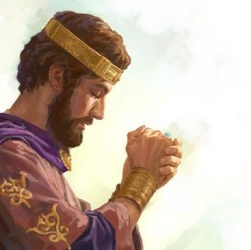
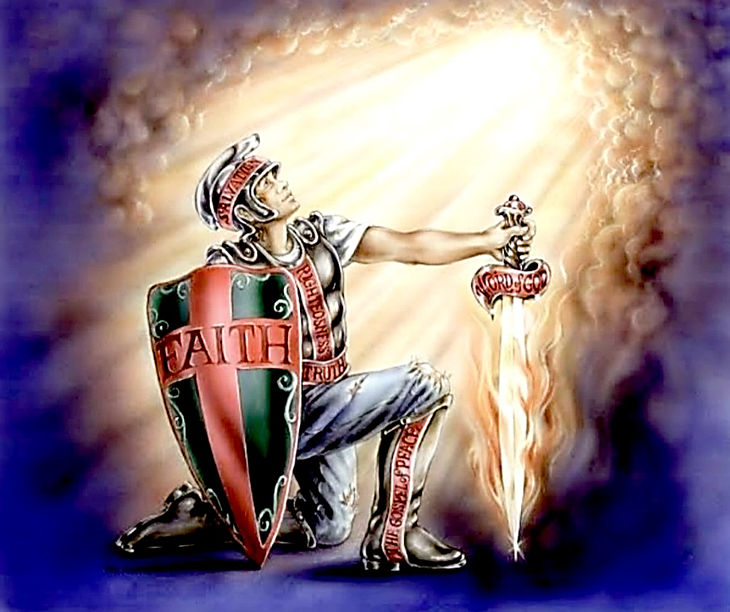
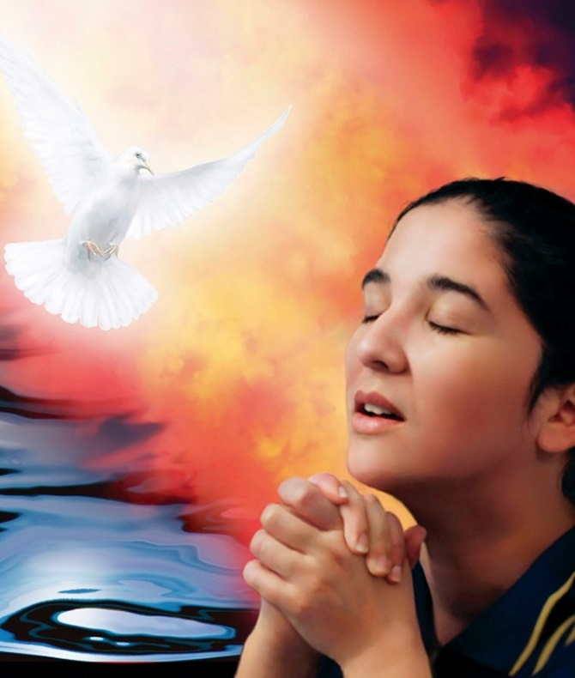
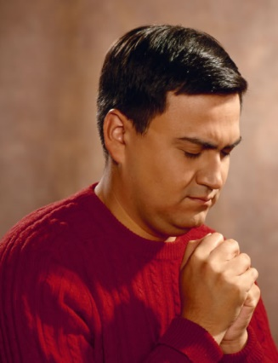
PRAYER
In the face of the impending battle, Jehoshaphat called the people to bow in prayer before God (2 Chronicles 20:18).
Even more so in the spiritual struggle in which we are immersed, prayer plays a primary role. It allows us to connect with our General, presenting our perplexities and receiving His instructions. Paul makes three indications regarding prayer:
How prayer should be:
"At all times." We should never cease to pray, even when we do not see an immediate answer (Lk. 18:1-8; 1 Th. 5:17).
"In the Spirit." The Holy Spirit transforms our prayers with “groanings which cannot be uttered” (Rom. 8:26 NIV).
Whom our prayer helps:
We should supplicate "for all the saints." We are not alone in the fight; we must support one another through intercessory prayer.
Specific requests:
"And for me." Those called to proclaim the gospel especially need the prayers of believers to boldly present the message ("with confidence" NIV).

Slide 12
“We must put on every piece of the armor, and then stand firm. The Lord has honored us by choosing us as His soldiers. Let us fight bravely for Him, maintaining the right in every transaction... Put on as your breastplate that divinely protected righteousness which it is the privilege of all to wear. This will protect your spiritual life […]
All who have put on the robe of Christ's righteousness will stand before Him as chosen and faithful and true. Satan has no power to pluck them out of the hand of the Saviour. Not one soul who in penitence and faith has claimed His protection will Christ permit to pass under the enemy's power.”
E. G. W. (God’s Amazing Grace, January 23)

