Slide 1
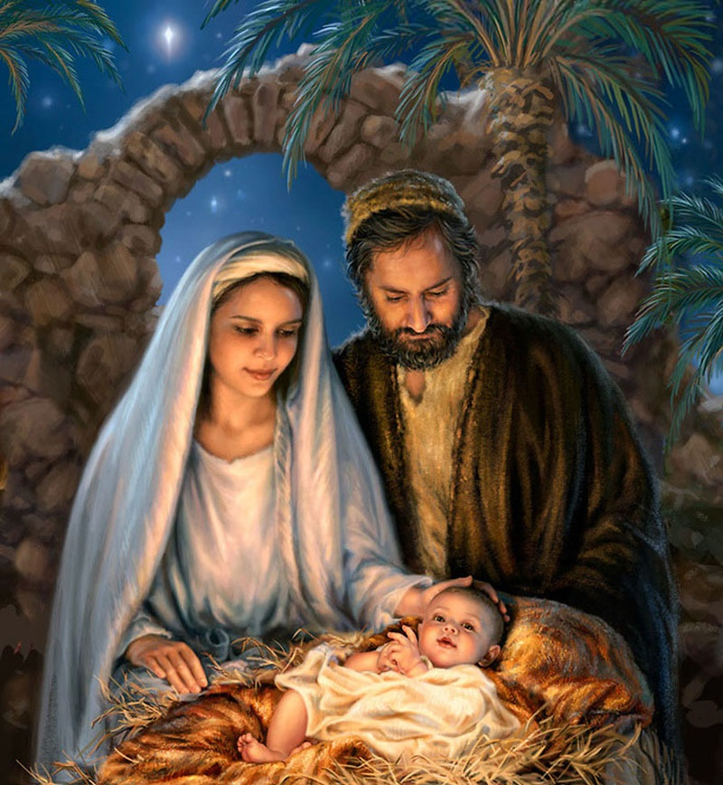
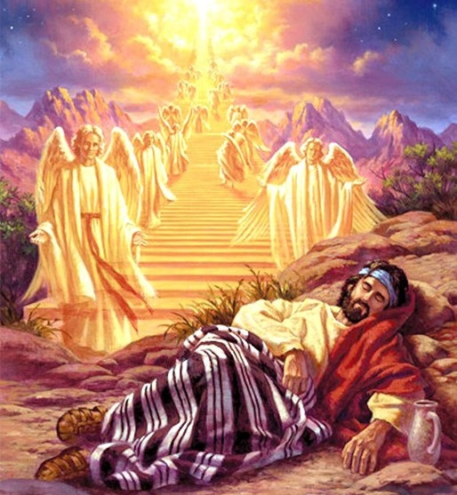
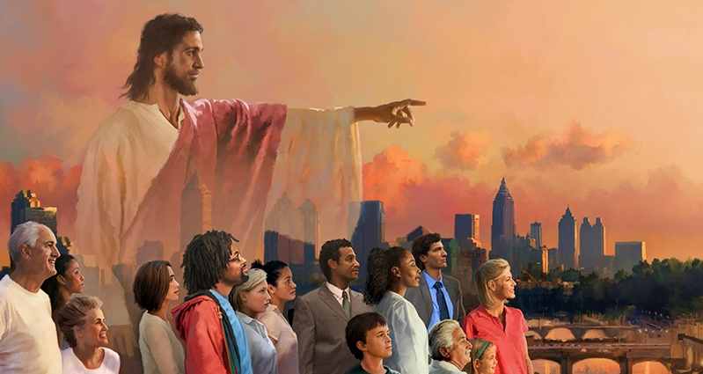
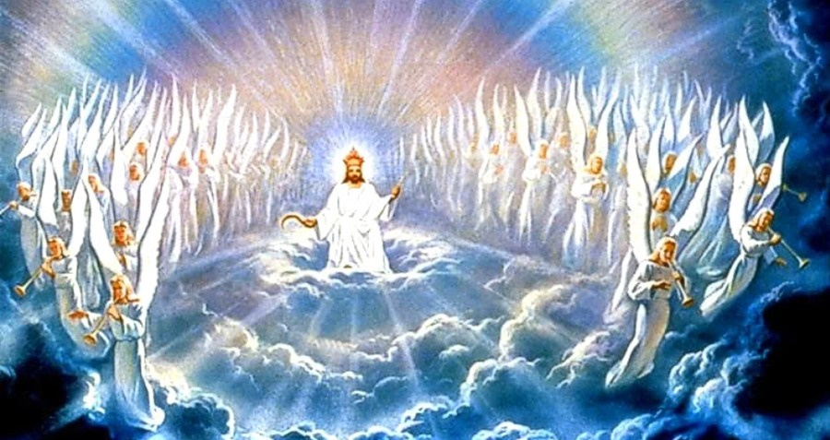
Lesson 1 for October 7, 2023
GOD’S MISSION TO US: PART 1

Slide 2
"But the Lord God called to the man and said to him, 'Where are you?'" (Genesis 3:9)

Slide 3
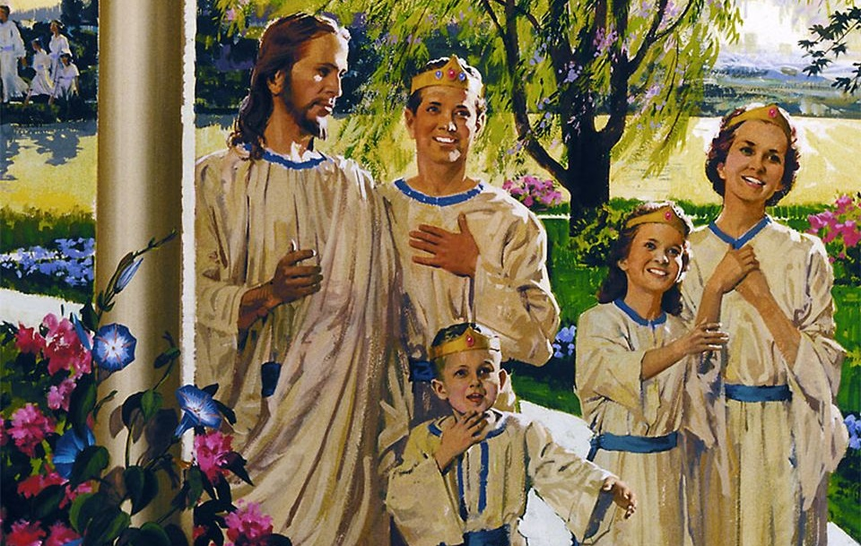
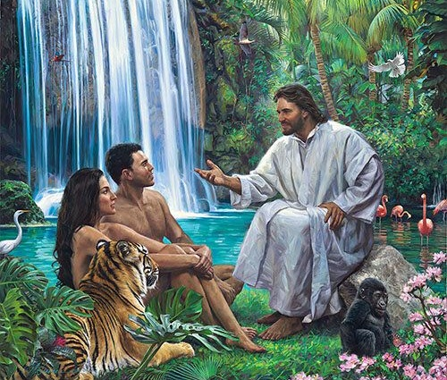
We were created to live eternally with God. However, sin created a gap that completely separated us from His presence.
But God did not give up on His original plan. He refused to be separated from us. Thus, a mission was set: to eradicate sin and restore humanity to its original condition.
The announced mission of God:
God reacts to sin
The active mission of God:
God was with us in the past
God dwelt with us
God is with us today
The fulfilled mission of God:
God will eradicate sin

Slide 4
THE ANNOUNCED MISSION OF GOD

Slide 5
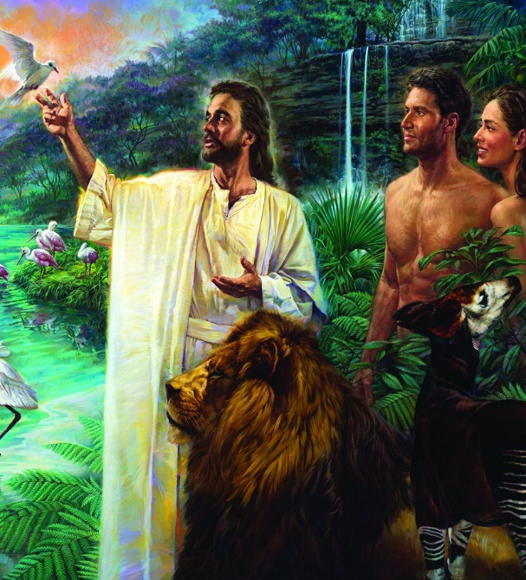
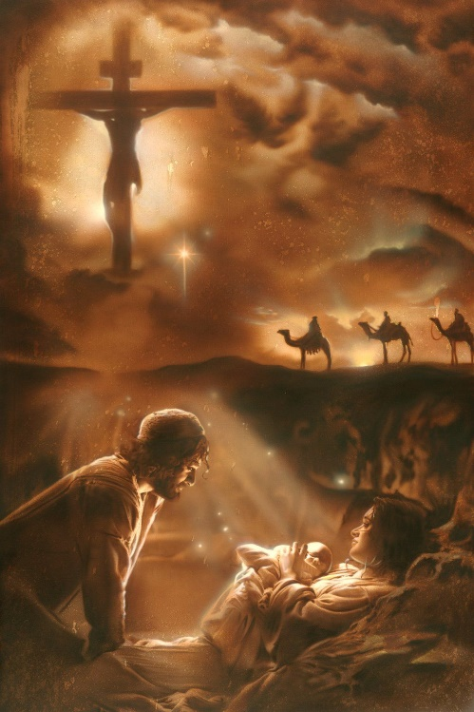
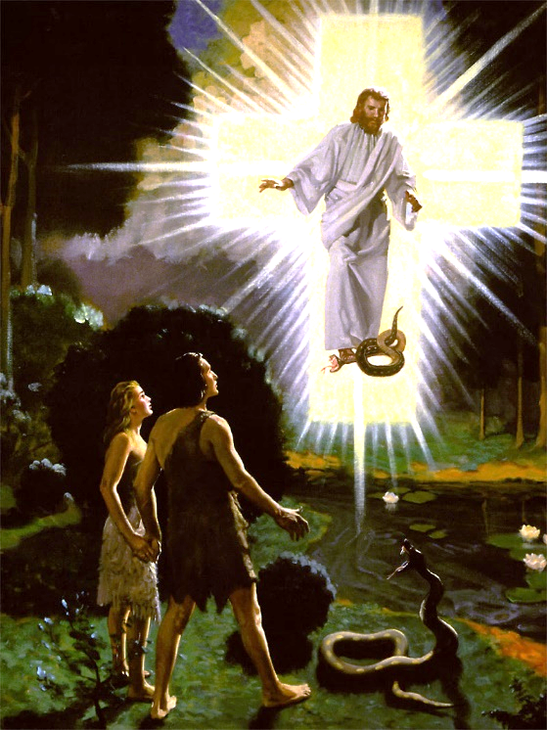
GOD REACTS TO SIN
"But the Lord God called to the man, and said to him, 'Where are you?'" (Genesis 3:9)
From the beginning, God's relationship with humanity is based on love, a divine attribute that He shared with us (1 John 4:16).
This love must be offered willingly and is manifested in obedience to divine laws (John 14:15). Therefore, Adam and Eve's disobedience disrupted our relationship with God (Genesis 2:16-17; 3:12).
But God refused to distance Himself from us. He decided to carry out a mission that was planned to be executed in the case of disobedience (Ephesians 1:4).
Approaching with questions that would make Adam and Eve reflect on their mistake, He encouraged them to acknowledge their error (Gn. 3:9-13). Immediately, He presented His redemptive mission to them (Gn. 3:14-15).

Slide 6
THE ACTIVE MISSION OF GOD

Slide 7
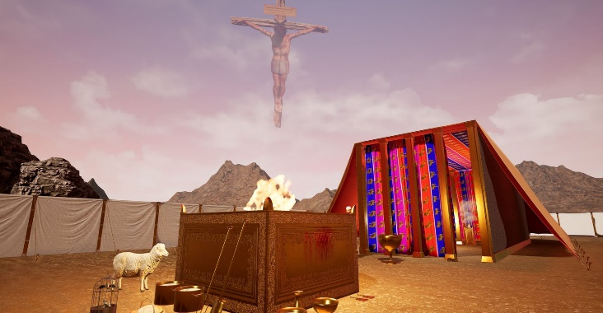
GOD WAS WITH US IN THE PAST
"Behold, I am with you and will keep you wherever you go, and will bring you back to this land. For I will not leave you until I have done what I have promised you." (Genesis 28:15)
The Bible records several occasions when God Himself came down to see humankind (Genesis 11:5; 18:20-21; Exodus 3:7-8). But apart from these specific events, we see that God desired to be personally with us:
With Abraham (Gn. 17:7)
With Isaac (Gn. 26:3)
With Jacob (Gn. 28:15)
With Joseph (Gn. 39:2)
With the people of Israel (Ex. 29:43-45)
God dwelt in the Sanctuary, but through symbols (1 Kings 8:27-30). This was only part of the mission, anticipating its ultimate fulfillment.

Slide 8
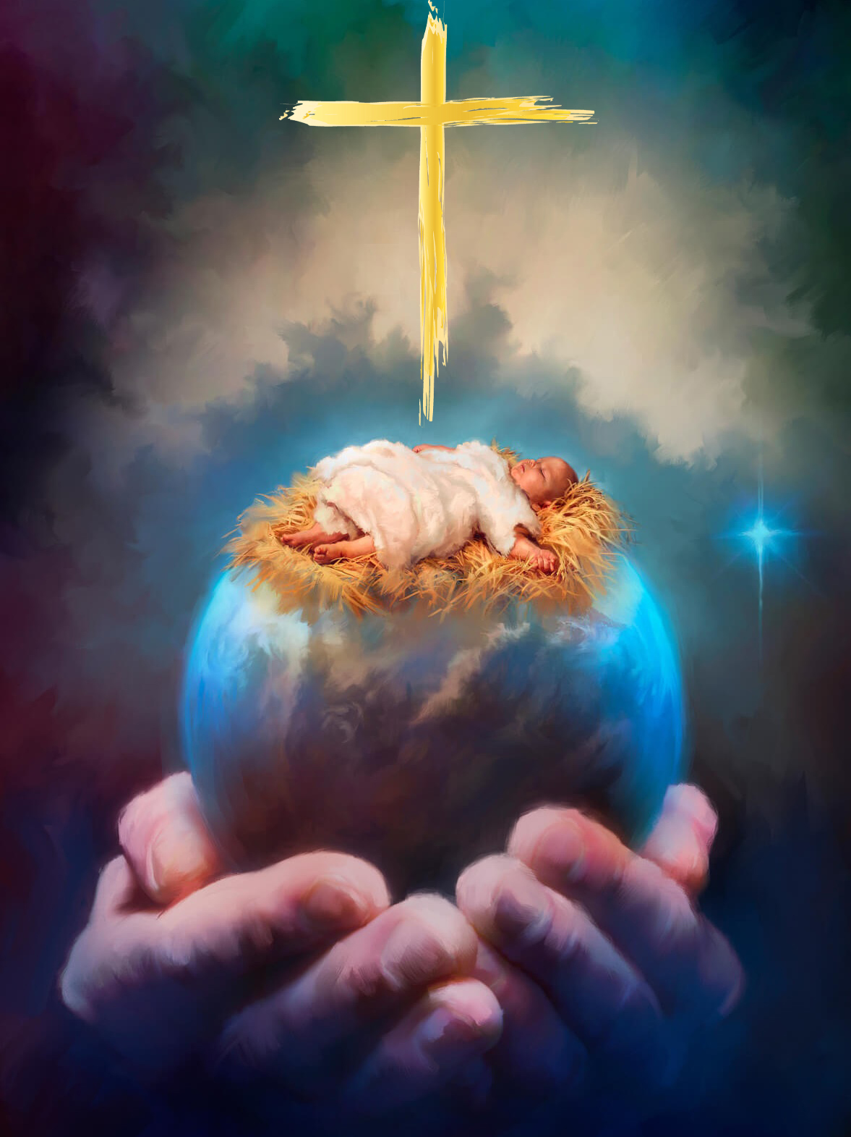
GOD DWELT WITH US
"The Word became flesh and made his dwelling among us." (Juan 1:14 NIV)
God's missionary strategy progressed. It was time to become human and fulfill the promise given in Eden (Galatians 4:4-5).
By incarnating Himself, God presented Himself as "Emmanuel" ["God with us"] (Isaiah 7:14; Matthew 1:21-23). His love and desire to be with us materialized in Jesus, fully human and fully divine (1 John 5:20).
With His life, death, and resurrection, Jesus fulfilled the prophecies of the Old Testament, according to God's previously laid out plan.
On the cross, God's mission reached its climax. Now, the reunion of God with humanity is possible once again. But the mission was not yet complete.

Slide 9
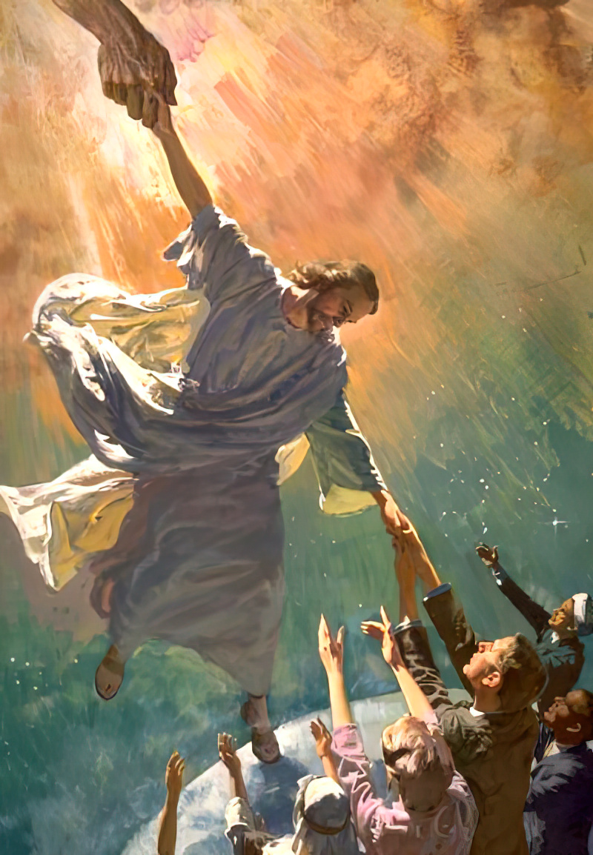
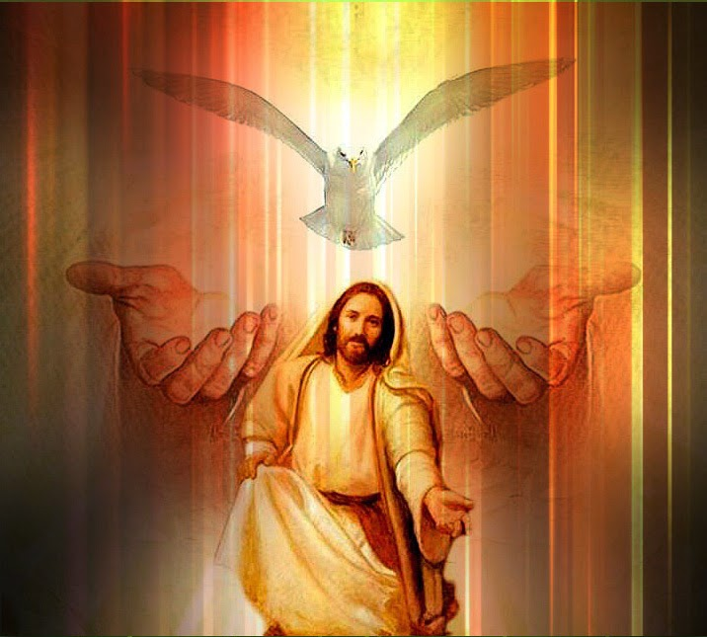
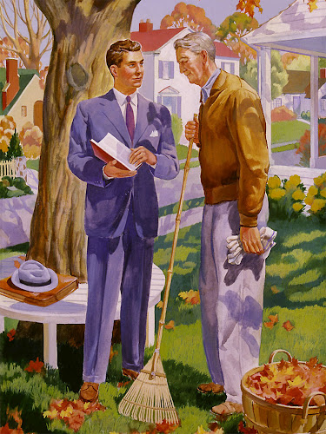
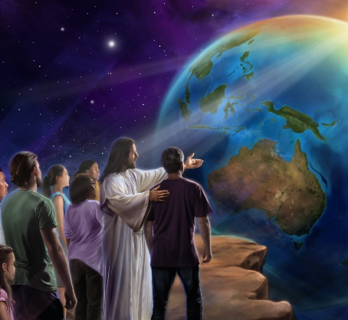
GOD IS WITH US TODAY
"and lo, I am with you always, even to the end of the age. Amen." (Matthew 28:20)
As the "image of the invisible God" (Colossians 1:15), during His ministry, Jesus showed us God's missionary nature: "For the Son of Man has come to seek and to save that which was lost" (Luke 19:10).
When the time came for Him to return to Heaven, He resisted leaving us alone. He assured us that God would continue to be with us in the Person of the Holy Spirit (John 14:16). Thus, He Himself is with us "always, even to the end" (Matthew 28:20).
Along with the promise of His presence, Jesus entrusted us to continue His mission: to seek the sinner and teach them the path of salvation (Matthew 28:18-20).

Slide 10
THE FULFILLED MISSION OF GOD

Slide 11
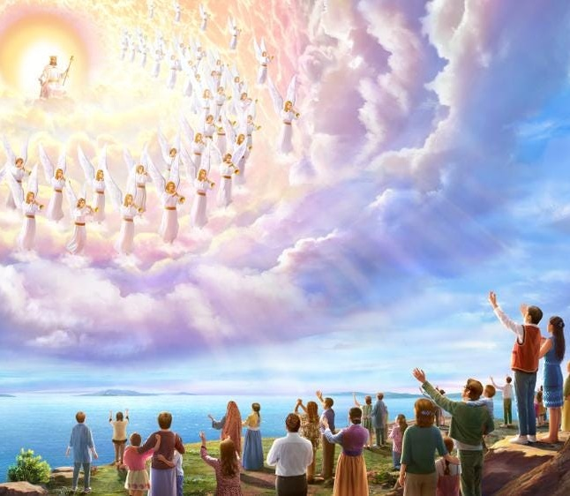
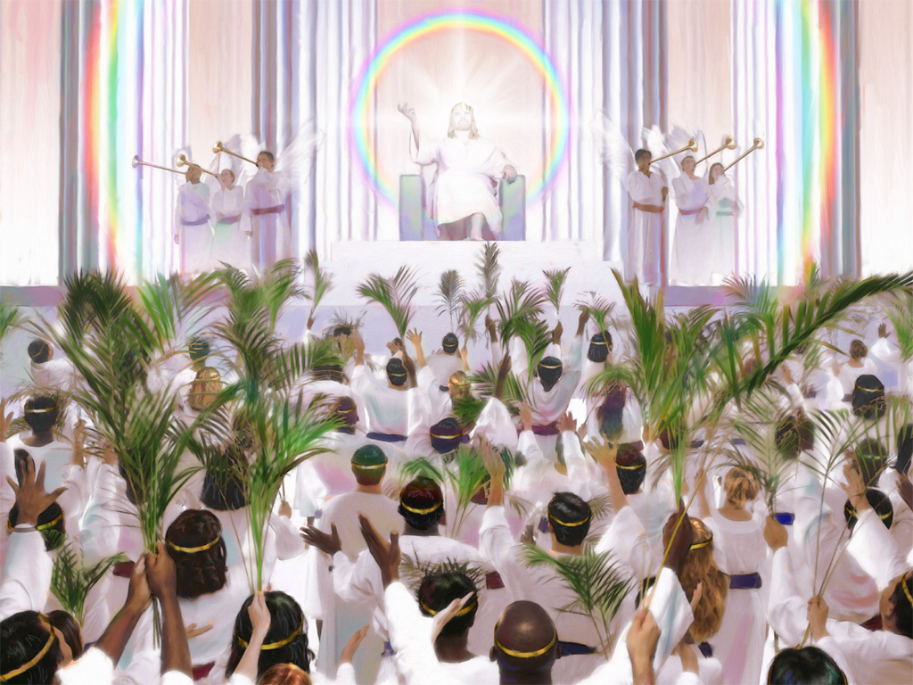
GOD WILL ERADICATE SIN
"so Christ was offered once to bear the sins of many. To those who eagerly wait for Him, He will appear a second time, apart from sin, for salvation." (Hebrews 9:28)
Jesus promised that He would come for us (John 14:1-3). This is known as the "blessed hope" (Titus 2:13). When this happens, God's mission will have been completed.
At that moment, "the tabernacle of God" (the real one, not in images or symbols) will be with us, and God will dwell with us for eternity (Revelation 21:3).
We will be able to see Him face to face again (Revelation 22:4). We will talk with Him and worship Him in person.
The God of mission will finally fulfill His desire to be with His children eternally. What a tremendous privilege to be part of this reality!

Slide 12
"Since Jesus came to dwell with us, we know that God is acquainted with our trials, and sympathizes with our griefs. Every son and daughter of Adam may understand that our Creator is the friend of sinners. For in every doctrine of grace, every promise of joy, every deed of love, every divine attraction presented in the Saviour's life on earth, we see 'God with us.'"
E. G. W. (The Desire of Ages, Cp. 1, p. 24)

Slide 13
WEEKLY CHALLENGE
Pray every day of the coming week for God to open your heart to be part of His mission.
ADVANCED CHALLENGE
Learn the name of someone in your life you don’t already know—a neighbor, coworker, shopkeeper, bus driver, janitor, etc. Begin praying for him or her each day.

