Slide 1
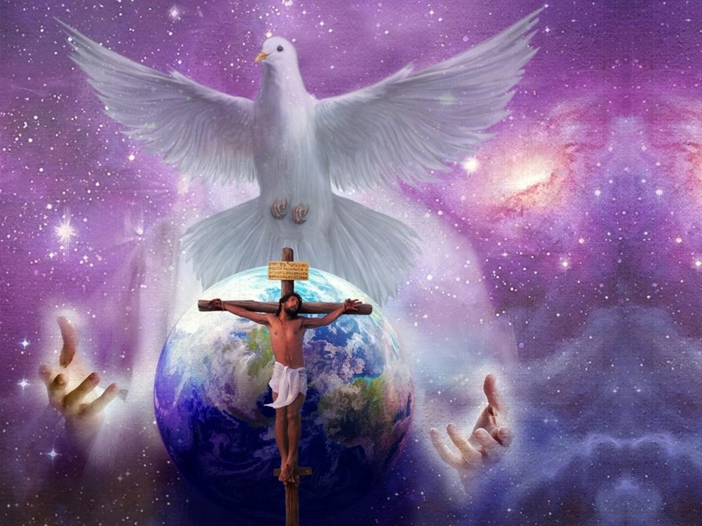
GOD’S MISSION TO US: PART 2
Lesson 2 for October 14, 2023

Slide 2
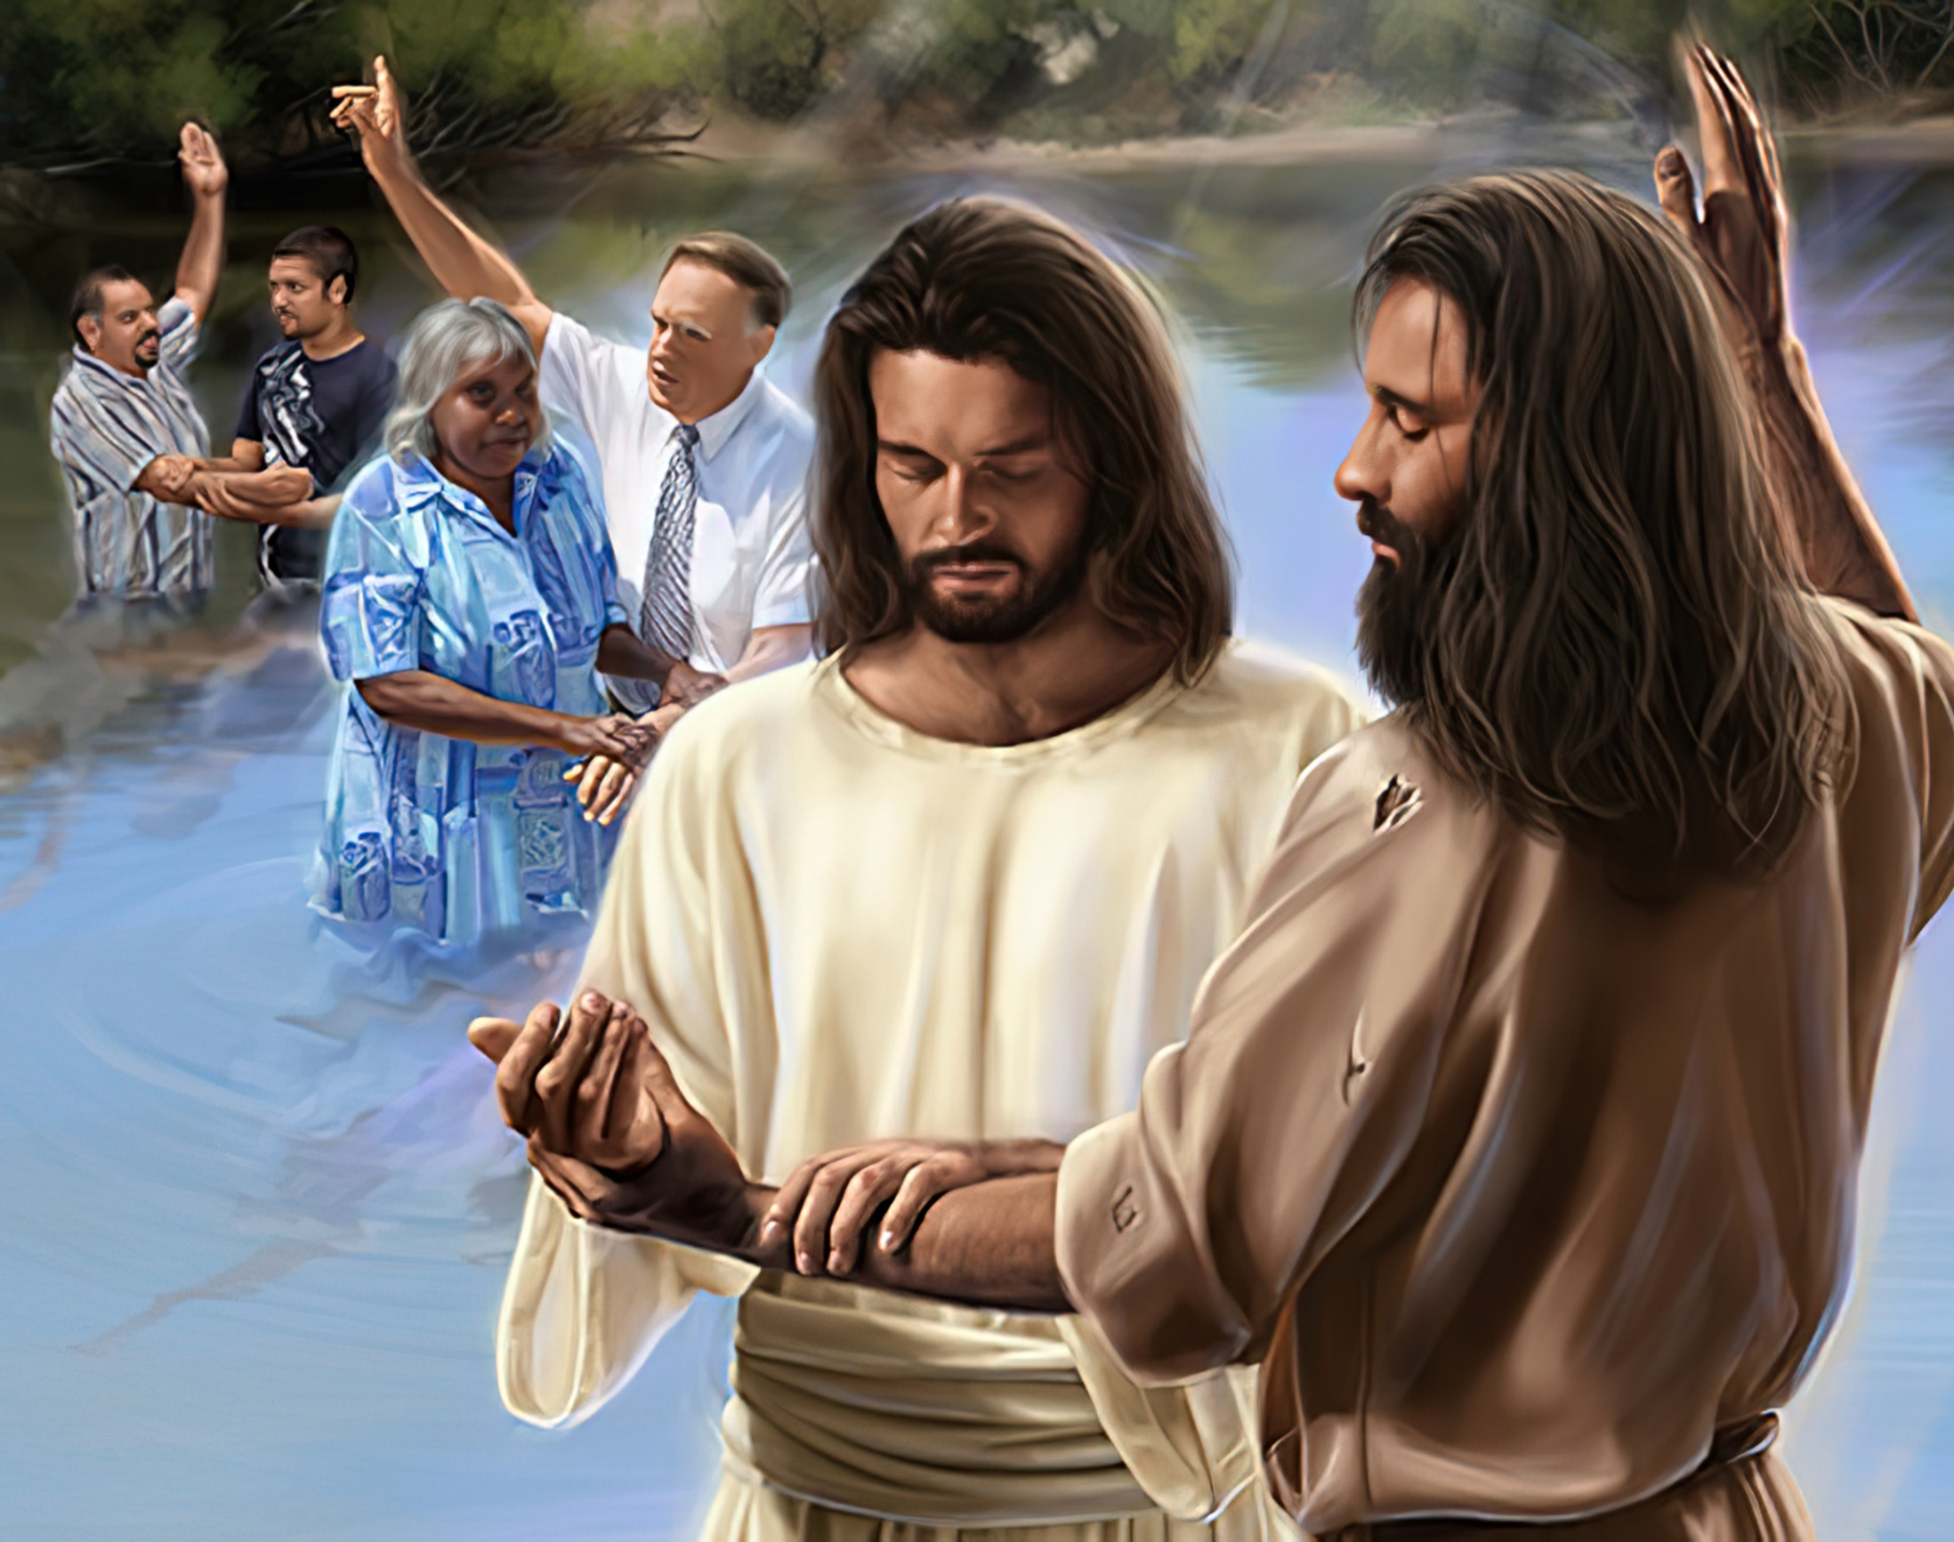
“Go therefore and make disciples of all the nations, baptizing them in the name of the Father and of the Son and of the Holy Spirit”
Matthew 28:19

Slide 3
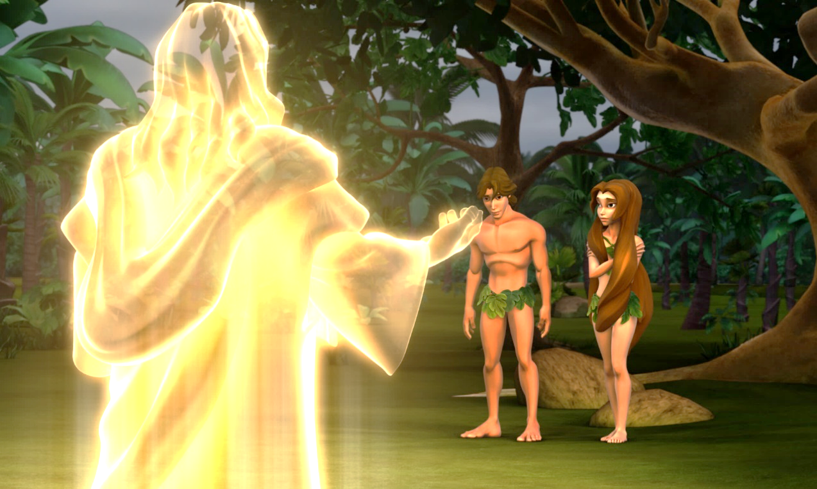
Since sin entered the world, God set out on a mission to restore His image in His children and mend the relationship with them, bringing humanity back to its state of purity and eliminating every trace of evil.
We will examine the nature and purpose of this mission and how God is carrying it out.
GOD'S MISSION ON OUR BEHALF
The Origin
The Triune God
The Focus
Making Disciples
The Message
The Eternal Gospel
The Channels
The People of God
The Recipients
The Whole World

Slide 4
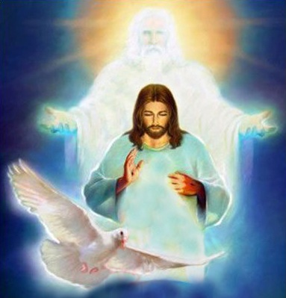
THE ORIGIN: THE TRIUNE GOD
“Just as the Father sent me, I am sending you. And with that, he breathed on them and said, 'Receive the Holy Spirit.’” (John 20:21-22)
The Father sends the Son to redeem us and promises to send us the Holy Spirit (John 3:16; Luke 24:49).
The Son fulfills the Father's will and asks Him to send us the Holy Spirit (John 4:34; 14:16).
The Holy Spirit continues the work initiated by the Father, leads us to the Son, and helps us fulfill our part in the mission (John 14:26; Acts 1:8).
The mission to restore humanity is carried out through the plan of salvation. This plan was conceived by God and set in motion by Him.
Each person of the Deity has a role in this plan:

Slide 5
“The Godhead was stirred with pity for the race, and the Father, the Son, and the Holy Spirit gave Themselves to the working out of the plan of redemption. In order fully to carry out this plan, it was decided that Christ, the only-begotten Son of God, should give Himself an offering for sin […] With Christ He gave all the resources of heaven, that nothing might be wanting in the plan for man's uplifting. Here is love—the contemplation of which should fill the soul with inexpressible gratitude! […] It will lead the disciple to deny self, take up the cross, and follow the Redeemer.”
E. G. W. (Counsels on Health, p. 222)

Slide 6
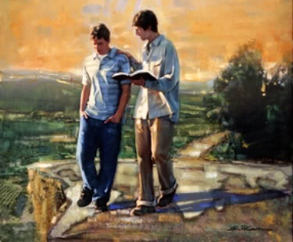
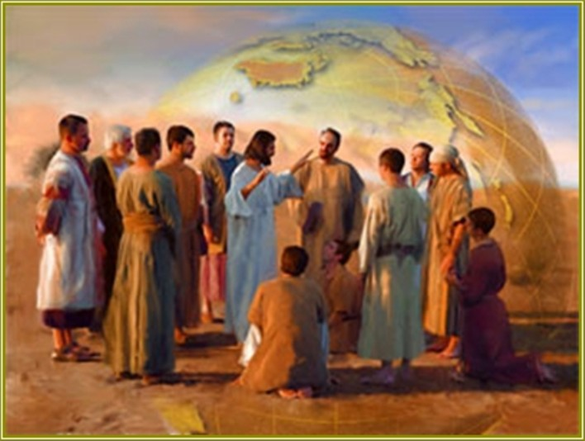
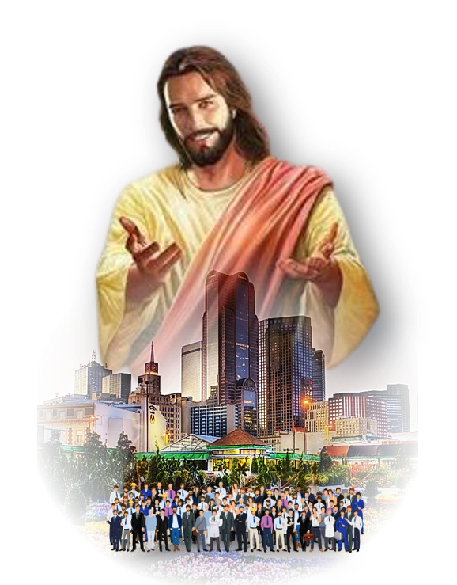
THE FOCUS: MAKING DISCIPLES
“Go, then, to all peoples everywhere and make them my disciples” (Matthew 28:19 GNT)
The primary goal of the mission is to make disciples, meaning that there should be people who share with the world what Jesus has done for them (Matthew 28:16-20).
Those who accept the message are baptized and taught to observe all that Jesus has commanded.
Neither the eleven individuals commissioned for this mission nor the 120 who received the power to carry it out could reach the entire world. It had to reproduce exponentially: one disciple begets several disciples who, in turn, beget new disciples.
The Father determined that with the presence of Jesus and the power of the Holy Spirit, we would take the gospel to every human being on our planet (Matthew 28:20; Acts 1:8).

Slide 7
THE MESSAGE: THE ETERNAL GOSPEL
“Then I saw another angel flying in the midst of heaven, having the everlasting gospel to preach to those who dwell on the earth—to every nation, tribe, tongue, and people.” (Rev. 14:6)
What is the eternal gospel that we must preach to the entire world?
Jesus came to our world and lived a perfect life (Acts 10:38)
He died on the cross to bear our sins (Isaiah 53:5; 1 Peter 3:18)
He rose, ascended to Heaven, and was exalted by the Father (Acts 2:32-33)
He currently intercedes for us in the heavenly sanctuary (Hebrews 7:25)
He will return to take us in glory to Heaven (1 Thessalonians 4:16-17)
Finally, He will establish God's kingdom on Earth (Revelation 21:1-4)
Our duty as disciples is to be prepared and prepare others so that, at the second coming of Jesus, we can be restored to the image of God and live eternally with Him.

Slide 8
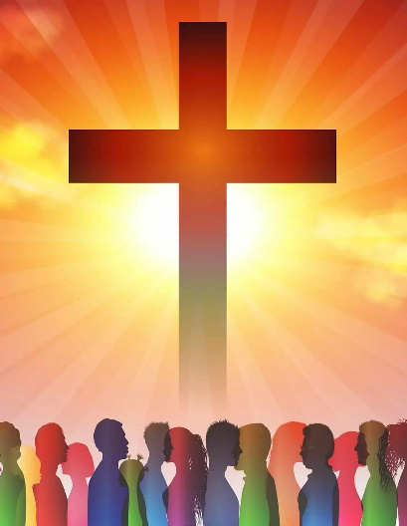
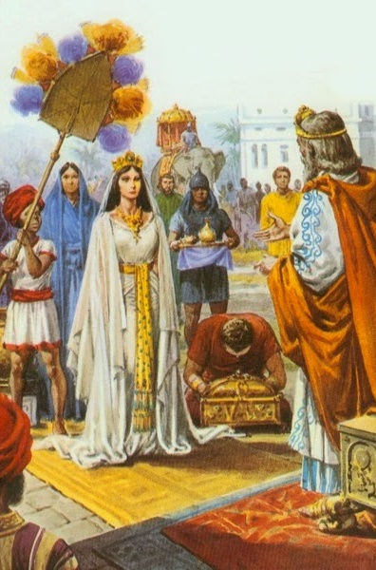
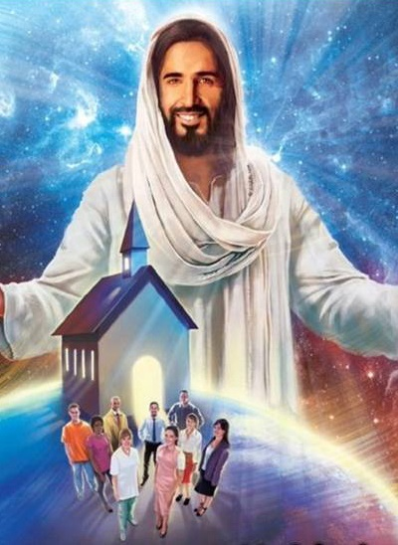
THE CHANNELS: THE PEOPLE OF GOD
“so that if I am delayed, you will know how people must conduct themselves in the household of God. This is the church of the living God, which is the pillar and foundation of the truth.” (1 Timothy 3:15)
The mission is not carried out by isolated disciples. God gathers His disciples into one body: the people of God.
In the Old Testament, the people of God were the Israelites—the descendants of Abraham—through whom all the world was to be blessed (Genesis 12:1-3). The missionary strategy was for the world to come to Israel to know God (Deuteronomy 4:6; Isaiah 49:6, 22).
Today, the people of God are the Church (Acts 2:47; Colossians 1:18). But, as we have seen, the missionary strategy has changed: we are to go out into the world and share the gospel (Matthew 28:19).

Slide 9
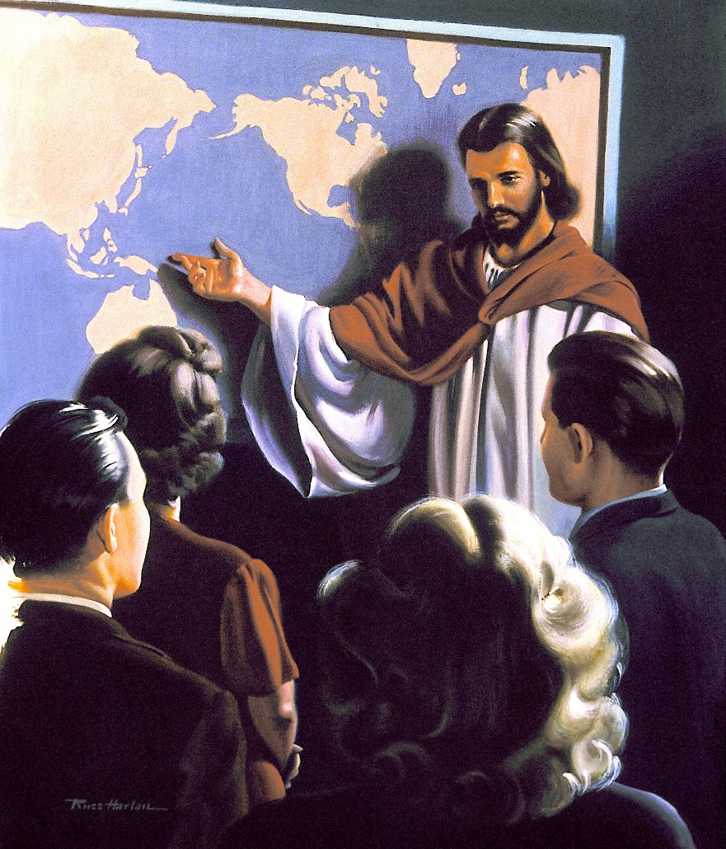
THE RECIPIENTS: THE WHOLE WORLD
“But you will receive power when the Holy Spirit comes upon you. And you will be my witnesses, telling people about me everywhere—in Jerusalem, throughout Judea, in Samaria, and to the ends of the earth.” (Acts 1:8)
The preaching of the gospel occurs at various levels:
Jerusalem
Judea
Samaria
The ends of the earth
Your family, your close friends
Your acquaintances, your workplace, your neighborhood
Your city, your country
Missions, the Internet, TV, books, ...
God’s mission calls us to reach individuals from all places, nations, people groups, languages, and ethnicities. This is our ultimate place of mission.

Slide 10
“The Saviour's commission to the disciples included all the believers. It includes all believers in Christ to the end of time. It is a fatal mistake to suppose that the work of saving souls depends alone on the ordained minister. All to whom the heavenly inspiration has come are put in trust with the gospel. All who receive the life of Christ are ordained to work for the salvation of their fellow men. For this work the church was established, and all who take upon themselves its sacred vows are thereby pledged to be co-workers with Christ.”
E. G. W. (The Desire of Ages, Cp. 86, p. 822)

Slide 11
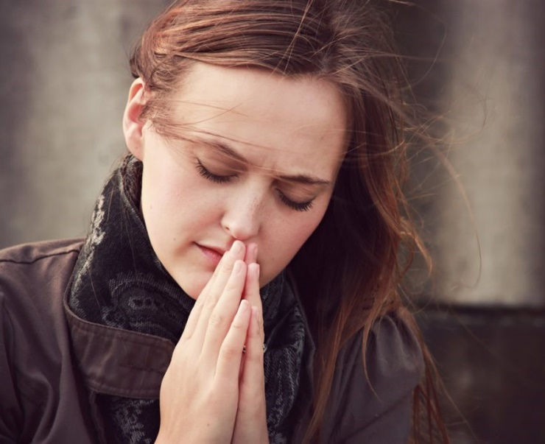
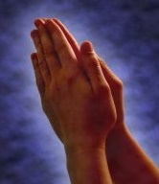
WEEKLY CHALLENGE
Pray every day this week for the community where you live. God has placed you there for a reason.
ADVANCED CHALLENGE
Research the demographics of your area (what kind of people live around you)—ethnic and religious background, old, young, poor, wealthy, languages spoken, and so on. Ask God to show you how you may be a channel of His love to them.

