Slide 1
GOD'S CALL TO MISSION
Lesson 3 for
October 21 ,2023

Slide 2
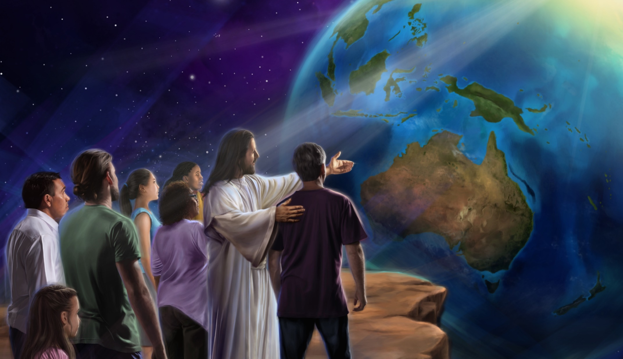
“But you will receive power when the Holy Spirit comes on you; and you will be my witnesses in Jerusalem, and in all Judea and Samaria, and to the ends of the earth” (Acts 1:8)

Slide 3
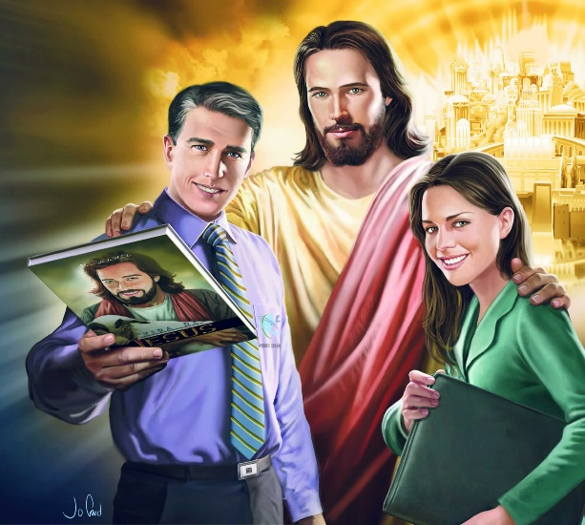
After the big flood, God gave humanity a second chance, and gave them specific instructions (Gen. 9:1).
The whole Earth was to be filled with the knowledge of God, and all people were to await the coming of the Savior.
Given the failure to follow His instructions, God called various people to fulfill the mission of making the message of salvation known. You are one of those people. If you accept the mission, you may wonder: “where to start?”
God's call to mission
Reasons for rejecting the mission.
The purpose of the mission.
Fulfilling the mission:
The example of Abraham.
Get out of the comfort zone.
Where to start?

Slide 4
GOD'S CALL TO MISSION

Slide 5
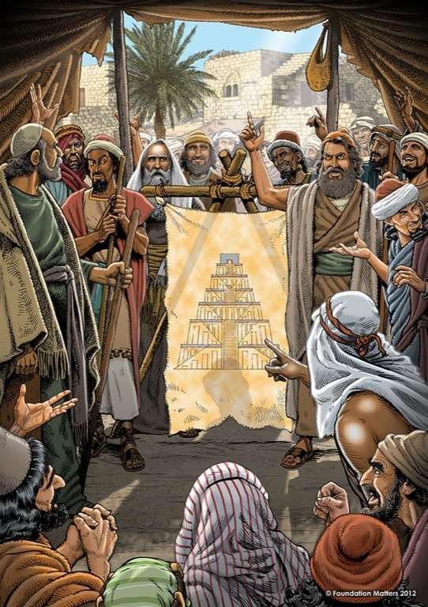
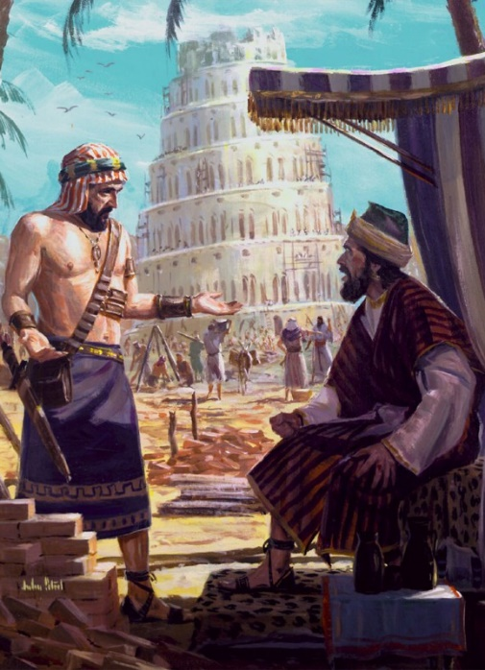
REASONS FOR REJECTING THE MISSION
“And they said, Come, let us build ourselves a city and a tower, whose top will reach to heaven; and let us make a name for ourselves, lest we be scattered over the face of the whole earth” (Genesis 11:4)
God's command was clear: “fill the earth” (Gen. 9:1). But those who survived the flood had other plans (Gen. 11:1-4):
They did not want to obey God by spreading themselves over the Earth
They did not trust God's promise not to send a new flood
They trusted in their own salvation effort (“a tower”)
They wanted to achieve fame (“a name”)
They were united in purpose. They had created their comfort zone and felt comfortable in it. They became disobedient, distrustful, self-sufficient and proud. Can you be immersed in a comfort zone that prevents you from carrying out God's mission?

Slide 6
THE PURPOSE OF THE MISSION
“I will make you into a great nation, and I will bless you;
I will make your name great, and you will be a blessing” (Genesis 12:2 NIV)
He promised to save us from sin (Gen. 3:15)
He chose Abraham's descendants to fulfill his promise (Gen. 17:19)
He chose Jacob, Judah and David (Nm. 24:17; Gn. 49:10; 2S. 7:16)
He announced the place of the birth of the Savior (Mic. 5:2)
He indicated the exact date of his appearan ce (Dn. 9:24-27)
Finally, the promise was fulfilled in Jesus (Mt. 1:21)
God had a specific plan for humanity:
From Eve to Jesus, God chose various people to whom he assigned the mission of blessing humanity with the good news of salvation (although, perhaps, they did not understand all that this entailed). God invites you to continue blessing the world by proclaiming the gospel.

Slide 7
FULFILLING THE MISSION

Slide 8
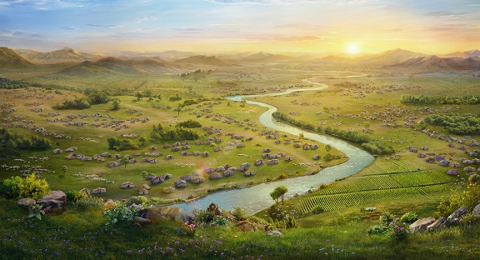
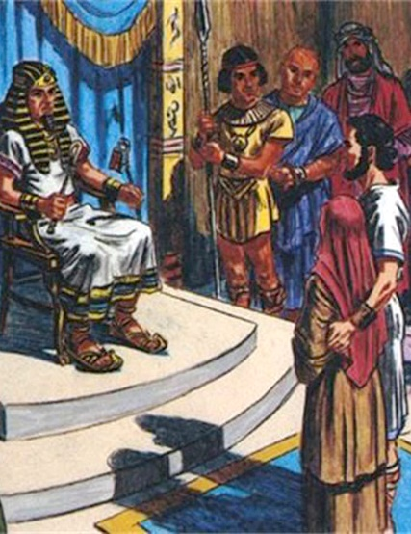
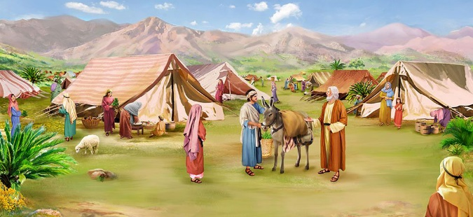
ABRAHAM'S EXAMPLE
“He took his wife Sarai, his nephew Lot, […] and they set out for the land of Canaan, and they arrived there” (Genesis 12:5)
God assigned Abraham a mission and a territory to carry it out. Obediently, he went to the place God indicated to him (Gen. 12:1-5).
But things were not easy. The difficulties overwhelmed him to the point of abandoning his place in the mission (Gen. 12:10). As his faith failed, he made more mistakes (Gen. 12:11-13).
Patiently, God “pushed” him to return to Canaan (Gen. 12:17-20). He hadn't abandoned him; He was still counting on him. Despite his mistakes, God forgave Abraham and gave him another chance (and a few more).
God sends you to fulfill his mission. You may fail or make mistakes at some point, but He is patient and merciful. It restores you, and continues to count on you.

Slide 9
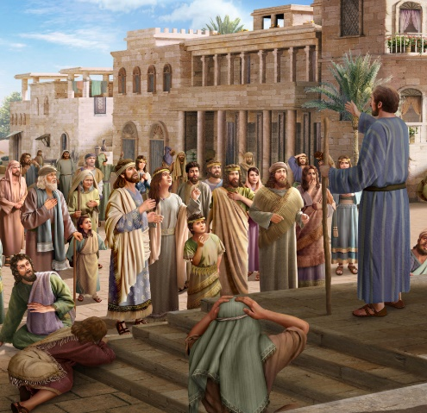
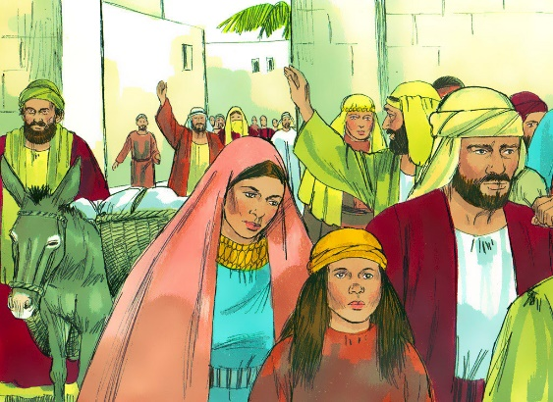
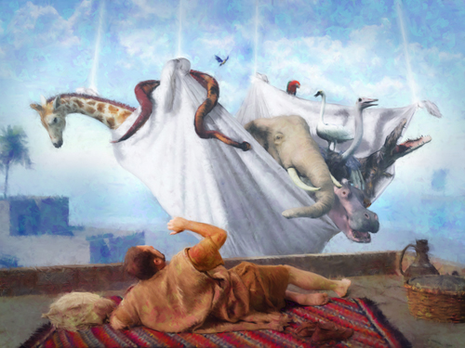
LEAVE THE COMFORT ZONE
“At that time a great persecution arose against the church which was at Jerusalem; and they were all scattered throughout the regions of Judea and Samaria, except the apostles” (Acts 8:1)
After its success in Jerusalem, the church seemed to have no intention of expanding further (Acts 2:41; 4:4). It was his comfort zone.
Because of the persecution instigated by Saul, the believers were scattered and carried the mission to Judea, Samaria and other places; However, their vision of the mission was still limited (Acts 8:1, 4; 11:19).
Peter himself believed it was an abomination to speak the gospel to Gentiles, so God had to perform a miracle on him (Acts 10:28).
Like Peter, sometimes we will have to put aside our comfort, or our personal feelings and opinions, in order to correctly fulfill the mission that God has assigned to us.

Slide 10
WHERE TO START?
“and you shall be witnesses to Me in Jerusalem, and in all Judea and Samaria, and to the end of the earth”
(Acts 1:8)
The mission is to be witnesses of Jesus. That is, in telling “what we have seen and heard” about Jesus (Acts 4:20). How do I do it?
Acts 1:8 gives us the guideline. First of all, starting with my comfort zone: my home, my family, my friends [Jerusalem]. Next, we must expand that area and extend ourselves to people we don't trust as much [Judea], even those we don't like [Samaria].
As we are led by the Holy Spirit, we may be called to cross physical, cultural, ethnic, etc. boundaries. The limit: “to the ends of the earth.”

Slide 11
“With the help of God, every true believer can see where there is work to be done. When the human will cooperates with the will of God, it becomes omnipotent, and the worker can make opportunities […] If you will go to work in earnest, ways will open before you for the accomplishment of this work. Lean upon the divine arm for wisdom, strength, and skill for the work that God has given you to do.”
EGW (Our High Calling, October 19)

Slide 12
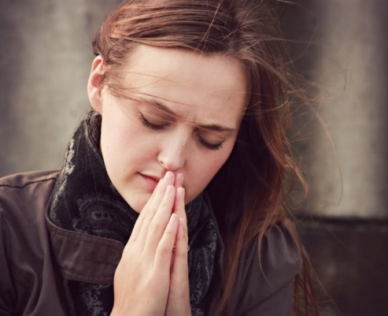
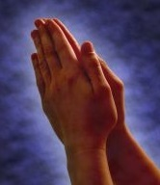
WEEKLY CHALLENGE
Identify and list groups of people with special needs in your community which the church has not made efforts to reach.
ADVANCED CHALLENGE
Begin praying for an opportunity, in the near future, to engage in mission with people with special needs.

