Slide 1
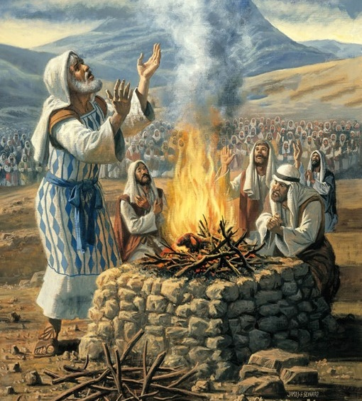
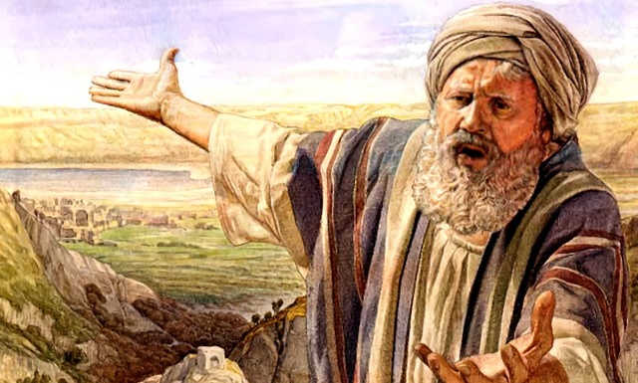
SHARE
GOD'S MISSION
Lesson 4
for October 28, 2023

Slide 2
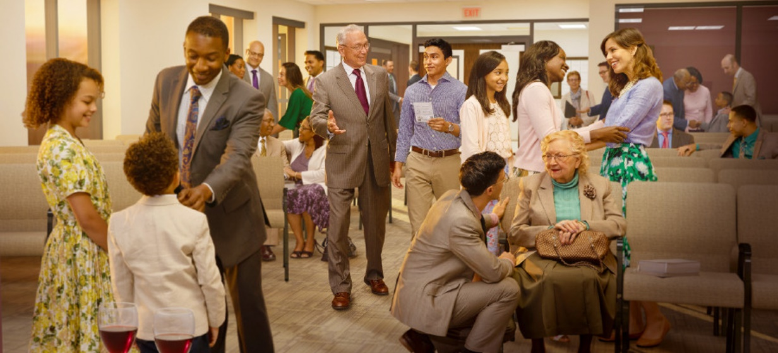
“A new commandment I give you: that you love one another. May they love each other as I have loved you. By this all will know that you are My disciples, if you have love for one another.” (John 13:34,35)

Slide 3
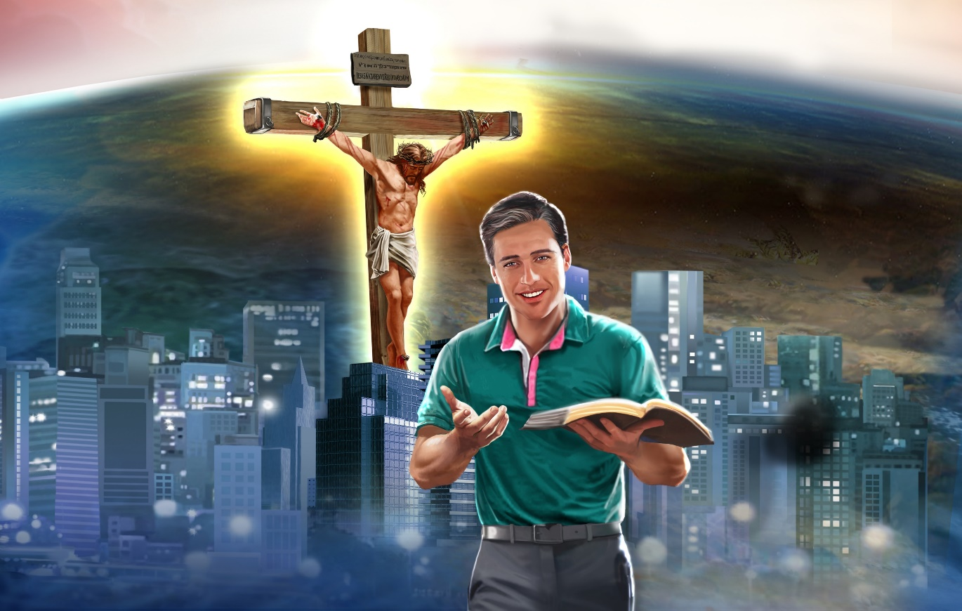
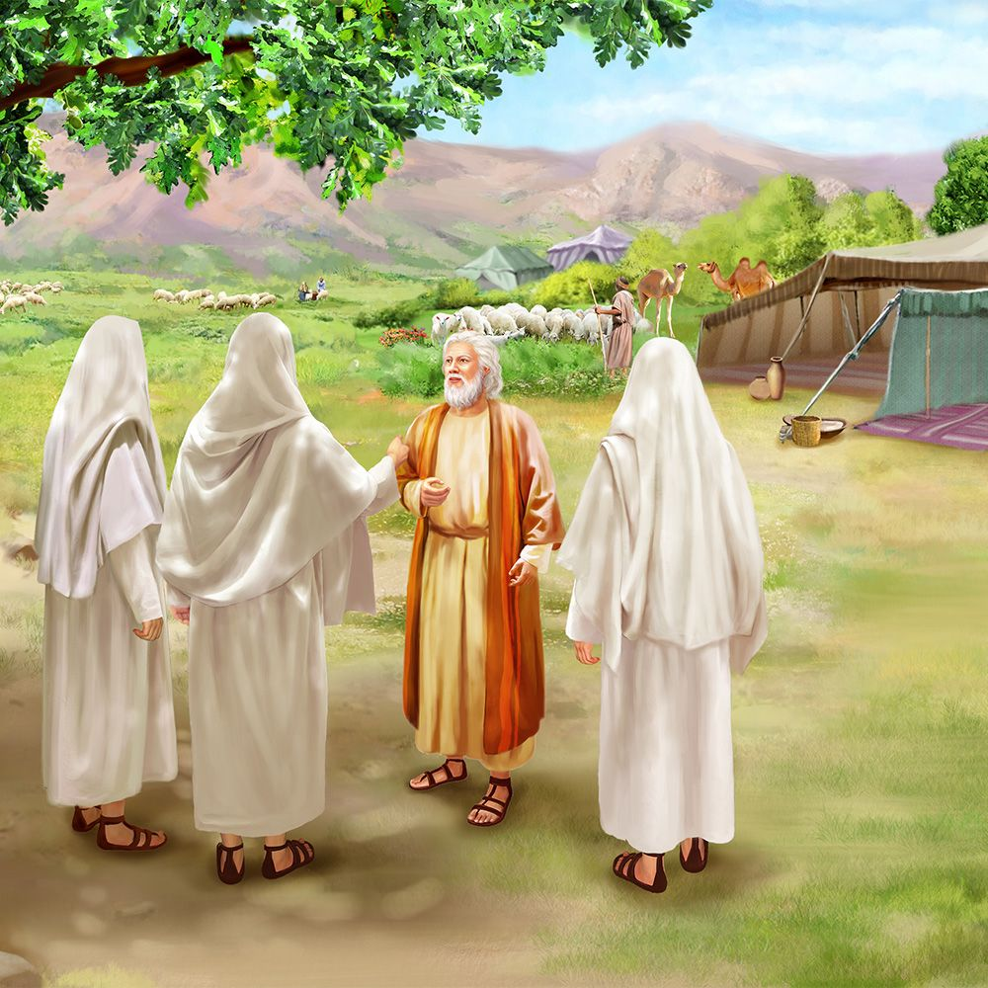
God's mission is to save humanity.
To achieve his purpose, He has assigned each of us a part in fulfilling that mission.
Through the example of Abraham, we will study some of the ways in which we can share God's mission.
Sharing God's mission:
Hospitality (Gen. 18:1-15).
Love for others (Gen. 18:16-23).
Intercessory prayer (Gen. 18:24-33).
Mission results:
Accept individual decisions (Gen. 19:1-29).
Submit to the divine will (Gen. 12:1-9).

Slide 4
SHARING GOD'S MISSION

Slide 5
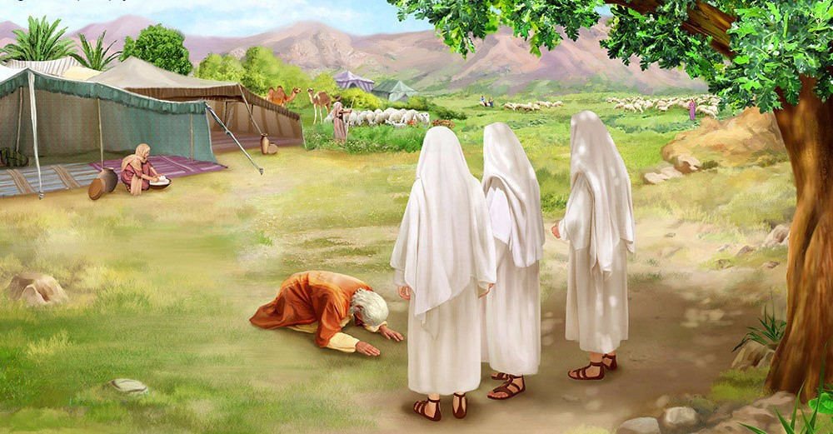
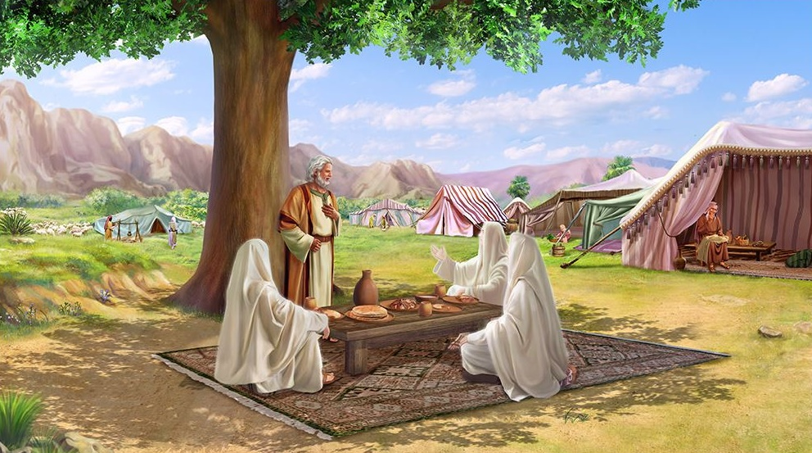
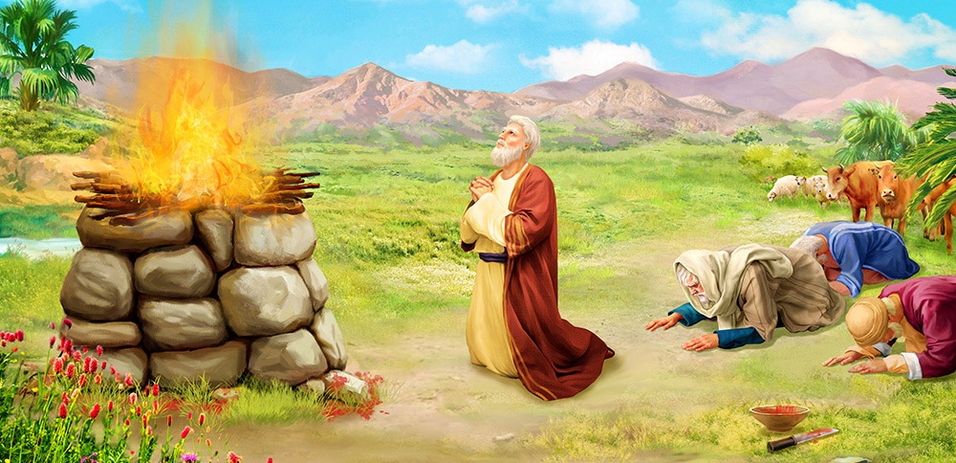
THE HOSPITALITY
“Do not forget hospitality, for by it some have hosted angels without knowing it” (Hebrews 13:2)
Sitting in the shade of the door of his tent, Abraham saw three people pass by him. Immediately, he ran towards them. He did not wait for them to request his hospitality (if they intended to do so), but took the initiative and offered them what he had (Gen. 18:1-8).
Abraham wanted to satisfy, to the best of his ability, the needs of those with whom he interacted – not only the material ones, but also the spiritual ones. Therefore, he built an altar wherever he went (Gen. 12:7-8; 13:18).
In this way, he became a blessing to those around him. An example to imitate.

Slide 6
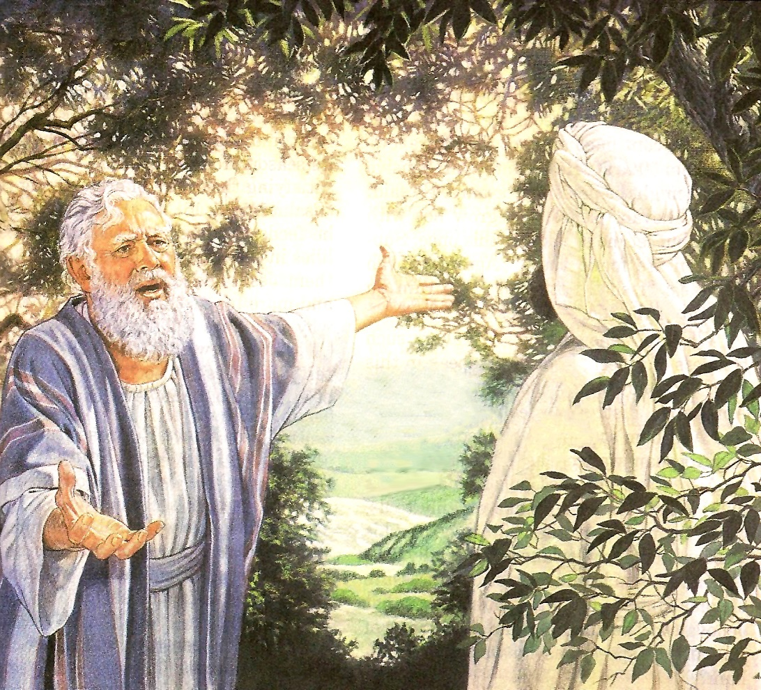
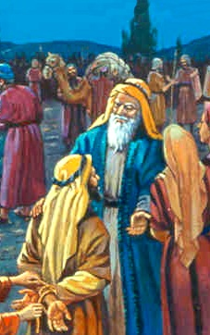
LOVE FOR OTHERS
“And Abraham came and said: Will you also destroy the righteous with the wicked?” (Genesis 18:23)
Who was Abraham worried about, the righteous or the wicked (Gen. 18:23)?
Abraham had had the opportunity to meet the inhabitants of Sodom when he rescued them from Chedorlaomer and accompanied them back to their city (Gen. 14:14-16, 21). He knew they were wicked. He also knew that a righteous family dwelt among them (2 Pet. 2:7).
God knew Abraham's heart, so he explained his plans to him, and waited for his reaction (Gen. 18:17-21).
If Abraham had not loved the wicked inhabitants of Sodom, he would have said: “Rescue my nephew, do not let him perish with the wicked.” But that wasn't what he asked for.
We are to love others because God died for them, and there is still hope that, at some point in their lives, they will accept salvation.

Slide 7
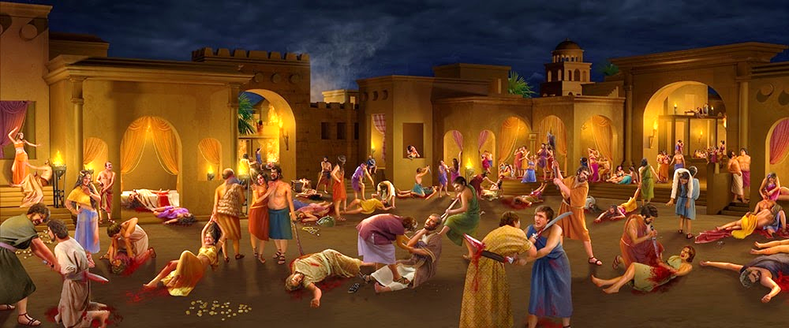
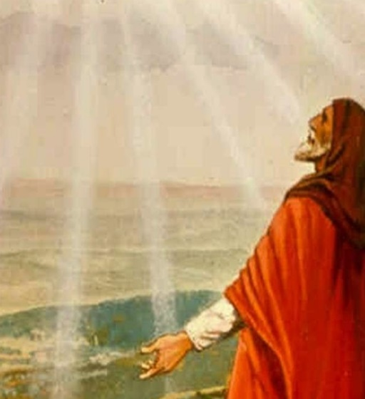
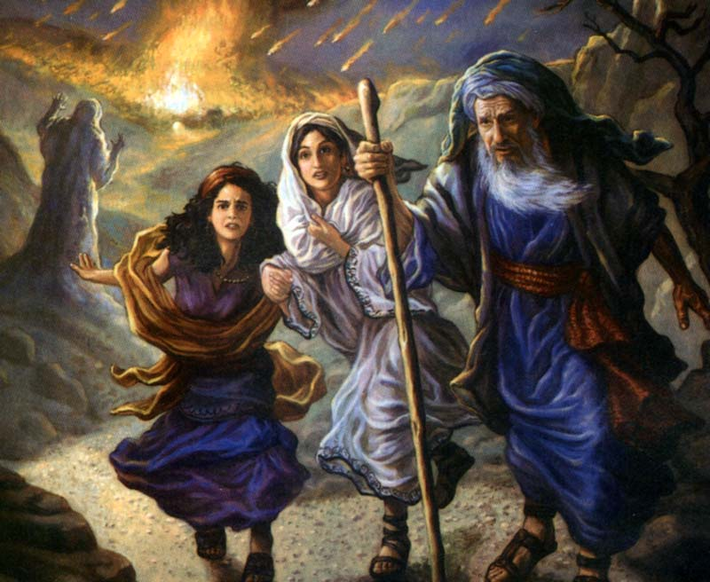
INTERCESSORY PRAYER
“Confess your trespasses to one another, and pray for one another, that you may be healed. The effective, fervent prayer of a righteous man avails much” (James 5:16)
Upon hearing the sentence on Sodom and the surrounding cities, Abraham interceded with God on behalf of its unworthy inhabitants (Gen. 18:24).
Surely among them there are fair people who do not deserve to die. Maybe 50… 45… 40… 30… 20… 10? (Gen. 18:25-32).
Actually, there were 4 (minus 1). And God spared an entire city – Zoar – for their love (Gen. 19:20-21)! That was the answer to Abraham's intercessory prayer.
We must intercede for those with whom we are in contact, not only for their physical needs, but also for their conversion.

Slide 8
MISSION RESULTS

Slide 9
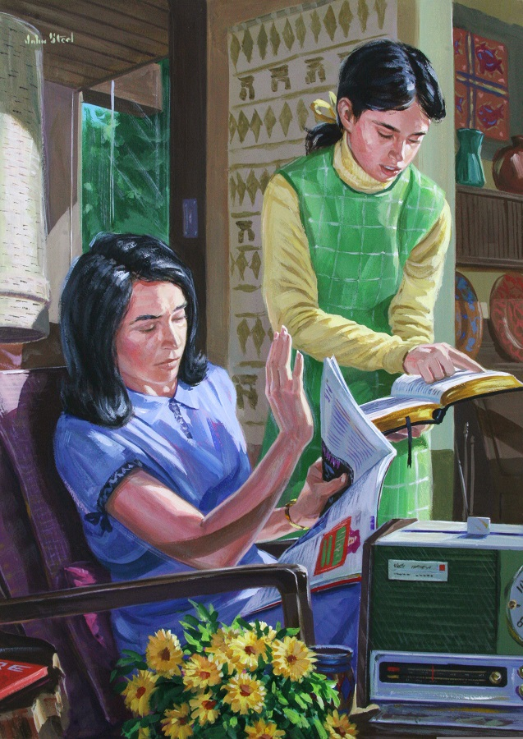
ACCEPT INDIVIDUAL DECISIONS
“Far be it from You to do such a thing as this, to slay the righteous with the wicked, so that the righteous should be as the wicked; far be it from You! Shall not the Judge of all the earth do right?” (Genesis 18:25)
ABRAHAM
Interceded for others (Gen. 18:24)
Sitting at the door (Gen. 18:1)
He received the angels (Gen. 18:2)
He invited them to eat (Gen. 18:5)
LOT
Sitting at the door (Gen. 19:1a)
He received the angels (Gen. 19:1b)
He invited them to eat (Gen. 19:3)
Interceded for others (Gen. 19:14)
Notice the similarities between Lot's behavior and Abraham's:

Slide 10
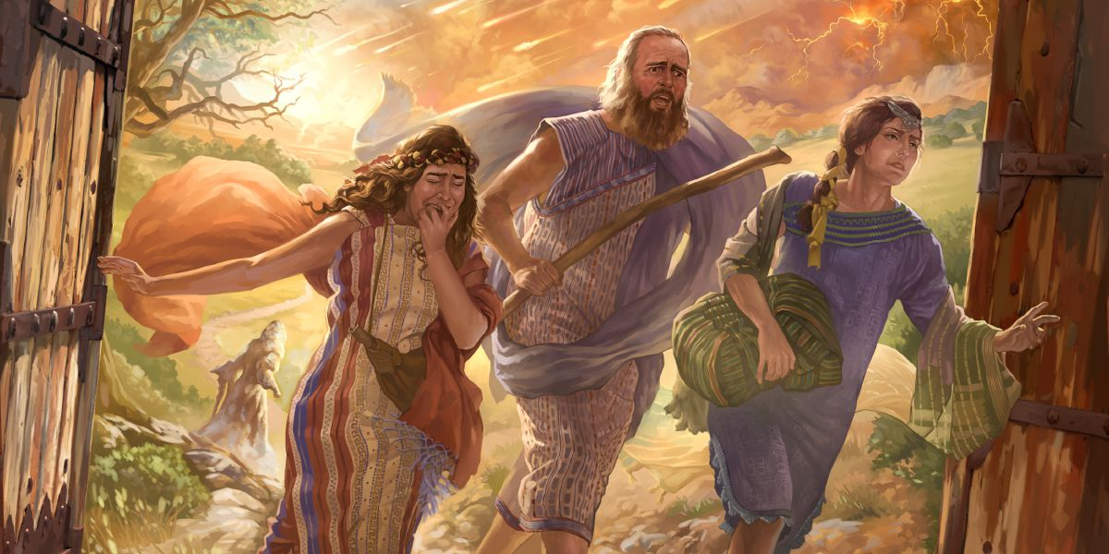
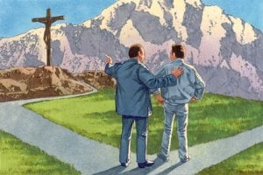
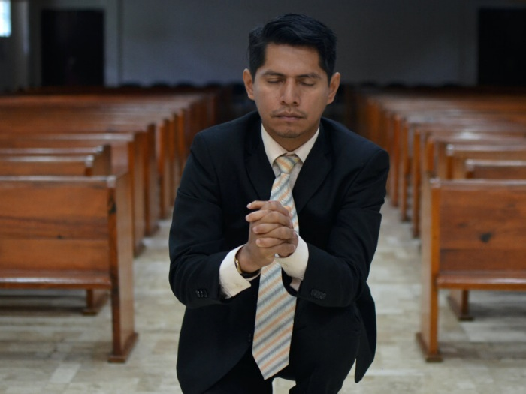
ACCEPT INDIVIDUAL DECISIONS
“Far be it from You to do such a thing as this, to slay the righteous with the wicked, so that the righteous should be as the wicked; far be it from You! Shall not the Judge of all the earth do right?” (Genesis 18:25)
Abraham interceded for Sodom, but only 3 people survived. Lot interceded for his sons, daughters, and sons-in-law, but only 2 daughters survived.
Was the intercession of these righteous men a failure? No.
God will not save anyone against their own will. Salvation depends on each person's choice.
However, intercessory prayer offers opportunities for change that would not otherwise be offered.

Slide 11
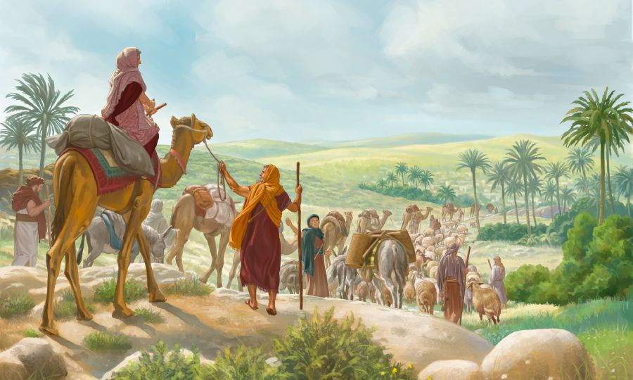
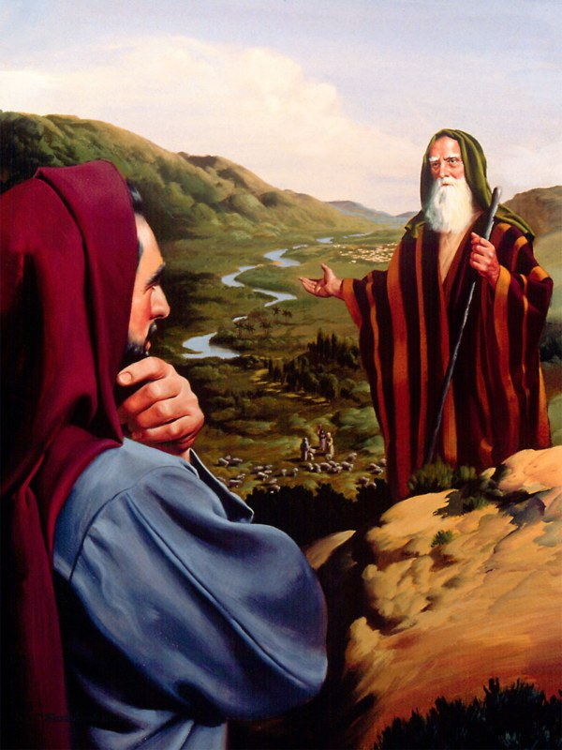
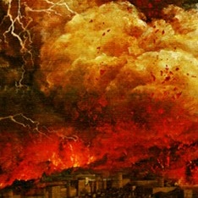
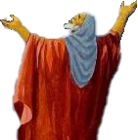
SUBMIT TO THE DIVINE WILL
“And Abraham went up in the morning […] And he looked towards Sodom and Gomorrah, […] and, behold, the smoke was rising from the earth like the smoke of a furnace” (Genesis 19:27-28)
When God called him to go to Canaan and be a blessing to the world, Abraham obeyed (Gen. 12:1-5). He did not ignore the call, nor did he give it any ifs or buts.
Having to separate from his nephew, he let him choose the territory, knowing that God would fulfill his will in any case (Gen. 13:8-12, 14-15).
After his intercessory prayer for Sodom, Abraham left the next morning hoping to see his request fulfilled. But what he saw was destruction (Gen. 19:27-28).
There were no complaints from him. Once again he submitted to the divine will. We must always accept God's will, even if it differs from ours.

Slide 12
“Love for perishing souls inspired Abraham's prayer. While he loathed the sins of that corrupt city, he desired that the sinners might be saved. His deep interest for Sodom shows the anxiety that we should feel for the impenitent. We should cherish hatred of sin, but pity and love for the sinner”
EGW (Patriarchs and Prophets, pg. 140)

Slide 13
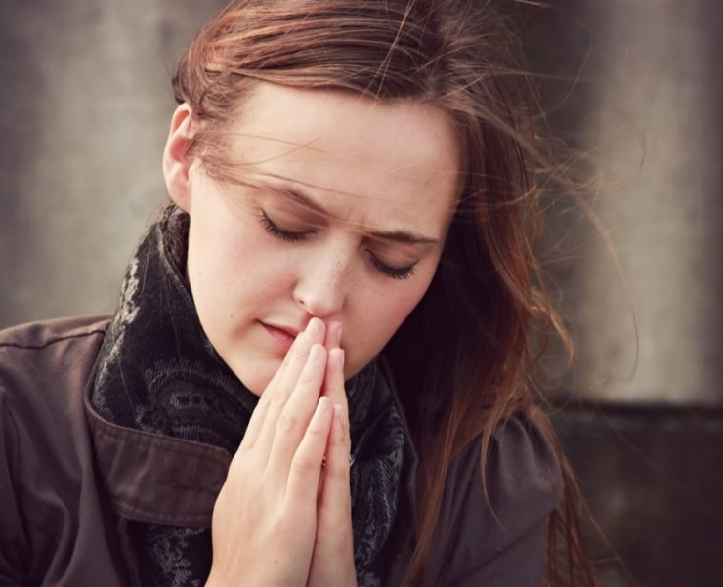
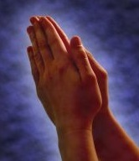
WEEKLY CHALLENGE
In our cities we face obstacles to preaching the gospel appropriately and effectively. We need to beg God to intervene.
ADVANCED CHALLENGE
Find a way to connect with someone who is going through a difficult situation similar to yours. Tell the person you are praying for them and ask God to show you what you can do to help them.

