Slide 1
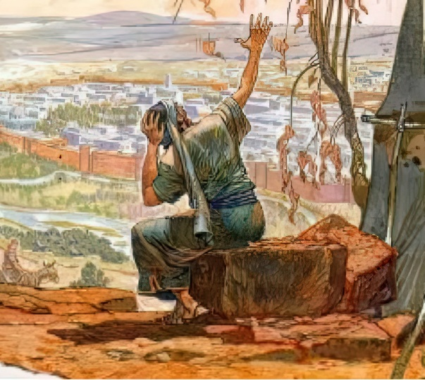
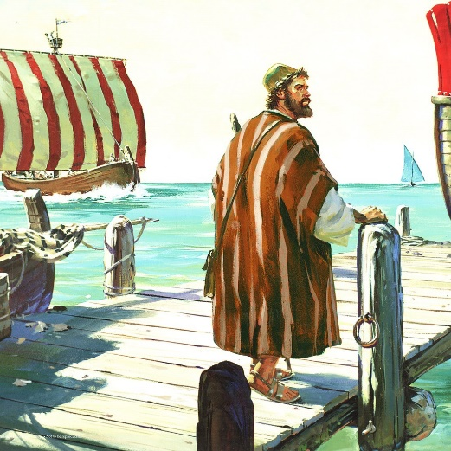
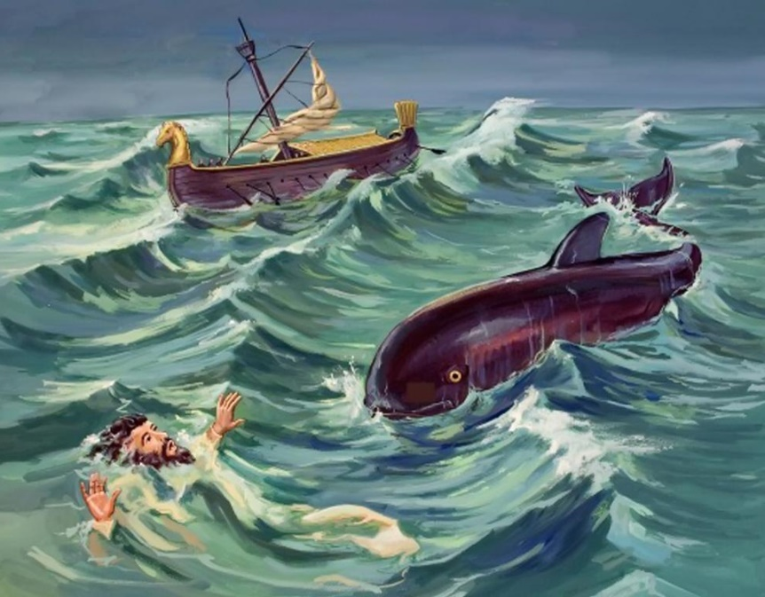
EXCUSES TO AVOID MISSION
Lesson 5 for November 4, 2023

Slide 2
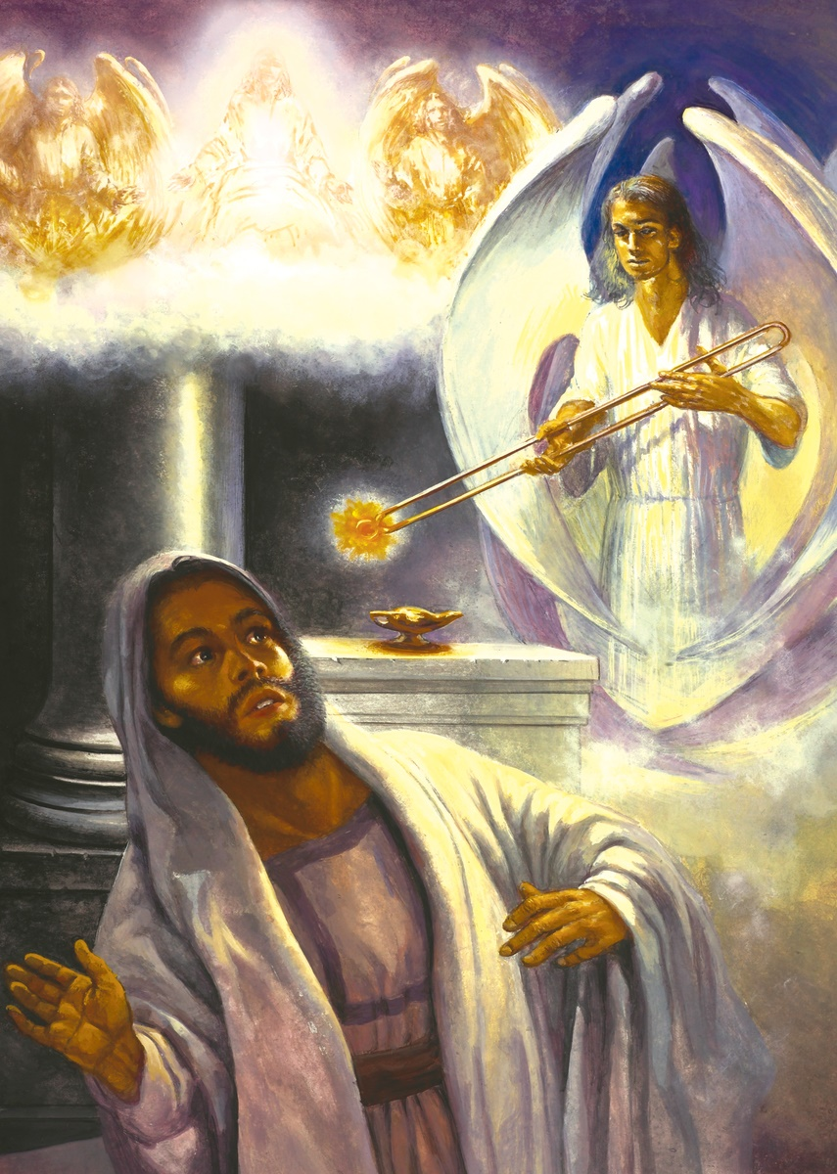
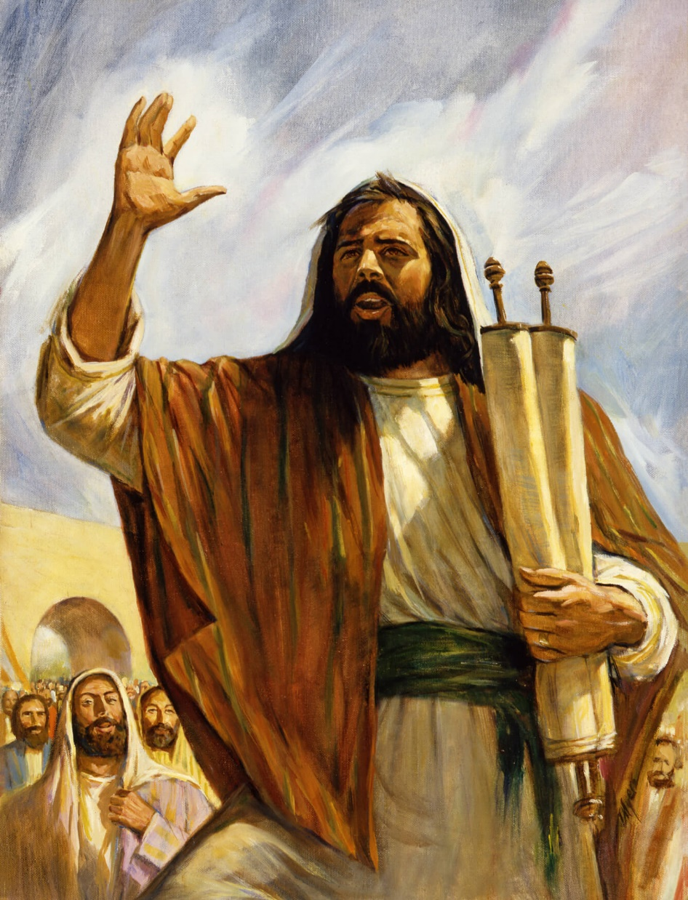
Also I heard the voice of the Lord, saying:
“Whom shall I send,
and who will go for Us?”
Then I said, “Here am I! Send me”
(Isaiah 6:8)

Slide 3
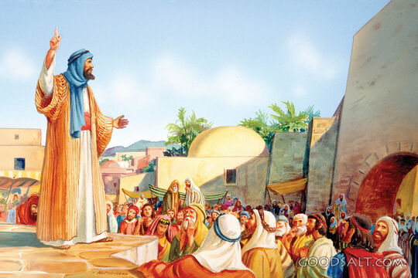
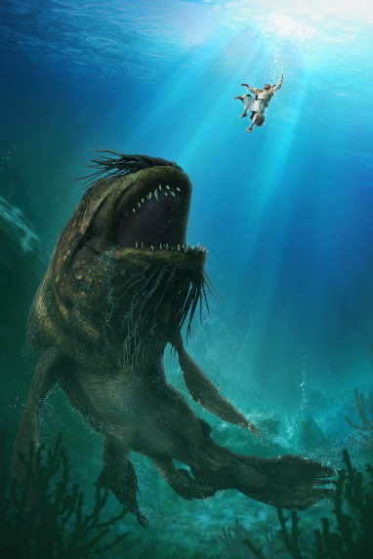
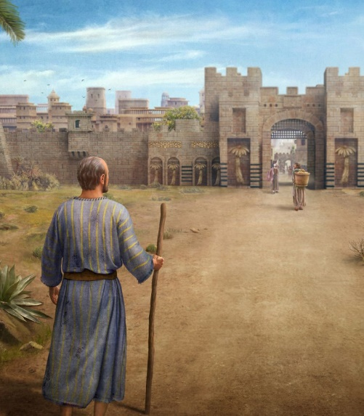
Jonah was considered a successful prophet. He had prophesied peace and it had been fulfilled (Jer. 28:9; 2K. 14:25).
However, when God asked him to go as a missionary to distant lands, he panicked and shied away from the mission.
But God did not abandon him. Little by little he worked with him to bless him and make him a source of blessing.
Excuses to avoid mission:
Fear (Jonah 1).
Misconceptions (Jonah 2).
Lack of spirit of sacrifice (Jonah 3).
Cognitive distortions (Jonah 4).
Obey without excuses:
“Here am I, send me” (Isaiah 6:1-8).

Slide 4
EXCUSES TO AVOID MISSION

Slide 5
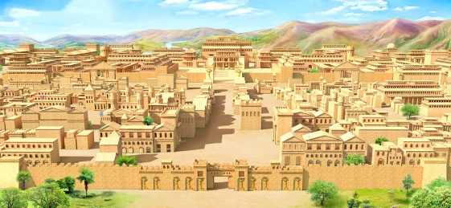
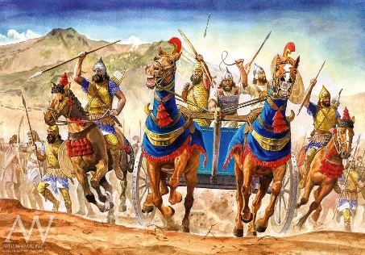
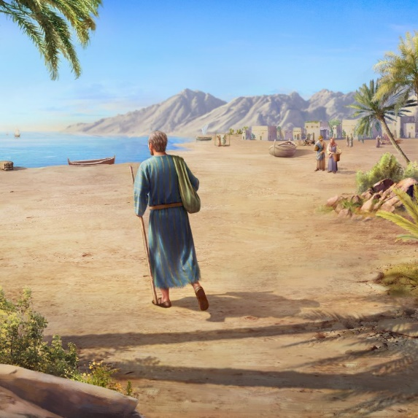
FEAR
“But Jonah arose to flee to Tarshish from the presence of the Lord…” (Jonah 1:3)
God sent Jonah as a missionary to distant lands, to preach in Nineveh, the capital of the Assyrian empire, Israel's enemy (Jonah 1:1-2). The Assyrians were known for their cruelty (Nahum 3:1-4).
Go preach to cruel enemies? How would they react when one of their enemies entered their capital and told them that they were going to be destroyed?
Put yourself in Jonah's situation. From a human point of view, wouldn't you also be filled with fear and trepidation?
Jonah reacted by fleeing so as not to carry out his mission. He believed he had enough reasons not to obey the divine order. However, he forgot something fundamental: God is our shield, with Him there is no fear (Ps. 115:11; 118:6).
Let us trust in God and not let our fears be an excuse for not preaching the message of salvation.

Slide 6
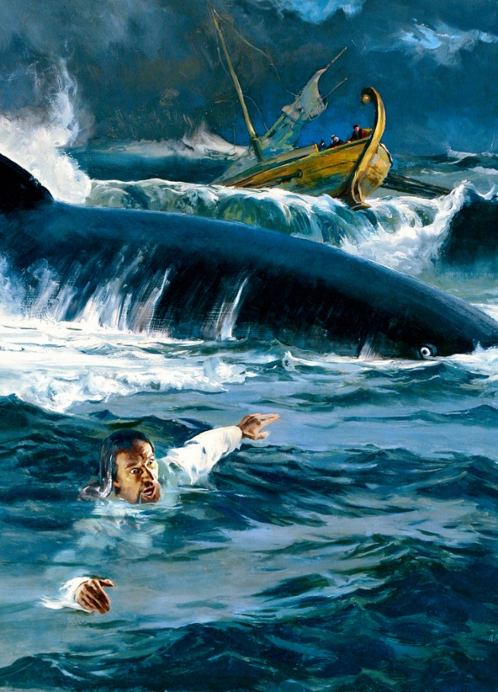
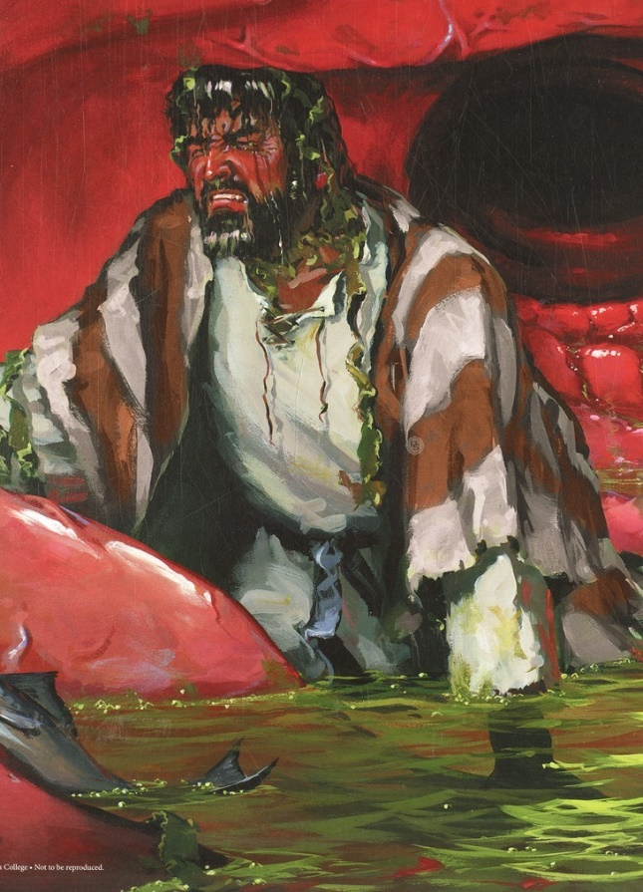
MISCONCEPTIONS
“And he said to them, “Pick me up and throw me into the sea; then the sea will become calm for you. For I know that this great tempest is because of me” (Jonah 1:12)
Jonah could have used this moment to tell them about the true God. But, instead of doing so, he himself proposed that they throw him into the sea.
We must seek our salvation and separate ourselves from contact with sinners
We must turn away from sin, but not from sinners. How can they abandon their sin if we do not teach them their error and bring them hope?
The success of the mission depends on ourselves
We are God's collaborators. Only He can transform people. Our mission is to sow. Success is always from God
God used his mistake to make him reconsider and turn to Him in prayer (Jonah 2:3-4, 6-7).
Like Jonah, we can also have misconceptions about God that can affect the fulfillment of our mission. Some common errors are:

Slide 7
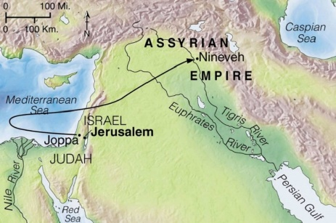
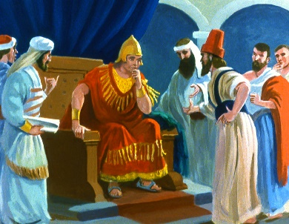
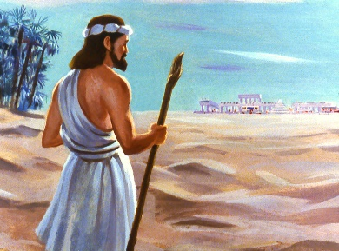
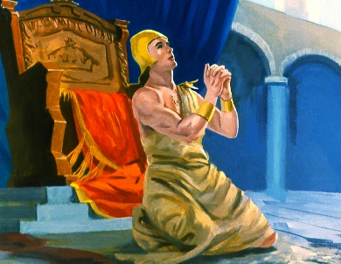
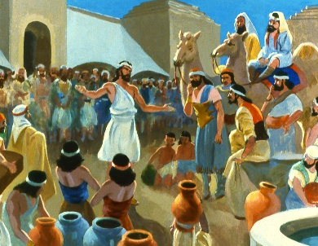
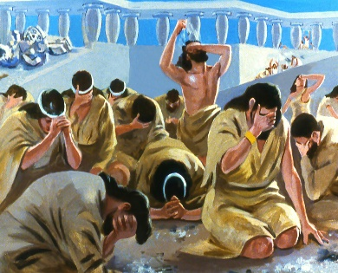
LACK OF SPIRIT OF SACRIFICE
“So Jonah arose and went to Nineveh, according to the word of the Lord…” (Jonah 3:3)
To fulfill the divine order, Jonah had to walk many kilometers; overcome his fears; swallow his prejudices; and give an unpleasant message. Quite a sacrifice for him.
But be careful: God accepts our sacrifice even when we do it reluctantly.
Without a spirit of self-sacrifice we will not be able to fulfill the mission that God has entrusted to us, since it is necessary that we deny ourselves certain comforts for the benefit of others.
We must give up our prejudices; dedicate part of our time and resources to the mission; be willing to be emotionally spent... All this for the love of perishing souls.

Slide 8
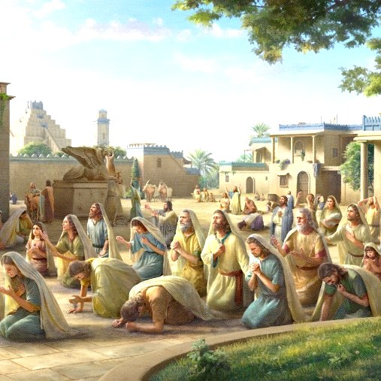
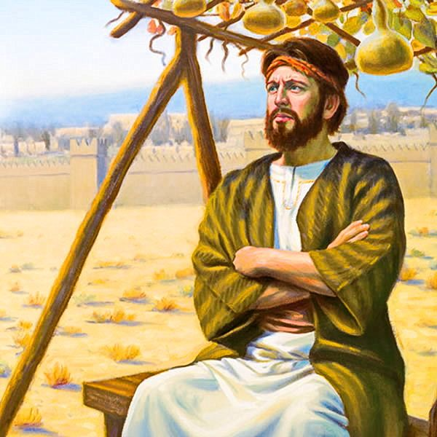
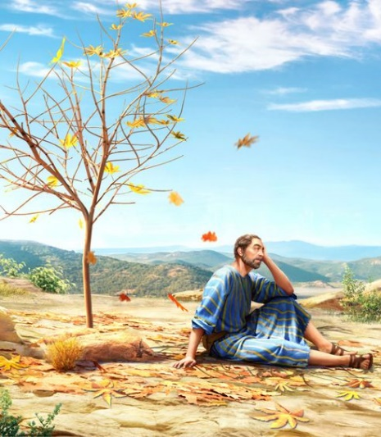
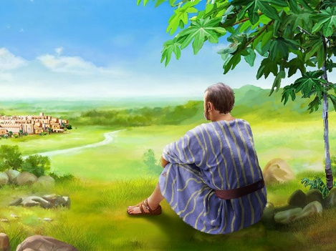
COGNITIVE DISTORTIONS
“But it displeased Jonah exceedingly, and he became angry” (Jonah 4:1)
With a single day's preaching, King Adad-nirari III and all his subjects humbled themselves and asked God to have mercy on them (Jonah 3:4-9).
But Jonah became depressed and angry (Jonah 4:1). What was going through Jonah's mind?
By examining the “gourd” example, we can see Jonah's distortion (Jonah 4:6-11):
The plant lives
The plant dies
Jonah is happy
Jonah gets angry
People lives
People dies
Jonah gets angry
Jonah is happy
Jonah placed more value on the life of a plant than on the life of people. What do you value most?

Slide 9
“When God opens the way for the accomplishment of a certain work and gives assurance of success, the chosen instrumentality must do all in his power to bring about the promised result. In proportion to the enthusiasm and perseverance with which the work is carried forward will be the success given. God can work miracles for His people only as they act their part with untiring energy.”
E. G. W. (Prophets and Kings, Chapter 21, page 263.1)

Slide 10
OBEY WITHOUT EXCUSES

Slide 11
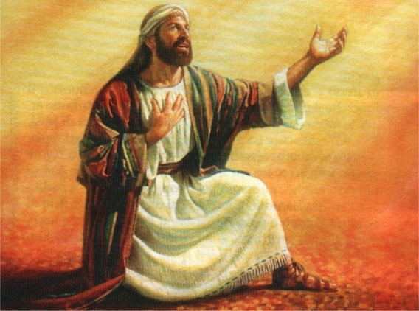
HERE AM I, SEND ME
“Also I heard the voice of the Lord, saying, Whom shall I send, and who will go for us? Then said I, Here am I; send me.” (Isaiah 6:8)
“In the charge given him, Jonah had been entrusted with a heavy responsibility; yet He who had bidden him go was able to sustain His servant and grant him success. Had the prophet obeyed unquestioningly, he would have been spared many bitter experiences, and would have been blessed abundantly” (Ellen G. WhiteProphets and Kings, p. 266).
God continues to ask for volunteers to speak to those who do not hear his voice or perceive his love. It needs messengers to bring hope to modern Nineveh.
When called, Isaiah responded without hesitation (Is. 6:8). God calls you. Do not hesitate. Do not make excuses. He needs you. Go!

Slide 12
“To everyone who becomes a partaker of His grace the Lord appoints a work for others. Individually we are to stand in our lot and place, saying, “Here am I; send me.” Isaiah 6:8. Upon the minister of the word, the missionary nurse, the Christian physician, the individual Christian, whether he be merchant or farmer, professional man or mechanic—the responsibility rests upon all. It is our work to reveal to men the gospel of their salvation”
E. G. W. The Ministry of Healing, pg. 148.2)

Slide 13
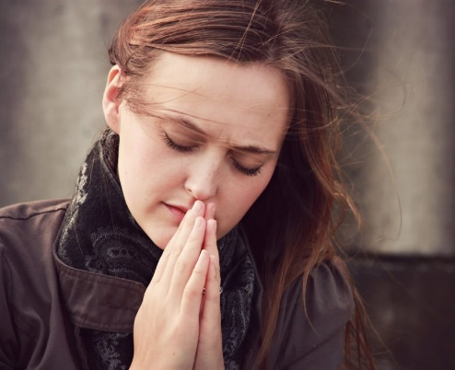
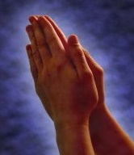
WEEKLY CHALLENG
Make a list of ten non-believers. Pray daily for each of them so that God will help you establish a friendship with them. Observe and identify their needs, their wounds and anxieties and pray specifically for them.
ADVANCED CHALLENGE
Choose a city nearby and another in a different part of the world. Start praying for the people who live and work in each of them. Ask God to bring forth a strong Adventist presence that can share the truth about Jesus' soon return

