Slide 1
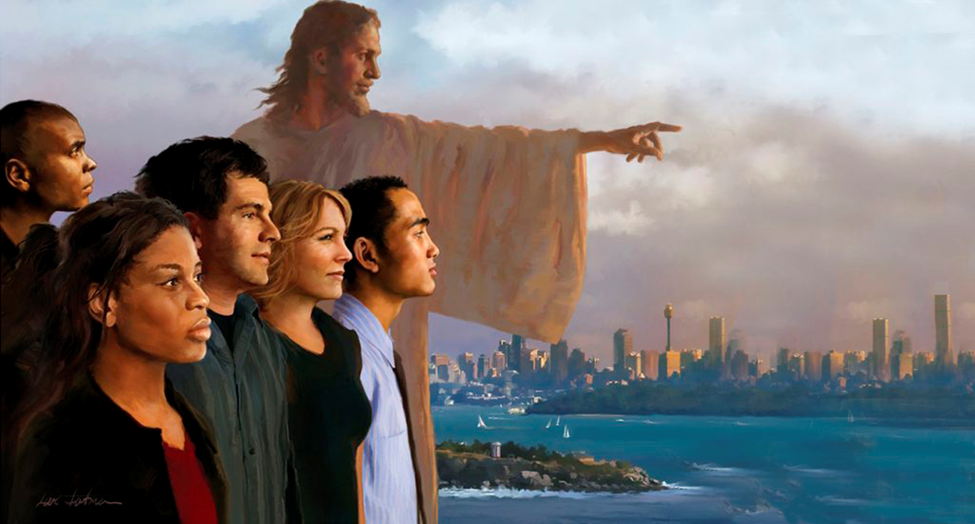
MOTIVATION AND PREPARATION FOR MISSION
Lesson 6 for November 11, 2023

Slide 2
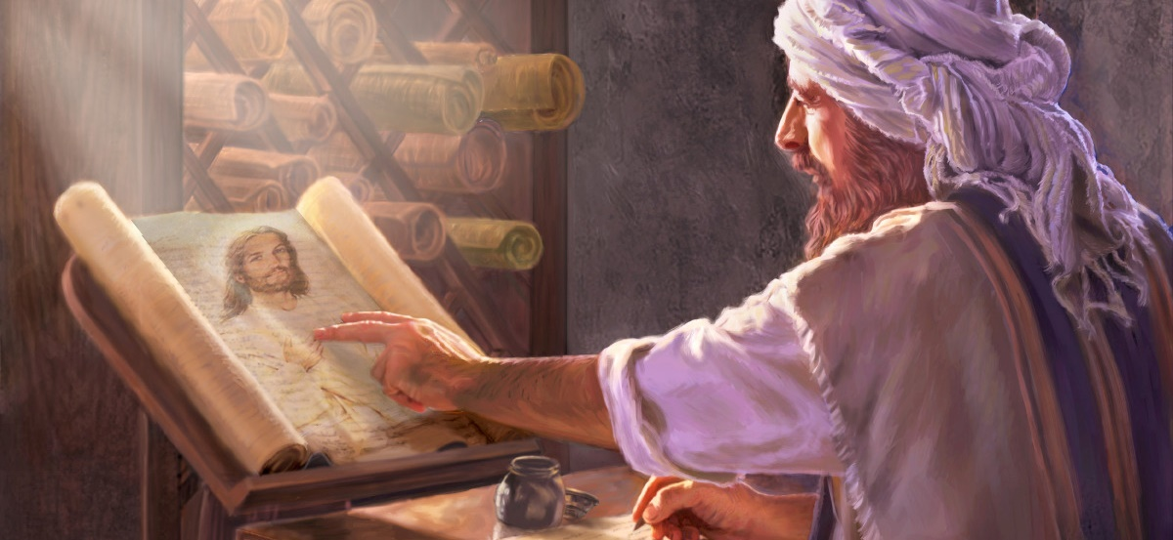
“These are the words which I spoke to you while I was still with you, that all things must be fulfilled which were written in the Law of Moses and the Prophets and the Psalms concerning Me” (Luke 24:44)

Slide 3
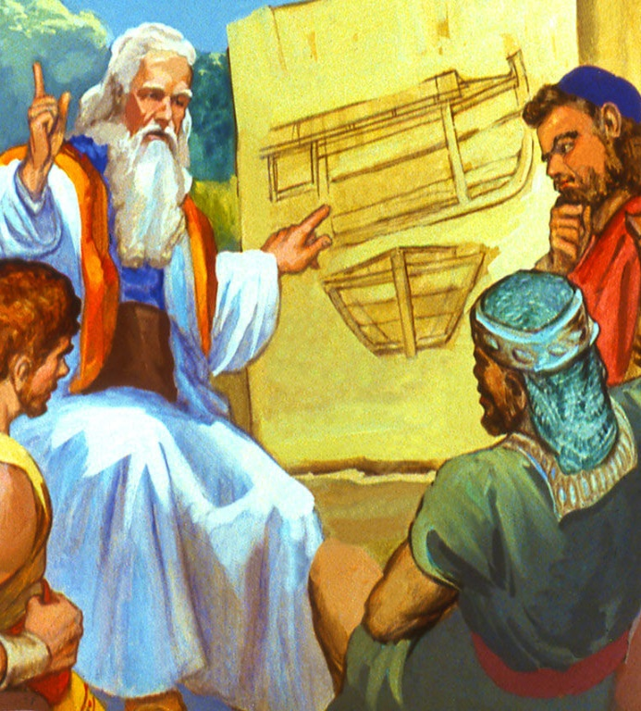
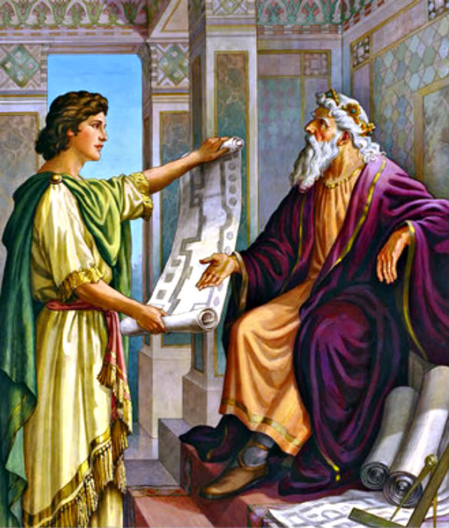
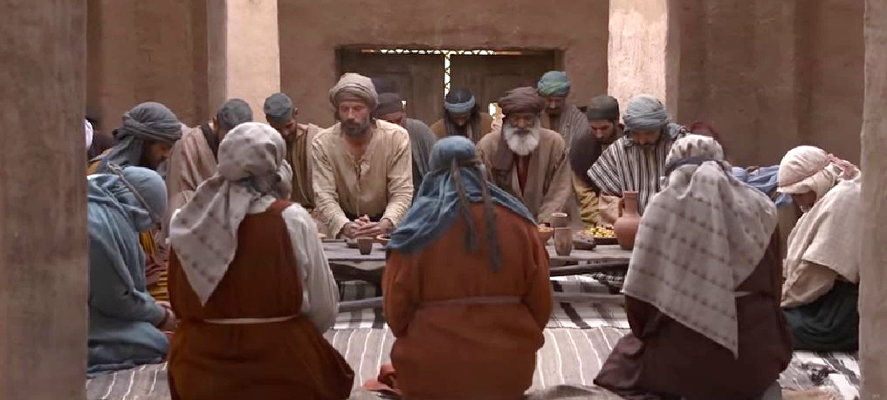
Starting a mission without planning it or making any preparation to carry it out is condemning it to failure.
Therefore, it is necessary that we prepare adequately to carry out the most important mission of our life: sharing the good news of Salvation.
Reviewing the history of the apostles, we will begin by studying motivation – essential for the success of any mission; We will see the previous steps to take before starting; how to start the mission; and, finally, how to continue doing it without faltering or becoming discouraged.
Motivations for the mission:
A personal experience.
A prophetic foundation.
Preparation for the mission:
Prayer and preparation.
Practicing the mission:
Unanimous activity.
Continue without failing.

Slide 4
MOTIVATIONS FOR THE MISSION

Slide 5
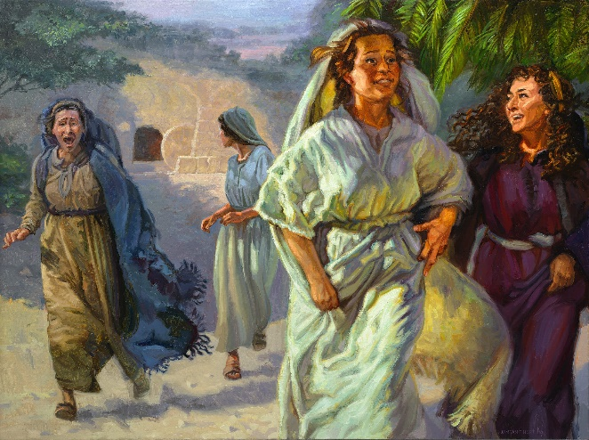
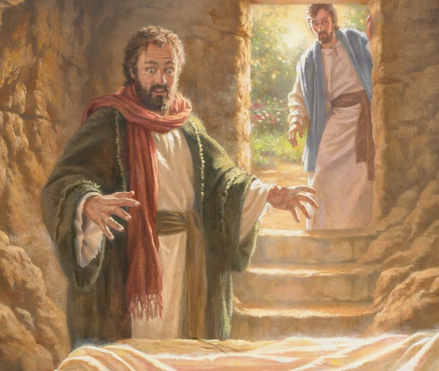
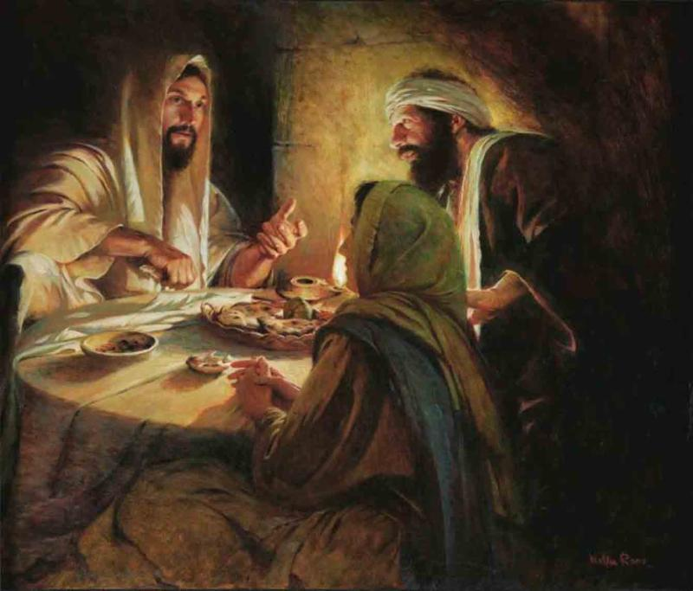
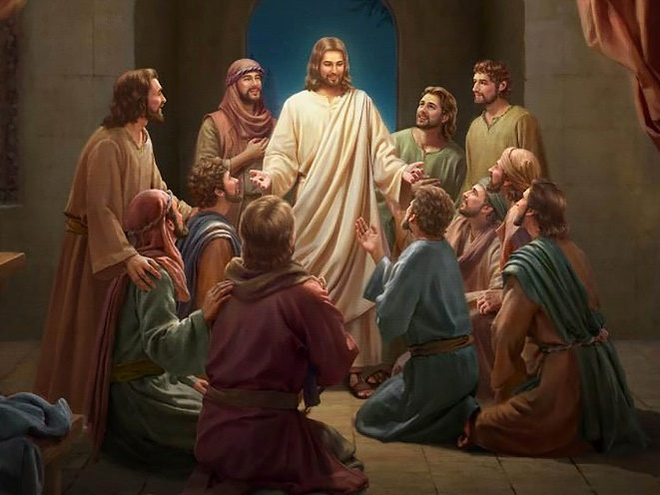
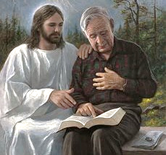
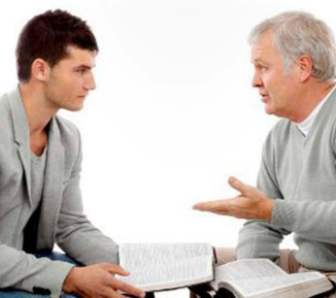
A PERSONAL EXPERIENCE
“And they departed quickly from the sepulchre with fear and great joy; and did run to bring his disciples word…” (Matthew 28:8)
While it was still dark, a group of women went to the tomb and found it empty. Some angels told them that Jesus had risen. They ran to share the news with the disciples. On the way, Jesus himself appeared to them. Full of joy, they told the news (Lk. 24:1-9; Mt. 28:8-10).
Surprisingly, the disciples did not believe them. Peter ran to the tomb, corroborated the women's story, and was amazed (Luke 24:12). However, he did not share the news until he had a personal encounter with Jesus (Lk. 24:34).
Two other disciples ran from Emmaus to Jerusalem to tell that they had had an encounter with the resurrected Jesus (Lk. 24:30-33).
Finally, the disciples believed when they saw Jesus in person (Luke 24:36). At that moment, Jesus entrusted them with the mission that, until then, they were not prepared to carry out (Lk. 24:46-49).
Our personal experience with Jesus is what motivates us to tell others what He has done for us.
What was the element that motivated all of them to share the gospel with others? A personal experience with Jesus.

Slide 6
“We need to have a living connection with God ourselves in order to teach Jesus. Then we can give the living personal experience of what Christ is to us by experience and faith. We have received Christ and with divine earnestness we can tell that which is an abiding power with us. The people must be drawn to Christ. Prominence must be given to His saving efficacy”
EGW (Selected Messages, volume 3, page 187)

Slide 7
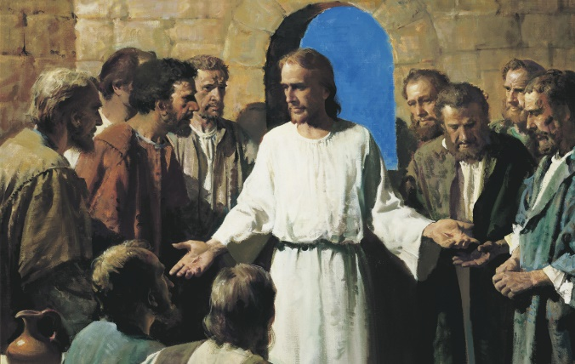
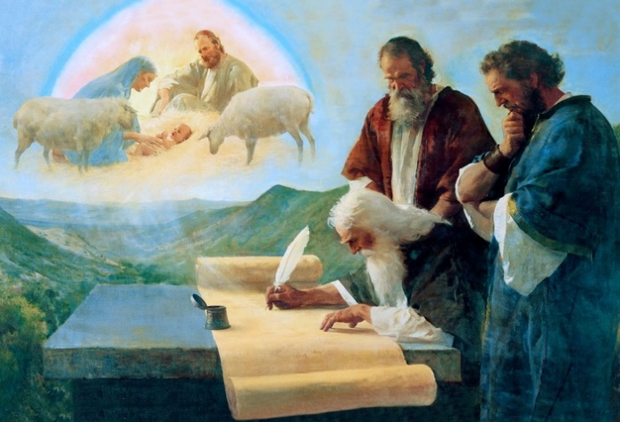
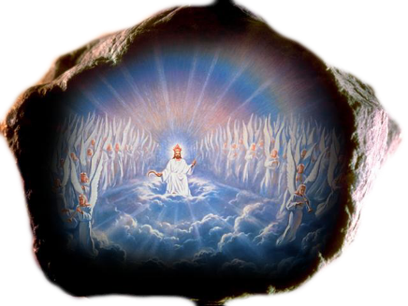
A PROPHETIC FOUNDATION
“These are the words that I spoke to you while I was still with you: that everything must be fulfilled that is written about me in the law of Moses, in the prophets, and in the psalms” (Luke 24:44)
When the resurrected Jesus appeared before the disciples, they went from fear to joy and, finally, believed (Lk. 24:36-43).
But, although personal experience is extremely important, Jesus was not satisfied with this. It led them to a second experience, not based on feelings but on reason: the knowledge of the prophetic Word of God (Lk. 24:44-46).
In this way, our personal experience is complemented by a deep knowledge of the Bible and, especially, of the prophecies (2 Pet. 1:19). Note that this knowledge can only be achieved when Jesus “[opens our] understanding” (Lk. 24:45).
Through the Old and New Testaments we can see how God announced historical events, and how they were fulfilled, especially those related to the birth, life, death and resurrection of Jesus.
By studying the prophecies we can see how history has developed as it was announced in the Bible (see, for example, Daniel 2). With this knowledge we will be able to share with others these prophecies and others that have yet to be fulfilled, especially those related to the Second Coming of Jesus and eternal life.

Slide 8
PREPARATION FOR THE MISSION

Slide 9
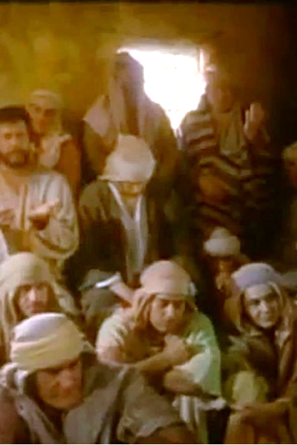
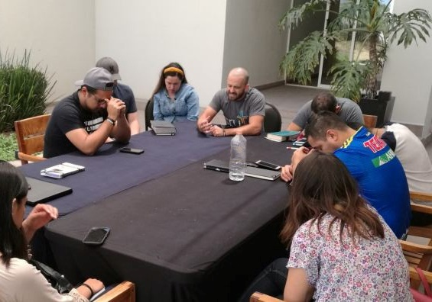
PRAYER AND PREPARATION
“And while they were together, he commanded them not to depart from Jerusalem, but to wait for the promise of the Father, which, he said to them, you heard from me” (Acts 1:4)
Although they were motivated, and had already been commissioned to carry out the mission, they were asked to wait a while until they received “power from on high” (Luke 24:49; Acts 1:4). What did they spend that waiting time on?
To prayer ( Acts 1:14). “The disciples prayed with intense earnestness for a fitness to meet men and in their daily intercourse to speak words that would lead sinners to Christ. Putting away all differences…” (EGW, AA. pg. 37).
To preparation ( Acts 1:15-26). The 12 being in charge of directing the mission, they proposed to repair the absence of one of them (Judas), so that the original plan could be followed. This was an act of “logistical preparation”
Before beginning any project for God's work, we must seek His guidance in prayer, and prepare the logistics of the action: what will we need? Who will carry out each part? How will we get the resources? …

Slide 10
PRACTICING THE MISSION

Slide 11
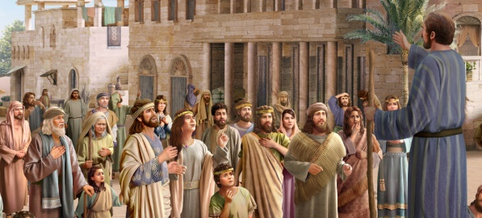
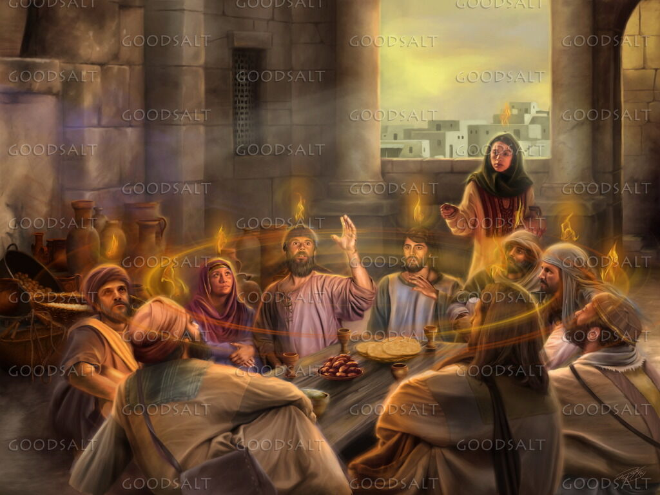
UNANIMOUS ACTIVITY
“All of them were filled with the Holy Spirit and began to speak in other tongues as the Spirit enabled them” (Acts 2:4)
The preparation was over. The time for action had arrived ( Acts 2:1-8, 32, 36-41):
They acted unanimously
Everyone received gifts of the Holy Spirit
They used these gifts to talk about Jesus
Faced with criticism, a leader defended the group
Jesus was presented to the people
They were accused of having crucified him
They were also assured that they could receive forgiveness
There was a call to repent
Many people accepted Jesus
We all have a part to play in the mission. To do this, each one is endowed with the gifts that the Spirit considers necessary (1Co. 12:11). In this way, the entire church, unanimously, proclaims the same message: Jesus has the power to save the vilest sinner.
By introducing Jesus, we allow the Holy Spirit to act on the heart of each person who listens, giving them the opportunity to repent and accept the Savior.

Slide 12
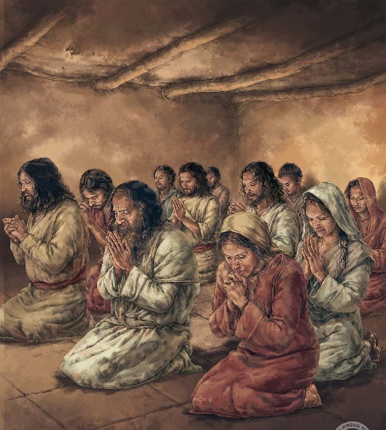
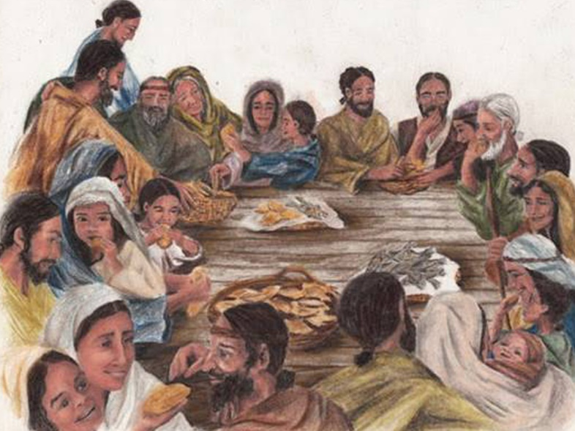
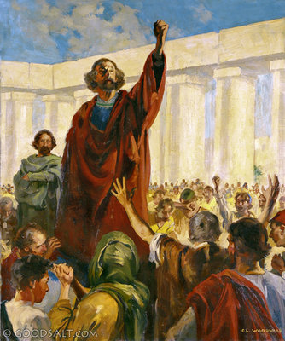
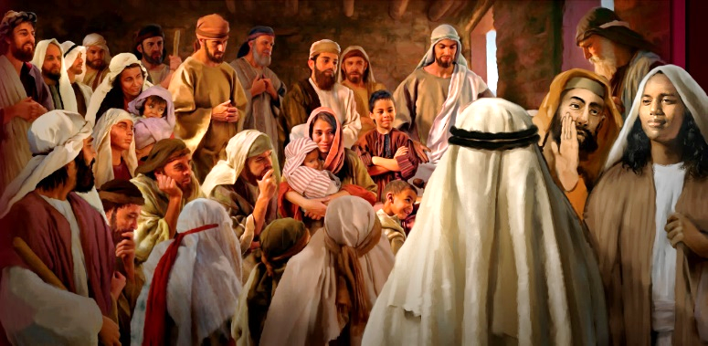
CONTINUE WITHOUT DECLINE
“They devoted themselves to the apostles’ teaching and to fellowship, to the breaking of bread and to prayer” (Acts 2:42)
In a single day, the church added 3,000 new members (Acts 2:41). Should they stop preaching and minister to new members? Should they stop serving new members and continue preaching?
The solution included both aspects (Acts 2:42-47):
Attention to new members:
Doctrine (teaching)
Communion (comradeship)
Breaking of bread (Holy Supper)
Prayers (in group)
Gospel Preaching:
Everyone gathered in the Temple [of the Jews, not in a Christian church] to testify about Jesus
They interacted with the entire town, earning their favor
Under the direction of the apostles, new members became preachers of the Word. Their lives showed the change brought about by Jesus in their hearts. “And every day the Lord added to the group those who were being saved” (Acts 2:47 NIV).

Slide 13
“Those who are of the household of faith should never neglect the assembling of themselves together; for this is God's appointed means of leading His children into unity, in order that in Christian love and fellowship they may help, strengthen, and encourage one another”
EGW (Our High Calling, 166)

Slide 14
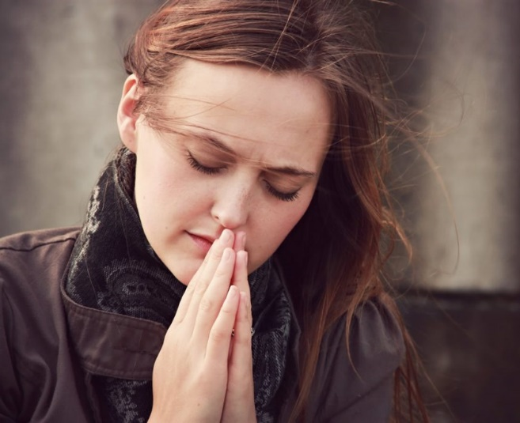
WEEKLY CHALLENGE
Think of someone in your life who you wish was a believer. Pray every day for that person to have a personal experience with Jesus.
ADVANCED CHALLENGE
Who are you discipling and leading into a relationship with Jesus? Look for ways to lead that person into fellowship with other believers.

