Slide 1
MISSION TO MY NEIGHBOR
Lesson 7 for November 18, 2023

Slide 2
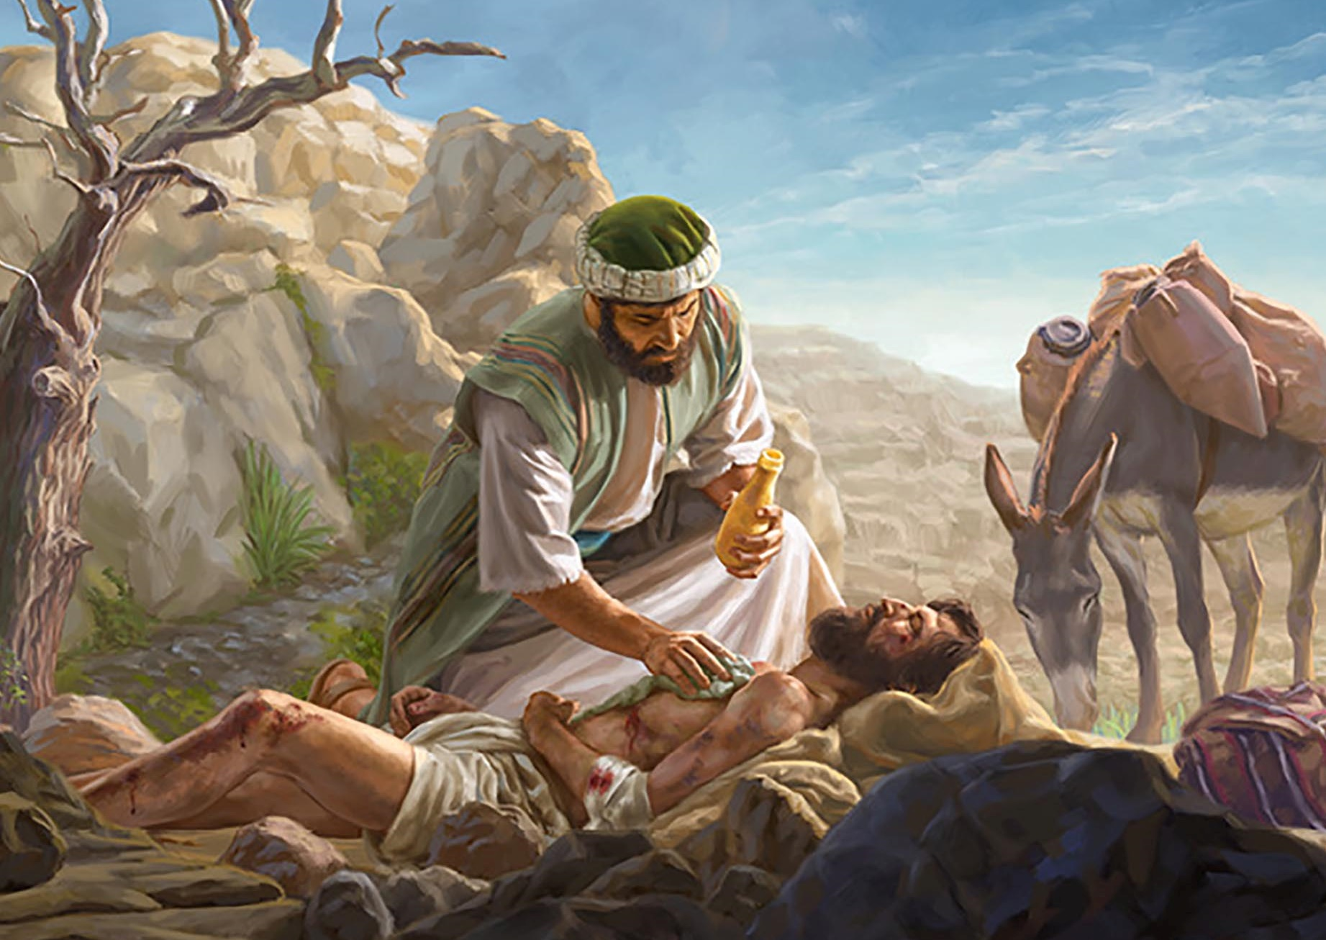
“And he answered, “You shall love the Lord your God with all your heart and with all your soul and with all your strength and with all your mind, and your neighbor as yourself”
(Luke 10:27)

Slide 3
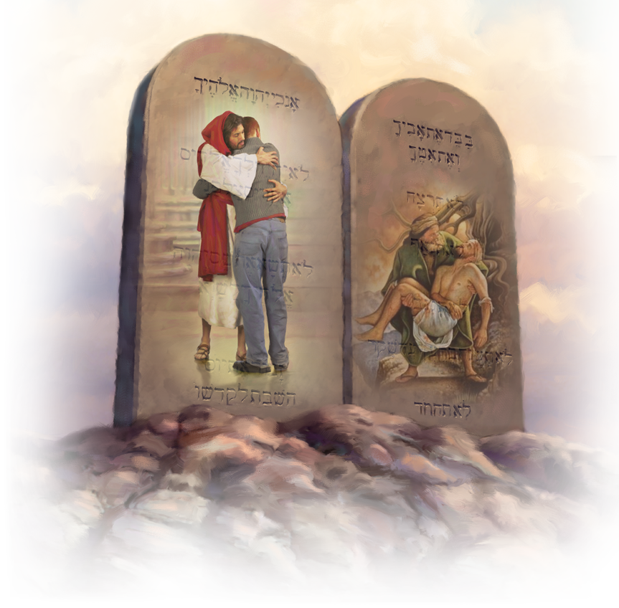
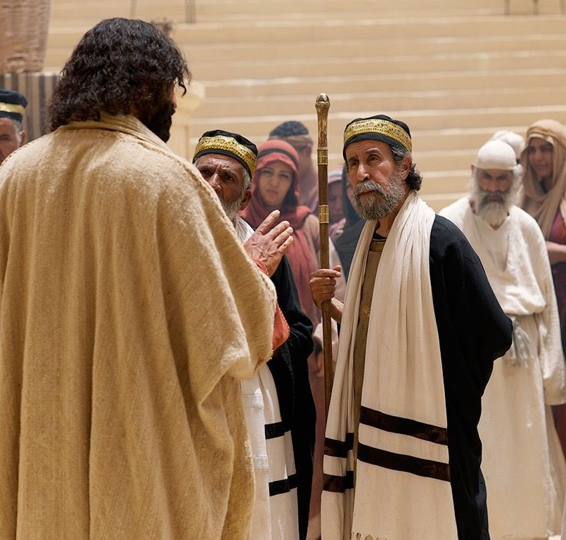
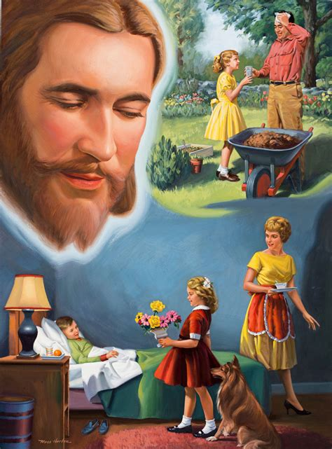
Since love is the summary of the Law, love must be demonstrated by obeying the Law (James 2:8-10).
This implies that love for God and neighbor cannot remain mere words or feelings. Love must be put into practice.
Starting from a question from a lawyer, Jesus taught us how to love God and our neighbors (Luke. 10:25-37).
Only through our love and service to others who need help can we demonstrate the authenticity of our love for Christ.
How to inherit eternal life? Luke 10:25.
The answer is in the Word. Luke 10:26.
Love in action. Luke 10:27-28.
And who should I love? Luke 10:29-37.

Slide 4
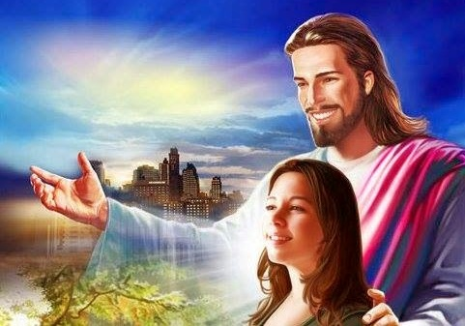
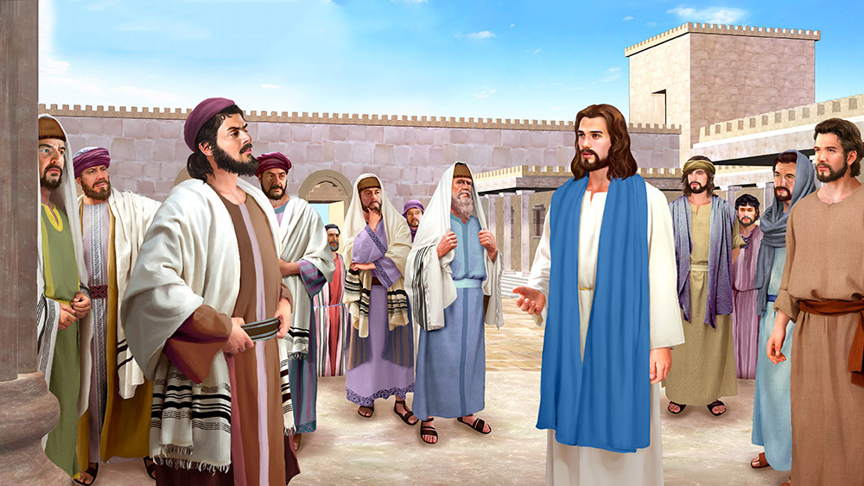
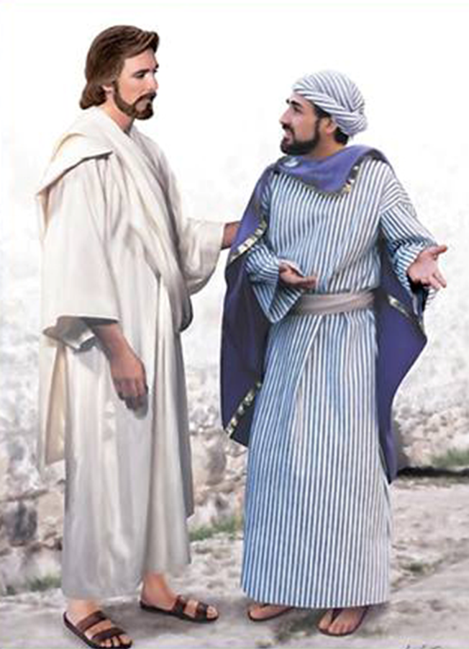
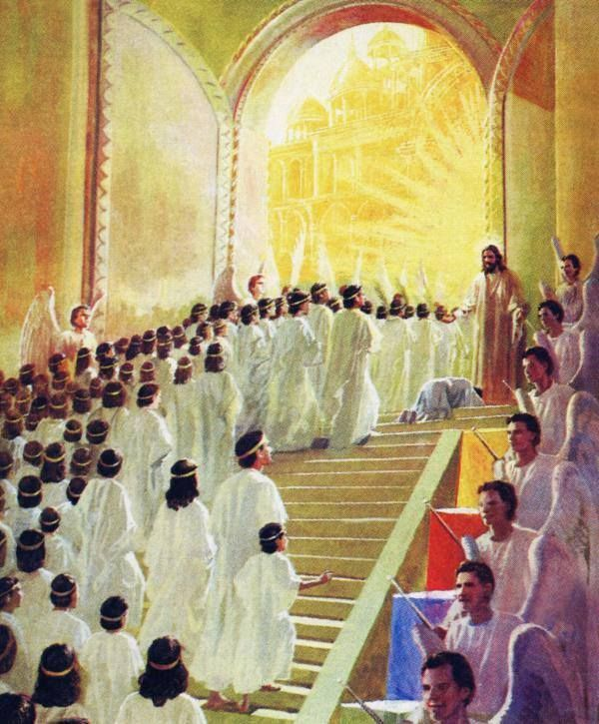
HOW TO INHERIT ETERNAL LIFE?
“On one occasion an expert in the law stood up to test Jesus. “Master,” he asked, “what must I do to inherit eternal life?” (Luke 10:25)
If it were not for the expression “to test him,” we would think that this expert in the law was a person who sincerely wanted Jesus to tell him how to obtain eternal life.
Jesus knew that his intentions were not good, however, he did not reproach him for anything, nor did he refuse to answer him. Always attentive to taking advantage of any opportunity for the mission, he took this opportunity to make a personal appeal.
Furthermore, the question was too important to leave unanswered: “By doing what will I inherit eternal life?”
Some time later, a rich young man asked him the same question (Luke. 18:18).
Like them, each of us has the same desire for transcendence; the same need to live beyond this short life (Ecclesiastes. 3:11; James 4:14).

Slide 5
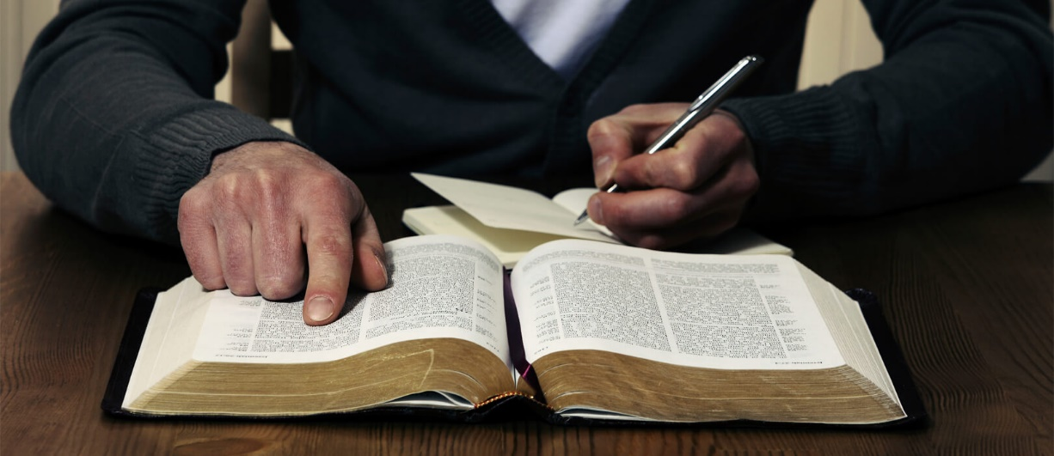
THE ANSWER IS IN THE WORD
“He said to him: What is written in the law? How do you read?” (Luke 10:26)
At times, we may be approached with provocative questions (for example, “why do you say there is only one God, but you worship three people?”). Maybe we think that, like the expert in the law, their only purpose is to provoke, annoy, or expose us.
Unlike Jesus, we cannot know people's real intentions (John 2:25). Perhaps, without knowing it, we are facing a sincere seeker of truth. Therefore, we must imitate the method that Jesus used to answer difficult or malicious questions.
To answer his trick question, Jesus led the expert in the law to look for the answer in the Word of God.
So, first of all, we must take our interlocutor to the Bible as the only authoritative source to know the truth (“What is written in the law?”).
Second, lead him into a personal Bible study (“How do you read?”). Don't settle for what we know or can tell you. It is important that we let the Word itself, under the guidance of the Holy Spirit, direct us to the knowledge of the truth (Psalms. 119:105).

Slide 6
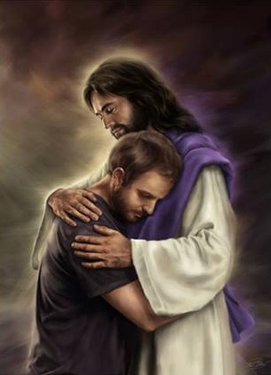
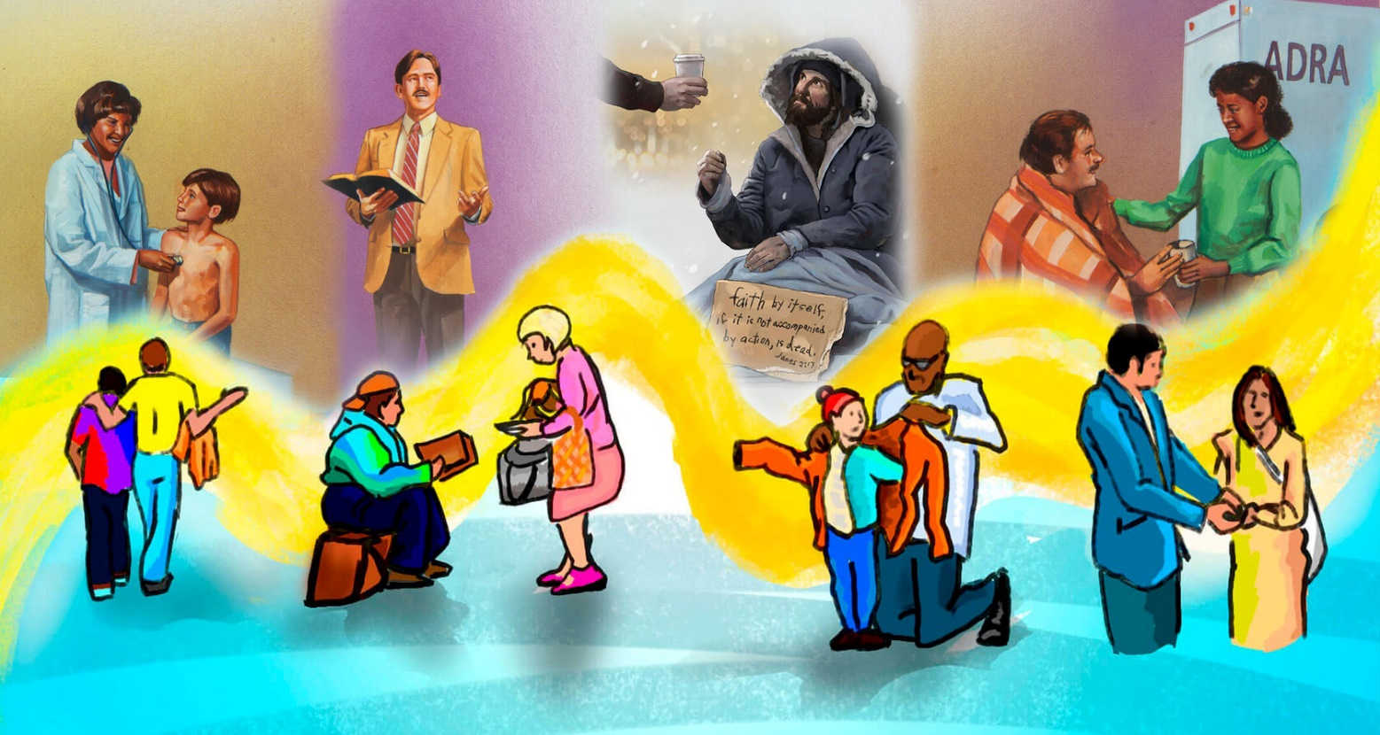
LOVE IN ACTION (1)
“He answered, “‘Love the Lord your God with all your heart and with all your soul and with all your strength and with all your mind’; and, ‘Love your neighbor as yourself.’ “You have answered correctly,” Jesus replied. “Do this and you will live” (Luke 10:27-28)
The theory was good: “You answered well.” To have eternal life, we must love God and our neighbors.
But what about practice? Going from theory to practice is not always easy. But Jesus made it very clear: “DO this, and you will live”.
How can I show that I love God and my neighbor?
According to John, I show that I love God when I love my neighbor (1Jn. 4:20). So, love is shown in the way I treat others.
James tells us very clearly “Suppose a brother or a sister is without clothes and daily food. If one of you says to them, “Go in peace; keep warm and well fed,” but does nothing about their physical needs, what good is it?” (James 2:15-16 NIV).
The challenge is to do what we know is right. Just knowing about how to love is not enough. We have to put it into practice!

Slide 7
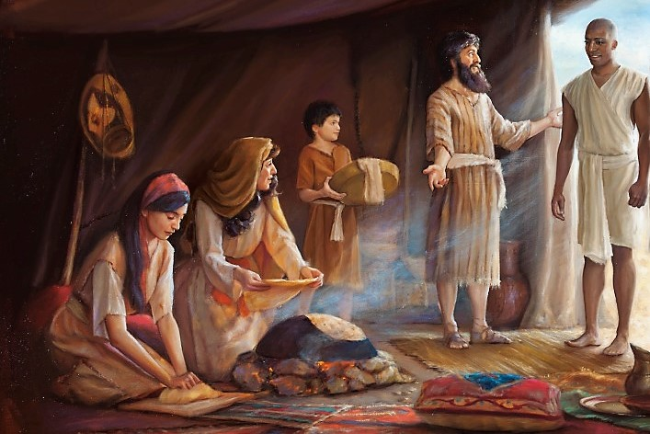
LOVE IN ACTION (2)
“For the entire law is fulfilled in keeping this one command: “Love your neighbor as yourself” (Galatians 5:14)
In short, when I love my neighbor in a practical way I demonstrate that I love God and, according to Paul, I am fulfilling the Law (Galatians. 5:14).
Isaiah 1:17
Jeremiah 22:16
Ezekiel 22:29
Hosea 10:12
Micah 6:8
Zacariah 7:9-10
Malachi 3:5
“Learn to do right; seek justice. Defend the oppressed. Take up the cause of the fatherless; plead the case of the widow”
“He defended the cause of the poor and deedy, and so all went well. Is that not what it means to know me? Declares the Lord”
“The People of the land practice extortion and commit robbery; they oppress the poor and needy and mistreat the forigner, denying them justice”
”Sow righteousness for yourselves, reap the fruit of unfailing love”
“He has shown you, O mortal, what is good. And what does the Lord require of you? To act justly and to love mercy and to walk humbly with your God”
“This is what the Lord Almighty said: ‘Administer true justice; show mercy and compassion to one another. Do not oppress the widow or the fatherless, the foreigner or the poor. Do not plot evil against each other”
“So I will come to put you on trial […] against those who defraud laborers of their wages, who oppress the widows and the fatherless, and deprive the foreigners among you of justice, but do not fear me,” says the Lord Almighty”
But this is not a new message. Jesus and the apostles are transmitting the echo of the message proclaimed by the prophets. A message of justice and equitable and loving treatment of our fellow human beings (especially the needy and helpless).

Slide 8
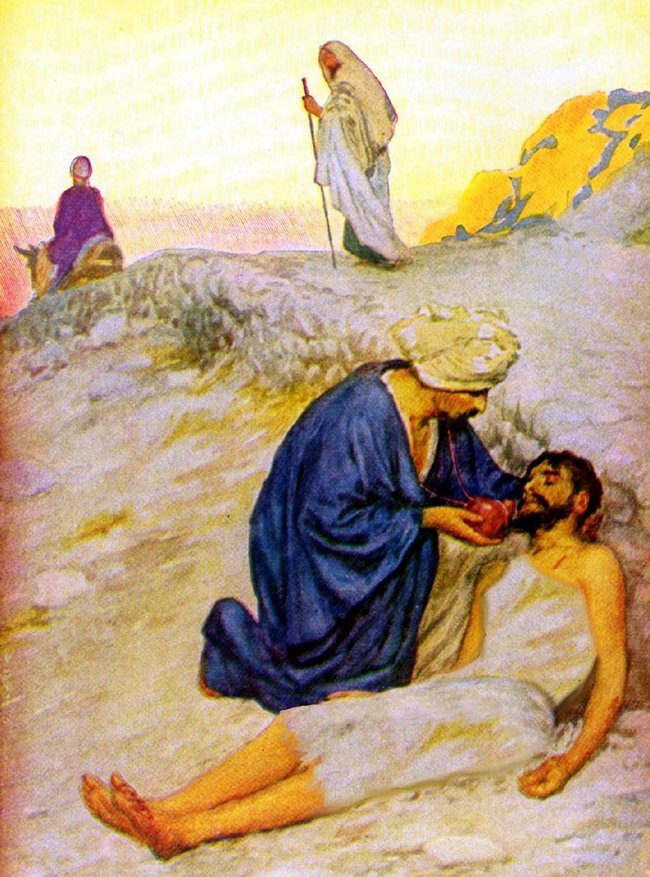
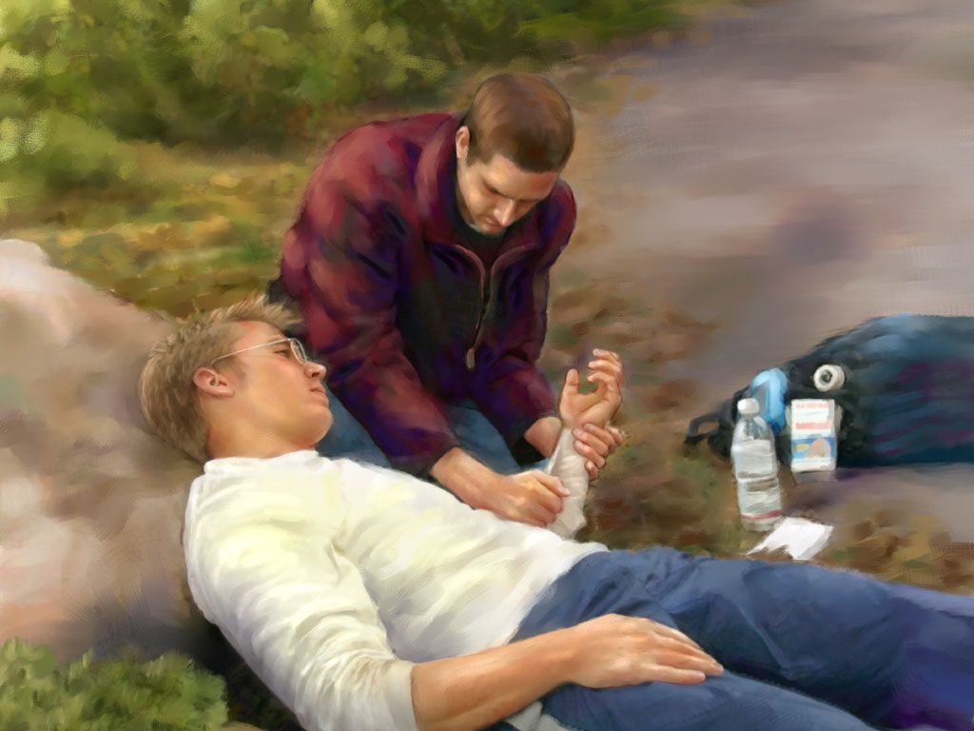
AND WHO SHOULD I LOVE?
“Who, then, of these three do you think was the neighbor of the one who fell among the thieves?” (Luke 10:36)
Through a story that occurred between Jerusalem and Jericho, Jesus showed the meaning of loving your neighbor: being merciful to him and helping him in his need (Luke 10:30-36).
Confronted with his hypocrisy, the expert in the law had to reluctantly acknowledge that his neighbor was not the one he liked, but the one to whom he did good (Luke 10:37).
Our neighbor is not merely those who belong to the same church or faith as us, but everyone who needs our help.
Mercy and goodness are beyond all religious, social, cultural, ethnic, or any other kind of barrier.
Ellen G. White defines our neighbor this way: “Our neighbor is every person who needs our help. Our neighbor is every soul who is wounded and bruised by the adversary. Our neighbor is everyone who is the property of God” (The Desire of Ages, p. 503).

Slide 9
“To leave a suffering neighbor unrelieved is a breach of the law of God.... He who loves God will not only love his fellow men, but will regard with tender compassion the creatures which God has made. When the Spirit of God is in man it leads him to relieve rather than to create suffering.... We are to care for every case of suffering, and to look upon ourselves as God's agents to relieve the needy to the very uttermost of our ability”
E. G. W. (Sons and Daughters of God, February 15)

Slide 10
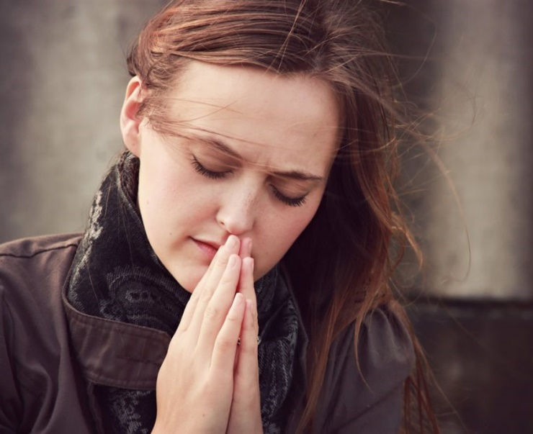
WEEKLY CHALLENGE
Start praying daily for someone who is different from you, or even for someone you don't like personally.
ADVANCED CHALLENGE
Identify the emotional, physical, and social needs of some non-Adventist acquaintances. Consider how you can personally meet these needs. What can you do to prune them practically over the next week?

