Slide 1
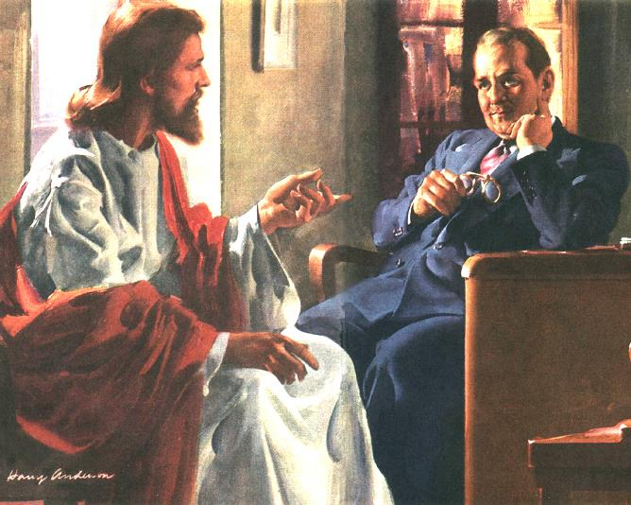
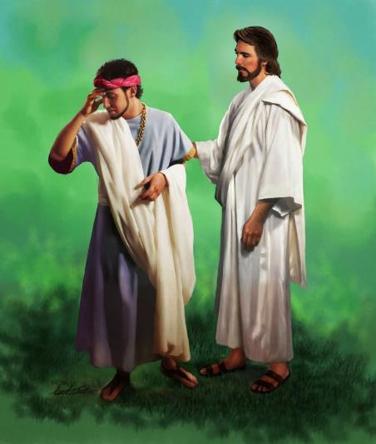
MISSION TO THE POWERFUL
Lesson 9 for December 2, 2023

Slide 2
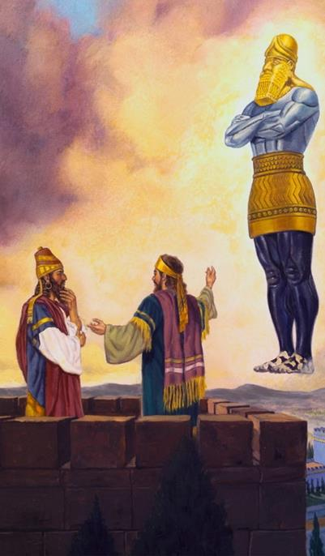
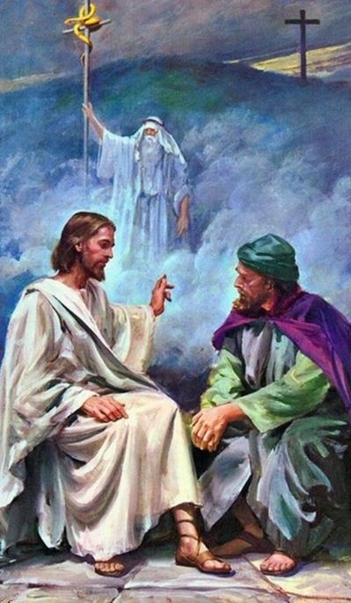
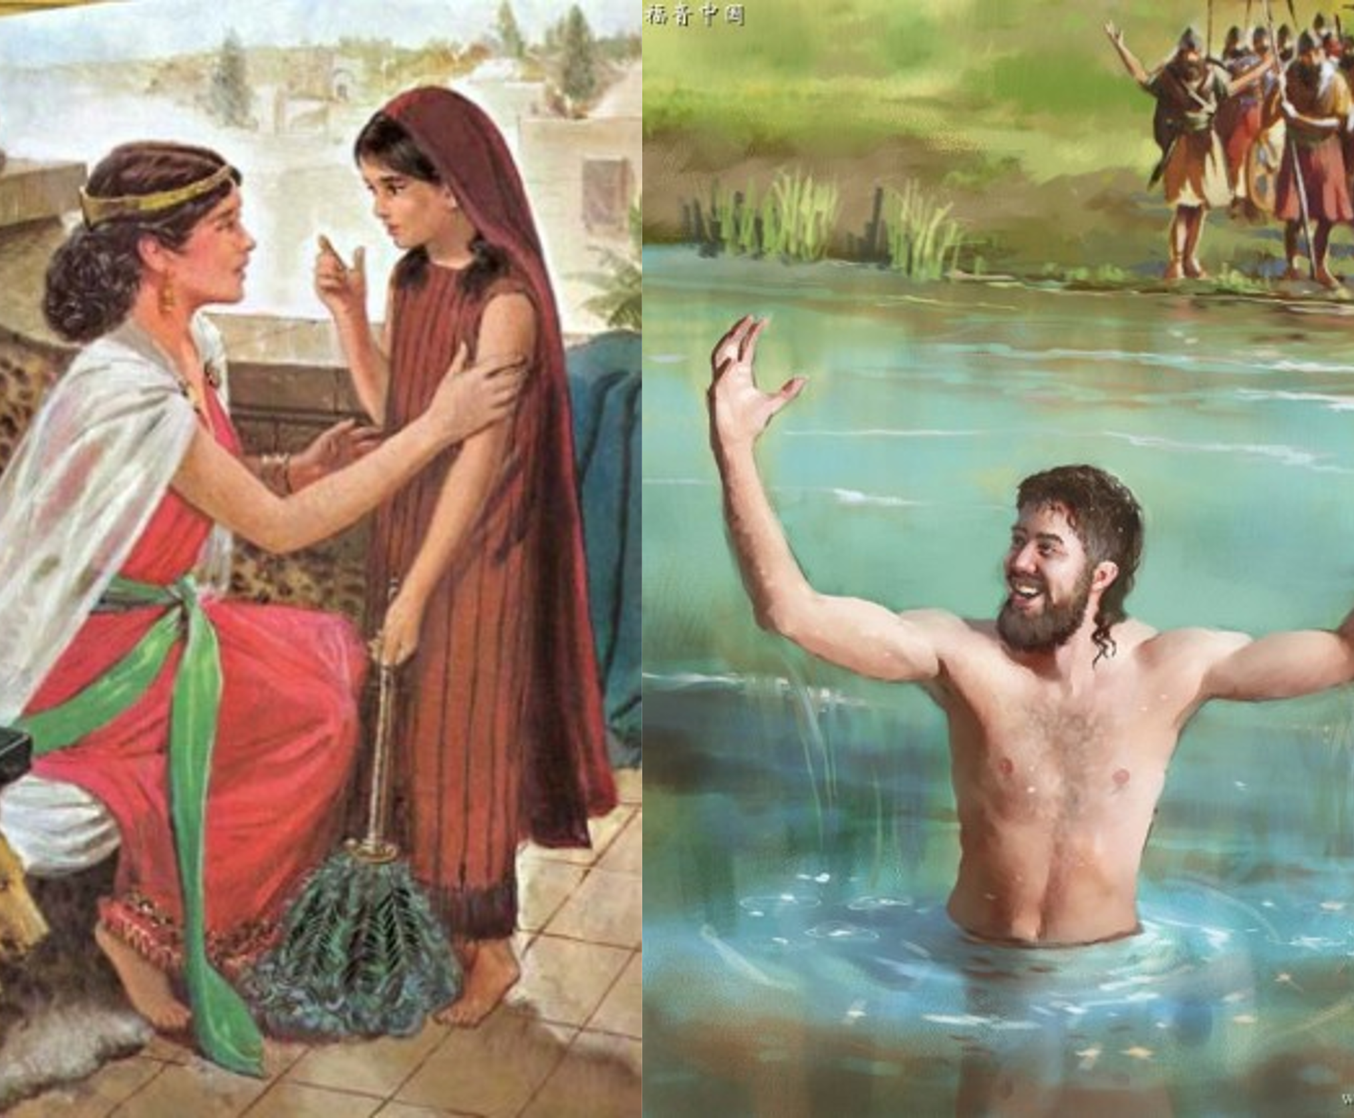
For what profit is it to a man if he gains the whole world, and loses his own soul? Or what will a man give in exchange for his soul?” (Matthew 16:26)

Slide 3
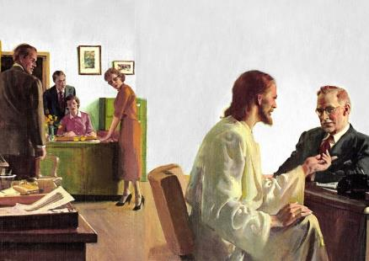
There are people who seem to be outside our circle of influence. Powerful people, either due to their economic capacity or their social position: great businessmen; eminent politicians; leaders…
Are they excluded from the mission? Don't they need the message of salvation? Of course, like all of us, powerful people also need divine grace. They need to know their Savior.
God uses faithful believers and special situations to reach this unique group. What needs do they have? How can we use these needs to lead them to Jesus?
Nebuchadnezzar
Naaman
Nicodemus
The rich young man
Joseph of Arimathea
Need for humility
Need time to grow
Need of the Savior
Need to establish priorities
Need to collaborate

Slide 4
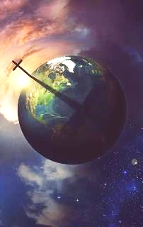
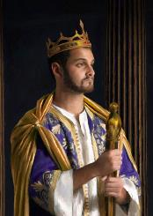
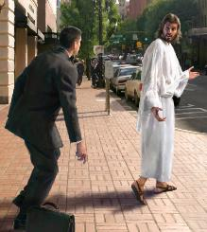
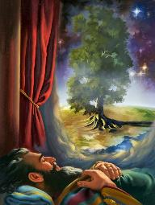
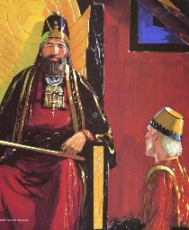
NEBUCHADNEZZAR: NEED FOR HUMILITY
“[God our Savior] wants all men to be saved and come to the knowledge of the truth” (1 Timothy 2:4)
Salvation is not only granted to a special group of “elect”. The atonement made by Jesus encompasses all humanity (1Tim. 2:4). This, of course, includes the king or president of the nation.
However, it is practically impossible to approach these kind of people. On the other hand, their position of power can lead them to think that they do not need anything. That, thanks to their knowledge, skill, wealth or intelligence, they can achieve all their goals.
This is what happened to King Nebuchadnezzar (Dan. 4:30). Through his story, we see that God can use special methods to reach the high ones:
He elevates faithful people, like Daniel, to positions of influence, to use them as bridges to reach the powerful ones (Dan. 4:19, 27).
He intervenes directly to humble their pride and arrogance and lead them to recognize their dependence on God (Dan. 4:33-37).

Slide 5
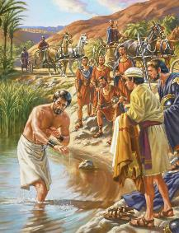
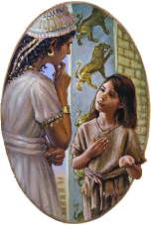
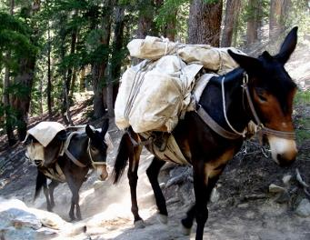
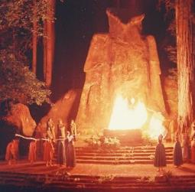
NAAMAN: NEED OF TIME TO GROW
“But may the Lord forgive your servant for this one thing: When my master enters the temple of Rimmon to bow down and he is leaning on my arm and I have to bow there also—when I bow down in the temple of Rimmon, may the Lord forgive your servant for this” (2nd Kings 5 :18 NIV)
Naaman was a “great” person in Syria (2 Kings 5:1). Using a girl, God guided him to the prophet Elisha to be healed of his leprosy (2 Kings 5:2-3, 9-14). At that moment, Naaman gave his life to God and decided to serve Him (2 Kings 5:17).
But his knowledge of God was limited. It took “the load of a couple of mules” to be able to worship him. After all, the god Rimmon lived in Syria and the true God in Israel. So (according to his knowledge) he needed to take some land from Israel to Damascus so he could worship the God of Israel.
His second request was “permission to sin” (2 Kings 5:18). He knew that his political obligations were going to conflict with his new faith. But Elisha did not rebuke him, nor correct his error (2 Kings 5:19). Why?
Naaman needed time to grow, time to know God, time to change. Perhaps to help him grow, Elisha later visited Damascus (2 Kings 8:7).

Slide 6
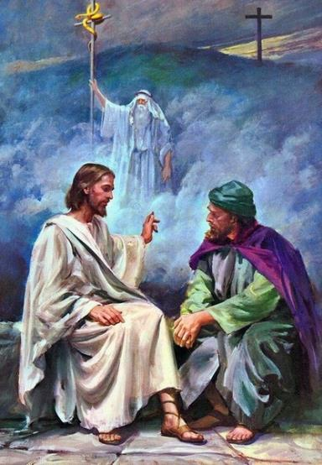
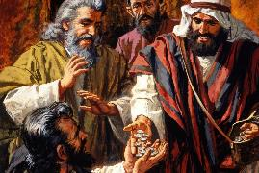
NICODEMUS: NEED OF THE SAVIOR
“Now there was a Pharisee, a man named Nicodemus who was a member of the Jewish ruling council. He came to Jesus at night…” (John 3:1-2a)
Despite recognizing that Jesus' teaching came from God (John 3:2), Nicodemus, the “teacher of Israel” (John 3:10), was reluctant to openly acknowledge that he was a follower of the Master of Galilee.
Pride? Attachment to his position of power? Fear of rejection from peers? (John 12:42-43).
God was patient with him. He even used it to save Jesus' life at critical moments in his ministry (John 7:40-53).
When Nicodemus saw Jesus lifted up between heaven and earth, “as Moses lifted up the serpent in the wilderness” (John 3:14), he knew without a doubt that he had found the Savior. Not caring what they thought of him, he decided to take care of the expenses of Jesus' funeral (John 19:39-40).
“Nicodemus came forward in its defense. No longer cautious and questioning, he encouraged the faith of the disciples and used his wealth in helping to sustain the church at Jerusalem and in advancing the work of the gospel” (EGW AA p. 105).

Slide 7
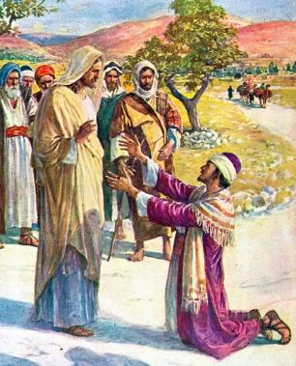
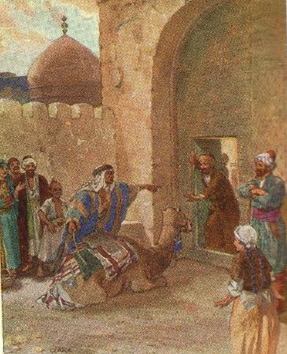
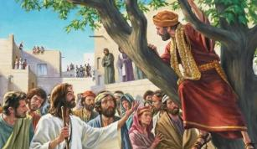
THE RICH YOUNG MAN: NEED TO ESTABLISH PRIORITIES
“Jesus answered, “If you want to be perfect, go, sell your possessions and give to the poor, and you will have treasure in heaven. Then come, follow me” (Matthew 19:21)
It is easier for a camel to go through the eye of a needle? Can a rich man be saved? (Matt. 19:24). On the other hand, if a rich man cannot be saved, “who then can be saved?” (Matt.19:25).
Let's go by parts. No matter how rich one is, no one can buy the salvation of his soul (Ps. 49:8). Furthermore, Jesus did not say that a rich man cannot be saved, but rather that “it is difficult for a rich man to enter the kingdom of heaven” (Matt. 19:23).
Do the rich, then, need to divest themselves of their wealth to serve God wholeheartedly?
No, but wealth can be a blindfold that blinds your eyes and prevents you from seeing and meeting the needs of others (Mtt. 19:21); or it may be a god that you give priority to in your life (1Tim. 6:10; Col. 3:5). Therefore, for a rich person to enter the kingdom of heaven, they have to change their priorities, putting God first..
Zacchaeus changed his priorities. He did not need to leave his wealth to give himself completely to Jesus (Lk. 19:8-10).

Slide 8
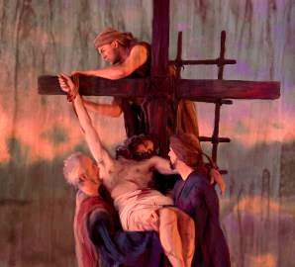
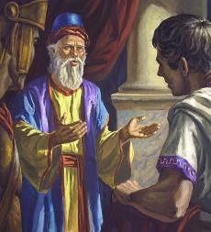
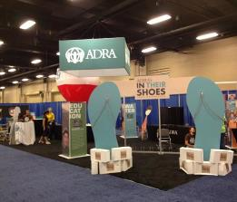
JOSEPH OF ARIMATHEA: NEED TO COLLABORATE
“Later, Joseph of Arimathea asked Pilate for the body of Jesus. Now Joseph was a disciple of Jesus, but secretly because he feared the Jewish leaders. With Pilate’s permission, he came and took the body away” (John 19:38)
Joseph openly declared himself a disciple of Jesus when he had the opportunity to do something for Him. In this way, he was used by God to fulfill Isaiah's prophecy (Is. 53:9; Mt. 27:57-60).
Without Joseph's intervention, Jesus would have been buried in a common grave, since the disciples would never have been able to ask Pilate to give them Jesus' body for burial.
One way to fulfill the mission on behalf of the rich and powerful is to offer them the opportunity to collaborate with the mission (it really seems paradoxical).
Let's propose a community help project (for example). A project that visibly impacts the well-being of those in need. The rich and powerful will feel the need to collaborate in it. Maybe it's for prestige or for other reasons. But, perhaps it is to be able to express their desire for help, their desire to do something for others. Let's give them the opportunity to participate in something good so that, in turn, they can also be reached by Jesus.

Slide 9
““Those who belong to the higher ranks of society are to be sought out with tender affection and brotherly regard. Men in business life, in high positions of trust, men with large inventive faculties and scientific insight, men of genius, teachers of the gospel whose minds have not been called to the special truths for this time, —these should be the first to hear the call. They should be given the invitation […]
Many in high social positions are heart-sore and sick of vanity. They are longing for a peace that they have not. Even those in the highest ranks are not to be passed by. Many of them are hungering and thirsting for salvation”
E. G. W. (Christ's Object Lessons, p.230)

Slide 10
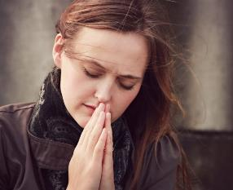
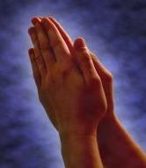
WEEKLY CHALLENGE
Add to your daily prayer list someone who is in a position of power, who is a non-believer, and who is someone you might come into contact with from time to time.
ADVANCED CHALLENGE
Write a letter or email to someone who is in a position of power (even someone you don't know) and tell them you are praying for them.

