Slide 1
MISSION TO THE UNREACHED: PART 1
Lesson 10 for December 9, 2023

Slide 2
“The God who made the world and everything in it is the Lord of heaven and earth and does not live in temples built by human hands” (Acts 17:24)

Slide 3
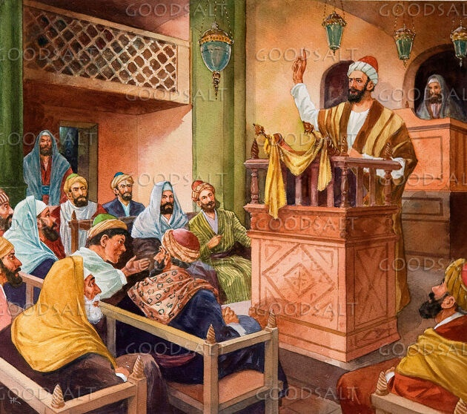
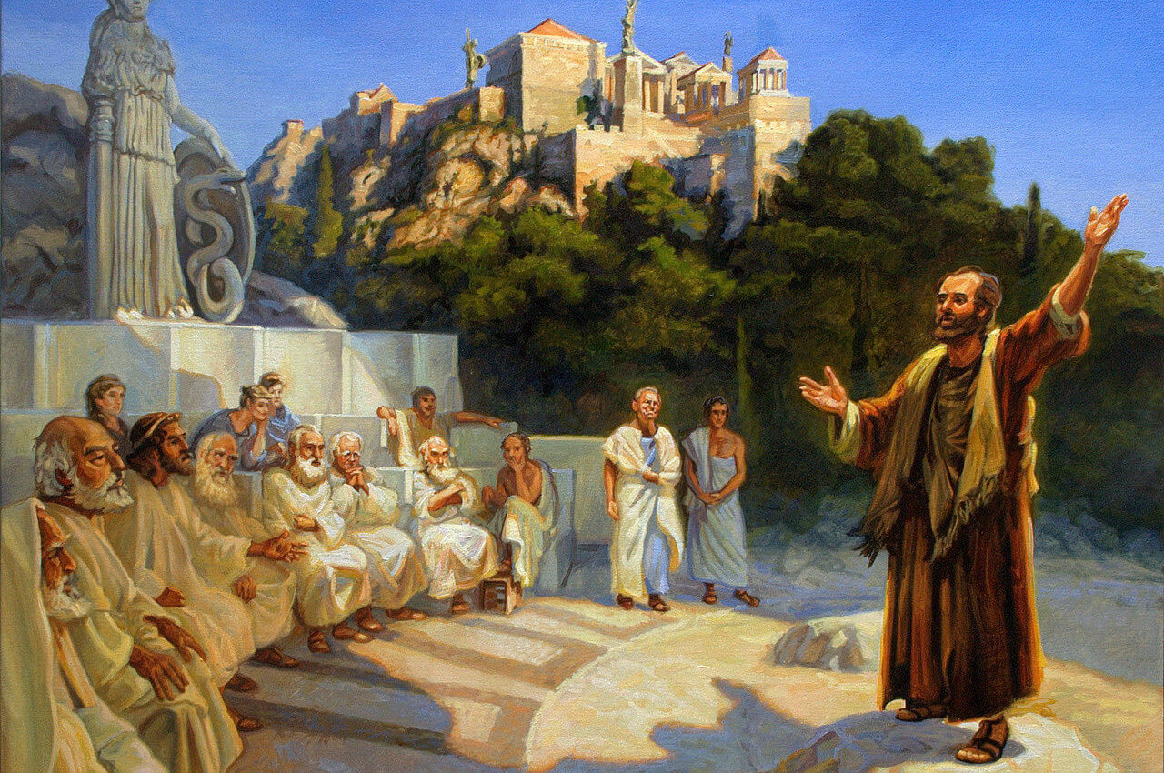
Upon entering a synagogue, Paul preached in a very different way than the one he used when he contacted pagans who knew nothing about Judaism.
Presenting the message of salvation to those who already know Jesus (even if they have some doctrinal misconceptions) is relatively easy. We use similar concepts; a common vocabulary; we share Bible reading; etc
However, reaching out to those who know nothing about Jesus, or who reject Christianity entirely, is more complex. How to reach them?
New fields for the mission:
New ways of thinking. Acts 17:1-16.
New ways of preaching. Acts 17:17-21.
How to evangelize non-Christians:
Find common ground. Acts 17:22-23.
Adapt our speech. Acts 17:24-27.
Present Christ. Acts 17:28-34.

Slide 4
NEW FIELDS FOR MISSION

Slide 5
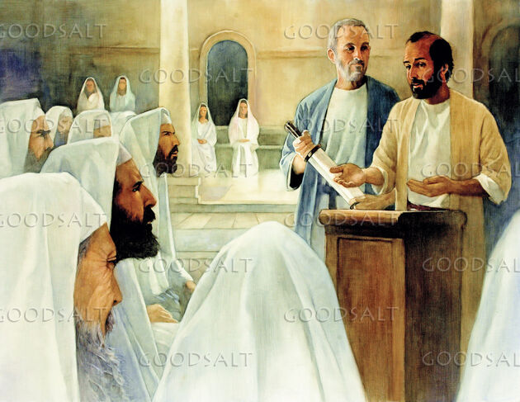
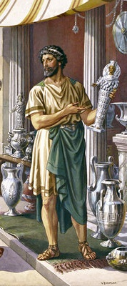
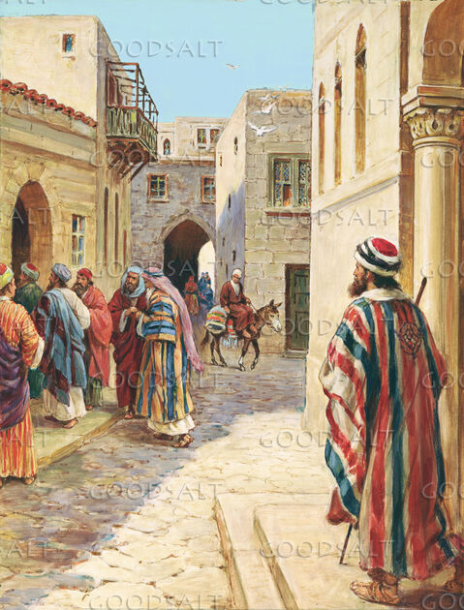
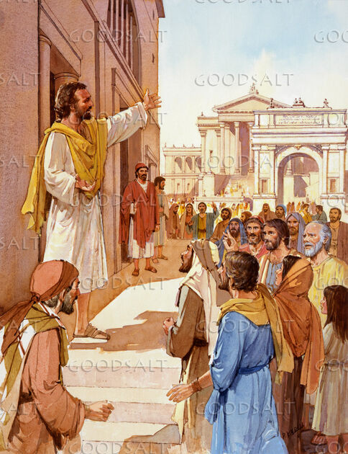
NEW WAYS OF THINKING
“While Paul was waiting for them in Athens, he was greatly distressed to see that the city was full of idols” (Acts 17:16 NVI)
Paul used to come into contact with the Jews to introduce them to Jesus based on what they already knew about the Messiah (Acts 17:1-2, 10).
In Athens, he encountered a challenge: how to reach people who knew nothing about the true God. Studious people, with philosophical thinking, and accustomed to worshiping hundreds of gods.
His intense desire was that they too would be saved, but how could he teach them the path of truth? How to bring them to Jesus?
Radically different strategies were needed. Inspired by the Holy Spirit, Paul decided to reach the pagans using his own methods.
He had to adapt to a new way of thinking. If he spoke to the Jews in the synagogues like a rabbi, he would speak to the pagans in the city squares like a philosopher.

Slide 6
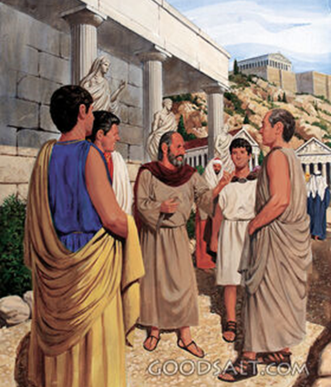
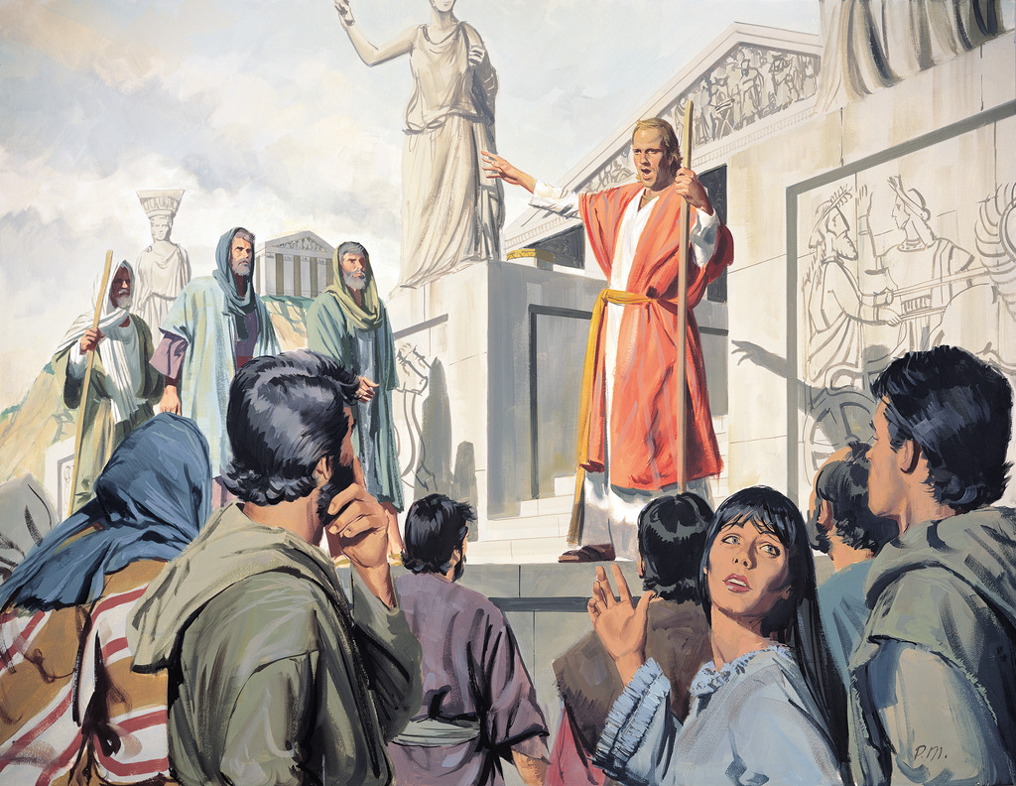
NEW WAYS OF PREACHING
“You are bringing some strange ideas to our ears, and we would like to know what they mean” (Acts 17:20)
After some time preaching in the square, the Athenians were surprised by the ideas that Paul presented.
Avid seekers of new teachings, the Athenians wanted to understand more clearly what Paul was preaching: “new gods,” “new teaching,” “strange things”.
What he said about God had nothing to do with the way their capricious and vain gods acted. Accustomed to debating philosophical thoughts, they saw the coherence of their reasoning.
Paul had become familiar with Greek thought and culture. He had read the classical authors and walked the streets of Athens, carefully observing everything he saw, and getting to know the way of thinking and acting of its inhabitants.
The Holy Spirit was preparing him for a new way of preaching to people who were not used to hearing about the one true God.

Slide 7
HOW TO EVANGELIZE NON-CHRISTIANS

Slide 8
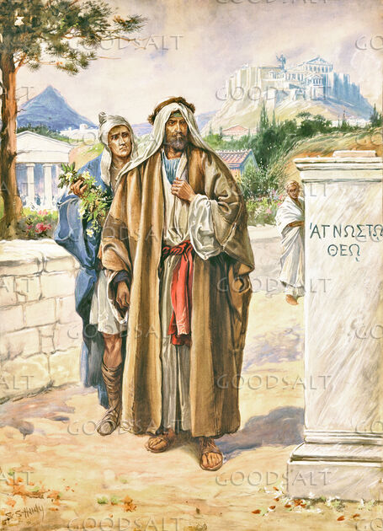
FIND COMMON POINTS
“For as I walked around and looked carefully at your objects of worship, I even found an altar with this inscription: to an unknown god. So you are ignorant of the very thing you worship—and this is what I am going to proclaim to you” (Acts 17:23)
In his dissertation at the Areopagus, what was Paul's way of dealing with the pagans? Acts 17:22-23.
Praised them
He praised the fact that they were religious people, interested in spiritual things.
He respected them
He didn’t address them as an expert who was going to change their perception of the world, but as someone who wanted to share his knowledge as an equal.
Take advantage of common points
He found in the altar to the “Unknown God” a bridge that united both thoughts.
He did not mock his ignorance
On the contrary, he admired their desire to worship even that which was unknown to them.
Preaching to people with beliefs radically different from ours is a challenge that we must face with the utmost tact. With all due respect, we must look for points in which our interlocutors can be praised and even admired; and those that are common with our way of thinking or acting.

Slide 9
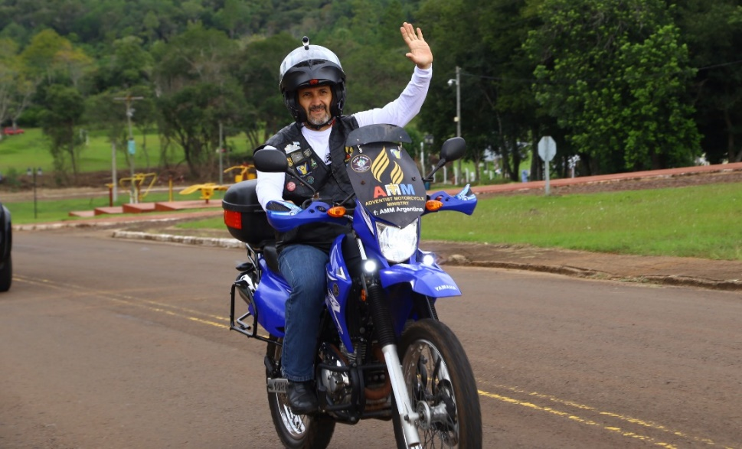
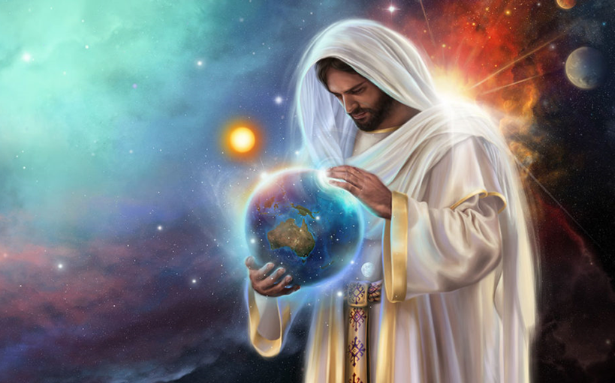
ADAPT OUR SPEECH
“The God who made the world and everything in it is the Lord of heaven and earth and does not live in temples built by human hands” (Acts 17:24)
To reach non-Christian people we must adapt our speech. We will have to use unconventional methods, starting from common points.
Evangelize by doing “hangouts” with a group of bikers? Talk about Jesus based on a movie? Accept that my listeners worship a multitude of gods and talk to them about one of them to get to Jesus?
These are not the speeches we expect to hear in a traditional church, or speaking with Christians of other denominations. We must speak to others about what they know, not what only we know.
Creation is the common point that Paul used. He presented the Creator God, and even used references to Greek poets to reinforce his thinking.
Once he had their attention, he made a call to which they could now respond: seek God! (Acts 17:27).

Slide 10
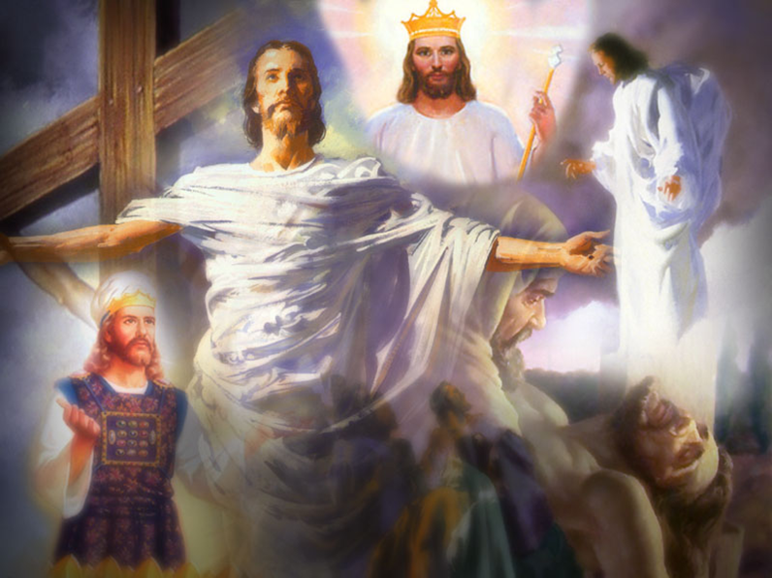
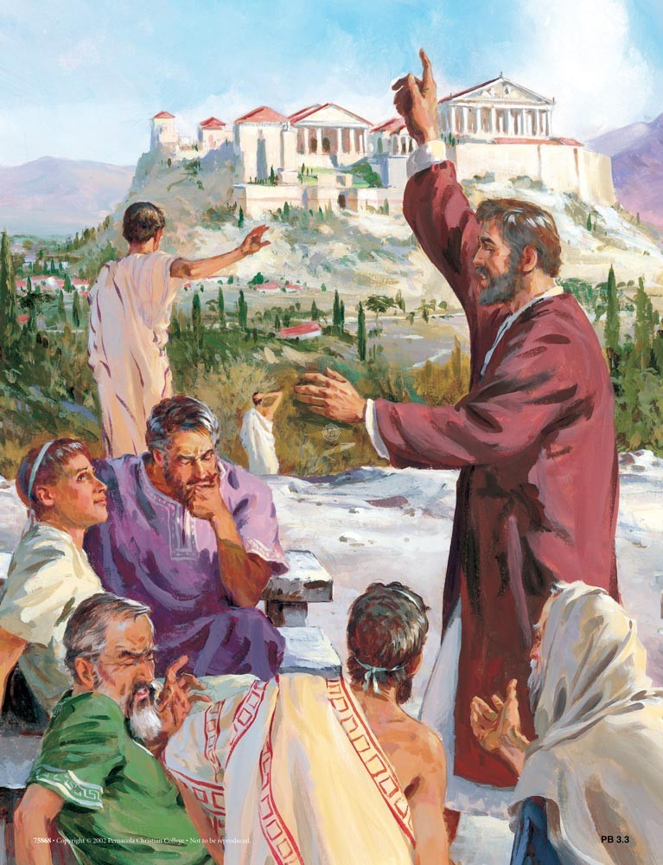
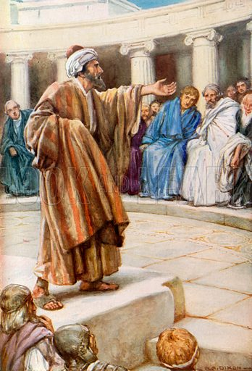
PRESENT CHRIST
“For he has set a day when he will judge the world with justice by the man he has appointed. He has given proof of this to everyone by raising him from the dead” (Acts 17:31)
Sooner or later, the time comes to move from common ground to new teachings. After all, we achieve nothing by always talking about common ground. The Holy Spirit will show us the moment and the way in which we should openly present Jesus.
In his speech at the Areopagus he spoke at length before introducing Jesus (surely, Luke only gives us the summary of the speech).
Everyone heard the same thing, but not everyone reacted the same way. Our responsibility is to present Jesus in the most appropriate way. The result will depend on the heart of each listener.
When the time came, some laughed, others preferred to continue talking at another time. A few were immediately convinced. (Acts 17:34).

Slide 11
Ellen G. White (Evangelism, p. 70)
“New methods must be introduced. God's people must awake to the necessities of the time in which they are living. God has men whom He will call into His service, —men who will not carry forward the work in the lifeless way in which it has been carried forward in the past.......
In our large cities the message is to go forth as a lamp that burneth. God will raise up laborers for this work, and His angels will go before them. Let no one hinder these men of God's appointment. Forbid them not. God has given them their work. Let the message be given with so much power that the hearers shall be convinced”

Slide 12
WEEKLY CHALLENGE
Prayerfully ask God to specifically guide you in how best to witness to someone you know
ADVANCED CHALLENGE
Explore social networks as a possible “Areopagus”, so that you can present the gospel to non-believers with the clarity and discretion of Paul

