Slide 1
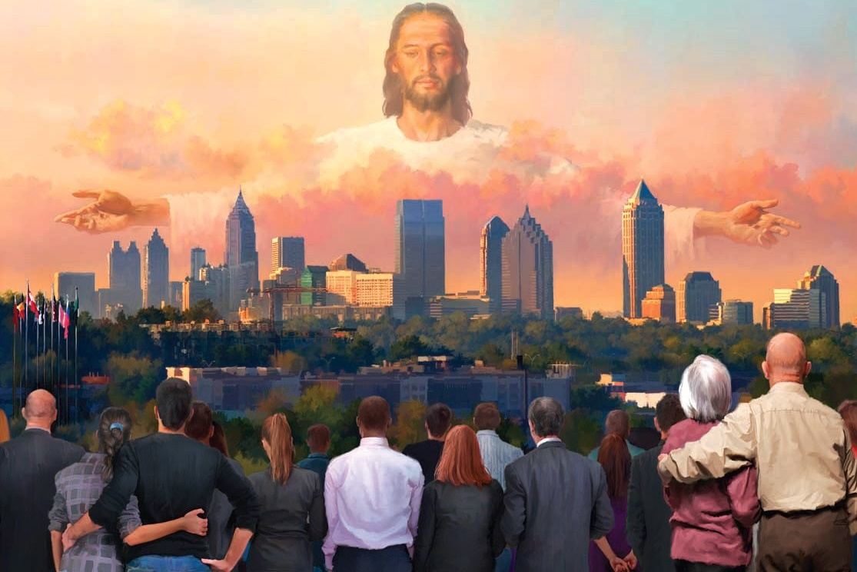
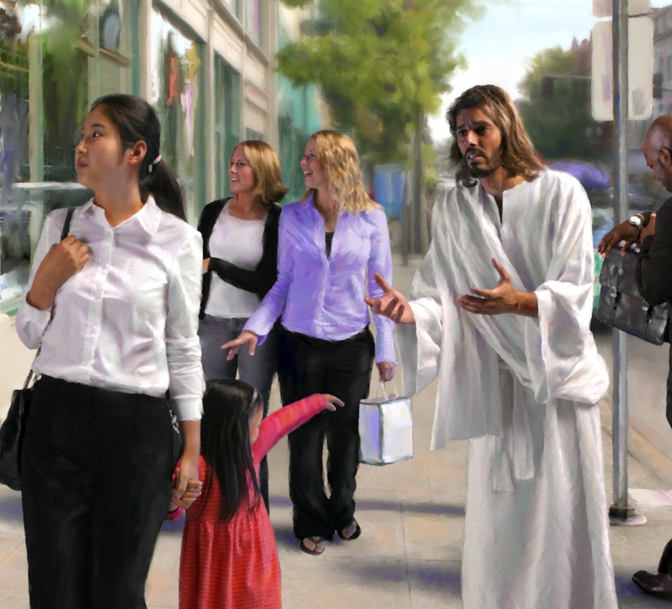
MISSION TO THE UNREACHED: PART TWO
Lesson 11 for December 16, 2023

Slide 2
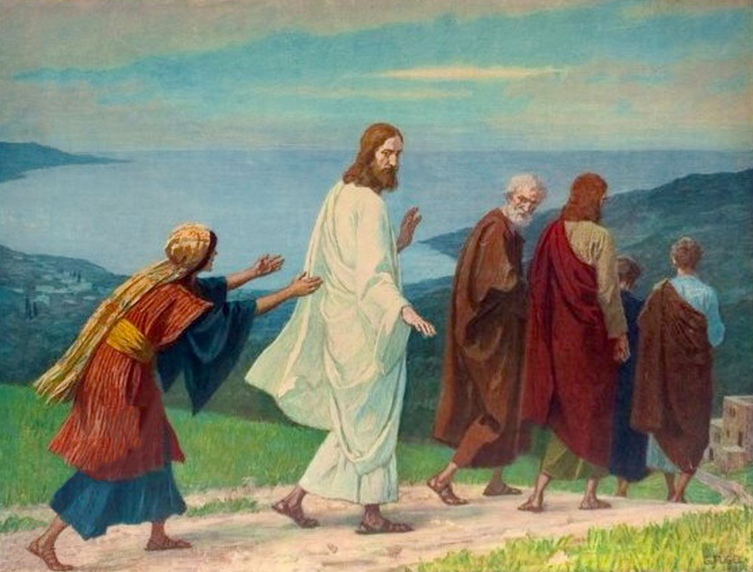
“Then Jesus answered and said to her, ‘O woman, great is your faith! Let it be to you as you desire.’ And her daughter was healed from that very hour”
(Matthew 15:28, NKJV)

Slide 3
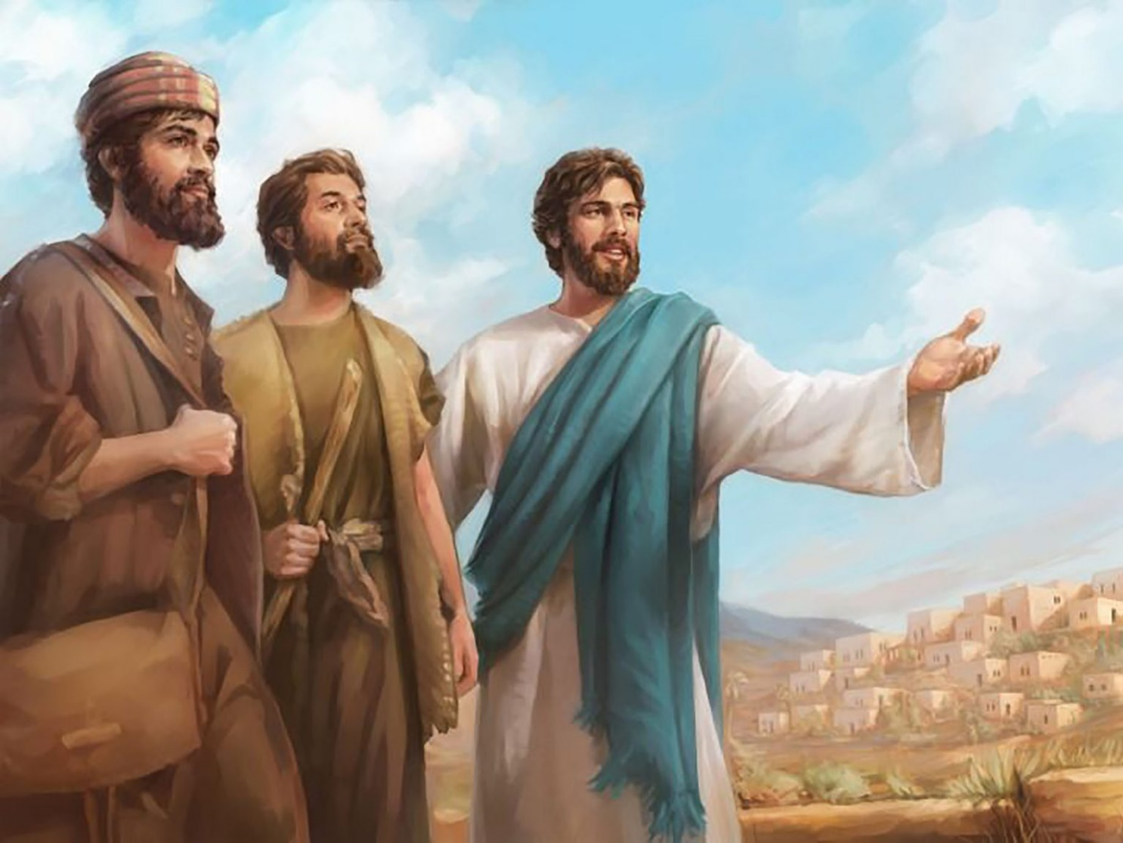
Jesus saw the crowds “as sheep without a shepherd” (Matthew 9:36). He felt compassion for them, and saw the need for someone to help them. “Pray ye therefore the Lord of the harvest, that he will send forth labourers into his harvest” (Matthew 9:38). You and I are those workers.
Our cities are full of people who don't know what Jesus has done for them. Many have distorted ideas about God, or reject Him outright. They don't know it, but they need us. They need someone to bring them to the feet of Jesus.
We are called to be a light among the people. To do this we must love them, know them, know how they feel, what they think, what their aspirations and needs are.
Face challenges.
Search for the lost.
An inclusive work.
Save the lost.
Be a light among the people.

Slide 4
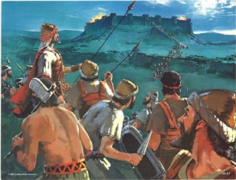
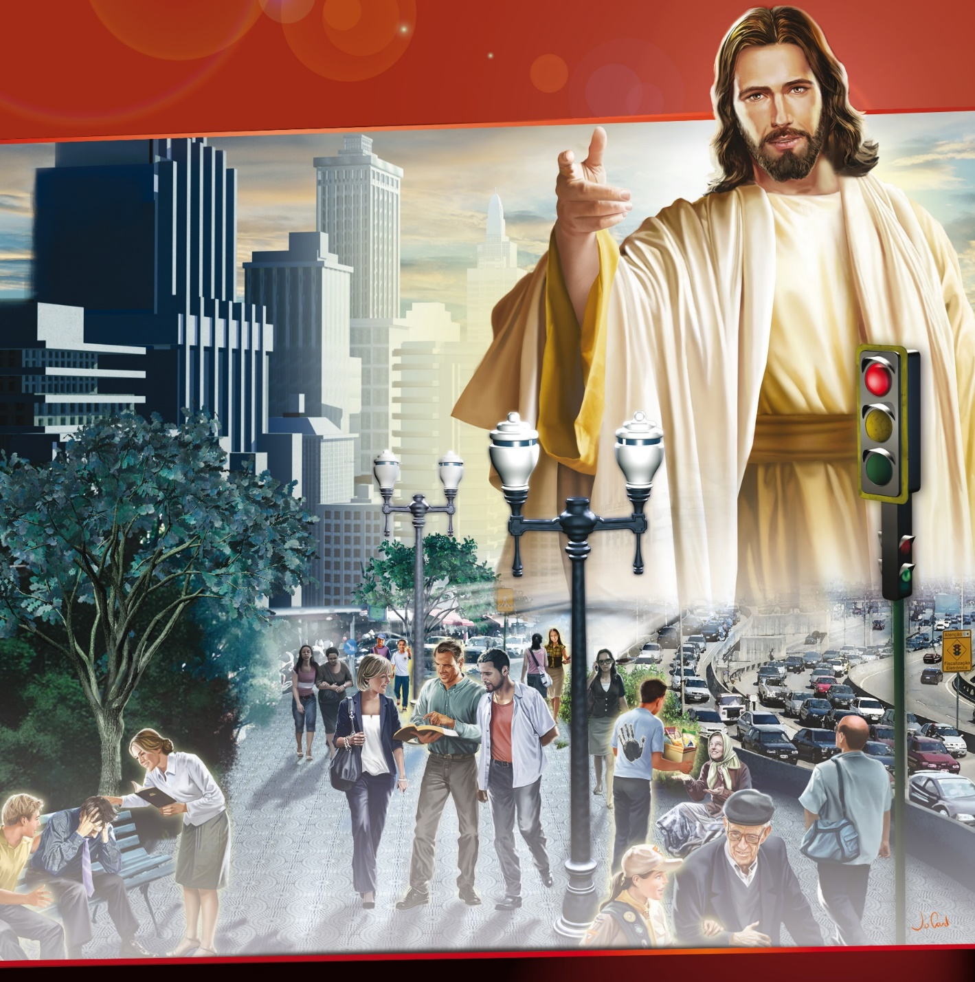
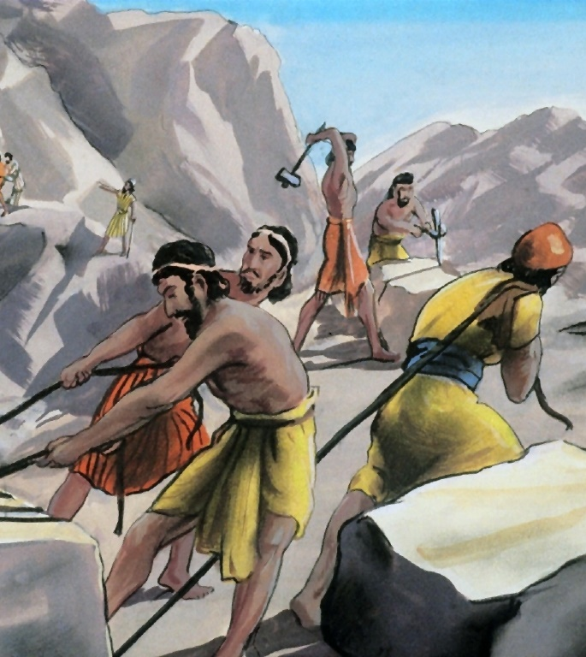
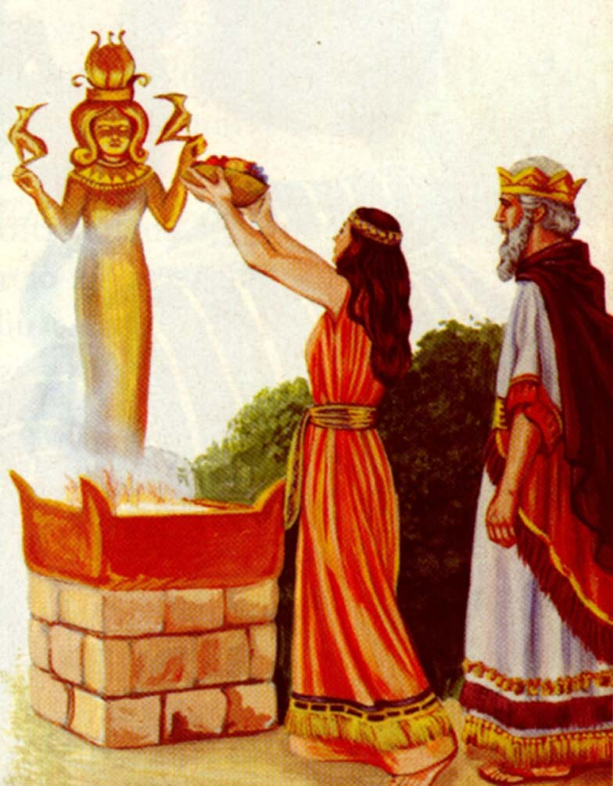
FACE CHALLENGES
“Now these are the nations which the Lord left, to prove Israel by them, even as many of Israel as had not known all the wars of Canaan” (Judges 3:1)
Just as he did with ancient Israel, God has made us dwell in the midst of our “enemies”.
Unlike that time, our war is not physical, but spiritual. Our enemies are not people to destroy, but people to save and win for Christ.
The war is especially intense in cities, where we face a multitude of challenges: a deteriorated environment; health problems; high or excessively low standard of living; racism; intolerance; nationalism; restrictions on freedom of religion and expression; etc.
Inevitably, we must unite with those we want to win to Christ, as Solomon did (1Ki. 5:1-11). However, we must avoid being carried away by them, as he was (1 Kings 11:1, 4).

Slide 5
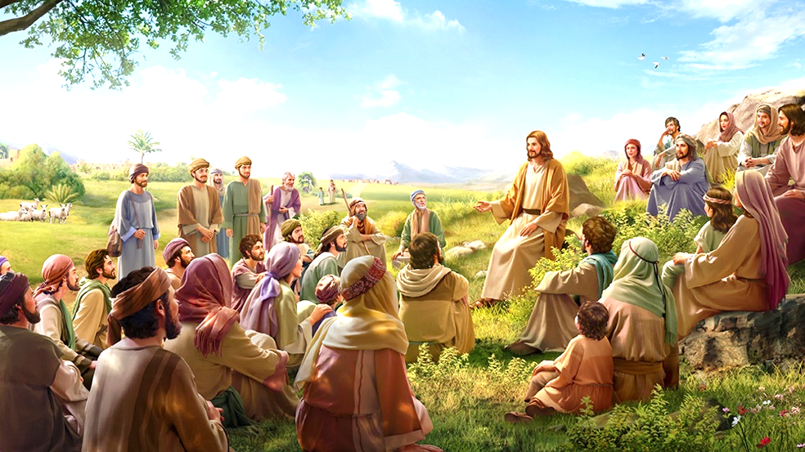
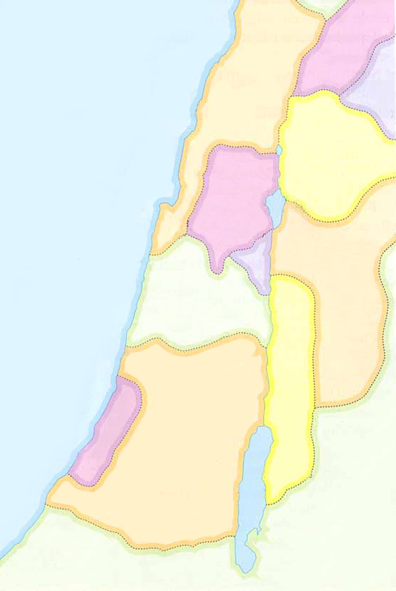
SEARCH FOR THE LOST
· Sidón
“But when he saw the multitudes, he was moved with compassion on them, because they fainted, and were scattered abroad, as sheep having no shepherd” (Matthew 9:36)
Phenicia
· Tiro
Mediterranean
Sea
Iturea
Undoubtedly, Jesus cares about each person individually. However, He also cares about “the multitudes.” Part of the mission, then, is to reach the multitudes.
TRANSJORDAN
Galilee
Decapolis
And where are the crowds? In the cities. In urban centers that are sometimes occupied by millions of people, “faceless masses”, to whom we must present the shepherd of the sheep.
Samaria
Jesus traveled many places during his ministry. In this way, multitudes from Syria, Galilee, Decapolis, Jerusalem, Judea and Transjordan followed him (Mt. 4:23-25).
Jerusalem ·
Perea
When he was already known in these places, Jesus decided to go to the region of Tire and Sidon (Phoenicia), whose culture was totally different. Due to its location next to the Mediterranean Sea, its main means of living was maritime trade. On the other hand, their cities were full of pagan temples.
Judea

Slide 6
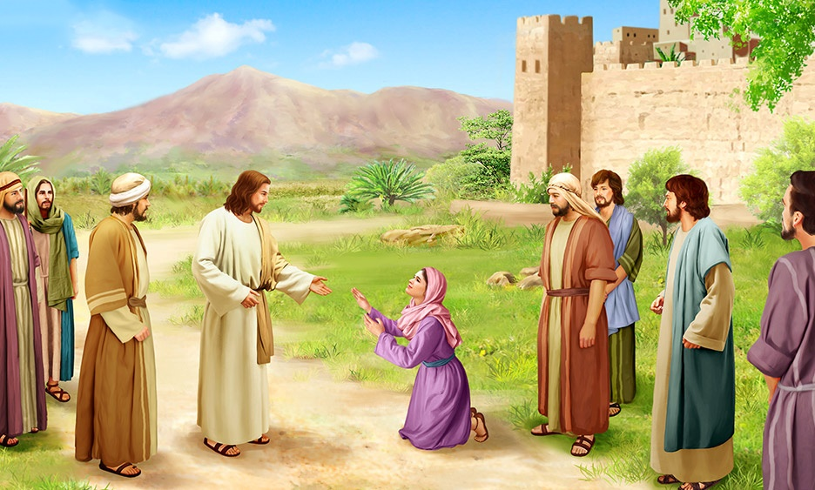
AN INCLUSIVE WORK
“And, behold, a woman of Canaan came out of the same coasts, and cried unto him, saying, have mercy on me, O Lord, thou son of David; my daughter is grievously vexed with a devil” (Matthew 15:22)
“The woman was a Greek, a Syrophenician by nation; and she besought him that he would cast forth the devil out of her daughter” (Mark 7:26)
What do we end up with, was the woman Canaanite, Greek or Syrophoenician? In reality, it was all of that. It all depends on the point of view of the narrator or his readers. Matthew wrote his gospel with a Jewish audience in mind. For the Jews, this woman was a Canaanite. That is, it belonged to the idolatrous peoples who were to be expelled from the Promised Land. Unworthy, as they thought, of salvation.
Mark wrote his gospel with a Roman audience in mind. They used the term “Greek” to describe it, because it was not Roman (“Gentile” for the Jews, “barbarian” for the Greeks). For this reason, Mark specifies his nationality.
Both evangelists wanted to emphasize that the woman was foreign to the people of Israel, so that they would understand why Jesus treated this woman that way before granting her request. Everyone needed to understand that the gospel is not just for a specific group, but is inclusive, encompassing all people in all nations and ethnic groups.

Slide 7
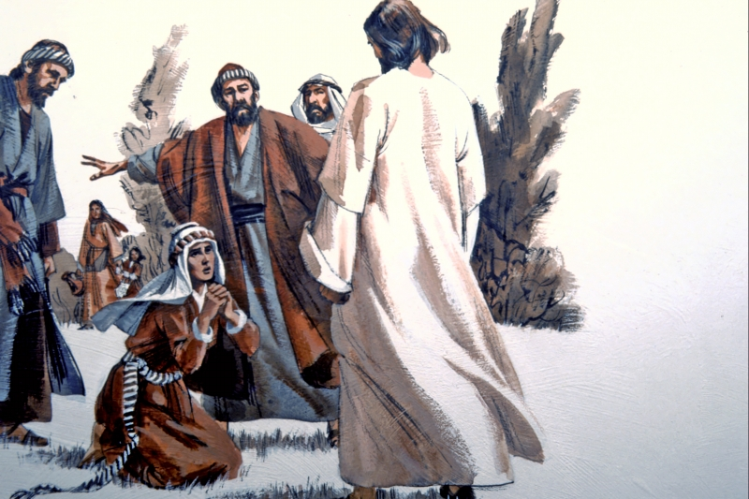
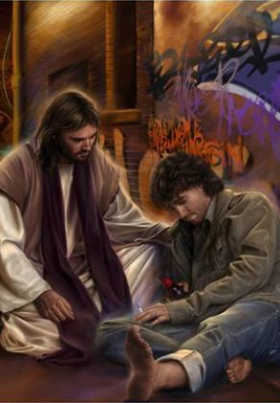
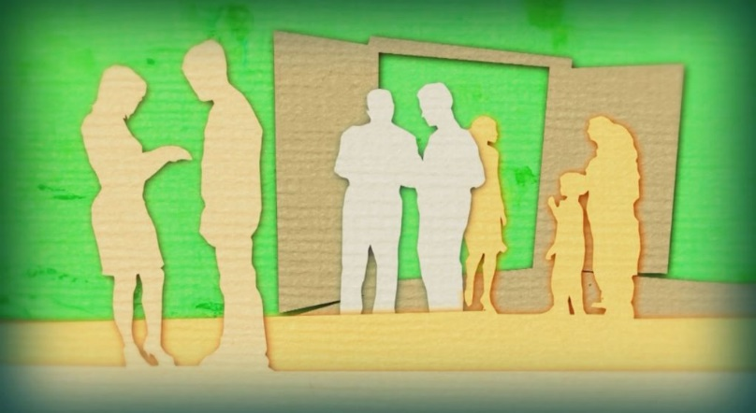
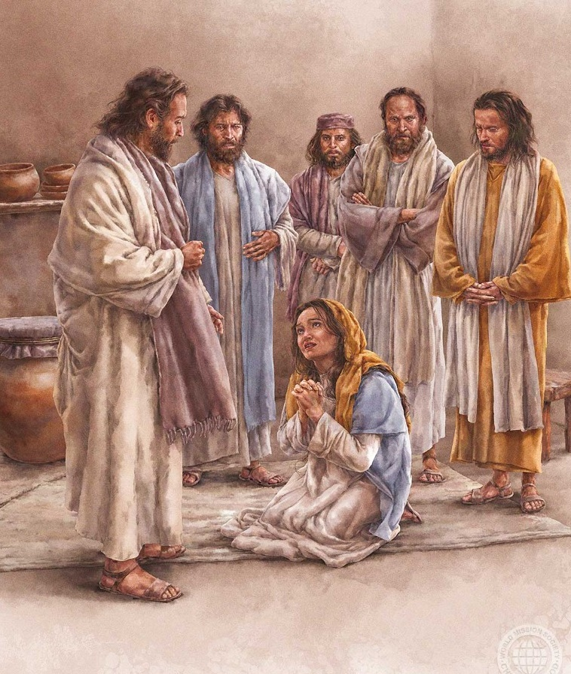
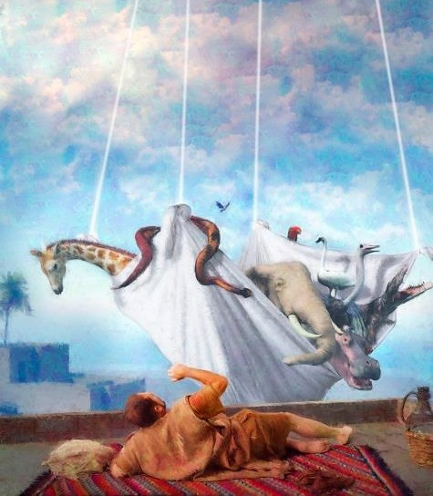
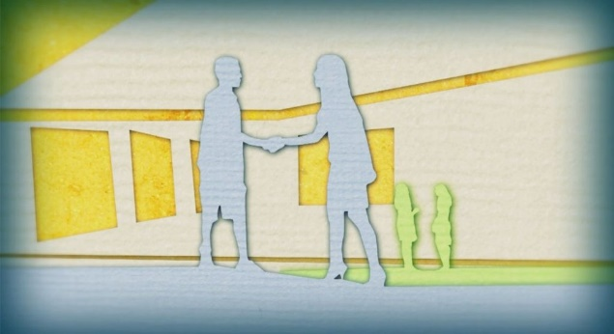
SAVE THE LOST
“But he answered her not a word. And his disciples came and besought him, saying, Send her away; for she crieth after us” (Matthew 15:23)
In every urban center there are groups of people with whom we do not feel inclined to deal. Maybe it's because of their religion, their ethnic origin, their customs. Maybe it's because of their propensity for violence, or because of their extreme poverty.
We do not know many things about the woman who presented herself to Jesus, but she was among the group of “untreatable” people. To the astonishment of his disciples, Jesus recognized her faith and healed her daughter (Mt. 15:28).
Jesus' message is clear: save the lost no matter who he or she is or what we think of him or her.
It took time for the apostles to accept this. The Holy Spirit had to impress Peter through a vision to make him accept that he had to bring the message of salvation to the Gentiles (Acts 10:9-28).

Slide 8
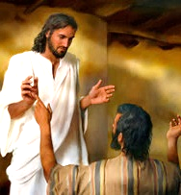
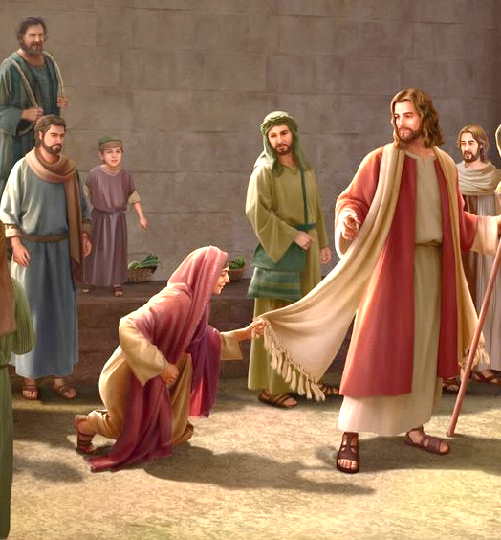
BE A LIGHT AMONG PEOPLE
“I tell you that he will avenge them speedily. Nevertheless, when the Son of man cometh, shall he find faith on the earth?” (Luke 18:8)
During his ministry, Jesus encountered unbelief in the people. However, he also found faith in the most unexpected people.
His hometown (Mark 6:1, 5-6)
Cities where he preached (Mt. 11:21-23)
His listeners (Mt. 6:30)
His apostles (Mt. 8:26)
A blind beggar (Mark 10:46, 52)
A leper (Mt. 8:2-3)
A pagan soldier (Mt. 8:5, 13)
A foreigner woman (Mt. 15:22, 28)
LACK OF FAITH
WITH GREAT FAITH
One lesson that we can apply to today is that faith is found in unexpected places: in the cities among foreigners, pagans, and people with different religions. In humility, we must go into the cities as Jesus did, seeking out those who, when presented with truth, will respond with a saving faith in Jesus. And they are indeed out there.

Slide 9
E. G. W. (Selected Messages,
Draw in Even Cords, Letter 62.-1910)
E. G. W. (The Call of the Cities, pg. 21)
“The duty of God's servants at this time is to preach the Word in the cities. Christ came from the heavenly courts to this earth in order to save souls and we, as almoners of His grace, need to impart to the inhabitants of the great cities a knowledge of His saving truth”
“The terrible disasters that are befalling great cities ought to arouse us to intense activity in
giving the warning message to the people in these congested centers of population while we still have
an opportunity. The most favorable time for the presentation of our message in the cities has passed by.
Sin and wickedness are rapidly increasing; and now we shall have to redeem the time by laboring all the more earnestly”

Slide 10
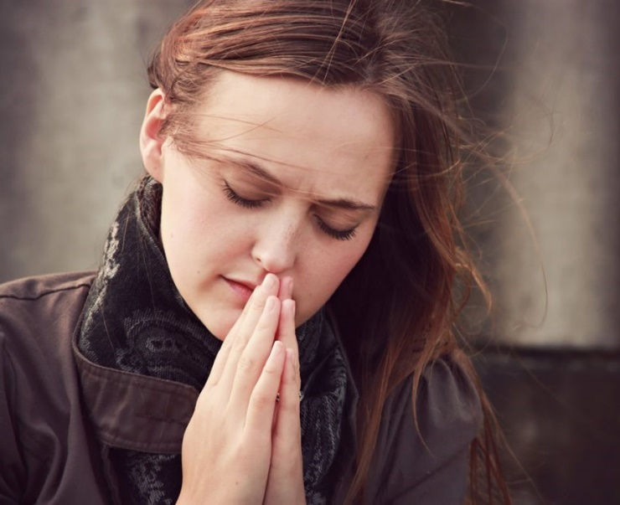
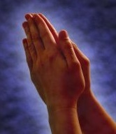
WEEKLY CHALLENGE
Open your heart in prayer, asking for a greater portion of faith with which to share your love for those near and far.
ADVANCED CHALLENGE
How did you come to know Jesus and the precious message of the three angels? List three spiritual blessings you have experienced from Jesus in your personal life.

