Slide 1
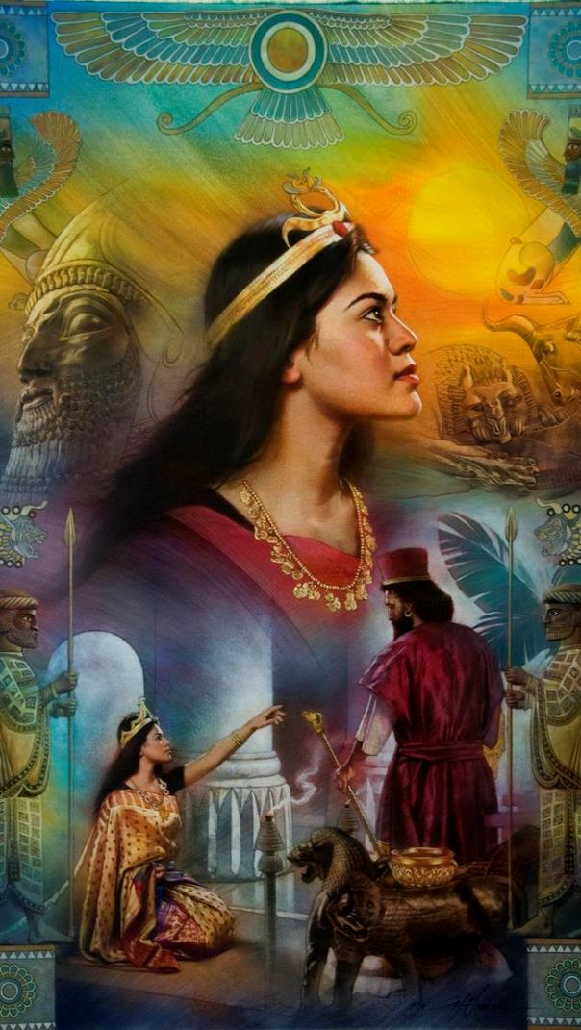
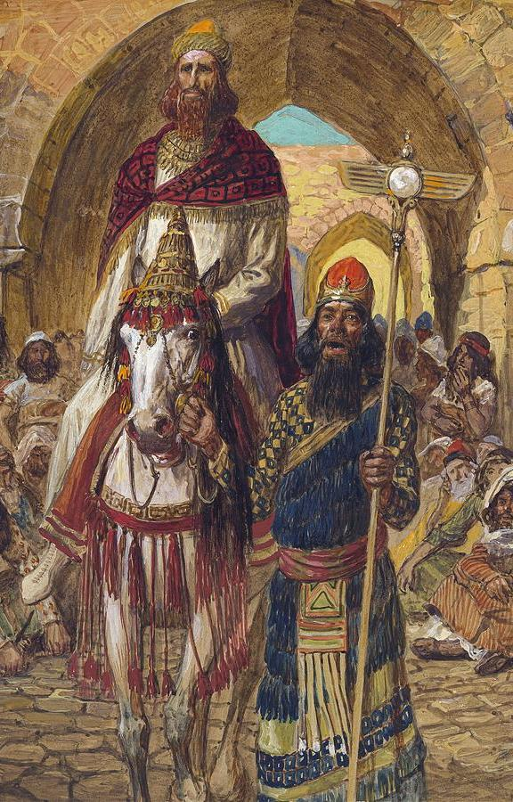
ESTHER
AND
MORDECAI
Lesson 12 for December 23, 2023

Slide 2
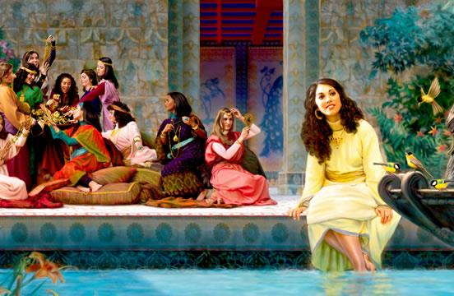
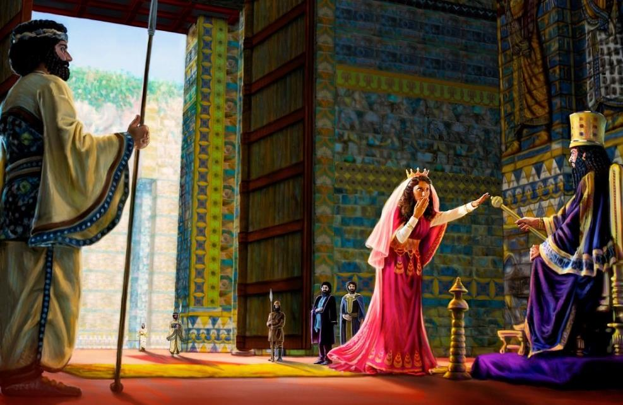
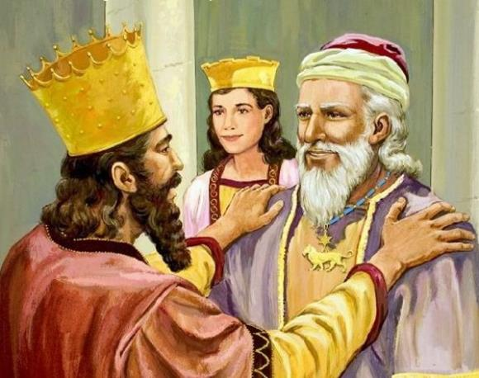
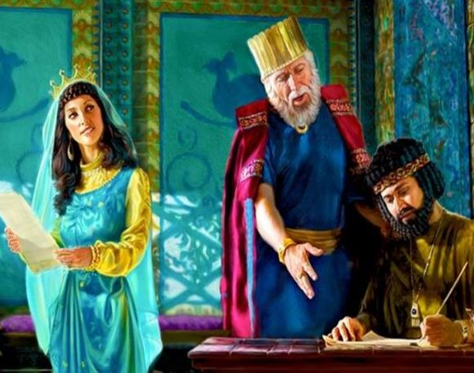
“I will give you as a light to the nations, that my salvation may reach to the end of the earth” (Isaiah 49:6, NRSV)

Slide 3
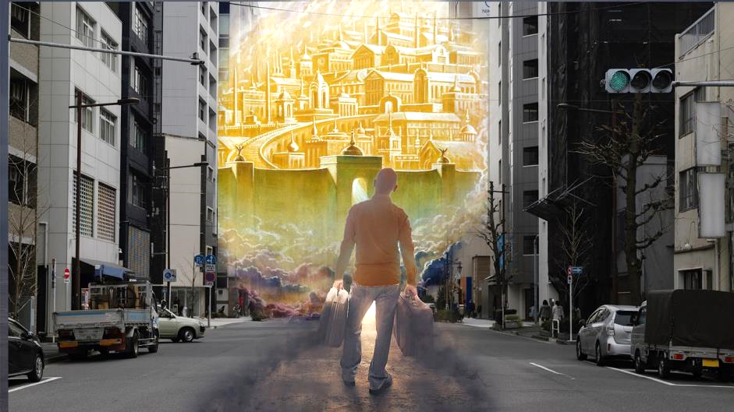
We are citizens of the Kingdom of God and we are governed by the laws that govern that Kingdom.
This implies that, regardless of whether we live in the country in which we were born or another, we are foreigners. We live in a strange land. and we have to live with laws that, at times, contradict the Law of God.
Despite this, most of us do not have legal or cultural problems to testify of our faith. However, there are places where expressing our faith can bring us serious problems.
Witnesses in a strange land:
Daniel and his friends.
Esther and Mordecai.
The human part:
The testimony of Mordecai.
The testimony of Esther.
The divine part:
The miracle of Purim.

Slide 4
WITNESSES IN A STRANGE LAND

Slide 5
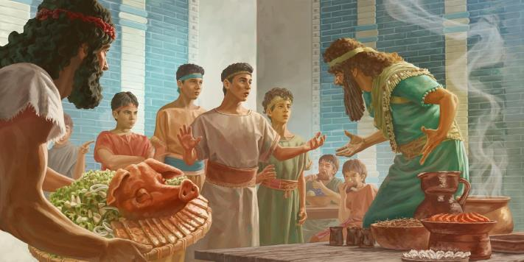
DANIEL AND HIS FRIENDS
“But Daniel purposed in his heart that he would not defile himself with the portion of the king's meat, nor with the wine which he drank” (Daniel 1:8a)
For Daniel and his friends everything changed in the year 605 BC. These young men of the Jewish royal lineage were taken to Babylon to be converted into loyal subjects of the Empire (Dn. 1:1-7).
They were named after Babylonian gods
They were educated in the culture and laws of Babylon
Their diet was changed
They were separated from their family
It was easy to serve God in a place where everyone worshiped correctly and obeyed His Law. In Babylon, however, they could be forced to eat impure foods (Dan. 1:8), or to worship other gods (Dan. 3:4-6).
Curiously, those who remained in Jerusalem were unfaithful (Ez. 8:10-16), while Daniel and his friends remained faithful (Dan. 3:16-18). What was the reason for this difference?
In contrast, for those who are determined to be faithful, even the most unfavorable environment cannot keep them from obedience.

Slide 6
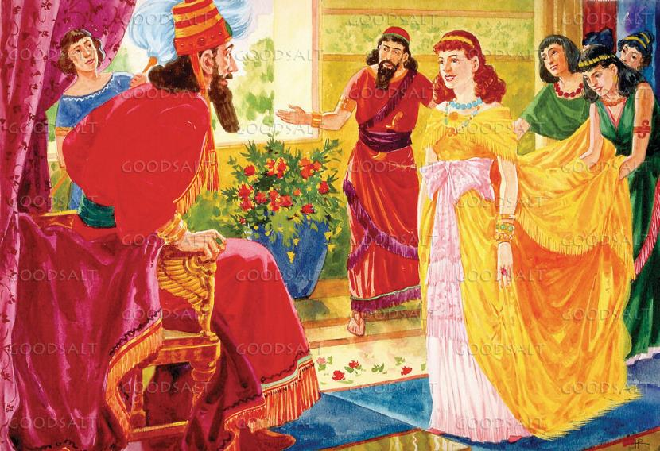
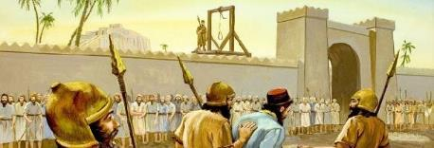
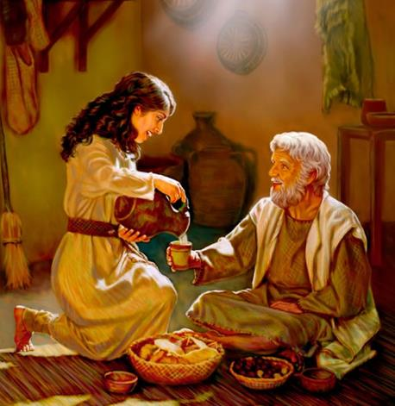
ESTHER AND MORDECAI
“Esther had not shewed her people nor her kindred: for Mordecai had charged her that she should not shew it” (Esther 2:10)
In 479 BC, Esther became the wife of Xerxes I [Hebrew, Ahasuerus] and thus queen of the Persian Empire. Why did he hide his Jewish origin (Est. 2:10, 20)?
When Cyrus conquered Babylon, he allowed the Jews to return to Jerusalem. However, many decided to stay in the places where they had been taken. This was the case of the ancestors of Mordecai and his cousin Esther.
After the defeat of Salamis by the Greeks (480 BC) the political environment in Persia was unstable. As we can see from the story of Haman, any person or group of people could be accused of sedition and sentenced to destruction (even without any proof).
It was time to be prudent (Eccl. 3:1, 7; Amos 5:13). However, when the situation called for a clear testimony, Esther and Mordecai boldly testified to their faith.

Slide 7
THE HUMAN PART

Slide 8
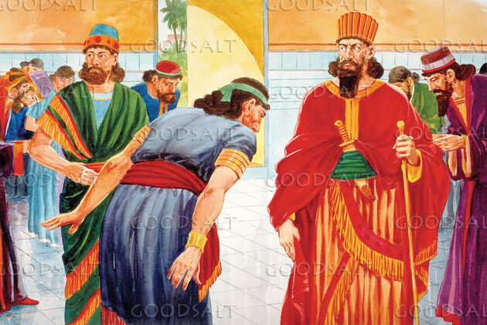
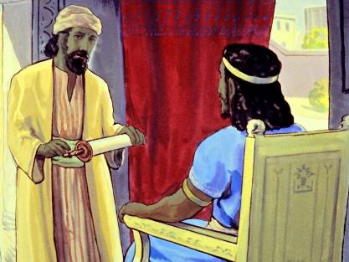
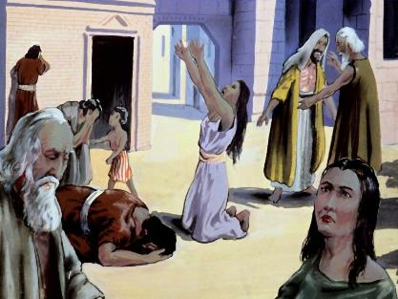
THE TESTIMONY OF MORDECAI
“Then the king's servants, which were in the king's gate, said unto Mordecai, Why transgressest thou the king's commandment?” (Esther 3:3)
The king had ordered everyone to honor Haman (Est. 3:1-2). What reasons did Mordecai have for disobeying?
He didn't kneel
He did not humiliate himself
Because doing so was an act of worship, and only God should be worshiped.
Because the Amalekites had been cursed by God (Ex. 17:14, 16), and honoring the Amalekite Haman meant dishonoring God.
His attitude caught the attention of his colleagues. It was not the time to remain silent. In the face of conflict, he explained that God's Law prevented him from honoring men the way Haman wanted to be honored.
Racial hatred and his own pride led Haman to seek, not only the death of Mordecai, but that of the entire Jewish people: “they have different laws from other peoples and do not carry out the orders of His Majesty” (Est. 3:8).
This will also happen at the end of time.

Slide 9
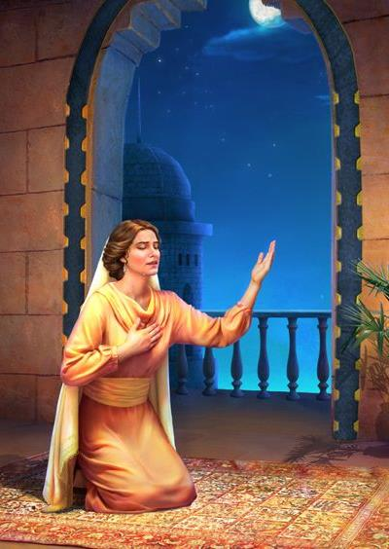
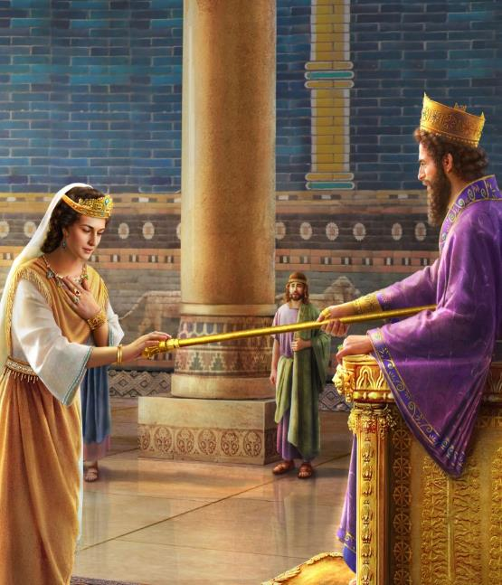
THE TESTIMONY OF ESTHER
“Go, gather together all the Jews that are present in Shushan, and fast ye for me, and neither eat nor drink three days, night or day: I also and my maidens will fast likewise; and so will I go in unto the king, which is not according to the law: and if I perish, I perish” (Esther 4:16)
When she learned about the royal decree, Esther's faith wavered. Why risk her life by going before the king if no one knew she was Jewish (Esther 4:11)?
Mordecai knew Esther well. Perhaps she just needed her cousin to make her see clearly the seriousness of the events: “Think not with thyself that thou shalt escape in the king's house, more than all the Jews. For if thou altogether holdest thy peace at this time, then shall there enlargement and deliverance arise to the Jews from another place; but thou and thy father's house shall be destroyed: and who knoweth whether thou art come to the kingdom for such a time as this?” (Esther 4:13-14).
Now she knew why she had been chosen queen. She also knew what she should do: prayer and fasting. Only God could do what neither she nor anyone else could do. She left her life in the hands of God. Now was the time to bear witness to her faith. “And if I perish, let me perish” (Esther 4:16).

Slide 10
THE DIVINE PART

Slide 11
THE MIRACLE OF PURIM
“Then Esther the queen, the daughter of Abihail, and Mordecai the Jew, wrote with all authority, to confirm this second letter of Purim” (Esther 9:29)
Haman cast lots [Pur] to determine when to wipe out the Jews (Est. 9:24-26). How did God turn this Pur into the festival of Purim?
He gave courage to Esther (Est. 4:16)
It moved the heart of Ahasuerus (Est. 5:2)
He inspired Esther with a plan (Est. 5:4, 8)
He made Ahasuerus honor Mordecai (Est. 6:1-3, 11)
He put the precise words in Esther's mouth (Est. 7:3-6)
He allowed Haman to show all his perfidy (Est. 7:7-8)
Ahasuerus's attitude towards the Jews changed (Est. 8:7-8)
Although God's name does not appear in the book of Esther, his presence and activity is evident. What were the consequences? “And many of the people of the land became Jews; for the fear of the Jews fell upon them.” (Esther 8:17). God worked and continues to work to bring lost souls to the knowledge of Him.

Slide 12
“The crisis that Esther faced demanded quick, earnest action; but both she and Mordecai realized that unless God should work mightily in their behalf, their own efforts would be unavailing. So Esther took time for communion with God, the source of her strength. […]
“God wrought in behalf of His penitent people”
EGW (Daughters of God, pg. 46.5 and 47.1

Slide 13
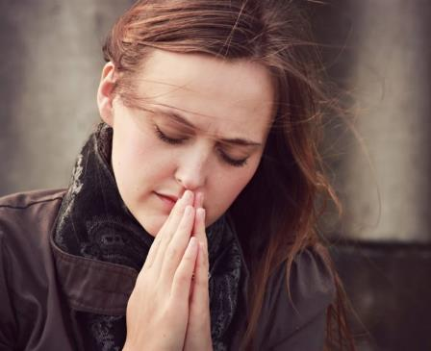
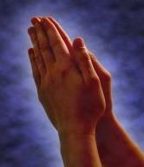
WEEKLY CHALLENGE
Pray that God will give you the courage to share something He has done for you with one of the people on your prayer list this week
ADVANCED CHALLENGE
Start a journal of small (or big) special things God does for you. Review it and pray that God brings these things to your mind at the right time so you can share them with someone

