Slide 1
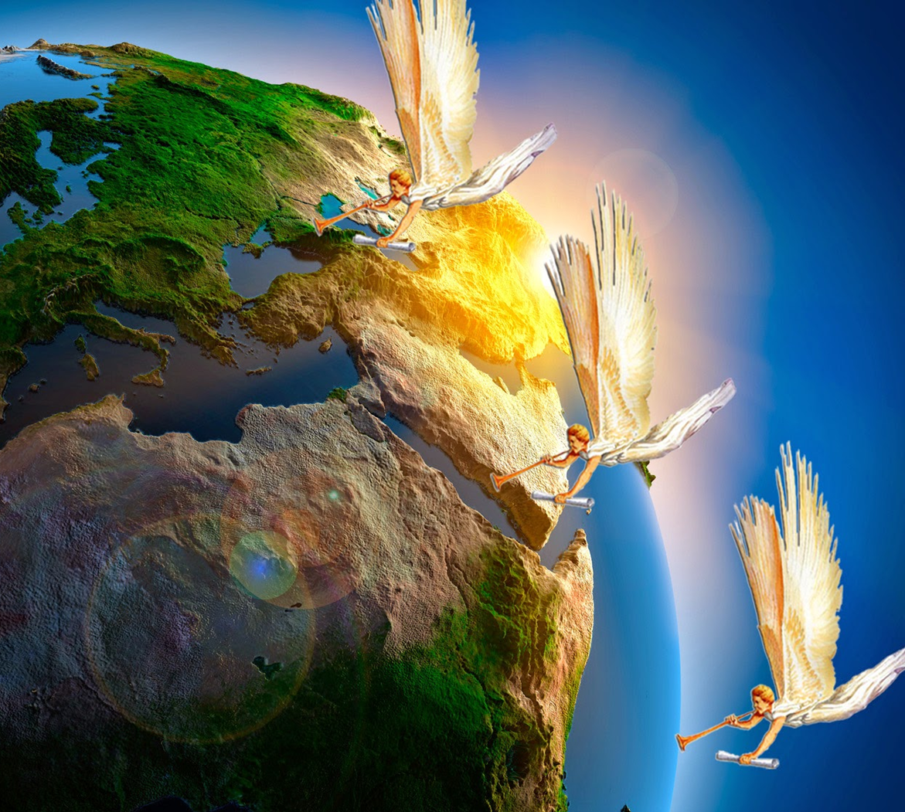
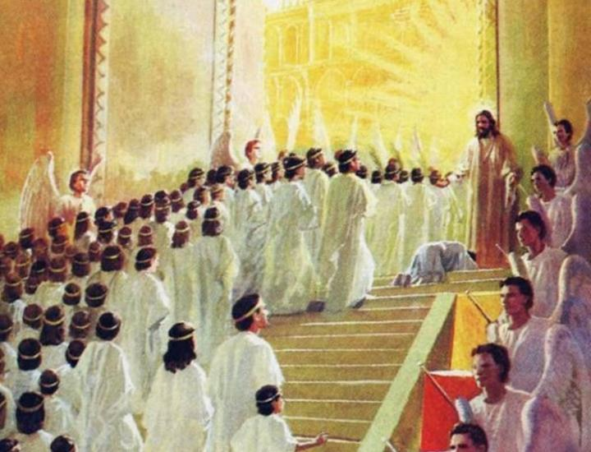
Lesson 13 for
December 30, 2023
THE END OF GOD'S MISSION

Slide 2
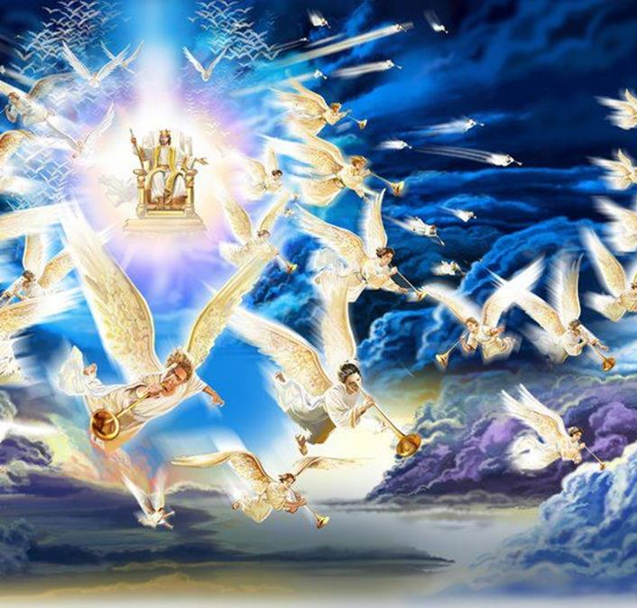
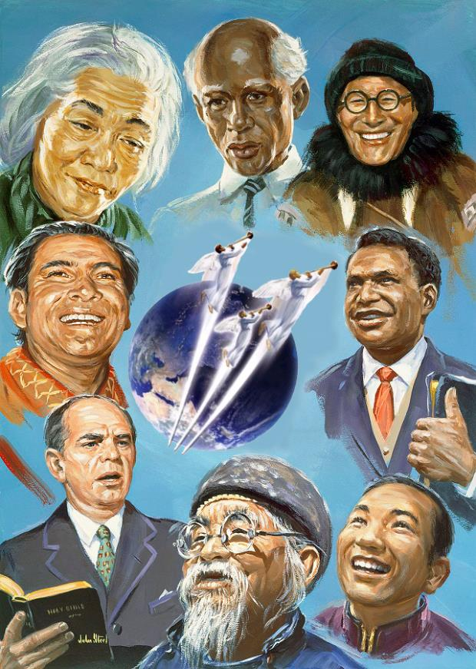
“Since everything will be destroyed in this way, what kind of people ought you to be? You ought to live holy and godly lives as you look forward to the day of God and speed its coming. f That day will bring about the destruction of the heavens by fire, and the elements will melt in the heat” (2 Peter 3:11,12)

Slide 3
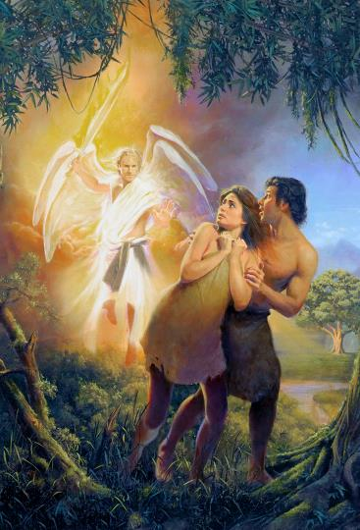
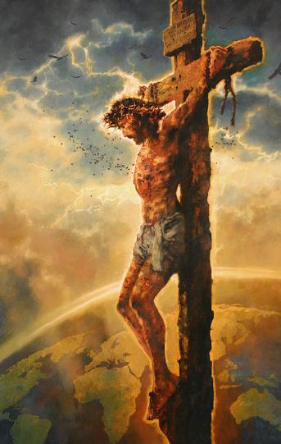
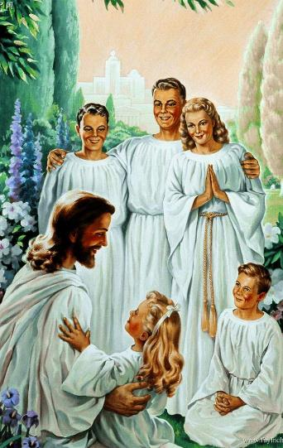
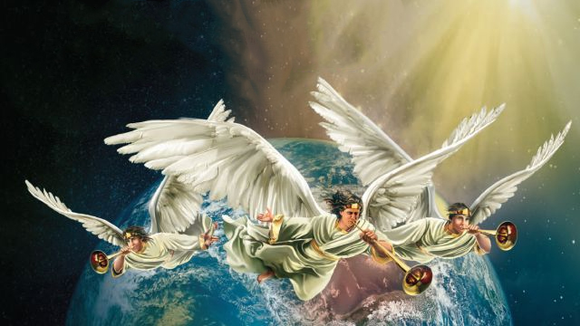
God's mission is for humanity to live with Him happily and in harmony.
The breach that occurred in Eden was restored by Jesus through his incarnation, death, and resurrection.
But the mission has not yet reached its ultimate goal. There's still a little bit left. We can and must still collaborate with God in the fulfillment of his mission.
God's mission for the last days:
The message of Revelation.
The message of the three angels.
The accepted or rejected message.
The culmination of God's mission:
The success of the mission.
Mission completed?

Slide 4
GOD'S MISSION FOR THE LAST DAYS

Slide 5
THE MESSAGE OF REVELATION
“The revelation from Jesus Christ, which God gave him to show his servants what must soon take place” (Revelation 1:1a)
A MESSAGE FROM DIVINITY TO HUMANITY
From God the Father
From God the Holy Spirit
“From him who is, and who was, and who is to come” (Rv. 1:4)
The Eternal reveals to us his plan to save us
“and from the seven spirits before his throne” (Rv. 1:4)
From God the Son
He gives us power to fulfill the mission
“and from Jesus Christ, who is the faithful witness, the firstborn from the dead, and the ruler of the kings of the earth. To him who loves us and has freed us from our sins by his blood” (Rv. 1:5)
Through his blood he cleanses our sins and makes us kings and priests (Rv. 1:6)
By participating in God's mission, Jesus makes us priests. We have the opportunity to intercede on behalf of others, bringing them the message of salvation (1P. 2:9).

Slide 6
THE MESSAGE OF THE THREE ANGELS
“Then I saw another angel flying in midair, and He had the eternal gospel to proclaim to those who live on the earth—to every nation, tribe, language and people” (Revelation 14:6)
The last message that must be proclaimed to the world consists of three fundamental points:
Show the gospel of salvation to everyone
Direct the world's attention to the Creator and his Law
Warn of the consequences of rejecting the divine call
By deceiving Adam and Eve, Satan took control of this world from God. But Jesus, dying on the cross, paid the ransom price and regained dominion. The “prince of this world” (Jn. 16:11) had been defeated.
And every converted soul adheres to this victory: “They triumphed over him by the blood of the Lamb and by the word of their testimony; they did not love their lives so much as to shrink from death” (Rv. 12:11).
And those of us who have already overcome become spokespersons for the last warning message. A message that demands a decision for life or death.

Slide 7
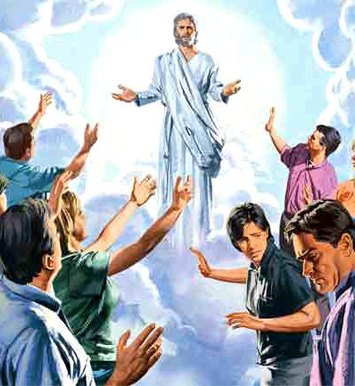
THE MESSAGE ACCEPTED OR REJECTED
“Who wants all men to be saved and come to the knowledge of the truth” (1 Timothy 2:4)
In offering salvation, God excludes no one. The call is universal. God is love, and that love is offered to all equally (1Jn. 4:8; 2P 3:9).
But just because salvation is offered to everyone does not mean that everyone accepts it. Because many “although they knew God, they did not glorify Him as God, nor were thankful” (Romans 1:21).
Some will obtain salvation even without ever having heard of it (Rom. 2:12-16). But in the time of the end, there will come a time when everyone will have clearly heard the message and will make a decision about it.
Satan will pressure the world to make laws against freedom of conscience and prevent people from accepting the message. Humanity will be polarized into two groups: those who accept Jesus; and those who reject it.

Slide 8
THE CULMINATION OF GOD'S MISSION

Slide 9
THE SUCCESS OF THE MISSION
“I planted, Apollos watered, but God gave the increase” (1 Corinthians 3:6)
How can we know that we have succeeded in the mission? By the number of interested parties who attended? By the number of Bible studies taught? By the number of baptisms achieved?
Without a doubt, these are indicators of mission success. But not of our success, but of God's success (1Co. 3:6). Our success: fulfilling our part in the mission.
How can we contribute, then, to the success of the mission?
2Co. 11:2
Being pure and loyal to Jesus
Is. 30:21
Following the orders given to us by the Holy Spirit
Mt. 28:19-20
Telling others about Jesus
Rev. 14:5
Always being truthful
Heb. 3:12
Avoiding falling into doubt or disbelief
Heb. 3:13
Encouraging each other
Phil. 2:3
Acting with humility
1Jn. 1:8-9
Acknowledging our imperfection

Slide 10
“God expects those who bear the name of Christ to represent Him in thought, word, and deed. Their thoughts are to be pure and their words and deeds noble and uplifting, drawing those around them nearer to the Savior .... In a special sense Seventh-day Adventists have been set in this world as watchmen and light bearers. To them has been entrusted the last message of mercy for a perishing world. On them is shining wonderful light from the Word of God. What manner of persons, then, ought they to be ?”
E. G. W. (In Heavenly Places”, November 21)

Slide 11
MISSION COMPLETE?
“Nevertheless we, according to His promise, look for new heavens and a new earth in which righteousness dwells” (2 Peter 3:13)
God is going to make “all things new” (Rv. 21:5). In this new world “there will be no more death, nor will there be any more crying, nor crying, nor pain” (Rv. 21:4).
The mission will have been completed at last, with a land full of people of all ethnicities and cultures eager to worship God. People full of love and happiness.
How important it is, then, that we now look for the best way to reach all these people of all ethnic and cultural groups.
But, wait... Has God's mission really been over, that mission in which God sought to dwell eternally in happy harmony with us?
All of us who have made the decision to love God and accept his sacrifice will be part of the divine mission throughout eternity, learning more about God's love every day.

Slide 12
“The influence of the gospel is to unite in one great brotherhood. We have only one Model that we are to imitate in character building, and then we all shall have Christ's mold; we shall be in perfect harmony; nationalities will blend in Jesus Christ, having the same mind, and the same judgment, speaking the same things, and with one mouth glorifying God”
EGW (Our High Calling, June 14)

Slide 13
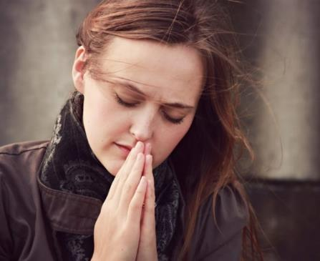
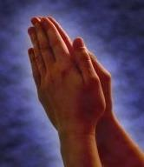
WEEKLY CHALLENGE
Pray for opportunities to communicate the promise of a New Earth to the people on your daily prayer list
ADVANCED CHALLENGE
Develop a strategy to address weaknesses. Share your ideas with your church leaders, and work with them to implement a plan to become a more intentional disciple-making church

