Slide 1
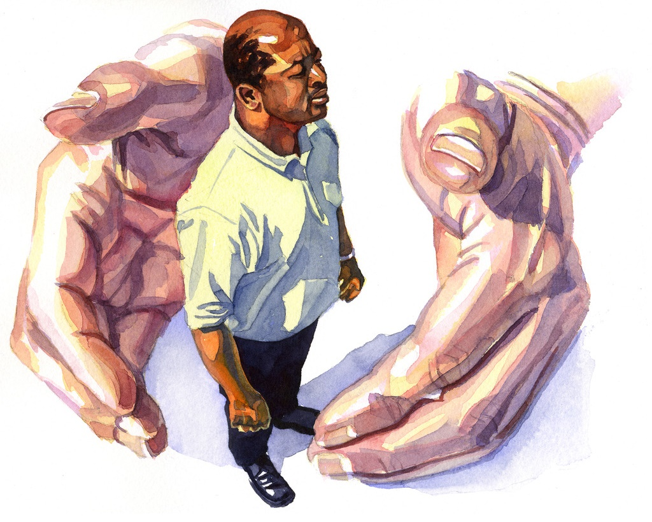
THE LORD HEARS AND DELIVERS
Lesson 4 for January 27, 2024

Slide 2
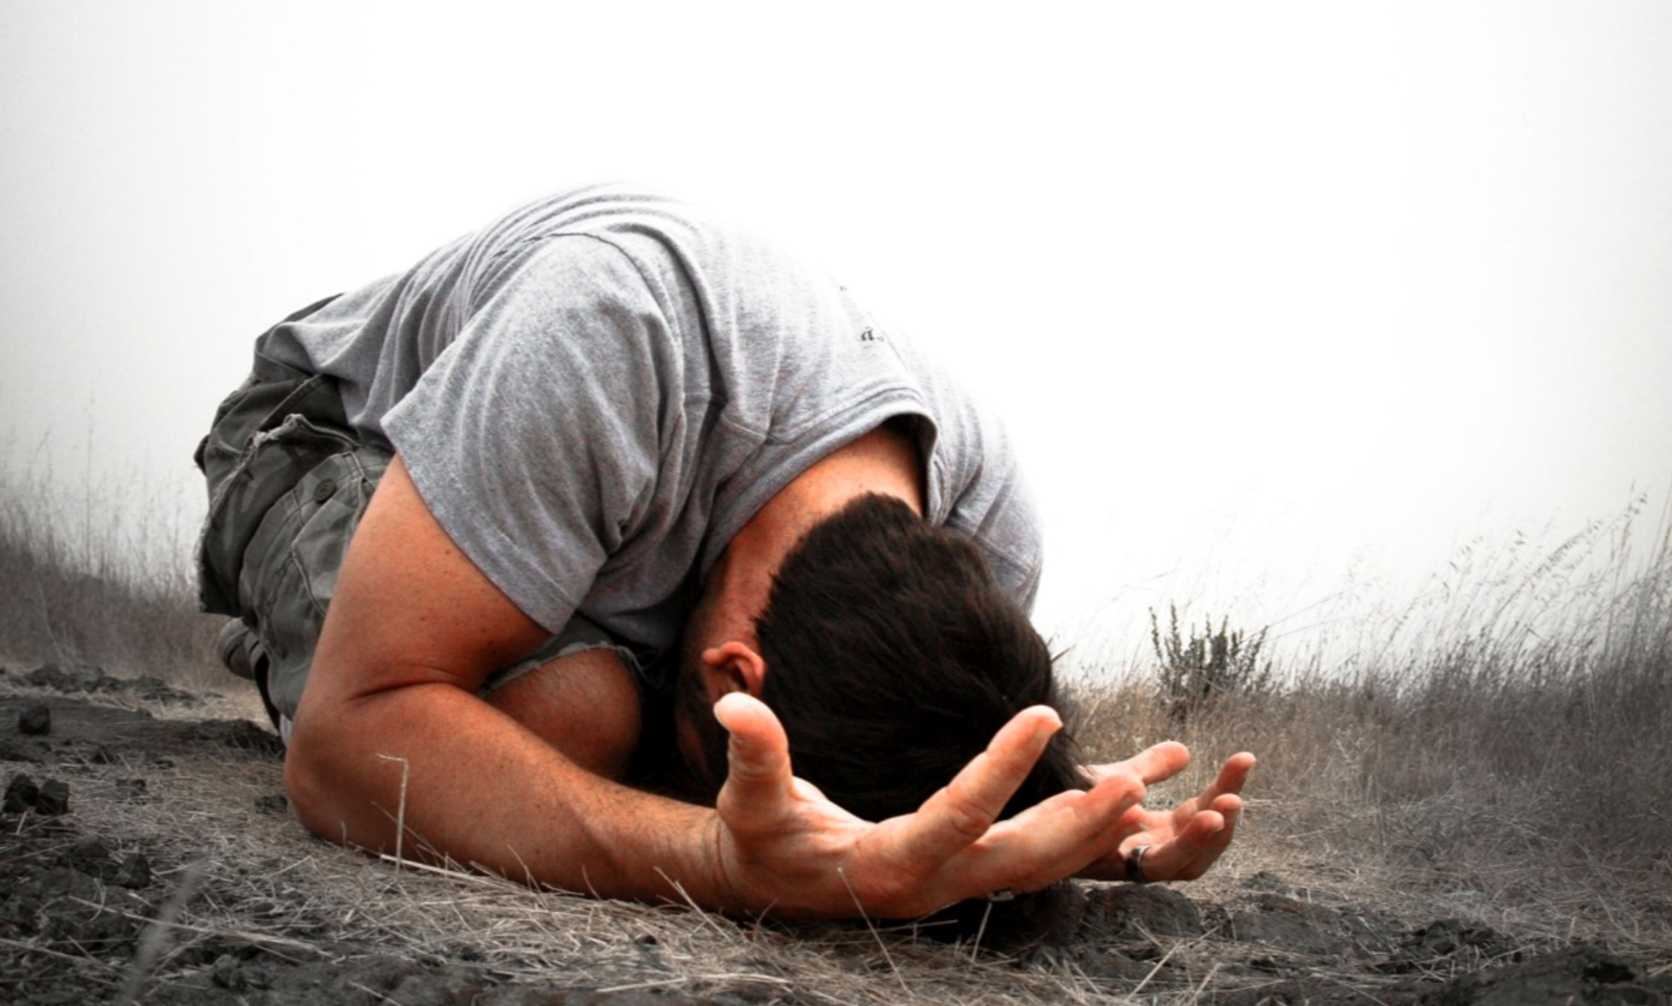
“The righteous cry out, and the LORD hears them; he delivers them from all their troubles” (Psalms 34:17)

Slide 3
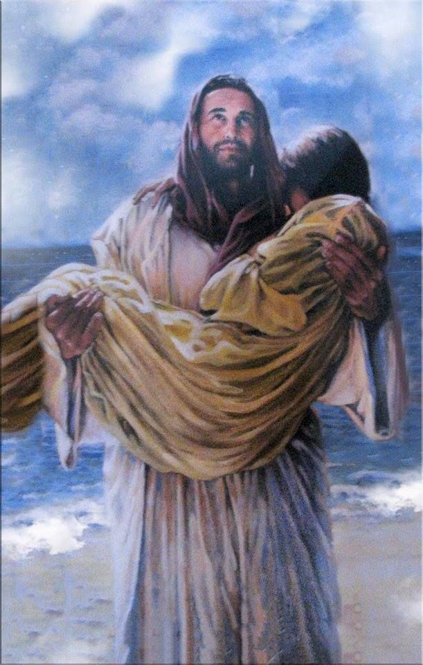
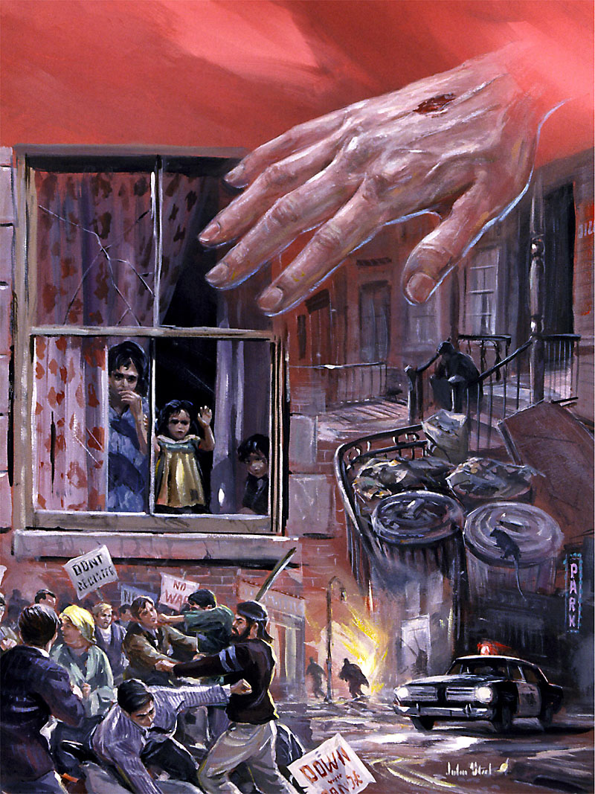
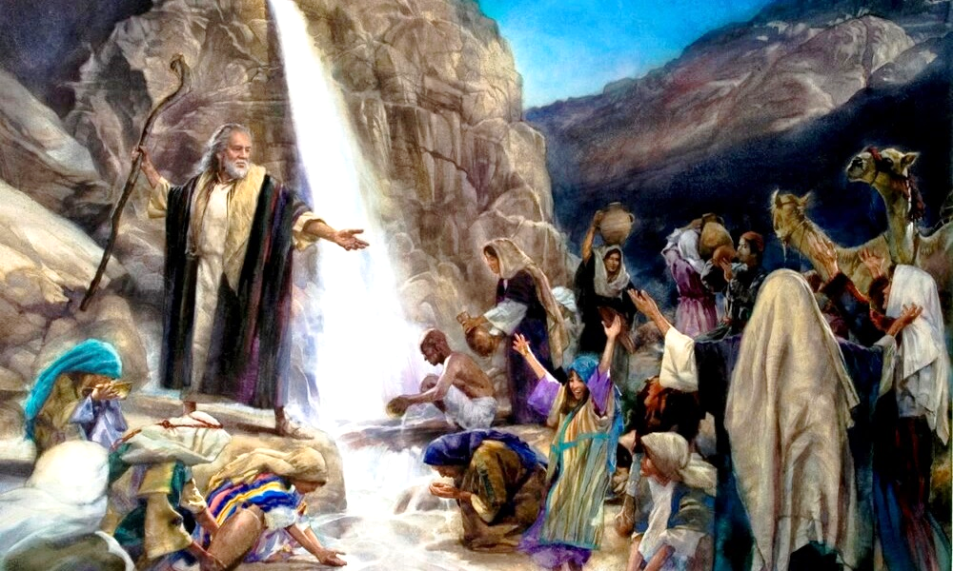
The Lord is not a distant and passive god. He knows us, cares for us, defends and liberates us.
God hears us and acts on our behalf. This was the experience of the people of Israel; and the experience of the psalmists who cried out to God in times of difficulty.
We are not alone in our difficulties; we have a Lord who comes to our defense.
The Lord knows (Psalm 139).
The Lord cares (Psalm 121).
The Lord defends (Psalm 17).
The Lord delivers (Psalm 114).
The Lord hears and saves.

Slide 4
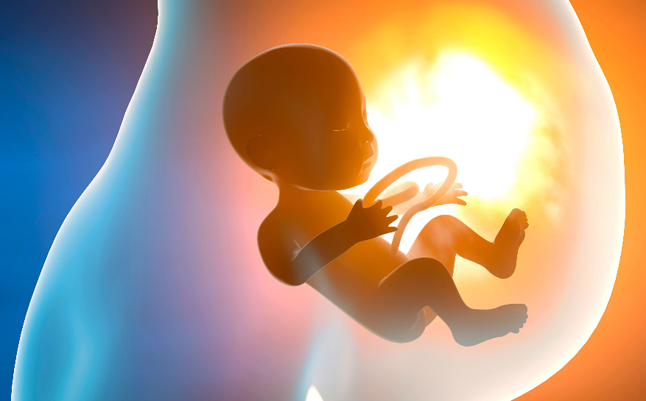
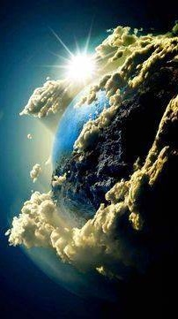
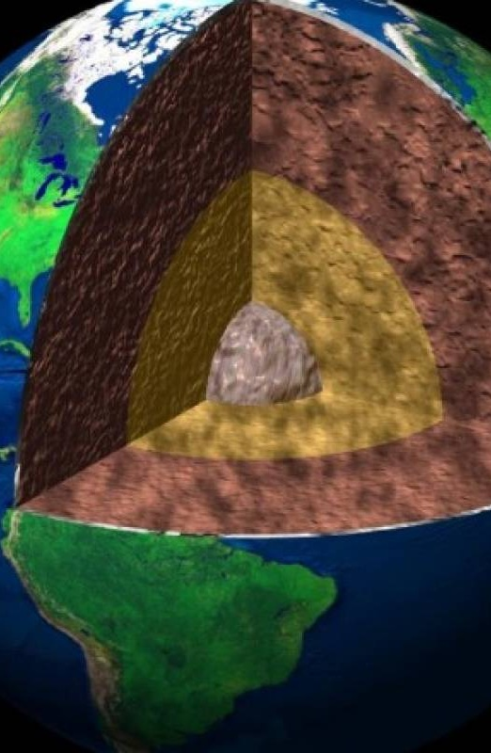
THE LORD KNOWS
“O lord, thou hast searched me, and known me” (Psalm 139:1)
David is aware that his entire life is transparent before God (Ps. 139:2-3). God already knew him before he was born, since God was who made him grow in his mother's womb (Ps. 139:13-16).
You can meet God wherever you go, because God is in every place. If you ascend to the highest (heavens), He is there; If you go down to the depths (Sheol), He finds you; If you turn to the east (the wings of dawn), He guides you; If you heads west (the end of the sea), his hand defends you (Ps. 139:7-10).
There is no place so dark that it can hide you from the presence of God (Ps. 139:11-12). But David does not seek to flee. He wants and desires to be examined by God. Try to live a righteous life that pleases God, turning away from evil (Ps. 139:17-23).
He knows that if he fails, God will make his ways straight (Ps. 139:24). Is this your experience with God?

Slide 5
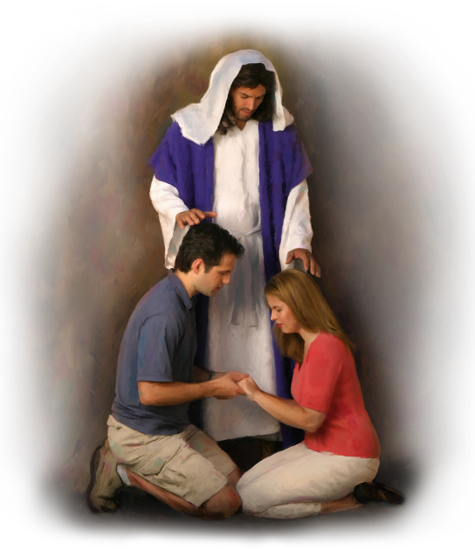
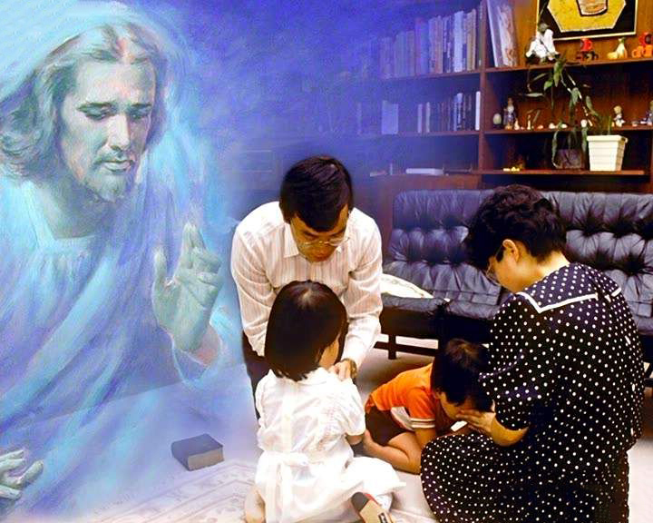
THE LORD CARE
“The Lord shall preserve thee from all evil: he shall preserve thy soul” (Psalm 121:7)
No matter how desperate your situation, God hears (Ps. 130:1-2). When we cry out, He acts on our behalf (Ps. 9:10). There is hope for everyone who seeks the Lord's favor (Ps. 16:8).
In Psalm 121 we find a description of our Helper, Help and Guardian:
He will not allow us to slip on the path of life (v. 3)
He constantly watches over us (v. 4)
He gives us physical and spiritual refuge (v. 5-6)
He is always at our side to defend us (v. 7)
He will take care of us at all times and in all places (v. 8)
Where to go to seek help in difficulty? To the mountains? To economic power? To the political powers? To our family and friends? (Ps. 121:1).
Although they can be a help, all of them can fail us. There is only One who never fails: “My help cometh from the Lord, which made heaven and earth” (Ps. 121:2 KJV).

Slide 6
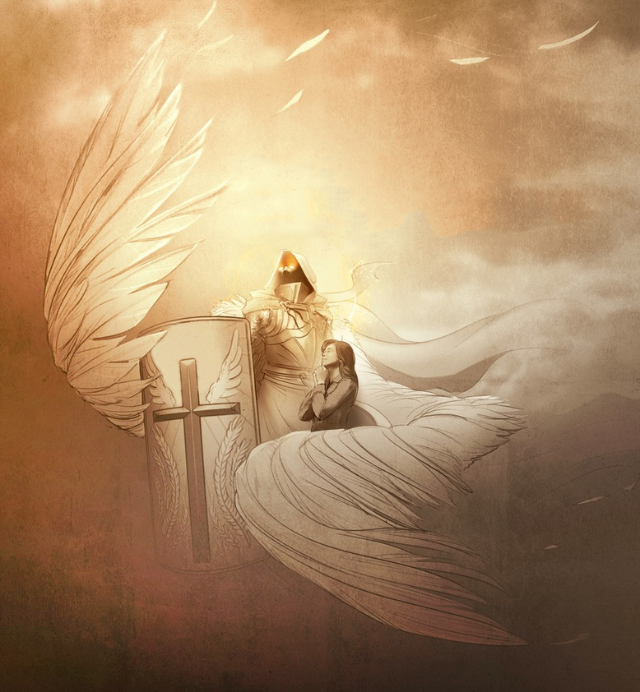
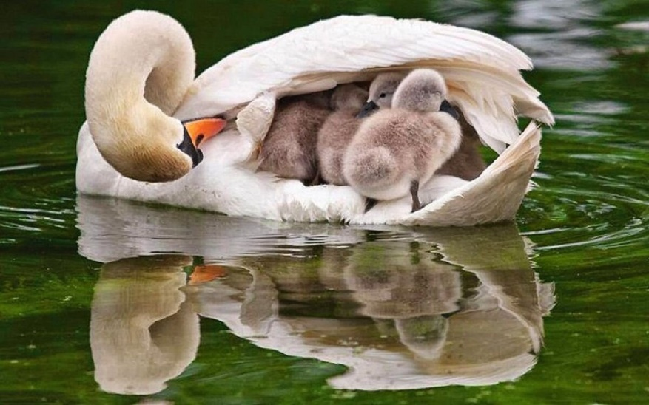
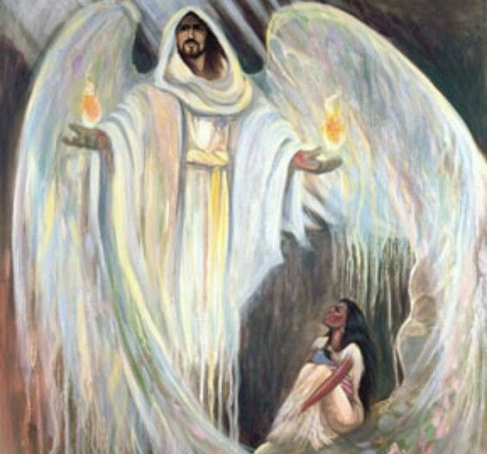
THE LORD DEFENDS
“Keep me as the apple of the eye, hide me under the shadow of thy wings” (Psalm 17:8)
Confident in a life consistent with what God expects from him, David asks him to be his defender (Ps. 17:1-5).
The psalmist uses the metaphor of birds to tell us about how God defends us: “He will cover you with his feathers, and under his wings you will be safe” (Ps. 91:4). He also uses military language to tell us about his active defense: “it will be your shield and your bulwark” (Ps. 91:4 NVI).
Other metaphors include the “shelter,” the “shadow,” the “castle,” the “right hand” (Ps. 91:1-2; 17:7-8). All of them talk to us about protection and security.
Without a doubt, we have a Lord who defends us in all adversity. Let us turn to Him. Let us take refuge under his shadow.

Slide 7
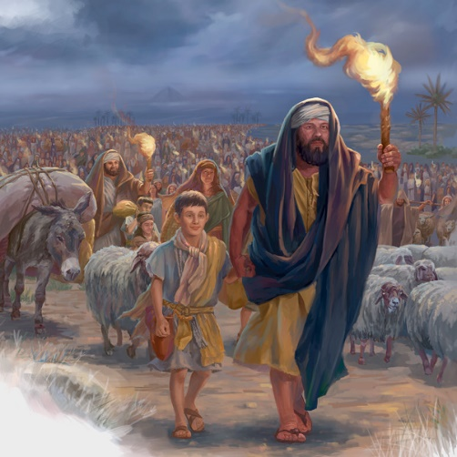
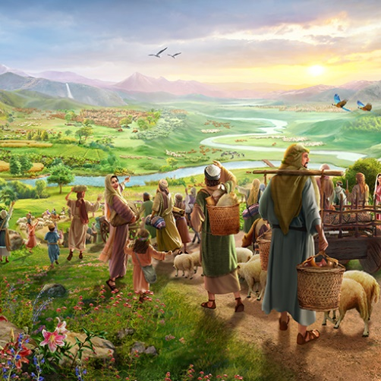
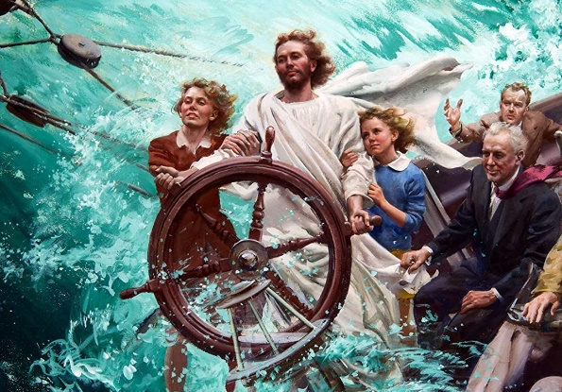
THE LORD FREES
“The sea saw it, and fled: Jordan was driven back” (Psalm 114:3)
The greatest example of liberation that we find (and that is remembered in several psalms) is the departure of Israel from Egypt, and its entry into Canaan.
The [Red] sea saw God and fled (v. 3a)
The Jordan River turned back (v. 3b)
The mountains and the hills leaped (v. 4)
Psalm 114 expresses in a brief and poetic manner the way in which God smoothed out the difficulties for his people to reach the Promised Land:
As Creator, God used his power over nature to free his people. Won't He do the same for us today?
Paul tells us that these things happened to give us an example (1Co. 10:1-6). Like them, we too have been miraculously delivered from sin, and our journey to Heavenly Canaan is fraught with danger (mountains and hills). But before the Lord “the earth trembles” (Ps. 114:7).

Slide 8
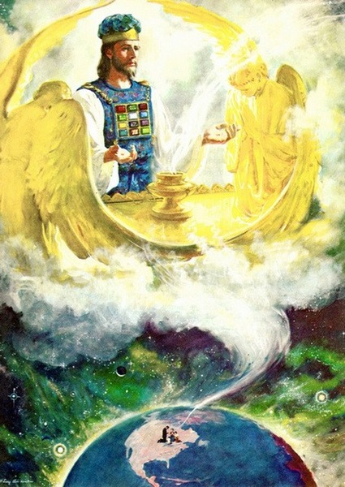
THE LORD HEARS AND SAVES
“May he send you help from the sanctuary and grant you support from Zion” (Psalm 20:2)
Although the sanctuary (Temple) was on Mount Zion (Jerusalem), the Israelites were clear that God did not physically dwell there. God dwells on high, in “that true tabernacle which the Lord pitched, and not man” (Heb. 8:2), but from there He hears and saves (Ps. 20:2; 3:4; 1Ki. 8: 30).
For this reason, we can confidently approach Him with the certainty that we will be heard (Heb. 4:16). But what can He do from his sanctuary?
Give salvation (Ps. 14:7)
Keep us from evil (Ps. 27:5)
Provide for our needs (Ps. 36:8)
Defend the defenseless (Ps. 68:5)
Strengthen us (Ps. 68:35)
When people maintain a right relationship with God through repentance and acceptance of His grace and forgiveness, they can invoke God's guarantee of deliverance. The Sanctuary service represented the salvation found in Jesus.

Slide 9
“Keep your wants, your joys, your sorrows, your cares, and your fears before God. You cannot burden Him; you cannot weary Him. He who numbers the hairs of your head is not indifferent to the wants of His children. “The Lord is very pitiful, and of tender mercy.” James 5:11. His heart of love is touched by our sorrows and even by our utterances of them. Take to Him everything that perplexes the mind. Nothing is too great for Him to bear, for He holds up worlds, He rules over all the affairs of the universe. Nothing that in any way concerns our peace is too small for Him to notice. There is no chapter in our experience too dark for Him to read; there is no perplexity too difficult for Him to unravel. No calamity can befall the least of His children, no anxiety harass the soul, no joy cheer, no sincere prayer escape the lips, of which our heavenly Father is unobservant, or in which He takes no immediate interest”
E. G. W. (Steps to Christ, pg. 100)

