Slide 1
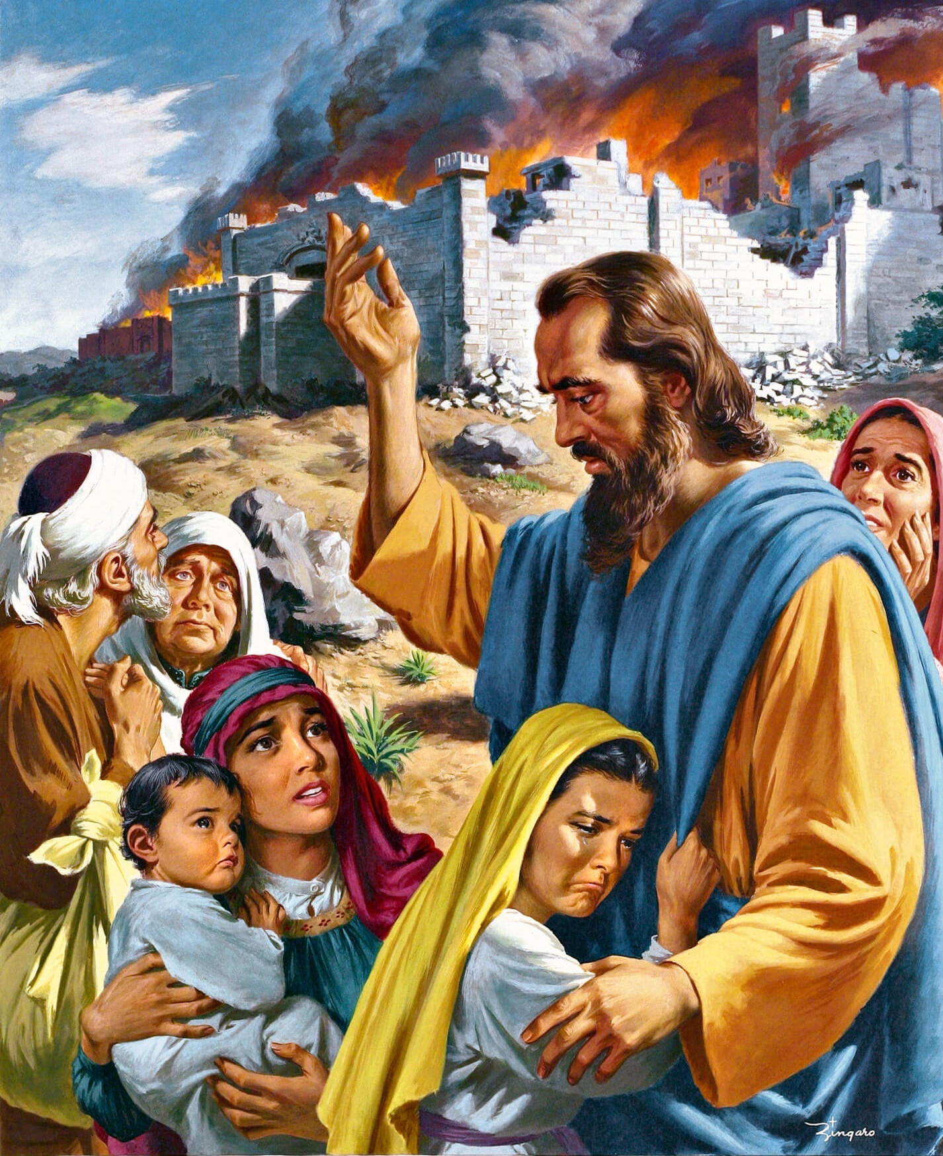
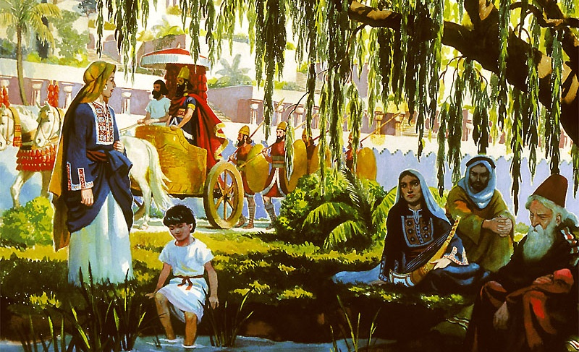
SINGING THE LORD’S SONG IN A STRANGE LAND
Lesson 5 for February 3, 2024

Slide 2
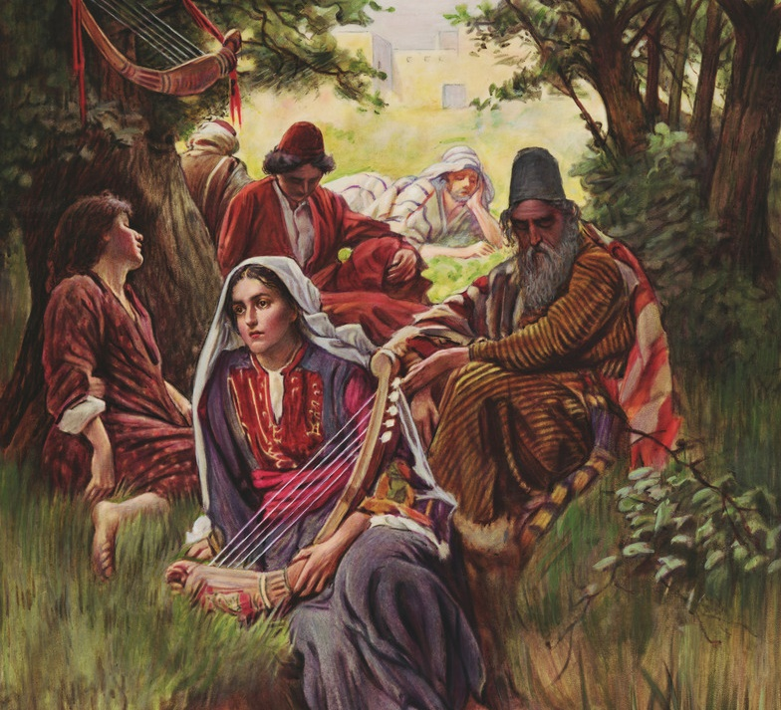
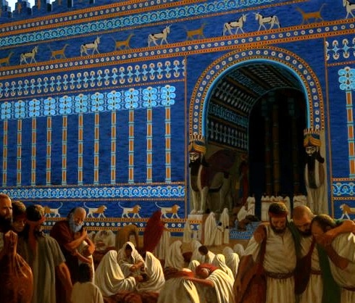
How shall we sing the Lord’s song in a strange land?
(Psalm 137:4)

Slide 3
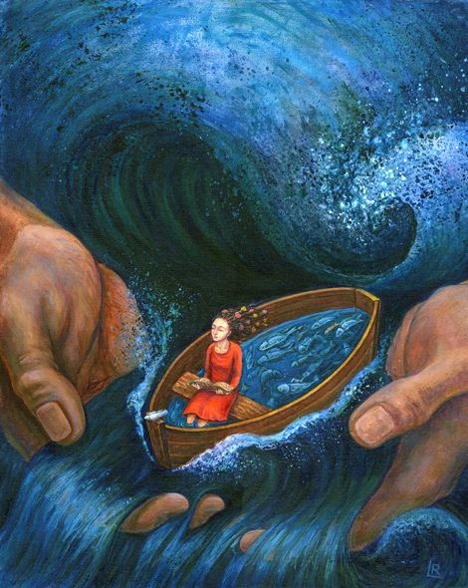
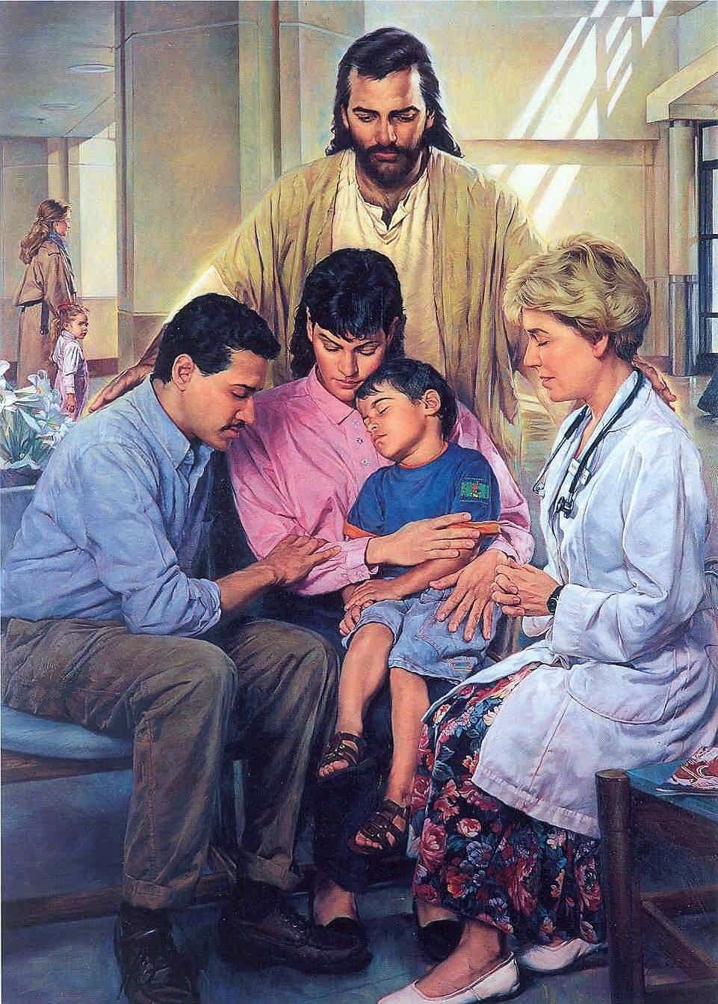
Biblical faith often involves uncertainty and suspense as much as confidence and affirmation. Sometimes the uncertainty and suspense, especially in the face of evil and the seeming absence of God, can be almost unbearable.
However, uncertainty should never refer to God, his loving and righteous character, or his faithfulness. The psalmists may have doubts about the future, but they often appeal to God's unwavering love and faithfulness.
Why does God allow sin and suffering to exist? (Psalms 74 and 79)
Why does God allow the innocent to suffer? (Psalm 88)
Why doesn't God put an end to our current suffering ? (Psalm 69)
Have His promises in Scripture failed? (Psalm 77)
Why do the wicked prosper? (Psalms 37 and 73)

Slide 4
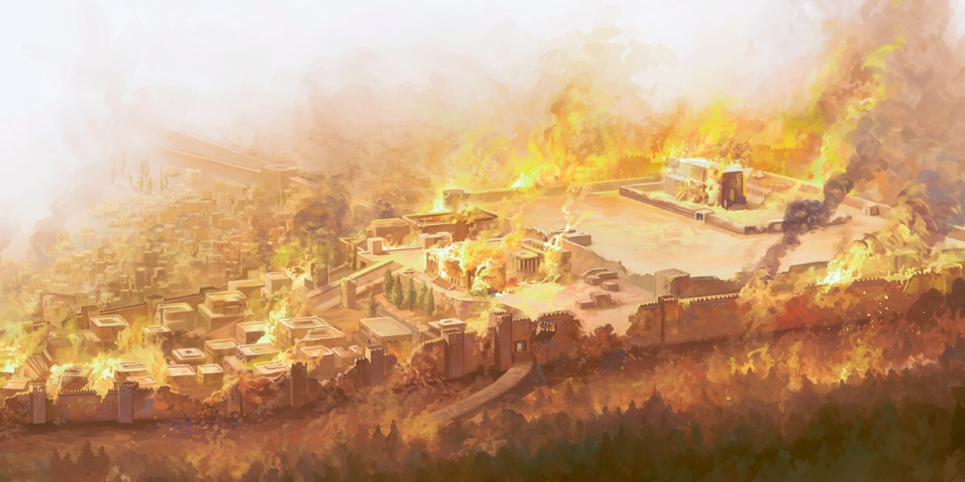
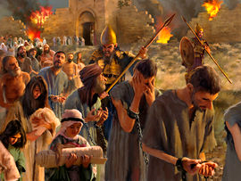
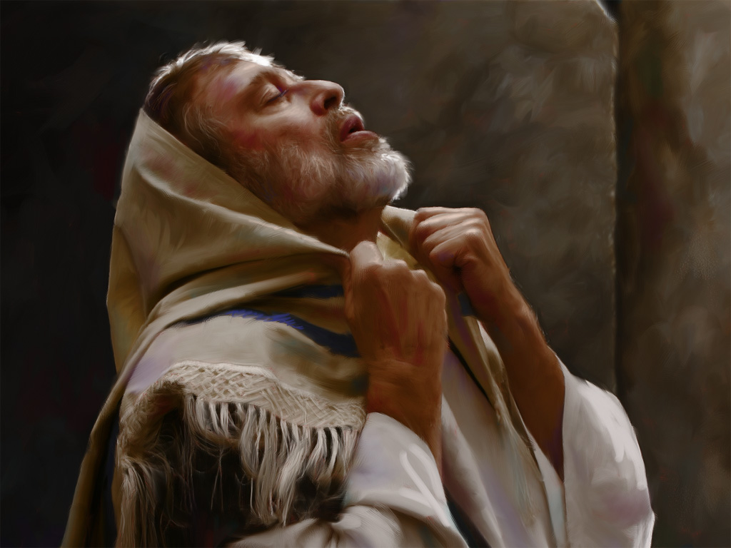
WHY DOES GOD ALLOW SIN AND SUFFERING TO EXIST?
“Why should the nations say, “Where is their God?” Before our eyes, make known among the nations that you avenge the outpoured blood of your servants.” (Psalm 79:10)
When King Nebuchadnezzar destroyed the Temple and razed Jerusalem, God's people were totally confused (Ps. 79:1-4; 74:3-8).
How long would God allow suffering? How long will the victory of the wicked? How long will the name of God be blasphemed? How long will he not forgive sin? How long will he remain silent? (Ps. 79:5; 74:9-11) .
If God's people were destroyed, where was the honor of God's Name? The only solution the psalmist sees is for God to avenge his people and destroy their enemies, as he had done in the past (Ps. 79:6-7, 12; 74:13-19).
Aware that sin had brought them to this situation, he asks God to listen, remember his covenant, forgive sin, remove suffering, and act on behalf of his people (79:8-9, 11, 13; 74: 20-23).

Slide 5
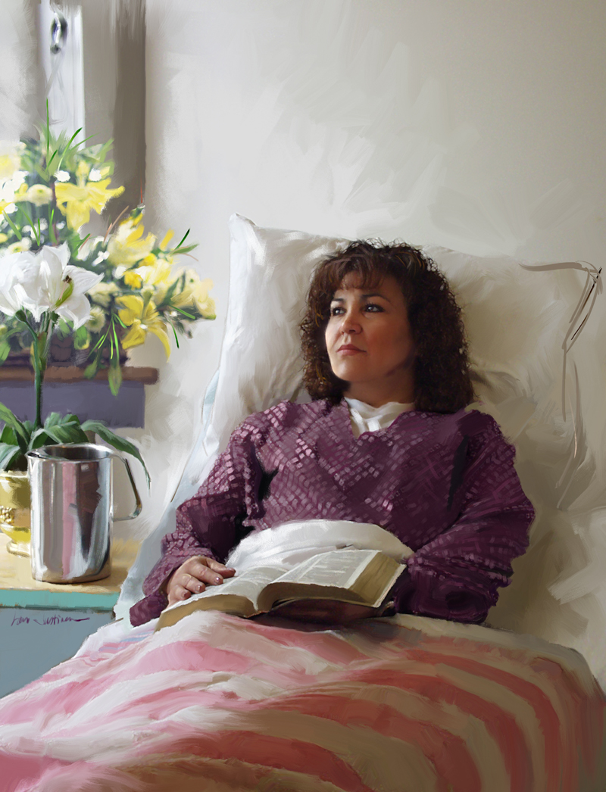
WHY DOES GOD ALLOW THE INNOCENT TO SUFFER?
“I am overwhelmed with troubles, and my life draws near to death” (Psalm 88:3)
The person who loves God and wants to serve Him could be expected to be free from evil, protected by God. But the reality is that the righteous also suffer like others.
The psalmist, sick, awaits death, and does not understand why God does not respond (Ps. 88:3-4, 9-14). He even accuses God of being the cause of his illness and pain (Ps. 88:6-8, 16-18).
There is no mention in Psalm 88 of the sins that could have caused his illness. In reality, his suffering (as often happens with our suffering) did not derive from any sin of his own. This reality makes suffering something difficult to understand, inexplicable.
There is only one solution: cry out to Him who controls everything, and wait for Him to act in due time (Ps. 88:1-2).

Slide 6
WHY DOES GOD NOT END OUR CURRENT SUFFERING?
“I am worn out calling for help; my throat is parched.
My eyes fail, looking for my God” (Psalm 69:3)
To what extent does the psalmist feel the distance from God?
How do you respond to the apparent absence of God?
It is like a deer that cannot find water to drink (Ps. 42:1-3)
He is distressed, hurt, without the will to live (Ps. 102:2-4)
He seems to live in a desert, like the pelican, the owl or the solitary bird (Ps. 102:6-7)
He feels sunk in the mire, unable to stand, without help from God (Ps. 69:1-3)
He does not remain silent, he persists in prayer (Ps. 69:13)
He examines himself (Ps. 69:5-6)
He declares his love for God (Ps. 69:7, 9)
He is sure that God will not remain silent forever (Ps. 69:33-36; 42:5; 102:13)
The psalms demonstrate that communication with God must continue, regardless of life's circumstances.

Slide 7
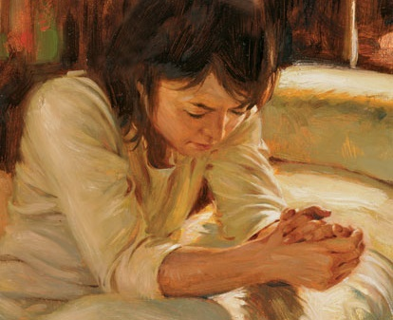
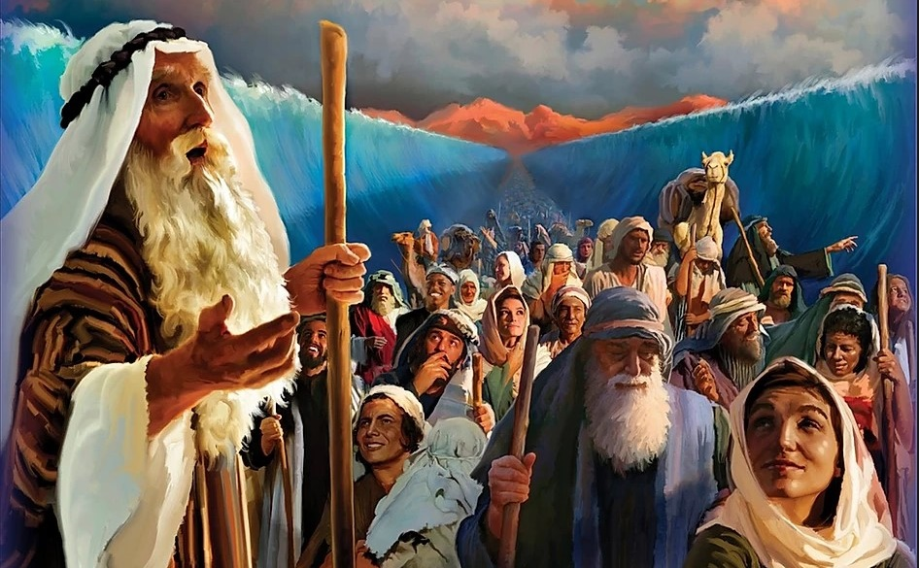
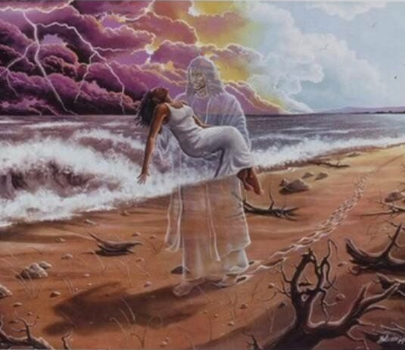
HAVE THEIR PROMISES FAILED IN THE SCRIPTURES?
Has his unfailing love vanished forever? Has his promise failed for all time? (Psalm 77:8)
Have you ever felt like the psalmist (Ps. 77:1-6)? He cries out to God hoping for an answer, but he does not find it; in his desperation he refuses consolation; he remembers the moments when he sang to God and meditated on Him. And he says: “Now, has God forgotten me? Where are your promises?” (Ps. 77:7-9 ).
The answer is in the past (Ps. 77:10-12; Josh. 21:45). God has done wonders before the nations (Ps. 77:13-17). He made a way in the sea and led his people by the hand of Moses and Aaron (Ps. 77:18-20).
However, not all of his actions were obvious. At times, he acted without his hand being noticed: “your footsteps were not known” (Ps. 77:19).
Whether openly revealed or hidden, God acts. Let us trust Him.

Slide 8
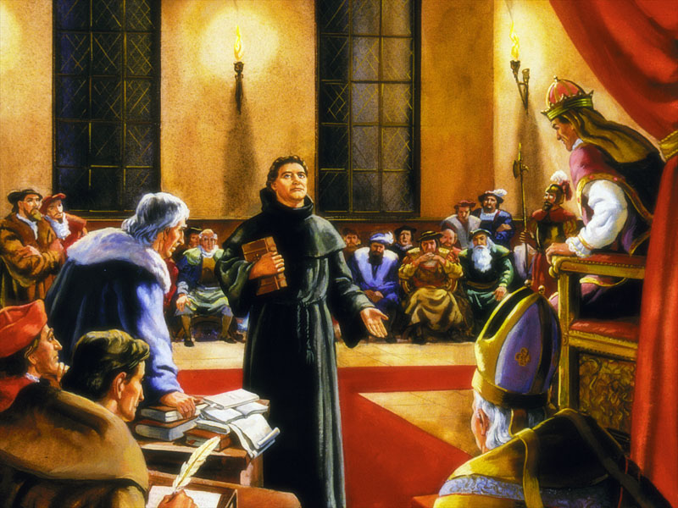
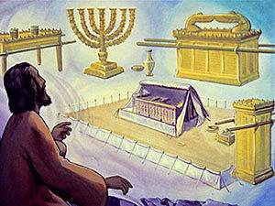
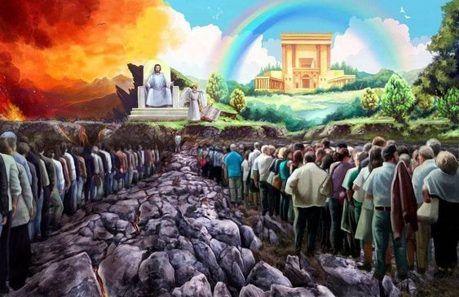
WHY DO THE WICKED PROSPER?
“For I envied the arrogant, when I saw the prosperity of the wicked” (Psalm 73:3)
The theory is: “what innocent person has been lost? and where have the righteous been destroyed? As I have seen, those who plow iniquity and sow evil reap it” (Job 4:7-8).
However, the reality is different. Many wicked people prosper and do not suffer, although they have God removed from their lives (Ps. 73:3-9); but those who seek to serve God suffer and suffer (Ps. 73:13-14).
Let's be realistic: in this world “the law is weakened, and judgment does not come out according to the truth; Because the wicked besieges the righteous, therefore justice goes astray” (Hab. 1:4).
This almost caused Asaph's feet to slip (Ps. 73:2). But, when God led his steps to the Sanctuary, he finally understood (Ps. 73:17).
We must see the prosperity of the wicked in its true perspective. We should not look at “today”, but “at the end”. When the wicked face divine judgment they will cease to exist, they will lose the happy eternity reserved for the righteous.

Slide 9
“The Lord's merciful kindness is great toward us. He will never leave nor forsake those who trust in Him. […] My brethren and sisters, you who feel that you are entering upon a dark path, and like the captives in Babylon must hang your harps upon the willows, let us make trial of cheerful song. You may say, how can I sing, with this dark prospect before me, with this burden of sorrow and bereavement upon my soul? […] When we bring our petitions to the throne of grace, let us not forget to offer also anthems of thanksgiving. […] The eternal life of our Savior provides us with a constant cause for gratitude and praise”
“We want to have fresh in our memory every tear the Lord has wiped from our eyes, every pain He has soothed, every anxiety removed, every fear dispelled, every want supplied, every mercy bestowed, and strengthen ourselves for all that is before us through the remainder of our pilgrimage.”
EGW (Selected Messages, Book 2, A Time for Prayer and Praise p.268)
EGW ( This Day With God,February 19)

