Slide 1
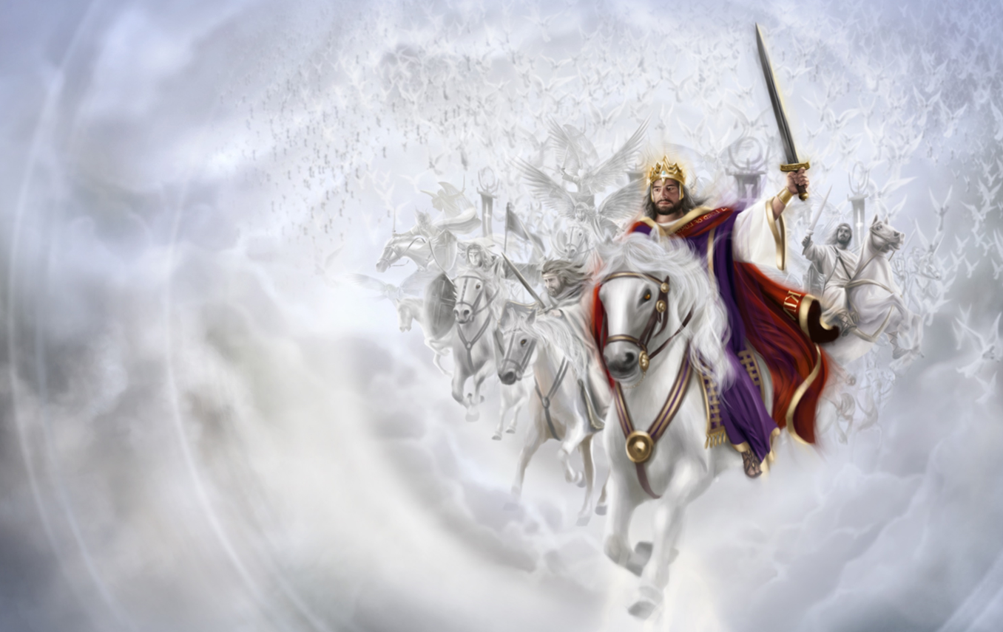
I WILL ARISE
Lesson 6 for February 10, 2024

Slide 2
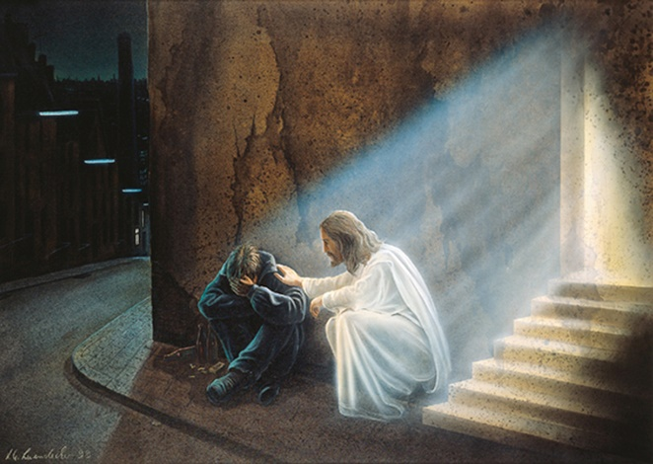
“For the oppression of the poor, for the sighing of the needy, now I will arise,’ says the Lord; ‘I will set him in the safety for which he yearns.'”
(Psalm 12:5)

Slide 3
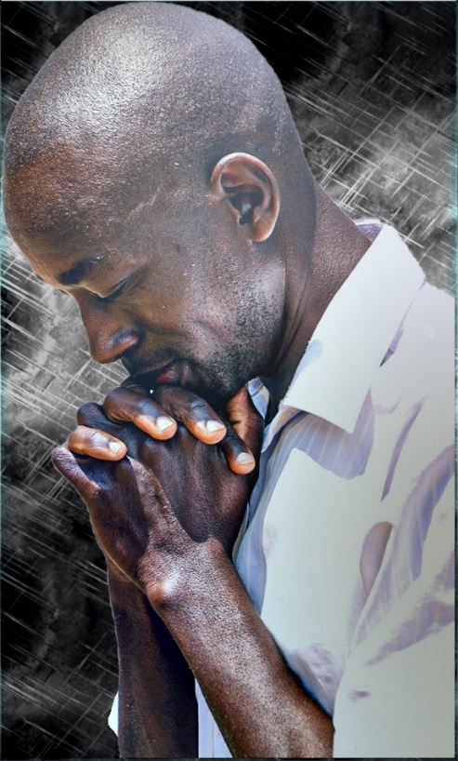
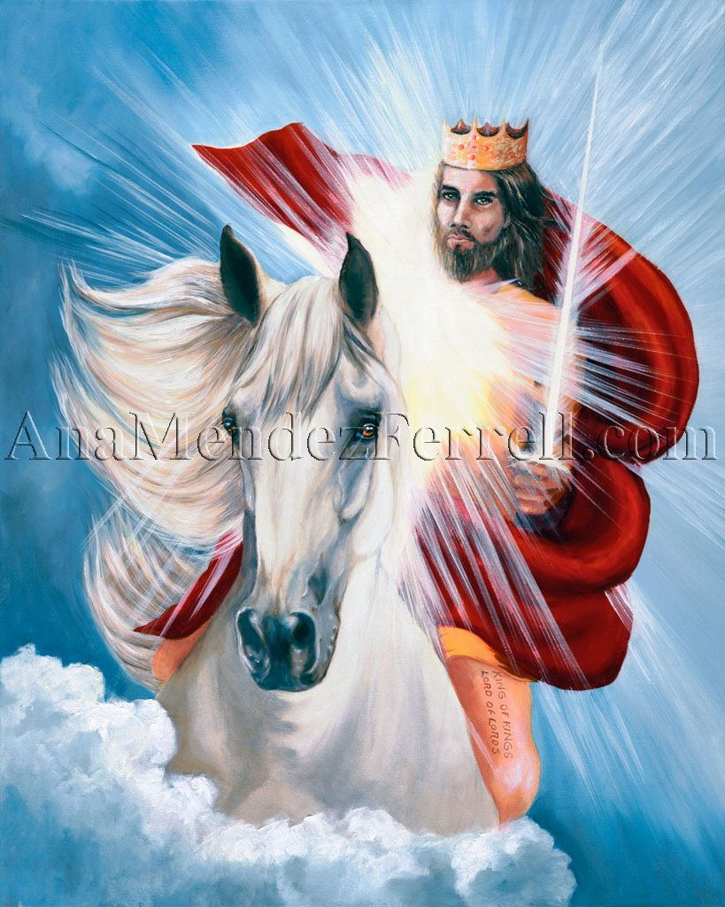
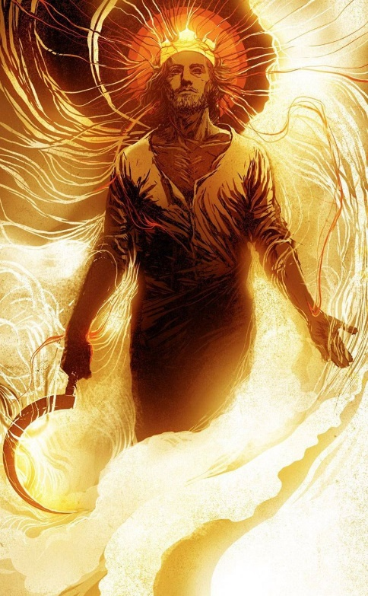
When hardship or injustices surrounds the psalmist, he cries out, “Arise, Jehovah” (Ps. 3:7; 7:6; 9:19; 10:12; 17:13; 35:2; 44:26; 74 :22; 82:8; 132:8).
In the face of the cry, the Lord rises up like a warrior to defend the defenseless (Ps. 12:5); and to judge and save “the meek of the earth” (Ps. 76:9).
God also has a set deadline to rise from his place in the Sanctuary to execute his wrath – his “strange work” ( Is . 28:21) – and have mercy on his people (Ps. 102:13).
The Warrior (Psalm 18).
Justice:
Divine justice (Psalm 41).
Human justice (Psalm 82).
The trial:
Divine wrath.
The Sanctuary (Psalm 99).

Slide 4
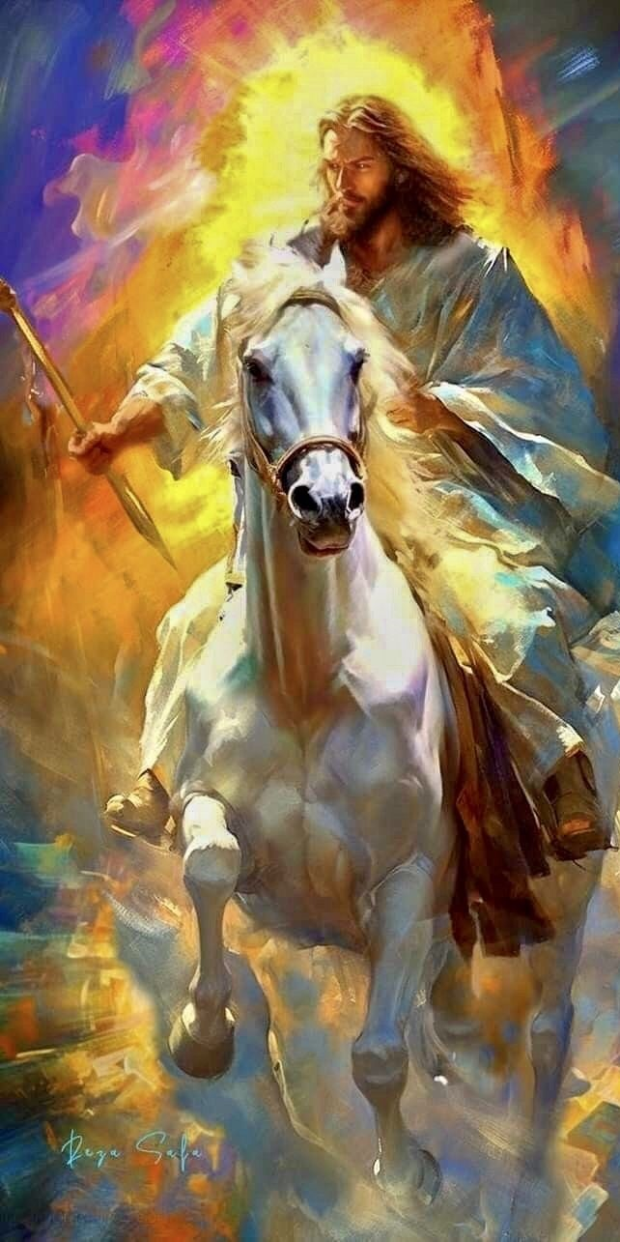
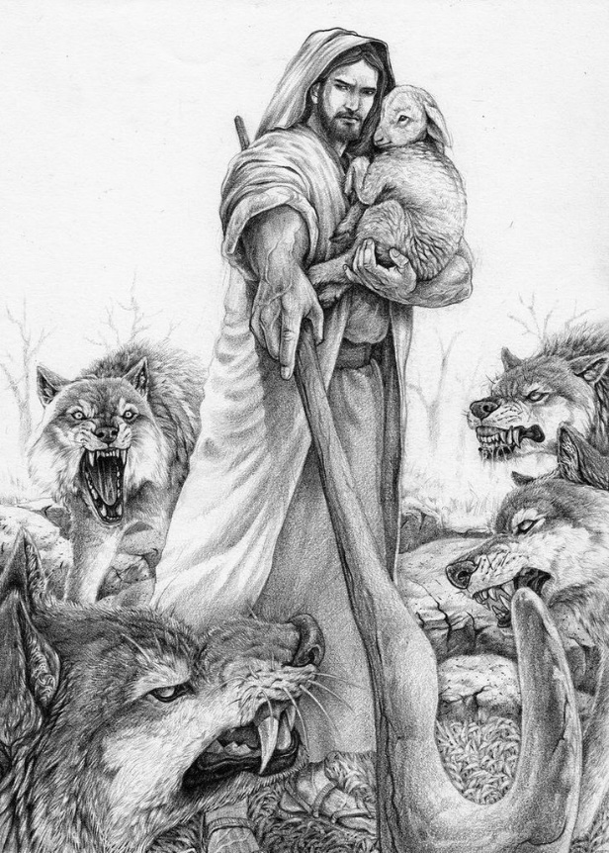
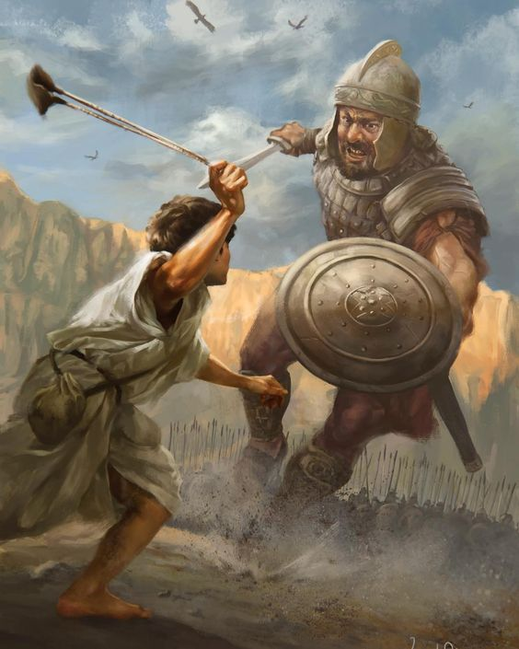
THE WARRIOR
“He delivered me from my strong enemy, and from them which hated me: For they were too strong for me” (Psalm 18:17)
Does God have the power to defend us? Of course (Ps. 18:2).
We can see God manifesting himself as a warrior riding a horse; causing the earth to tremble and raising smoke and fire in its wake; paralyzing the enemy with his powerful voice; using the forces of nature as his arrows; and thus delivering those who cry to Him (Ps. 18:7-18).
Although he was a warrior accustomed to battle, David never trusted his own strength, his intelligence, or his skill in handling weapons. He owed all his victories to God, who always fought for him (Ps. 18:47-48).
The sheer determination and magnitude of God’s action should disperse any doubt about God’s great care and compassion for the sufferers or about His ability to defeat evil. We just need to wait for Him to do it.

Slide 5
JUSTICE

Slide 6
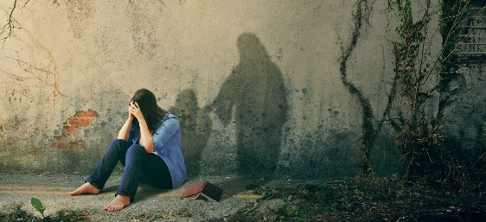
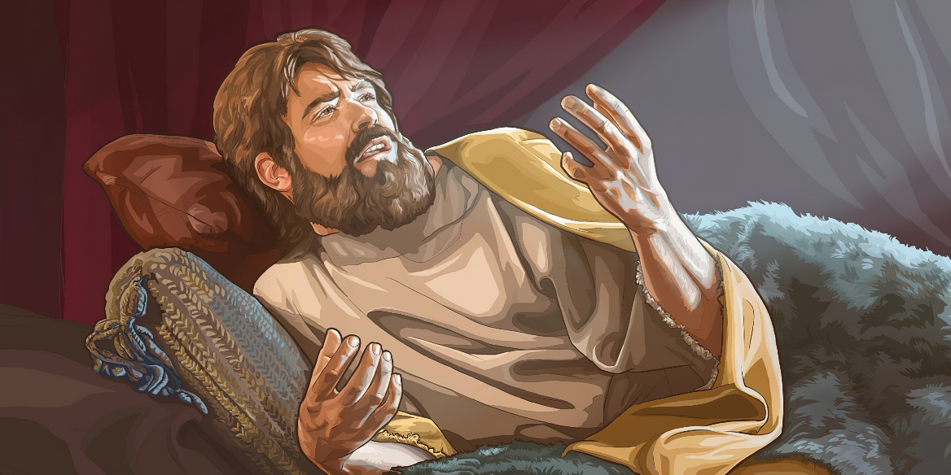
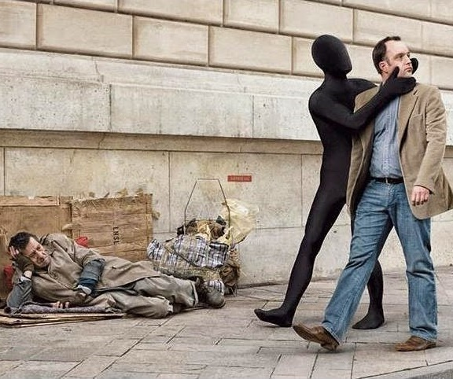
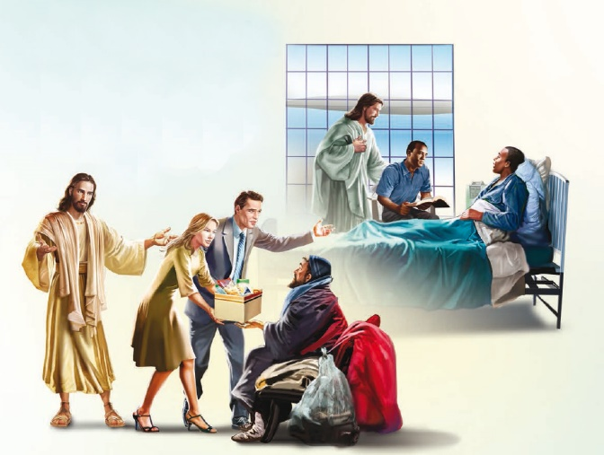
DIVINE JUSTICE
“For the oppression of the poor, For the sighing of the needy, now will I arise, saith the LORD; I will set him in safety from him that puffeth at him” (Psalm 12:5)
The Bible makes it very clear that God does not tolerate injustice. If the needy or the oppressed cry out to God, He rises up to give them justice (Ps. 12:5).
When he felt vulnerable and sick, and his own friends secretly wished for his death, David cried out to God (Ps. 41:7-9). Confessing his own unworthiness, he left his case in the merciful hands of God, confident that He would hear him (Ps. 41:4, 11-13).
God's attitude toward those in need calls us to feel the same way, that is, we should care for them. The Lord rewards those who have this attitude (Ps. 41:1-3).
We must rise up against oppression, not relying on our wisdom or ability, but on the wisdom and power of God. Only He can act justly. God will judge all mistreatment, as well as negligence in helping the oppressed (Mt. 25:31-46).

Slide 7
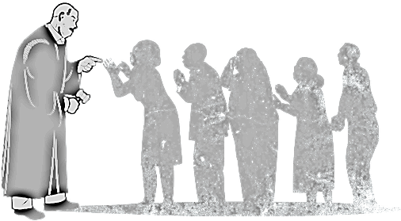
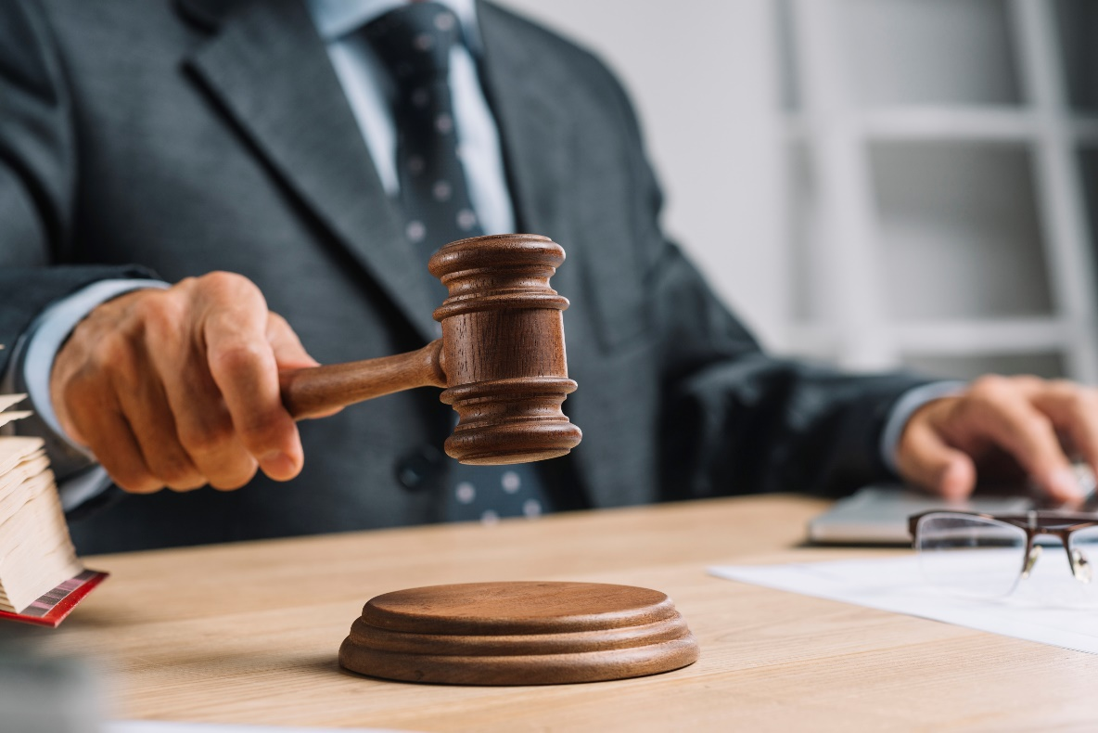
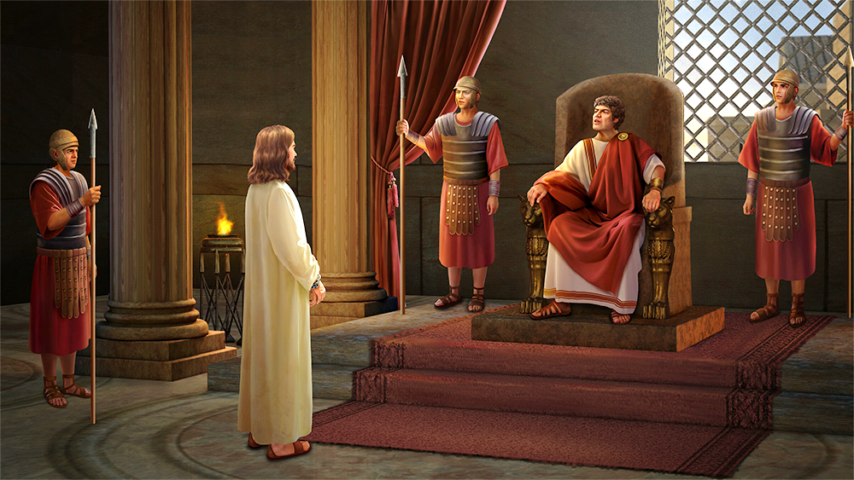
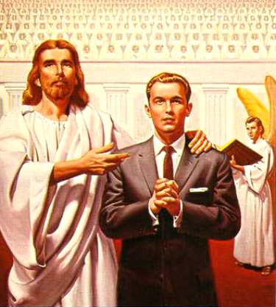
HUMAN JUSTICE
“Defend the poor and fatherless: Do justice to the afflicted and needy" (Psalm 82:3)
God delegated the ability to judge to the leaders of the people, with the king being the main judge of Israel (Ps. 72:1-2). Those who judge by divine delegation are called “gods” (Ps. 82:1).
This delegation goes beyond the people of God. Everyone who has the ability to judge, does so by divine authority, even if they do not recognize it (Jn. 19:10-11; Rom. 13:1).
The authority they receive makes them accountable to God for the way they administer justice (Ps. 82:2).
God indicates the way in which a human judge should judge (Ps. 82:3-4). If they do it correctly, they are considered “sons of the Almighty” (Ps. 82:6). Otherwise, they themselves will fall under divine judgment (Ps. 82:7-8).

Slide 8
THE TRIAL

Slide 9
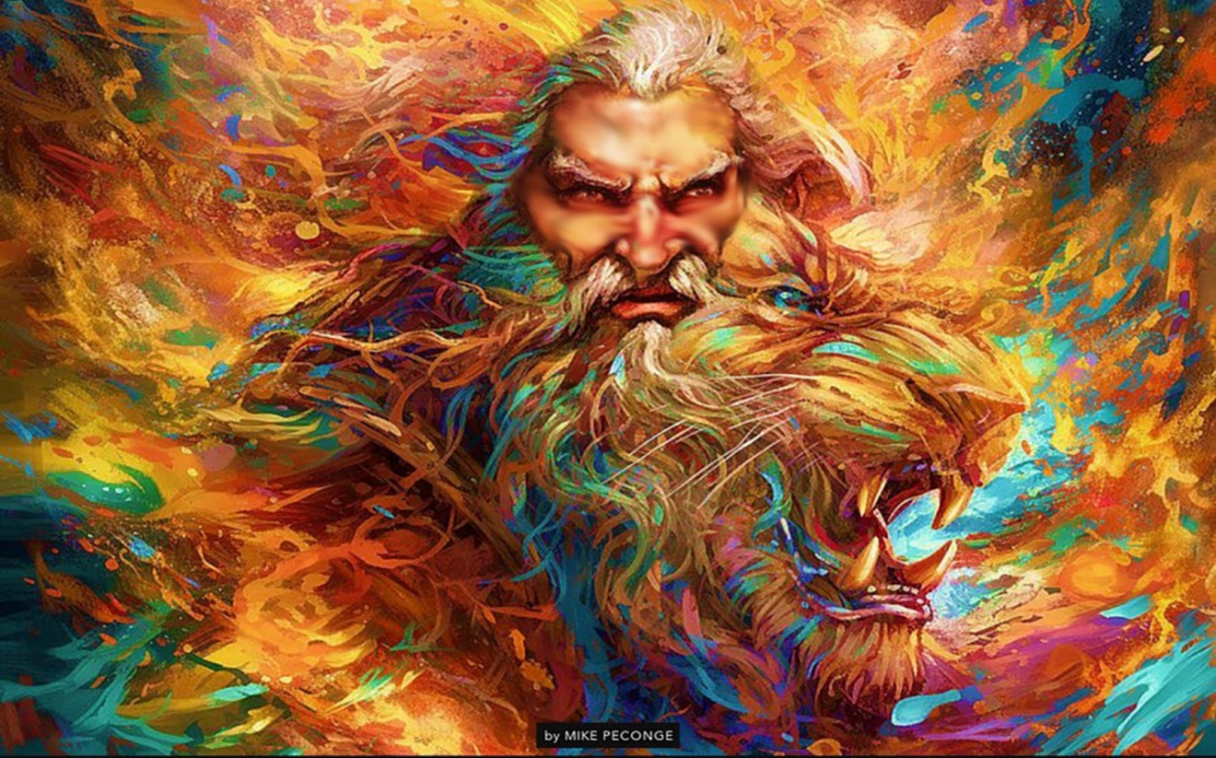
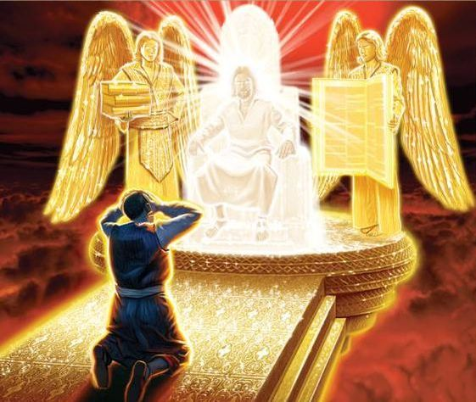
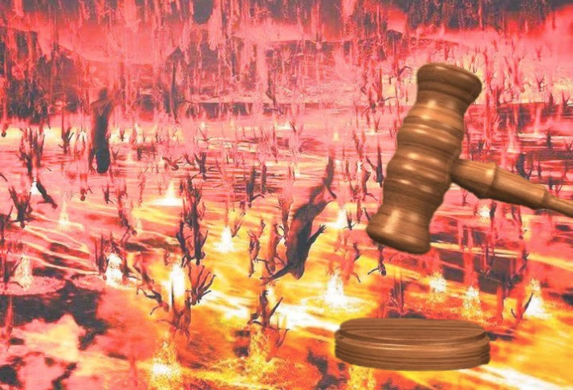
THE DIVINE WRATH
“Pour out thine indignation upon them, and let thy wrathful anger take hold of them” (Psalm 69:24)
How can we harmonize the words of Psalm 137:9 – “Happy shall he be, that taketh and dasheth thy little ones against the stones” – with Jesus' request to love even our enemies?
The psalms that plead for God to take revenge and pour out his wrath on men are harsh and disconcerting. Especially when we have in mind our own anger and our own way of getting revenge.
However, the psalmist never intends to take revenge on himself. Leave those acts to God, because only God can do true justice, and give people their deserved payment for their actions.
Inspiration has left these words so that we can see clearly that good and evil cannot be taken lightly. Evil has its consequences, and the wrath of God is manifested as the only means for its eradication.

Slide 10
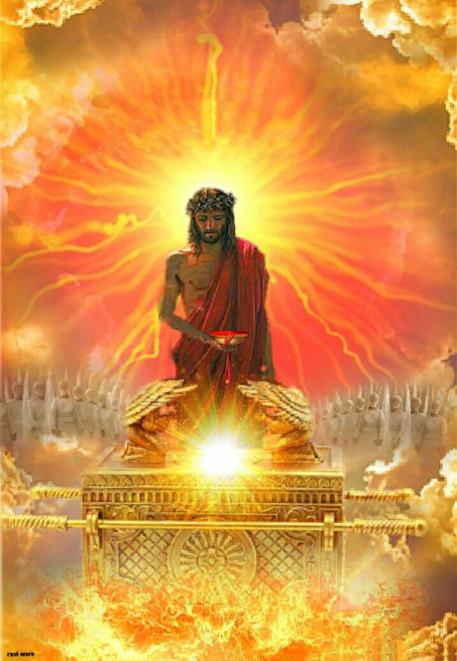
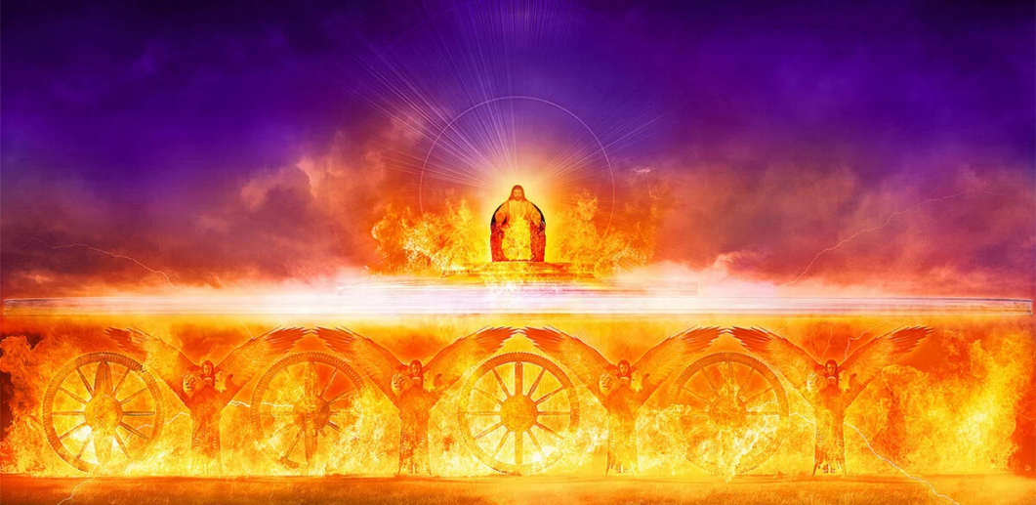
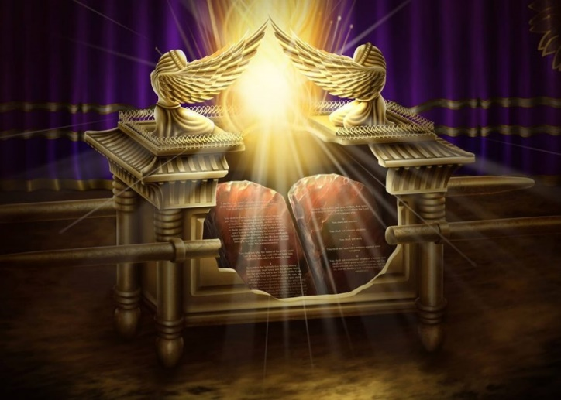
THE SANCTUARY
“Until I went into the sanctuary of God; Then understood I their end” (Psalm 73:17)
The Celestial Sanctuary is closely linked with the Judgment. In the Holy of Holies, where the Lord reigns “sitting on cherubim” (Ps. 99:1), the work of judgment is done (Dan. 7:9-10).
This is the place where the forgiveness of sin and the restoration of justice takes place. This implies both the absolution of those who cling to the Savior and the condemnation of those who reject Him (Ps. 1:5-6).
As clearly symbolized in the ark of the testimony, the Judgment is based on the fulfillment or violation of God's Law, the Ten Commandments.
Sure of divine forgiveness, God's servants long for the hour of Judgment, and cry out for its arrival so that justice may be fulfilled at last (Ps. 7:6-8; 9:19; 67:4; 99:4; 135 :14).

Slide 11
“As the bow in the cloud is formed by the union of the sunlight and the shower, so the rainbow encircling the throne represents the combined power of mercy and justice. It is not justice alone that is to be maintained; for this would eclipse the glory of the rainbow of promise above the throne; men could see only the penalty of the law. Were there no justice, no penalty, there would be no stability to the government of God. It is the mingling of judgment and mercy that makes salvation complete.”
EGW (Maranatha: The Lord is coming, November 14)

