Slide 1
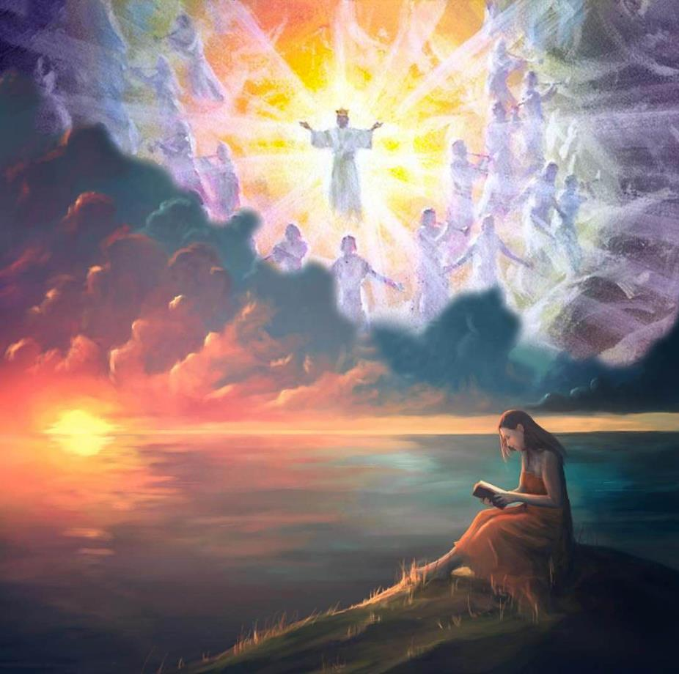
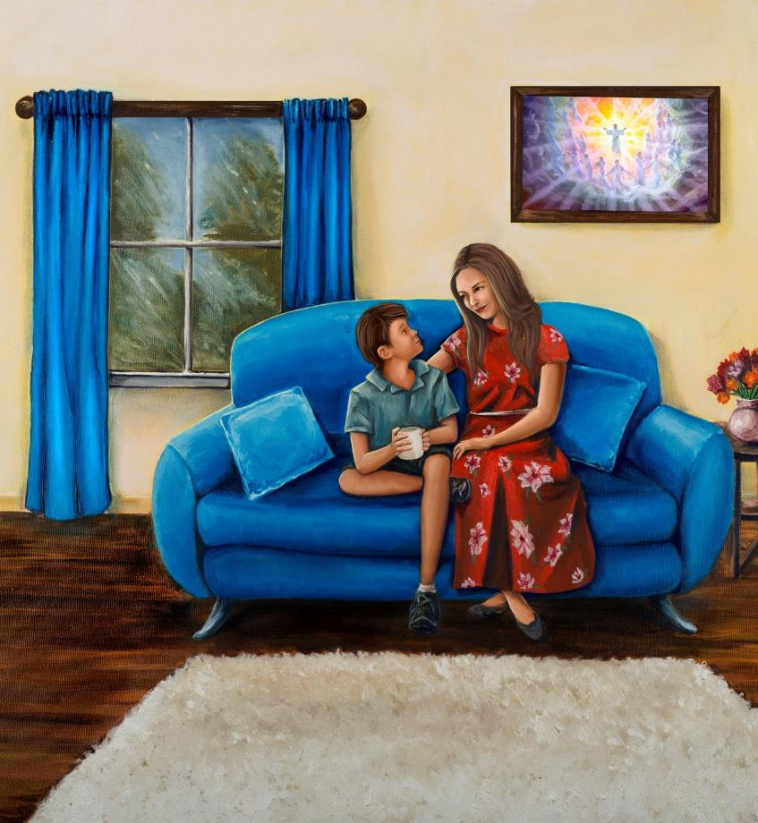
WAIT ON THE LORD!
Lesson 13 for March 30, 2024

Slide 2
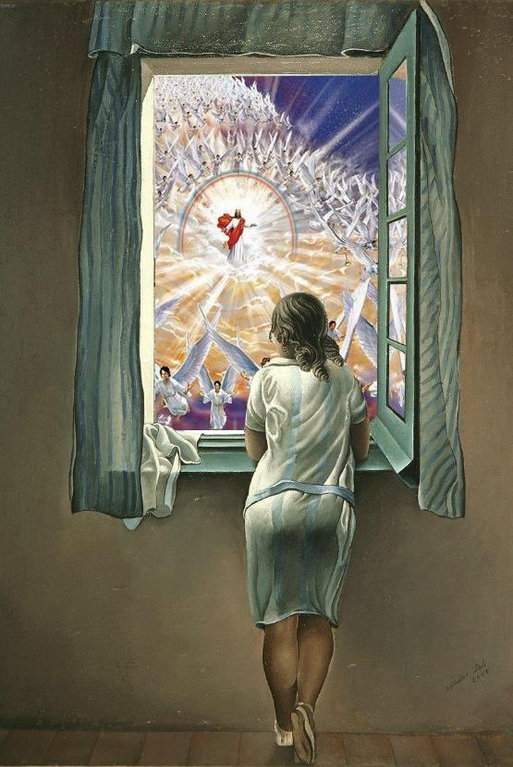
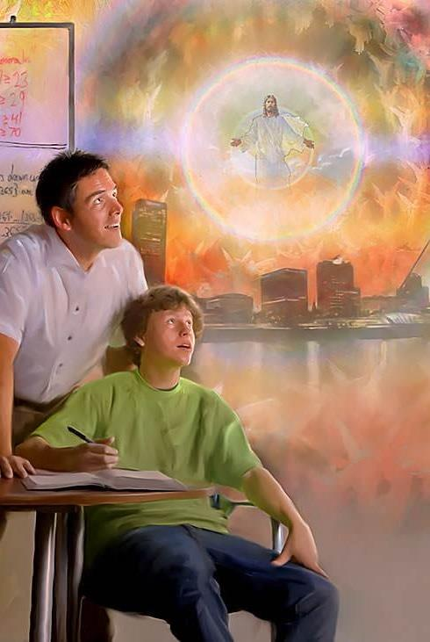
“Wait on the Lord; be of good courage, and He shall strengthen your heart; wait, I say, on the Lord!”
(Psalm 27:14)

Slide 3
Hope is what keeps us going when we no longer have any strength left.
In this world sunk in sin and misery there is no hope for a better life, free from illness, pain and death. This is because only God has the power to eliminate sin, which is the root of all these evils.
Therefore, the psalmists encourage us to wait. Wait through this night of affliction in which we live, until the glorious morning comes, when “there shall be no more death, nor sorrow, nor crying. There shall be no more pain, for the former things have passed away” (Revelation 21:4).
Wait on the Lord.
Wait with humility (Psalm 131).
Wait in difficult times (Psalm 126).
Wait for Redemption (Psalm 92).
Wait for the glorious morning (Psalm 143).

Slide 4
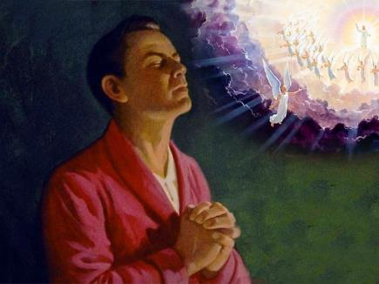
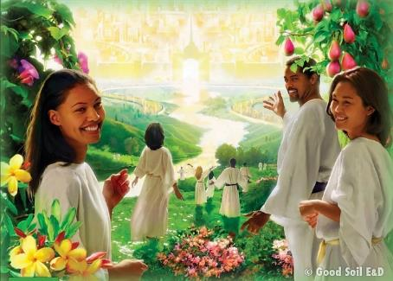
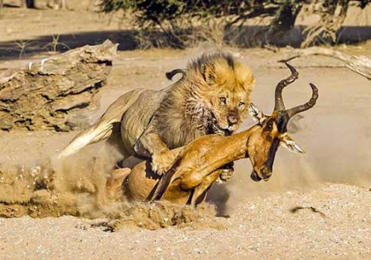
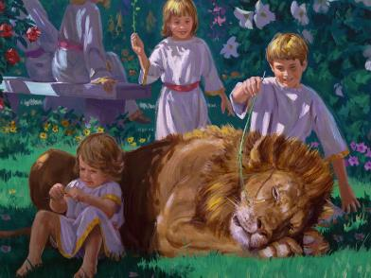
WAITING ON THE LORD
“And now, Lord, what do I wait for? My hope is in you” (Psalm 39:7)
Our life is full of small or big waits. We wait for the birth of a baby, the result of an exam, the cure of an illness...
However, waiting on the Lord goes beyond this type of waiting. First of all, it is a positive expectation. The result of the exam may be a failure; or the cure may never come. However, waiting on God will surely result in a happy life, free from sin.
But this wait implies perseverance. The wait is long, but we must not succumb to despair (Hab. 2:3).
We do not wait alone. All Creation eagerly awaits our deliverance (Rom. 8:18-25). It is not a passive wait, but an active one. We must long for it, and strive to retain it (Ps. 63:1; 27:14).

Slide 5
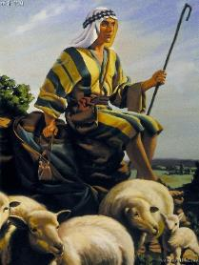
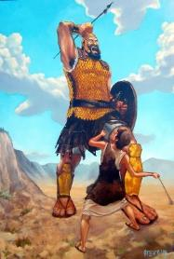
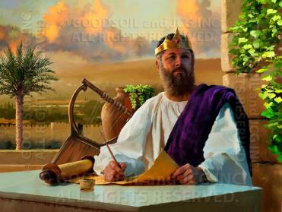
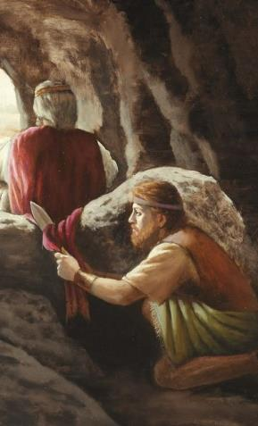
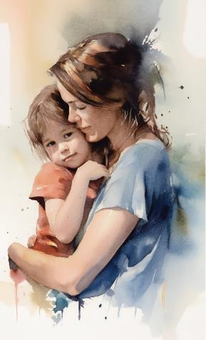
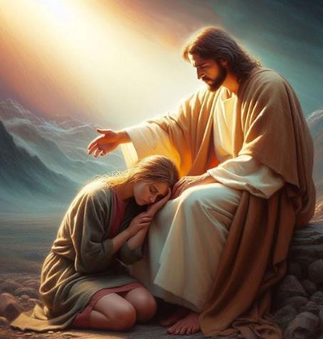
WAIT WITH HUMILITY
“My heart is not proud, Lord, my eyes are not haughty; I do not concern myself with great matters or things too wonderful for me. But I have calmed and quieted myself, I am like a weaned child with its mother; like a weaned child I am content. Israel, put your hope in the Lord both now and forevermore” (Psalm 131)
David, the author of Psalm 131, was anointed as a future king when he was a humble shepherd. He defeated a giant, won a thousand battles, and was finally acclaimed as king over Israel.
Despite his gradual rise, David retained his humility. He did not attempt to take for himself honors that God had not given him, even when circumstances seemed favorable (1 Sam. 24:6).
He felt like a “weaned child” before the Lord. Spontaneous weaning occurs in a child between 2 and 7 years of age. Aware of his weakness and ignorance, the child still seeks the tender arms of his mother to find comfort and protection in them.
Likewise, we are invited to be like that little child, waiting confidently and humbly in the eternal arms of our Father (Mt. 18:3; Deut. 33:27; Ps. 131:3).

Slide 6
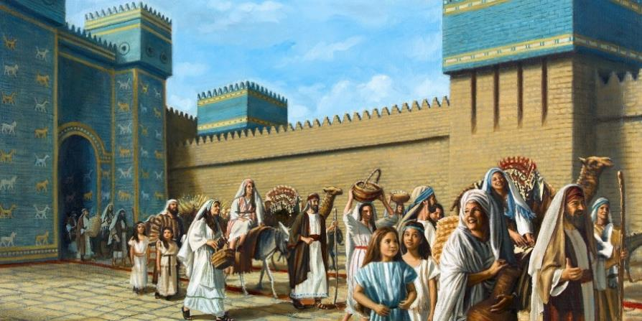
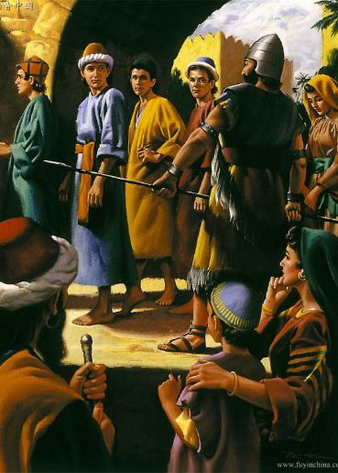
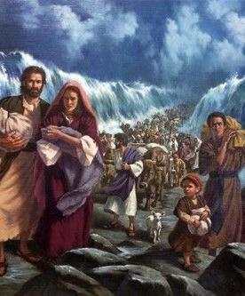
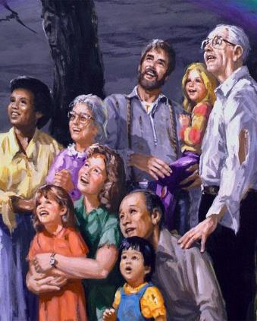
WAIT IN DIFFICULT TIMES
“When the Lord brought back the captivity of Zion, we were like those who dream” (Psalm 126:1)
The context in which Psalm 126 was written is very uninspiring: Israel was held captive in Babylon, while Jerusalem and the Temple were destroyed.
However, the psalmist sings: “The Lord has done great things for us, and we are glad” (Ps. 126:3).
Happy in captivity? Joyful in pain? Can we be joyful today in a world held captive by sin?
Yes, happy. Happy because we do not look at the current suffering. Our gaze turns back to observe the great things that God has done.
Then, we will look to the future with joy. When Jesus comes, weeping will turn to rejoicing (Ps. 126:6). “We were like those who dream” (Ps. 126:1).

Slide 7
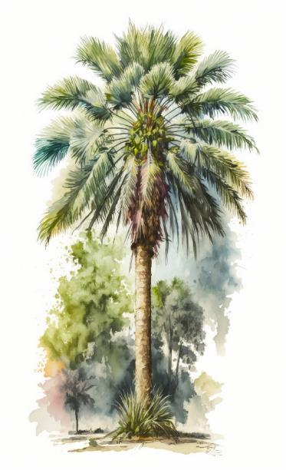
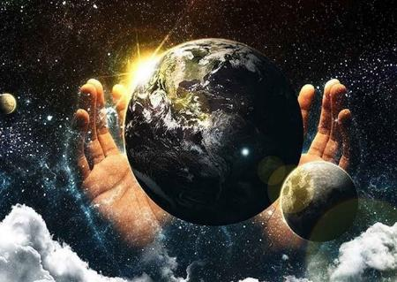
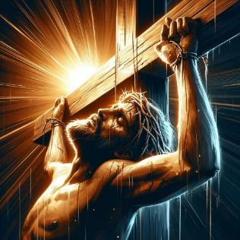
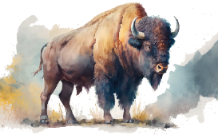
WAIT FOR REDEMPTION
“The righteous shall flourish like a palm tree, He shall grow like a cedar in Lebanon” (Psalm 92:12)
In the superscription of Psalm 92 we can read: “Song for the Sabbath.” We can find in it the two aspects of the Sabbath: Creation and Redemption.
Psalm 92:10
Psalm 92:15
We are “anointed.” A special word is used here referring to the oil that is mixed with the sacrifice (Lev. 2:5). We are a sacrifice to God (Rom. 12:1).
We share our hope with others.
“to proclaim: ‘The LORD is righteous; He is my Rock, and in him there is no injustice.’ ” (Psalm 92:15 NIV)
We rejoice in the contemplation of what God has created (Ps. 92:4-5). But many do not accept the Creator, nor the redemption He offers (Ps. 92:6-7).
However, those of us who accept the Savior will be created anew. Like palm trees, we will flourish, we will bear fruit, we will be vigorous (Ps. 92:12-14).
While we wait for that moment, every Saturday we renew our hope in two ways:

Slide 8
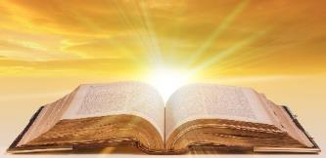
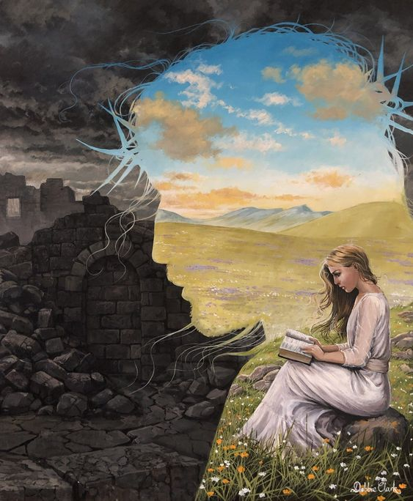
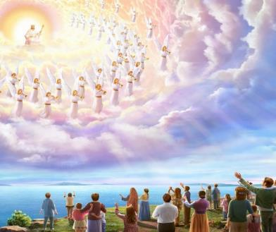
WAIT FOR THE GLORIOUS MORNING
“‘In My Voice You shall hear in the morning, O Lord; in the morning I will direct it to you, and I will look up” (Psalm 5:3)
The morning will end the night of despair and anguish (Ps. 130:5-6; 30:5b). The transformation that the morning produces is described like this in Psalm 143:
The darkness of death (v. 3)
Is turned into
a path in which I walk confidently (v. 8)
The burial place (v. 7)
becomes
a land of righteousness (v. 10)
Peter encourages us to trust in God's Word to guide us until the morning dawns (2 Pet. 1:19). But when will morning come?
Jesus is “the Bright and Morning Star” (Rev. 22:16). When He comes, “There will be no more night there; and they have no need of the light of a lamp, nor of the light of the sun, for the Lord God will enlighten them” (Rev. 22:5). The wait is worth it.

Slide 9
“We are looking for the second coming of Christ. Our hope of His soon appearing in the clouds of heaven with power and great glory fills our hearts with joy. When the Saviour comes, those who are prepared to meet Him will exclaim, “Lo, this is our God; we have waited for Him, and He will save us: this is the Lord; we have waited for Him, we will be glad and rejoice in His salvation” [Isa. 25:9] […]
A crown of life that fadeth not away is reserved in heaven for the redeemed, who in heaven will be kings and priests unto God. This is the hope set before us. What a hope it is! Oh, that everyone may be ready for Christ's coming! God grant that you may be overcomers!”
EGW (Sermons and Talks V.2, Chapter 24, page 179 )

