Slide 1
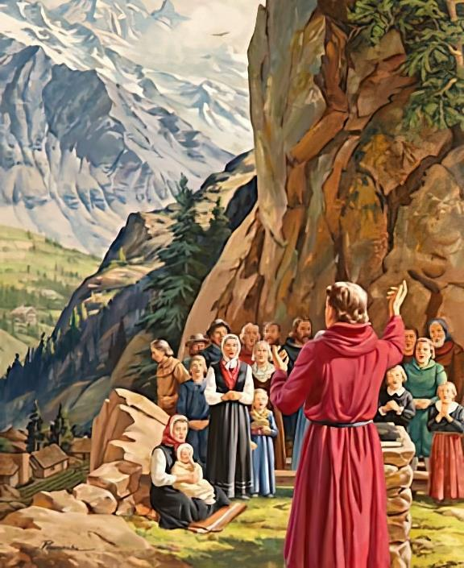
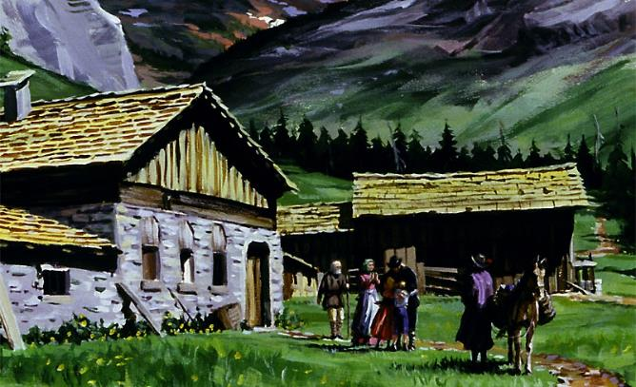
STANDING FOR THE TRUTH
Lesson 4 for April 27, 2024

Slide 2
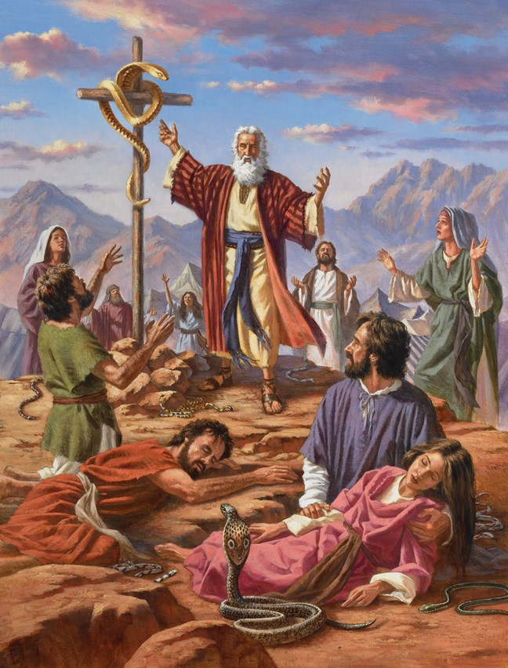
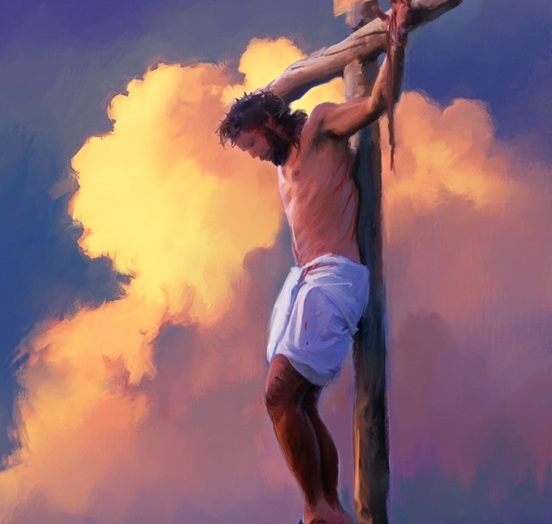
“And as Moses lifted up the serpent in the wilderness, even so must the Son of Man be lifted up, that whoever believes in Him should not perish but have eternal life” (John 3:14, 15, NKJV)

Slide 3
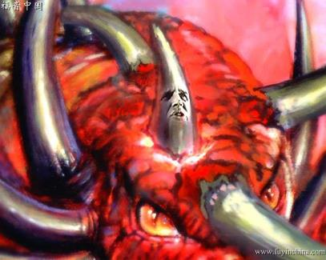
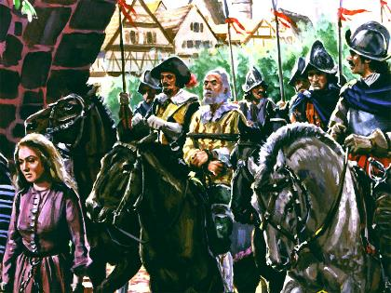
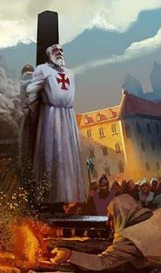
Daniel and Revelation herald a time during which Satan would use political-religious power to persecute and destroy those who stood firm in the truth.
This power “cast down the truth” (Dan. 8:12). At that time “Some of the wise will stumble, so that they may be refined, purified and made spotless until the time of the end, for it will still come at the appointed time.” (Dan. 11:35)
During this period – the Dark Ages – the truth was questioned. But there were people who came out in defense of the truth, and were willing to give their lives for it.
The truth in question:
Times of persecution.
Fidelity in the pursuit.
The defense of the truth:
Sharing the Bible: The Waldenses.
The star of the reform: John Wycliffe.
Strengthened by faith: John Huss and others.

Slide 4
THE TRUTH IN QUESTION

Slide 5
PERSECUTION TIMES
“He will speak against the Most High and oppress his holy people and try to change the set times and the laws. The holy people will be delivered into his hands for a time, times and half a time” (Daniel 7:25)
The period of persecution is announced in three different ways
“time, times and half a time” (Dan. 7:25; 12:7; Rev. 12:14)
1,260 days (Rev. 11:3; 12:6)
42 months (Rev. 11:2; 13:5)
The word “time” is synonymous with “year,” while the word “times” used by Daniel literally means “two times”.
Both in ancient times and today, the generic duration of a month is 30 days:
42 months
30 days
1.260 days
1 year
2 years
½ year
3 ½ years
All expressions indicate a single period: 1,260 days.
12 months
24 months
6 months
42 months
Under the principle of “day for year” (Ez. 4:6; Num. 14:34), this period of persecution spans 1,260 years of history.
42 months
30 days
1.260 days

Slide 6
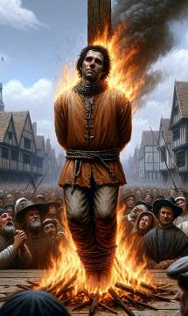
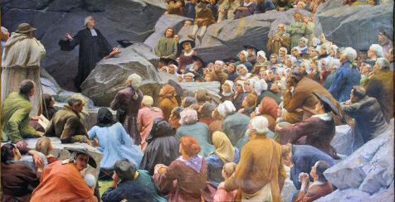
PERSECUTION TIMES
“He will speak against the Most High and oppress his holy people and try to change the set times and the laws. The holy people will be delivered into his hands for a time, times and half a time” (Daniel 7:25)
What historical period does the 1,260-year persecution announced by Daniel and Revelation cover?
Year 538
Year 1798
The Roman Church obtained political power when three tribes that embraced Arianism were defeated: Heruli, Vandals and Ostrogoths
The French general Berthier, under the orders of Napoleon, takes the Pope captive, ending the supremacy of the Roman Church
When ten political kingdoms arose from Rome (the tribes that invaded the empire), another kingdom would appear and overthrow three of the ten kingdoms (Dn. 7:23-25).
As prophesied, God prepared a place to help the faithful church: the wilderness, that is, places sparsely inhabited (Rev. 12:6, 14).
In the time of difficulties and persecution, faithful believers stood firm in defense of the truth, taking refuge in the love and care of God (Ps. 46:1-3).
Unfortunately, many had to pay for their loyalty with their blood.

Slide 7
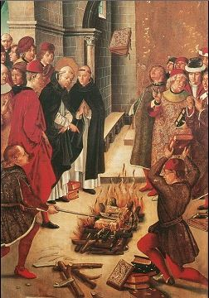
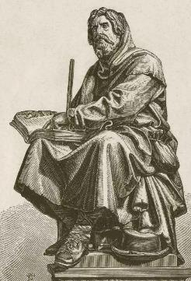
FAITHFULNESS IN THE PERSECUTION
“Dear friends, although I was very eager to write to you about the salvation we share, I felt compelled to write and urge you to contend for the faith that was once for all entrusted to God’s holy people” (Jude 1:3)
Once it gained political power, the Roman Church began to use its power to demand that everyone comply with its religious precepts, many of which had been perverted.
Added to this was growing corruption among the religious leadership. To prevent the masses from rebelling against his authority, he took from them the most precious thing: The Word of God.
But he could not destroy it completely. Faithful arose who, guided by biblical teachings and following the advice of Judas, fought vigorously to defend their faith (Jude 1:3).
Energized by the power of the Word, they fearlessly disseminated its teachings. Strengthened by promises like Revelation 2:10, they were faithful until death, knowing that they would receive the crown of life.

Slide 8
THE DEFENSE OF THE TRUTH

Slide 9
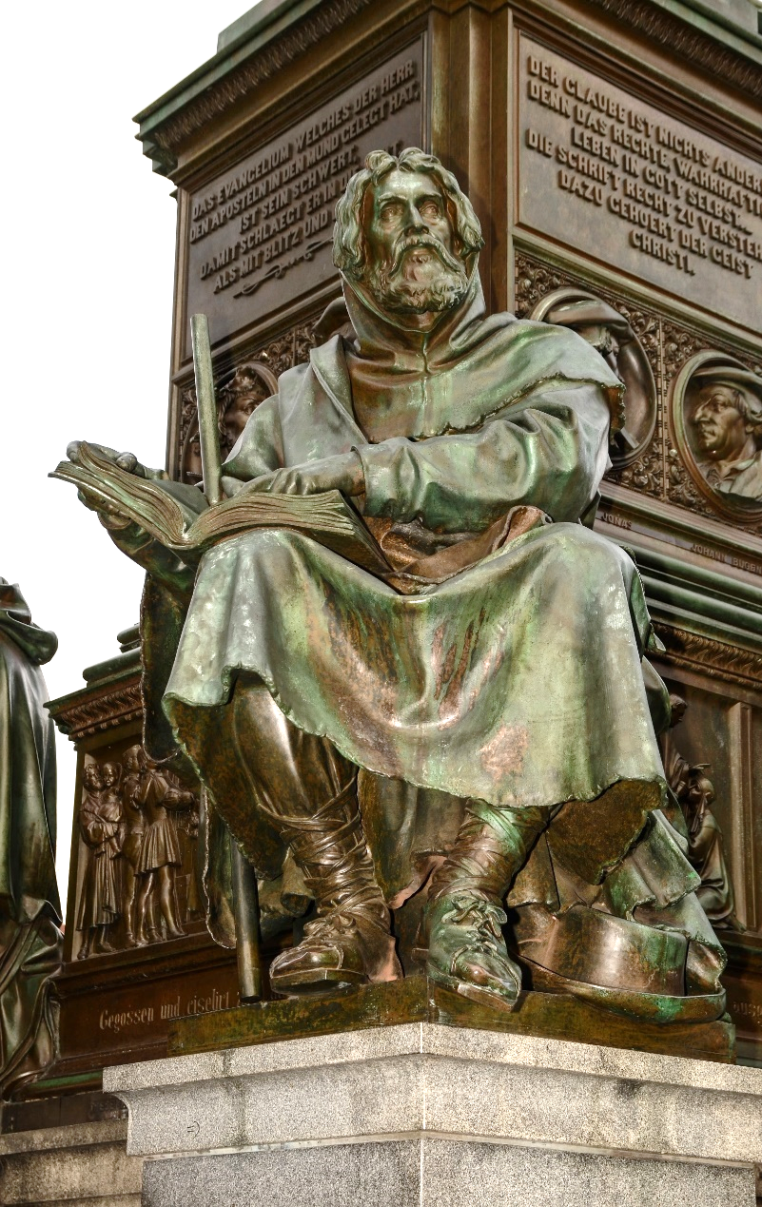
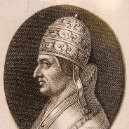
SHARING THE BIBLE: THE WALDENSES
“Peter and the other apostles replied: ‘We must obey God rather than human beings’ ” (Acts 5:29)
Peter Waldo (1140-1218), a wealthy French businessman who renounced his wealth to preach Christ, founded the “Poor of Lyon” movement, known as “Waldenses.” Pope Alexander III accepted his vow of poverty.
Shortly after, Francis of Assisi (1181-1226), who also took a vow of poverty, approved by Pope Innocent III, founded the Franciscan movement.
By then, Pope Lucius III had condemned the followers of Peter Waldo as heretics. However, the Franciscans became a pillar of the Roman Church while the Waldenses were persecuted to near extinction. Why?
For his fidelity. The first were faithful to the Pope, while the latter were faithful to the teachings of the Bible.

Slide 10
SHARING THE BIBLE: THE WALDENSES
What characterized the Waldenses?
They were the first to have the Bible available in their own language (until then, it was only available in Latin, Greek or Hebrew).
Since it was a forbidden book, they copied it in caves, hiding from the papists who besieged them.
They always carried biblical portions with them that, at opportune moments, they shared with others, giving them hope and encouragement in the Lord.
They preserved the biblical truths they knew for centuries. They were known for their fidelity and devotion.
Entire villages were converted both in the south of France and in the north of Italy, Piedmont.
Most of these villages were razed to the ground by the Papacy, and their inhabitants massacred.

Slide 11
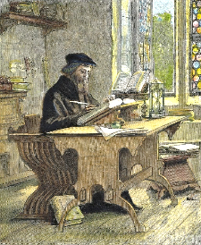
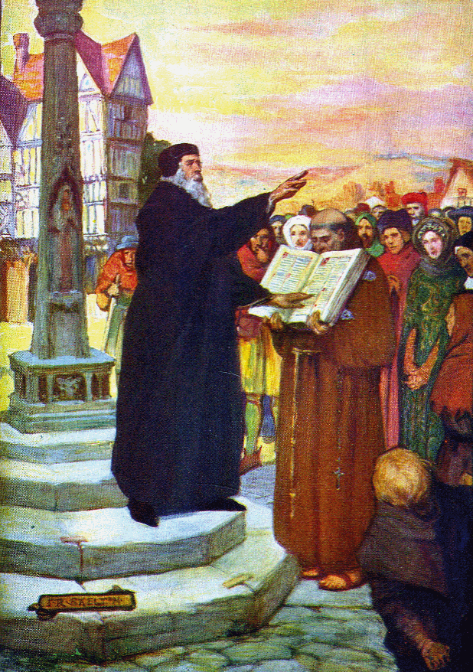
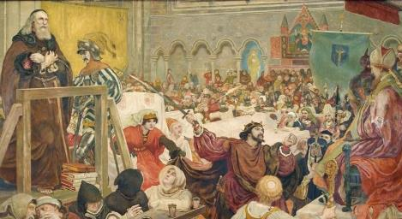
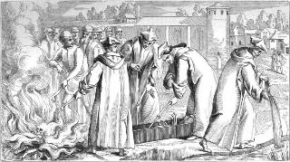
THE LIGHT OF THE REFORM: JOHN WICLEF
“The path of the righteous is like the morning sun, shining ever brighter till the full light of day” (Proverbs 4:18 NIV)
John Wycliffe (1324-1384) dedicated much of his life to translating the Bible into English. What motivated her to do this? Two reasons: Christ had transformed him through the Word; and wanted to share the love of Christ with others.
He, who sincerely studies the Bible, and opens his heart to the influence of the Holy Spirit, is transformed (Heb. 4:12).
Of course, this brought him into conflict with the official Church. Thanks to his contacts with high officials in England, John avoided death at the hands of the Church.
In 1428 the reformer's remains were burned, and his ashes were thrown into the river. His scattered ashes became a symbol of his legacy.
The small light of truth that John Wycliffe lit reached Bohemia, where John Hus took his legacy. In this way, the truth made its way until the dawn of the reform. The day was beginning to lighten.

Slide 12
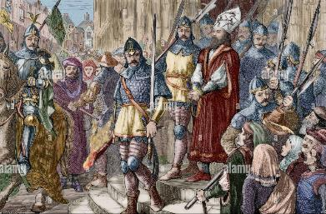
STRENGTHENED BY FAITH: JOHN HUSS AND OTHERS
“Whoever has the Son has life; whoever does not have the Son of God does not have life” (1 John 5:12)
After John Wycliffe, other reformers arose:
John Huss (1370-1415)
Jerome (1360-1416)
Tyndale (1494-1536)
Hugh Latimer (1490-1555)
What gave them courage to carry out their reforms and face problems and death?
They believed in the promises of Christ
The strength of Christ was enough for them to overcome the trials
They found joy in participating in the sufferings of Christ
His faithfulness was a powerful testimony to the world
They looked beyond the present, towards the glorious future
They knew that death was a defeated enemy
They held fast to the promises of God's Word
John Hus was imprisoned and eventually burned at the stake. From prison he wrote: “how merciful God has been to me, and how admirably he has sustained me.” Just as God's promises sustained his people in the past, they sustain us today.

Slide 13
“All who in that evil day would fearlessly serve God according to the dictates of conscience, will need courage, firmness, and a knowledge of God and His word; for those who are true to God will be persecuted, their motives will be impugned, their best efforts misinterpreted, and their names cast out as evil. Satan will work with all his deceptive power to influence the heart and becloud the understanding. […] The stronger and purer the faith of God's people, and the firmer their determination to obey Him, the more fiercely will Satan strive to stir up against them the rage of those who, while claiming to be righteous, trample upon the law of God. It will require the firmest trust, the most heroic purpose, to hold fast the faith once delivered to the saints”
EGW (The Acts of the Apostles, pg. 431.1)

