Slide 1
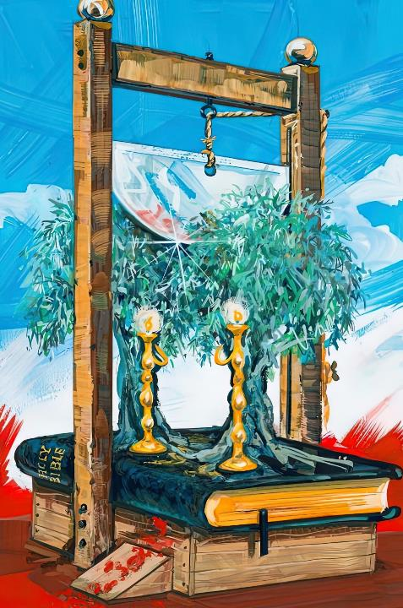
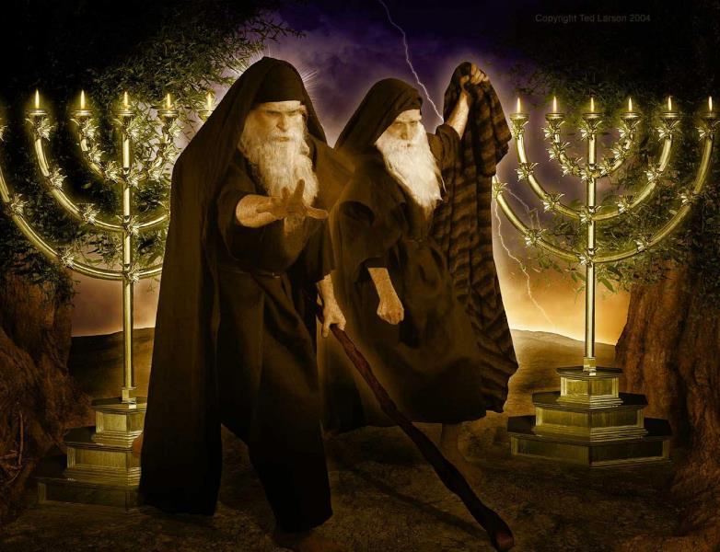
THE TWO WITNESSES
Lesson 6 for May 11, 2024

Slide 2
“The grass withers, the flower fades, but the word of our God stands forever” (Isaiah 40:8, NKJV)

Slide 3
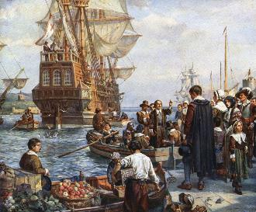
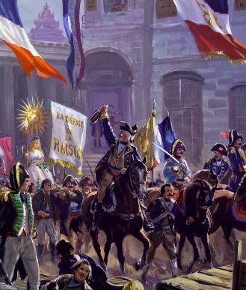
After the death of the great reformers, the reform suffered stagnation. The Reformed churches became cold, rigid and intolerant.
Great changes were taking place in the political and philosophical world. The widespread instability led some, like the Pilgrims, to flee their homes and seek help in the “land of the free,” North America.
In Europe, the crisis broke out in the form of a revolution. France stood as the first atheist state in modern Europe.
Until that moment, God had preserved his “two witnesses.” What happened to them during these critical moments in history?
Who are the two witnesses?
How long did they give their testimony?
How he died?
When were they resurrected and ascended to heaven?
What happened next?

Slide 4
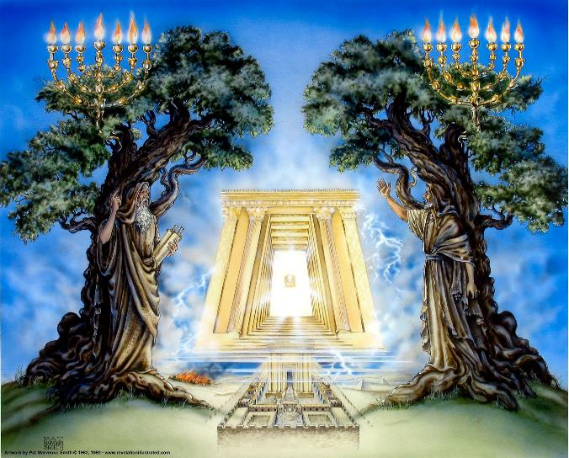
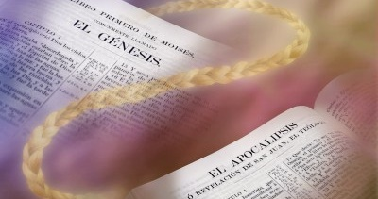
WHO ARE THE TWO WITNESSES?
“They are the two olive trees and the two lampstands, and they stand before the Lord of the earth” (Revelation 11:4)
The mention of the two olive trees and the two lampstands (Rev. 11:4) takes us to the vision of Zechariah 4. In it, the olive trees produce the oil that feeds a seven-branched lampstand (Zech. 4:1-3 , 12).
The olive trees are “the two anointed ones” that, together with the lampstand, represent “the word of the Lord” (Zech. 4:6, 14). That is, the Old and New Testaments.

Slide 5
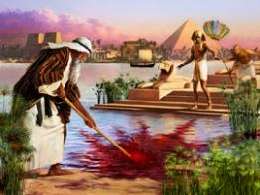
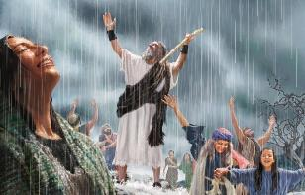
WHO ARE THE TWO WITNESSES?
Using Moses and Elijah as symbols, Revelation 11 says of these two witnesses:
They are dressed in sackcloth (3)
The Bible was preserved in troubling times
If someone wants to harm them, fire comes out of them (5)
They close the sky so it doesn't rain (6a)
They turn water into blood and cause plagues (6b)
Only those who studied the Bible were delivered from the plagues and spiritual darkness of the Middle Ages.
They stand before God (4)
God did not allow his word to disappear
The biblical message “devours” its enemies (Jer. 5:14)
He who rejects the Bible is deprived of the rain of the Holy Spirit (the oil).
As with Moses and Elijah, the Bible would suffer great persecutions; it would fight with atheist governments; it would ignite burning passions... History confirms the accuracy of this prophecy.

Slide 6
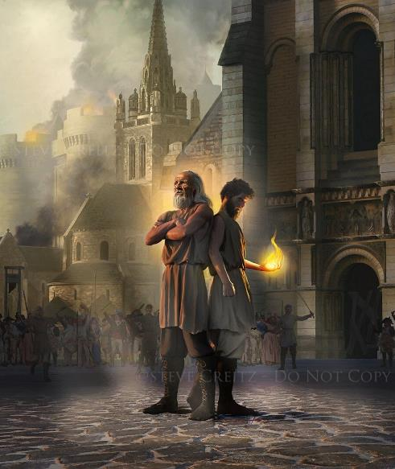
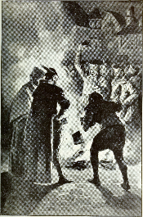
HOW LONG DID THEY GIVE THEIR TESTIMONY?
“And I will appoint my two witnesses, and they will prophesy for 1,260 days, clothed in sackcloth.” (Rev. 11:3)
Revelation chapter 11 begins with a vision of the Heavenly Sanctuary, and of those who worship before the altar of incense (Rev. 11:1).
The Court of the Heavenly Sanctuary is the Earth, where the “Gentiles” – unbelievers – trample the “holy city” – the people of God – for 42 months (v. 2).
At that time, the Word of God would be clothed in “sackcloth” – great hardships – (v. 3) [42 months x 30 days = 1,260 days (in prophecy, 1,260 years)].
From the year 538, the Roman church began to gradually impose its tradition above the Word of God, reaching the point of prohibiting the reading of the Bible and condemning to death those who had it, read it, or lived according to its beliefs (doctrines).
Near the end of this period, the reformers gave momentary relief to this persecution. (Matt. 24:22).

Slide 7
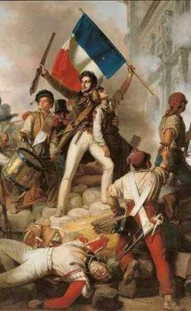
HOW DID THEY DIE?
“Now when they have finished their testimony, the beast that comes up from the Abyss will attack them, and overpower and kill them” (Revelation 11:7)
The abyss mentioned in Rev. 11:7 describes the place where demons dwell (Rev. 9:11; 20:1-3; Luke 8:30-31). The beast describes a political or religious power (as with the other beasts of Revelation and Daniel).
What power arose at the end of the 1,260 years, that is, around the year 1798?
The French Revolution, begun in 1789, gave rise to the so-called “government of terror” (1793-1794), making it very clear who was behind this government: Satan and his demons. This government is called three ways (Rev. 11:8):
Sodom : The Revolution began a period of great immorality
Egypt : Atheist government (Ex. 5:2), although they did not mind worshiping the “goddess of reason”
Where Jesus was crucified : Jesus' sacrifice will be rejected
During this period, religion was abolished, and the Bible banned and burned.

Slide 8
“The atheistical power that ruled in France during the Revolution and the Reign of Terror, did wage such a war against God and His holy word as the world had never witnessed. The worship of the Deity was abolished by the National Assembly. Bibles were collected and publicly burned with every possible manifestation of scorn. The law of God was trampled underfoot. The institutions of the Bible were abolished. The weekly rest day was set aside, and in its stead every tenth day was devoted to reveling and blasphemy. Baptism and the Communion were prohibited. And announcements posted conspicuously over the burial places declared death to be an eternal sleep.”
EGW (The Great Controversy, p. 273.2)

Slide 9
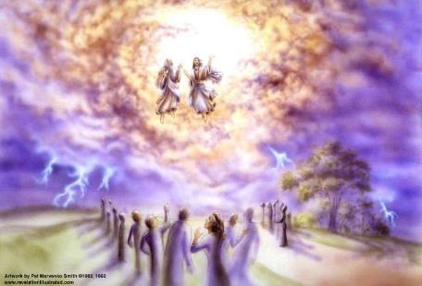
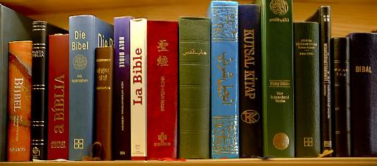
WHEN DID THEY RESURRECT AND GO UP TO HEAVEN?
“But after the three and a half days the breath of life from God entered them, and they stood on their feet, and terror struck those who saw them” (Revelation 11:11)
On November 26, 1793, Paris issued a decree abolishing religion. This decree was annulled on June 17, 1797. During this period of three and a half years, France rejoiced and was glad to have “liberated” from the tyranny of religion, and to have silenced the voice of the Bible (Rev. 11:9-10).
Instead of being silenced or destroyed, the Bible rose up stronger than before. Protestant missions carried the gospel message to the ends of the Earth (Rev. 11:11).
William Wilberforce created the first Bible Society in 1804 for the mass distribution of the Bible. The existing copies of the Bible multiplied by thousands, until it became the first best-selling book in the world. Currently, the distribution of the Word of God is unstoppable. It has been placed by God in a situation where no one can destroy it (Rev. 11:12).

Slide 10
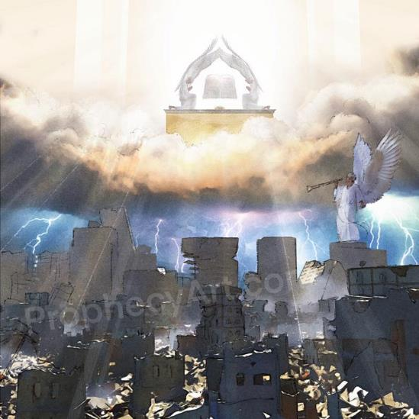
WHAT HAPPENED NEXT?
“Then God’s temple in heaven was opened, and within his temple was seen the ark of his covenant. And there came flashes of lightning, rumblings, peals of thunder, an earthquake and a severe hailstorm” (Revelation 11:19)
From the “resurrection” of the two witnesses, the last chapter of the cosmic conflict begins: the time of the end.
This time will culminate in the Second Coming, when all kingdoms will become the possession of Jesus, and He will reign eternally (Rev. 11:15).
That time will be preceded by wrath among the nations, and will end with the destruction of “those who destroy the Earth” (Rev. 11:18).
All of these events are framed in a context of worship in Heaven (Rev. 11:16-17), which culminates with the vision of the ark of the covenant in the Heavenly Sanctuary (Rev. 11:19).
Having arrived “the time of judgment” (Rev. 11:18), the standard of the Judgment is shown to the world: the ten commandments contained in the ark of the covenant.

Slide 11
“The Holy Spirit is beside every true searcher of God's word, enabling him to discover the hidden gems of truth. Divine illumination comes to his mind, stamping the truth upon him with a new, fresh importance. He is filled with a joy never before felt. The peace of God rests upon him. The preciousness of truth is realized as never before. A heavenly light shines upon the Word, making it appear as though every letter were tinged with gold. God himself speaks to the heart, making His word spirit and life.”
EGW (Reflecting Christ, April 14)

