Slide 1
“And war broke out in heaven: Michael and his angels fought with the dragon; and the dragon and his angels fought, but they did not prevail, nor was a place found for them in heaven any longer” (Revelation 12:7, 8, NKJV)

Slide 2
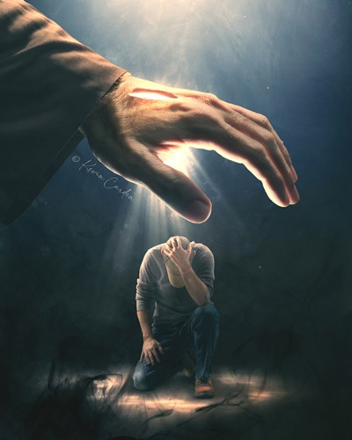
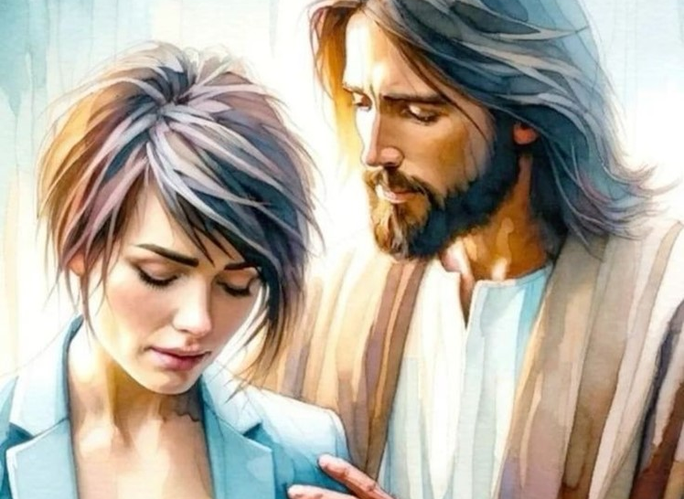
“Fear not, for I am with you; Be not dismayed, for I am your God. I will strengthen you, Yes, I will help you, I will uphold you with My righteous right hand” ((Isaiah 41:10, NKJV)

Slide 3
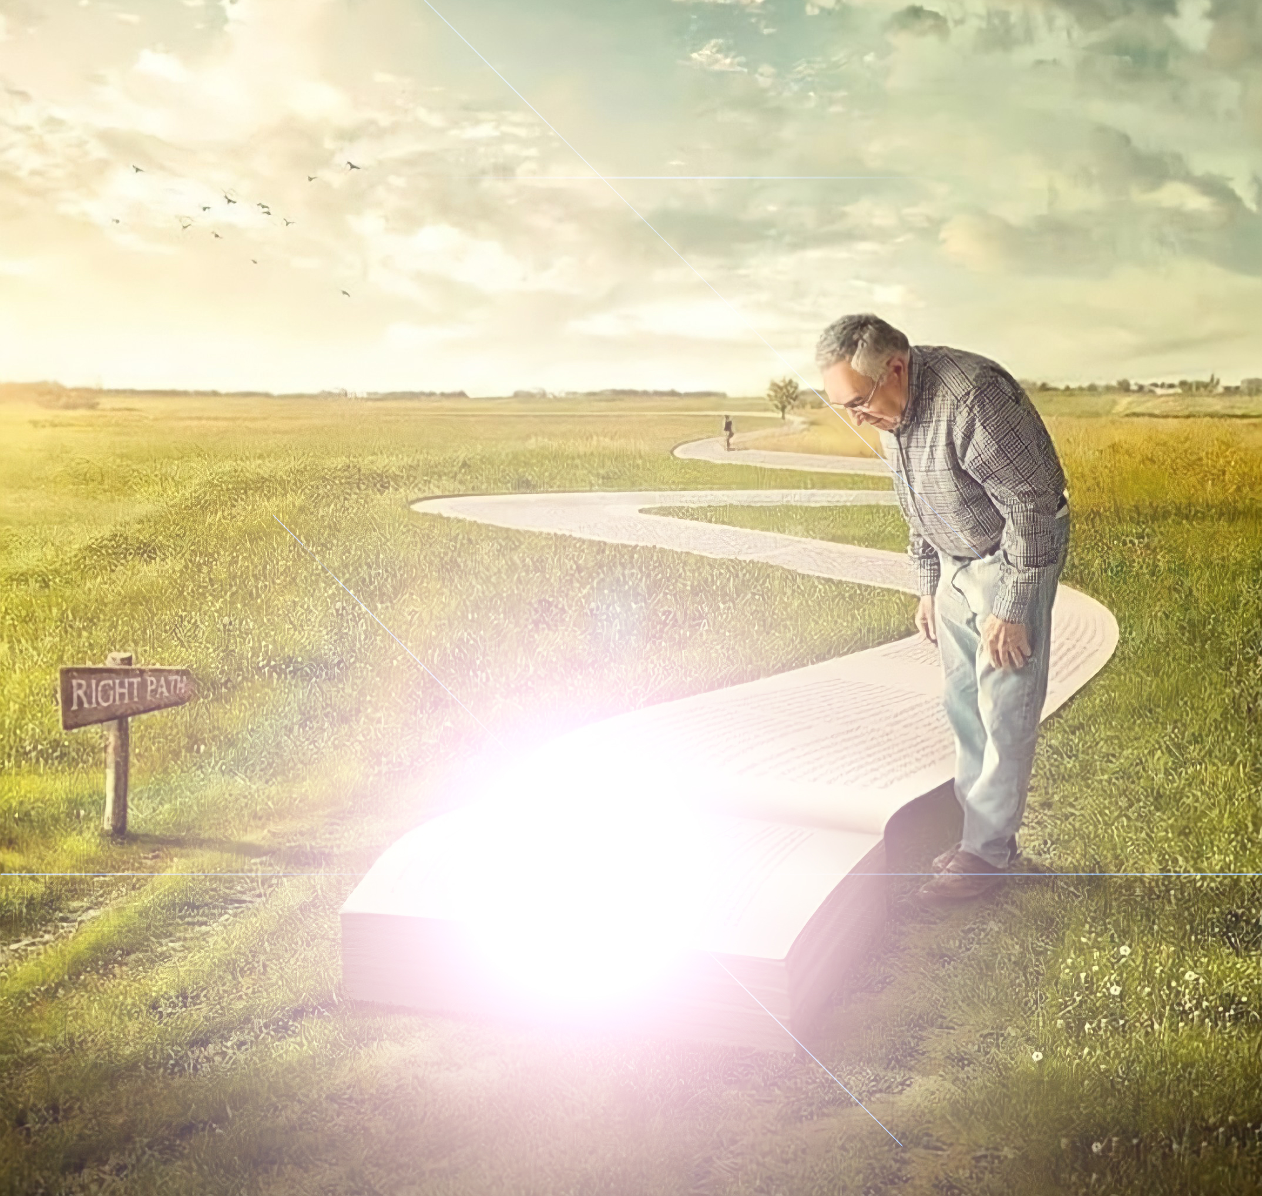
“Then Jesus said to them, ‘A little while longer the light is with you. Walk while you have the light, lest darkness overtake you; he who walks in darkness does not know where he is going’ ”
(John 12:35, NKJV)

Slide 4
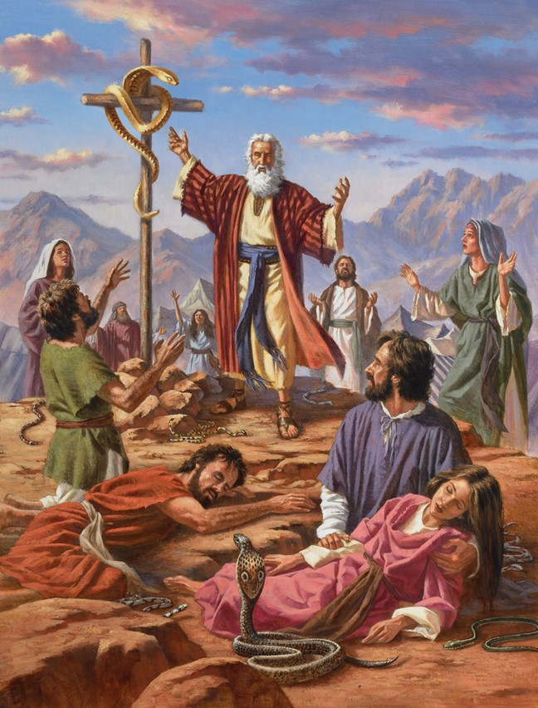
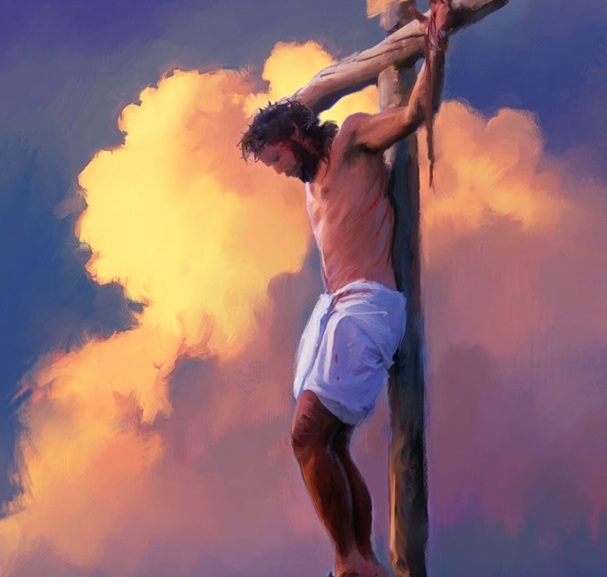
“And as Moses lifted up the serpent in the wilderness, even so must the Son of Man be lifted up, that whoever believes in Him should not perish but have eternal life” (John 3:14, 15, NKJV)

Slide 5
“Your word I have hidden in my heart, that I might not sin against You”
(Psalm 119:11, NKJV)

Slide 6
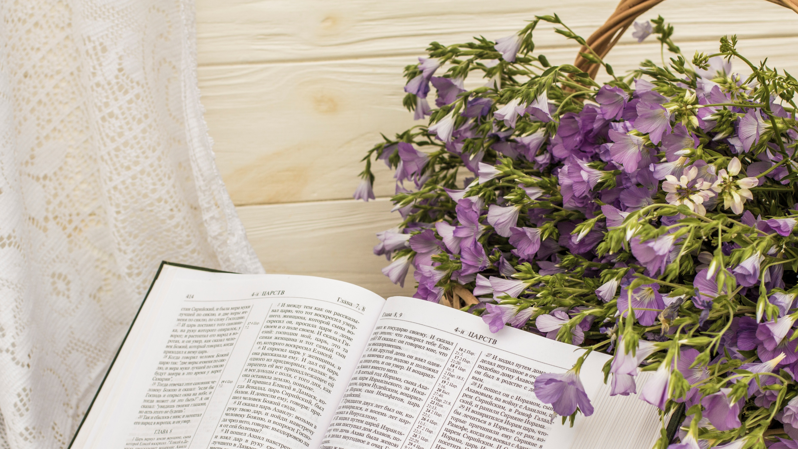
“The grass withers, the flower fades, but the word of our God stands forever” (Isaiah 40:8, NKJV)

Slide 7
“And it will be said in that day: ‘Behold, this is our God; we have waited for Him, and He will save us. This is the Lord; we have waited for Him; we will be glad and rejoice in His salvation’ ” (Isaiah 25:9, NKJV)

Slide 8
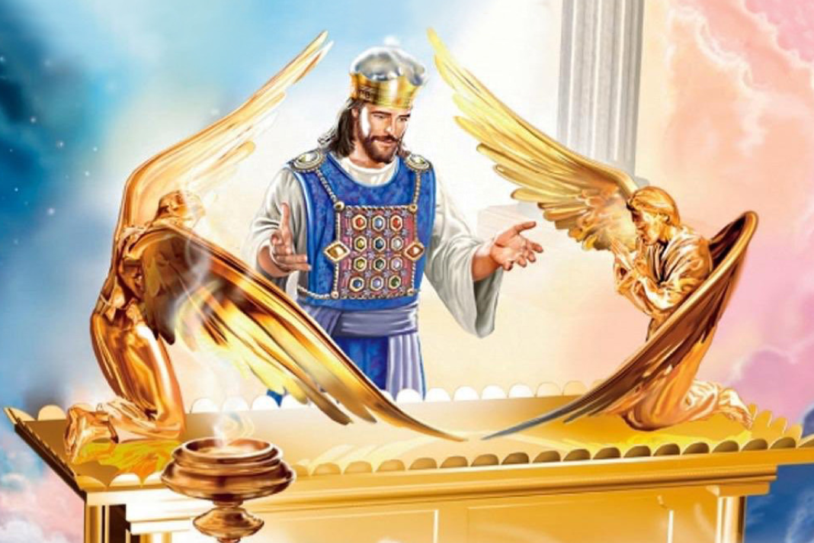
“We have such a High Priest, who is seated at the right hand of the throne of the Majesty in the heavens, a Minister of the sanctuary and of the true tabernacle which the Lord erected, and not man” (Hebrews 8:1, 2, NKJV)

Slide 9
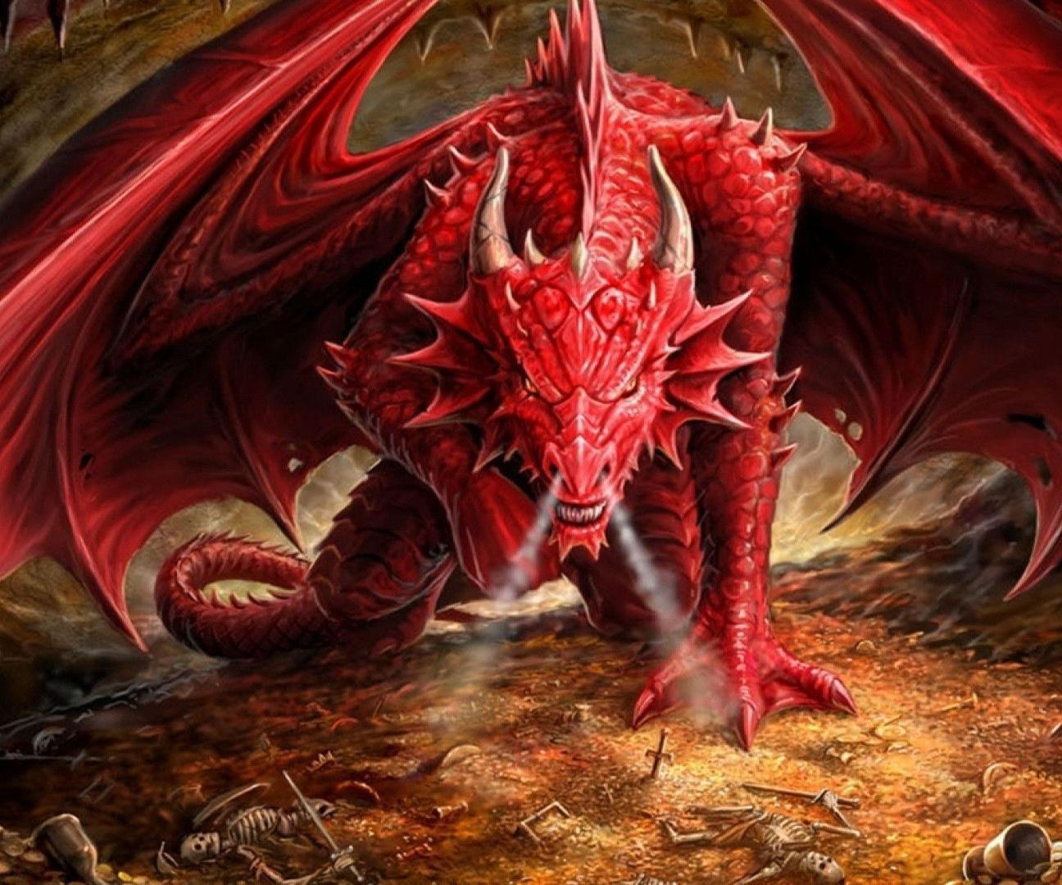
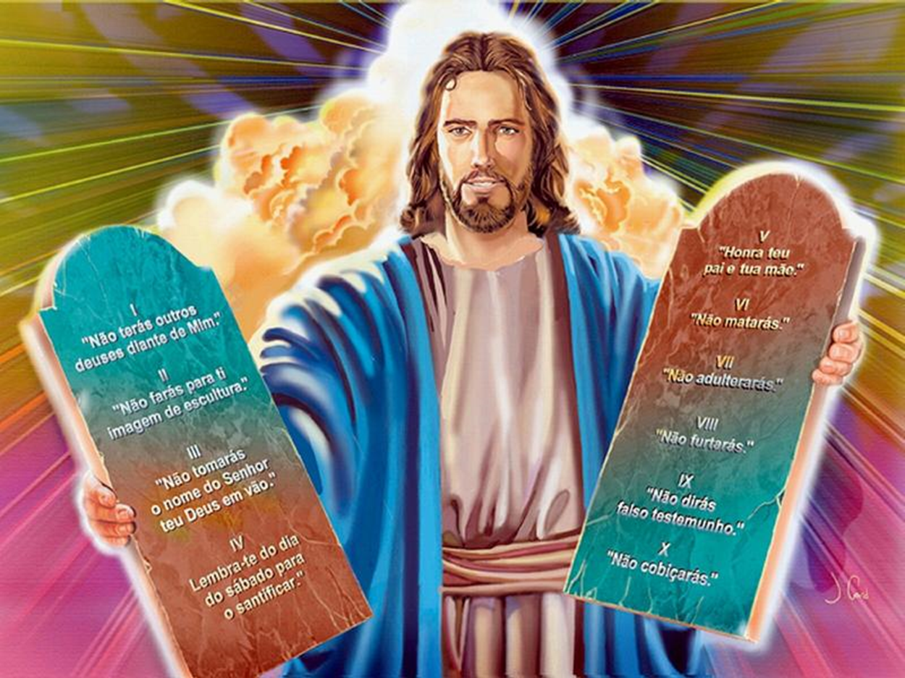
“And the dragon was enraged with the woman, and he went to make war with the rest of her offspring, who keep the commandments of God and have the testimony of Jesus Christ”
(Revelation 12:17, NKJV)

Slide 10
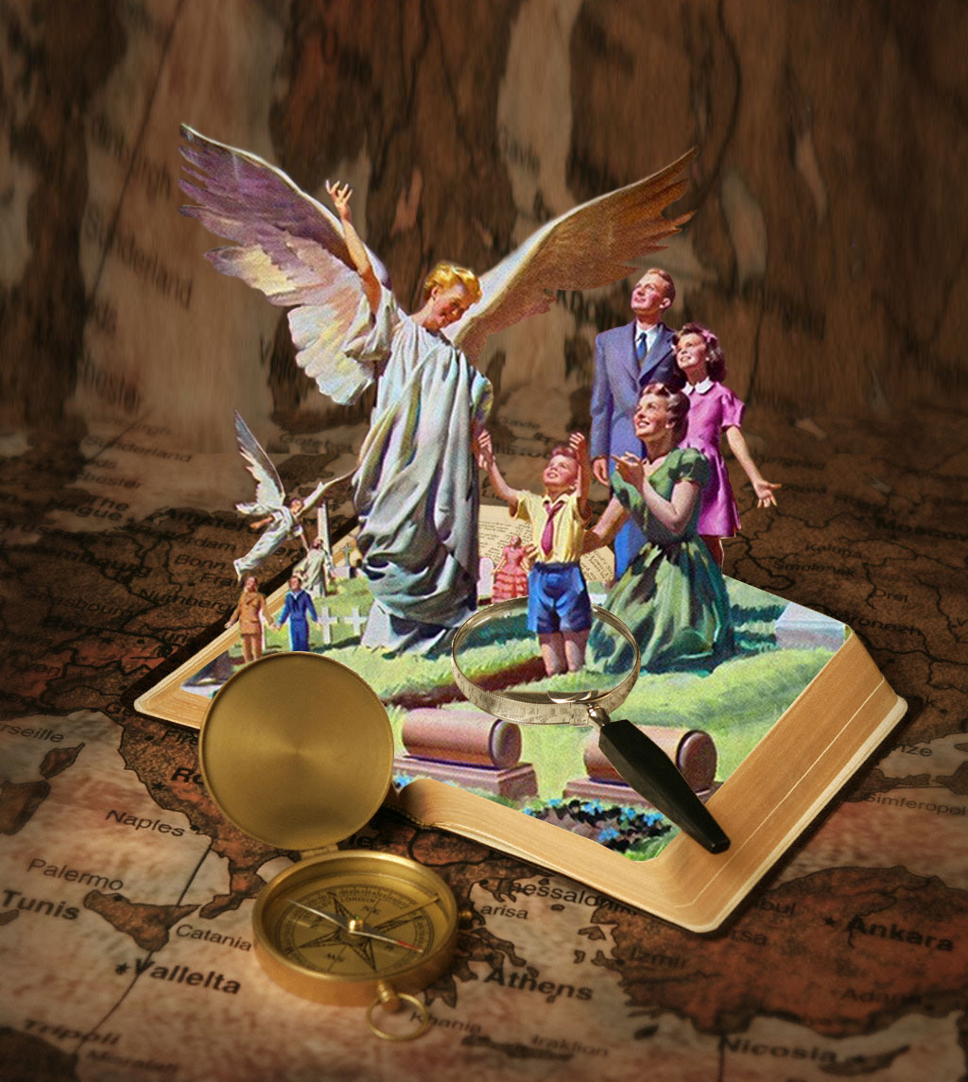
“For the Lord Himself will descend from heaven with a shout, with the voice of an archangel, and with the trumpet of God. And the dead in Christ will rise first. Then we who are alive and remain shall be caught up together with them in the clouds to meet the Lord in the air. And thus we shall always be with the Lord”
(1 Thessalonians 4:16, 17, NKJV)

Slide 11
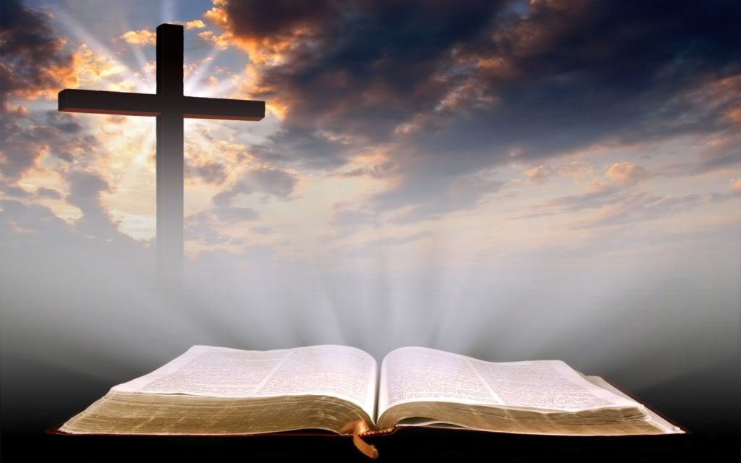
“Sanctify them by Your truth. Your word is truth”
(John 17:17, NKJV)

Slide 12
“Buy the truth, and do not sell it, also wisdom and instruction and understanding” (Proverbs 23:23, NKJV)

Slide 13
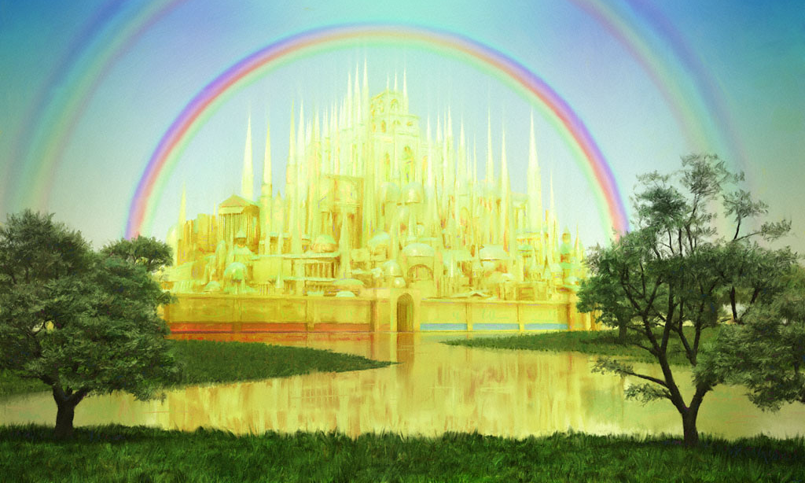
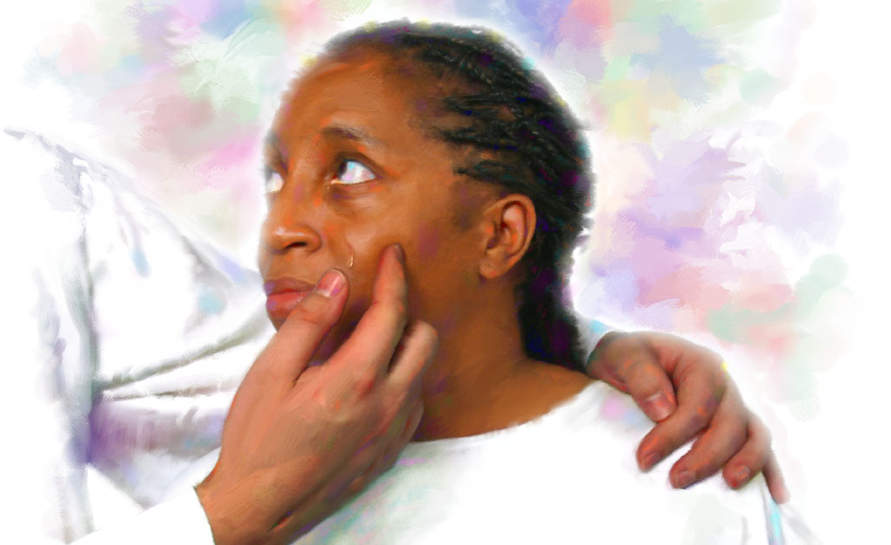
“And I heard a loud voice from heaven saying, ‘Behold, the tabernacle of God is with men, and He will dwell with them, and they shall be His people. God Himself will be with them and be their God. And God will wipe away every tear from their eyes; there shall be no more death, nor sorrow, nor crying. There shall be no more pain, for the former things have passed away’ ” (Revelation 21:3, 4, NKJV)

