Slide 1

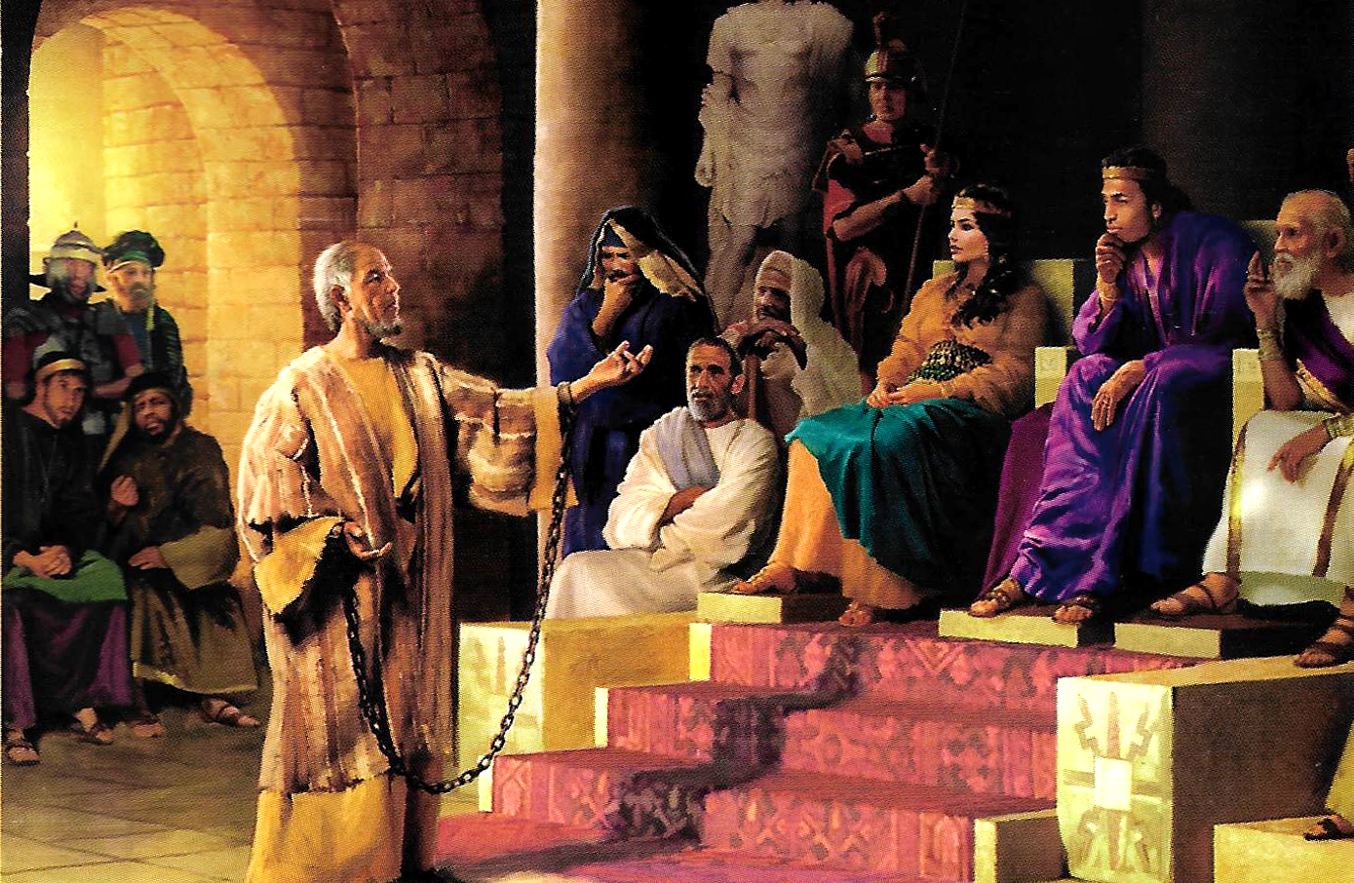
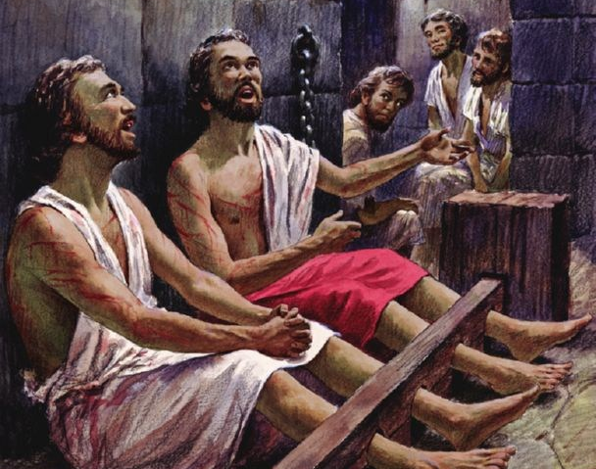
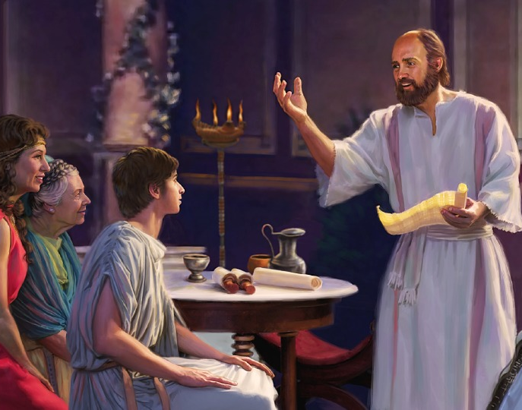
“Rejoice in the Lord always. Again I will say, rejoice!”
Philippians 4:4, NKJV

Slide 2
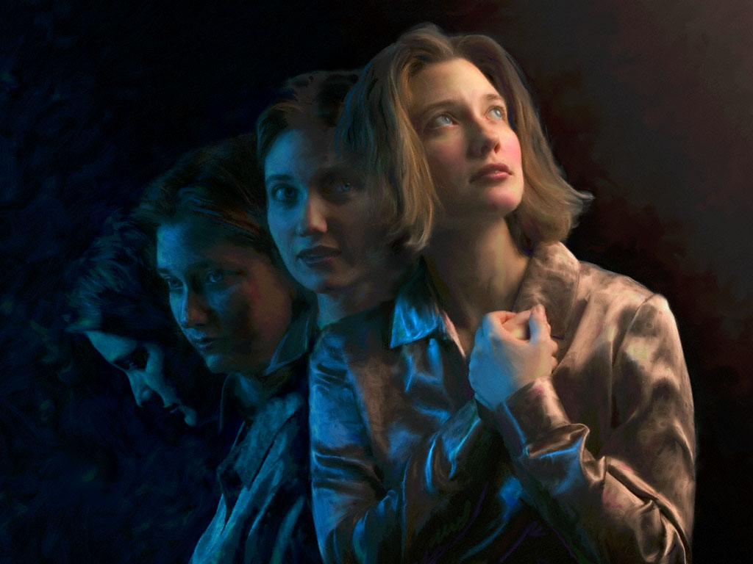

“Being confident of this very thing, that He who has begun a good work in you will complete it until the day of Jesus Christ”
Philippians 1:6, NKJV

Slide 3

“For
to me,
to live is Christ, and
to die
is gain”
Philippians 1:21, NKJV

Slide 4
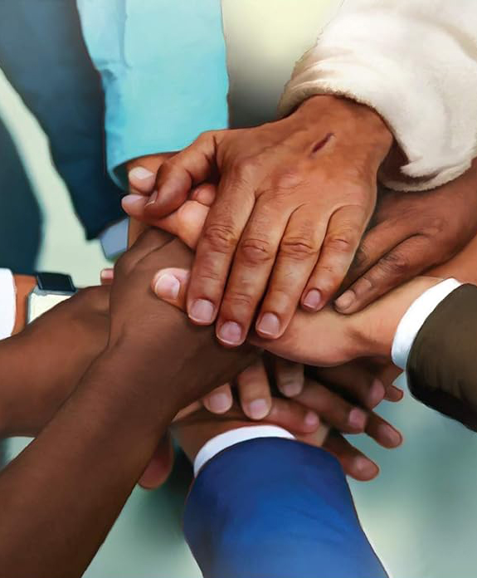
“Fulfill my joy by being like-minded, having the same love, being of one accord, of one mind”
Philippians 2:2, NKJV

Slide 5

“Do all things without complaining and disputing, that you may become blameless and harmless, children of God without fault in the midst of a crooked and perverse generation, among whom you shine as lights in the world”
Philippians 2:14, 15, NKJV

Slide 6


“That I may know Him and the power of His resur­rection, and the fellowship of His sufferings, being conformed to His death, if, by any means, I may attain to the resurrection from the dead”
Philippians 3:10, 11, NKJV

Slide 7
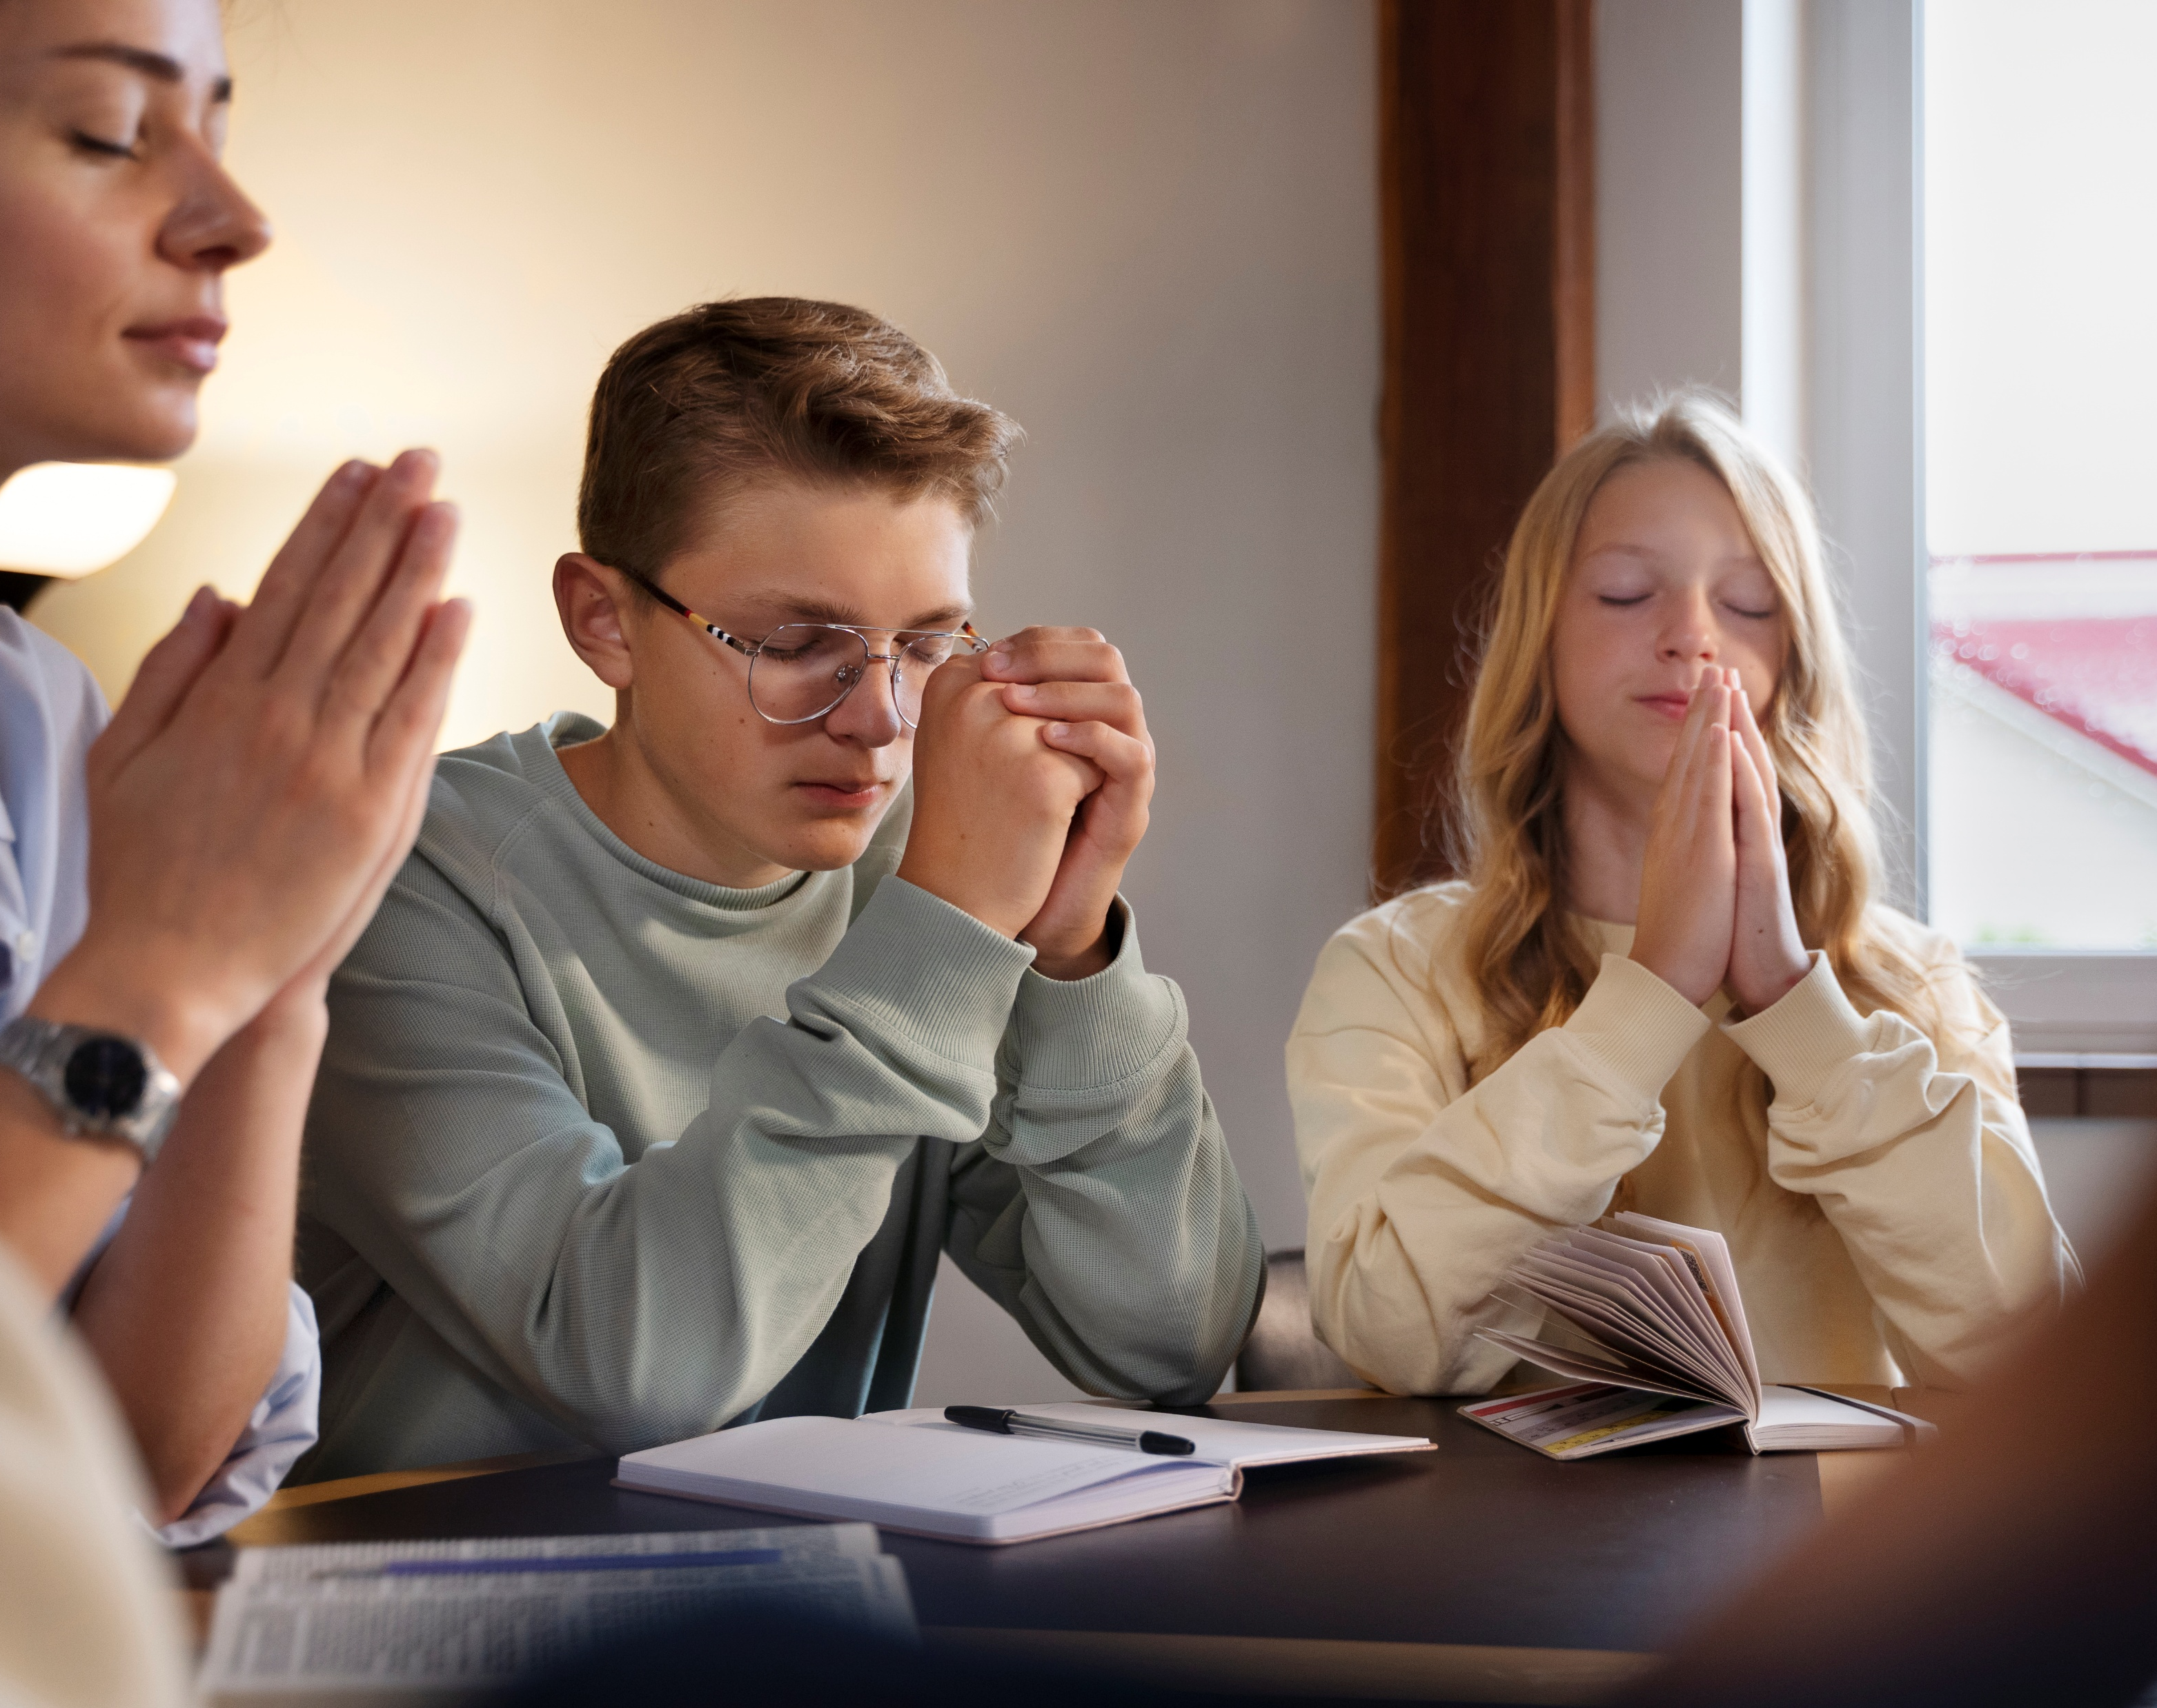
“Be anxious for nothing, but in everything by prayer and supplication, with thanksgiving, let your requests be made known to God”
Philippians 4:6, NKJV

Slide 8
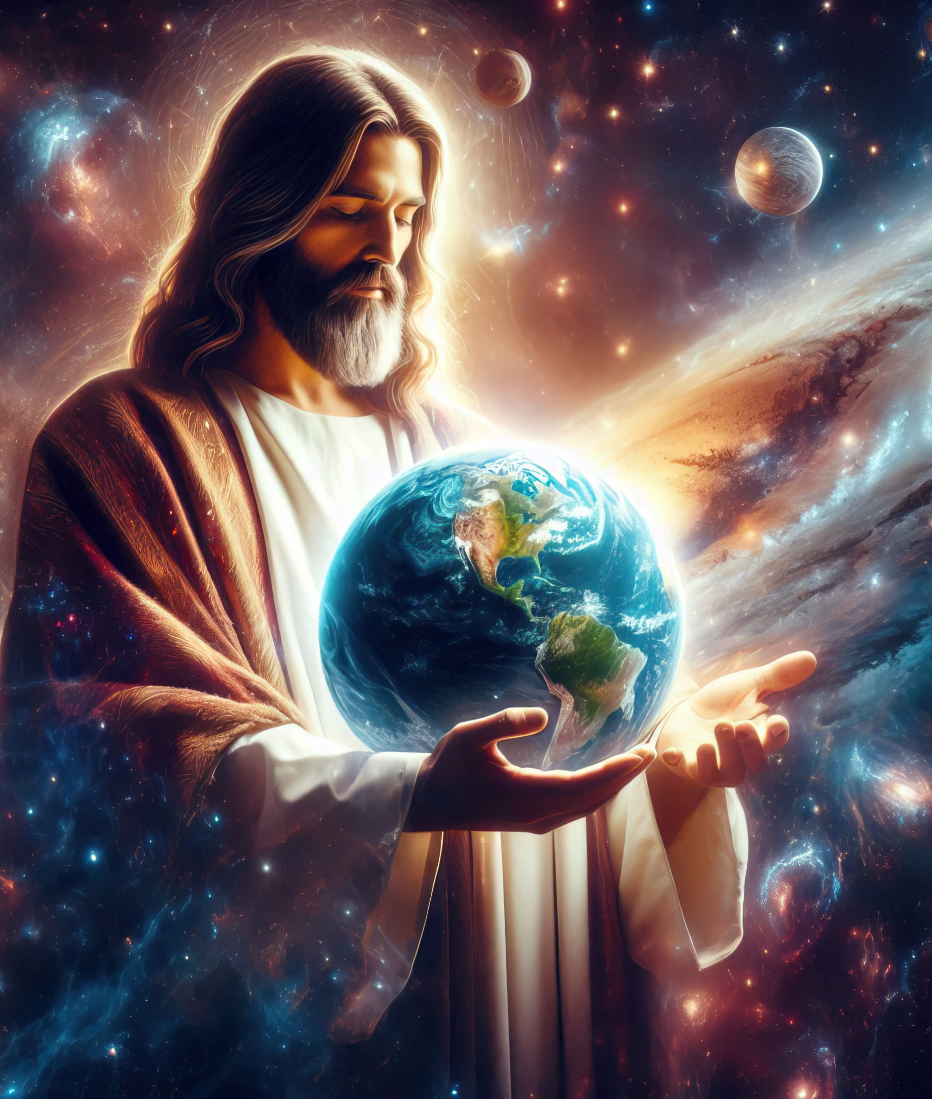
“He [Christ] is the image of the invisible God, the firstborn over all creation. For by Him all things were created that are in heaven and that are on earth, visible and invisible, whether thrones or dominions or principalities or powers. All things were created through Him and for Him. And He is before all things, and in Him all things consist”
Colossians 1:15–17, NKJV

Slide 9


2 Corinthians 5:21
“For he hath made him to be sin for us, who knew no sin; that we might be made the righteousness of God in him”

Slide 10
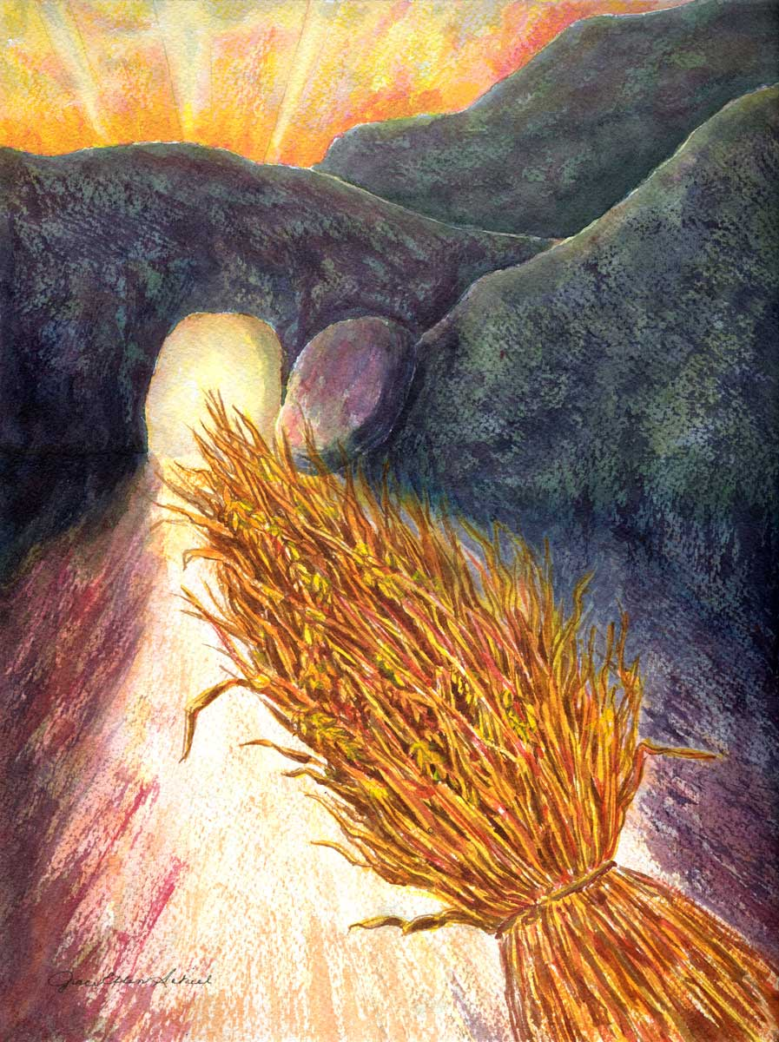
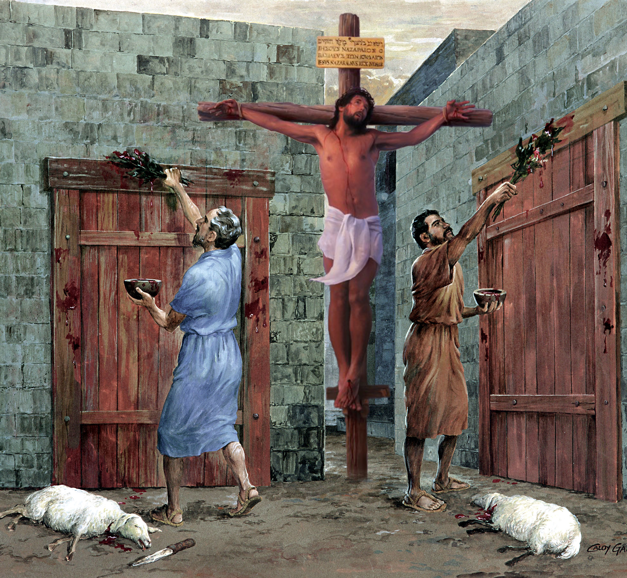
“So let no one judge you in food or in drink, or regarding a festival or a new moon or sabbaths, which are a shadow of things to come, but the substance is of Christ” Colossians 2:16, 17, NKJV

Slide 11

“But above all these things put on love, which is the bond of perfection”
Colossians 3:14, NKJV

Slide 12
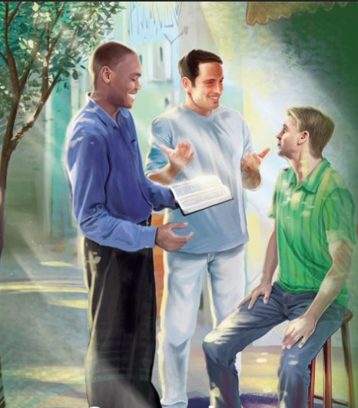
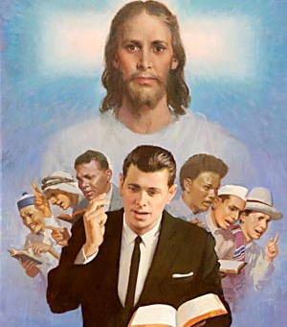


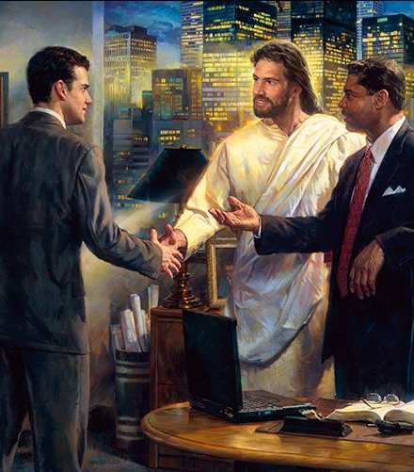
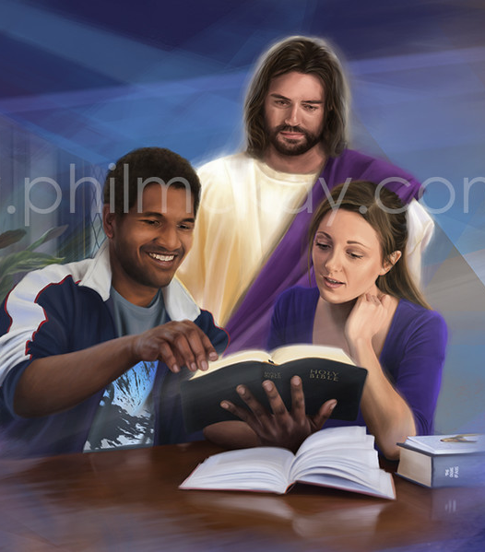
“Let your speech always be with grace, seasoned with salt, that you may know how you ought to answer each one” Colossians 4:6, NKJV

Slide 13


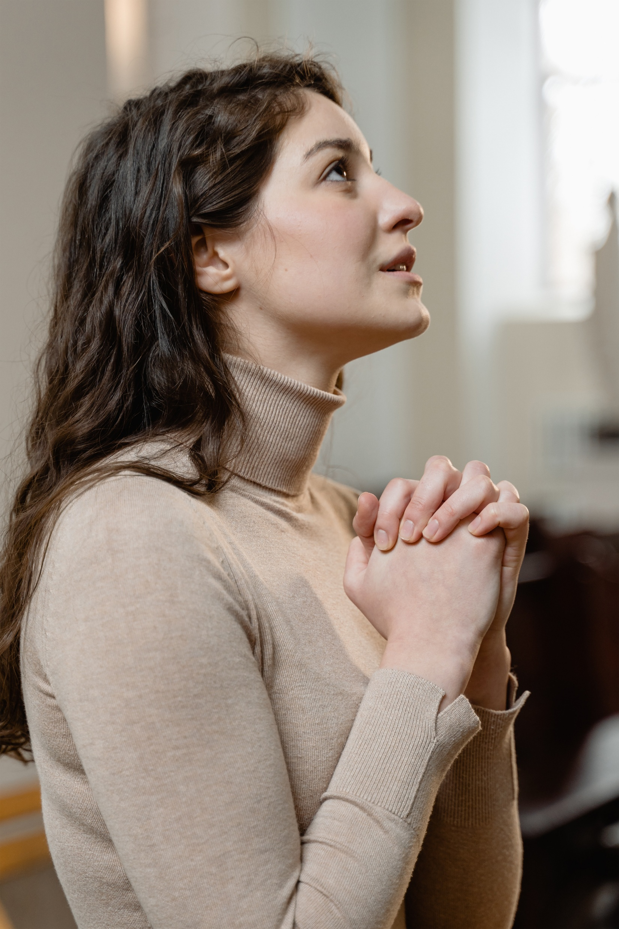
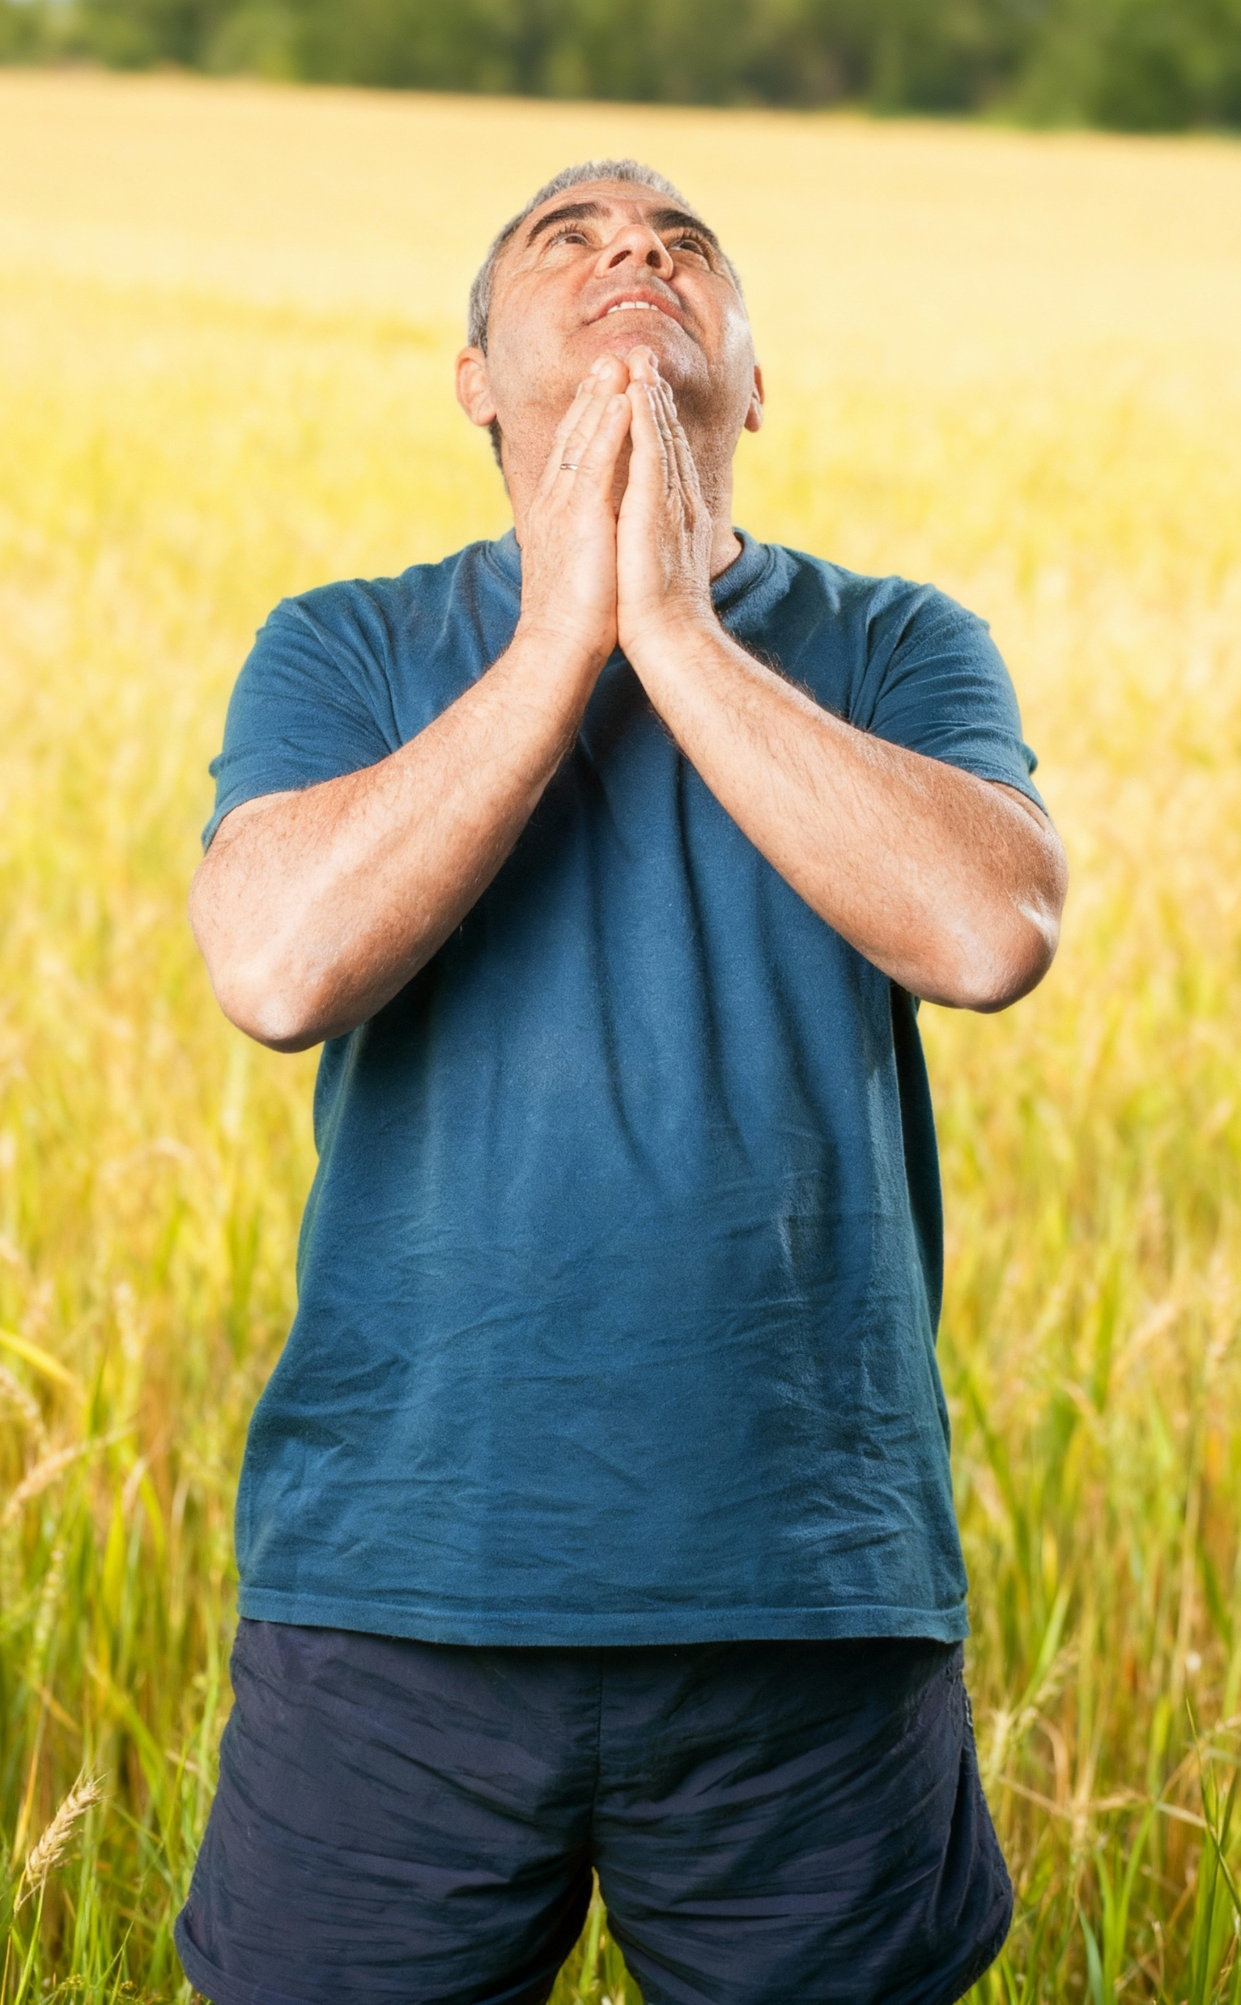
“In everything give thanks; for this is the will of God in Christ Jesus for you”
1 Thessalonians 5:18, NKJV

