Slide 1
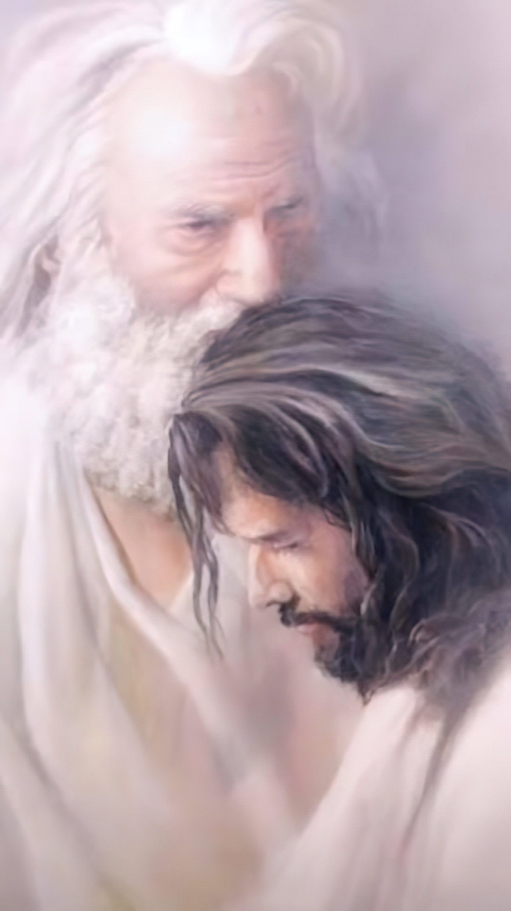
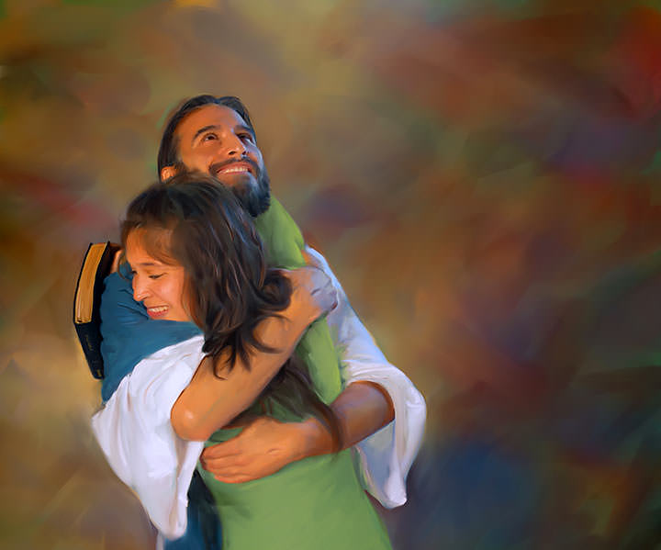
“As the Father loved Me, I also have loved you; abide in My love”
(John 15:9, NKJV)

Slide 2
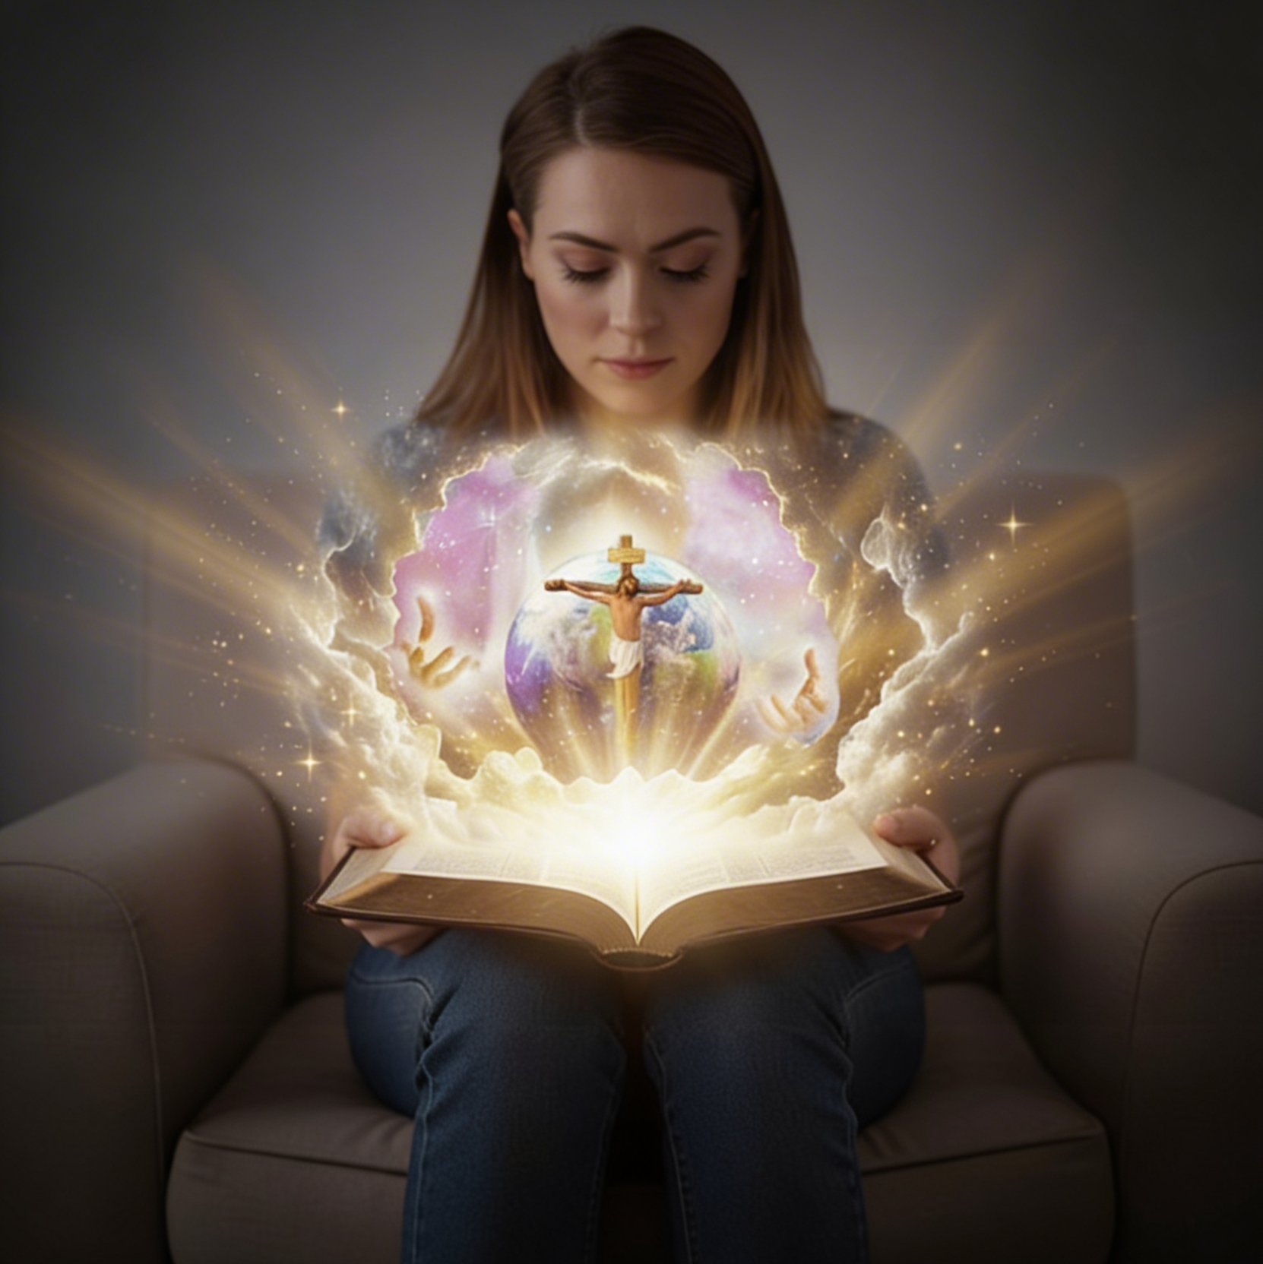
“And this is eternal life, that they may know You, the only true God, and Jesus Christ whom You have sent”
(John 17:3, NKJV)

Slide 3

“For whoever exalts himself will be humbled, and he who humbles himself will be exalted”
(Luke 14:11, NKJV)

Slide 4

“For the word of God is living and powerful, and sharper than any two-edged sword, piercing even to the division of soul and spirit, and of joints and marrow, and is a discerner of the thoughts and intents of the heart” (Hebrews 4:12, NJKV)
Notes:
Buscar en biblia-espada

Slide 5

“So shall My word be that goes forth from My mouth; it shall not return to Me void, but it shall accomplish what I please, and it shall prosper in the thing for which I sent it” (Isaiah 55:11, NKJV)

Slide 6

“I love the LORD, because He has heard my voice and my supplications. Because He has inclined His ear to me, therefore I will call upon Him as long as I live” (Psalm 116:1, 2, NKJV)

Slide 7
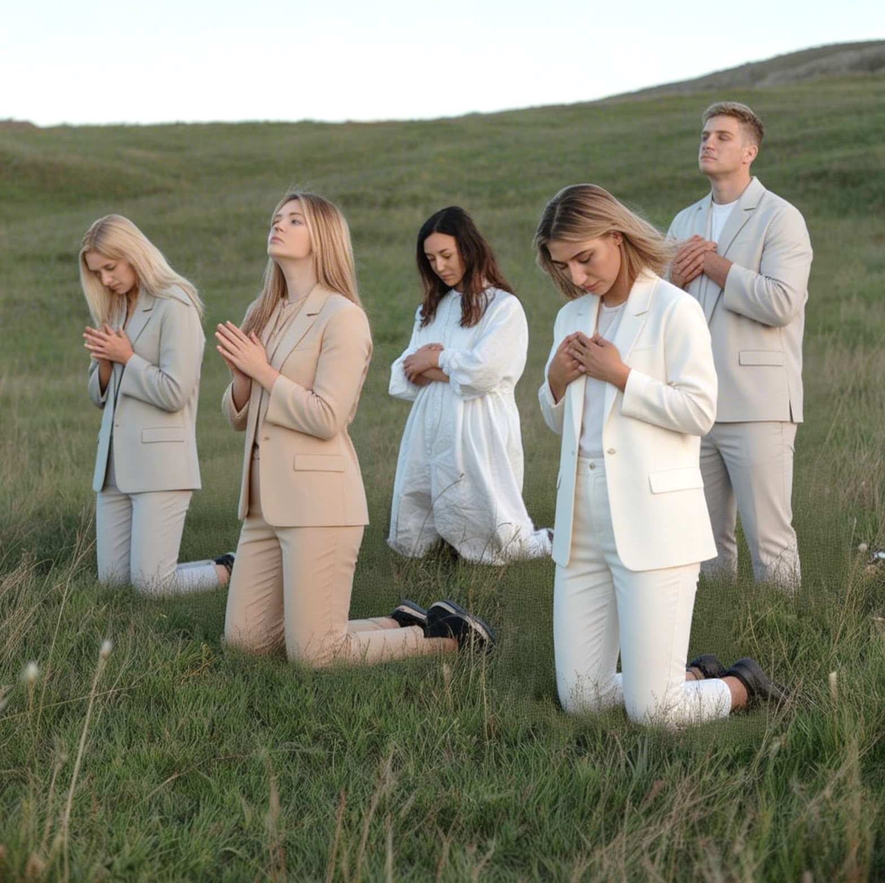
“Trust in Him at all times, you people; pour out your heart before Him; God is a refuge for us”
(Psalm 62:8, NKJV)

Slide 8

“Faith shows the reality of what we hope for; it is the evidence of things we cannot see”
(Hebrews 11:1, NLT)

Slide 9
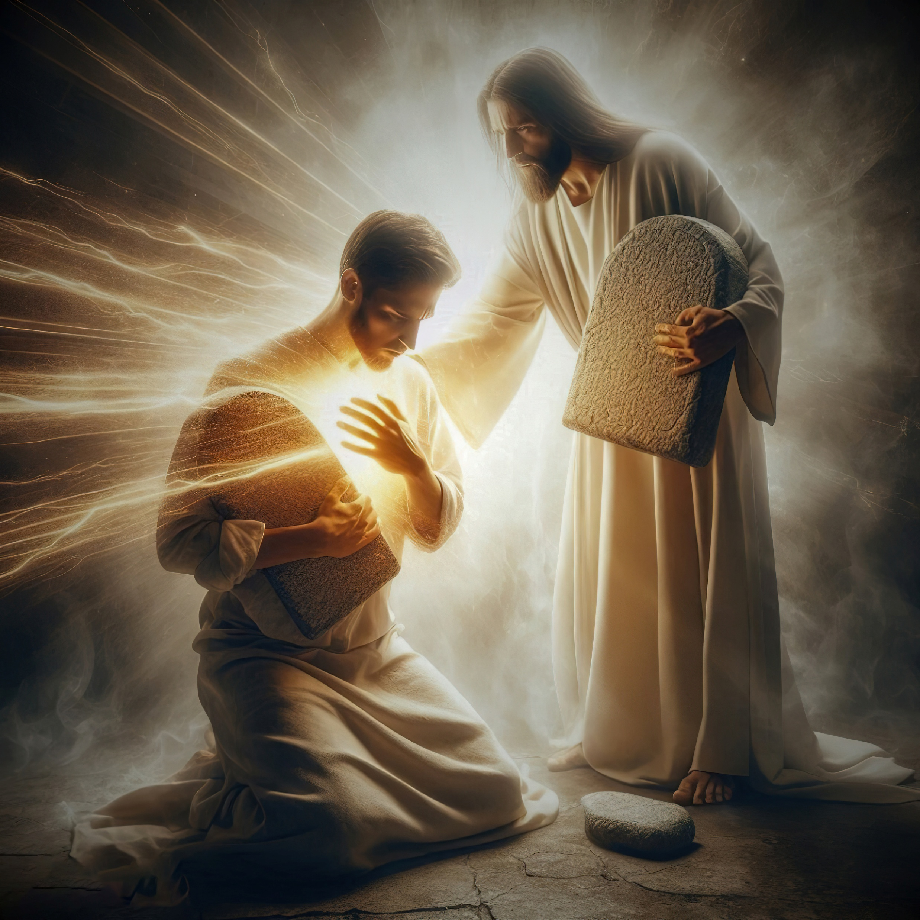
“I will never forget Your precepts, for by them You have given me life. I am Yours, save me; for I have sought Your precepts”
(Psalm 119:93, 94, NKJV)

Slide 10
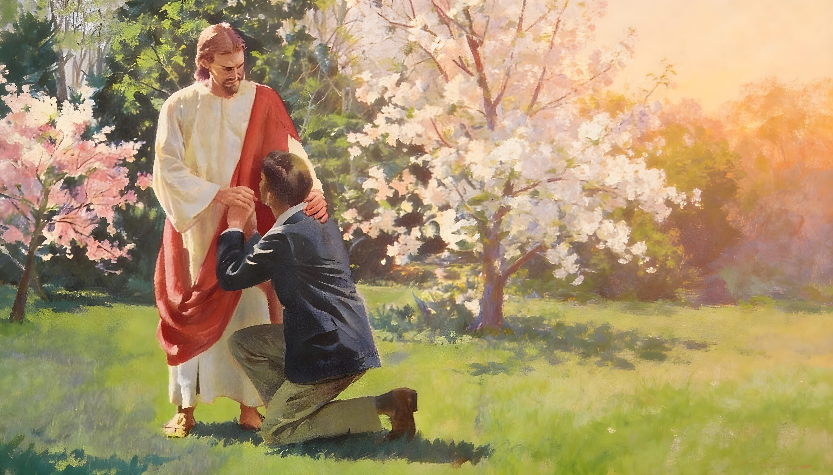
“If we confess our sins, He is faithful and just to forgive us our sins and to cleanse us from all unrighteousness”
(1 John 1:9, NKJV)

Slide 11
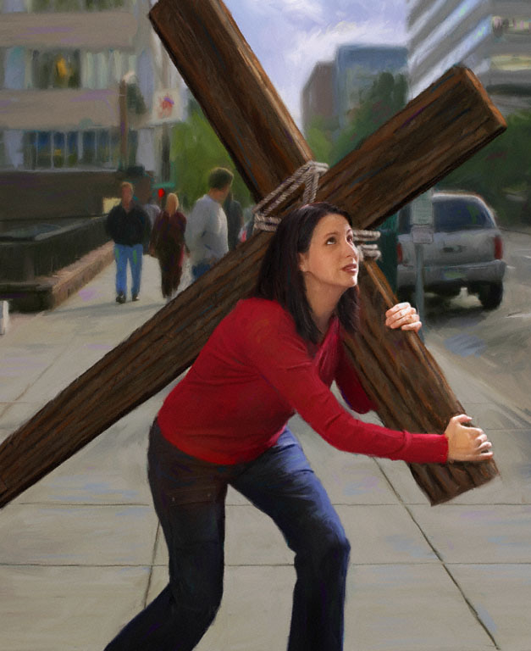

“And not only that, but we also glory in tribulations, knowing that tribulation produces perseverance; and perseverance, character; and character, hope. Now hope does not disappoint, because the love of God has been poured out in our hearts by the Holy Spirit who was given to us”
(Romans 5:3–5, NKJV)

Slide 12
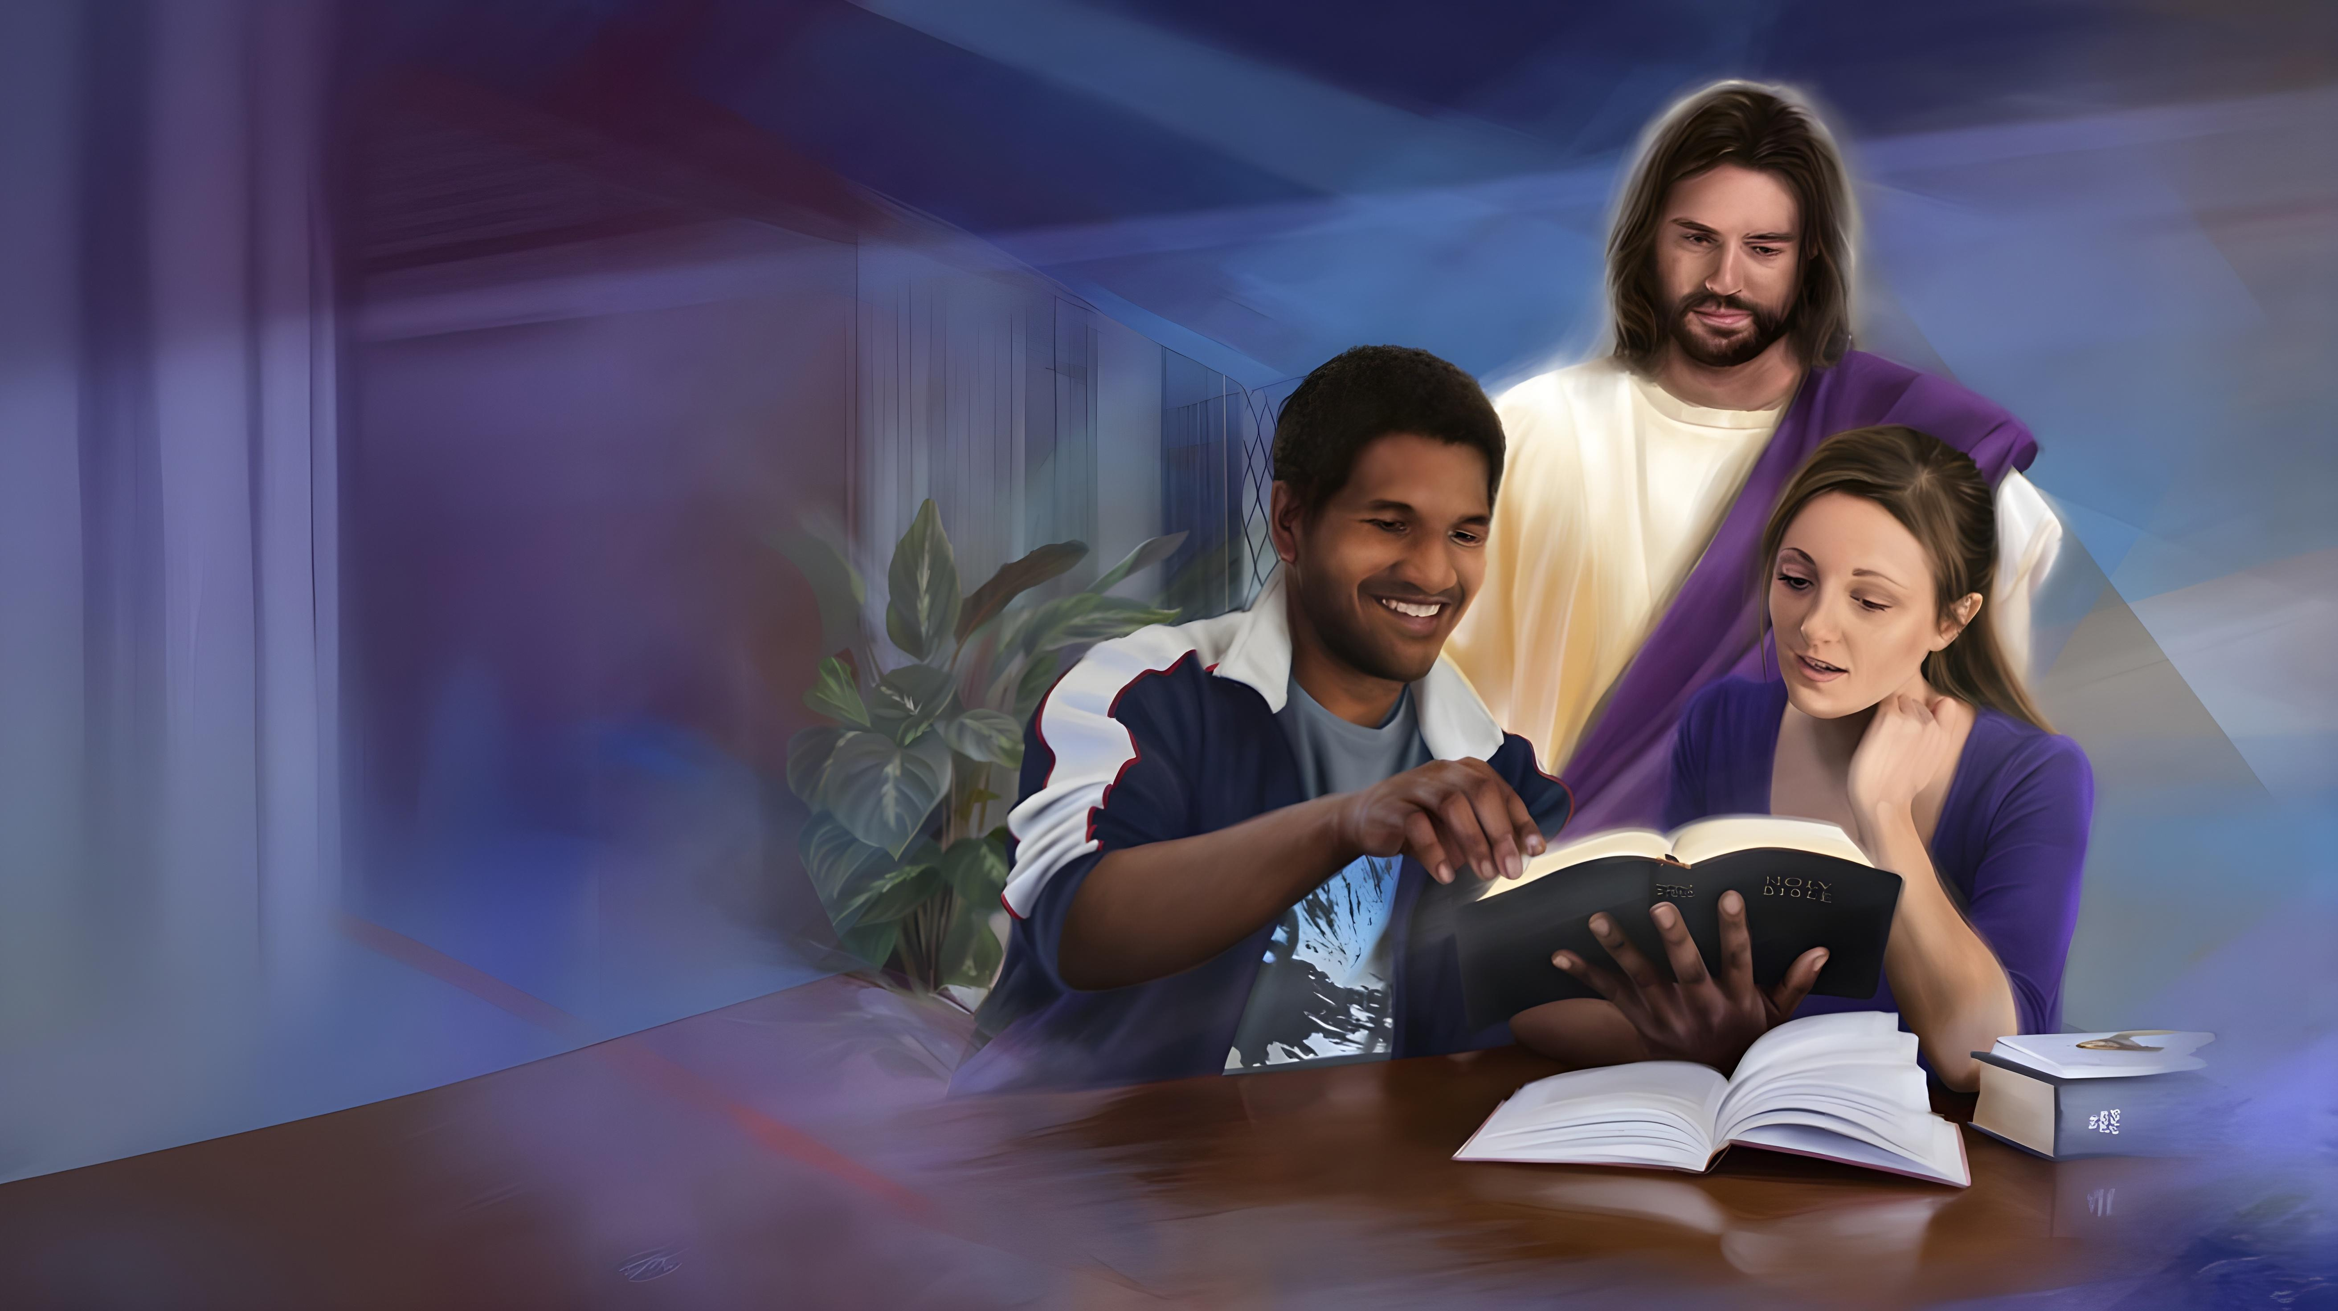
“The Lord GOD has given Me the tongue of the learned, that I should know how to speak a word in season to him who is weary. He awakens Me morning by morning, He awakens My ear to hear as the learned”
(Isaiah 50:4, NKJV)

Slide 13
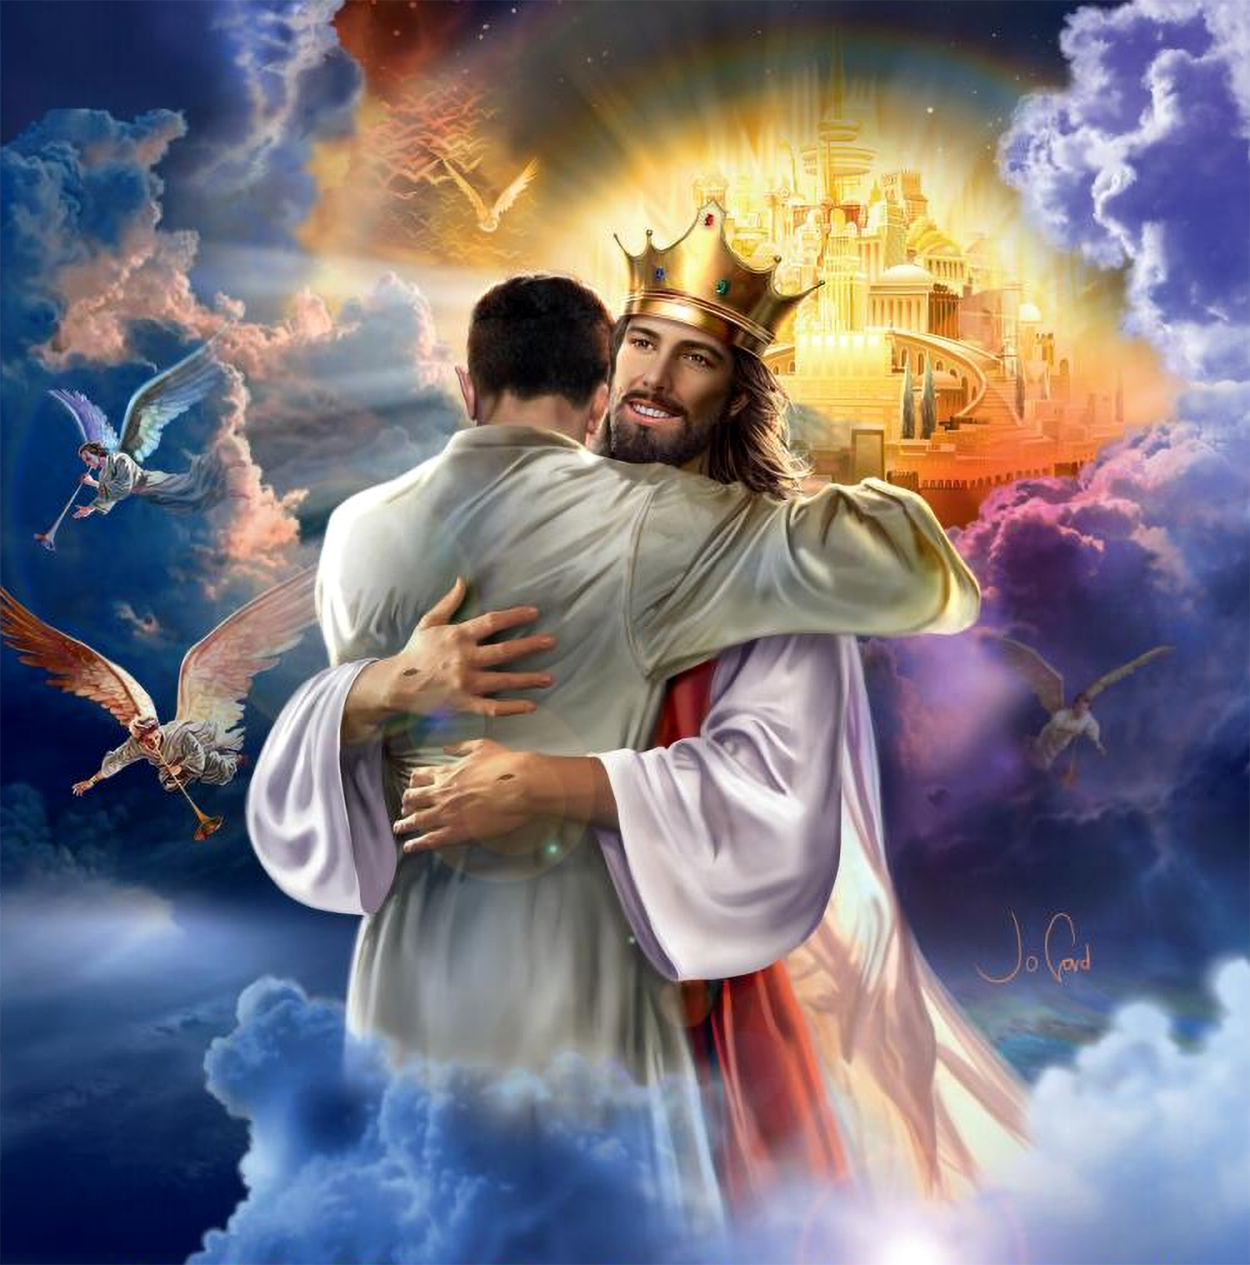

“Beloved, now we are children of God; and it has not yet been revealed what we shall be, but we know that when He is revealed, we shall be like Him, for we shall see Him as He is”
(1 John 3:2, NKJV)

