Slide 1
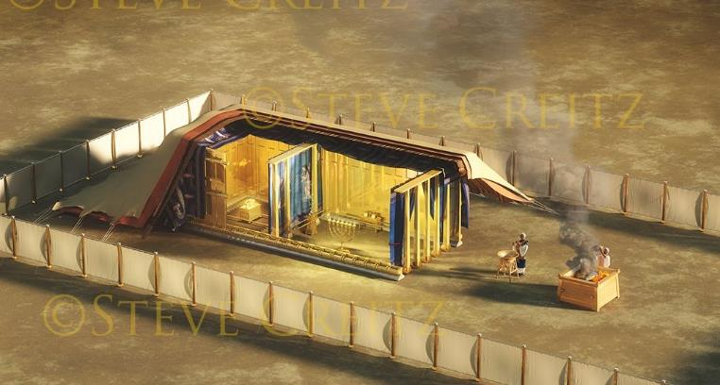
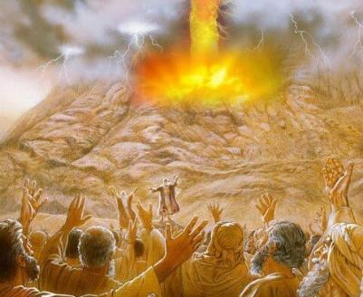
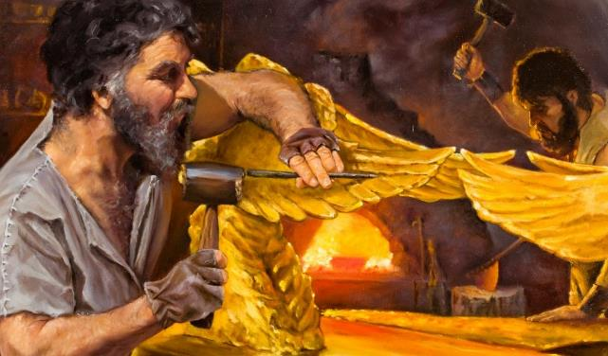
Lesoni 10 ya Septemba 6, 2025
KĨRĨKANĨRO NA ŨTARĨRIA WA MŨHANO

Slide 2
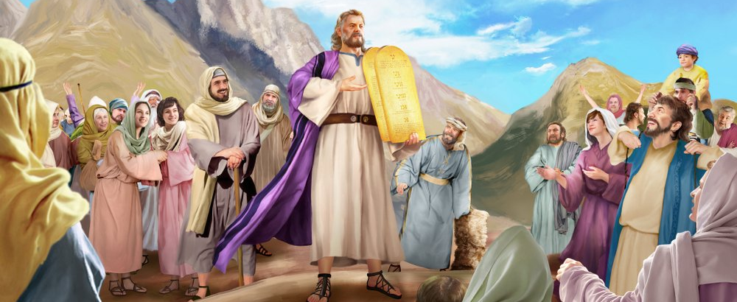
“Nake Musa agĩthiĩ na akĩĩra andũ ciugo ciothe cia MWATHANI na mawatho make, nao andũ magĩĩtĩkanĩria na mũgambo ũmwe, makiuga atĩrĩ, “Ũrĩa wothe MWATHANI oigĩte, nĩtũgwĩka’ ”
Thaama24:3, NKJV

Slide 3

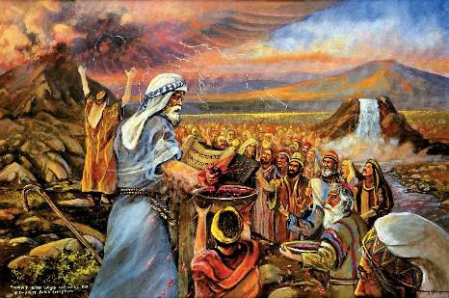
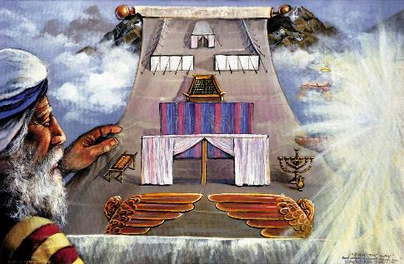


Thutha wa kwanĩrĩra na kayũ kanene Mathani marĩa Ikũmi na kũnengera Musa ona mawatho ma kĩmũthingi, Ngai nĩendaga kũgĩa na kĩrĩkanĩro na Aisiraeli.
Kĩrĩkanĩro o kĩhũthũ: ngũtuĩka Ngai wanyu, ndĩmũgitagĩre na ndĩmũrathime; nainyuĩ, mwathĩkĩre mathani Makwa.
Thutha wa kwandĩka kĩrĩkanĩro gĩkũnjo-inĩ, mwĩena yerĩ yarĩ ĩiguanĩre nakĩo. Andũ magĩgĩtaũkwo, makiuga nĩmegũgĩtũria. Ngai oigire egũgĩtũria atĩa? Na thakame; na iruga; na mũhiano wa kũmahotithia gũtaũkwo nĩ kĩrĩkanĩro.
Kĩrĩkanĩro:
  Thakame ya kĩrĩkanĩro (Thaama 24:1-6, 8)
  Kũhingio gwa kĩrĩkanĩro (Thaama 24:7)
  Irio cia kĩrĩkanĩro (Thaama 24:9-18)
Mũhiano:
  Gĩtũmi kĩa mũhiano (Thaama 25:1-9)
  Iharĩria rĩa mũhiano (Thaama 31:1-18)

Slide 4
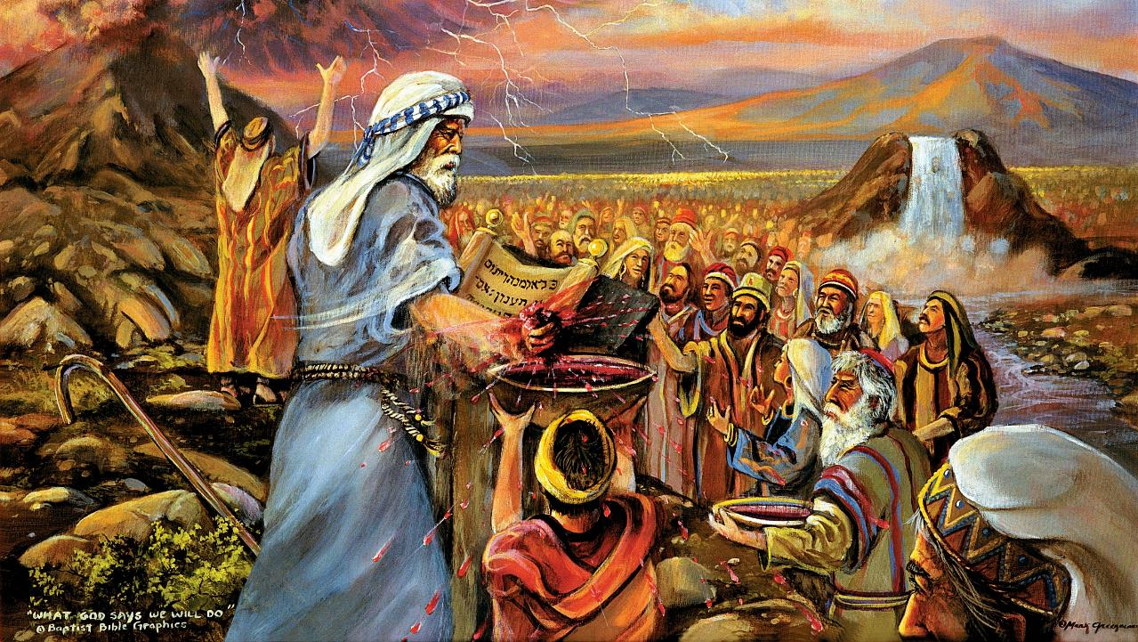
KĨRĨKANĨRO

Slide 5

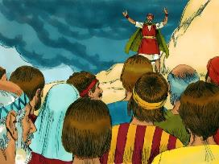
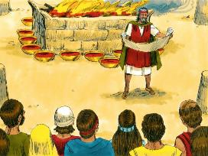
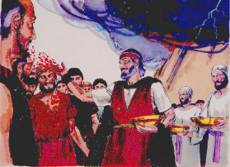
THAKAME YA KĨRĨKANĨRO
Musa agĩcooka akĩoya thakame ĩyo, akĩmĩminjaminjĩria andũ, na akiuga atĩrĩ, “Ĩno nĩ thakame ya kĩrĩkanĩro kĩrĩa MWATHANI aarĩkanĩire na inyuĩ kũringana na ciugo ici ciothe.’ ” (Thaama24:8)
Kĩrĩkanĩro gĩathondekirwo atĩa?
Kĩrĩkanĩro nĩgĩathomirwo (Thama. 24:3a)
Andũ makĩamũkĩria na wĩtĩkĩri (Thama. 24:3b)
Gĩkĩandĩkwo gĩ kĩririkano (Thama. 24:4a)
Kĩgongona gĩgĩakwo (Thama . 24:4b)
Itugĩ 12 ikĩhandwo (Thama. 24:4c)
Mahaki ma njino makĩrutwo (Thama. 24:5)
Nuthu ya thakame ĩkĩminjaminjĩrio kĩgongona (Thama. 24:6)
Kĩrĩkanĩro gĩgĩthomwo rĩngĩ (Thama. 24:7a)
Andũ magĩkĩamũkĩra o na wĩtĩkĩri orĩngĩ (Thama. 24:7b)
Nayo nuthu ya thakame ĩrĩa yatigarĩte ĩkĩminjĩrio andũ (Thama. 24:8a)
Musa akĩmĩanĩrĩra ta “thakame ya kĩrĩkanĩro” (Thama. 24:8b; Mt. 26:28)
Iruga rĩkĩgia rĩa kũigwithania kĩrĩkanĩro (Thama. 24:9-11)
Ngai agĩtambũra Aisiraelli ta andũ (itugĩ 12); We na njĩra ya mwanya ona thogora mũnene harĩ andũ ethĩ; na akĩĩruta we mwene kũrĩ o mũndũ mwanya mwanya (akĩmaminjĩria thakame Yake Mwene.
Ngai endaga ndũgu naithuĩ, o mũndũ mwanya, na ta atũrania hamwe a etĩkia.

Slide 6

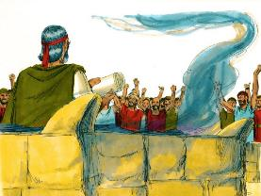
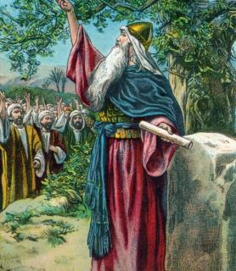
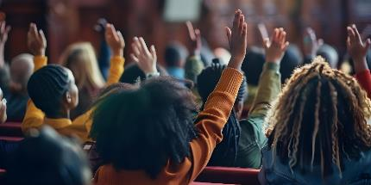
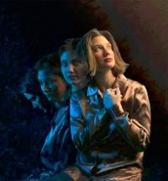
KŨHINGA GWA KĨRĨKANĨRO
“Ningĩ akĩoya Ibuku rĩa Kĩrĩkanĩro, na akĩrĩthomera andũ. Nao andũ magĩĩtĩkanĩria, makiuga atĩrĩ, “Nĩtũgwĩka ũrĩa wothe MWATHANI oigĩte; nĩtũgwathĩka.’ ”(Thaama24:7)
Na ũkinyanĩru wĩtambũrũkĩtie, andũ makĩrutĩra kũnyita kĩrĩkanĩro. Wĩrutĩri ũyũ warĩ wa o kahinda-kanini (Thama . 32:8).
Ona rũciaro rũrĩa rwarũmĩrĩire rũkĩrutĩra kunyita kĩrĩkanĩro (Josh. 24:18b). No Joshua akĩmakania weega: “Mũtingĩhota gũtungatĩra Mwathani” (Josh. 24:19 NIV).
Nĩkĩĩ kĩgiragia tũhote gwathĩkĩkra Ngai, ona twĩrirĩirie gwĩka wega?
Kĩndũire, tũrĩ aremi (Aro. 7:18), na tũtire ũndũ tũngĩka tũgarũre ũguo tũtariĩ (Aro. 7:24).
No tũngĩmwĩtĩkĩria We, Ngai no acĩnjie ũndũire witũ (Eze. 36:26-27). Atheragia, akeheria, akaheana, na agathĩrĩra nĩguo atĩ tũhote kũmwathĩkĩra We. No We ũngĩtũtua a hinya (1 Akor. 12:10).

Slide 7

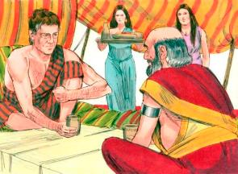
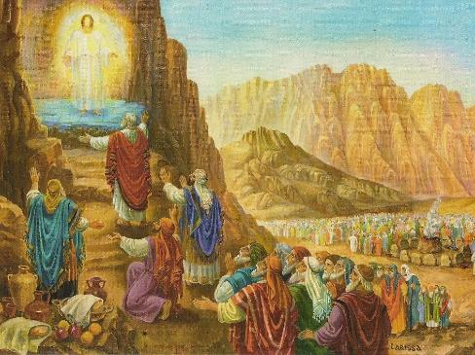
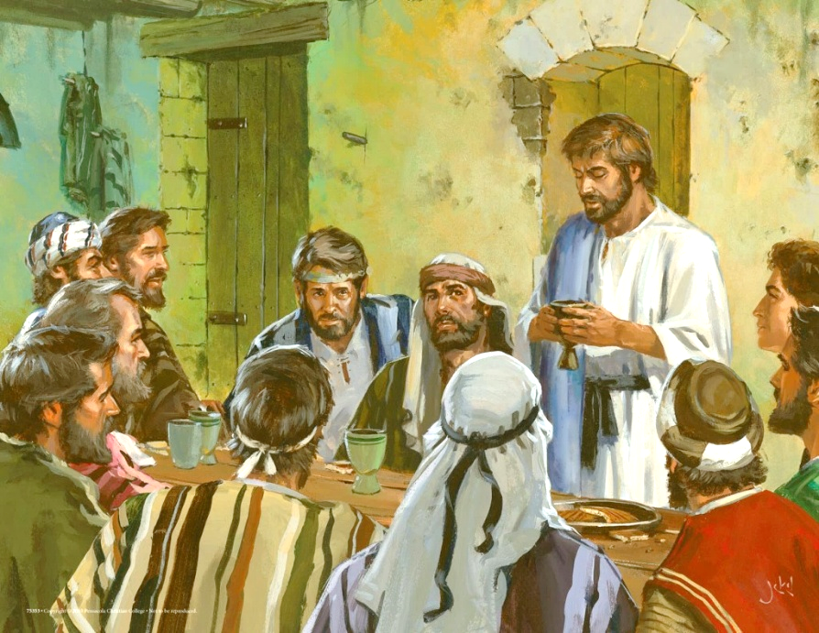
IRIO CIA KĨRĨKANĨRO
“Musa na Harũni, na Nadabu na Abihu hamwe na athuuri acio mĩrongo mũgwanja a Isiraeli makĩambata; […] nĩmonire Ngai , na makĩrĩa na makĩnyua” (Thaama24:9, 11b)
Ta ũrĩa tuonaga mũhiano-inĩ wa Jakubu na Labani, thĩiniĩ wa Irathĩro rĩa tene (ancient East) ũigwithanĩria wa kĩrĩkanĩro wakururanĩtie irio ciagayanagwo nĩ mĩena o yerĩ. (Kĩa. 31:44-54).
Hau Sinai, Ngai aheire “irio ci kĩrĩkanĩro” kũrĩ andũ 74: Musa, Aaroni, Nadabu, Abihu, na athuuri 70, makĩrũgamĩrĩra andũ oothe (Thama. 24:9-11).
Rĩrĩa Jĩsũ arutanĩre kĩrĩkanĩro kĩerũ, o nake ekire ũguo akĩgayana irio ciake na atũmwo arĩa 12 (Mt. 26:26-28).
O hĩndĩ ĩrĩa twarĩa Irio cia Mwathani, twerũhagia kĩrĩkanĩro gitũ na Ngai.
Rĩrĩa twarĩa mũgate na kunyua ndibeei, tũkũngũygĩria kuoherwo na ũhonokio ũrĩa tũrĩ naguo thĩiniĩ wa Jĩsũ (1 Akor. 11:26).
Ona maregete na gĩkĩro kĩa igũrũ ũhonokio, ti Nadabu, kana Abihu, kana Judasi, meheririo kuma gĩathĩ-inĩ gĩa “irio cia kĩrĩkanĩro.”

Slide 8
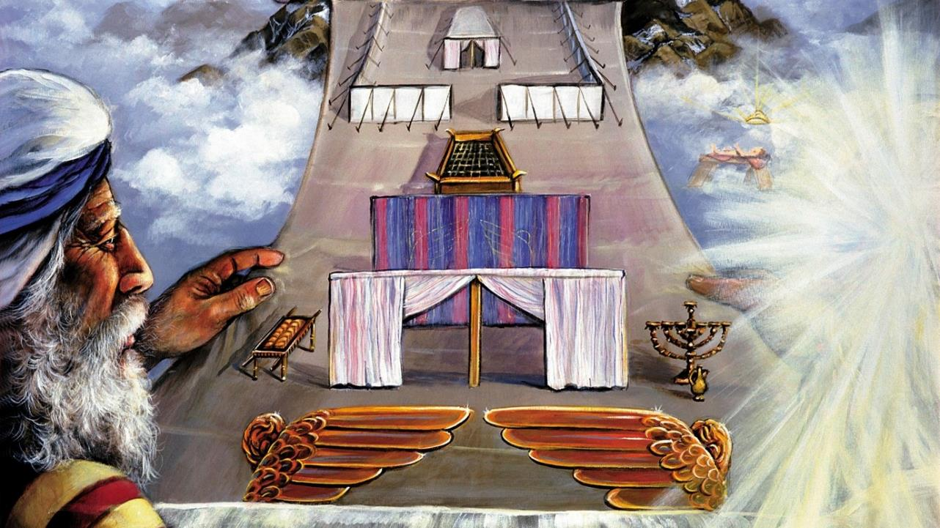
MŨHIANO

Slide 9

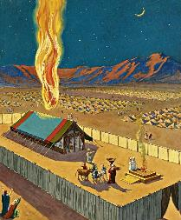
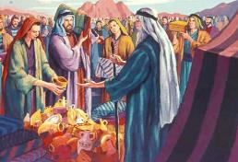
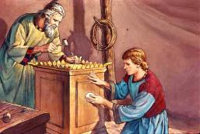
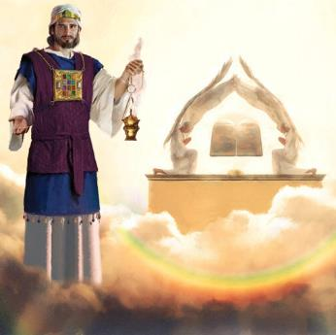
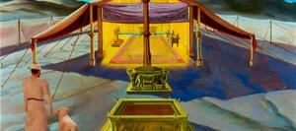
GĨTŨMI KĨA MŨHANO
“Ningĩ ũnjakithĩrie handũ haamũre, na niĩ nĩngatũũranagia nao” (Thaama25:8)
Niguo onanie ũma wa gwĩtĩkĩra kũhingia mwena Wake wa kĩrĩkanĩro, Ngai agĩtua gũka na aikaranie na andũ.
No gũkowo ho kwa kugaga gĩkuũ kĩa o rĩmwe kũrĩ o othe (Thama. 33:20). Nĩũndũ ũcio, akĩmatha maake kĩgongona harĩa angĩonanĩirie gũkorwo ho Gwake. Gũkorwo ho gũkũ kuonanagio na marũũri, nĩgũkorwo Ngai kĩrũgamo ndangĩtũũra thĩiniĩ wa hekarũ ona ĩmwe cia gũkũ thĩ (Atũ 17:24 ).
Musa nĩ onirio mũhiano ũcio na akĩheeo ũtarĩria wa mwanya ũkoniĩ mwako wayo. Andũ makĩũrio merutĩre indo iria ciabataranagia cia mwako
(Thama. 25:2-7).
Ci cierĩ ici kĩgongona na hekarũ iria Suleimani aakĩte ciarĩ mũhano wa kĩgongona kĩrĩa kĩa Igũrũ (Heb. 8:1-2; 1Ki. 8:27, 30).
Rĩrĩa Mũisiraeli aingĩraga kĩgongona-inĩ, aingĩraga—kĩ-rũri-inĩ rwa atĩ—thĩiniĩ wa harĩa ho harĩ gũkorwo ho kwa Ngai … o nginya rĩrĩa gĩtambaya gĩatarũkire Jĩsũ arĩkia gũkua.

Slide 10
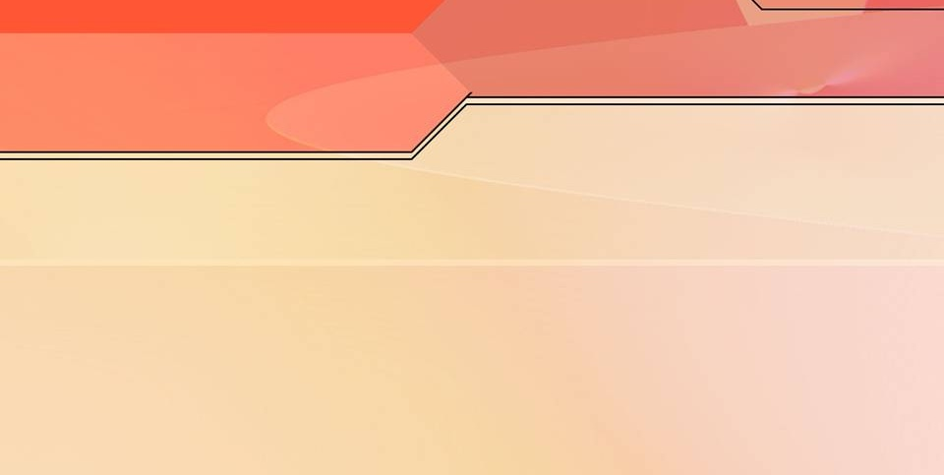
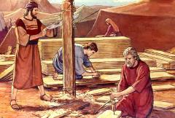
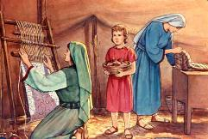
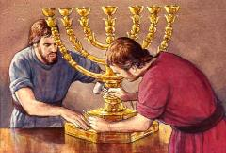
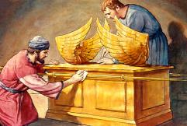
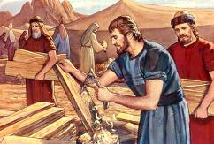
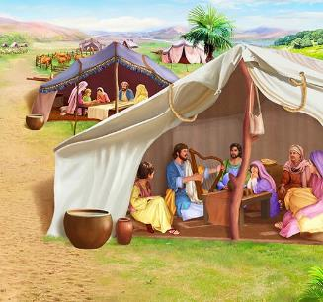
IHARĨRIA RĨA MŨHIANO
“Ta rora wone, nĩthuurĩte Bezaleli mũrũ wa Uri ũrĩa mũriũ wa Huri wa mũhĩrĩga wa Juda, na nĩndĩmũiyũrĩtie na Roho wa Ngai, na ũũgĩ na ũhoti na ũmenyo mawĩra-inĩ ma mĩthemba yothe ya moko” (Thaama31:2-3)
Ona gũtuĩka Ngai aheire Musa ũtarĩria mũbarĩrĩre wega ũkoniĩ mwako, ndamwĩrire ikĩro ciothe. Ta rĩu kĩraĩ na kĩgũrũ gĩakĩo gĩa gĩcango-rĩ, makerubi, matonyo ma athĩnjĩri, ouguo oũguo. marĩ mahane atĩa? Ũyũ nĩũndũ wa heire Roho Mũtheru mweke wa kũrutithania wĩra na iheeo cia aki.
Harĩ ũtarĩria ũyũ, Roho Mũtheru akĩmahotithia iheeo icio cia mwanya:
Bezaleli, ũrĩa nyabaara ya wĩra woothe (Tha. 31:2)
Aholiabu, ũrĩa warĩ mũnyinyi wake (Thama. 31:6a)
Andũ angĩ mateithĩrĩiriemwako-inĩ (Thama. 31:6b)
Gatagatĩ-inĩ ka ũtarĩria wa mwakĩre wa kĩgongona, nĩ harĩ na mũgweto wa mwanya wa Thabatũ (Thama. 31:12-17). Thabatũ ĩkonainie atĩa na maũndũ maya mothe?
ũtheru nĩguo bungũro. Nĩguo tũkuhĩrĩrie Ngai Mũtheru, no mũhaka tũthere Take. Thabatũ nĩyo rũri rũu rwa ũtheru (Thama. 31:13; Eze. 20:12, 20).
Notes:
Thaama31:2
See, I have called by name Bezalel the son of Uri, the son of Hur, of the tribe of Judah;
Thaama31:6a
And behold, I have set with him Aholiab the son of Ahisamach , of the tribe of Dan;
Thaama31:6b
and I have put wisdom in the minds of every wise-hearted person, so that they may do all that I have commanded you;
Thaama31:12-17 And the LORD spake unto Moses, saying, (13) Thou shalt speak unto the children of Israel, saying, Ye shall surely keep my sabbaths: for it is a sign between me and you throughout your generations, that ye may know that I am the LORD that sanctifies you. (14) Therefore ye shall keep the sabbath day, for it is holy unto you: whoso profaneth it shall surely be put to death: for whosoever doeth any work in it, that soul shall be cut off from among his people. (15) Siĩ days shall work be done: but the seventh day is a sabbath of rest holy to the LORD: whosoever doeth any work on the sabbath day shall surely be put to death. (16) Therefore shall the children of Israel keep the sabbath, to observe the sabbath throughout their generations for a perpetual covenant. (17) It is a sign between me and the children of Israel for ever: for in siĩ days the LORD made heaven and earth, and on the seventh day he rested, and was refreshed.

Slide 11

“Mwakĩre-inĩ wa kĩgongona ta handũ ha gũtũrwo ha Ngai, Musa atarĩirio athondeke indo ciothe kũrĩngana na mũhianĩre wa indo iria irĩ o igũrũ. Ngai akĩmwĩta thĩiniĩ wa kĩrĩma, na akĩmũguũrĩria maũndũ ma igũrũ, na mũhano wacio thĩiniĩ wa hema ya gũtũnganĩrwo, na kĩrĩa gĩothe gĩakonainie nayo, gĩgĩthondekwo.
Kwoguo kũrĩ Aisiraeli, arĩa arĩ o endaga kũmatwa irahĩro Rĩake, akĩguũria mũtugo Wake wĩ riri na mwagĩrĩru. […] No wagĩrĩru ũyũ o marĩ, ahinyaru kũwĩgwatĩra. ũguũrio wa hau Sinai warĩ tu ũmekĩre ruoro rwa kuona ũbatari na waagi wao.”
EGW (Education, p. 35-36)

