Slide 1
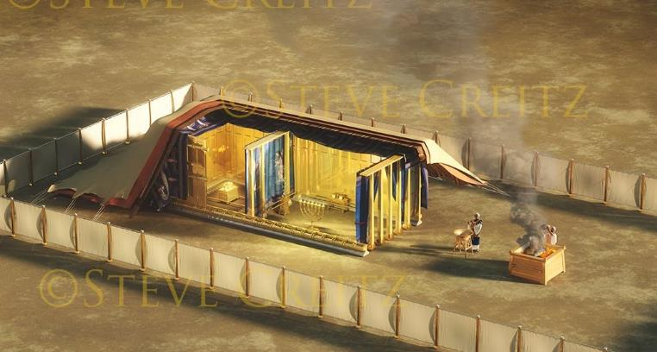
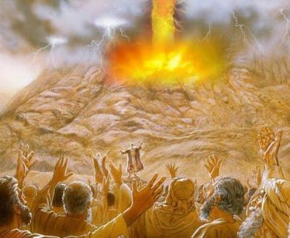
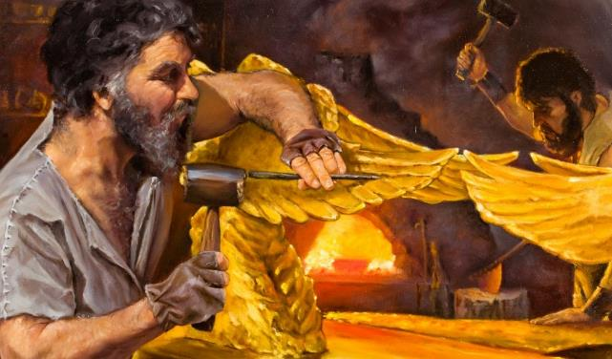
Lesson 10 mar Septemba 6, 2025
SINGRUOK GI CHENRO MA ONEGO LUW

Slide 2
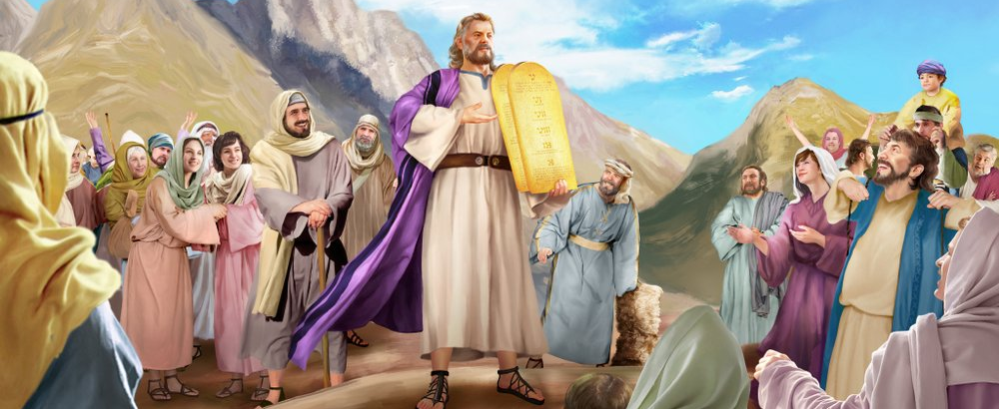
“Musa nodhi monyisogi chike kod buche duto mag Ruoth Nyasaye. Ji duto nodwoke niya, ‘Wayie timo gik moko duto ma Ruoth Nyasaye osewacho’” Wuok 24:3

Slide 3

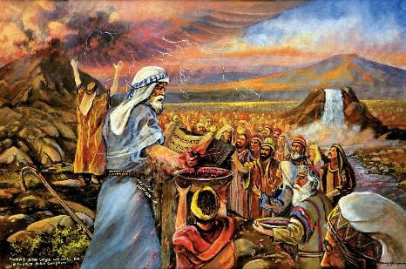
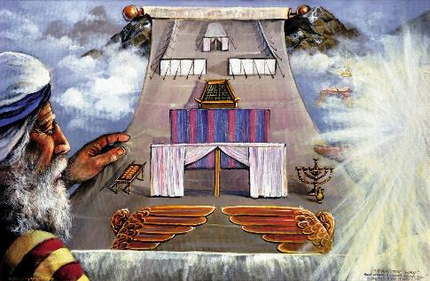


Bang’ lando Chike Apar gi dwol maduong’ kendo miyo Musa chike madongo, Nyasaye ne dwaro timo singruok gi Israel.
Singruokno ne yot: Abiro bedo Nyasachu, abiro ritou kendo gwedhou; un, urit chikena.
Bang’ ndiko singruokno e kitabu, ne nyaka kidieny ariyogo duto nyis ni giyie kode. Oganda ne onyiso yiegi ka giwacho ni gibiro rito singruokno. Ere kaka Nyasaye nonyiso noyie gi singruokno? Gi remo; gi nyasi; kendo gi ranyisi ma biro konyogi winjo tiend singruokno.
Singruok:
  Remo mar singruok (Wuok 24:1-6, 8)
  Chopo singruok (Wuok 24:7)
  Chiemo mar Singruok (Wuok 24:9-18)
Ranyisi:
  Tij Ranyisi (Wuok 25:1-9)
  Loso Ranyisi (Wuok 31:1-18)

Slide 4
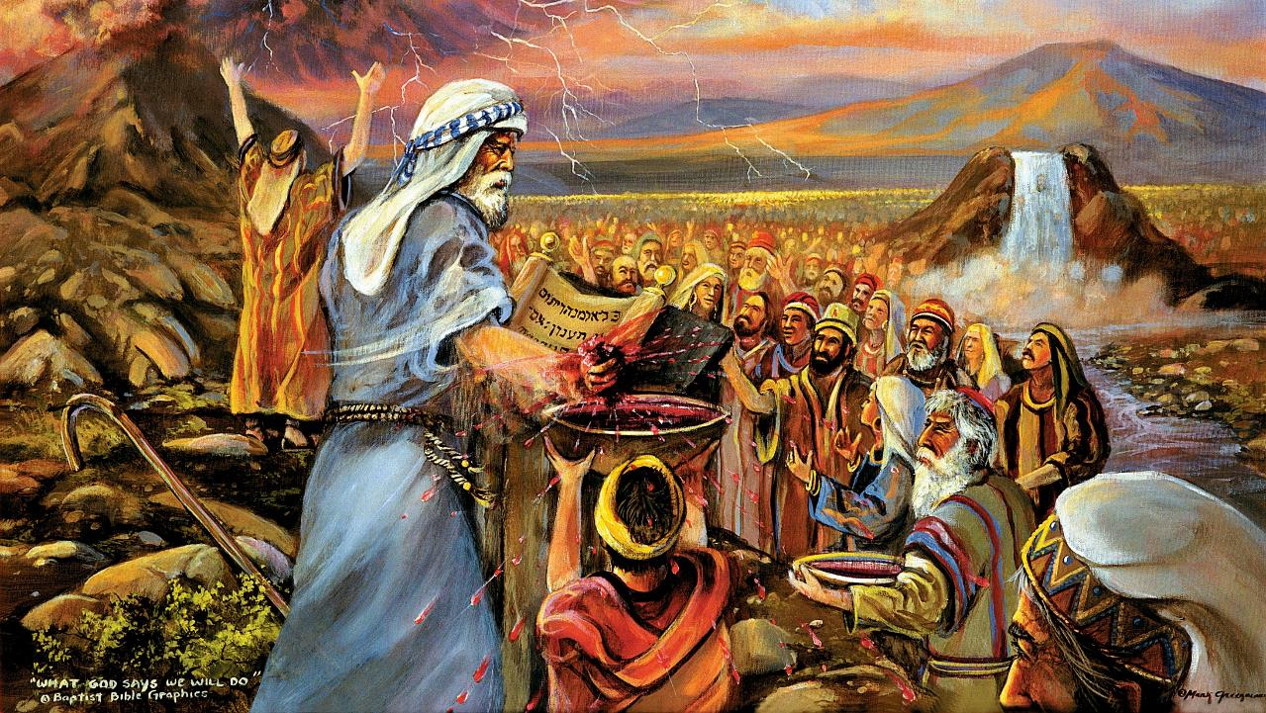
SINGRUOK

Slide 5
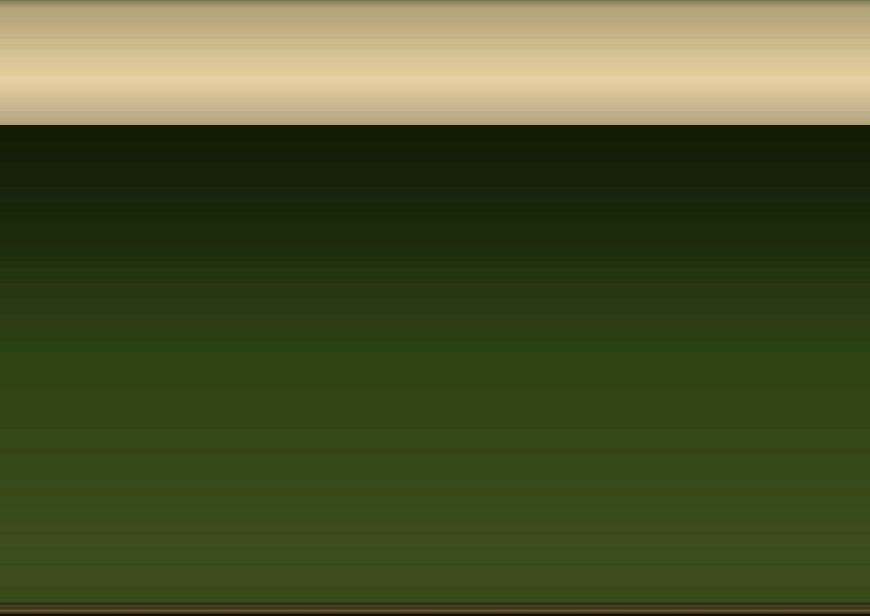
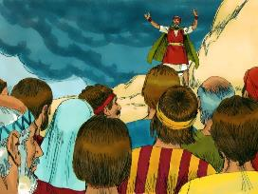
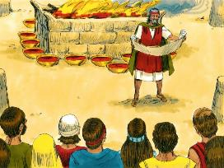
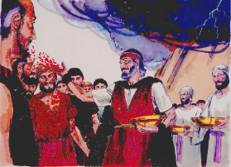
REMO MAR SINGRUOK
“Bang’ mano Musa nokawo remo, mokiro kuom ji, kowacho niya, ‘Ma e remo mar singruok mane Ruoth Nyasaye osemiyo utimo kode, kaluwore gi weche manie kitabuni.’ ” (Wuok 24:8)
Ere kaka ne otim singruokno?
Ne osom singruokno (Wuok 24:3a)
Ji nodwoko ni ee (Wuok 24:3b)
Ne okete e ndiko (Wuok 24:4a)
Noger kendo-mar-misango (Wuok 24:4b)
Nochungi kite 12 mag rapar (Wuok 24:4c)
Notim misengini miwang’o pep (Wuok 24:5)
Nus remo nokir e kendo-mar-misango (Wuok 24:6)
Ne osom singruokno kendo (Wuok 24:7a)
Ji nodwoko kendo ni ee (Wuok 24:7b)
Nus remo mane odong’ ne okir kuom ji (Wuok 24:8a)
Musa nowacho ni en “remo mar singruok” (Wuok 24:8b; Math. 26:28)
Ne olos chiemo mar siro singruokno (Wuok 24:9-11)
Nyasaye ne oyango Israel kaka oganda (kite 12); Ne omiyo nyithindo matindo luor ahinya; kendo ne ochiwore ne ng’ato ka ng’ato (ne okir rembe kuomgi).
Nyasaye dwaro bedo gi winjruok kodwa, ng’ato ka ng’ato kendo kaka riwruok mar jomoyie.

Slide 6

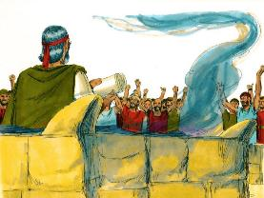
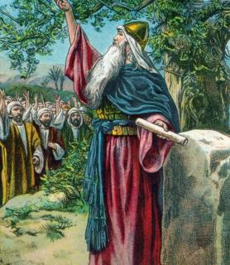

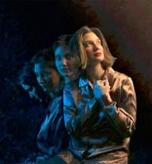
CHOPO SINGRUOK
“Bang’e nokawo kitabu mondikie weche mag singruokgo, mosomo matek mondo ji duto owinji. Giduto ne giwacho niya, ‘Wayie winjo Ruoth Nyasaye, kendo wanatim duto mosechiko.’” (Wuok 24:7)
E chuny mowinjore chuth, oganda nochiwore mar rito singruokno. Chiwruokno nobedo kuom kinde matin (Wuok 32:8).
Tieng’mane oluwo bang’gi bende nosingore mar rito singruokno (Josh. 24:18b). To Joshua nosiemogi maler kama: “Ok dunyal tiyo ni Ruoth Nyasaye” (Josh. 24:19).
Ang’o ma tamowa winjo Nyasaye, kata obedo ni wan gi gombo mabeyo?
Kuom kido, wan joma ok winj wach (Rumi 7:18), kendo ok wanyal timo gimoro amora mondo walok tim marwa (Rumi 7:24)
To ka wayiene, Nyasaye nyalo loko kitwa (Ezek. 36:26-27). Oloso, ogolo oko, ochiwo, kendo oketo mondo wabed gi nyalo mar winjo wachne. En kende ema miyowa teko (2 Kor. 12:10).

Slide 7

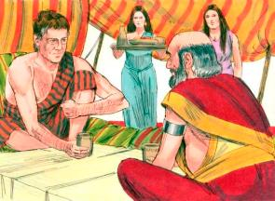
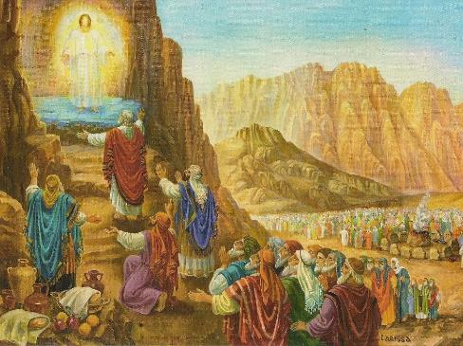
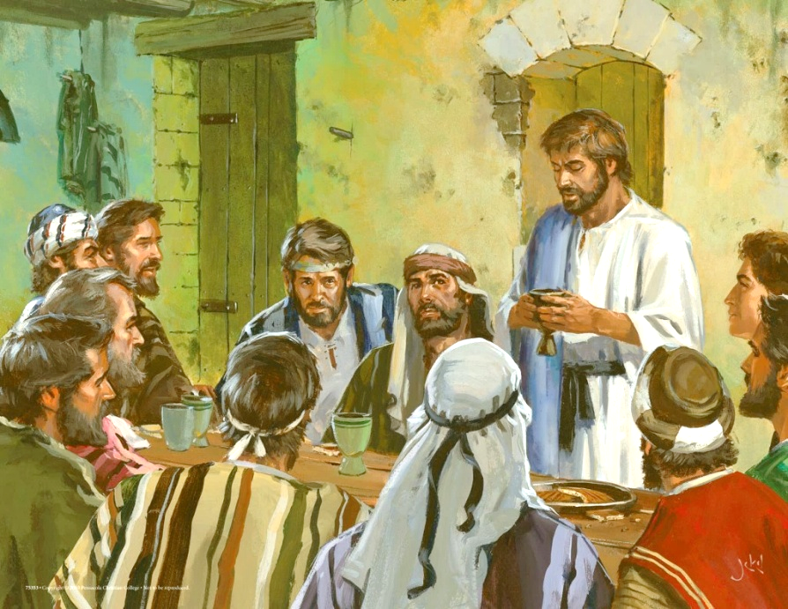
CHIEMO MAR SINGRUOK
“Musa gi Harun gi Nadab kod Abihu, kaachiel gi jodong Israel piero abiriyo nodhi e got, […] Ne gineno Ruoth Nyasaye, mi gichiemo kendo gimetho ” (Wuok 24:9, 11b)
Kaka waneno e ranyisi mar Jakobo kod Laban, e piny machon mar Wuokchieng’, timo singruok ne oriwo chiemo ma ne kidieny ariyogo duto chamo (Chakruok 31:44-54).
E Sinai, Nyasaye nomiyo ji 74 “chiemo mar singruok”: Musa, Harun, Nadab, Abihu, kod jodongo 70, ma ne ochung’ ne oganda duto (Wuok 24:9-11).
Ka Yesu noketo singruok manyien, en bende notimo kamano kuom pogo chiembe gi joote 12 (Mt. 26:26-28).
Kinde duto ma wachamo Sap Ruoth, waloso manyien singruokwa gi Nyasaye. Ka wachamo makati kod madho divai, wabedo gi nyasi mar ng’wono kod warruok ma wan-go kuom Yesu (1 Kor. 11:26).
Kata obedo ni e giko ne ok gidewo warruok, kata Nadab, kata Abihu, kata Juda ne ok otam chamo “chiemb singruok”.

Slide 8
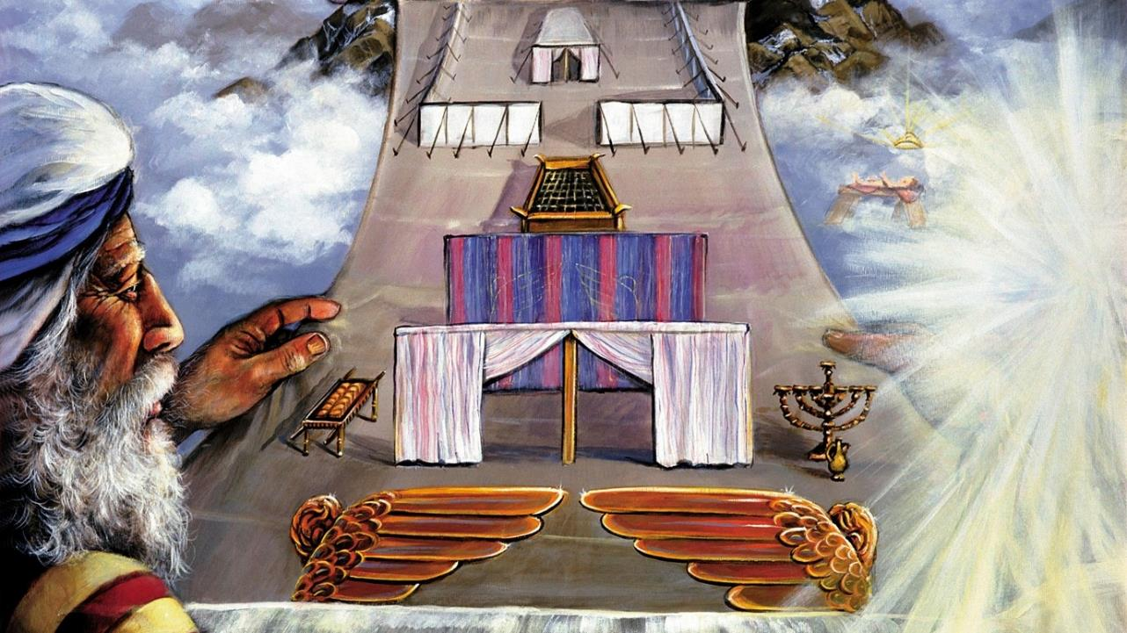
RANYISI

Slide 9

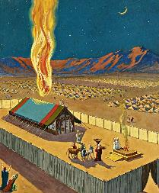
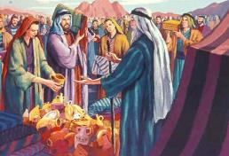
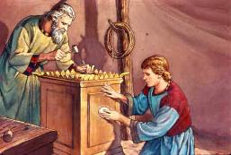
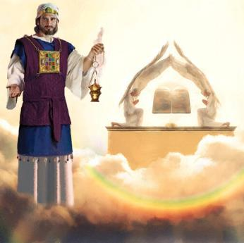
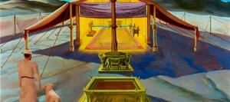
TIJ RANYISI
“Bang’ mano gigerna Kama Ler mondo adag kodgi” (Wuok 25:8)
Kaka ranyisi ni nobiro chopo kore mar singruok, Nyasaye nong’ado ni mondo odhi odag e kind ji.
To bedo Nyasaye e ringruok dine omiyo githo giduto mapiyo (Wuok 33:20). Kuom mano, ne omiyogi chik ni giger hekalu kama ne onyalo fwenyore negie. Bedone kodgi ne otimore kuom ranyisi, nikech Nyasaye ok dagi e hekalu moro amora mar piny (Tich Joote 17:24).
Ne onyis Musa ranyisi mar gedono kendo ne omiye yore makende kaka onego losegere. Ne okwa ji mondo ogol gik ma ne dwarore mag gedo (Wuok 25:2-7).
Hekalu kod hema mar romo ma Soloman ne ogero ne gin ranyisi mar hekalu ma ne oger e polo (Hib.8:1-2; 1Ruodhi 8:27, 30).
Ka ja-Israel ne odonjo e hekalu, ne odonjo — e yo mar ranyisi — e nyim Nyasaye owuon... nyaka chop riedruok nanga mogeng’o Kama Ler ka ne Yesu otho.

Slide 10
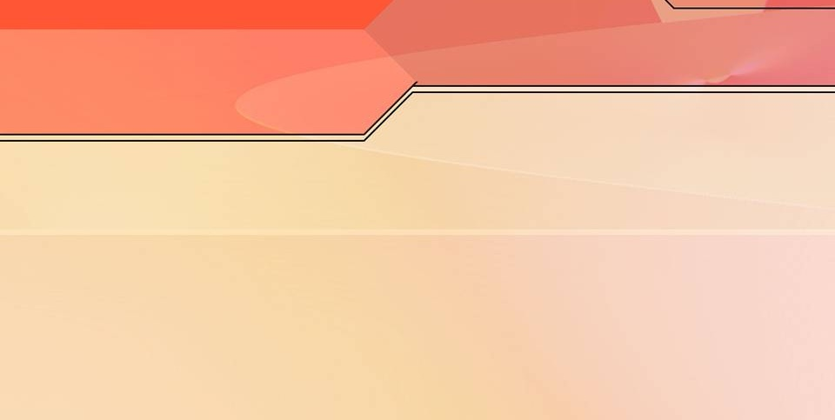
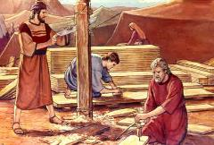
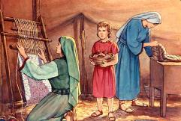
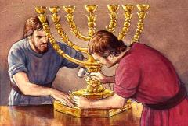
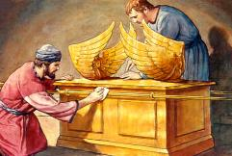
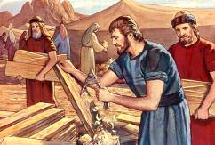
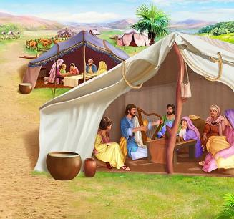
LOSO RANYISI
“Ng’e ni aseyiero Bezalel wuod Ur ma wuod Hur, ja Juda. Asepong’e gi Roho mara mondo obed gi lony kod nyalo, kaachel gi rieko mar ng’eyo tije duto mag lwedo” (Wuok 31:2-3)
Kata obedo ni Nyasaye nomiyo Musa puonj matut ahinya e wi gedono, ne ok onyise nonro duto. Karaya mar mula, kerubi, lep jodolo, kod mamoko, ne onego chal nade? Mano ne omiyo Roho Maler thuolo mar tiyo kod mich mag jogedo.
Kuom nonro matutgo, Roho Maler nochiwo mich makende ni:
Bezalel, ma ne otelo ne tijno duto (Wuok 31:2)
Oholiab, ma ne jakonyne maduong’ (Wuok 31:6a)
Jomamoko ma ne okonyo e tich (Wuok 31:6b)
E dier puonj mag gero hekalu, nitie weche makende ma owuoyo kuom Sabato (Wuok 31:12-17). Tudruok mane ma Sabato nigo gi gigi duto?
Maler e rayaw mar tiend wachni. Mondo wadhi machiegni gi Nyasaye Maler, nyaka wabed maler kaka en. Sabato en ranyisi mar lerno (Wuok 31:13; Ezek 20:12, 20).
Notes:
Exodus 31:2
See, I have called by name Bezalel the son of Uri, the son of Hur, of the tribe of Judah;
Exodus 31:6a
And behold, I have set with him Aholiab the son of Ahisamach , of the tribe of Dan;
Exodus 31:6b
and I have put wisdom in the minds of every wise-hearted person, so that they may do all that I have commanded you;
Exodus 31:12-17 And the LORD spake unto Moses, saying, (13) Thou shalt speak unto the children of Israel, saying, Ye shall surely keep my sabbaths: for it is a sign between me and you throughout your generations, that ye may know that I am the LORD that sanctifies you. (14) Therefore ye shall keep the sabbath day, for it is holy unto you: whoso profaneth it shall surely be put to death: for whosoever doeth any work in it, that soul shall be cut off from among his people. (15) Six days shall work be done: but the seventh day is a sabbath of rest holy to the LORD: whosoever doeth any work on the sabbath day shall surely be put to death. (16) Therefore shall the children of Israel keep the sabbath, to observe the sabbath throughout their generations for a perpetual covenant. (17) It is a sign between me and the children of Israel for ever: for in six days the LORD made heaven and earth, and on the seventh day he rested, and was refreshed.

Slide 11

“E gero hekalu kaka kar dak mar Nyasaye, ne omi Musa chik mondo olos gik moko duto kaluwore gi ranyisi mar gik ma ni e polo. Nyasaye noluonge e got, kendo nonyise gik ma ni e polo, kendo e chalgi, ne oloso hema mar lemo, kaachiel gi gik moko duto ma ne ni e iye.
Omiyo ne Israel, ma ne odwaro ni obed kar dak mare, ne ofwenyone kite ma nigi duong’ madwarore. [...] To kidono, gin kuomgi giwegi, ne gionge gi teko mar chope. Fwenyruok ma ne otimore e Sinai ne nyalo mana nyisogi dwaro ma ne gin-go kod bedo maonge kony.”
EGW (Education, p. 35-36)

