Slide 1
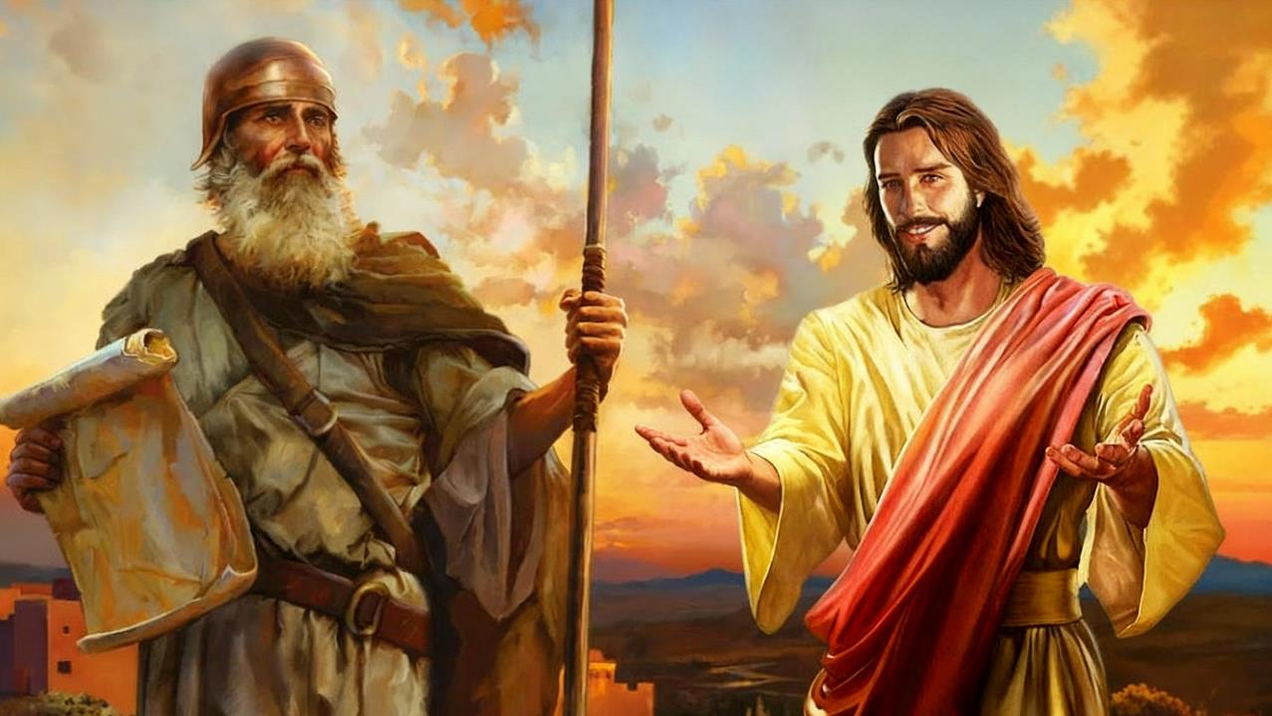
JOSHUA MADIERI
Lesson 10 mar Decemba 6, 2025

Slide 2
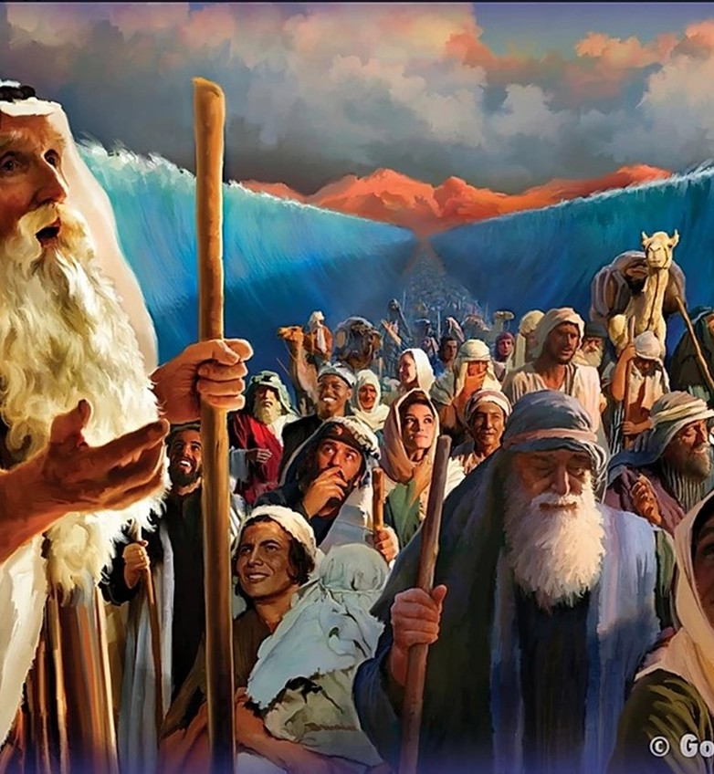
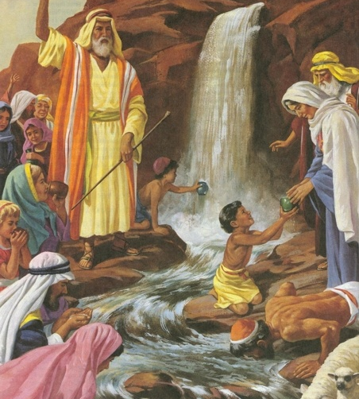
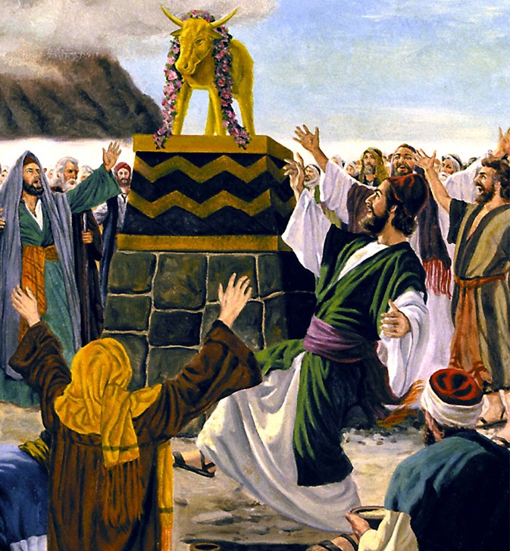
“Gigo duto notimorenigi kaka ranyisi, kendo ne ondikgi ni mondo watang’, wan mwadak e ndalo ma piny rumoeni” (1 Jo-Korintho 10:11)

Slide 3

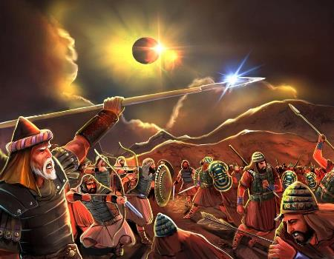
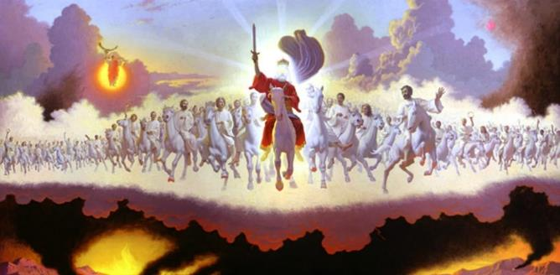







Wanyalo somo ngima mar Joshua, ma oler e kitepe mag Musa kod e kitap Joshua owuon, e yore ariyo mopogore (kendo ma konyore): kaka sigana kendo e yo mar ranyisi.
Mondo walok tiend ranyisi mar Joshua e yo makare, nyaka wang’e mokuongo chike ma tayo ranyisi mayudore e Biblos: tipo kod gima hie.
Ka mano osetim, wabiro luwo ranyisi mar Joshua kokalo kuom Biblos duto mondo wayudi weche ma Nyasaye oseweyonwa kokalo kuom Wachne e tudruok gi “ranyisi ma yudore kuom Joshua”.
Ranyisi mayudore e Biblos:
Tipo en ang’o?
Klase mag tipo
Ranyisi mayudore kuom Joshua:
Joshua kaka tipo
Joshua mahie
Joshua kaka tipo mar Kanisa

Slide 4

RANYISI MAYUDORE E BIBLOS

Slide 5


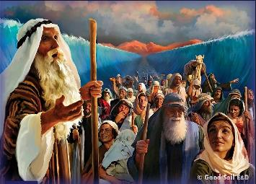
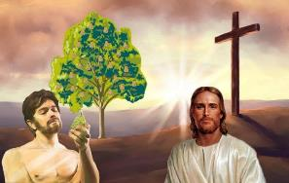
TIPO EN ANG’O?
“Gigo duto notimorenigi kaka ranyisi, kendo ne ondikgi ni mondo watang’, wan mwadak e ndalo ma piny rumoeni.” (1 Jo-Korintho 10:11)
Paulo – kod jondiko mamoko mag Biblos – tiyo kod wach mar “kido” mar nyiso ng’ato kata gima ne otimore chon ma ochung’ ne kata ng’ato ma wuok e kindene owuon kod/kata kinde mabiro (ma iluongo ni “gima hie.”
Kuom ranyisi, Jo-Rumi 5:14 wuoyo kuom Adam kaka ranyisi [“kido”] “mar Jal mane onego bi,” tiende ni Yesu—gima hie.
Ranyisi
Daudi (Zaburi 22:1)
Lendo mar Gima hie
Daudi manyien (Jer. 23:5)
Gima hie
Yesu (Math. 27:46)
Ranyisi
Misengni (T.Lawi 1:3-5)
Lendo mar Gima hie
Jatich masandore (Isa. 53:5-7)
Gima hie
Tho Yesu (Joh. 19:16-18)
E kinde mang’eny, wayudo e Muma Machon gik ma nyiso ni ji kata gik ma ne otimore gin ranyisi mag gimoro mabiro. Wane ranyisi ariyo:

Slide 6

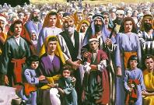
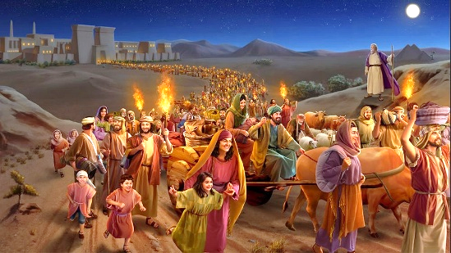
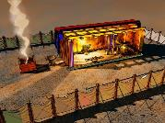
KLASE MAG TIPO
“mi odak kuno nyaka Herode otho. Mano notimore mondo ochop gima ne Ruoth Nyasaye omiyo janabi owacho, ni, ‘Naluongo wuoda mondo oa Misri’ ” (Mathayo 2:15)
Tipo ma ni e Muma Machon siemo gik mahie e yore adek mopogore e Muma Manyien: Kristo; Kanisa; kod giko mar ndalo.
TYPES AND ANTITYPES
Israel
Wuok
Hekalu
Kristo
Kanisa
Giko mar ndalo
Kristo
Kanisa
Giko mar ndalo
Kristo
Kanisa
Giko mar ndalo
Otere Misri
Math. 2:13-15h
Israel manyien
Gal. 6:16
Ji 144,000
Fweny 7:4
Ndalo 40 e Thim
Math. 3:16-4:2
Obatise kendo opidhe gi Kristo
1 Kor. 10:1-6
Wuok e kanise moweyo yie
Fweny 18:4
Ne en kaka hekalu e dierwa
Joh. 1:14; 2:21-22
Wan e hekalu mar Nyasaye
1 Kor. 3:16-17
Jerusalem manyien, hekalu marwa
Fweny 21:2-3
TIPO
GIMA HIE

Slide 7

RANYISI MAYUDORE KUOM JOSHUA

Slide 8


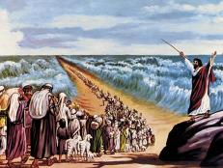
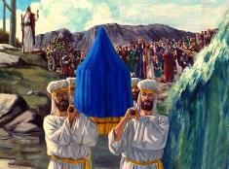
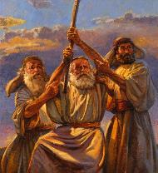
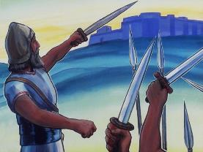
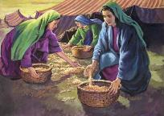
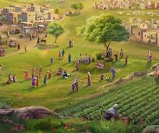
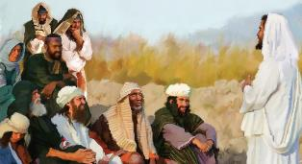
JOSHUA KAKA TIPO
“Ruoth Nyasaye ma Nyasachu noyier janabi moro ka an kuom jowu uwegi, kendo nyaka uwinj wachne.” (Rapar mar Chik 18:15)
Joshua notimo moko kuom gik mane Musa owacho kuom janabi mar ariyo mane dhi telo ne oganda (R.Chik 18:15-19).
Mana kaka Musa, Joshua ne yudo ote tir kowuok kuom Nyasaye; ne otimo nyasi mar Pasaka; ne okalo e pi; ne oneno Malaika mar Ruoth; ne orieyo lwete ma okelo loch; ne oluongo oganda mondo osiki jo adier bang’ thone; gi mamoko.
Mana ne ochako lwar e ndalo Musa kendo oweyo lwar e ndalo Joshua. Bende, Joshua notimo kaka Musa nochiwo chik kaka ipogo piny kod gero miere mag tony.
To oganda ne ong’eyo ni kor mar Musa ne odhi nyime ma okalo Joshua (Johana 1:21). Omiyo, Musa kod Joshua duto bedo tipo mar gima hie mane ochopo kor mane omi Musa kuom “Janabi”: Yesu (Tich Joote 3:22-26).

Slide 9


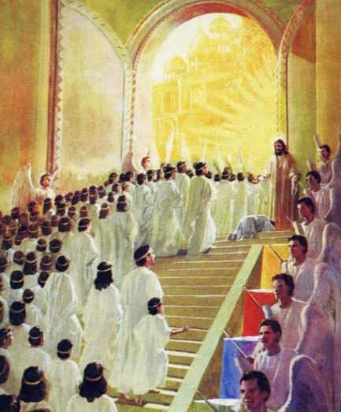
JOSHUA MAHIE
“Ruoth Nyasaye wacho kama: ‘Abiro dwoko kwayoni e kinde mowinjore. Adier, abiro konyi e ndalo mar resruok. Anariti mi achiwi ka ng’ama kelo winjruok e kinda gi ji, mondo ichak idwok piny kare, mi ipog ni ji puothe mojwang’.” (Isaya 49:8)
Dwaro mag lwenje mane Joshua oteloe ne en ni mondo Jo-Israel okaw Piny Mosingi. Isaya wuoyo kuom tij Mesia kaka mano ma bende oting’o chiwo “puothe mojwang’[ni joge]” (Isaya 49:8), ka otiyo gi weche ma chal gi mane otigodo e kitap Joshua.
En e yo mane ma ngima kod tich mar Joshua (kaka tipo) nyisore e ngima kod tich mar Yesu (kaka gima hie)?
Bang’ batiso e Aora Jordan, Yesu nokedo gi teko mag mudho
Ne odonjo e tije bang’ ndalo 40 e thim
Ne oloyo jasigu e msalaba
Omiyowa loch kuom wasikwa mag chuny
Omiyowa yueyo madieri
Ochiwonwa pok ma ok kethre

Slide 10

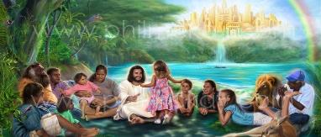
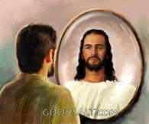
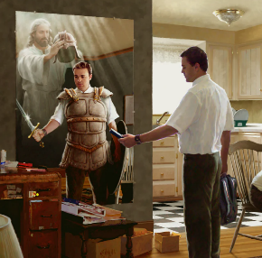

JOSHUA KAKA TIPO MAR KANISA
“nimar wasigu mwakedogo ok gin dhano, to wakedo gi joloch gi joma nigi teko,kod ruodhi mag piny motimo mudhoni, kaachiel gi lang chuny maricho ma ok mag pinyni.” (Jo-Efeso 6:12)
JOSHUA KOD KANISA
Kawuono wan gi lweny ma nyaka wakedgo, ma otelwae gi “Joshua” marwa, ma miyowa gik lweny ma dwarore (Ef. 6:10-12).
Bende, osebedo ka omiyowa pok, kendo opong’owa gi mich mag roho (Efes. 1:3, 11).
JOSHUA KOD NDALO GIKO
To chopo dwaro mar Joshua biro bedo e giko, ka jolweny duto mag richo osekethi, kendo wabiro kawo pok marwa chuth: piny ma wanyalo dak e iye gi geno (Fweny 20:7-9; Ezek. 28:26).
Kapok kindeno ochopo, we mondo wadongi e ng’uono kaka Joshua notimo, ka wawe Nyasaye mondo olokwa wachal kode matintin ndalo ka ndalo.

Slide 11

“Jo-Israel mag Nyasaye, ma wuotho ​​kadhi e piny Kanaan manie polo, nigi Jatend Lweny ma ne ok odwaro puonj moro amora mar dhano mondo oikre ne tich mare kaka jatelo mar chuny; kata kamano, ne omiye bedo ng’ama kare chuth bang’ neno chadruok; kendo “nimar en owuon osekadho e tem mar neno masira, omiyo koro onyalo konyo jogo mitemo.” Jo-Hibrania 2:10, 18. Jawarwa ne ok onyiso nyao kata bedo ni ok oromo chuth kaka dhano; kata kamano, ne otho mondo oyudnwa yor donjo e Piny Mosingi.”
EGW (Patriarchs and Prophets, p. 480)

