Slide 1

MEN OTEMJEJ EJ ÑAN KAIBOJOJ ANIJ
KAtak 5 ñan August 1, 2026

Slide 2

(1 Ri-Korint 10:31, NKJV)
“Innem, elañe komij mõñã ak idaak, ak jabdrewõt men komij kõmmane, komin kõmmane men otemjej ñan aibujuij an Anij”

Slide 3


Jino jen 1 Dri Korint 7, Paul ej lelok e make ñan uake elõñ kajitõk ko me Ri Korint ro rar jilkinlok ñan e (1 Cor. 7:1a).
1 Ri-Korinth Ro 8
Mōñā ko rej katok kaki ñan ekjab ko
(Meletlet im yokwe)
1 Ri-Korinth Ro 9
Paul ej kwalok jimwe ko an
(Jimwe ko an gospel eo)
1 Ri-Korinth Ro 10:1-13
Nan in Kakkōl ņae kabuñ ñan ekjab
(Menin Katak ko jen Ien Ko Mokta)
1 Ri-Korinth Ro 10:14-22
Kap eo an Irooj im kap in tiṃoṇ ro
(Jolok kabuñ ñan ekjab)
1 Ri-Korinth Ro 10:23-33
Kōmmane men otemjej ñan aibujuij eo an Anij
(Ta eo ekkar ñan kien im ta eo emman im ekkar)
Kin un in, meñe jebta 8 ñan 10 rej konono kin kabuñ ñan ekjap, Paul ej kobaik jet unin kōnono ko me ejelok air kõtan ñan jerawiwi in.
Ak, ej kajeoñ in kobaik juon men eo ilo kajjojo unin kōnono: yokwe im kautiej don, eo ej aikuj in tellok eklejia eo bwe ren juon wōt.
Ippān ļōmņak in, Paul ej kōmeļeļeik aikuj eo n̄an aolep men ko rej kōm̧m̧an ilo kabun̄, ak ilo mour in make, n̄an kōm̧m̧an n̄an aiboojoj eo an Anij.

Slide 4

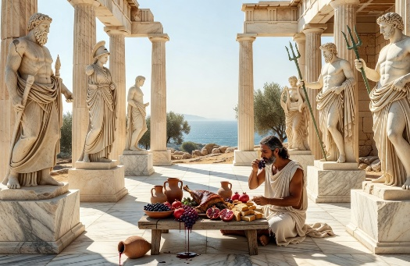

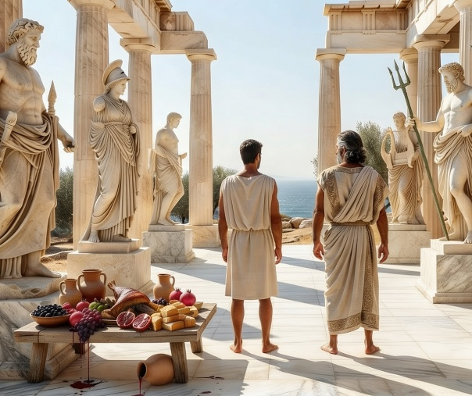

MELETLET IM YOKWE
1 Ri-Korint 8 (Mōñā ko rej katok kaki ñan ekjab ko)
“A jeḷāḷọkjeṇ ej utiej bōro, im yokwe ej kalōk.” (1 Ri-Korinth 8:1b)
Paul ej “kōjepel” kabuñ eo ñan ruo kumi: ro “rekajur” im ro “remõjno”.
1 Ri-Korint 8:4-7a
Ro rekajur rej melele bwe ekjap ko ejelok tokjeir, kinke ewõr juõn wõt Anij emol.
Ro remõjno rejjañin melele kin men in.
1 Ri-Korint 8:7b
Ro rekajur rej mõñã kanniõk ko kar emoj katok kaki ñan ekjap ko kinke rejelã bwe ekjap ko rejjab maroñ katton mõñã eo.
Ro remõjno rej tõmak bwe rej jerawiwi elañe rej mõñã kanniõk eo.
Ak ro rekajoor, kōn aer jeļā im waanjon̄ak, remaron̄ kōm̧m̧an bwe ro rem̧ōjņo̧ ren bun̄ ( 1 Kor. 8:10 ). Kin an yokwe jein ak jatin, eo ekajur ej aikuj in dāpij e make (1 Kor. 8:11-13).
Rikirijin ro rej aikuj likit yokwe mokta jen jelālokjen ñe jelālokjen emaron juon menin bōbrae ñan jein ak jatin eo “emõjno” (ilo ial in eddeklok ilo mour in ri-Kirijin).

Slide 5


JIMWE KO AN GOSPEL EO
1 Ri-Korint 9 (Paul ear jolok jimwe ko an)
“Ilo ejja wāween in wōt, Irooj eaar kakien bwe ro rej kwaļo̧k gospel eo ren bōk aer mour jān gospel eo.” (1 Ri-Korinth Ro 9:14)
Pablo renunció, al menos, a tres derechos por amor a los débiles:
⁕ Jimwe ñan bōk mona ko kijen jen eklejia eo (1 Cor. 9:4)
⁕ Jimwe ñan an bed ibben lio belen (1 Cor. 9:5)
⁕ Jimwe ñan jab maroñ kōmman jerbal in kōjparok mweik ak kamta (1 Cor. 9:6)
Paul ear jolok jimwe eo an einwot juon ri jilek ñan an bōk jibañ jen kabuñ ko ej jerbal ñan ir, einwot an kar ri jilek ro jet kōmmane.
Manit eo elaptata ibwiljin ri jilek ro ej bwe ren ito-itak ibben lio beleir ñan maroñ lale ir im jibañ ir ilo jerbal in kwalok nan eo. Kōrā in, einwot leo belen, enaj kar wor an jimwe ñan bōk jibañ jen eklejia eo.
Paul ekōnaan wot jerbal im bok kolā jen jerbal eo an make ñan bōbrae an armij ro lemnok ke ej bōk kõlā jen armij ro rej roñjake nań in kwalok ko an, im ñan lewoj ñan ir juon wanjonak kin mour ejjab atartar ñan armij ro jet.
Meñe Jisōs ear kalikar bwe ro rej kwalok gospel eo rej aikuj mour jen gospel eo, Paul im Barnabas rar make jolok men in bwe ren jab bōbrae ri tõmak ro (1 Cor. 9:12-14; Lk. 10:7).

Slide 6










MENIN KATAK KO JĀN IEN KO MOKTA
1 Ri-Korint 10:1-13 (Naan in Kakkōl ņae kabuñ ñan ekjab)
“Komin jab kabuñ ñan ekjap, einwot jet iaer; einwõt emwij je: ‘Armij ro rar jijet bwe ren mõñã im irak, im jutak bwe ren mõnõnõ’ ” (1 Ri-Korinth 10:7)
Eñjake eo an Exodus, melele kake ilo jitõb, ej juon men eo ej einlok wõt ad make. Kijoone loṃaḷo ej āinwōt bujen peptaij eo ad. (1 Cor. 10:1-2).
Mōñā im idaak ko rar bōki ilo āne jemaden ej einwot ad bōk koņaad ilo Kwojarjar eo, ijo jej mõñā im idaak, ilo jitõb, enbwinin im bõtõktõkin Jisōs (1 Cor. 10:3-4).
Kōjparok! Meñe rar iion men ko renana, Ri Israel ro rar buñ ilo bwid ko relap, ekoba kabuñ ñan ekjap im mour in lũñ. Lale bwe en jab walok men in ñan kij! (1 Ri-Korinth 10:5-10).
Kin menin ri jilek eo ej kajemlok mõttan jeje in kin juon nan in kakabilek ekajur: “Innem, elañe kwoj lemnok kwoj jutak bin, kwon kejbãrok bwe kwon jab buñ” (1 Cor. 10:12).

Slide 7



JOLÕK KABUÑ ÑAN EKJAB
1 Ri-Korinth 10:14-22 (Kap an Irooj im kap in tiṃoṇ ko)
“Kōn men in, ro jera rejitōnbōro, koṃwin ko jān kabuñ ñan ekjab” (1 Ri-Korinth 10:14)
Elañe mõñã ko rej katok kaki ñan ekjap ko remaroñ mõñã ilo ejelok inebata, etke Paul ej einwõt ej kakabilek nae menin ilo 1 Ri-Korinth 10:20?
Ej juon men ñan mōñā kanniōk ilo mweo, ilo ejelok bōd, im bar juon men ñan kōmmane ilo ien kwojkwoj eo an armij ijo rej kabuñ ñan ekjab ko. Ilo an bōk kunan ilo kain kwojkwoj rot kein, ri tõmak eo ej jolok tõmak eo an im bõk kabuñ ñan ekjap.
Ilo ad bōk koņaad ilo Kōjota eo ekwojarjar jej erom m̧ōttan ānbwinnin Kraist (kabun̄ eo), ak, ilo ad bōk koņaad ilo m̧akūtkūt in kabun̄-jar n̄an ekjab, jej bōk koņaad ippān tim̧o̧n ro
(1 Cor. 10:16-20).
Jejjab maroñ bōk kab in Kwojarjar, nebar Jisōs, im –ilo ien eo wot– bōk jen kap eo ej nebar demon ro (1 Cor. 10:21).

Slide 8



TA EO EKKAR ÑAN KIEN IM TA EO EKKAR IM EMMAN
1 Ri-Korint 10:23-33 (Kõmmõne men otemjej ñan Kaibojoj Anij)
“Kõn men in, meñe kom̦ij m̦õñã ak idaak, ak jabdewõt men kom̦ij kõm̦m̦ane, kom̦win kõm̦m̦ane men otemjej ñan aiboojoj an Anij.” (1 Ri-Korinth Ro 10:31)
“Emelim kommon men otemjej, ak ejjab aolep men remmon” (1 Ri-Korinth Ro 10:23).
Ruo waanjonok ko rejimwe:
Jikin wia kanniōk eo ear wiakake mōñā ko kar katok kaki ñan ekjab ko im mōñā ko rar jab katok kaki. Ri tõmak eo ej jab aikuj in kajitõk rar ke katok ak jab kanniok eo bwe en jab lelok lemnak eo ke ej watõk bwe ejjab jimwe an mõñã kain kanniõk rot in (1 Cor. 10:25).
Juon eo ejjab ri tõmak ear kir juon ri tõmak bwe en mõñã. Ri tõmak eo ear mõñã ilo ejelok kajitõk (men otemjej rej maroñ ñan e). Ak ri-lotok eo ear ba bwe kanniōk eo kar katok kake ñan juon ekjab. Kin menin, bwe en jab kainebataik lemnok eo an ri kur eo, kar watōke bwe ejjab jimwe an ri tõmak eo mõñã kanniõk eo (1 Ri-Korinth Ro 10:27-29).
Pedped in katak kein rej barāinwōt ruo: nōbar Anij ilo men otemjej (1 Kor. 10:31); im ñan bukõt tokjen eo an ro jet ( 1 Kor. 10:24, 32 ).
Menin ej, ñan yokwe Anij ilõñin men otemjej im ro ri turum einwõt kwe make (einwõt an kar Jesus kajitõk ibben likao eo ri mweie).

Slide 9

“Ri jilek eo ear kallimur ñan ri Korint ro, "Eo ej lemnok ej jutak en lale bwe en jab buñ." Elañe rej erom ri utiej buru im liki ir make, jab lale im jar, renaj kar wōtlok ilo jerawiwi ko relap, im kirtok illu eo an Anij ioir make. […]
Paul ear akwelap ñan ro jein im jatin bwe ren kajitõk ibbeir make ta eo nan ko air im jerbal ko air renaj jelet ro jet im bwe ren jab kõmman jabdrewõt, meñe ejelok ruõn, eo enaj einwõt ej kõtlok kabuñ ñan ekjap ak kajorrãn ro rej mõjno ilo tõmak. "Innem elañe komij mōñā ak idaak, ak jabdrewot komij kōmmane, komin kōmmane men otemjej ñan aibujuij an Anij. Komin jab kōmman jabdrewot men in lõkatip, jab ñan ri Ju ro, jab ñan ro dri ailiñ ko, jab ñan eklejia an Anij.”
EGW (The Acts of the Apostles, p. 316)

