Slide 1

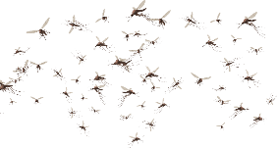
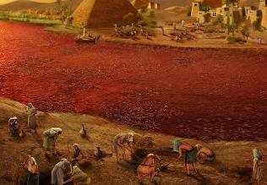
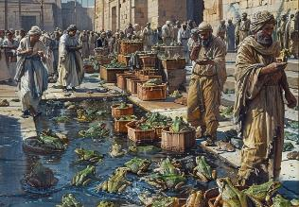
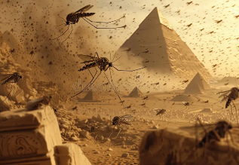
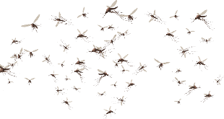
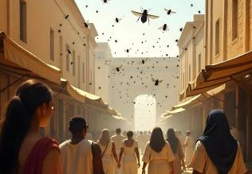
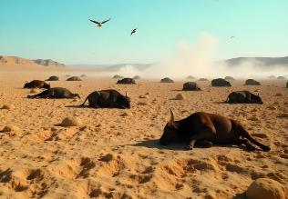
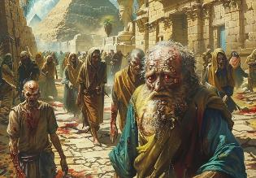
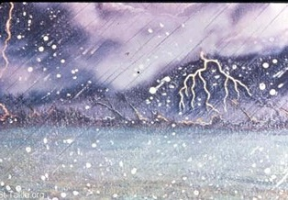
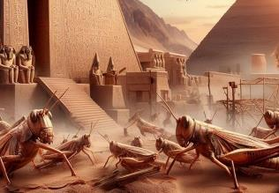
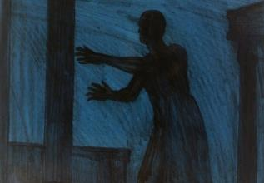
INHLUPHO
EZATHELWAYO
Isifundo sesine kNtulikazi ilanga lamatshumi amabili lesithupha , 2025

Slide 2
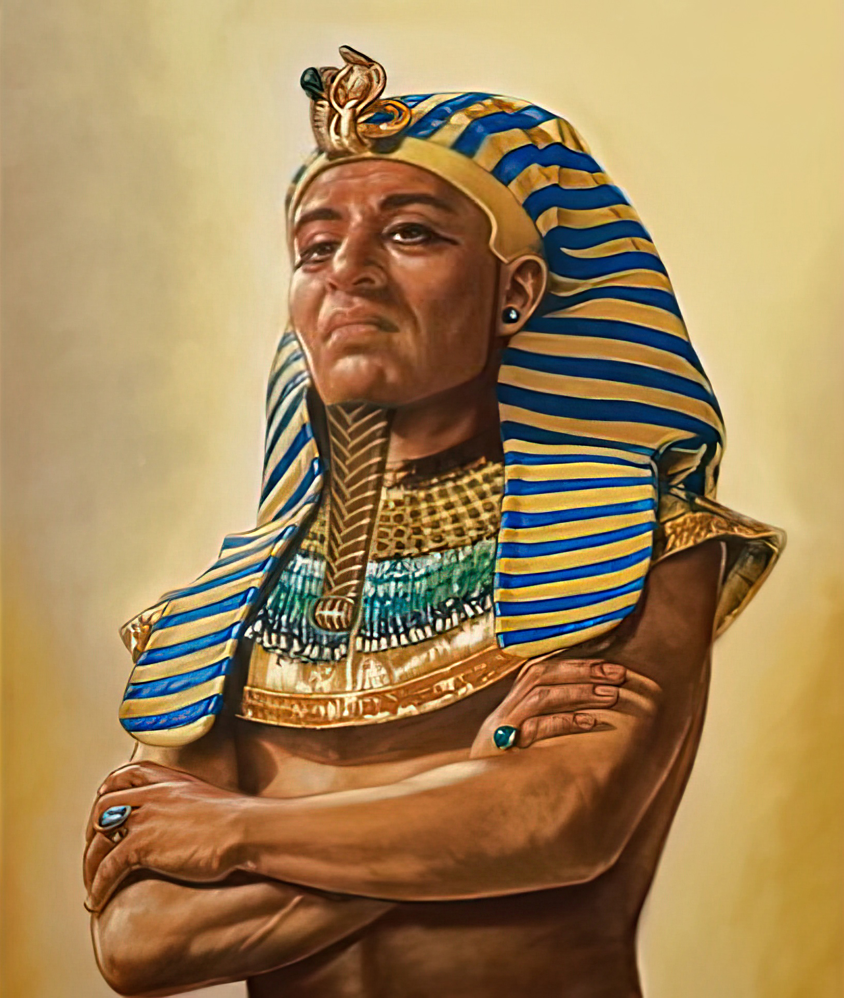
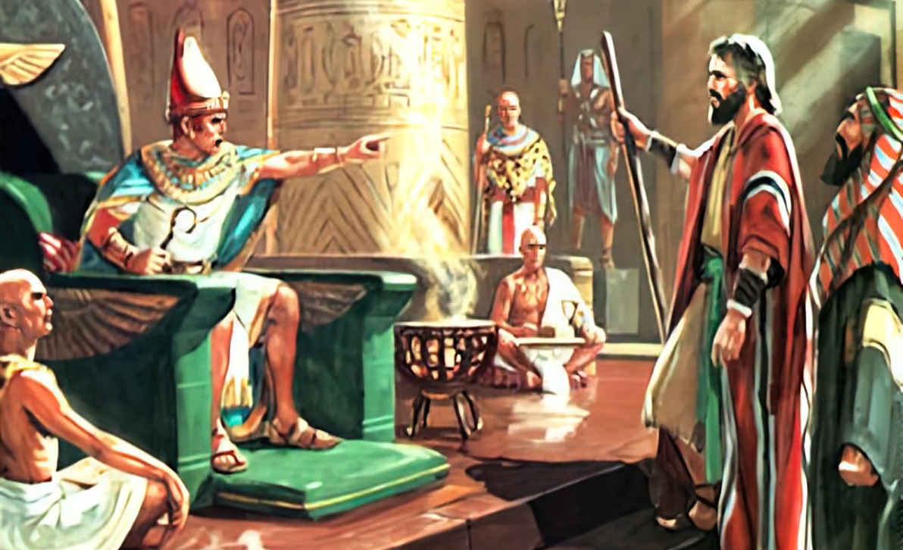
“Inhliziyo kaFaro yaba lukhuni, kabavumelanga abantwana bakwa-Israyeli ukuba bahambe, njengalokho uJehova etshilo ngoMose.”— Eksodusi 9:35

Slide 3

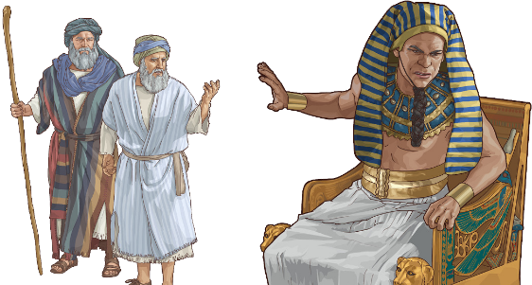
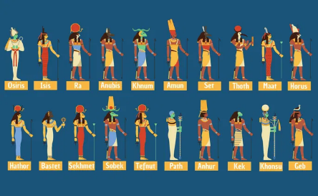
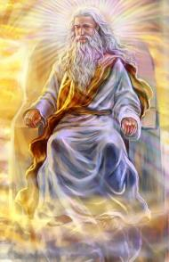




Kuthe abantu bakaNkulunkulu bebhekane lempi, uNkulunkulu watshela ukuba baqale babonisane ngendlela yokuthula. Uma isivumelwano sasingelakufinyelelwa, kwakufanele kuthathwe isinyathelo (Dut. 20:10-12).
Le yindlela uNkulunkulu aphatha ngayo iGibhithe. Isixazululo esilokuthula sase sizanyiwe, kodwa uThutmose wala ukusamukela. Sase sifikile isikhathi sokuthatha inyathelo.
Lapho izinhlupho zivela, akekho unkulunkulu onkulunkulu baseGibithe ababengavikela iGibithe emandleni kaNkulunkulu oyedwa weqiniso.
Isandulelo:
  Ukulwa Kwenyoka ( Eksodusi 7:8-12 )
  Inhliziyo ewomileyo (Eksodusi 7:13)
Inhlupho ezathelwayo:
  Inhlupho ezintathu ezilula ( Eksodusi 7:14–8:19 )
  Inhlupho ezintathu ezinzima ( Eksodusi 8:20-9:12 )
  Inhlupho ezintathu ezinzima ( Eksodusi 9:13–10:29 )

Slide 4

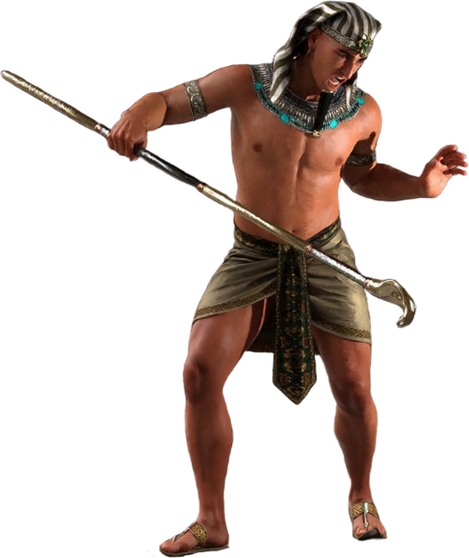
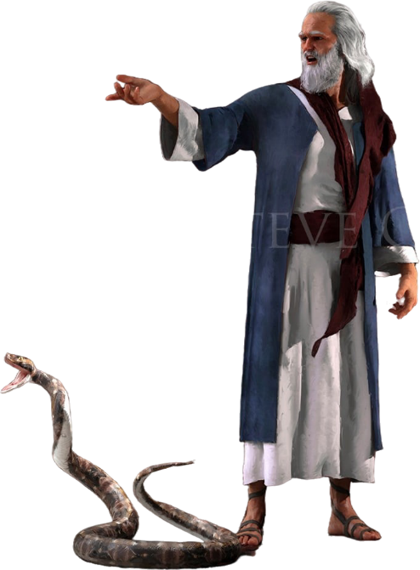
ISANDULELO

Slide 5

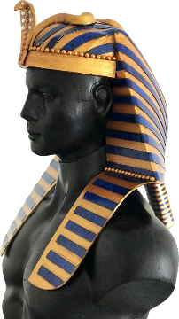
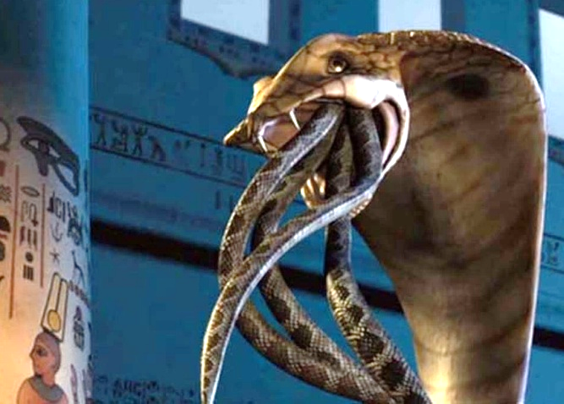
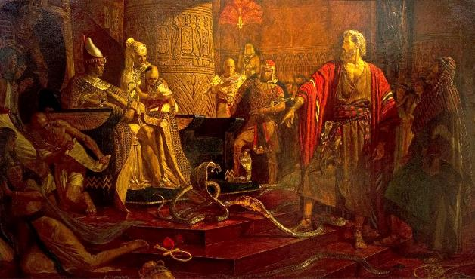
UKULWA NGENYOKA
“Yilowo lalowo waphosa induku yakhe phansi, yaba yinyoka, kepha induku ka-Aroni yaginya induku zabo.” (Funda u-Eksodusi 7:12.)
UNkulunkulu waveza ukuthi ukukhululwa kuka-Israyeli kwakuyimpi yena ngokwakhe ayilwa labonkulunkulu baseGibhithe. ( Eks. 12:12; Num. 33:4 ).
Emqheleni wakhe, uphawu lwamandla akhe, uFaro wayegqoke i-cobra enhle emele unkulunkulukazi u-Uadyet.
Ngokuphendula induku ibe inyoka, uNkulunkulu wayebekela unkulunkulukazi inselela ngokuqondileyo ( Eks. 7:10 ). Ingabe wayengenelisa ukuvikela uFaro?
USathane walingisa isimangaliso esebenzisa izanusi ( Eks. 7:11 ). Kodwa akakwazi ukudala ukuphila; inyoka zakhe zazifana lezinyoka kuphela. Ngakho, uNkulunkulu wadala inyoka ephilayo, ekwazi ukuginya izidalwa ezingaphiliyo ( Eks. 7:12 ).
Kanjalo uNkulunkulu wabonisa ukuthi nguye olamandla legunya lokubusa, hatshi onkulunkulu baseGibhithe.

Slide 6

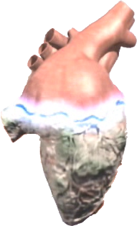
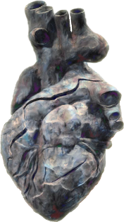


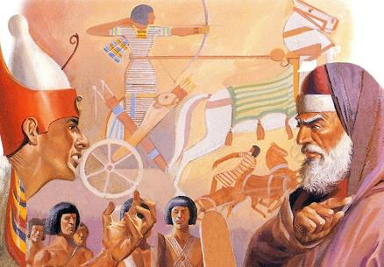

INHLIZIYO ELUKHUNI
“Inhliziyo kaFaro yaba lukhuni, kabalalelanga, njengalokho etshilo uJehova” ( Eksodusi 7:13 )“
Encwadini ka-Eksodusi, kuthiwa izikhathi ezingu-9 uNkulunkulu wayenza lukhuni inhliziyo kaFaro ( Eks. 4:21; 7:3; 9:12; 10:1; 10:20; 10:27; 11:10; 14:4; 14:8 ), futhi izikhathi ezingu-9 kuthiwa uFaro ngokwakhe wayenza lukhuni inhliziyo yakhe. ( Eks. 7:13; 7:14; 7:22; 8:15; 8:19; 8:32; 9:7; 9:34; 9:35 ). Kulingene! Ngubani owayenza lukhuni inhliziyo kaFaro?
Ngemva kwezinhlupho ezinhlanu zokuqala, kutshiwo ngokucacileyo ukuthi uFaro wayenza lukhuni inhliziyo yakhe. Okuyikuthi, wenqaba ukusabela kahle obizweni lukaMoya oNgcwele lokukhulula u-Israyeli.
Ngemva kohlupho lwesithupha, uNkulunkulu wenza lukhuni inhliziyo yakhe (Eks. 9:12). Ngokusobala uFaro wayesedlulile umngcele wokuphenduka. Ngakho, ohluphweni lwesikhombisa, waphiwa elinye ithuba, kodwa waphinda ayenze lukhuni inhliziyo yakhe ( Eks. 9:34-35 ).
Kusukela ngaleso sikhathi kuqhubeke, isiphetho sakhe savalwa. UNkulunkulu wayeyenze lukhuni inhliziyo kaFaro ngoba wayesenqume ngokuqinileyo ukungaphenduki

Slide 7

EGW ( The Review and Herald , Nhlolanja 17, 1891)
“Ngesikhathi sinye ngasinye sokwaliwa kokukhanya, uJehova wabonakalisa amandla akhe kakhulu; kodwa inkani yenkosi yanda ngabo bonke ubufakazi obutsha bamandla lobukhosi bukaNkulunkulu wezulu, kwaze kwaba yilapho umcijo wokugcina womusa waqedwa emgodleni waphezulu. Khona-ke indoda yaba lukhuni ngokupheleleyo ngenxa yokuphikelela kwayo. amkholise, ngoba wayevinjwe inkani lobandlululo, lapho uMoya oNgcwele wawungakwazi ukufinyelela enhliziyweni yakhe uFaro wazinikela ekungakholwani kwakhe nasebulukhunini benhliziyo yakhe.”

Slide 8

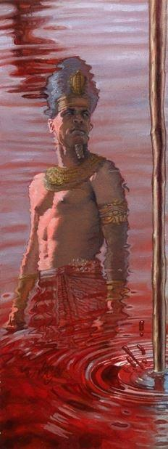
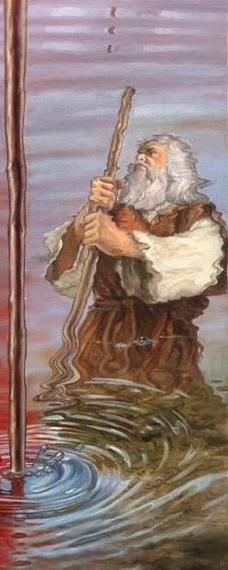
IZINHLUPHO

Slide 9

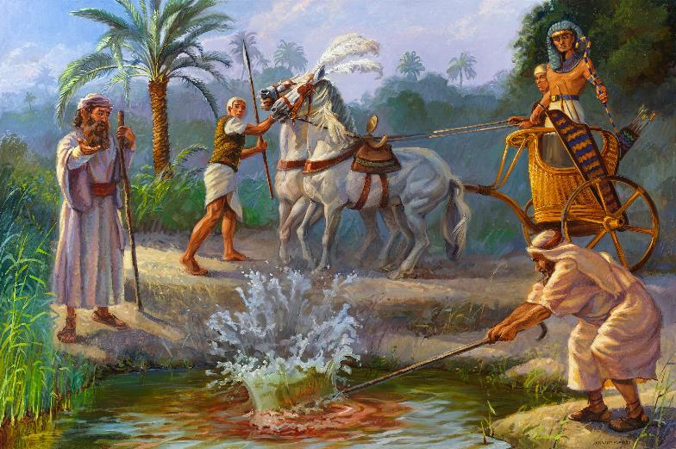
UHLUPHO LWAKUQALA ULUNGANENO:IGAZI
“Lokhu okutshiwo nguJehova: Ngalokhu lizakwazi ukuthi mina nginguJehova: Ngodondolo olusesandleni sami ngizatshaya amanzi oMfula iNayili, aphenduke abe yigazi.” ( Eksodusi 7:17 )
Hapi, unkulunkulu weNayile
Ekodusi 7:14-25
INayile, lougcwala kwayo, kwanika iGibhithe ukuphila. Kodwa ngubani owadala imithombo yamanzi? Izazi zalingisa ukuguqulwa kwamanzi, kodwa azikwazanga ukubiselakloku ayayikho khona.

Slide 10

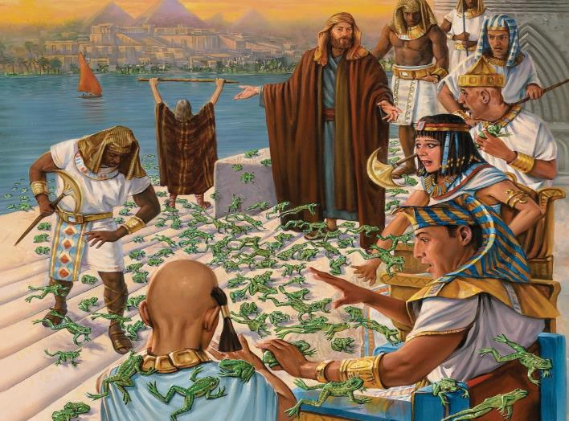
UHLUPHO LWESIBILI (OLUNGANZIMA) AMAXOXO
“Khona-ke uJehova wathi kuMose: “Yisho ku-Aroni ukuthi: ‘Yelula isandla sakho nenduku yakho phezu kwemifudlana nemisele namachibi, wenze ukuba amasele akhuphukele ezweni laseGibhithe.” (Eksodusi 8:5)
Heket, unkulunkulu wamaxoxo
Ekodusi 8:1-15
Zaphinda futhi izangoma zilingisa isifo senhlupho, kodwa zahluleka ukusimisa.

Slide 11

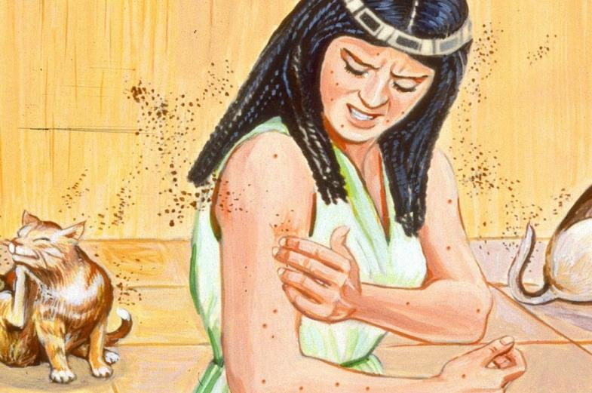
UHLUPHO LWESITHATHU (OLUNGANZIMA) INTWALA
“Khona-ke uJehova wathi kuMose: “Tshela u-Aroni, uthi, ‘Yelula induku yakho, ushaye uthuli lomhlabathi,’ futhi kulo lonke izwe laseGibhithe uthuli luyoba yimiyane.’” ( Eksodusi 8:16 )
Geb, unkulunkulu womhlaba
Ekodusi 8:16-19
Ukudala ukuphila ngothuli lomhlabathi ( Gen. 1:24 )? Kwakungasekho ukuthandabuza ngesissa sezinhlupho: “Lona ngumunwe kaNkulunkulu” (Eks. 8:19). Lezangoma zigcine zithule.

Slide 12

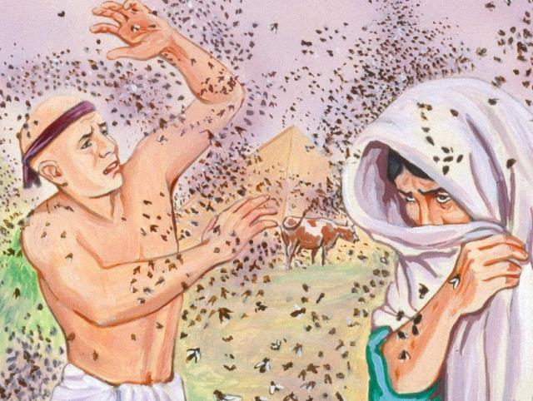
UHLUPHO LWESINE (OLUNZIMA) IMPUKANE
“Futhi iNkosi yenza lokhu. Kwatheleka ixuku lempukane endlini kaFaro lasezindlini zezinceku zakhe; kulo lonke elaseGibithe izwe lachithwa zimpukane.”— Eksodusi 8:24 .
Uatchit, unkulunkulukazi wamaxhaphozi
Ekodusi 8:20-32.
Ngokokuqala ngqá, ama-Israyeli avikelwa kulesi sifo. Lokhu kwaholela ekutheni uFaro axoxisane labo, kodwa wagcina ehlulekile ukugcina isivumelwano sakhe

Slide 13

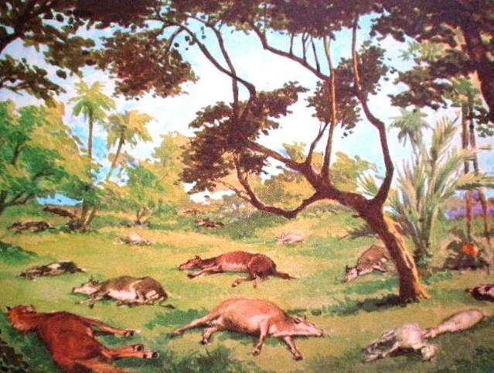
UHLUPHO LWESIHLANU(OLUNZIMA) UKUFA KWEZIFUYO
“Isandla sikaJehova siyakuletha isifo esibi phezu kwezinkomo zakho ezisendle, laphezu kwamahatshi akho, lembongolo zakho, lamakamela akho, laphezu kwezinkomo zakho, lezimvu zakho, lezimbuzi zakho” (Eksodusi 9:3
Khnum, unkulunkulu umdali
Ekodusi 9:1-7.
Onkulunkulu abanengi babelamakhanda ezilwane, ngakho lesi sifo salulaza inengi labo.

Slide 14

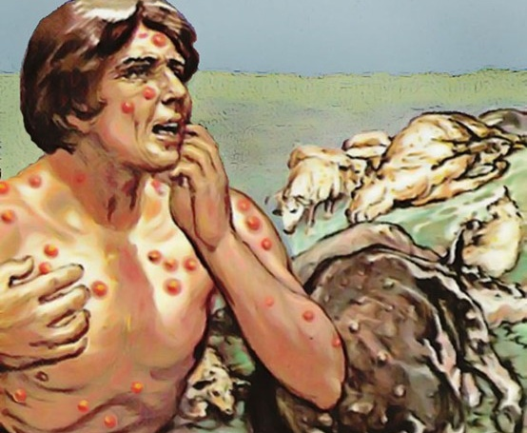
UHLUPHO LWESITHUPHA (OLUNZIMA) IZILONDA
“Base bethatha umlotha esithandweni, bema phambi kukaFaro, uMose waluphonsela emoyeni, kwaqubuka amathumba i ebantwini lasezinkomeni.” ( Eksodusi 9:10
Sekhmet, unkulunkulukazi wokusilisa
Ekodusi 9: 8-12 .
Ngitsho lezanusi zazingakwazi ukuzelapha (Eks. 9:11). UFaro wayengathandabuzii ukuthi lezi zinhlupho zazivelangaphi. Kodwa wayesenqume ukwala ukukhothamela uNkulunkulu, futhi uNkulunkulu wamvumela ukuba avune izithelo zokuhlubuka kwakhe ( Eks. 9:12 ).

Slide 15

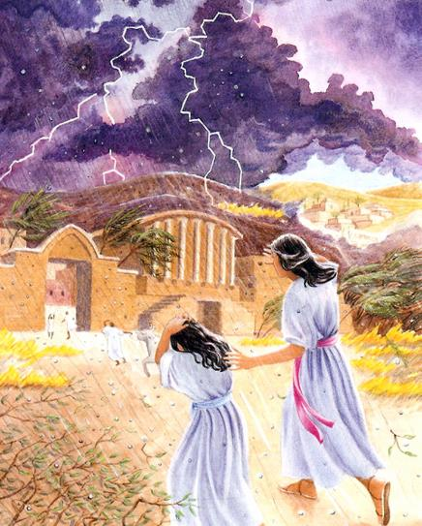
UHLUPHO LWESIKHOMBISA (OLUNZIMA KAKHULU) ISIQHOTHO
“Ngakho kusasa ngalesi sikhathi ngiyakuthuma isichotho esibi kakhulu esingakaze sibe khona eGibithe, kusukela osukwini elasungulwa kuze kube manje” ( Eksodusi 9:18 )
Nut, unkulunkulukazi wesibhakabhaka
Ekodusi 9:13-35.
Ukholo lwamaGibhithe lwavivinywa. Labo abakholwayo basindisa ukuphila kwezinceku zabo lemfuyo yabo. ( Eks. 9:20 ). UFaro akazange akholwe, futhi langoba wayesivuma isono sakhe, ukuvuma kwakhe kwakungelsio iqiniso. ( Eks. 9:27-30 ).
Seth, unkulunkulu wezivunguvungu

Slide 16

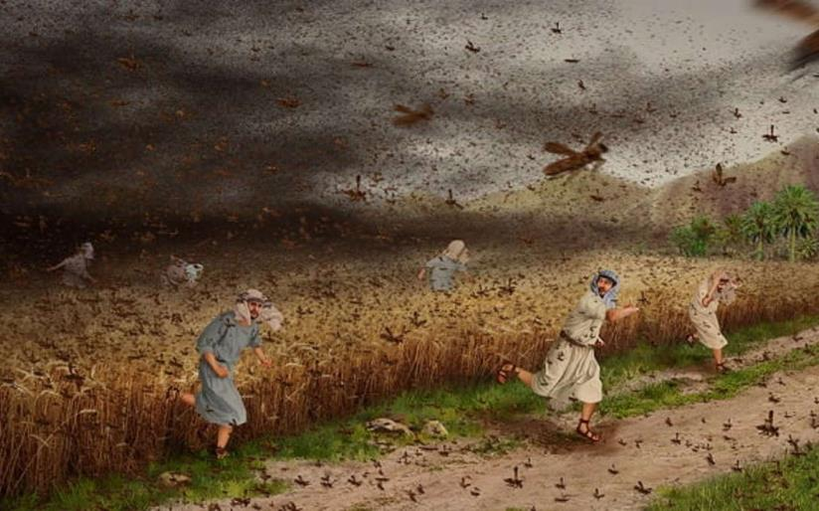
UHLUPHO LWETSHIYANGALOMBILI ( OLUNZIMA KAKHULU): INTETHE
“Uma usala ukubekela bahambe, kusasa ngiyakuletha intethe ezweni lakini” (Eksodusi 10:4)
Neper, unkulunkulu wezilimo
Ekodusi 10:1-20.
Njengoba iGibhithe seliihlukuluziwe, abaseGibhithe bancenga uFaro ukuba akhulule u-Israyeli. ( Eks. 10:7 ).

Slide 17

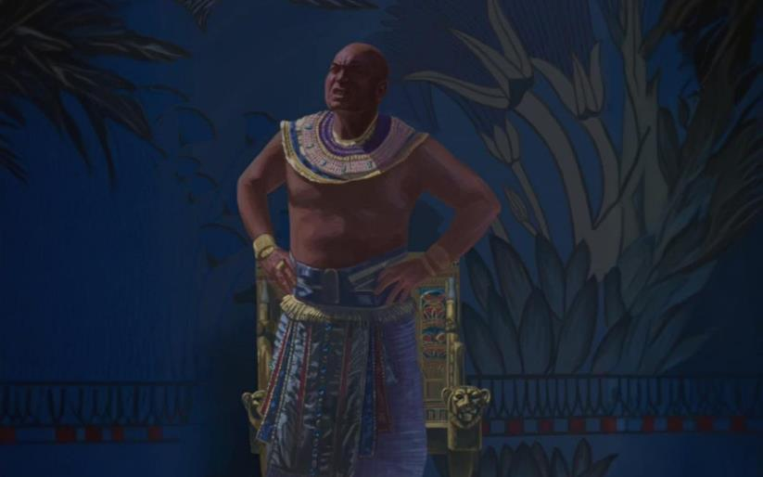
UHLUPHO LWETSHIYANGALONYE (OLUNZIMA KAKHULU): UBUNYAMA
“Khona-ke uJehova wathi kuMose: “Yelulela isandla sakho esibhakabhakeni ukuze ubumnyama budlule phezu kweGibhithe—ubumnyama obambekayo.”— Eksodusi 10:21
Ra, unkulunkulu welanga
Ekodusi 10:21-29.
Impilo yaseGibhithe yama zinsuku ezintathu (Ngaphandle kwaseGosheni). UNkulunkulu wanika uFaro isikhathi sokuzindla, uFaro wehluleka ukusisebenzisa lelothuba ngokugcweleyo.

Slide 18

EGW (Patriarchs and Prophets, p. 263)
“Ngaphambi kokutshaywa lnhlupho lunye ngalunye, uMose kwakufanele achaze isimo saso kanye lempumela, ukuze inkosi izisindise kulo uma ikhetha, sonke isijeziso esaliwayo sasizalandelwa ngesinye esinzima kakhulu, kuze kube yilapho inhliziyo yakhe ezithandayo ithotshwe, futhi wayezavuma uMenzi wezulu lomhlaba njengoNkulunkulu weqiniso lophilayo.Uthixo wayezakupha abantu baseGibhide ithuba lokubona ubuze benhlakanipho yabakhulu babo emyalelweni kaJehova abantu baseGibithe ngenxa yokukhonza kwabo izithombe futhi athule ukuziqhenya kwabo ngezibusiso ababezithola konkulunkulu babo abangenangqondo, ukuze ezinye izizwe zazi ngamandla aKhe futhi zithuthumele ngenxa yezenzo zaKhe zamandla, futhi abantu baKhe bahole ekukhonzeni kwabo izithombe futhi bamkhonze ngokuhlanzekileyo.”

