Slide 1
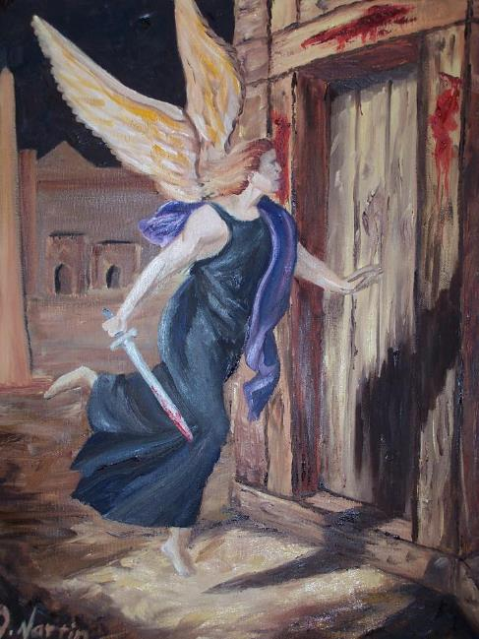
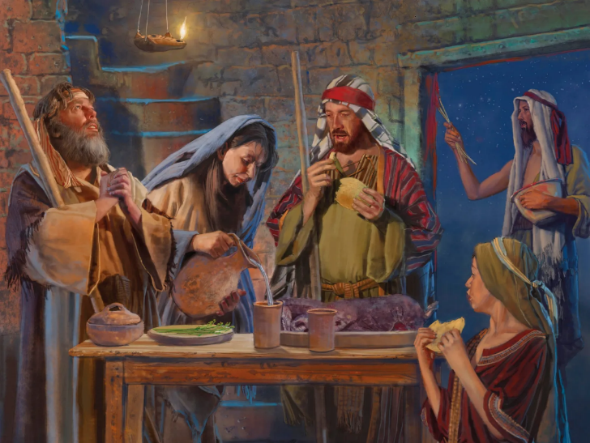
IPHASIKA
Isifundo sesihlanu ilanga lesibili kuNcwabakazi 2025

Slide 2
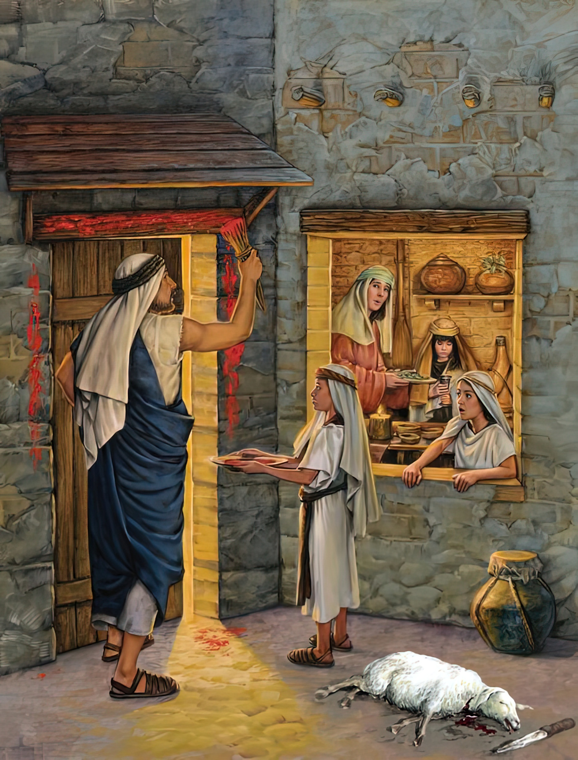
“Kuyakuthi nxa abantwana benu besithi kini, ‘Litshoni ngale inkonzo?’ lithi, ‘Kungumhlatshelo wephasika likaJehova, owadlula phezu kwezindlu zabantwana bakwa-Israyeli eGibhithe lapho etshaya abaseGibhithe futhi ekhulula izindlu zethu.’” Ngakho abantu bagobisa amakhanda abo bakhulekela ’”— Eksodusi 12:26-27

Slide 3

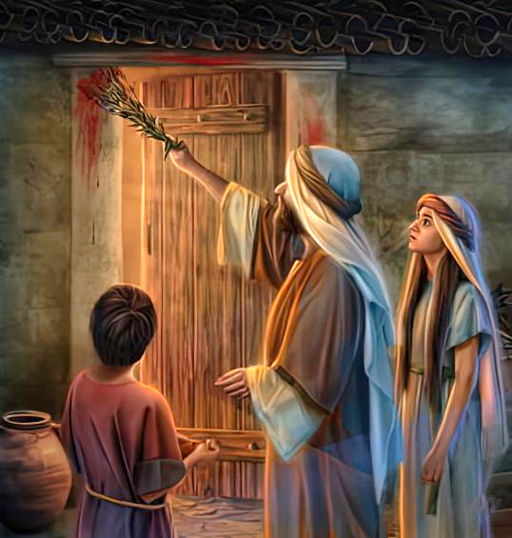
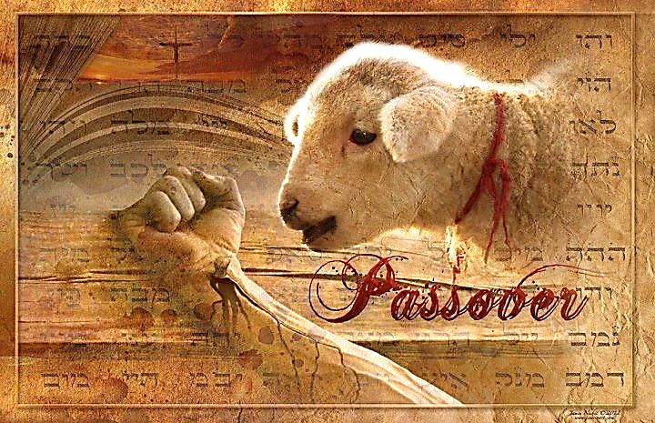
Uhlupho lwetshumi lwahlasela zonke imhuli zaseGibhithe ezazingafuni ukulandela iziqondiso zikaNkulunkulu. Aluzange lufike ngokuphangisa, kodwa lwamenyezelwa kusasele izinsuku ezinengi.
Eqinisweni, kwakuyikuhlolwa kokholo. Akekho owayedinga ukufa ngalobo busuku. Wonke umuntu wayelethuba lokusindisa ukuphila kwezibulo lakhe.
LiWundlu kuphela elalahlwayo. Nguye kuphela owayezakufa. Igazi lakhe kuphela elalizakwenza uMbhubhisi adlule. Kungani? Ngoba NGUKRISTU YEDWA OSISINDISAYO. Futhi lokhu kwakuzakhunjulwa izizukulwane ngezizukulwane… aze afike.
Isixwayiso(Eksodusi 11)
Ukulungiselela(Eksodusi12:1-16)
(Igazi lemvubelo (Eksodusi 12:17-23)
Khumbula Futhi Ufundise (Eksodusi 12:24-28)
Uhlupho lwetshumi (Eksodusi 12:29-30)

Slide 4


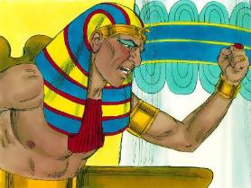
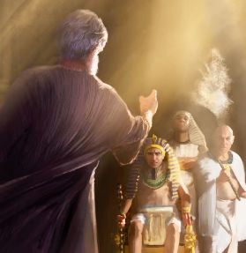
ISIXWAYISO
“UJehova wathi kuMose: “Ngizoletha inhlupheko eyodwa phezu kukaFaro laphezu kweGibhithe. emva kwalokho uzakulivumela ukuba lisuke lapha. Lapho elivumela ukuba lihambe, ngokuqinisekileyo uyonixosha nokunikhipha lapha.’” ( Eksodusi 11:1 , NW.
Ngemva kwezinsuku ezintathu zobunyama, uFaro wamthukuthelela uMose futhi wamalela ukuba abuyele esigodlweni ( Eks. 10:28 ).
Isikhathi sokwahlulela kukaNkulunkulu sesifikile ( (Ex. 12:12):
Kwabaziphakamisayo, abazidlayo labahlukuluzayo: isijeziso, lesibopho sokubuyisela lokho okudlanguliweyo
( Eks. 11:4-5, 2 )
Kulabo abalalela imilayo kaNkulunkulu: ukweqa isijeziso, futhi bakhululwe (Eks. 11:7-8)
Kodwa uMose wayengelakuwulalela lo mlayo, ngoba ukuphila kwezibulo likaFaro kwakusengozini. Endimeni yakhe ‘njengonkulunkulu’ kaFaro ( Eks. 7:1 ), kwadingeka amxwayise ngalokho ayezakwenza ( Amose 3:7 ).
Manje kwakunguMose owasuka phambi kukaFaro ethukuthele. Ethukuthele ngenxa yenkani yakhe kanye lempumela yesinqumo sakhe. Ngaphandle kokumhlonipha uMose, abanengi baseGibhithe bala ukulalela isixwayiso ( Eks. 11:3 ).

Slide 5


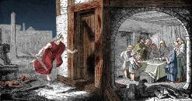
UKULUNGISELELA
“Khulumani kuyo yonke inhlangano yakwa-Israyeli, lithi: ‘Ngolweshumi lwale nyanga yilowo lalowo uyakuzithathela iwundlu ngokwendlu kayise, iwundlu ngendlu.” (Eksodusi 12:3)
UNkulunkulu wakuchaza kabanzi okwakufanele bakwenze ukuze uMbhubhisi “adlule”. (iPhasika, iPhasika), lezibulo lalingayikufa;
Ngosuku lwetshumi kwakufanele babeke eceleni iwundlu elingenasici emhulini ngayinye, loba emhulini ezinengi ( Eks. 12:3-5 ).
Ngomhla ka-14, lapho kuhwalala, kwakumele banikele ngalo ( Eks. 12:6 )
Kwakumele bagcobe izinsika zeminyango lekhothamo ngegazi ( Eks. 12:7
Kwakumelwe badle inyama eyosiweyo ngokupheleleyo, lesinkwa esingelamvubelo lezihlahlana ebabayo ( Eks. 12:8-10
Lapho besidla ngokuphangisa, kwakufanele bagqoke futhi balungele ukuhamba ( Eks. 12:11
Lapho bephuma eGibhithe, kwakufanele baqhubeke besidla isinkwa esingelamvubelo izinsuku eziyisikhombisa ( Eks. 12:15 )
UNkulunkulu walungiselela abantu bakhe ukuba baqondisise umusa Wakhe, futhi bamkhonze (Eks. 12:27b).

Slide 6


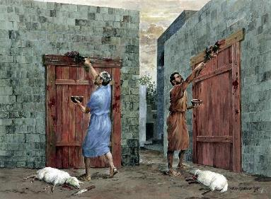
IGAZI LEMVUBELA
“Khona-ke uMose wabiza wonke amadoda amadala akwa-Israyeli, wathi kuwo: “Zithatheleni amawundlu ngokwemhuli zenu, lihlabe iwundlu lePhasika” (Eksodusi 12:21)
Mhla ziyi-14, ingxenye ezimbili zabamba isigaba elibalulekile emcimbini: igazi lemvubelo.
Kwakufanele bakhiphe imvubelo ezindlini zabo bapheke isinkwa ngaphandle kwayo (isinkwa esingelamvubelo). Njengoba ukuhamba kwase kuseduze, babengeke babe lemvubelo phakathi kwezigaba zabo zokuqala ( Eks. 12:17-20 ). Lemvubelo iluphawu lwesono, futhi isinkwa esingelamvubelo singumfanekiso wempilo entsha kuKristu Jesu ( 1 Kor. 5:6-8; 2 Kor. 5:17 ).
Igazi laliyi-mele usindiso. Lalimele igazi likaJesu—awalichitha esiphambanweni—ukuze, ekwaHlulweni, uNkulunkulu “adlule” ukulahlwa kwethu ( 1 Johane 1:7; 2:1-2 ).
Ihisopi okwakufafazwa ngalo igazi ( Eks. 12:22 ) liluphawu lokuhlanzwa kwesono ( IHu. 51:7 ).

Slide 7

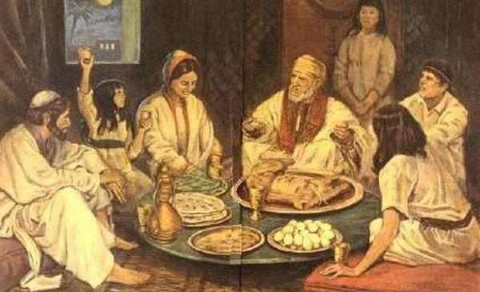
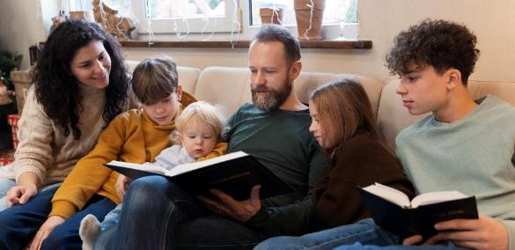
KHUMBULA UFUNDISE
“Woyigcina le nto ibe yisimiso kuwe lakubantwana bakho kuze kube phakade” ( Eksodusi 12:24 )
Ngitsho langaphambi kokuba abakhiphe eGibhithe, uNkulunkulu wafundisa imindeni yamaHeberu ukuba ilondoloze imbali yabo ngokutshela izingane zabo unyaka lonyaka ( Eks. 12:24-27 ).
Kusukela lapho, iPhasika lalizaba ngumkhosi wezimhuli. Ithuba lokuba abazali badlulisele ulwazi ngoNkulunkulu ezinganeni zabo
Indaba yenkululeko kwakufanele ichazwe kabanzi, futhi kumuntu wokuqala (Dt. 26:5-9).
Lokhu kumumethe isifundo esikhethekileyo kakhulu kithi. Kufanele sidlulisele ukholo lwethu ezinganeni zethu. Kumele sibatshele ngalokho uNkulunkulu akwenzileyo, hatshi embalini kuphela, kodwa lasezimpilweni zethu. Kufanele sikhothame phambi kwabo futhi sikhonze (Eks. 12:27).

Slide 8
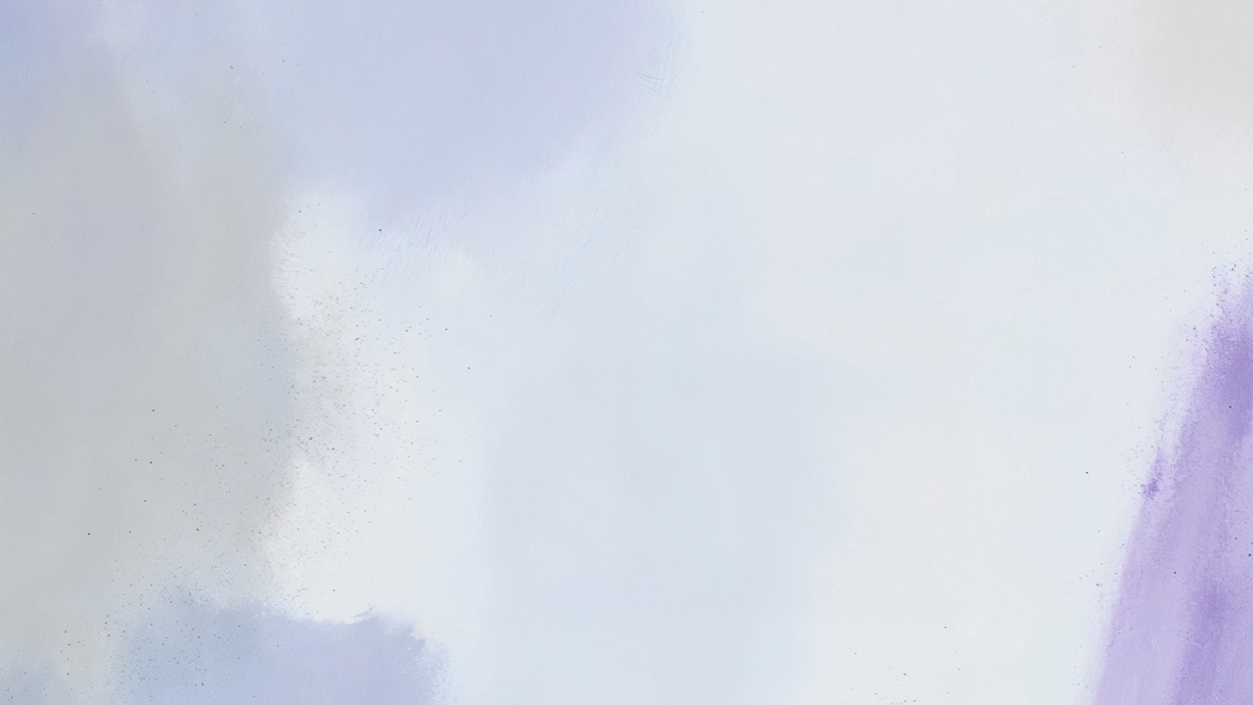

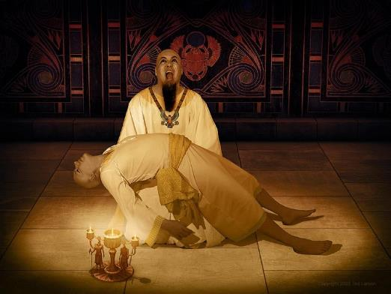
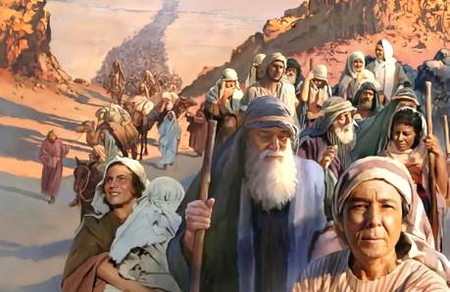
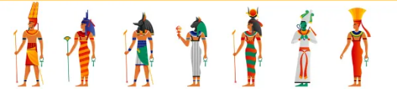
UHLUPHO LWETSHUMI
“Kwathi phakathi kobusuku uJehova wabulala wonke amazibulo ezweni laseGibithe, kusukela kulo izibulo likaFaro owayehlezi esihlalweni sakhe sobukhosi kuze kube izibulo lesibotshwa esasisetilongweni, kanye lawo wonke amazibulo ezinkomo” (Eksodusi 12:29).
UFaro wayefake umlayezo wokuba bonke abafana bamaHeberu babulawe ngaphandle kokukhetha ( Eks. 1:22 ). UNkulunkulu wanquma ukufa okulesinqumo kumazibulo kuphela (Eks. 12:29). Kuzo zonke izindlu lapho igazi lewundlu lingagcotshwanga khona, kwakusifa oyedwa (Eks. 12:30).
Izahlulelo zikaNkulunkulu zase zehlele ngokugcweleyo onkulunkulu baseGibhithe, uFaro wayengumeli wabo ( Eks. 12:12 ).
Akekho unkulunkulu waseGibhithe owaphakamisa isandla sakhe ukuze asize, futhi uFaro wayengelakwenza lutho ukuvimbela le nhlekenhleke..
NjengakuFaro, isono sethu singaba lomphumela omubi kwabanye. Kodwa, njengoMose, ukwethembeka kwethu lokuqina kwethu kungasindisa abaningi.

Slide 9

“Kwadingeka ukuba bazihlukanise labaseGibhithe bona labantwana babo, bababuthele ezindlini zabo, ngoba uma loba nguphi wabakwa-Israyeli wayetholakala ezindlini zabaseGibhithe, uzowa ngesandla sengelosi ebhubhisayo, futhi babelaywe ukuba bagcine umkhosi wephasika njengomthetho, ukuze lapho abantwana babo bebuza ukuthi yayiyini inkonzo enjalo, babatshele lapho ingelosi ibabhubhisa ngokumangalisayo eGibhithe ebusuku. izibulo lomuntu, lezibulo lenyamazana, wadlula phezu kwezindlu zabo, futhi akukho loyedwa kumaHeberu owabulawayo owayelophawu lwegazi ezinsikeni zeminyango yabo […] Bona [abanye baseGibhithe] banxusa ukuba bavunyelwe ukungena ezindlini zama-Israyeli lemindeni yabo, ngalobo busuku obunzima lapho ingelosi kaNkulunkulu kufanele ibulale amazibulo amaGibhithe ayengawakhonzi, futhi ayengenalo onkulunkulu bawo ukubhubhisa ama-Israyeli amukela abaseGibhithe abakholwayo ezindlini zabo”
EGW ( Spiritual Gifts, vol. 3, p. 223)

