Slide 1
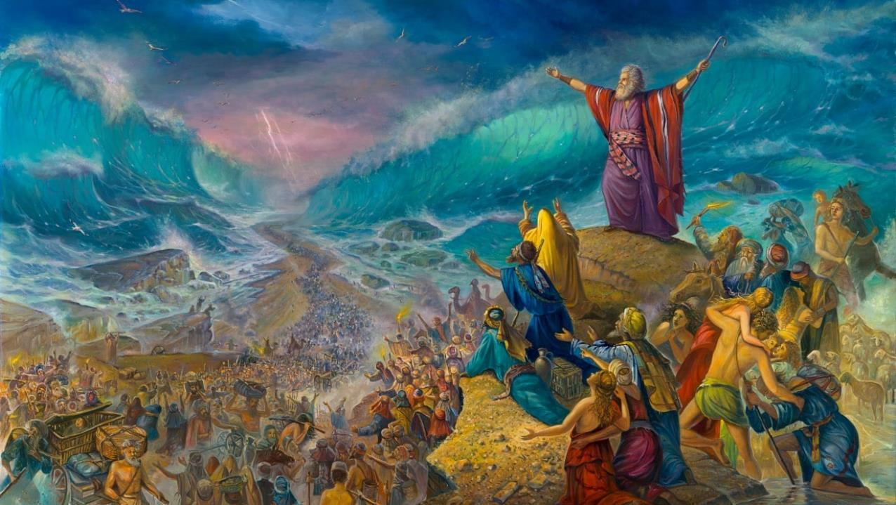
PHAKATHI KOLWANDLE OLUBOMVU
, Isifundo sesithupha kuNcwabakazi ilanga letshiyangalonye ku 2025

Slide 2
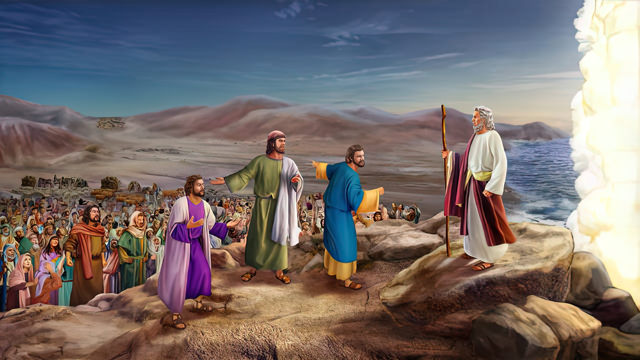
“UMose wathi kubantu: “Lingesabi; yimani, libone ukusindisa kukaJehova azolenzela khona lamuhla, ngokuba abaseGibithe elibabonayo lamuhla alisayikubuye libabone phakade; uJehova uyakulilwela, lina bambani ukuthulakwenu.”— Eksodusi 14:13-14

Slide 3

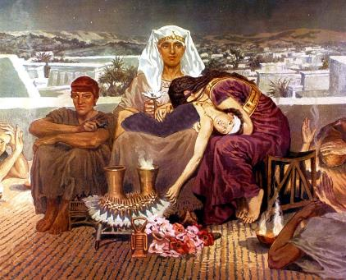
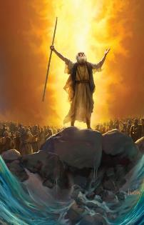
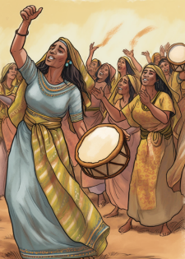



UNkulunkulu wayexwayisile kusukela ekuqaleni ukuthi ukuphuma eGibhithe kwakuzahlanganyela lokufa—loba okungenani ukusongela ngokufa—kulizibulo likaFaro ( Eksodusi 4:22-23 ).
Ukuze avike ukufa kwamazibulo futhi akwazi ukuwakhipha eGibhithe, uNkulunkulu wayebacele isenzo sokholo: Umkhosi wePhasika. Manje, njengoba Wayebaholela ekucineni, kwase kuyisikhathi sokuthatha inyathelo lesibili lokukholwa: ukuya phambili
Ngemva kokuwela uLwandle Olubomvu, ekugcineni ekhululiwe ebugqilini baseGibhithe, u-Israyeli wahlabelela iculo lokudumisa uMkhululi wabo.
Ukuphuma eGibhithe:
  Ngicela uhambe! (Eksodusi 12:31-36)
  Ukungcweliswa Kwamazibulo (Eksodusi13:1-16)
Ukuwela uLwandle Olubomvu:
  Babhajwe Enkangala (Eksodusi 13:17-14:12)
  Indlela olwandle (Eksodusi 14:13-31)
Umkhosi Wokuthokoza:
  Ingoma KaMosi (Eksodusi 15:1-21)

Slide 4
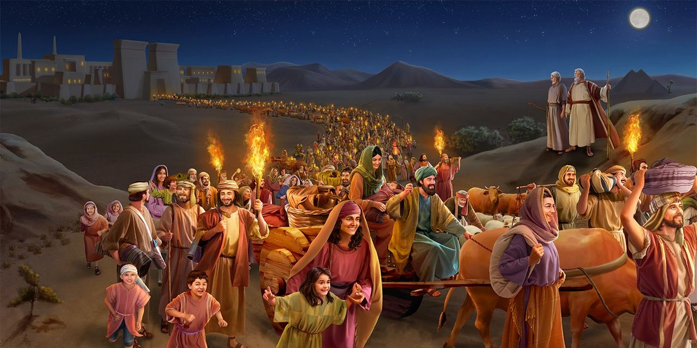
UKUPHUMA EGIBHITHE

Slide 5


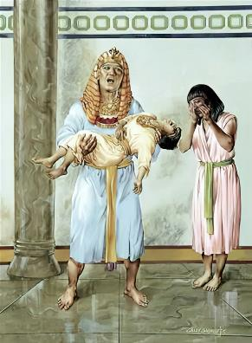
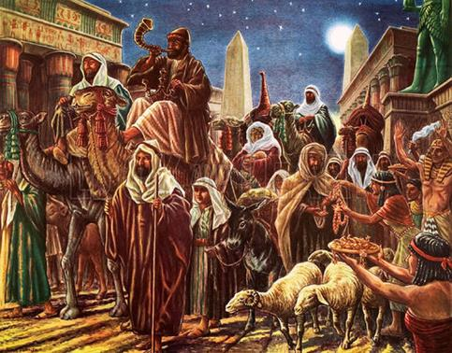
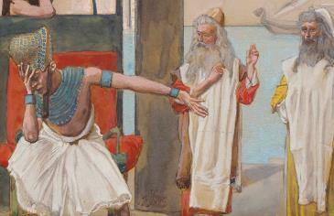
NGICELA UHAMBE!
“AbaseGibithe banxusa abantu ukuba baphangise basuke ezweni,: “Ngokuba kungenjalo, siyakufa sonke.” ( Eksodusi 12:33 )
Lonke iGibhithe laliyincithakalo, “ngokuba kwakungekho ndlu lapho kwakungekho ofileyo” ( Eks. 12:30 ). Imvumo kaFaro yokuba u-Israyeli ahambe yeza sokuphuze kakhulu
Ngenkulumo ethi “ngibusise lami” ( Eks. 12:32 ), uFaro waveza imizwa yabo bonke abantu bakhe: ngicelasingehlelwa lutho futhi!
Kwakungekhona ukubonakaliswa kokuzisola ngobuqotho ngesono sakhe, kodwa kwakuyisifiso sokuba lomonakalo ume.
Kuthe u-Israyeli efuna inkokhelo ngeminyaka yokusebenza kwawo, abaseGibhithe “babanika konke ababekucela” ( Eks. 12:36 ). Ngale ndlela, uNkulunkulu waqinisekisa ukuthi izibulo Lakhe lalizophuma liphephile eGibhithe—futhi izandla ligcwele.

Slide 6

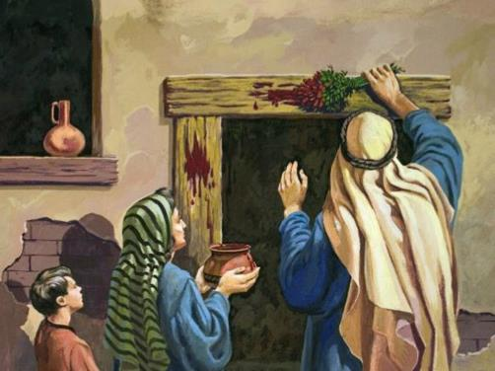
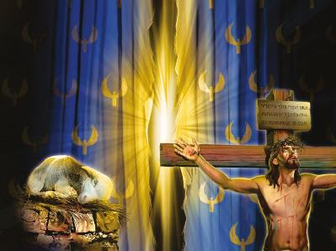

UKUNGCWELISWA KWAMAZIBULO
“Ngcwelisa wonke amazibulo esilisa, izibulo ngalinye laso sonke isibeletho phakathi kwabantwana bakwa-Israyeli lingelami, kungakhathalekile ukuthi umuntu loba inyamazana. ( Eksodusi 13:2 )
Ayengcweliswa njani amazibulo?
Bangcweliswa ngokufa. Wonke amazibulo kwakufanele afe. Kodwa kwase kusenziwa ilungiselelo lokuthatha indawo yezibulo, ukuze kufe esinye isidalwa esikhundleni sawo.
Nanzelela ubudlelwano:: U-Israyeli ulizibulo likaNkulunkulu ( Eks. 4:22 ); iBandla lalamuhla lingu-Israyeli wakomoya ( Gal. 6:16 ); ngakho-ke, sonke kufanele sife ukuze singcweliswe kuNkulunkulu; kodwa kukhona uMuntu owafa endaweni yethu.
UJesu, “liWundlu likaNkulunkulu” ( Johane 1:29 ) wafa ukuze loba ngubani ogcoba igazi lakhe emnyango wenhliziyo yakhe angafi kodwa abe lokuPHILA OKUPHAKADE
UNkulunkulu useyenzile kakade ingxenye yakhe. Kungumthwalo wethu ukuzivumela ukuba simbozwe ngegazi lakhe elihlengayo

Slide 7
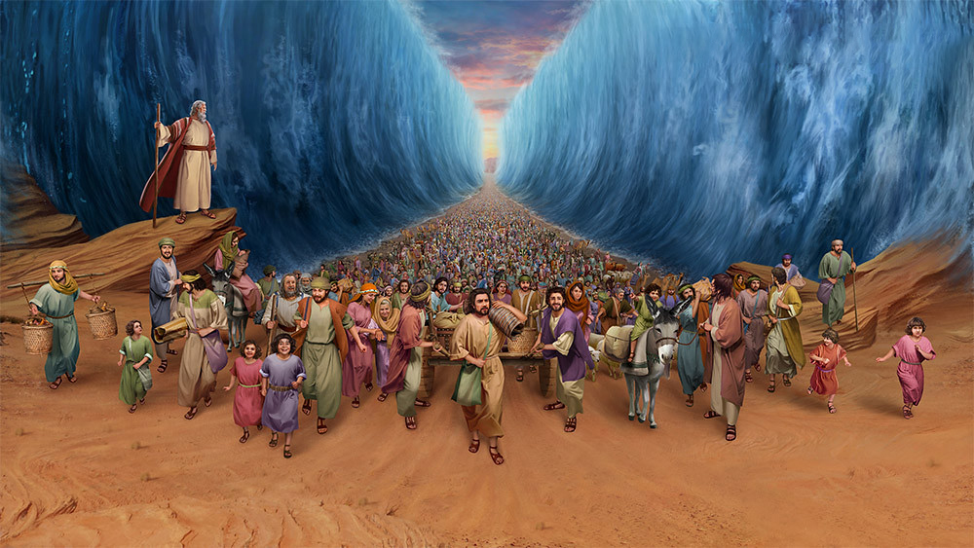
UKUWELA ULWANDLE OLUBOMVU

Slide 8


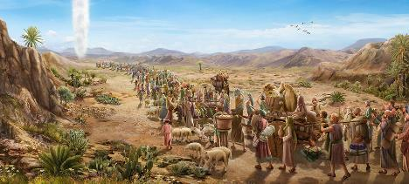
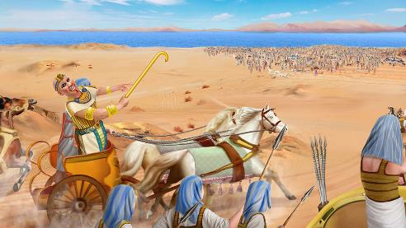
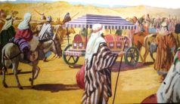
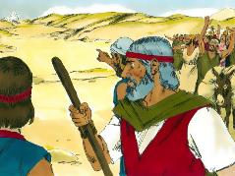
BAVINJELWA ENKANGALA
“UFaro uzacabanga ukuthi, ‘Abantwana bakwa-Israyeli bayazulazula ezweni bedidekile, bevinjezelwe enkangala. ( Eksodusi 14:3 )
Ngemvumo kaFaro, uIsrayeli waphuma “elungele ukulwa” ( Eks. 13:18 NIV). Kodwa uNkulunkulu wayengafuni ukuthi babhekane lezimpi, ngakho wabaholela nxazonke (Eks. 13:17).
Ngaleso sikhathi, uFaro wazisola ngokuphenduka kwakhe futhi walandela u-Israyeli ( Eks. 14:5 ). U-Israyeli manje wayesevaleleke enhlane, engelandlela yokuphunyuka ( Eks. 14:2-3, 9 ).
Njengesenzo sokholo, babehambe lebhokisi letshe likaJosefa (Eks. 13:19). Ngaphezu kwalokho, uNkulunkulu wayebahola ngendlela eyisimangaliso ( Eks. 13:21 ).
Ngalokho, lapho bebona ibutho likaFaro, ukholo lwabo lwawohloka ngokupheleleyo. ( Eks. 14:10-12 ). Batshetsha bakhohlwa izimangaliso ababezenzilwe! Kambe lokhu kungenzeka lakithi?
“Remember the wonders he has done” (1 Chr. 16:12)

Slide 9

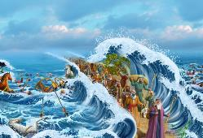
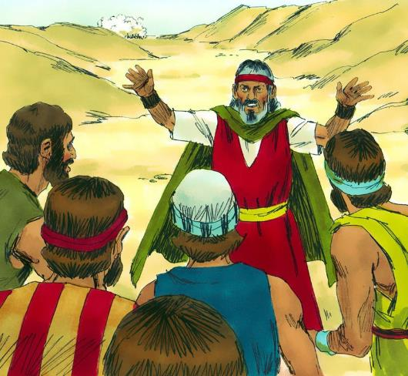
INDLELA OLWANDLE
“UMose wathi kubantu: “Lingesabi; yimani, libone ukusindisa kukaJehova azolenzela khona lamuhla, ngokuba abaseGibithe elibabonayo lamuhla alisayikubuye libabone phakade; uJehova uyakulilwela, lina bambani ukuthulakwenu.”— Eksodusi 14:13-14
Ngenxa yokungabi lokholo kwabantu, uMose wabakhuthaza ukuba bathembele kuNkulunkulu ( Eks. 14:13-14 ):
"Lingesabi"
Inyathelo lakuqala lokuzuza ukunqoba yikuthembela kuNkulunkulu
“Yimani liqine”
Kufanele sihlale ngesineke emsebenzini wethu, ngaphandle kokungunguna.
“Bona insindiso”
Uma sivumela uNkulunkulu asiqondise, siyonqoba lakanjani.
“UJehova uzolilwela”
UNkulunkulu usilwela ngokumelana loSathane futhi isono. I-Calvary iyibufakazi obukhulu kakhulu balokhu.

Slide 10

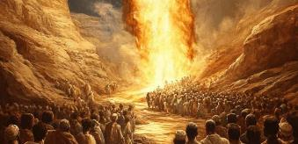
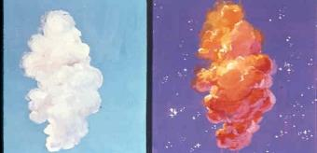
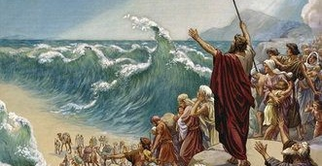
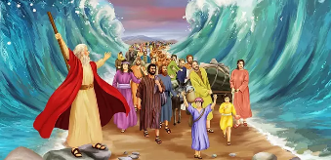
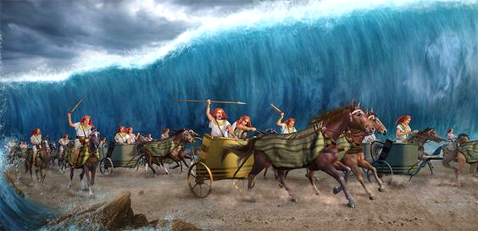
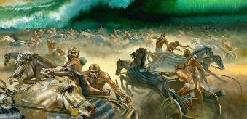
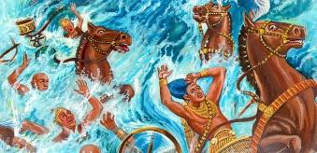
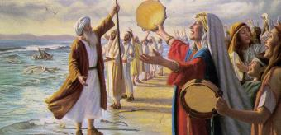
INDLELA OLWANDLE
UNkulunkulu wanika abantu umlayo owodwa kuphela: “hambani phambili” (Eks. 14:15). Kusukela ngalomzuzu, kwaqala okungalindelwanga (Eks. 14:19-31):
Ingelosi kaNkulunkulu lensika yefu kwakumi phakathi kwekhempu ka-Israyeli lempi yabaseGibhithe
Ebusuku, insika yayiwubumnyama kwabaseGibhithe, lokukhanya kuma-Israyeli
UMose waphakamisa intonga yakhe futhi ulwandle lwahlukana ukuze u-Israyeli awele emhlabathini owomileyo
U-Israyeli wangena olwandle, amanzi enjengezindonga ngakwesokunene langakwesobunxele
AbaseGibhithe labo bangena olwandle
Ekuseni, uNkulunkulu wacasula abaseGibhithe
Njengoba bezama ukubuyela emuva, ulwandle lwabuyela endleleni yalo, lwabhubhisa lonke ibutho.
Okhunjini lolwandle, u-Israyeli wabona ukunqoba, futhi bakholwa kuNkulunkulu lakuMose

Slide 11
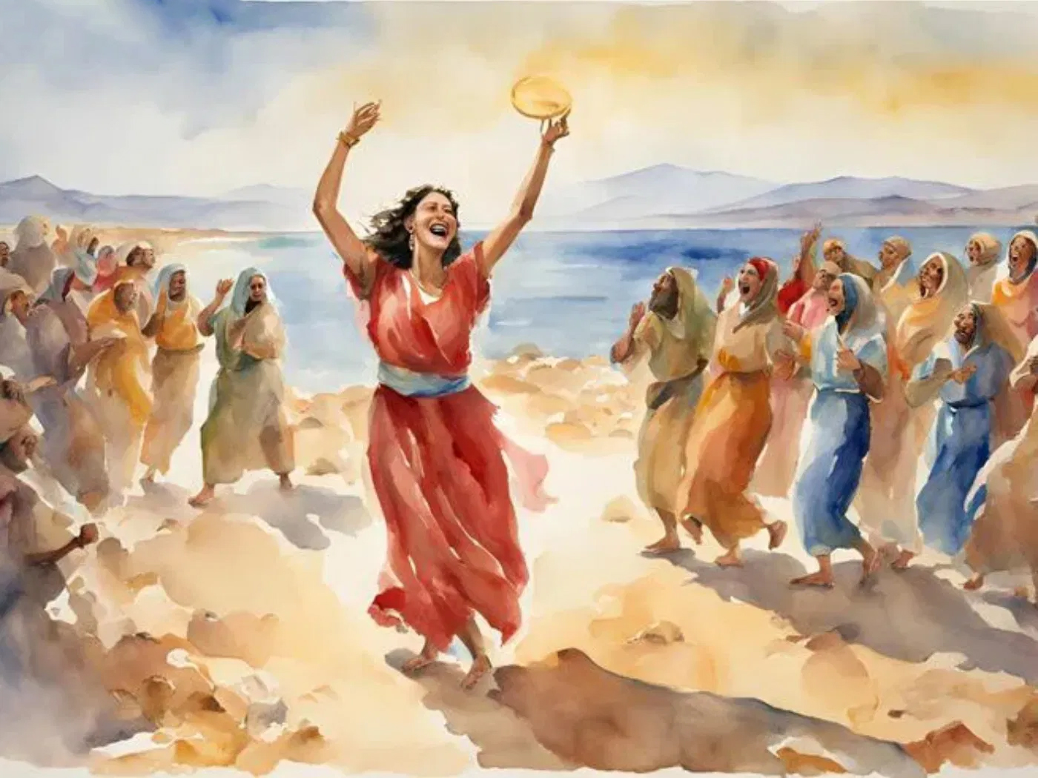
UMKHOSI WOKUTHOKOZA

Slide 12


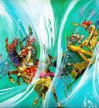
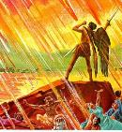
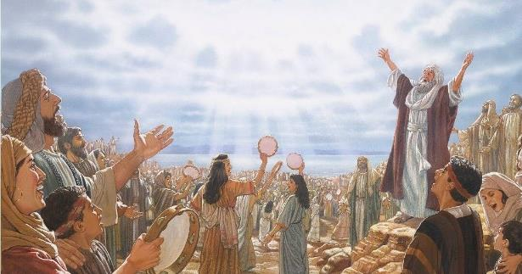
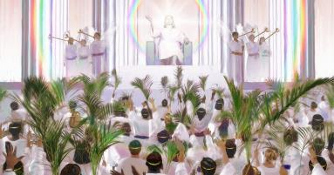
INGOMA KAMOSI
“Futhi bahlabelela ingoma kaMose inceku kaNkulunkulu leyeWundlu: “Mikhulu futhi iyamangalisa imisebenzi yenu. INkosi uNkulunkulu uMninimandla onke. Zilungile futhi ziliqiniso izindlela zakho, Nkosi yezizwe” (IsAmbulo 15:3).
Ebona okwakwenzekile, uMose uhola u-Israyeli ngengoma yokudumisa, kuyilapho uMiriyamu esabela ngeqembu labahlabeleli kanye labesifazane ( Eks. 15:1, 20-21 ).
Kule ngoma, akutshiwo lutho ngalokho u-Israyeli akwenzileyo. Aligcini ngokudumisa uNkulunkulu ngokubhubhisa isitha ( Eks. 15:6 ), kodwa futhi linconywa ngemisebenzi yalo ( Eks. 15:11 ). Ukusabela kwalabo abezwa lokho okwenzekileyo kuyamenyezelwa (Eks. 15:14).
Ngaphezu kwalokho, kumenyezelwa lokho uNkulunkulu asazokwenza: “Uyakubaletha ubatshale entabeni yefa lakho” (Eks. 15:17).
Lapho izahlulelo zikaNkulunkulu sezibonakalisiwe, futhi ububi lokucindezela sekuqediwe, abahlengiweyo bezizwe bazamdumisa ngalezo zahlulelo ezilungileyo, behlabelela iculo likaMose leleWundlu ( IsAm. 15:3 ).

Slide 13

“Ekukhululeni imiphefumulo yethu ebugqilini besono, uNkulunkulu usenzele ukukhululwa okukhulu kulokwamaHeberu oLwandle Olubomvu.” Njengebutho lamaHeberu, kufanele sidumise uJehova ngenhliziyo langomphefumulo langokuhlabelela ‘ngemisebenzi Yakhe emangalisayo kubantwana babantu. Labo abahlezi phezu komusa kaNkulunkulu omkhulu, futhi abangazinakanga izipho zaKhe ezincane, bazibhinca ibhanti lenjabulo futhi bahubele uJehova ezinhliziyweni zabo Izibusiso zansuku zonke esizithola esandleni sikaNkulunkulu, futhi ngaphezu kwakho konke ukufa kukaJesu ukuze kulethe injabulo lezulu esingakwazi ukulifinyelela, kufanele kube isihloko sokubonga njalo.”
EGW (Conflict and Courage, March 28)

