Slide 1
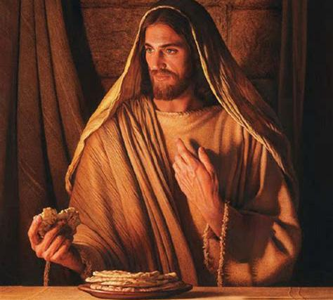
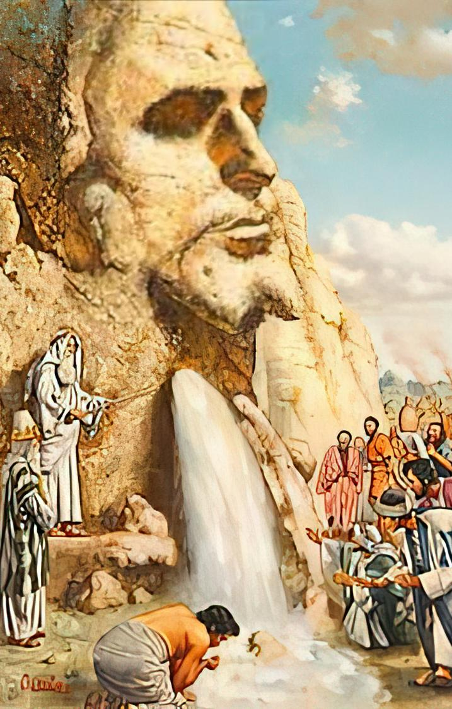
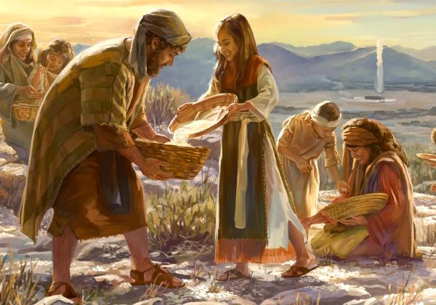
ISINKWA
LA MANZI OKUPHILA
Isifundo sesikhombisa ilanga lestshumi lesithupha kuNcwabakazi 2025

Slide 2
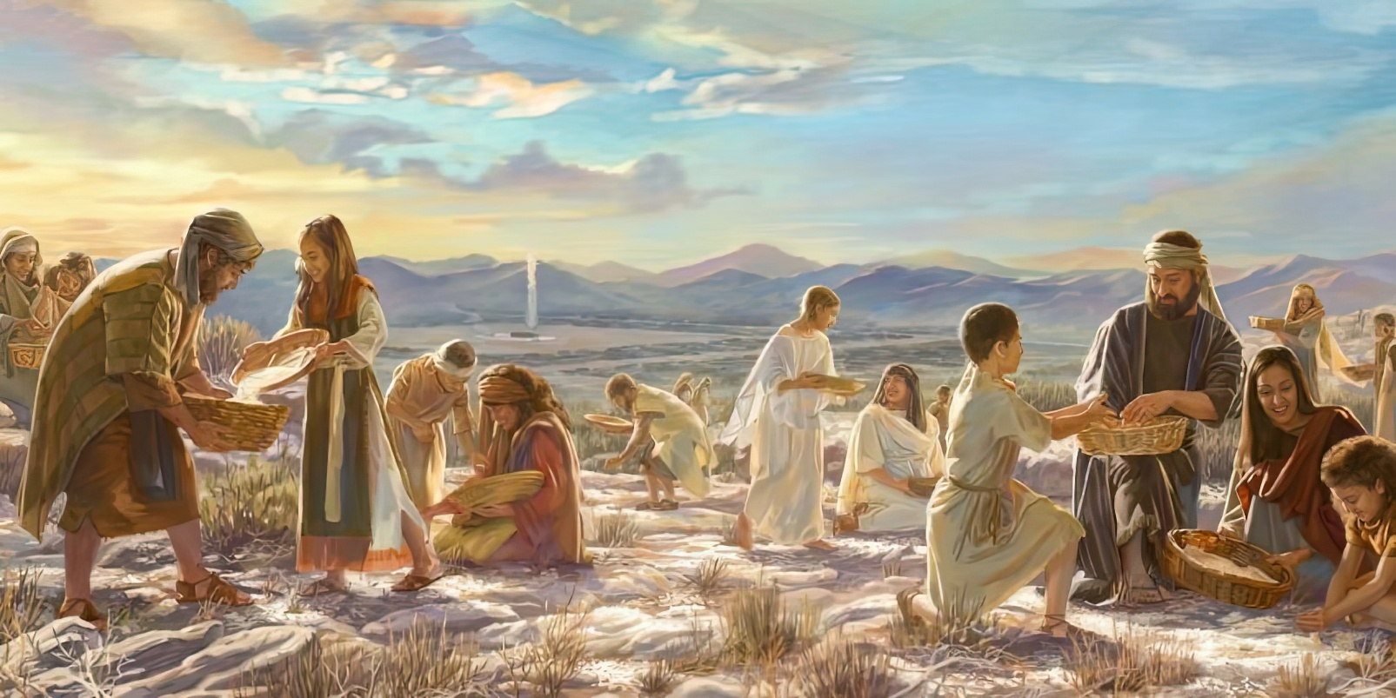

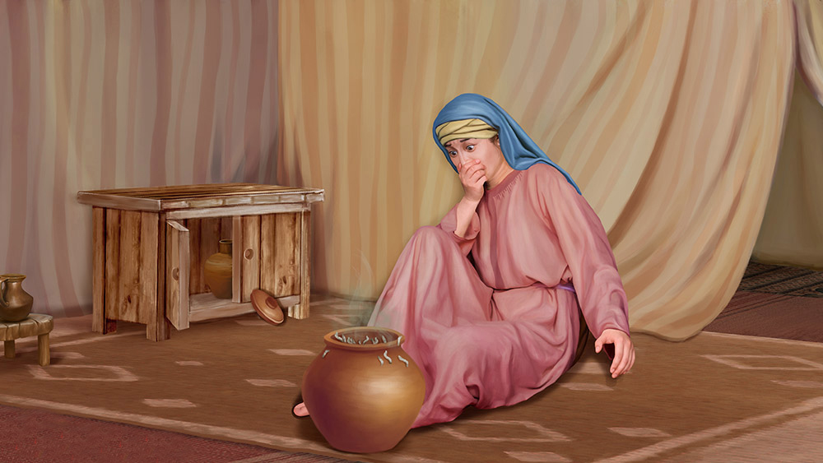
“UJehova wathi kuMose: “Koze kube nini lisala ukugcina imiyalo yami lemithetho yami na? Bhekani, ngokuba uJehova ulinikile isabatha; ngalokho uyalinika ngosuku lwesithupha isinkwa sezinsuku ezimbili; yilowo lalowo makahlale endaweni yakhe, kungaphumi muntu endaweni yakhe ngosuku lwesikhombisa.” Baphumula-ke abantu ngosuku lwesikhombisa. Eksodusi 16:28-30

Slide 3

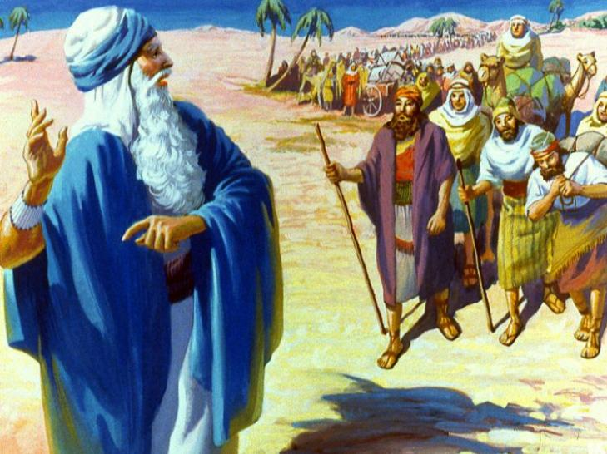
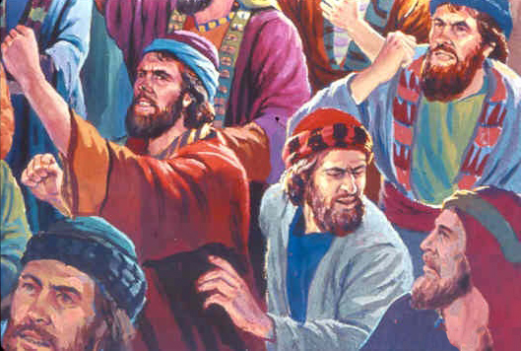
Ekugcineni base bewele umngcele waseGibhithe. Ekucineni base besendleleni eya eKhanani, izwe eligeleza uchago loluju.
Izinsuku ezintathu, yonke into yayibonakala iphelele. Kodwa izimpahla ababenazo zase ziphela. Babezokondla kanjani abantu abayizigidi ezimbili enkangala?
Lapho kuqala izimpawu zenkathazo, abantu baqala ukukhonona. Babengancamela ukufela eGibhithe! Ngokusobala, ukholo lwabo kwakudingeka lukhule futhi luqiniswe. Ngakho uNkulunkulu wabapha amanzi lesinkwa; wabavikela ezitheni zabo; futhi wabasiza ukuhlela..
Amanzi ahlanzekileyo (Eksodusi 15:22-27)
Isinkwa saseZulwini (Eksodusi 16:1-36)
Idwala laseHorebe (Eksodusi 17:1-7)
Izandla eziphakanyisiweyo (Eksodusi 17:8-16)
Iseluleko esihle (Eksodusi 18:1-27)
Isinkwa lamanzi okuphila: UJesu

Slide 4

“Okuhlangenwe lakho okuhlukahlukeneyo kwamaHeberu kwakuyisikole sokulungiselela ikhaya labo elithenjisiwe eKhanani.” UNkulunkulu wayezafuna abantu baKhe ngalezinsuku babuhlolisise ngenhliziyo ethobekileyo langomoya ofundisekayo ukulingwa uIsrayeli wasendulo adlula kukho, ukuze bafundiswe ekulungiseleleni kwabo iKhanani lasezulwini.
EGW (Patriarchs and Prophets, p. 293)

Slide 5


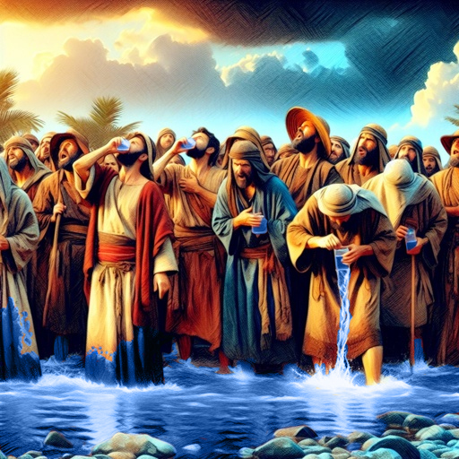
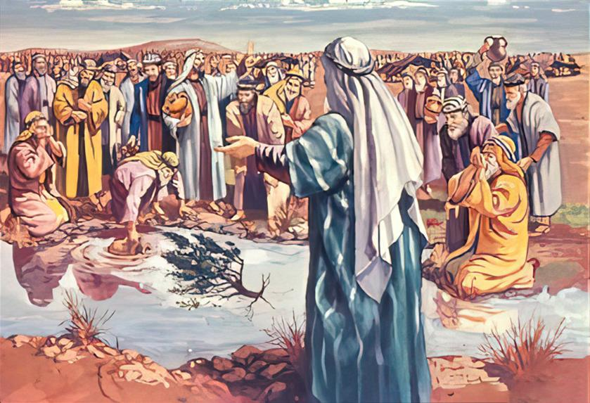
AMANZI AHLANZIWEYO
“Bathe befika eMara, abazange bawanathe amanzi akhona, ngoba ayebaba.” ( Eksodusi 15:23 ) Ngakho indawo leyo yabizwa ngokuthi iMara.
Uma uNkulunkulu elathi, kuyini okubi engenzeka kithi? Lokhu kwabonakala kuyilwazi ylwbantu bakwa-Israyeli ngemva kokuwela uLwandle Olubomvu.
Kuthe bethola amanzi engahlambululekie ukuba bawanathe, bakhonona, “Sizanathani?” ( Eks. 15:24 ). UNkulunkulu wayengawahlanza amanzi bengaka fiki, kodwa walinda isikhathi esifaneleyo.
Waphinde wacela uMose ukuba amsize ekwenzeni lesi simangaliso, emcela ukuba aphose ihlahla ukuze ahlanze amanzi. (Eks.15:25
UNkulunkulu ufuna ukuba siqaphele ubukhona Bakhe, silindele imiyalo Yakhe, futhi sibambisane Laye
Uma ama-Israyeli agcwalisa izimfuneko zikaNkulunkulu, elalela imithetho uNkulunkulu ayemnike yona, ayezaba lesiqiniseko sokuthi ayeyovikeleka ebubini ( Eks. 15:26 ).

Slide 6


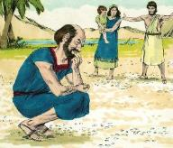
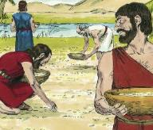
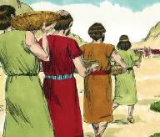
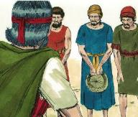
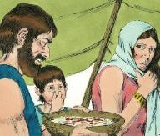
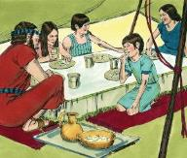
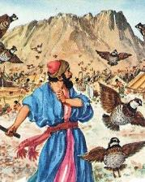
ISINKWA ESIVELA EZULWINI
“Kuthe ama-Israyeli ekubona, athi omunye komunye: “Kuyini lokhu?” Ngoba babengazi ukuthi kuyini. UMose wathi kubo: “Yisinkwa uJehova alinike sona ukuba lisidle” (Eksodusi 16:15).
Isifiso sokudla inyama sabangela u-Israyeli ukuba akhonone ngoMose lo-Aroni ( Eks. 16:2-3 ). Kodwa ukukhonona kwabo kwakuphambene loNkulunkulu uqobo Lwakhe (Eks. 16:8). Kwakuyini uhlupho lwabo?
Lesi sinkwa sezulwini sasiyisimangaliso ngempela:
Bakhohlwa okwedluleyo
Bagxila ebunzimeni bamanje
Balahlekelwa yikusasa elithenjisiwe
Lapho ilanga liphuma, sasincibilika
(Ex . 16:21)
Inani elifanayo lalisiwa insuku ezinhlanu (Ex. 16:16)
Ngelanga lesithuphakwakusiwa okuphindwe kabili
(Ex. 16:22)
Ngemva kokubapha izagwaca ukuba badle, uNkulunkulu wabapha isinkwa esaneleyo ukuba badle nsuku zonke… iminyaka engu-40!
( Eks. 16:35 )
NgeSabatha akukho lutho olwalusiwa (
(Ex. 16:26)
Ngosuku olulodwa kusiya kolunye kwakugcwele impethu (Ex. 16:20)
Kusuka ngolwesihlanu kusiya ngesabatha kwakungnakali (Ex. 16:23-24)

Slide 7


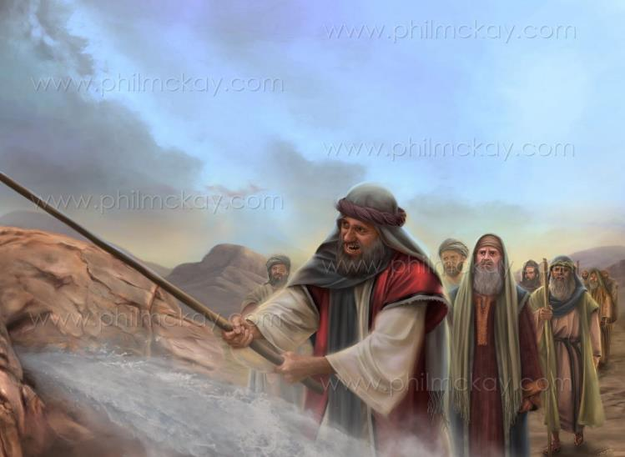
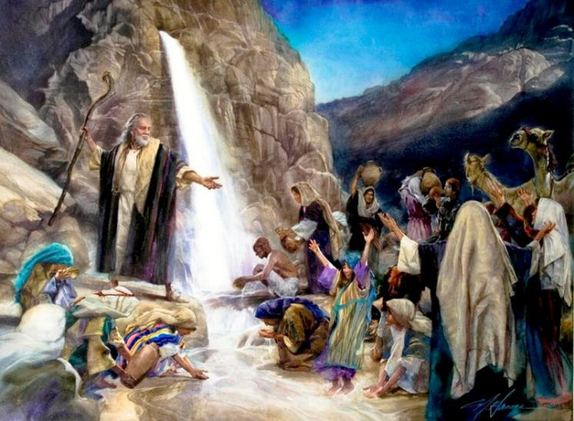
ITSHE LASEHOREB
“Ngizakuma lapho phambi kwakho elitsheni laseHorebe, Tshaya idwala, kuphume amanzi kulo, abantu banathe. Wakwenza-ke lokho uMose emehlweni abadala bakwa-Israyeli.”— Eksodusi 17:6;
“Ujehova engabe ephakathi kwethu loba akekho na?” (Funda ukuthi: 17:7.) Unkulunkulu kazange abakuthumele isinkwa sezulwini nsuku zonke na? Abazange bakubone eyezini?
Ukungakholwa okwaboniswa ngu-Israel kuyamangalisa. Kodwa uPawuli uyaxwayisa ukuba singaweli esibonelweni sokungakholwa (Heb. 3:12).
Ngaphezu kokungakholwa kwabo, uJesu wadabula idwala futhi wabanikeza amanzi kulo lonke uhambo lwabo. “Ulidwala lomoya elibalandelayo” ( 1 Kor. 10:4 ).
Kubo, ngokuphathelene lathi, uKristu unguMthombo wokuphila loMniki wokuphila okuphakade.

Slide 8

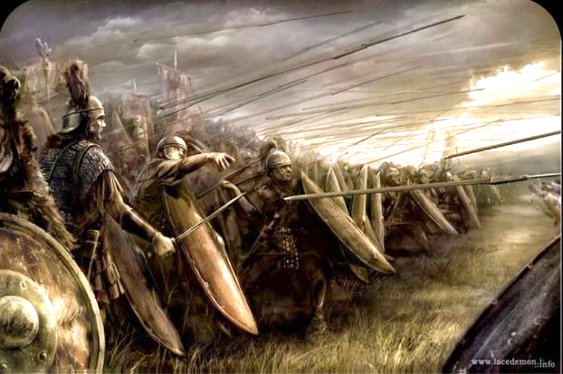
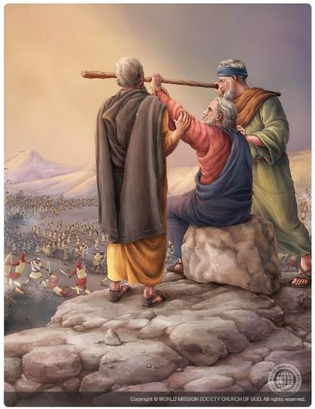
IZANDLA EZIPHAKAMILEYO
“Ama-Amaleki eza, ahlasela ama-Israyeli eRefidimi” (Eksodusi 17:8)
Njengoba edlula enkangala, ama-Amaleki ahlasela u-Israyeli, futhi uMose wacela uJoshuwa ukuba awavikele kuyilapho yena, u-Aroni, loHure bekhuphukela entabeni “ngenduku kaNkulunkulu” ( Eks. 17:8-10
Kungani ama-Amaleki ahlasela?
Babezwile ngalokho uNkulunkulu ayekwenzile eGibhithe. Kodwa, ngokungafani lamanye amaKhanani, ayengesabi. Baklolodela uNkulunkulu futhi bamdelela ngokuhlasela abantu Bakhe, ukuze nje babonise ukuthi balamandla kulaye. ( Eks. 17:16 ).
Uma nje uMose ephakamisa induku kaNkulunkulu, u-Israyeli wayenqoba. Kodwa lapho izingalo zakhe sezikhathele, u-Israyeli wasehlulwa. ( Eks. 17:11 ).
Kwase kufike isikhathi sokuthi kube lomthwalo onzima kwabanye abaholi. U-Aroni loHure basekela uMose futhi bamsiza ukuba enze umsebenzi kaNkulunkulu uphumelele, ngaleyo ndlela banqoba isitha ( Eks. 17:12 ).

Slide 9


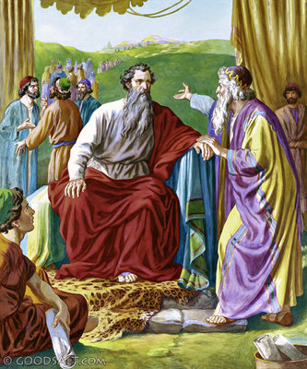
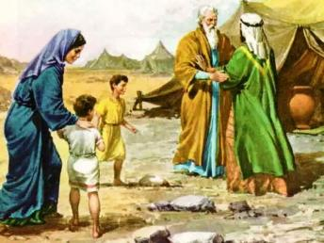
ISELULEKO ESIHLE
“Kepha khetha amadoda anelisayo kubantu bonke, amadoda amesabayo uNkulunkulu, amadoda athembekileyo azonda inzuzo embi, uwamise abe yizikhulu zezinkulungwane, lezamakhulu, lezamatshumi ayisihlanu, lezamatshumi. ( Eksodusi 18:21 )
Ebona isibonakaliso uNkulunkulu ayesimemezele kuMose, uJetiro, kanye loZipora lamadodana akhe, bahamba bayambona eHorebe ( Eks. 3:12; 18:1-5 ).
UJetiro, ngokuba wayengasi mIsrayeli, wayekhonza uNkulunkulu. Ngakho-ke, ngemva kokuthola umbiko kaMose ngalokho okwenzeka eGibhithe, wadumisa uNkulunkulu futhi wamenzela imihlatshelo ( Eks. 18:8-12 ).
Ngosuku olulandelayo, ngemva kokubuka uMose ehlulela abantu bonke yedwa, wamnika iseluleko esihlakaniphileyo: ukwabelana ngemithwalo yemfanelo ( Eks. 18:17-23 ).
Ngokuthobeka uMose wawavuma amazwi kaNkulunkulu kulesi seluleko. Ngakho-ke, wasilalela iseluleko sikayisezala futhi wakhetha abantu abakwazi ukuthwala imithwalo yemfanelo.
Izici zayo (Eks. 18:21):
Hlonipha uNkulunkulu
Thembeka
Zonda ukuthenga imfanelo

Slide 10


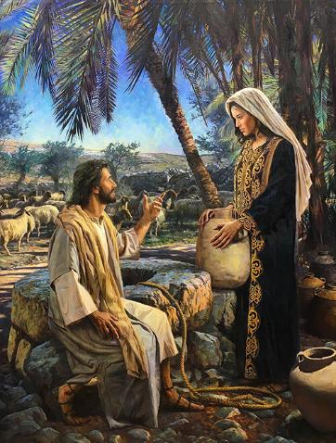
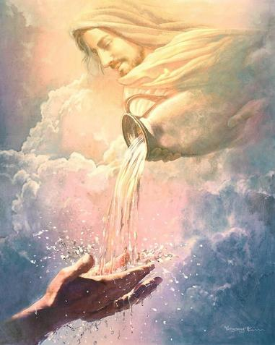
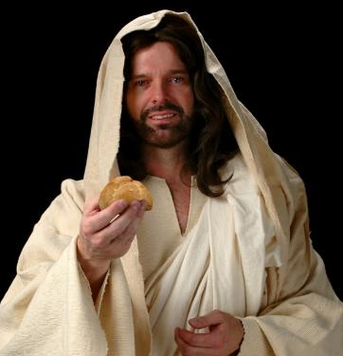
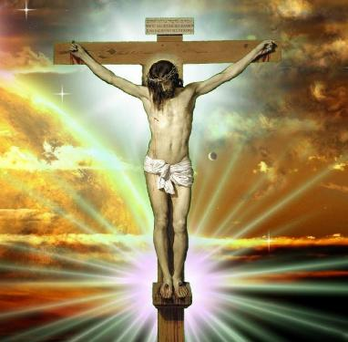
ISINKWA LAMANZI OKUPHILA: UJESU
“Mina ngiyisinkwa esiphilayo esehle ezulwini, odla lesi sinkwa uyakuphila phakade, lesi sinkwa siyinyama yami engizayinikela ukuphila kwezwe” ( Johane 6:51 )
UPawulu usitshela ukuthi izindaba zika-Eksodusi zalotshelwa ukufundisa thina, okuyikuthi, zisebenza ngokomoya ezimpilweni zethu (1 Kor. 10:1-11).
Lezi zindaba zisixwayisa ngokuhwaba; ukukhonza izithombe; ubufebe; ukulinga uNkulunkulu; kanye lokunyeya.
Ngaphezu kwalokho, uJesu wabhekisela kuye ngokukhethekileyo izindaba zamanzi edwala lesinkwa esivela ezulwini
Nguye onika amanzi okuphila, afanekisela uMoya oNgcwele (Joh. 4:14; 7:37-39). Nguye kuphela olokwanelisa ukoma kwethu kwangaphakathi ukuthula, injabulo lentokozo.
UJesu wathi uyisinkwa seqiniso esehla ezulwini. Leso sinkwa siyinyama Yakhe (Johane 6:51). Ngumzimba Wakhe, owahlephulwa esiphambanweni ukuze ulethe insindiso kubo bonke “abazakudla”—okuyikuthi, ukumamukela njengoMsindisi futhi babe lobuhlobo bansuku zonke Laye. UKristu kuphela onganelisa ukoma lokulamba kwethu okungokomoya

Slide 11

“UMhlengi womhlaba uyazazi izidingo zawo wonke umphefumulo, lapho sicindezelwa futhi sidangele, uyakwazi, futhi nguye osinika ukuqabula kwakomoya.
Imithombo yomhlaba ngokuvamileyo izatshiywa ingelalutho, lamachibi awo ome; kodwa kuKristu kukhona umthombo ophilayo esingawudonsa njalonjalo. Kungakhathalekile ukuthi sidonsa futhi sibapha kangakanani abanye, inala izasala. Ayikho ingozi yokuqeda ukunikezwa; ngokuba uKristu ungumthombo weqiniso ongatshiyo
EGW (The Signs of the Times, April 22, 1897)

