Slide 1

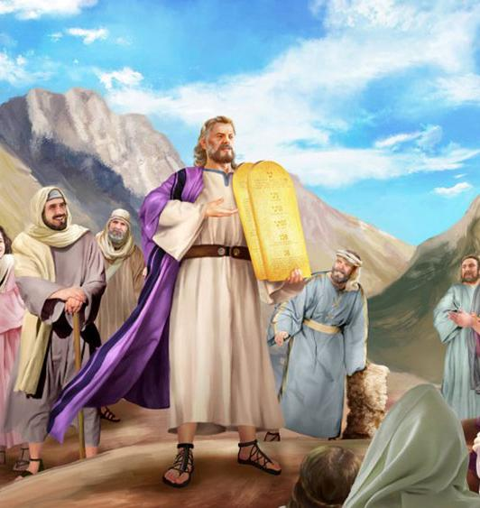
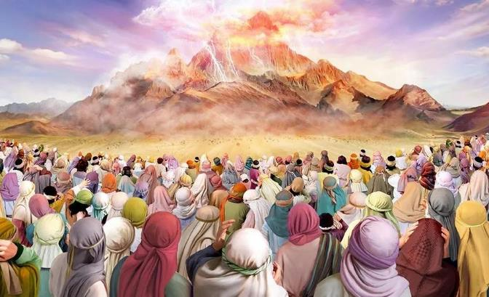
ISIVUMELWANO ESINAI
Isifundo setshiyangalombili kuNcwabakazi ilanga lamatshumi amabili lantathu ku2025

Slide 2
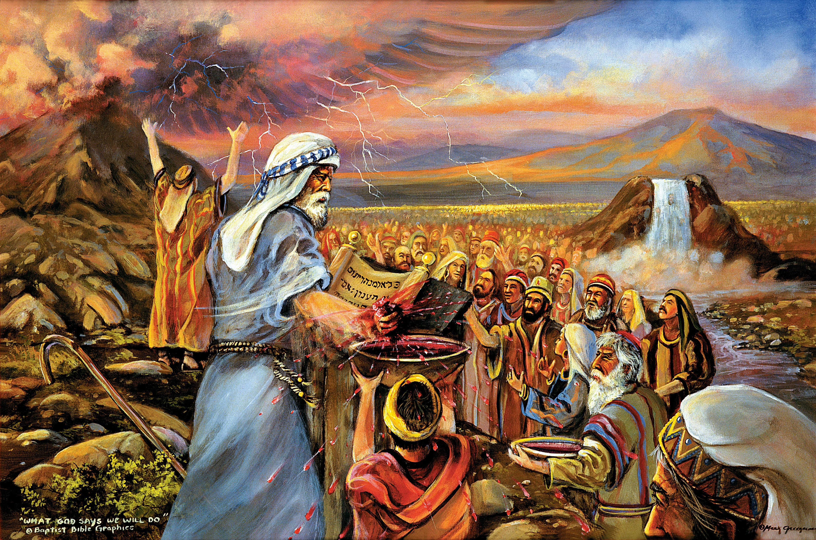
““Likubonile engikwenzileyo kwabaseGibithe, lokuthi ngalithwala ngamaphiko okhozi, ngaliletha kimi; manje uma ngempela lilalela izwi lami, ligcine lesivumelwano sami, liyakuba-yingcebo kimi phakathi kwezizwe zonke, ngokuba umhlaba wonke ungowami; liyakuba-ngumbuso wabapristi lesizwe esingcwele kimi.”—Eksodusi 19:4-4.”

Slide 3

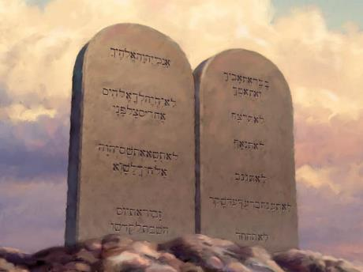
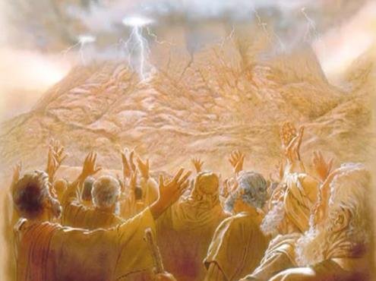








Ukuwela uLwandle Olubomvu kwakulibanga elimqoka ku-Israyeli. Isenzakalo sesibili esasilibanga elimqoka sasiyikumenyezelwa koMthetho ngomlomo kaNkulunkulu ngokwakhe.
Ngaleso sikhathi, u-Israyeli wazalwa eyisizwe esingcwele. Yathola imithetho eyayizobusa ukuba khona kwayo
Kodwa kwakungaphezu nje kwemithetho yenkolo, yomphakathi, loba yezempilo. Imithetho Elitshumi, yisisekelo sayo yonke le mithetho, ingumfanekiso wesimilo sikaNkulunkulu, ngakho-ke, ayisebenzi ku-Israyeli kuphela, kodwa lakuwo wonke umntwana kaNkulunkulu.
Ukwethulwa koMthetho:
  Abamukeli boMthetho (Eksodusi 19:1-8)
  Umuphi-womthetho ( Eksodusi 19:9-25 )
  Imithetho Elitshumi ( Eksodusi 20:1-17 )
Incazelo yoMthetho:
  Umsebenzi woMthetho.
  UMthetho njengesithembiso.
  Umthetho njengesiphetho.

Slide 4

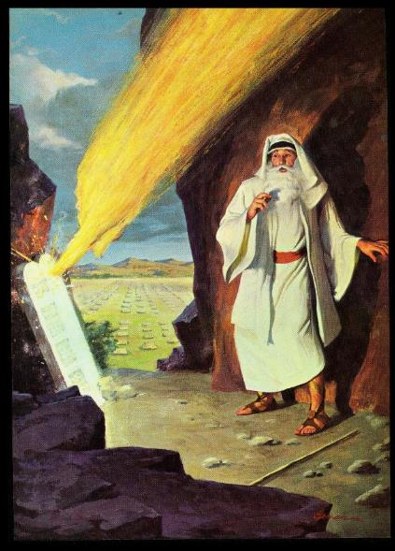
UKWETHULWA KOMTHETHO

Slide 5

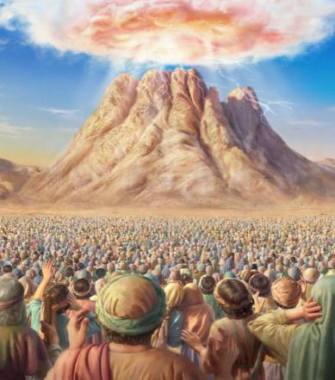
ABAMUKELI BOMTHETHO
“Lina ngokwenu likubonile lokho engakwenzayo eGibithe, lokuthi ngalithwala ngamaphiko okhozi ngaliletha kimi.” ( Eksodusi 19:4)
Kungani uNkulunkulu wayekhiphe u-Israyeli eGibhithe?
Ukumkhonza ( Eks. 5:1; 7:16; 8:1, 20; 9:1, 13; 10:3 ). Ngokwenza kanjalo, babezothola inzuzo enkulu (phakathi kwazo izwe laseKhanani).
Ngenyanga yesithathu ngemva kokuphuma kwabo eGibhithe, bamisa amatende eduze kweNtaba iSinayi. Lapho kwabekwa izisekelo zokudalwa kwesizwe sakwa-Israyeli. UNkulunkulu wenza isivumelwano labo, base besamukela (Eks. 19:1-8).
Ngokwamukela isivumelwano, u-Israyeli wayezaba yini ( Eks. 19:5-6 )?
ABANTU ABANGCWELE
Babezazinikela kuNkulunkulu, futhi bembule isimo Sakhey.
UMBUSO WABAFUNDISI
Babezaxhumanisa abanye abantu loNkulunkulu, futhi babafundise imithetho yakhe.
IGAMA ELIKHETHEKILEYO ELIVELA KUNKULUNKULU
UNkulunkulu wayezakwenza u-Israyeli abe umzila wokukhanyisela umhlaba ngolwazi Ngaye

Slide 6

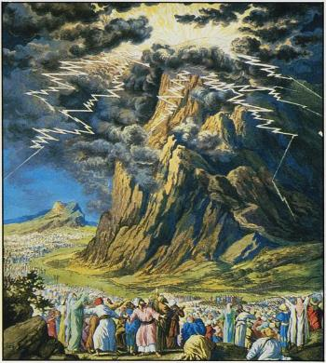
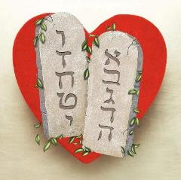
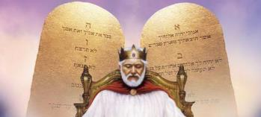
OPHA-UMTHETHO
“Intaba yaseSinayi yagcwala intuthu, ngokuba uJehova wehlela phezu kwayo esemlilweni, yasukuma intuthu kuyo njengentuthu yesithando, lentaba yonke yazamazama kakhulu.”— Eksodusi 19:18 .
Ukwethulwa koMthetho kaNkulunkulu eSinayi kwakuyinto enhle kakhulu leyesabekayo ( Heb. 12:18-21 ). Akekho olungiselwe into efana laleyo. Ngakho-ke, abantu kwakudingeka bazihlanze kusengaphambili futhi bagcine ibanga elifanele ukuze bangadliwa yinkazimulo yaphezulu ( Eks. 19:10-12 ).
Kungani kwakudingeka ilungiselelo elinjalo?
Amazwi uNkulunkulu ayezawakhuluma kubo ayeyikubonakaliswa kwesimo Sakhe uqobo. Ukuyilalela kuyikuphila; ukungazilaleli kuyikufa. U-Israyeli kwakufanele aqaphele ngokugcweleyo ukubaluleka lokuqakatheka “kwamazwi esivumelwano, iMithetho Elitshumi” ( Eks. 34:28 ).
Kuye kwabhalwa izinguqulo ezimbili zalo Mthetho: enye ekuqaleni kuka-Eksodusi, enye njengengxenye yezinkulumo zikaMose zokugcina ngaphambi kokungena eKhanani.
Lanxa kungabonakala kusesabisa ukwethulwa kwawo, uMthetho ubonisa okuhle kakhulu kwesimo sikaNkulunkulu: uthando ( Roma 13:10 ).

Slide 7
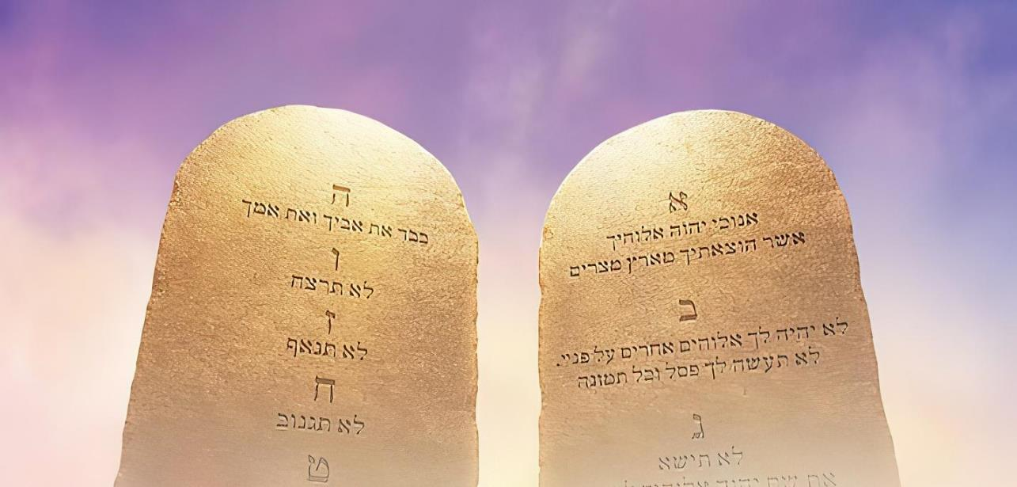

IMITHETHO ELITSHUMI
“NginguJehova uNkulunkulu wakho owakukhipha eGibhithe, ezweni lobugqila” (Eksodusi 20:2).
UNkulunkulu wethula uMthetho ngokwenza umsebenzi wawo oyinhloko ucace: “Ngikuhlengile esonweni, ngakho-ke, yilokhu okumele ukwenze kusukela manje kuqhubeke” (Eks. 20:2). Ukugcina uMthetho, kithina, kuyikusabela ekuhlengweni. Kuyimpendulo yothando othandweni olwamukelweyo.
“Uthando luyikugcwaliseka komthetho” ( Roma 13:10 )
Thanda uNkulunkulu ( Dut. 6:5; Eks. 20:3-11 )
Thanda umakhelwane wakho ( Lev. 19:18; Eks. 20:12-17 ).
Zihloniphe ukuze kungabikhona isifiso sobugovu esingcolisa isimilo sethu.
Hlonipha usuku lwaKhe lokuphumula lokukhonza, iSabatha
Dumisa futhi uhloniphe uNkulunkulu ngokumupha indawo yakuqala ekuphileni kwethu.
Dumisani uNkulunkulu ngaphandle kokumsusa ngaloba yisiphi isithombe
Hlonipha igama likaNkulunkulu, indumela, lesimo sakhe
Hlonipha abazali
Hlonipha impilo
Hlonipha umtshado
Hlonipha impahla yabantu
Hlonipha udumo lwabanye

Slide 8

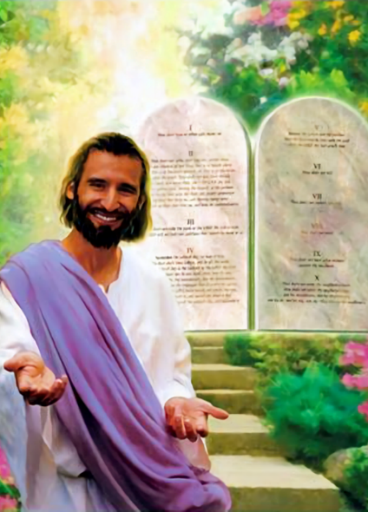

INCAZELO YOMTHETHO

Slide 9


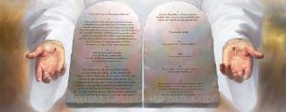

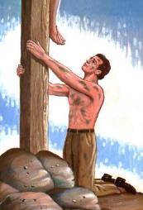
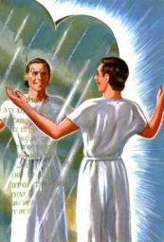
UMSEBENZI WOMTHETHO
“Ngakho umthetho waba ngumlondolozi wethu kwaze kwafika uKristu, ukuze silungisiswe ngokholo” (KwabaseGalathiya 3:24).
Yiyiphi eminye yemisebenzi yoMthetho?
Insindiso ayikho phakathi kwemisebenzi yayo (Gal. 2:16). UMthetho ufana lesibuko lapho izono zethu zibonakaliswa khona (Jakobe 1:23-25).
Kusivikela ebubini (IHu. 119:104)
Usinika ukuhlakanipha ( Dut. 4:6 )
Kusinika inkululeko ( Jakobe 2:12 )
Kusinika ukuthula (IHu. 119:165)
Usinika ukuchuma ( Josh. 1:8 )
Ukhomba izono zethu ( Rom. 7:7 )
Usinika ukuhlakanipha ( Dut. 4:6 )
Ukwephula isibuko akususi amabala; ukungasinanzi akukwenzi futhi. Kodwa ngaphandle “kwesibuko” [umthetho] besingeke sazi ukuthi singcolile [ngesono], lokuthi sidinga “iduku” [uKristu] ukuze asihlanze
IBhayibheli licacile: UMthetho muhle ( Roma 7:12 ); ukuzindla ngayo kuyathokozisa ( IHu. 1:2 ). “O, yeka indlela engiwuthanda ngayo umthetho wakho, ngizidla ngawo usuku lonke” (IHu. 119:97).

Slide 10


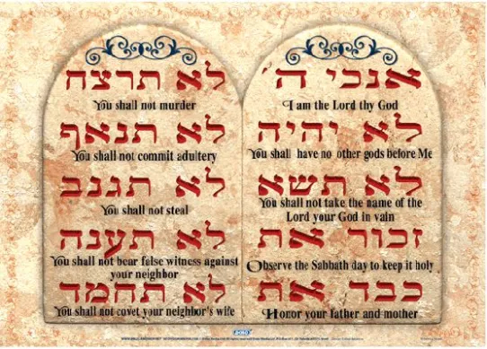

UMTHETHO NJENGESITHEMBISO
“Wamemezela kini isivumelwano sakhe alilaya ukuba lisenze, AMAZWI ELITSHUMI, wawaloba ezibhebheni ezimbili zamatshe” (Duteronomi 4:13, isiHebheru sokuqala
NgesiHeberu, izikhathi ezintathu iMithetho Elitshumi okukhulunywe ngayo, ibizwa ngokuthi “amagama alitshumi”. ( Eks. 34:28; Dut. 4:13; Dut. 10:4 ).
Ake sicabange ngalokhu. Sisuke sitsho ukuthini uma sisithi komunye umuntu, “Ngikunika izwi lami”?
Eqinisweni, asikuniki lutho; sikwenzela isithembiso. Siyakuqinisekisa ukuthi sizokwenza okuthile okuphathekayo.
Ngakho, igama lesiHeberu elithi “dabar” lingahunyutshwa ngokuthi “izwi” loba “isithembiso.”
Isibonelo: “Akuphuthanga lezwi elilodwa [dabar] kuzo zonke izithembiso zakhe ezinhle azithembisa ngenceku yakhe uMose” (1 AmaKhosi 8:56).
Imithetho Elitshumi iyizithembiso ezilitshumi uNkulunkulu azenza kithi, ezihloselwe ukusiqondisa endleleni efaneleyo

Slide 11

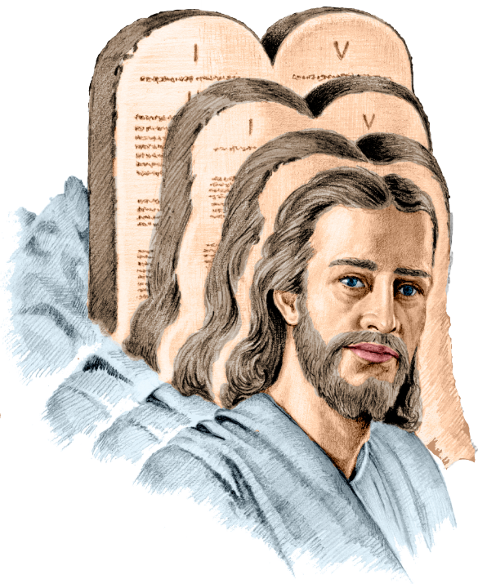
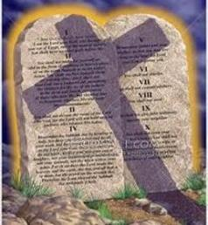
UMTHETHO NJENGESIPHETHO
“Ngokuba uKristu uyisiphetho somthetho kube yikulunga kubo bonke abakholwayo” (KwabaseRoma 10:4).
Igama elithi “ukuphela” elisetshenziswe emthethweni kaPawulu kwabaseRoma 10:4 lithi “telos.” Ithini incazelo yaleli gama?
Incazelo eyinhloko ithi: umcijo ukhonjiswe njengomkhawulo loba inhloso. Ngencazelo (izincazelo zesibili): isiphetho, , umphumela, inhloso. Incazelo yawo ethile kufanele inqunywe ngumutsho osetshenziswe kuwo
Uma sihumutsha lokhu ngokuthi “uKristu uyisiphetho somthetho,” awusekho umthetho kusukela ekufeni kukaJesu. Ngakho-ke, asikho isono. UPawulu wayezabe eziphikisa (Roma 7:7).
Uma sihumutsha “uKristu uyindawo umthetho okhomba kuyo,” uPawulu akaguquguquki, ngoba umthetho usasebenza, futhi usiholela kuKristu (Roma 3:31; Gal. 3:24

Slide 12

EGW (Patriarchs and Prophets, p. 305)
“Umthetho wawungakhulunywa ngalesi sikhathi ukuze kuzuze amaHebheru kuphela. UNkulunkulu wabahlonipha ngokubenza abagadi labagcini bomthetho waKhe, kodwa wawuzophathwa njengempahla engcwele yomhlaba wonke. Imiyalo yeDecalogue yenzelwe wonke umuntu, futhi yanikezwa ukufundisa lohulumeni wabo bonke. Imithetho elitshumi, emifishane, ebanzi, futhi enegunya, ihlanganisa umsebenzi womuntu kuNkulunkulu lakubantu bakibo; futhi konke kusekelwe esimisweni esikhulu esiyisisekelo sothando.”

