Slide 1

UKUPHILA UMTHETHO
Isifundo setshiyangalonye kuNcwabakazi ilanga lamatshumi amathathu ku2025

Slide 2
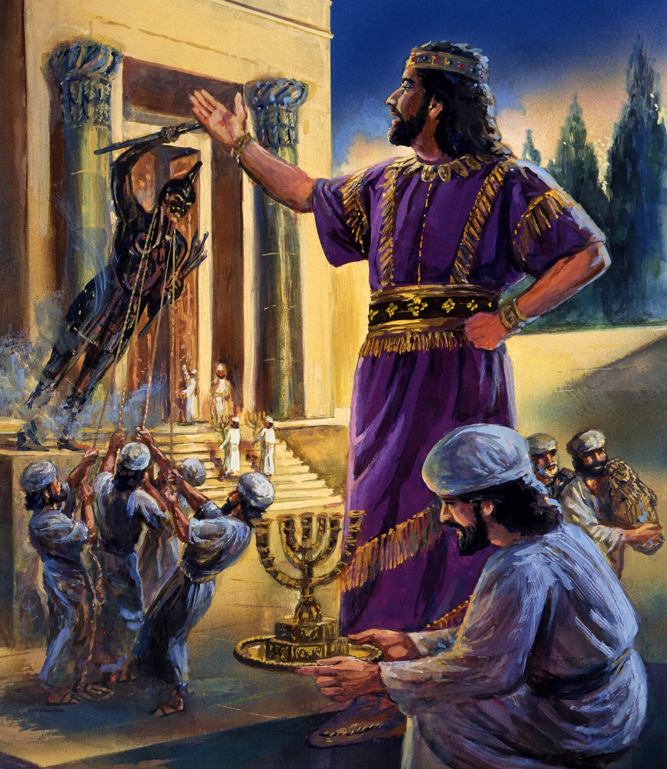
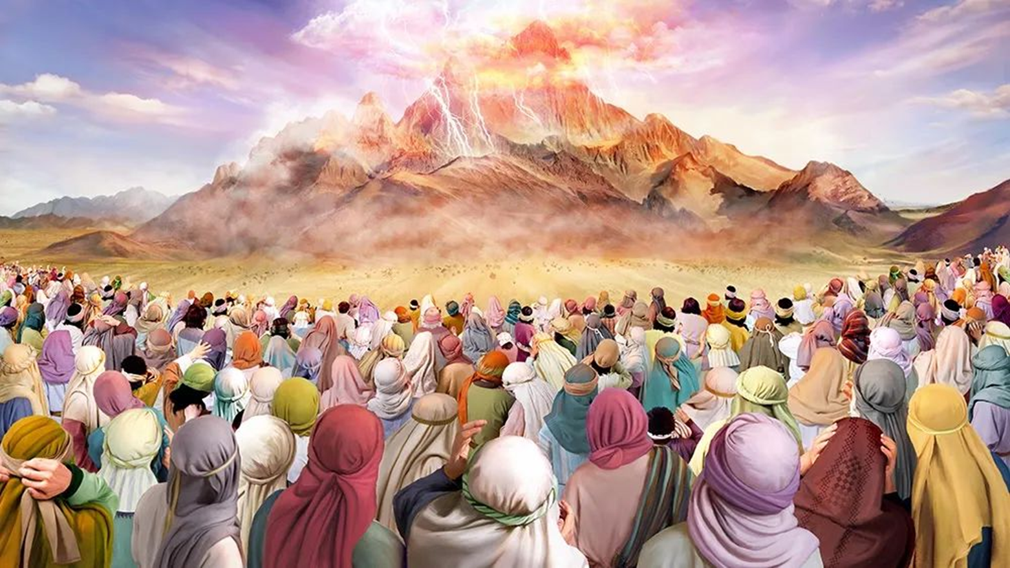
“Ngakho-ke uJehova wathi kuMose: "Yilokhu ozakutsho kubantwana bakwa-Israyeli: 'Libonile ukuthi ngikhulume lani ngisezulwini. Aliyikwenza lutho lami, nlngazenzeli onkulunkulu besiliva loba onkulunkulu begolide.”— Eksodusi 20:22-23 .

Slide 3

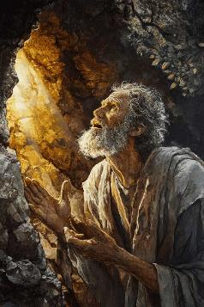
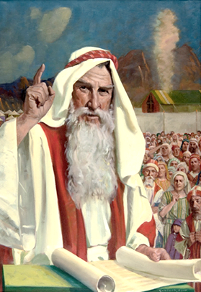
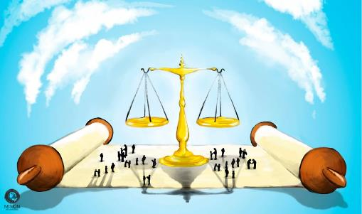


Ngemva kokumemezela imithetho elitshumi, abantu bacela uMose ukuba abe ngummeli phakathi kukaNkulunkulu labo (Eksodusi 20:19). Kusukela ngaleso sikhathi kuqhubeke, uNkulunkulu wanika uMose imithetho, futhi wayidlulisela kubantu..
Le mithetho, ebizwa ngokuthi “ikhodi yesivumelwano,” yayihloselwe ukulawula izimpilo zabantu bakwa-Israyeli, ngakho-ke, leyethu kanye (ngokuzivumelanisa okudingekayo leqiniso lethu lamanje).
Ngamafitshane, ukusetshenziswa okungokoqobo kweMithetho Elishumi ezimweni ezithile zokuphila kwansuku zonke
Indlela yokuphila umthetho:
  Indlela Yokulawula Ubudlwangudlwangu ( Eksodusi 21:1-32 )
  Indlela Yokuphila Emphakathini ( Eksodusi 21:33-23:19 )
  Indlela Yokunqoba ( Eksodusi 23:20-33 )
Uwuzwisisa njani umthetho:
  Umthetho wokuphindiselela.
  Umvuzo lesijeziso.

Slide 4

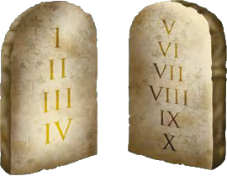

INDLELA YOKUPHILA UMTHETHO

Slide 5

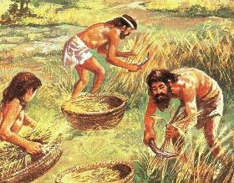
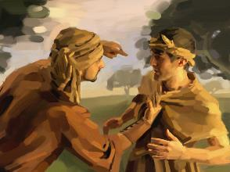
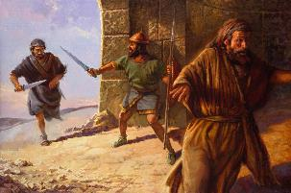
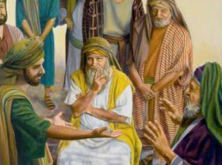
INDLELA YOKULAWULA UBUDLWANGUDLWANGU
“Loba ngubani otshaya umuntu ngenxeba elibulalayo wobulawa lokubulawa.”— Eksodusi 21:12
Ikhodi yesivumelwano iqala ngokulawula izici ezintathu ezibalulekile zomphakathi wamaHeberu:
Ubugqili (Ex. 21:2-11)
  Amadoda akhululwa ngemva komnyaka wesikhombisa.
  Abesifazane, uma bengatshadanga, labo babekhululekile.
  Oyindoda angaqhubeka eyisigqila uma ethanda..
Isigwebo sokufa ( Eks. 21:12-17 ). (Ex. 21:12-17)
  Ngobulala ngamabomu
  Kulowo ohlukumeza loma othuka abazali bakhe
  Ngomthumbi
Ukulimala(Ex. 21:18-32)
  Isibopho sokubuyisela imbadalo
  Uma kuphuma isisu, umahluli kanye lowesifazane (lomyeni wakhe) bayabhadalisa inhlawulo..
Yonke le imithetho izama ukunqanda ukuhlukunyezwa lokudlwanguluzwa phakathi kwabantu.

Slide 6

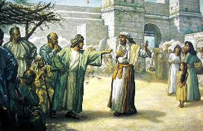
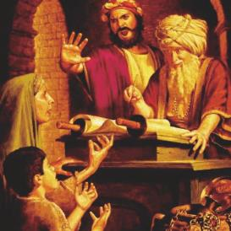
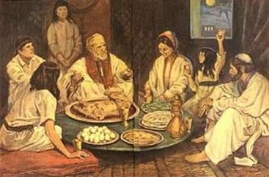
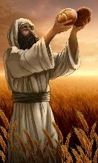
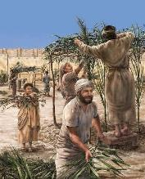
INDLELA YOKUPHILA EMPHAKATHINI
“Uma indoda eyenga intombi engayithathanga, bese ilala layo, kufanele ikhiphe ilobolo, ibe ngumkayo.” ( Eksodusi 22:16 )
UNkulunkulu akazange aneliseke ngokuthi nje asitshiye lemithetho “eyisisekelo” futhi asivumele siyisebenzise ngendlela esibona kufanele. Wayeqikelela ukunikeza izibonelo ezibambekayo ukuze sizisebenzise ngendlela efaneleyo.
Lezi zibonelo zihlanganisa ukuhlasela kwezinyamazana lezinyamazana ( Eks. 21:35-36 ); ukuboleka lokubhadalisa abantu abahlalayo ( Eks. 22:14-15 ); ubuhlobo kungakabi lomtshado ( Eks. 22:16 . njalonjalo
Kugcizelelwa ngokukhethekileyo ukuvikela ababuthakathaka labakhangelelwa phansi, kodwa ngaphandle kokubapha izinzuzo ezingalunganga—okuyikuthi, ngaphandle kokuhlanekezela ukwahlulela ukuze kuzuze loba kubalimaze ( Eks. 22:21-23; 23:2-3, 6 ).
Njengoba iyisivumelwano phakathi kukaNkulunkulu labantu bakhe, le mithetho yayihlanganisa lendlela okufanele sibe lobuhlobo ngayo Laye. Ngaphezu kokuphumula kweSabatha, kwakulesibopho sokugcina imikhosi esikhumbuza ukukhululwa kwethu esonweni, ekuvikelweni kwaphezulu, lasesikhathini esizayo esikhazimulayo esisilindeleyo.

Slide 7

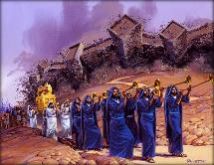
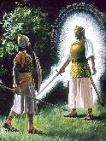
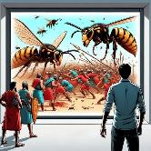
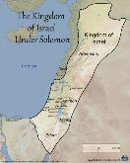
UNGAKUTHOLA KANJANI UKUNQOBA
UNkulunkulu utshela u-Israyeli ukuthi enzeni
Zwana izwi lakhe, ukuze uNkulunkulu abe yisitha sezitha zakhe ( 23:21-22 )r
Khonza uNkulunkulu kuphela, ukuze asuse konke ukugula ( 23:24-26 )
Ukungenzi sivumelwano lamaKhanani, ukuze bangabakhonzi onkulunkulu bawo ( 23:32-33 )
UNkulunkulu utshela uIsrayeli ukuthi uzakwenzani
Uzathumela ingelosi Yakhe ukuba ibavikele futhi ibangenise [ukuvikela] (23:20)
Ingelosi izahamba phambi kwabo futhi ibase eKhanani [isiqondiso] (23:23)
Uzathumela ukwesaba kwabakhileyo (23:27).
Uzathumela unyolovu ukuba ubaxotshe (23:28)
Uzawaxotsha kancane kancane ( 23:29-30 ).
Uzawanikela esandleni sakwa-Israyeli aze abuse kusukela eMedithera kuze kufike e-Ewufrathe (23:31).
“Bheka, ngithuma ingelosi phambi kwakho ukuba ikugcine endleleni, ikuse endaweni engiyilungisileyo” ( Eksodusi 23:20 )
Kungani uNkulunkulu engamniki u-Abrahama izwe lamaKhanani? “Ngokuba ububi bama-Amori abukapheleli” (Gen. 15:16).
Ngemva kweminyaka engamakhulu amane yomusa, amaKhanani ayengakantshintshi indlela zawo. Kwase kuyisikhathi sokupha izwe ku-Israyeli… ngokuthula! ( Eks. 13:17 )
Ngabe uNkulunkulu wayebakhiphe eGibhithe ngaphandle kokuba balwe, wahlukanisa ulwandle kabili, wabondla ngokuyisimangaliso, futhi wabaqondisa ngeNgelosi yaKhe... wayengeke yini akwazi ukubanika iKhanani ngaphandle kokuba balilwele?

Slide 8

“Kuyo yonke le iminyaka umthetho kaNkulunkulu ubulokhu ulondolozwe njengendinganiso ephakemeyo kakhulu yokuziphatha.” Akusizo zonke izinto ezisungulwe yisayensi loba imicabango ezuzisayo eziye zakwazi ukuthola umsebenzi owodwa obalulekileyo ongahlanganiswa lalesi simiso.
Umthetho kaNkulunkulu uyikulondeka kokuphila lempahla lokuthula lenjabulo. Yanikezwa ukuze kuvikeleke okuhle kwethu kwalamhlanje laphakade.”
EGW (The Upward Look. October 7)

Slide 9

INDLELA YOKUZWISISA UMTHETHO

Slide 10

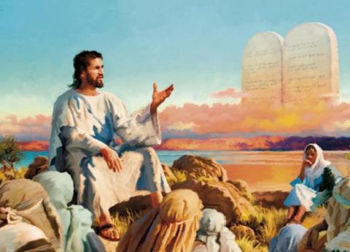


UMTHETHO WOKUPHINDEZELA
“Ilihlo ngelihlo, izinyo ngezinyo, isandla ngesandla, unyawo ngonyawo.”— Eksodusi 21:24
Lapho uJesu esipha iNtshumayelo yaseNtabeni, wawuqeda umthetho wokuziphindiselela (Math. 5:38-42) … loba akazange yini?
Inkulumo ethi “lizwile ukuthi kwathiwa… kodwa mina ngithi kini” ayizange iqede loba yiwuphi umthetho (uJesu wasebenzisa inkulumo efananayo lapho ethi “ungabulali” loba “ungaphingi,” kodwa wayengahlosanga ukukuqeda). Eqinisweni, uJesu wayewukhulisa njalo uMthetho, ewuthuthukisa, futhi ewupha incazelo yawo yeqiniso..
Kwakungasiyo inhloso yeqiniso yomthetho wokuziphindiselela ukuthi umuntu alahlekelwe yilihlo loba isandla ngenxa yokulimaza omunye.
Lo umthetho wasungulwa ngenjongo yokuvimbela ukuziphindiselela, ukuqeda imibango yegazi, l1okuziphindiselela ngaphandle kophenyo kusengaphambili. Ukulimala kwakudingeka kuhlolwe amajaji, bese kusungulwa isinxephezelo semali esifanele futhi kukhokhwe. Lo mkhuba wavela ukuze kunqandwe ukuthi abantu bangathathi ukuthonisa ngezandla zabo. Kwakumele kwenziwe ukwahlulela, kodwa ngokuvumelana loMthetho kaNkulunkulu.

Slide 11




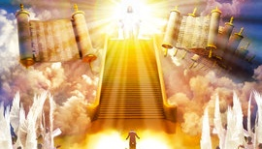
UMVUZO LE SIJEZISO
Ngakho, uma kungenziwanga ngabomu, kodwa uNkulunkulu ekuvumela ukuba kwenzeke, kumele babalekele endaweni engizayikhetha. (Funda u-Eksodusi 21:13.)“
Isifiso sokuziphindiselela sigxile kakhulu kithi. Futhi kuhlale kungahambisani lokubi esikutholileyo: "Uma enze lokhu kimi, ngizokwenza okwengeziweyo kuye."
UJesu usimema ukuba senze okuphambene lalokho esikufisayo: ukubuyisela okubi ngokuhle (Mt. 5:44). Pho kuphi ukwahlulelwa? Ngubani ozakhokhela umenzi wobubi lokho okumfaneleyo?
UNkulunkulu akasitsheli ukuthi umhlukumezi ngeke ajeziswe, futhi loba yisiphi isenzo siyophindiselwa. Kodwa usitshela ngokucacileyo ukuthi uyakuba ngumphindiseli (Roma 12:19-21).
Ngokuba ukuziphindiselela komuntu siqu kubekezelelwa emithethweni yesivumelwano, kwaliwe ngokwakha isimiso sokwahlulela ukuze kuvinjelwe ukuhlukumezwa ( Eks. 21:12-13, 22; 22:8-9 ).
Akekho ongathatha ngesikhathi esisodwa indima yejaji, ijaji, kanye lomakhiphi. Uma isijeziso kufanele sikhitshwe, kufanele senziwe ngenqubo yokwahlulela elokulunga. Futhi uKristu uyoba nguMahluleli ophakeme lowokugcina.

Slide 12

“NjengoMdali wakho konke, uNkulunkulu ungumbusi phezu kwakho konke, futhi ubophekile ukuba afuqe umthetho Wakhe endaweni yonke.” Ukufuna okuncane kakhulu ezidalweni Zakhe kulokulalela umthetho Wakhe kungaba ukuziyeka zibe incithakalo. Ukwehluleka ukujezisa ukweqa umthetho Wakhe bekuyoba ukubeka indawo yonke esiphithiphithini. phakathi kwesono lobungcwele.”
EGW ( The Signs of the Times , June 5, 1901)

