Slide 1
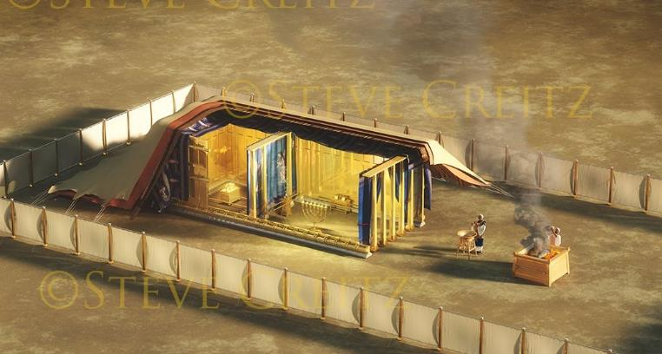
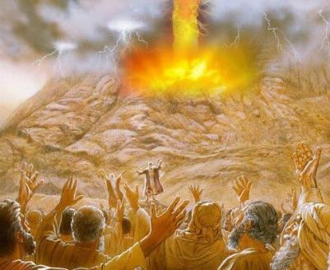
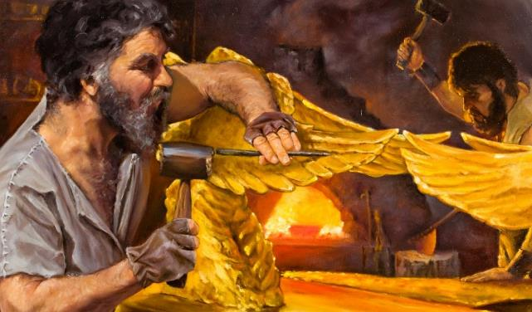
Isifundo setshumi kuMpandula ilanga lesithupha ku2025
ISIVUMELWANO KANYE LOHLELO

Slide 2
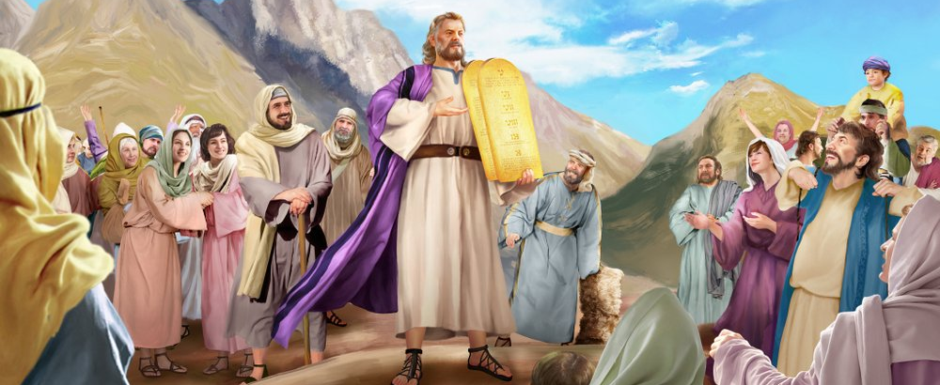
“UMose weza wabatshela abantu onke amazwi kaJehova lezahlulelo zonke. Bonke abantu baphendula ngazwi linye bathi: “Wonke amazwi uJehova awakhulumileyo sizawenza.”— Eksodusi 24:3

Slide 3

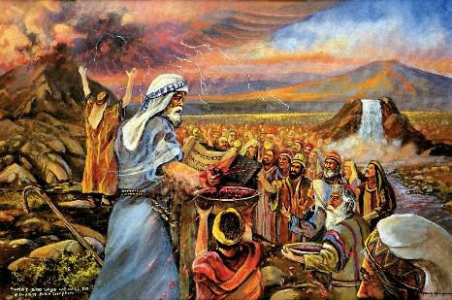
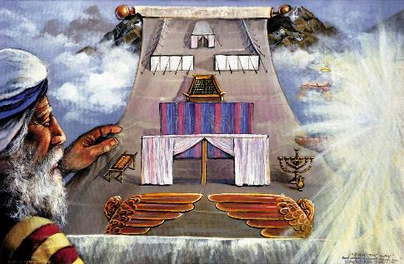


Ngemva kokumemezela ngokuzwakalayo iMithetho Elishumi futhi wayipha uMose iqoqo lemithetho eyisisekelo, uNkulunkulu wayefuna ukwenza isivumelwano lo-Israyeli.
Isivumelwano sasilula: Ngizoba nguNkulunkulu wakho, ngizokuvikela futhi ngikubusise; wena, gcina imithetho yami.
Ngemva kokubhala isivumelwano kusiphece sombhalo, bobabili izinhlangothi kwadingeka basiqinisekise. Abantu bavuma, bathi bazoyigcina. UNkulunkulu wabavumisa kanjani? Ngegazi; ngedili; kanye lesibonelo sokubasiza baqonde isivumelwano.
Isivumelwano:
  Igazi Lesivumelwano (Eksodusi 24:1-6, 8)
  Ukugcwaliseka Kwesivumelwano (Eksodusi 24:7)
  Isidlo Sesivumelwano (Eksodusi 24:9-18)
Isibonelo:
  Injongo Yesibonelo (Eksodusi 25:1-9)
  Ukulungiswa Kwesibonelo (Eksodusi 31:1-18)

Slide 4
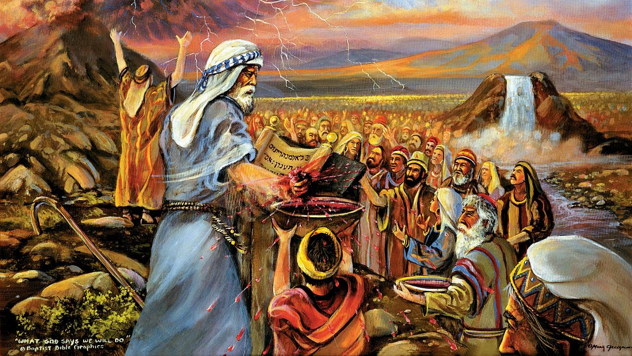
ISIVUMELWANO

Slide 5

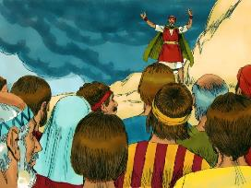
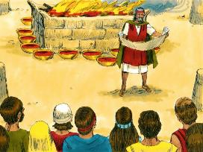
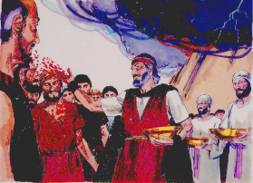
IGAZI LESIVUMELWANO
“UMose wasethatha igazi, wafafaza ngalo phezu kwabantu, wathi: ‘Leli ligazi lesivumelwano uJehova asenze lani ngokwawo wonke lawa mazwi..’ ” (Eksodusi 24:8)
Senziwa kanjani isivumelwano?
Isivumelwano safundwa ( Eks. 24:3a )
Abantu basabela ngokuvuma (Eks. 24:3b)
Kwalotshwa phansi (Eks. 24:4a)
Kwakhiwa i-lathi (Eks . 24:4b)
kwamiswa izinsika ezili tshumi lambili (Eks. 24:4c)
Iminikelo yokutshiswa yayinikelwa (Eks. 24:5)
Ingxenye yegazi yafafazwa e-lathini (Eks. 24:6)
Isivumelwano saphinda safundwa (Eks. 24:7a)
Abantu baphinde bavuma futhi (Eks. 24:7b)
Enye ingxenye yegazi yafafazwa phezu kwabantu (Eks. 24:8a)
UMose walimemezela ‘njengegazi lesivumelwano’ ” (Eks. 24:8b; Mt. 26:28)
Kwenziwa isidlo ukuze kuqiniswe isivumelwano (Ek. 24:9-11)
UNkulunkulu wabheka u-Israyeli njengesizwe (izinsika ezilitshumi lambili); Wayebazisa ngokukhethekileyo abatsha; futhi Wazinikela kumuntu ngamunye ngamunye (efafaza igazi lakhe phezu kwabo).
UNkulunkulu ufisa ubuhlobo lathi, ngabanye lanjengomphakathi wamakholwa.

Slide 6

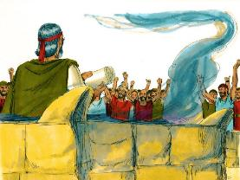
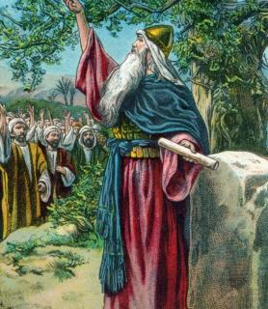
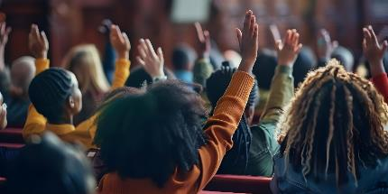

UKUGCWALISEKA KWESIVUMELWANO
“Wayesethatha incwadi yesivumelwano, wayifundela abantu, bathi: ‘Sizokwenza konke uJehova akutshileyo, sizakulalela.’ ” ( Eksodusi 24:7 )
Ngobuqotho obupheleleyo, abantu bazibophela ekugcineni isivumelwano. Lokho kuzibophela kwaba ngokwesikhashana ( Eks. 32:8 ).
Isizukulwane esilandelayo laso sazibophela ekugcineni isivumelwano ( Josh. 24:18b ). Kodwa uJoshuwa wabaxwayisa ngokucacileyo: “Ngeke likwazi ukukhonza uJehova” (Josh. 24:19 NIV).
Yini esivimbela ukuba silalele uNkulunkulu, laphezu kwezinhloso zethu ezinhle?
Ngokwemvelo, asilaleli ( Rom. 7:18 ) futhi akukho lutho esingakwenza ukuze siguqule ukuthambekela kwethu ( Roma 7:24 ).
Kodwa uma simvumela, uNkulunkulu angaguqula imvelo yethu (Hez. 36:26-27). Uyahlanza, athathe, uyapha, futhi abeke ukuze simlalele. Nguye kuphela osenza sibe lamandla (2 Kor. 12:10).

Slide 7

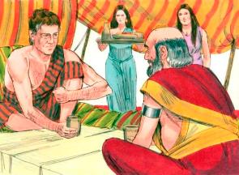
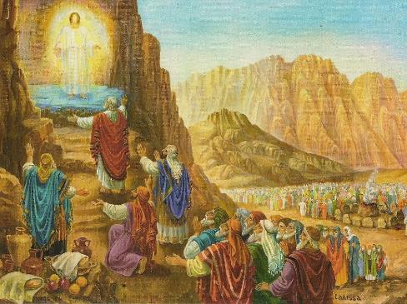
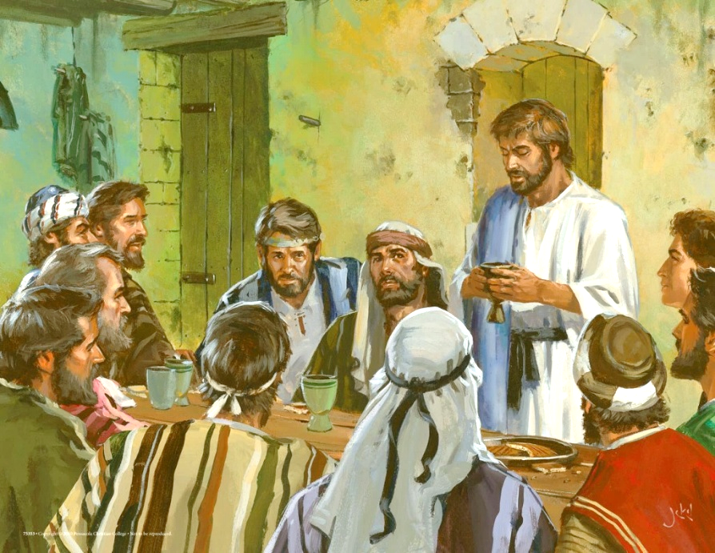
ISIDLO SESIVUMELWANO
“Khona-ke oMose, lo-Aroni, loNadabi, lo-Abihu, lamalunga angamatshumi ayisikhombisa akwa-Israyeli bakhuphuka; bambona uNkulunkulu, badla, baphuza.”— Eksodusi 24:9, 11b
Njengoba sibona esibonelweni sikaJakobe loLabani, eMpumalanga yasendulo ukuqinisekiswa kwesivumelwano kwakuhlanganisa ukudla okwahlanganyelwa yizinhlangothi zombili (Gen. 31:44-54).
ESinayi, uNkulunkulu wenza “isidlo sesivumelwano” kubantu abangu-74: uMose, u-Aroni, uNadabi, u-Abihu, labadala abangu-abangamatshumi ayisikhombisa, ababemele bonke abantu ( Eks. 24:9-11 ).
Lapho uJesu emisa isivumelwano esitsha, wakwenza langokudla labafundi abalitshumi lambili ( Mt. 26:26-28 ).
Ngaso sonke isikhathi lapho sidla iSidlo SeNkosi Sakusihlwa, sivuselela isivumelwano sethu loNkulunkulu. Ngokudla isinkwa lewayini, sidumisa intethelelo lensindiso esilayo kuJesu (1 Kor. 11:26).
Ngaphezu kokwala kwabo ekugcineni insindiso, uNadabi, loba u-Abihu, loba uJuda abakhishwanga kulesi ‘sidlo sesivumelwano.

Slide 8
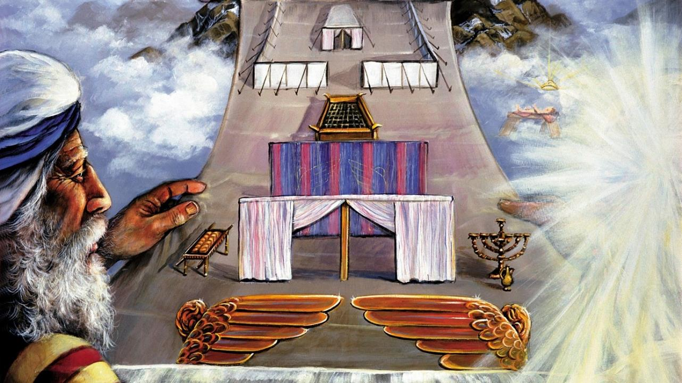
ISIBONELO

Slide 9

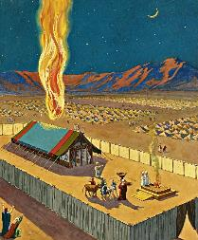
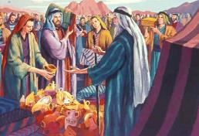
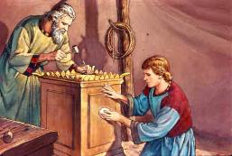
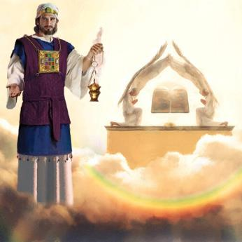
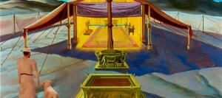
INJONGO YESIBONISO
“Bangenzele indlu engcwele, ngihlale phakathi kwabo” (Eksodusi 25:8).
Njengesiqinisekiso sokuthi wayezoyifeza ingxenye yakhe yesivumelwano, uNkulunkulu wanquma ukuhamba ayohlala phakathi kwabantu.
Kodwa ukuba khona kukaNkulunkulu ngokwenyama kwakuzatsho ukufa ngokuphangisa kubo bonke (Eks. 33:20). Ngakho-ke, wabalaya ukuba bakhe indawo engcwele lapho ayengabonakalisa khona ubukhona bakhe. Lokhu kuba khona kwabonakaliswa ngemifanekiso, njengoba uNkulunkulu engahlali ngokoqobo kuloba yiliphi ithempeli lasemhlabeni ( IzEnzo 17:24
UMose waboniswa umfuziselo futhi wanikwa iziqondiso eziqondileyo zokwakhiwa kwawo. Abantu bacelwa ukuba banikele ngezinto ezidingekayo ( Eks. 25:2-7 ).
Kokubili indawo engcwele lethempeli elakhiwa nguSolomoni kwakuyisibonelo sendlu engcwele eyakhiwa eZulwini ( Heb. 8:1-2; 1 AmaKhosi 8:27, 30 ).
Lapho umIsrayeli engena endlini engcwele, wayengena—ngokomfanekiso—ebukhoneni bukaNkulunkulu… kwaze kwadabuka iveli lapho uJesu esifa.

Slide 10

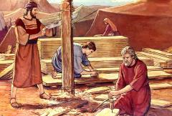
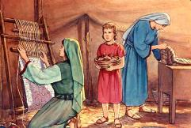
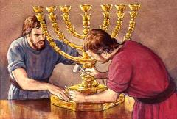
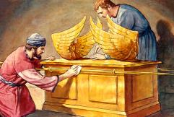
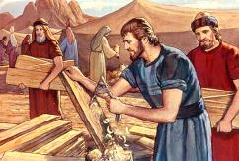
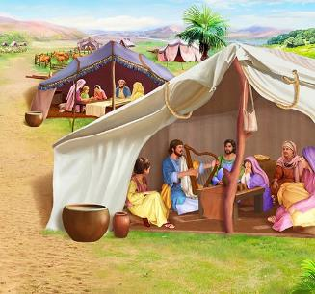
UKULUNGISWA KWESIBONELO
“Bheka, ngikhethile uBesaleli indodana ka-Uri kaHure, owesizwe sakwaJuda, 3 ngimgcwalisile ngoMoya kaNkulunkulu, ngokuhlakanipha, lokuqonda, lokwazi, langabo bonke abukhali.”— Eksodusi 31:2-3 .
Ngokuba uNkulunkulu wapha uMose iziqondiso ezicacileyo mayelana lokwakhiwa, akazange amtshele zonke. Kufanele ubukeke kanjani umcengezi wethusi, amakherubi, lezigqoko zabapristi, lokunye? Lokhu kwanika uMoya oNgcwele ithuba lokusebenza ngeziphiwo zabakhi.
Ngale milayezo, uMoya oNgcwele uphiwe izipho ezikhethekileyo:
(UBhezaleli, owayeqondisa wonke umsebenzi ( Eks. 31:2 )
u-Aholiyabe, owayengumsizi wakhe omkhulu ( Eks. 31:6a )
Abanye abantu ababesiza emsebenzini ( Eks. 31:6b )
Phakathi kweziqondiso zokwakha indlu engcwele, kukhulunywa ngokukhethekileyo ngeSabatha. ( Eks. 31:12-17 ). Lihlangene ngani iSabatha lakho konke lokhu?
Ubungcwele buyisihluthulelo. Ukuze sisondele kuNkulunkulu oNgcwele, kufanele sibe ngcwele njengaye. ISabatha liluphawu lwalobo bungcwele ( Eks. 31:13; Hez. 20:12, 20 ).
Notes:
Exodus 31:2
See, I have called by name Bezalel the son of Uri, the son of Hur, of the tribe of Judah;
Exodus 31:6a
And behold, I have set with him Aholiab the son of Ahisamach , of the tribe of Dan;
Exodus 31:6b
and I have put wisdom in the minds of every wise-hearted person, so that they may do all that I have commanded you;
Exodus 31:12-17 And the LORD spake unto Moses, saying, (13) Thou shalt speak unto the children of Israel, saying, Ye shall surely keep my sabbaths: for it is a sign between me and you throughout your generations, that ye may know that I am the LORD that sanctifies you. (14) Therefore ye shall keep the sabbath day, for it is holy unto you: whoso profaneth it shall surely be put to death: for whosoever doeth any work in it, that soul shall be cut off from among his people. (15) Six days shall work be done: but the seventh day is a sabbath of rest holy to the LORD: whosoever doeth any work on the sabbath day shall surely be put to death. (16) Therefore shall the children of Israel keep the sabbath, to observe the sabbath throughout their generations for a perpetual covenant. (17) It is a sign between me and the children of Israel for ever: for in six days the LORD made heaven and earth, and on the seventh day he rested, and was refreshed.

Slide 11

“Ekwakhiweni kwendlu engcwele njengendawo yokuhlala uNkulunkulu, uMose wayalaywa ukuba enze zonke izinto ngokomfanekiso wezinto ezisezulwini, uNkulunkulu wambiza entabeni, wamembulela izinto zasezulwini, lamiswa ngomfanekiso wazo itabanakele kanye lakho konke okuqondene lalo.
Ngakho ku-Israyeli, wayefisa ukwenza indawo Yakhe yokuhlala, Wembula isimo Sakhe esihle esikhazimulayo. […] Kodwa lokhu kufanela, bona ngokwabo, babengelawo amandla okufinyelela. Ukwambulwa eSinayi kwakungabahlaba umxhwele kuphela ngesidingo sabo lokungabi lakuzisiza.”
EGW (Education, p. 35-36)

